Slide 1
Horizon Europe and Marie Sklodowska Curie Actions: opportunities for research, networking and disseminating knowledge
Manuela Minguzzi, PhD
Research Developer – Social Sciences and Humanities & Excellent Science Unit
Research Division (ARIC)
University of Bologna

Slide 2
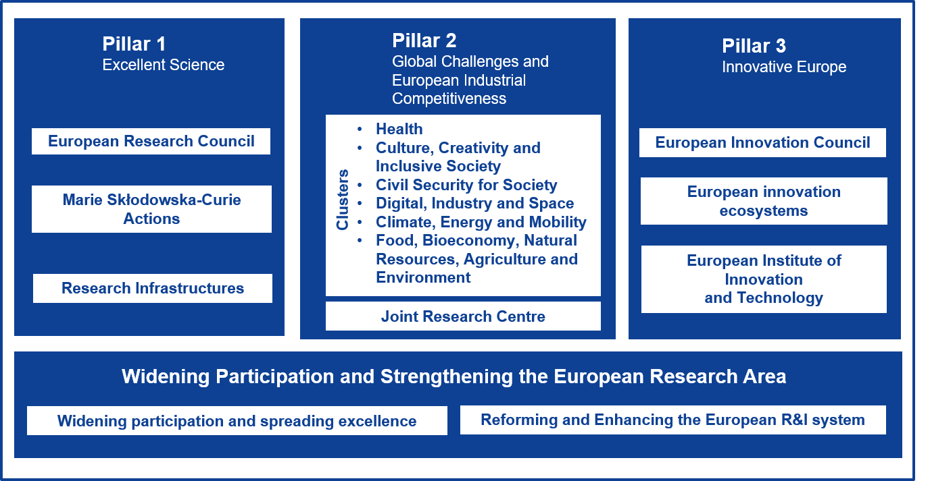
Horizon Europe: EU Framework Programme for Research and Innovation 2021-2027
Fundamental Science
Bottom up approach
Global Challenges
Top-down
approach
Innovation
Bottom-up
approach
Notes:
European Innovation Council: Support for innovations with potential breakthrough and disruptive nature with scale-up potential that may be too risky for private investors. This is 70% of the budget earmarked for SMEs.
EIC as one-stop shop for innovation to help SME to innovate and scale up
Missions: Sets of measures to achieve bold, inspirational and measurable goals within a set timeframe. There are 5 main missions as part of Horizon Europe.
Missions as key novelty for more impact and visibility

Slide 3
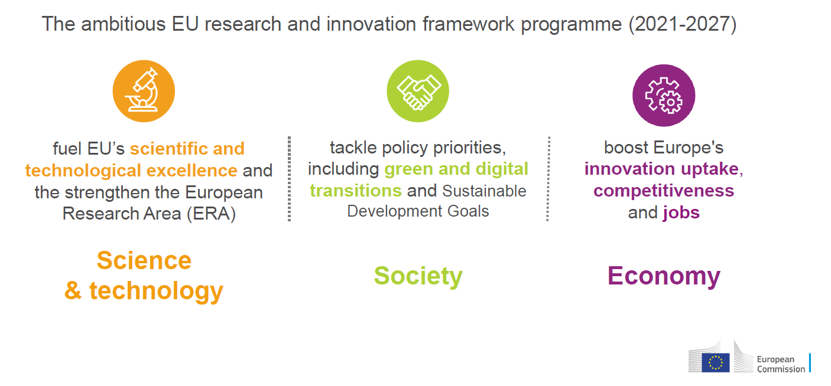
Foundamental objectives of Horizon Europe
Notes:
Tackles Climate Change
Helps to achieve the UN’s Sustainable Development Goals
Boosts the EU’s competitiveness and growth
Facilitates collaboration and strengthens the impact of research and innovation in developing, supporting and implementi EU policies while tackiling global challenges
Supports the creation and better diffusion of excellent knowledge and technologies
Creates jobs, fully engages the EU’s talent pool, boosts economic growth, promotes industrial competitiveness and optimises investment impact within a strengthened European Research Area.
L’obiettivo generale di Horizon Europe è produrre un impatto scientifico, tecnologico, economico e sociale dagli investimenti dell’Ue in ricerca e innovazione, in modo da:
(i) rafforzare le basi scientifiche e tecnologiche dell’Unione e lo Spazio europeo della ricerca;
(ii) attuare le priorità strategiche dell’Ue e concorrere alla realizzazione delle politiche europee (tra cui la transizione verde e digitale), contribuendo a fronteggiare le sfide globali del nostro tempo, enunciate dagli obiettivi di sviluppo sostenibile dell’Agenda 2030 delle Nazioni Unite e dall’accordo di Parigi sul clima.
(iii) promuovere la sua competitività in tutti gli Stati membri, incentivando la diffusione dell’innovazione e la creazione di posti di lavoro in Europa;

Slide 4
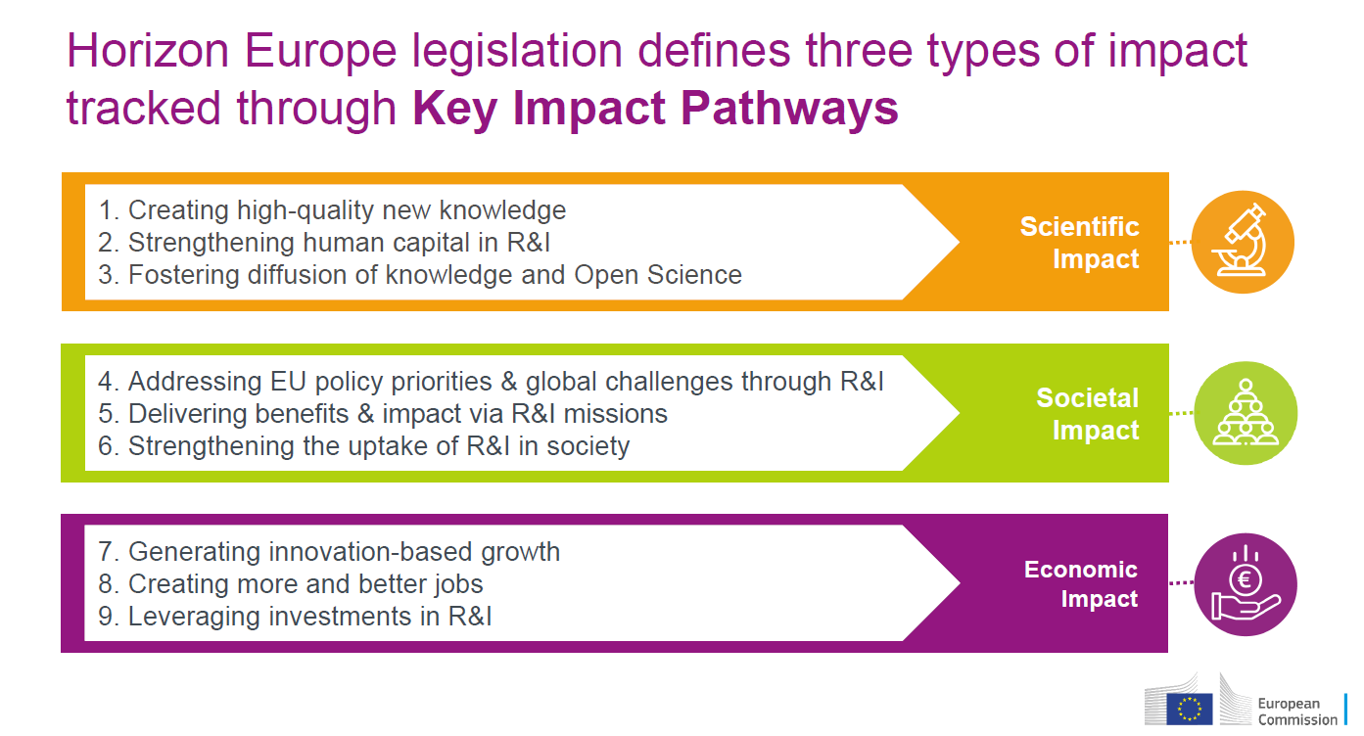
Three pillars structure
A new cross-sectoral clusters approach
Strategic planning as direction-setting for the work programmes
Impact pathways to track progress with the achievement of the Programmes’s objectives over time.

Slide 5
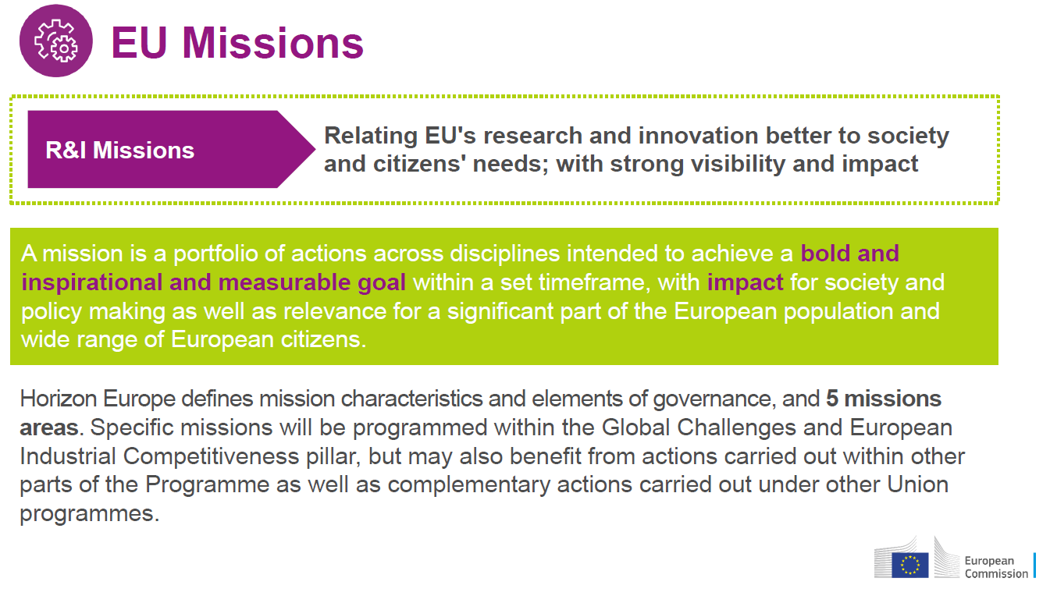
A key pathway to be oriented in the HE funding landscape
Notes:
Missions are a new way to bring concrete solutions to greatest challenges, ambitious goals reached by concrete results by 2030.
deliver impact by putting R&I into a new role, combined with new forms of governance and collaboration, as well as by engaging citizens.
link activities across different disciplines and types of research
Top down

Slide 6
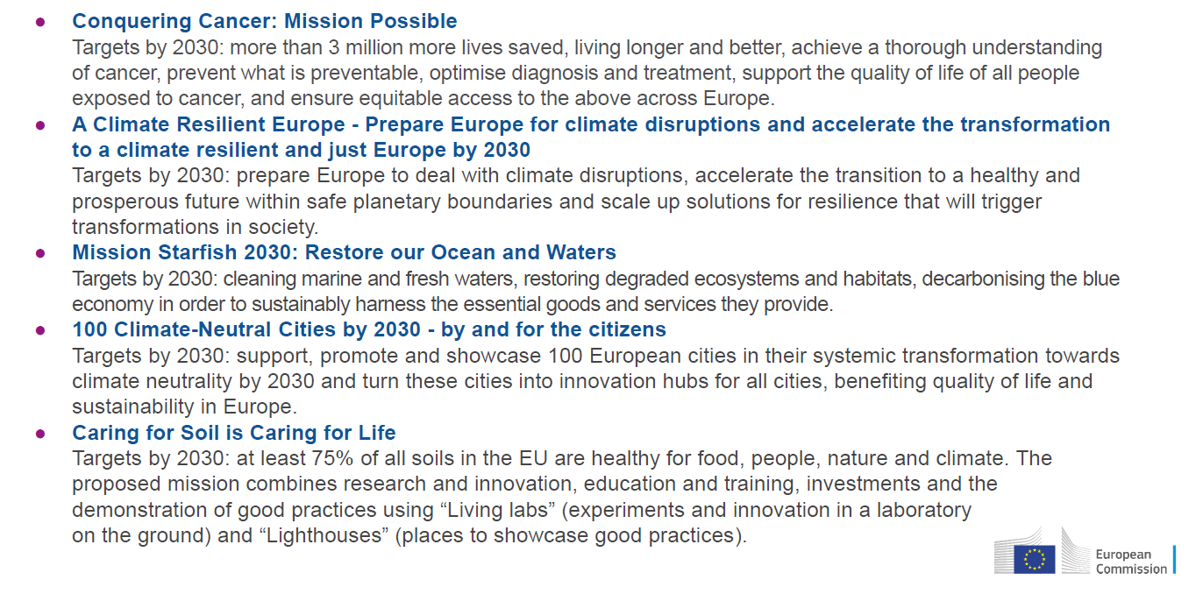
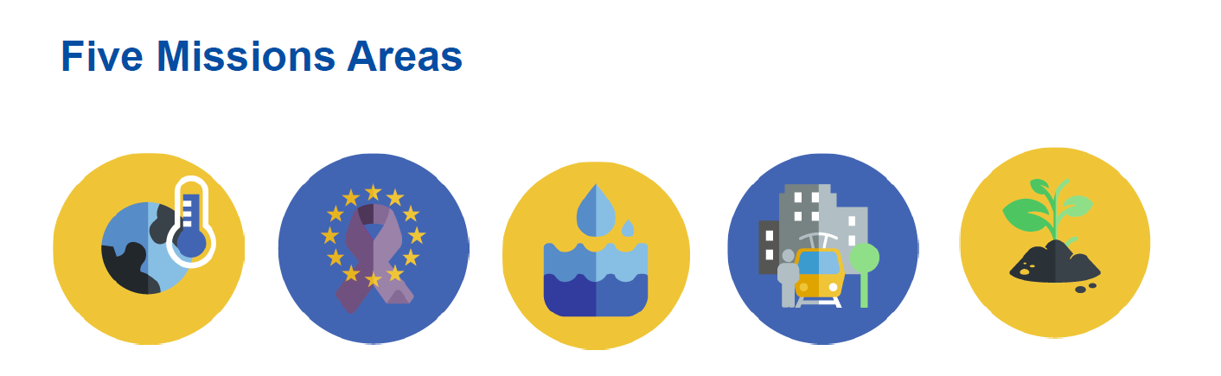
Missions: the sense of Destinations

Slide 7
Pillar II: specific objectives and key elements
to generate knowledge, strengthen the impact of research and innovation in developing, supporting and implementing Union policies and support the access to and uptake of innovative solutions in European industry, notably in SMEs, and society to address global challenges, including climate change and the Sustainable Development Goals
Top Down: the EC defines the topic, the priorities
Sistematic approach based on Impact
Based on collaborative approach at interdisciplinary, intersectoral, transversal and international collaborations, to gain higher impact and innovative potential at the intersection between disciplines and sectors
Essential role of Industry to gain objectives
Notes:
Another collaborative approach that represent the vision and the organisation is the one of pillar II

Slide 8
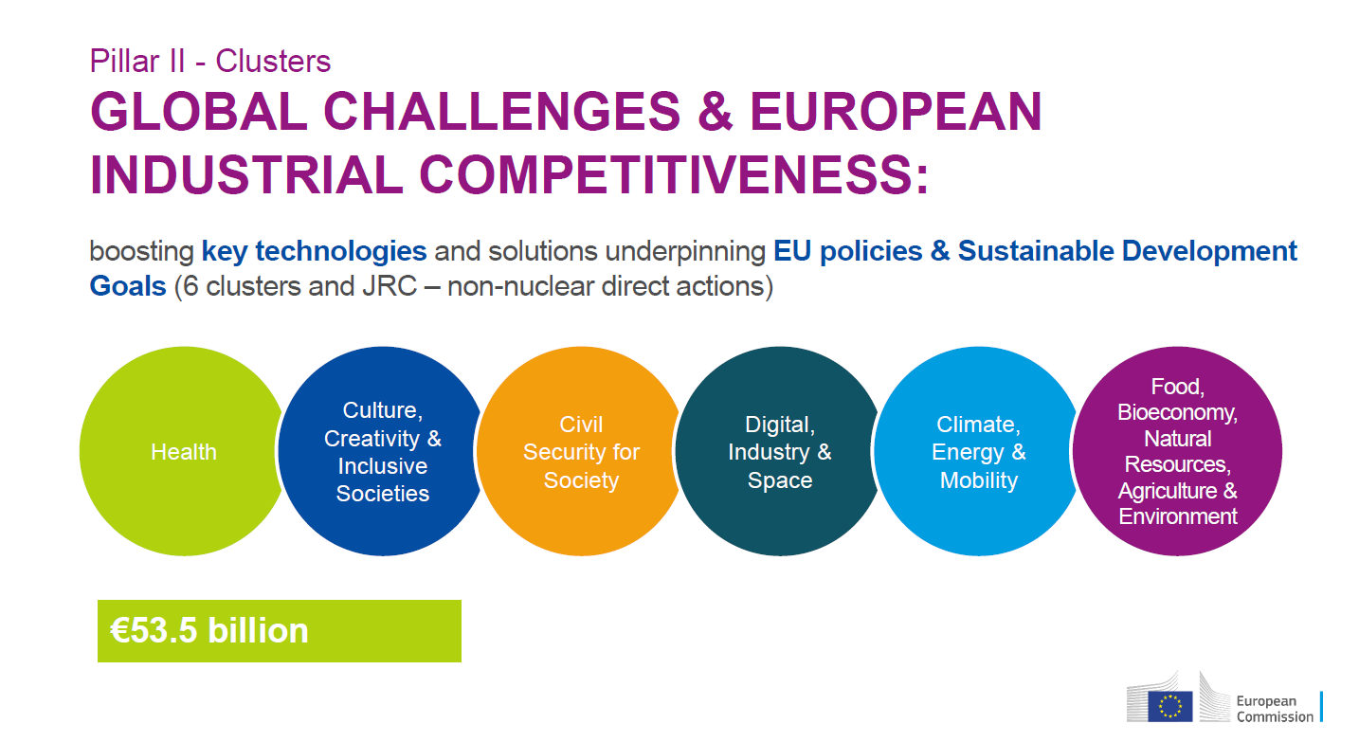
Notes:
Each Cluster has several area of interventions that are the destinations defined by the work programme and the impact oriented strategic plan of the EU policies. Collaborative project with different expertise of the participants

Slide 9
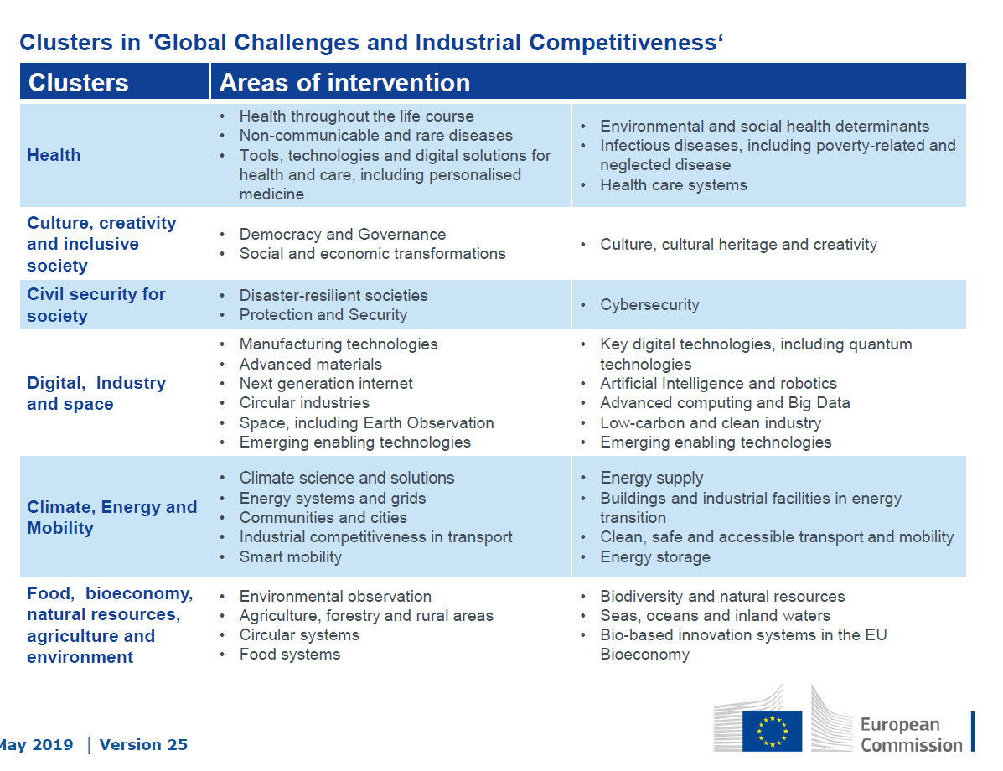
Each Cluster addresses several Area of Intervention and each years specific topics are published

Slide 10
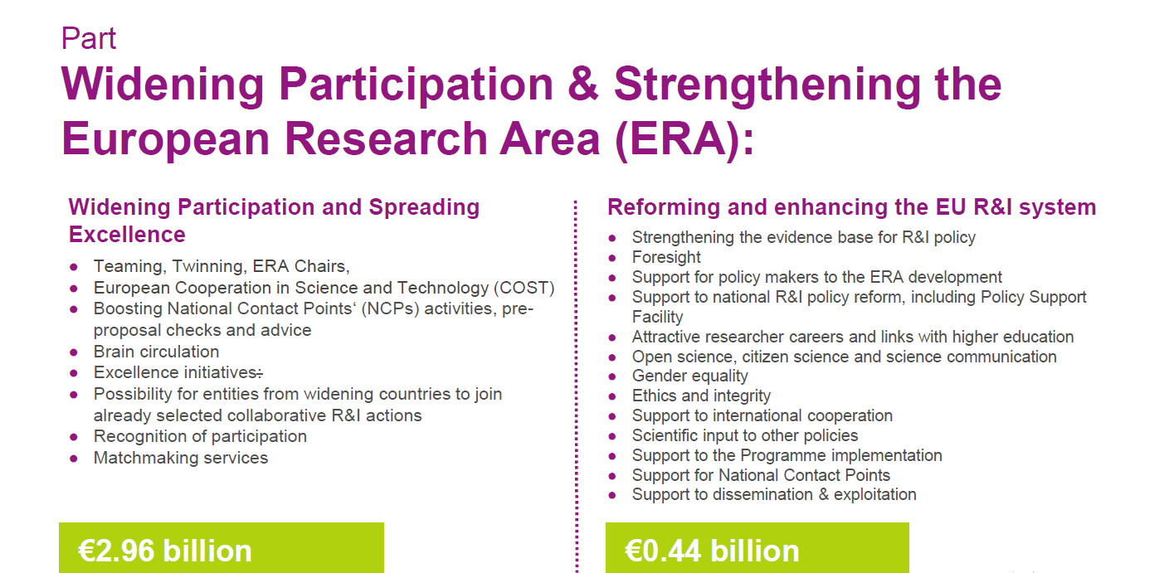
to optimize the Programme's delivery for strengthening and increasing the impact and attractiveness of the European Research Area, to foster the excellence-based participations from all Member States, including low R&I performing Member States, in Horizon Europe and to facilitate collaborative links in European research and innovation.
Top down
Target industry, academia, civil society and public authorities, with emphasis on citizens (co-design) and their needs
Notes:
Target industry, academia, civil society and public authorities, with emphasis on citizens (co-design) and their needs
Policy engeneering (ERA, SDGs, Green Deal, Data Strategy, Digital Education Plan, Shaping Europe’s Digital Future)
Project and financial engeneering (Regional Funds, EIT, S3, Missions, EIC, Partnerships, EOSC, InvestEU)
First stage & Second stage, 100% funding rate, CSA mainly, RIA mostly in destination 3
Technology or societal readiness level
Impact oriented(HE) vs Challenge oriented(H2020)
New KPIs(Outcome based in HE) vs Standard KPIs (Output based in H2020)
Target industry, academia, civil society and public authorities, with emphasis on citizens (co-design) and their needs

Slide 11
Excellent Science (Pillar 1):
Reinforcing and extending the excellence of the EU’s science base
Notes:
RI financing project with the objective to put into a unique system at EU level all research infrastructures in many fields

Slide 12
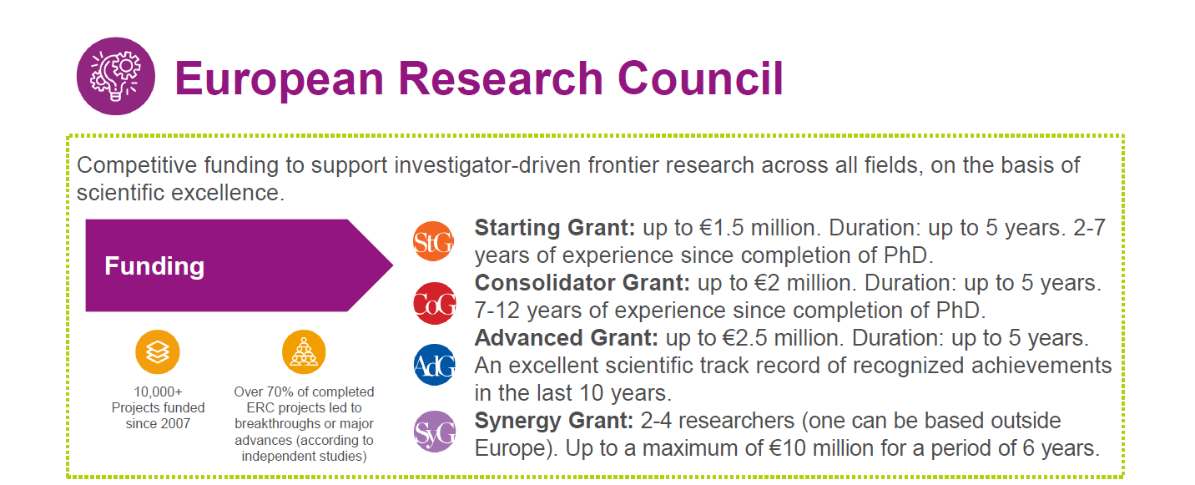
  Pushing forward the frontiers of knowledge in EU MS/AC
  Providing attractive long-term funding, awarded on the sole criterion of excellence, to support excellent investigators and their research teams, to pursue ground-breaking, high-risk/high-gain research.
  Curiosity driven research
Notes:
Pushing forward the frontiers of knowledge
Reinforcing the excellence, dynamism and creativity of European research.
Research funded by the ERC is expected to lead to advances at the frontier of knowledge and to set a clear and inspirational target for frontier research across Europe.
Excellence
Providing attractive long-term funding, awarded on the sole criterion of excellence, to support excellent investigators and their research teams, to pursue ground-breaking, high-risk/high-gain research.
1 researcher (Principal Investigator); 1 host institution; 1 project; 1 selection and evaluation criterion: scientific excellence
No consortia, no networks, no co-financing
Applications can be made in any field of research, including social sciences and humanities
Host institutions must provide conditions for the researcher to direct the research and manage its funding
The grant is 'portable' to another host institution, if the grant holder wishes so
Research must be carried out in one of the 28 EU member states or associated countries
Curiosity driven research

Slide 13
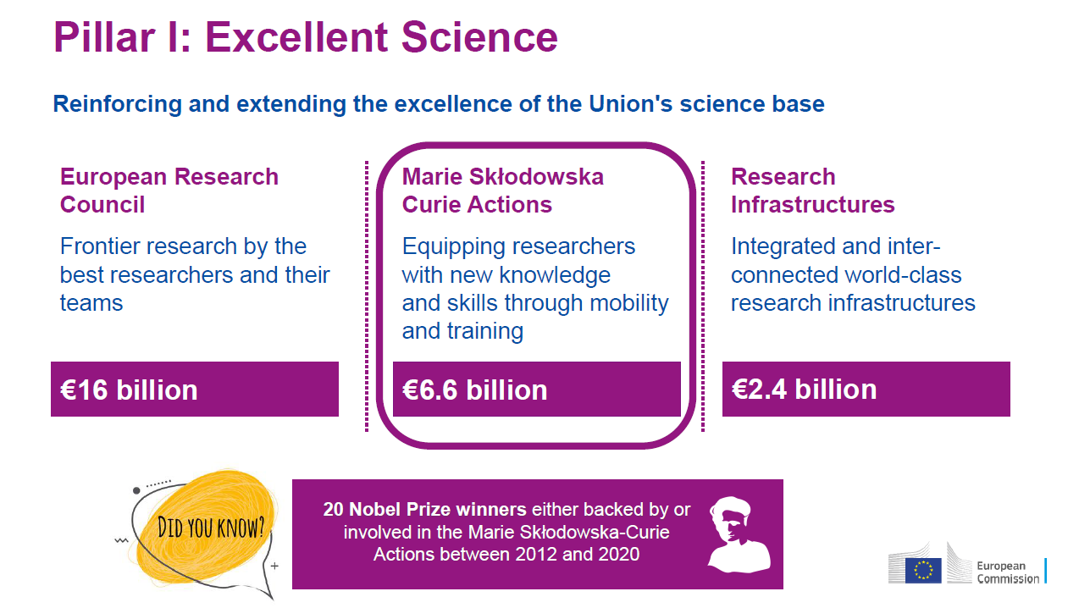
to develop, promote and advance scientific excellence, support the creation and diffusion of high-quality new fundamental and applied knowledge, skills, technologies and solutions, training and mobility of researchers, attract talent at all levels and contribute to full engagement of Union's talent pool
Bottom up : all scientific domains and topics can apply

Slide 14
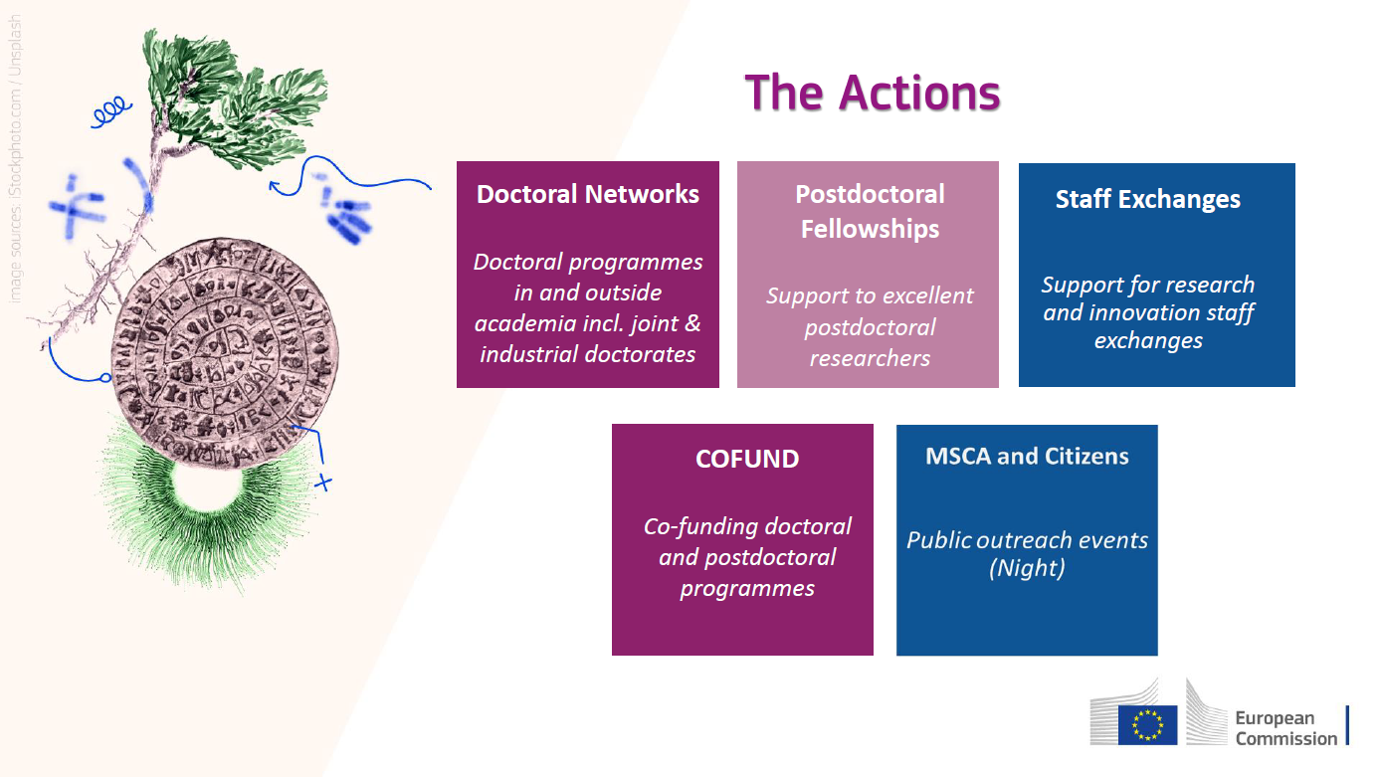
Notes:
From all the research career stage

Slide 15
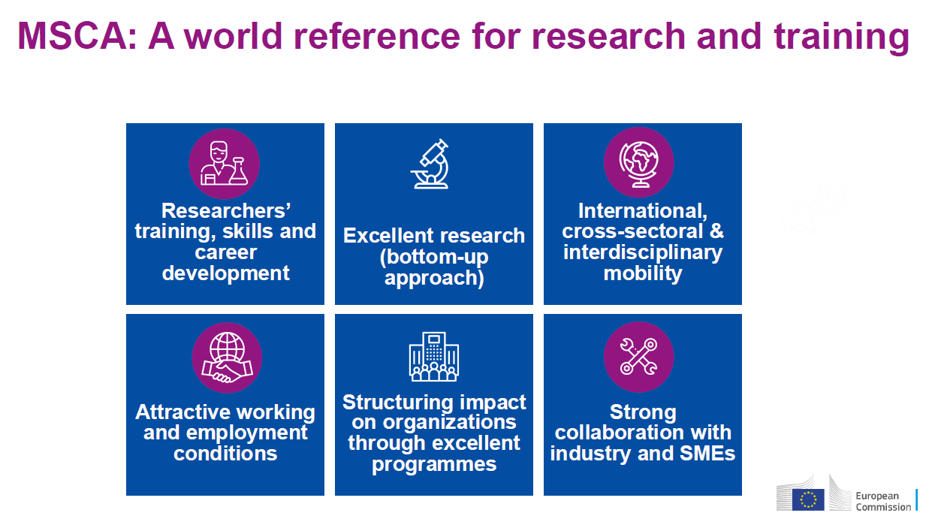
MSCA website
Notes:
Key features

Slide 16
MSCA Principles and Structuring Effects
Excellence
Open Science & RRI
Guidelines for Supervision
Bottom Up
Mobility
Gender friendly & inclusive
Recruitment & Working Conditions
Green Deal & MSCA Green Charter

Slide 17
MSCA Principles
Excellence
Fostering new Skills through Excellent Training, Knowledge and Innovation
Contribute to Excellent research, boosting jobs and international experience
Training, Supervision and Career guidance provided
From basic research to market take-up collaborations fostered knowledge transferred
R&I methodologies applied the research conducted

Slide 18








MSCA Principles
Bottom Up
SCIENTIFIC DOMAINS
Economic Sciences (ECO)
Physics (PHY)
Environment and Geosciences (ENV)
Chemistry
(CHE)
Social Sciences and Humanities (SOC)
Life Sciences (LIF)
Information Science and Engineering (ENG)
Mathematics
(MAT)
Notes:
All scientific fields including EURATOM areas

Slide 19
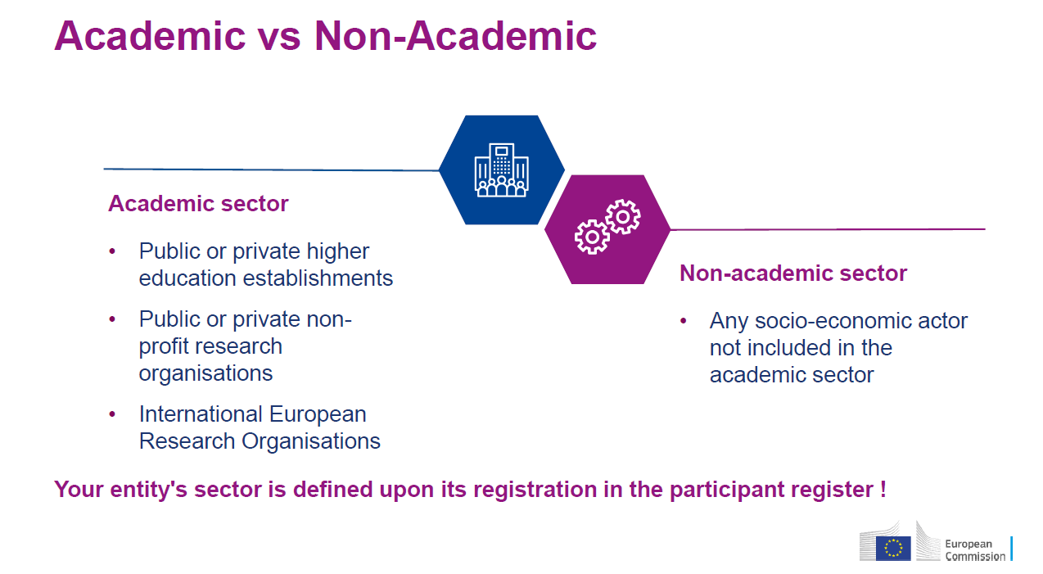
MSCA Principles
Mobility
Physical mobility researchers who receive funding have to move from one country to another to acquire new knowledge, skills and competences, and develop their research career
3 I’s (= International, Inter-sectorial, Interdisciplinary) is a key requirement
Nurturing Excellence through mobility of Researchers across Borders, Sectors and Disciplines
Fostering to set-up strategic collaborations worldwide
Attracting foreign talents to Europe

Slide 20
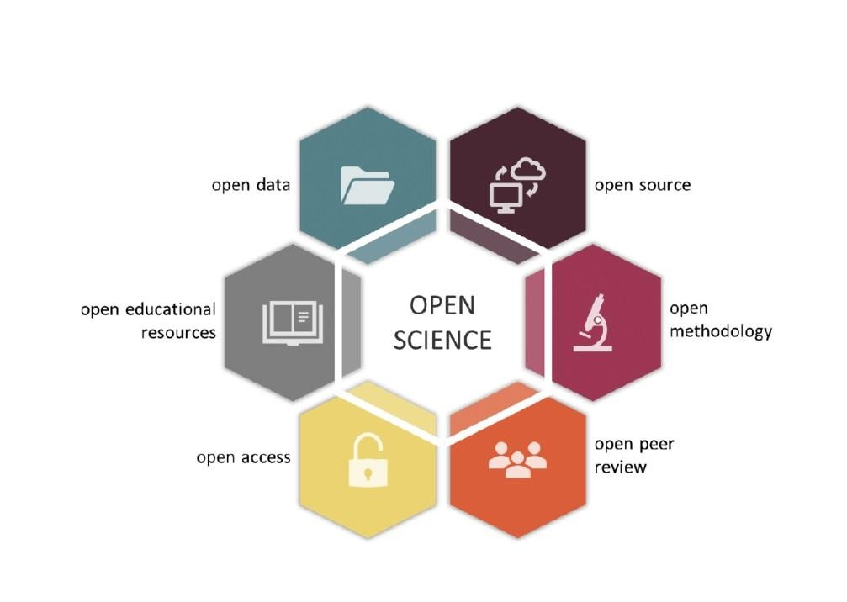
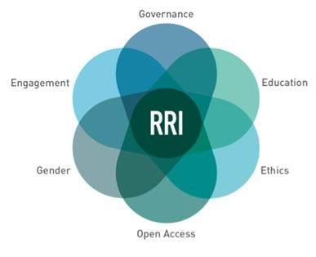
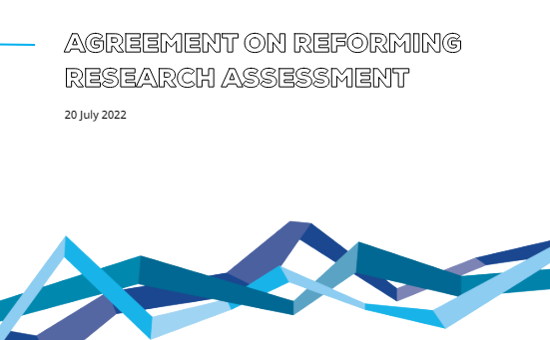
MSCA Principles
Open Science & RRI
The MSCA endorse Open Science and Responsible Research and Innovation (RRI) and supports DORA declaration

Slide 21
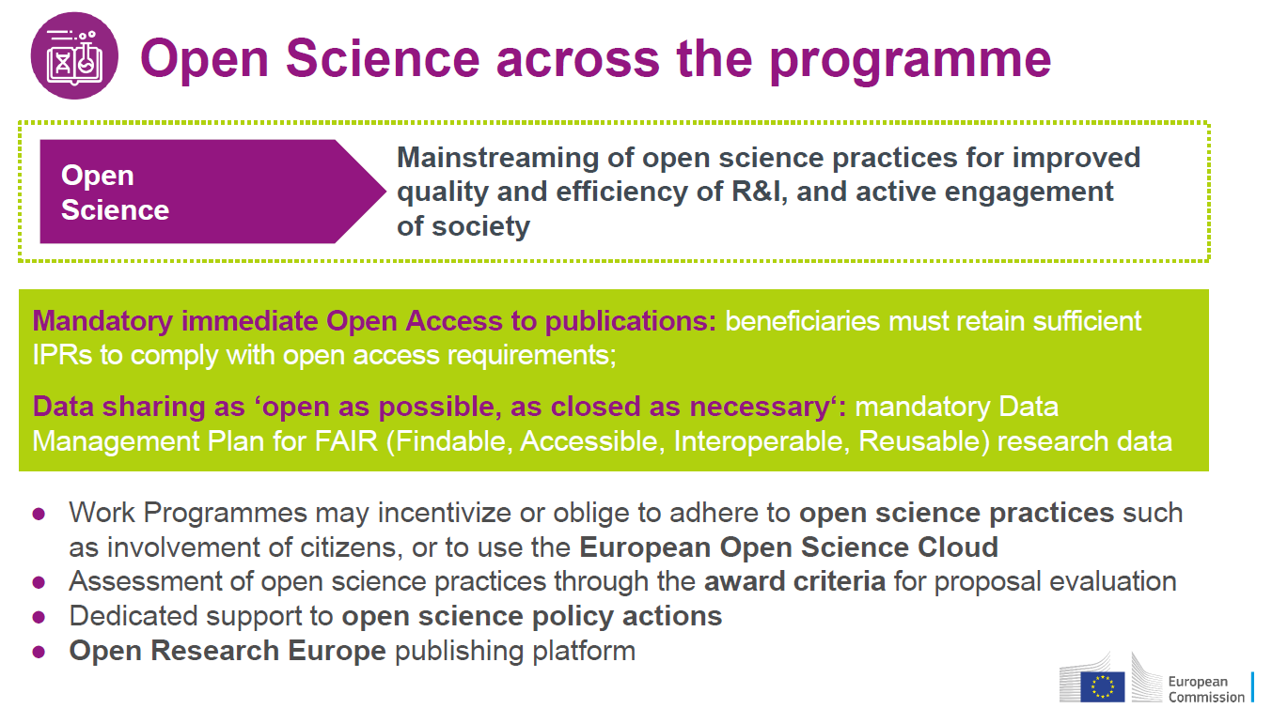

Slide 22
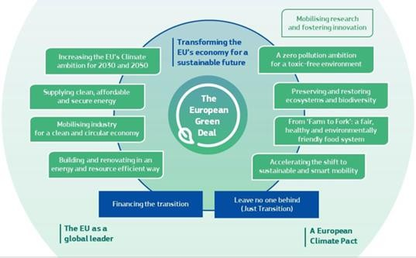
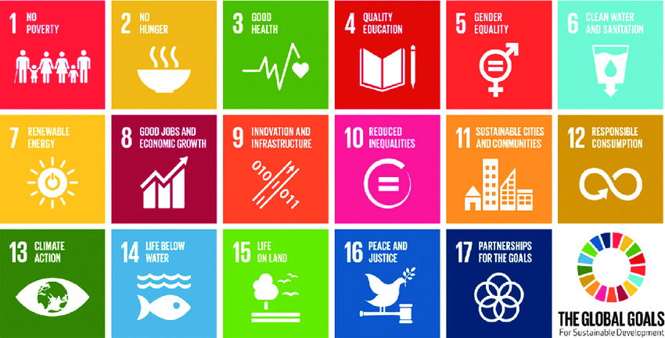
MSCA Principles
Green Deal & MSCA Green Charter
NEW
‘Greener MSCA’ promotes sustainable behaviors and policies, through MSCA Green Charter, Green Deal thematic clustering events….
European Green Deal
United Nation’s 2030 Agenda and the Sustainable
Development Goals
Notes:
Contribution to the European Green Deal objectives, Horizon Missions & SDG

Slide 23
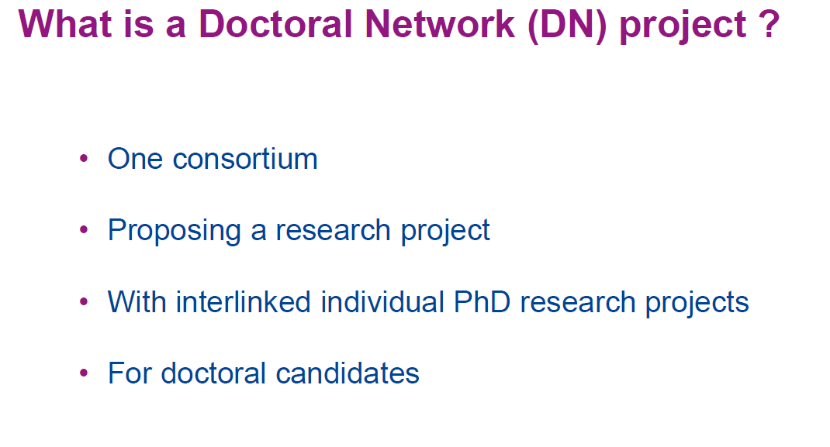
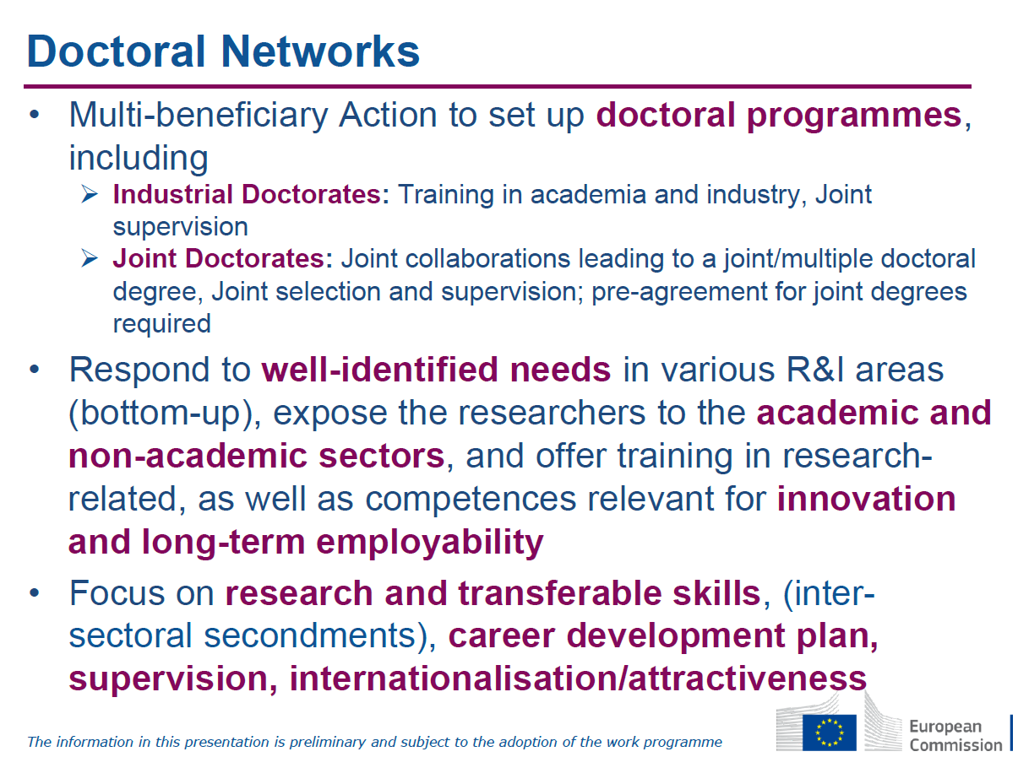
Objective: to train creative, entrepreneurial, innovative and resilient doctoral candidates, able to face current and future challenges and to convert knowledge and ideas into products and services for economic and social benefit

Slide 24
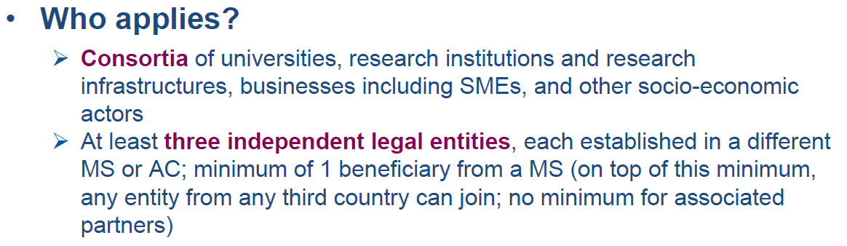
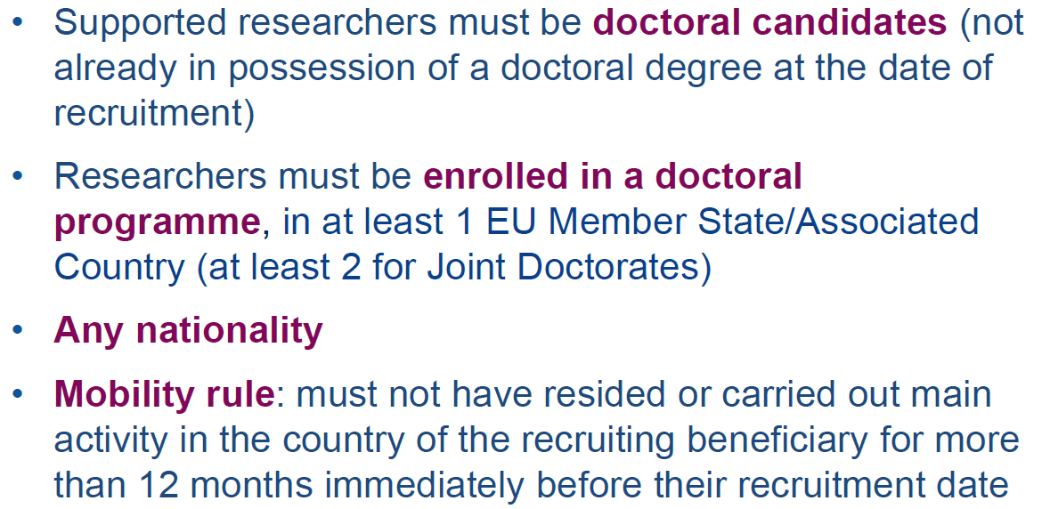
MSCA Doctoral Networks

Slide 25
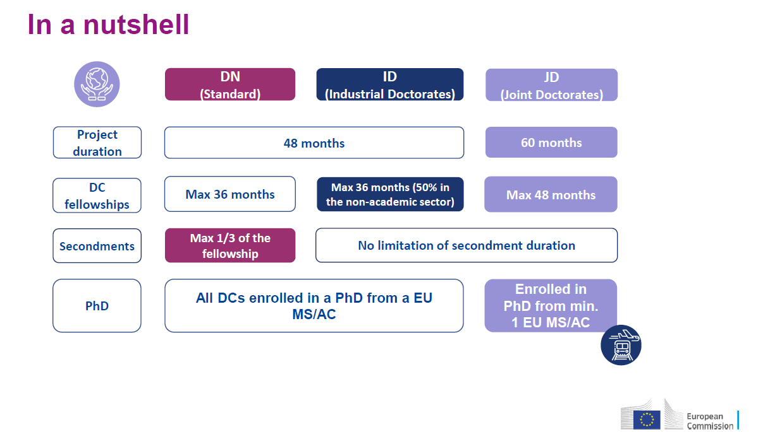
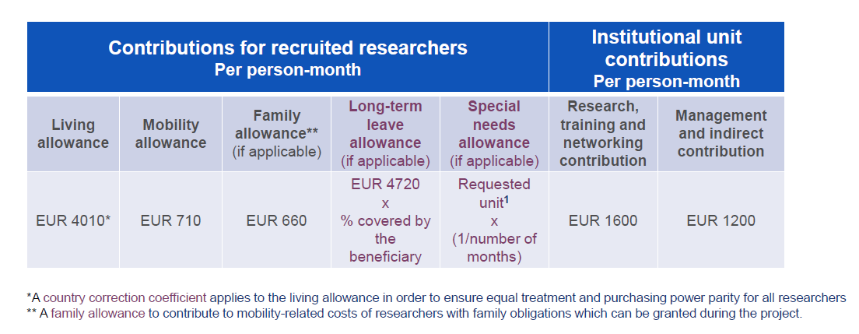
MSCA Doctoral Networks

Slide 26
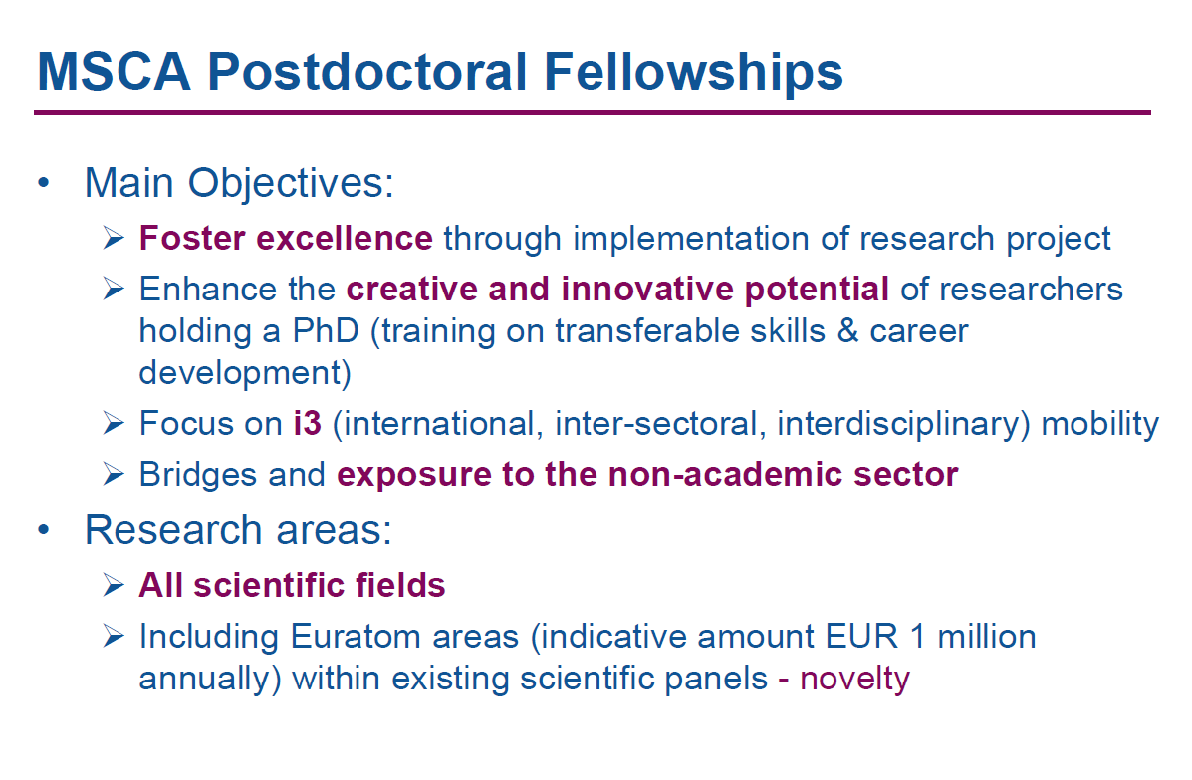
2-Postdoctoral Fellowships
Objective: to enhance the creative and innovative potential of researchers holding a PhD, wishing to acquire new skills through advanced training, international, interdisciplinary and inter-sectoral mobility

Slide 27
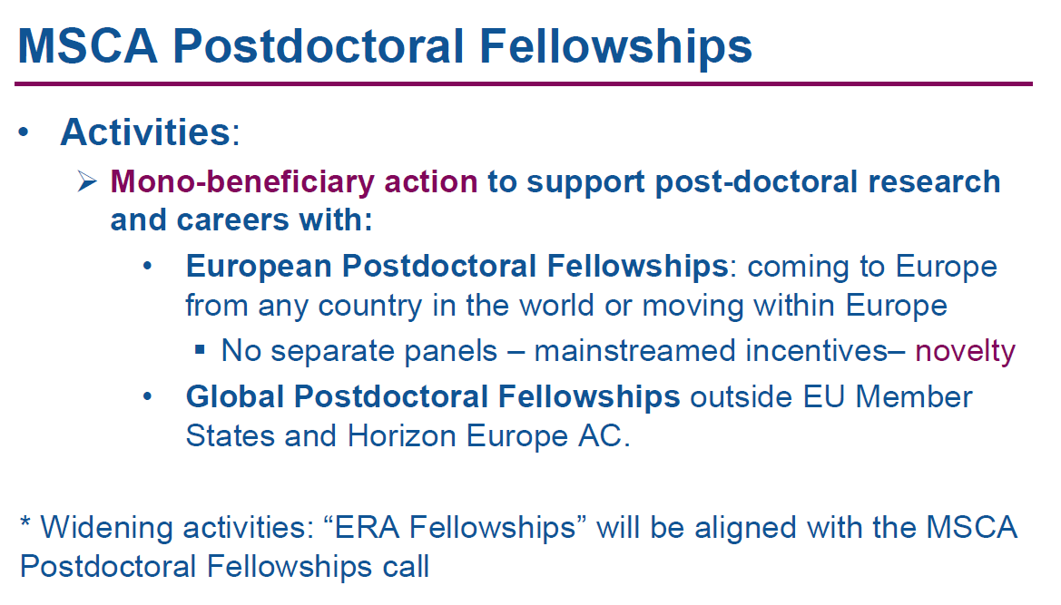
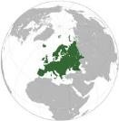

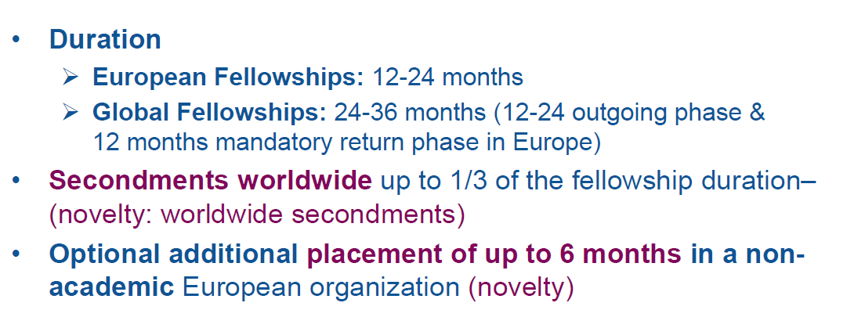
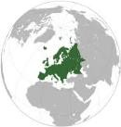

European Fellowships
Incoming phase 1- 2 years
Global Fellowships
Outgoing phase 1-2 years
Return phase 1 year
Supported researchers must have a maximum of 8 years full-time equivalent experience in research (maternity, paternity, research in Third Country etc.)
Years outside research and career breaks will not be counted
Working conditions: generally full-time employment contract including social security

Slide 28
Postdoctoral Fellowships - Impacts
Postdoctoral Fellow
Host Organistion
Supervisor/s
Increase set of skills, both research- related and transferable ones
Improved employability and career prospects both in and outside academia
New mind-sets and approaches to R&I
Increase in higher impact R&I output
Enhanced networking and communication capacities
Greater contribution to the knowledge-based economy and society
Experience of mobility and the benefits that it brings
Enhanced working conditions for researchers
Enhanced quality and sustainability of research training and supervision
Enhanced cooperation and
stronger networks
Increased global attractiveness
Better transfer of knowledge between sectors and disciplines
Stronger R&I capacity among
participating organisations
Feedback of research results into teaching and education
Helps build international profile
Helps to develop leadership skills and independence
Helps to develop/expand skills of the research group
Build/strength existing and new
collaborations/networks
Develops funding ID

Slide 29
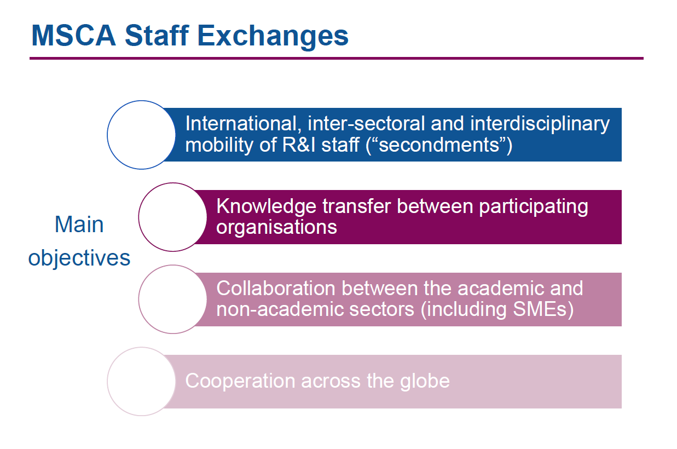
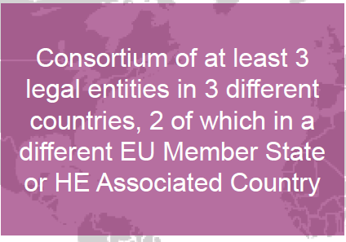
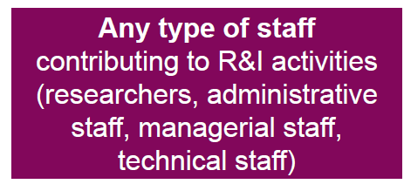
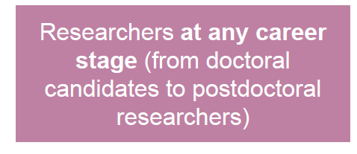

Slide 30
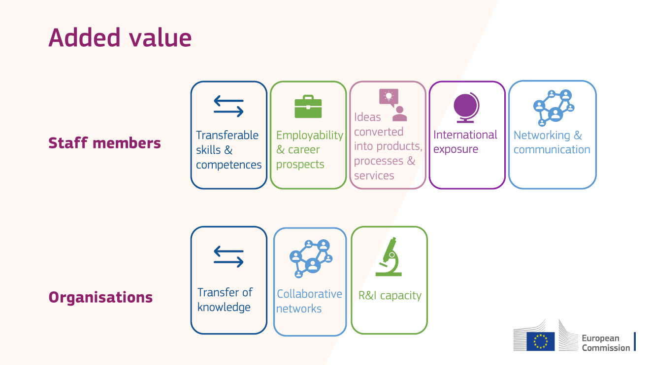
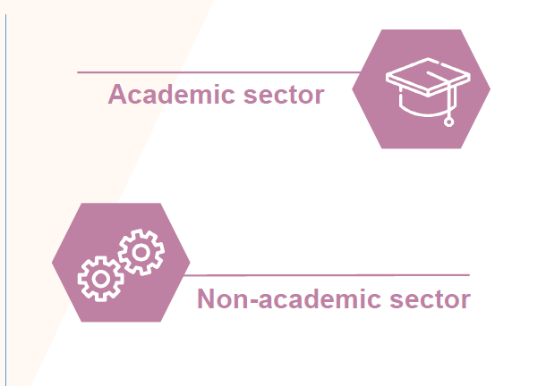
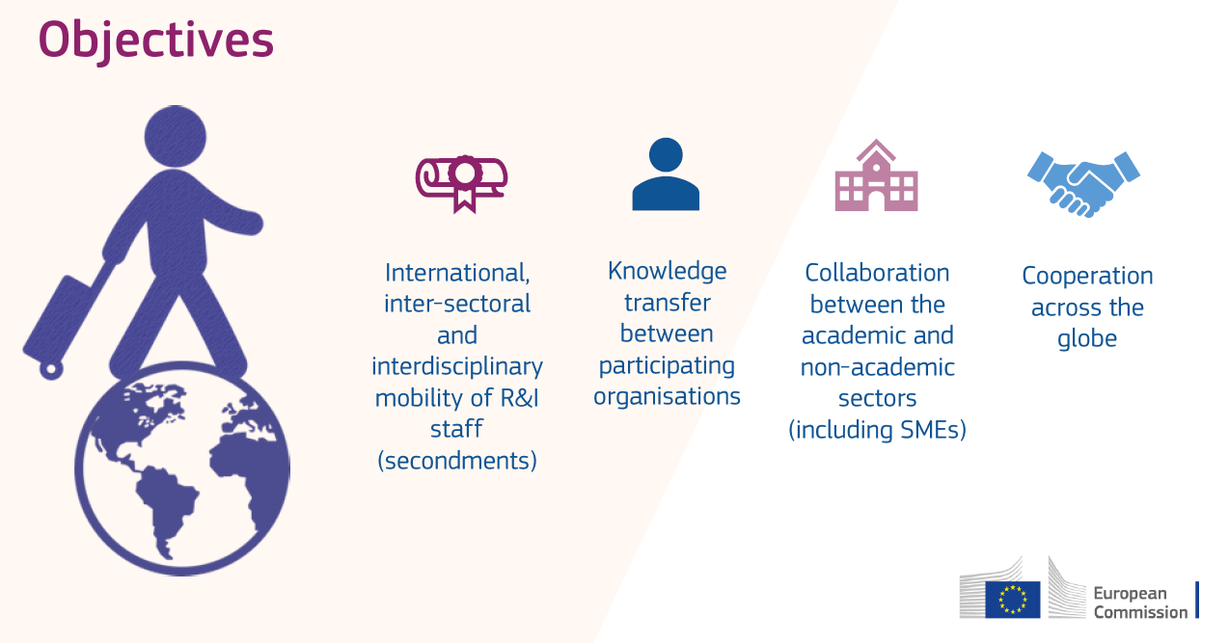

Slide 31
Interdisciplinary: first level keyword MSCA

Slide 32
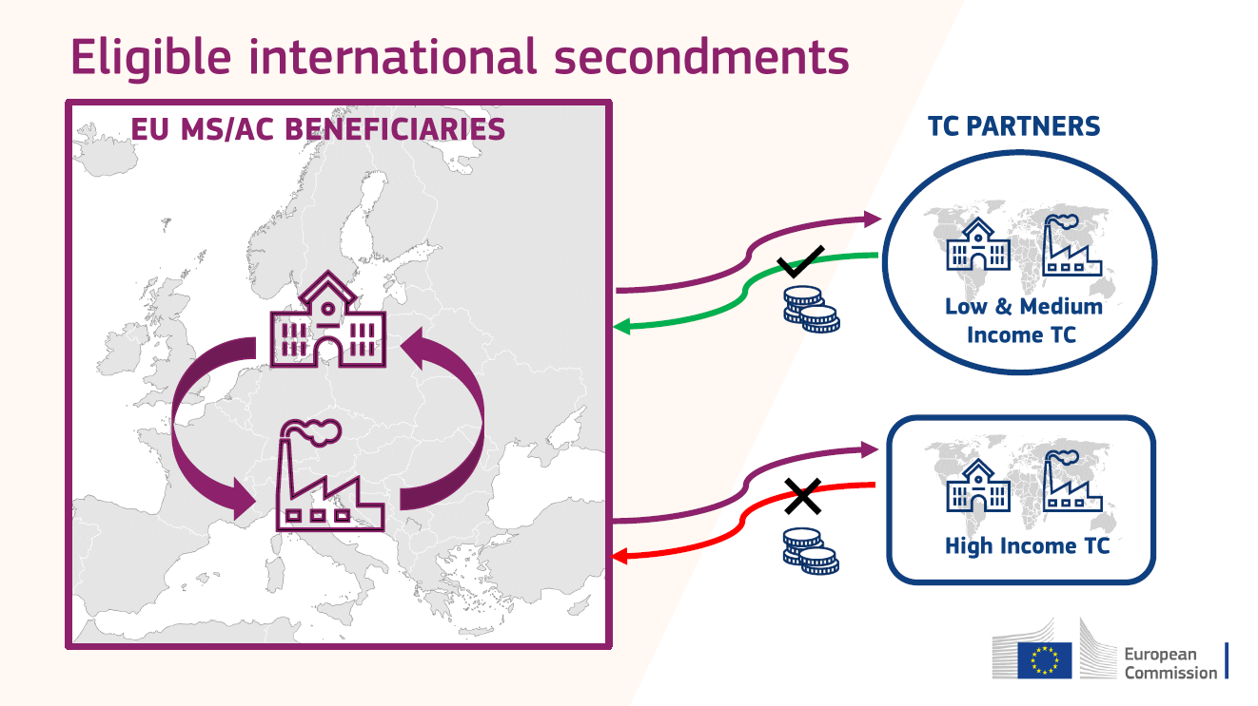
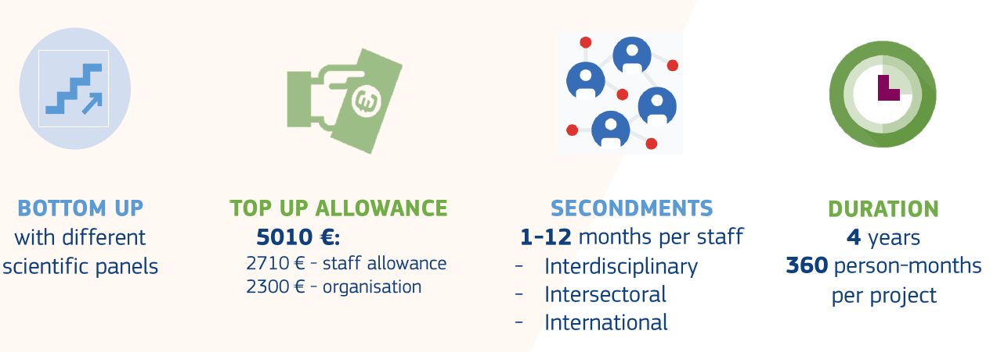

Slide 33
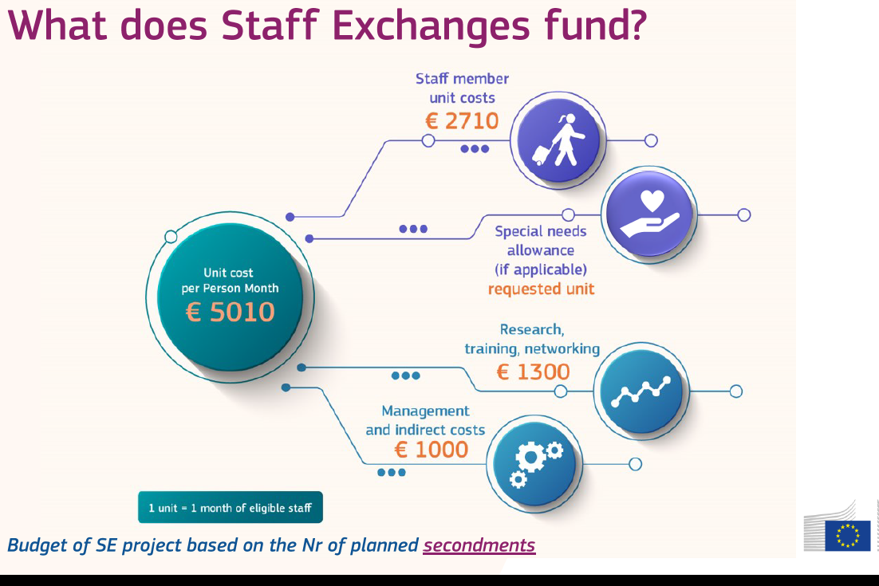

Slide 34
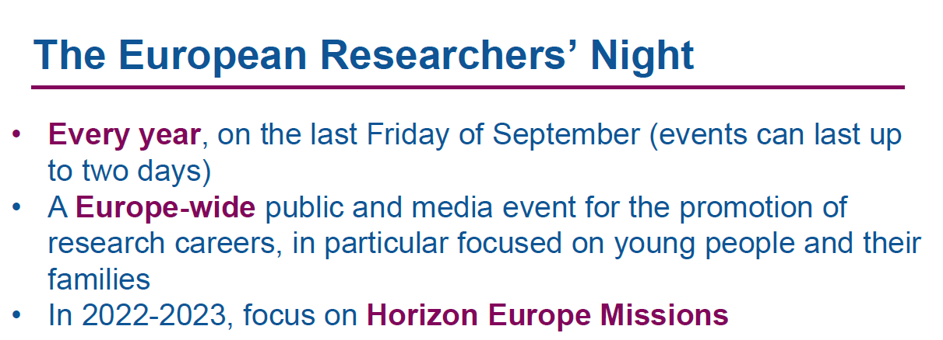


MSCA and Citizens..from Night in H2020
26 September 2025
https://ec.europa.eu/research/mariecurieactions/msca-acthttps://marie-sklodowska-curie-actions.ec.europa.eu/actions/msca-citizens/join-a-celebration-of-scienceions_en
image: Flaticon.com
Notes:
On 26 September 2025, the European Researchers’ Night will be celebrated across the continent. It is expected to welcome over 1.5 million people of all ages into museums, universities and research institutions in 460 cities across 25 countries.

Slide 35
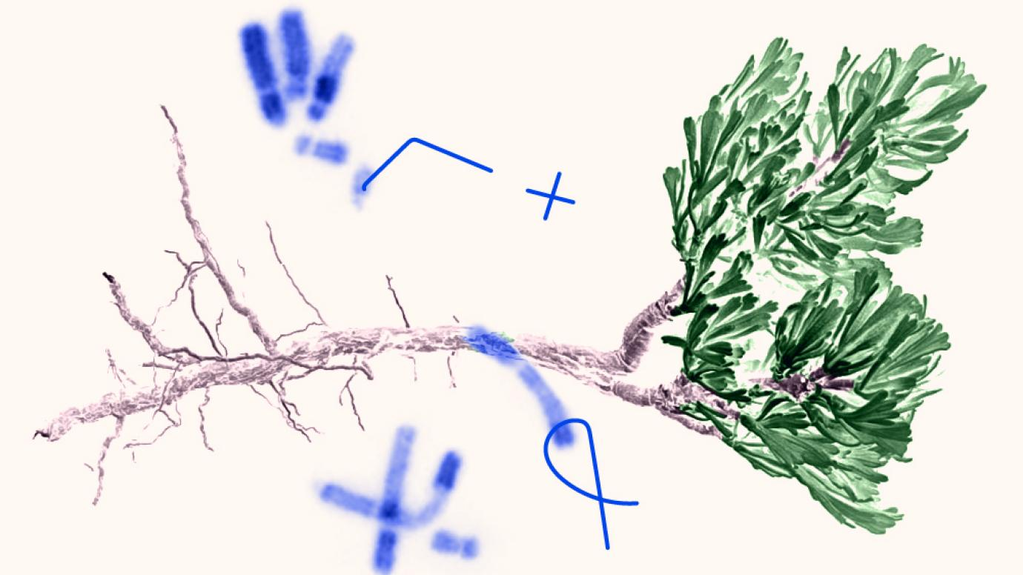
The European Researchers’ Night
  brings research and researchers closer to the public, attracting over 1.5 million visitors across Europe and beyond each year
  promotes excellent research projects across Europe and beyond
  increases the interest of young people in science and research careers
  shows how researchers’ work affects our daily lives
455 cities
25 countries in 2024
Notes:
Attracting over 1.5 million citizens yearly, this is the largest collaborative science outreach initiative in Europe. In 2024, events took place in 455
cities and in 25 countries, presenting excellent research projects through interactive and creative formats.

Slide 36
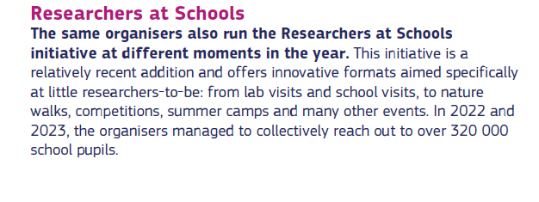
Who can apply
higher education institutions
research institutions and infrastructures
museums, scientific centres and festivals
science communication companies
organisations involved in science engagement
local, regional and national governments, education authorities and agencies
other socio-economic actors
For each call, around 45 projects are funded across Europe and beyond. If you are selected, you will join this vibrant family of science outreach professionals with dedicated beneficiary meetings to allow mutual learning.
• Projects run for two years (2026 & 2027). So, you will have funding for two consecutive years.
• We have increased the maximum contribution from €300 000 to €350 000.
Notes:
Increase awareness among the general public of the importance and benefits of R&I, especially EU-funded research, and its concrete impact on citizens’ daily life;

Slide 37
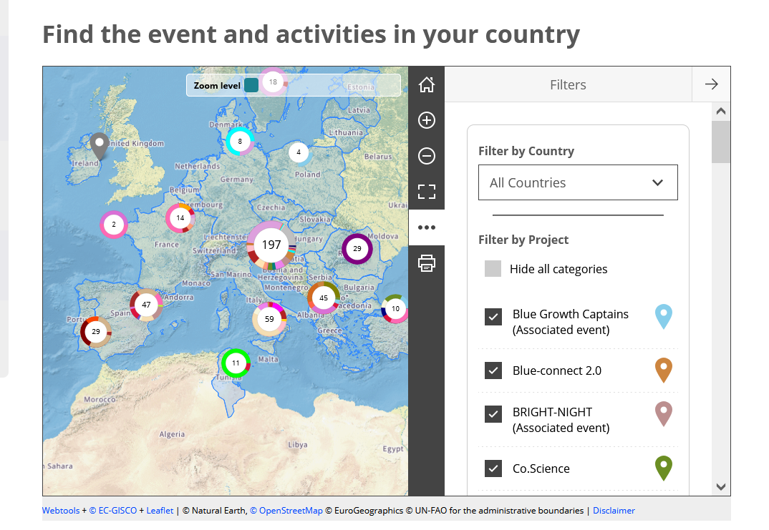
Be part of the International Celebration of Science
https://marie-sklodowska-curie-actions.ec.europa.eu/actions/msca-citizens/join-a-celebration-of-science
Notes:
The European Researchers’ Night is the largest research communication and promotion event taking place across EU Member States and Horizon Europe Associated Countries. A wide geographic coverage that reflects the European nature of this initiative is key.

Slide 38
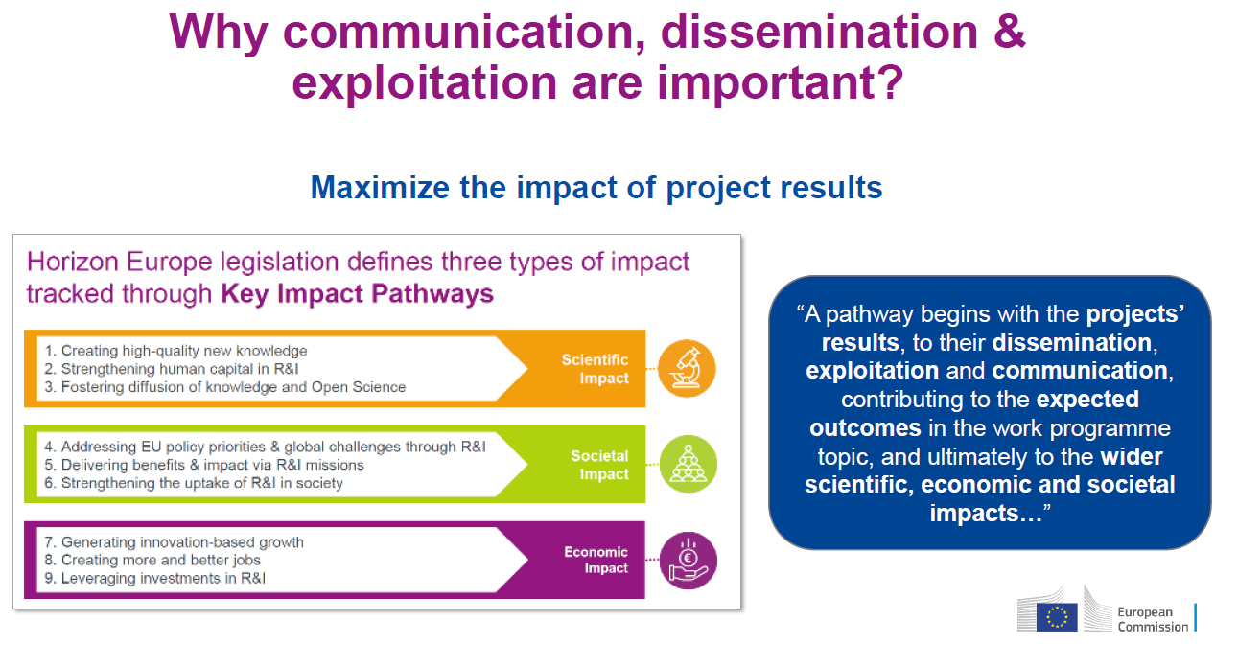

Slide 39
Dissemination and exploitation of research results
Dissemination and exploitation is an obligation and opportunity for a project to further scale-up the results, bring value to the work done, help to diffuse knowledge
The public disclosure of the results by appropriate means (other than resulting from protecting or exploiting the results), including by scientific publications in any medium.
The use of results in further research and innovation activities other than those covered by the action concerned, including among other things, commercial exploitation such as developing, creating, manufacturing and marketing a product or process, creating and providing a service, or in standardisation activities.
Taking strategic and targeted measures for promoting the action itself and its results to a multitude of audiences, including the media and the public, and possibly engaging in a two-way exchange
Dissemination
Exploitation
Communication

Slide 40
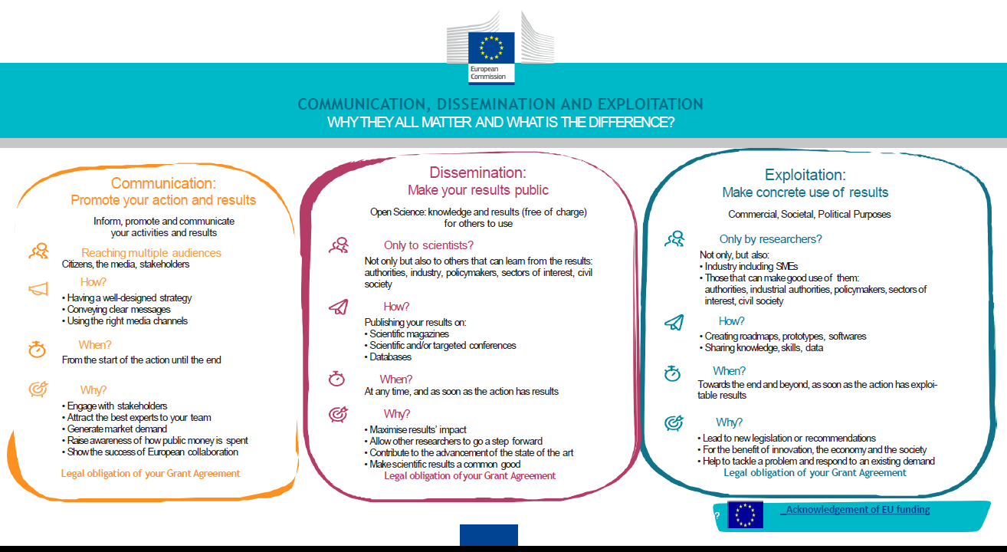
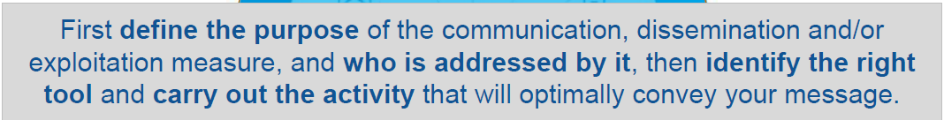

Slide 41
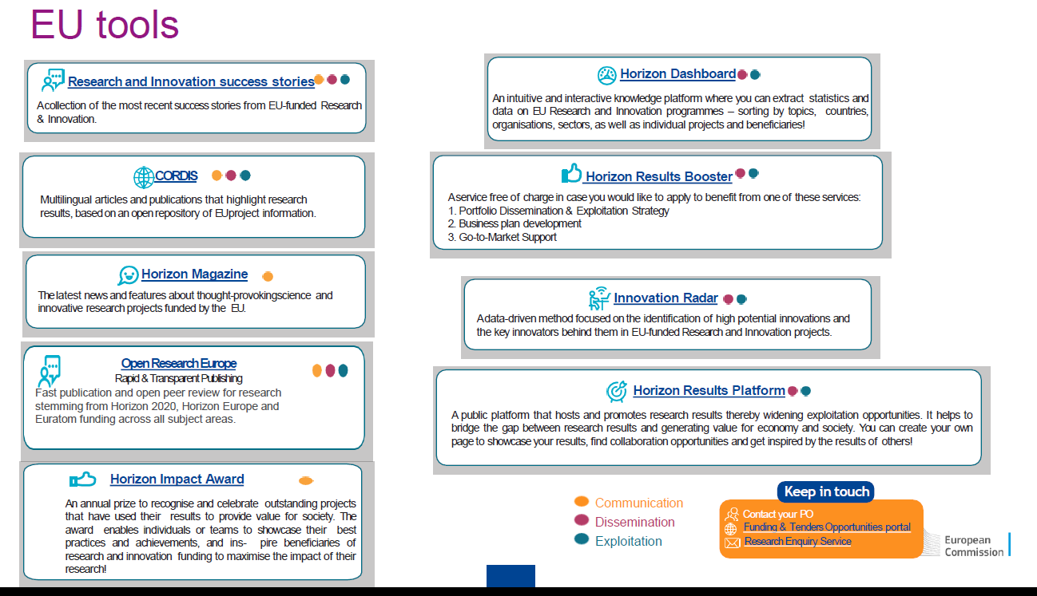

Slide 42
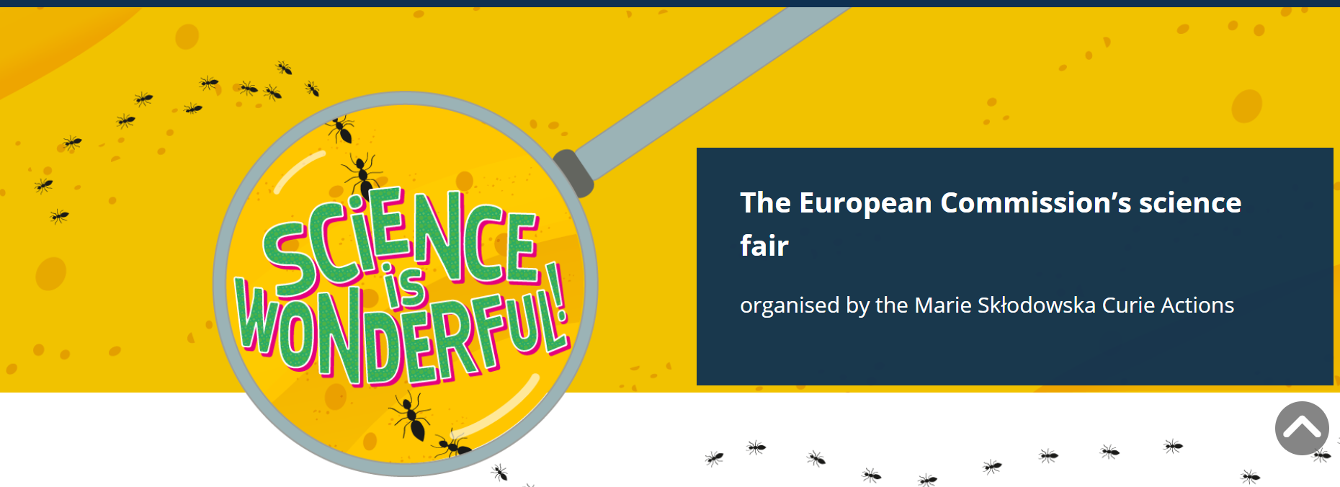
Science is Wonderful! bridges this research with schools across the European Union. It celebrates the value and impact of EU-funded research by giving primary and secondary school students the chance to interact with leading researchers and innovators, learn more about their work in engaging formats and ask questions about scientific careers. Since its inception in 2015, Science is Wonderful! has organised an annual science fair that interactively showcases research projects and innovations through presentations, hands-on experiments, games and quizzes.
resources for educators and students

Slide 43



Slide 44


Why is science wonderful?

Slide 45
Credits:
Manuela Minguzzi. PhD
Research Developer – Social Sciences and Humanities & Excellent Science Unit
Research Division ARIC
University of Bologna, Italy
manuela.minguzzi3@unibo.it
es@unibo.it

