Slide 1
Chern-Simons Inflation and Baryogenesis?
Stephon H.S Alexander
PRINCETON UNIVERSITY
HAVERFORD COLLEGE
INSTITUTE FOR GRAVITATION AND THE COSMOS, PENN STATE

Slide 2
Collaborators:
Antonino Marciano
David Spergel

Slide 3
Outline
I. Introduction & Motivation
II. Basic Motivation and Idea of Inflation
III. Scalar Field Inflation: The Good and the Bad
IV. Chern-Simons Inflation and the Standard Model
Observable Effects: Baryogenesis
VI. Conclusion and Outlook

Slide 4
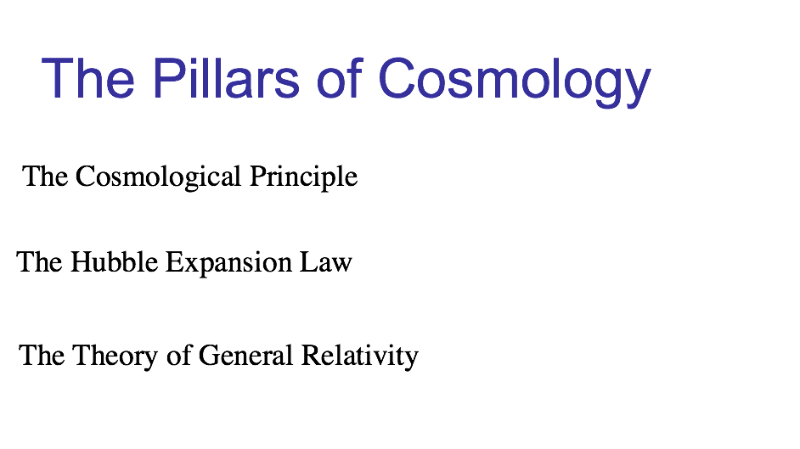
These principles combine to provide a unique mathematical solution of Einstein’s eqs.- an expanding universe that emerged from a big-bang.

Slide 5
Predictions of SBB
Predicts the formation of light nuclei (BBN) in galaxies (caveat : Baryogenesis)
Predicts Hubble Recession Law
Predicts Thermal History
Predicts the Blackbody nature of the CMB

Slide 6
But our Universe is not smooth and featureless…

Slide 7
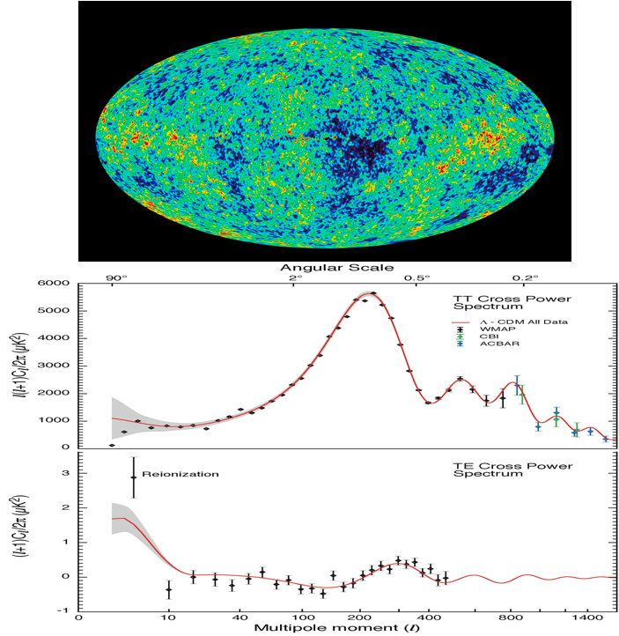

What causes these fluctuations?
Fluctuations grow into galaxies

Slide 8
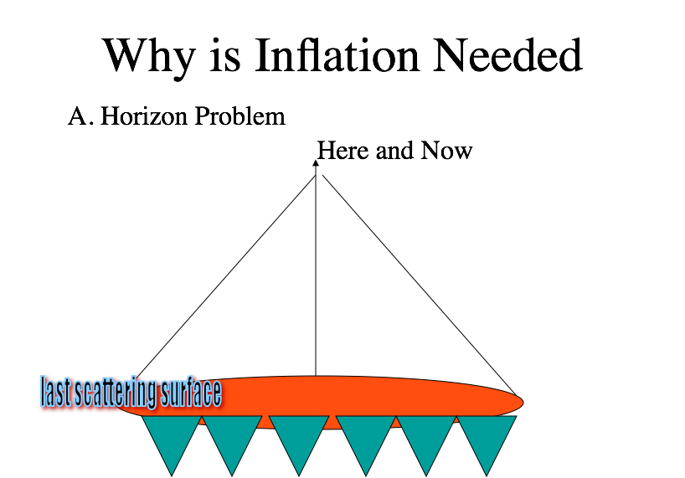
Alan Guth ‘81
Standard Big Bang

Slide 9
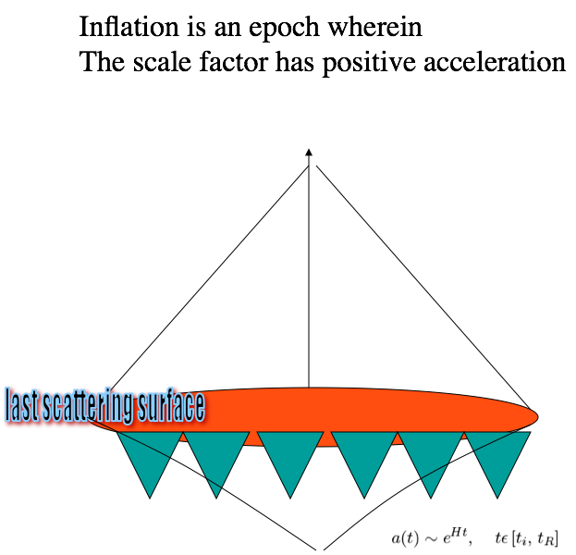

Inflation Solves Horizon Problem
Accomplished by
Making Gravity ‘repulsive’
Tiny piece of space

Slide 10
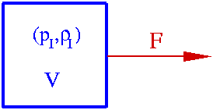
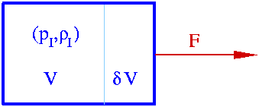
The Idea Behind Inflation
Gravity should be “repulsive”
work done on the system ⇒ dW=-Fds= PdV<0
Q: But, who does the work (on the Universe)?
A: Gravity itself (if filled e.g. with repulsive vacuum energy)?
Friedmann equation (FLRW):
Analogous to F=ma

Slide 11
Paradigm Shift:
General Relativity and QFT
In Standard Big Bang, we assumed that matter was an ideal classical fluid.
Inflation marries Quantum Field Theory with General Relativity:
Enables us to use important tools developed by Particle Physics to address structure formation.
Classical Fluid Vacuum Energy

Slide 12
Inflation and The Standard Model: Take 1
- Guth originally proposed inflation by using ideas from:
(1) Condensed Matter Physics: (Spontaneous symmetry breaking).
(2) Particle Physics: SU(5) GUT. (Old Inflation)
- This idea did not work (too much anisotropy, bubble nucleation).
- More “improved models” (New Inflation, Slow roll)

Slide 13
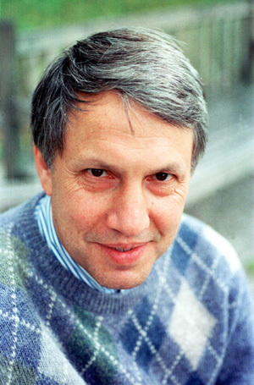
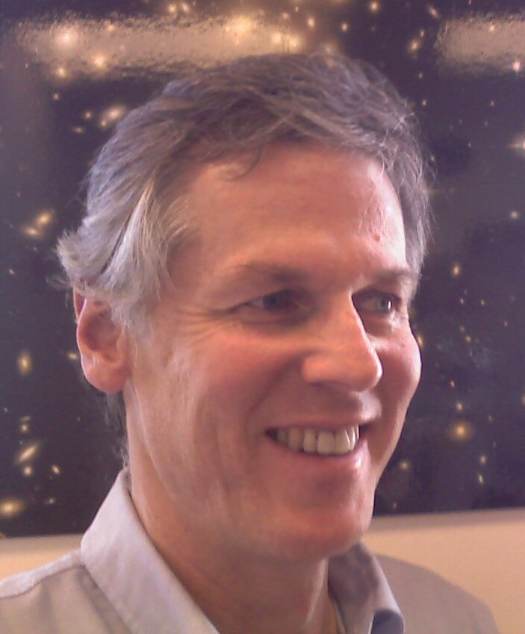
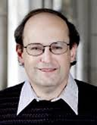
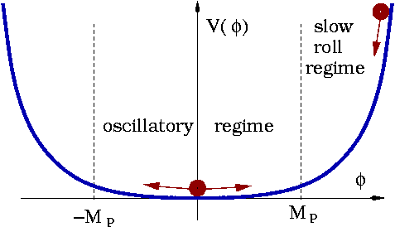
Slow Roll “Chaotic Inflation”
RECIPE:
Initial conditon: Magically
place scalar field at the top.
Begin:
Chaotic Inflationary Model (Linde 1982)
Credit: T. Prokopec

Slide 14
Scalar Inflation Summary
Two phases:
  “slow roll” down a mild slope gives inflation
  Faster fall into lowest energy state and oscillation -> reheating
Oscillations around minimum potential are damped by particle formation, universe gets reheated

Slide 15
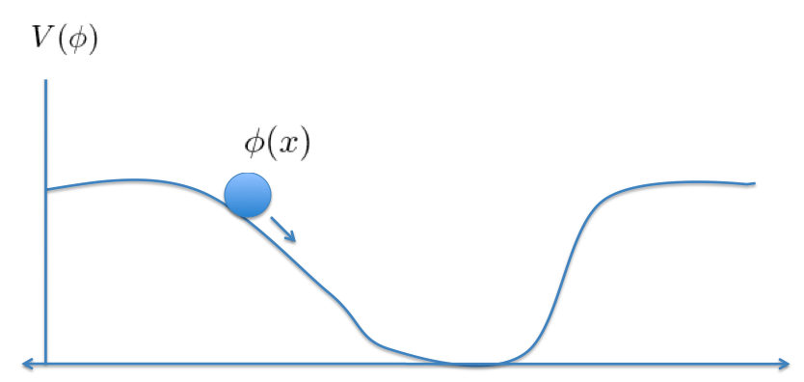
But it is hard to get a field with these properties in our standard model of particle physics

Slide 16
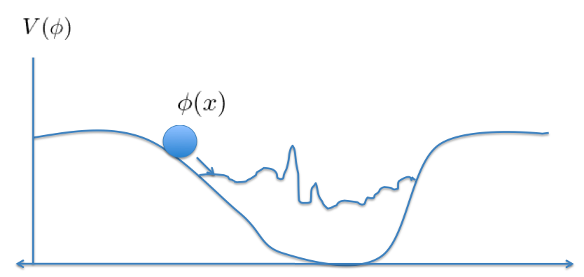
Quantum fluctuations destroy flatness.

Slide 17
Open Questions for Inflation
What is the identity of the inflaton field?
Can inflation address the matter-antimatter asymmetry?
Can we find new connections between
inflation and the standard model of particle physics, with observable consequences?

Slide 18
Inflation is a great idea waiting for a
realistic physical model.
Can inflation return to its roots and connect
to the Standard Model of Particle
Physics?

Slide 19
Hint: Scalar fields are conceptually problematic (refer to Brandenberger’s notes)
Make scalars secondary and keep the good things about inflation (ie. structure formation).
Instead seek inflation from vector (gauge) fields since they are observed in nature.
CAN WE GET INFLATION WITH VECTOR FIELDS FROM THE STANDARD MODEL?

Slide 20
Vector Inflation
In ’89 Larry Ford proposed a vector field model of inflation. But it suffered from a few problems:
I. Vector fields spoil isotropy.
II. The “Slow-Roll” conditions were difficult
to realize naturally.
III. Vector model did not seem to buy
anything new.
IV. Recently revisited by Mukhanov et. al, Dimopoulous, Lyth.

Slide 21
A question lurks
Does particle physics (QFT) naturally generate inflation using vector fields to overcomes past hurdles?
YES!
Furthermore, we get a natural connection to another cosmological problem …
The matter-antimatter asymmetry
(baryogenesis)

Slide 22

CLAIM
- At ~GUT energy scales the universe comprises of a plasma of gauge fields and fermionic currents (as opposed to non-zero scalar density).
- Energy density of universe dominated by
gauge-fermion interaction energy.
- Dramatically different intitial condition from
traditional scalar inflation

Slide 23
Physical Mechanism
Pre Inflationary Universe comprises of an initial white-noise spectrum of background gauge fields and fermion current.
Plasma and non-linear gravitational backreaction amplify gauge field (as opposed to conventional redshift).
Inflation is generated from the interaction energy of the gauge field and fermion current (like Lorentz Force).

Slide 24
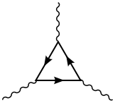
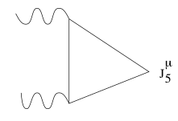
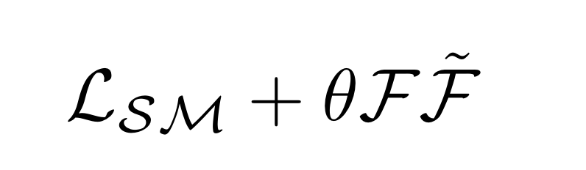
Chern-Simons Inflation
The standard model has quantum anomalies:
These Triangle Feynman Graphs contribute an additional term the standard model action.
(Alexander, Marciano, Spergel, hep-th/11070318)
These effects have been observed (eta meson
decay into two photons ‘t Hooft)

Slide 25
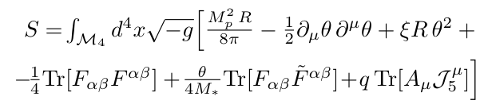
The Action

Slide 26
Given a general massless gauge theory
there are three forms of anisotropies
to overcome
Isotropic
Electromagnetic
Anisotropy
Off-diagonal
Anisotropy

Slide 27

Isotropy or Not?
Claim: The purely isotropic part of gauge field-current interaction dominates energy momentum tensor self-consistently.

Slide 28
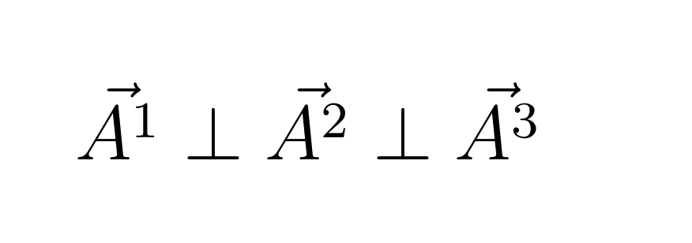
ISOTROPY I
Mutually Orthogonality of Vector Field Cancels
Spatial Anisotropy

Slide 29


ISOTROPY II: FLAVOR SYMMETRY
Problematic because there are anisotropies
of the same order of magnitude in EM tensor
This is resolved by having N copies of
gauge fields randomly oriented on initial time hypersurface

Slide 30
Instantiation
Check consistency of Einstein Field Equations and Equations of motion that yield inflation.

Slide 31
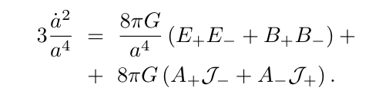



Einstein Equations
Key Insight: A.J ~ Constant
Inflation

Slide 32


Gauge Field Amplification
Chern-Simons Source
Fermion Current

Slide 33

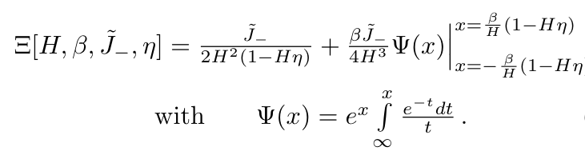
General Solution for Gauge Field

Slide 34

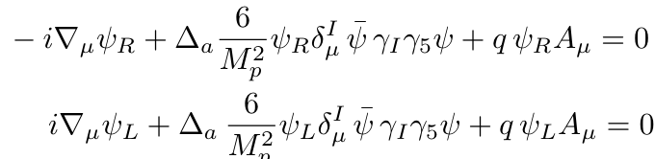
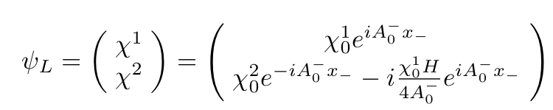
Fermionic Dynamics

Slide 35
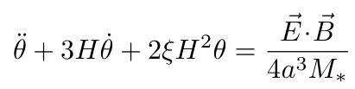
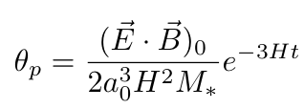
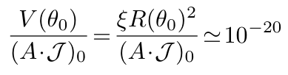
Consistency condition
for theta field
Backreaction from Theta insignificant

Slide 36

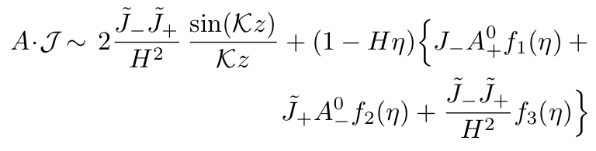

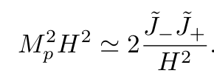

Solutions
Scale inside initial
Hubble radius:

Slide 37
These equations self-consistently generate an inflationary space-time

Slide 38
Baryogenesis
The Gauge Field configuration responsible for inflation also generates baryon asymmetry at the end of inflation due to the Chern-Simon’s term and ABJ Anomaly
All three Sakharov Conditions are naturally satisfied during the inflationary epoch (Alexander, Peskin, Sheikh-Jabbari, PRL 05)

Slide 39
Sakharov Conditions
Sakharov argued in the 1960's that any explanation of this puzzle had to contain three elements:
1.Baryon number must be violated efficiently, early in the universe,
II. The discrete symmetries C and CP must be violated,
The universe must fall out of thermal equilibrium, at the moment when baryon/lepton number switches from being violated, to being conserved.
ALL THREE CONDITONS ARE SATISFIED AND INTERRELATED
IN CHERN-SIMONS INFLATION!

Slide 40

Sakharov Loves Inflation
(Aexander, Peskin, Sheikh-Jabbari PRL 05,Lyth et. al JCAP 06)
Baryon Violation: Chiral Anomaly
CP Violation:
Out of Equilibrium: Inflationary Background

Slide 41
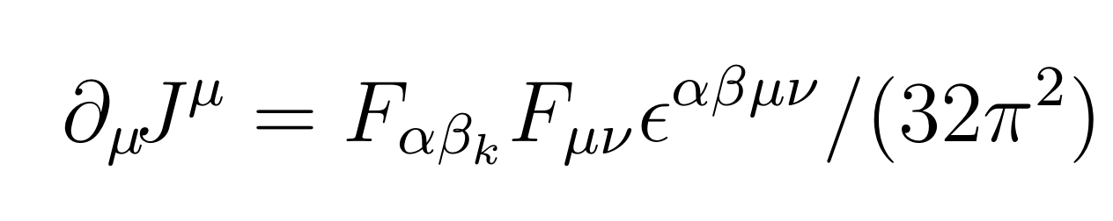
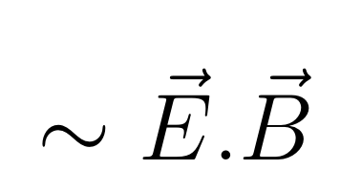
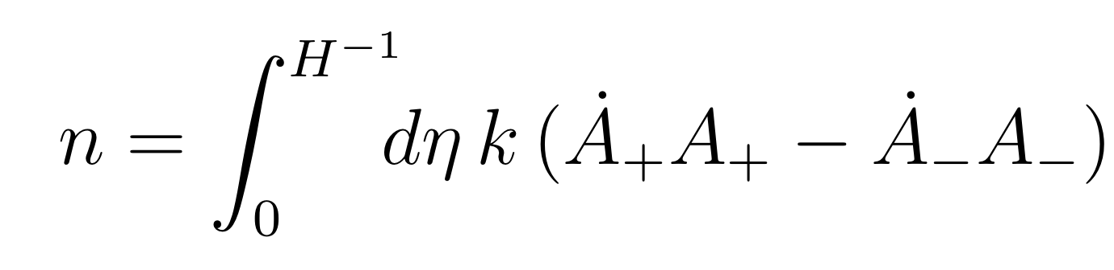
New Effect: Ending Inflation with Baryon Asymmetry
Recall the Anomaly
Diagram:
Fermion number
Chern-Simons
Condition for Inflation!

Slide 42
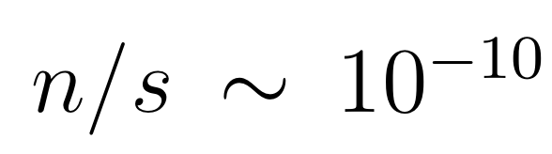
Gauge Field gets converted into Fermions through the triangle anomaly.
Gauge field dilutes and Inflation Ends.
A Problem: Not quite enough matter asymmetry.
Observations
(WMAP and BBN)
Theory!!?

Slide 43
Things to work on
Reheating
Dark Matter Production and Baryogenesis
Relation to Dark Energy
New Observational Signatures (ie. Violation of stastical isotropy, non-gaussianity, parity violation in CMB)

Slide 44
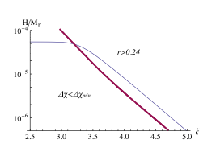
Potential Observational Effects:
CMB Polarization cross correlation due to Birefringence
(Caldwell, Gluscevic, Kamionkowski astro-ph 1104.1634)
Birefringent Inflationary
Gravitational Waves
(Lue, Wang, Kamionkowski ‘03,
Alexander, Peskin, Sheikh-Jabbari , PRL ‘05
Alexander, Martin, PRD ‘06
Sorbo, astro-ph ’11,Maldacena et al, )
GW
Amplitude
Parity Coupling

Slide 45
Conclusion & Outlook
Inflationary physics resolves problems of Standard Big Bang Scenario.
Inflation provides a microphysical mechanism for the generation of the observed large scale structure.
Many fine tunings with scalar field inflation. Difficult to make contact with nature. Difficult to differentiate between models.
I Proposed a new model of inflation that fits into the structure of the Standard Model and makes use of novel quantum effect.
Much to understand and new exciting projects for students to explore (ie. Reheating, Baryogenesis, CMB polarization, Gauge Oscillons, Quantum Cosmology etc.)

