Slide 1
GRAVITATIONAL BREMSSTRAHLUNG IN
ULTRA-PLANCKIAN COLLISIONS
Theodore Tomaras
University of Crete

Slide 2
1. MOTIVATION
About 12% energy losses in e+e- collisions at Z⁰
(Altarelli, Martinelli, 1986)
Reasonable expectation:
Even more gravitational radiation in ultra-planckian collisions.
PRACTICALLY MOST NATURAL CONTEXT:
TeV-SCALE GRAVITY with LARGE EXTRA DIMENSIONS
OTHER GOALS:
Study characteristics of gravitational radiation per se
Provide checks of other computations and computer simulations
3. Maybe modify estimates of BH production cross-section ??
4. Useful information about the QG S-matrix

Slide 3
2. At ultra-planckian energies gravity is (a) dominant (G_{N} E² >> 1) and (b) classical
A.D.D.:
■ A formal argument
Classicality:
Also obtained for:
(Giudice, Rattazzi, Wells
Veneziano,…)

Slide 4
Ultra-relativistic scattering
■ An explicit demonstration
Gal’tsov, Kofinas, Spirin, TNT:
GKST 0903.3019 (JHEP)
(d=0: Deibel, Schucher)
Cross-section identical to the QM eikonal approximation.
All orders in the QM sense.
‘t Hooft (1987), ACV (1987), Verlindes (1992), Kabat+Ortiz (1992)

Slide 5
GRAVITATIONAL BREMSSTRAHLUNG IN
ULTRA-PLANCKIAN COLLISIONS IN M₄xT^{d}
Amati, Ciafaloni, Veneziano
Cardoso et al
Choptuik and Pretorius
Christodoulou
D’Eath and Payne
Giddings et al
Yoshino et al
…………………………
See our papers….
The same PEDESTRIAN APPROACH: MASSIVE POINT PARTICLES (“STARS”)
GKST: 0908.0675 (PLB),
1003.2982 (JHEP),

Slide 6
3. A SIMPLER MODEL:
SCALAR BREMSSTRAHLUNG IN GRAVITY-MEDIATED U-P COLLISIONS
ConstantinouGST: 1106.3509

Slide 7
THE SOLUTION UP TO FIRST ORDER
The
LAB frame

Slide 8
THE SECOND ORDER EQUATION –
SCALAR RADIATION
m
m
m’
m’
THE EMITTED ENERGY

Slide 9
GENERAL REMARKS (GRAVITATIONAL RADIATION)
Radiation efficiency:
(A)
(B)
(C)

Slide 10
THE LOCAL SOURCE
(k, n)
m
(p, l)
m’

Slide 11
COUNTING POWERS OF γ IN THE EMITTED ENERGY
FROM THE LOCAL CURRENT ALONE:
THE EMITTED
ENERGY

Slide 12
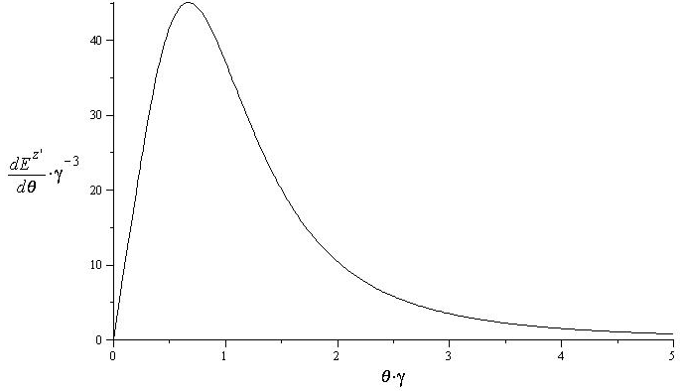
The frequency and angular distributions are very well localized
Frequency and angular distributions - GRAPHS
Angular distribution of E^{z’} in D=4 for γ=1000

Slide 13
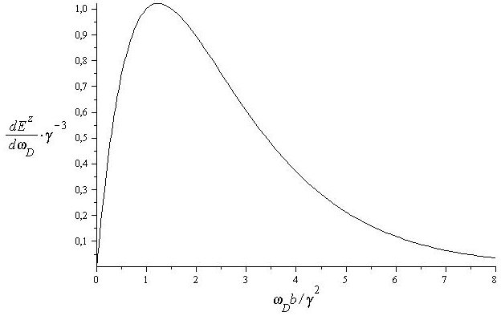
Frequency distribution of E^{z} in
D=7 and for γ=1000
…so it is simple to obtain
the powers of γ

Slide 14
THE NON-LOCAL SOURCE
f
m
(p-k, l-n)
(k, n)
(p, l)
m’

Slide 15
DESTRUCTIVE INTERFERENCE
In the regime:
The terms of O(γ) and O(1)
in ρ^{n} and σ^{n}₀ cancel in the sum.
For synchrotron in d=0: Gal’tsov, Grats, Matyukhin (1980)

Slide 16
SUMMARY: THE SOURCE OF Φ-RADIATION
Contains only K_{α}(z)
Contains only K_{α}(z’)
A new characteristic
frequency:

Slide 17
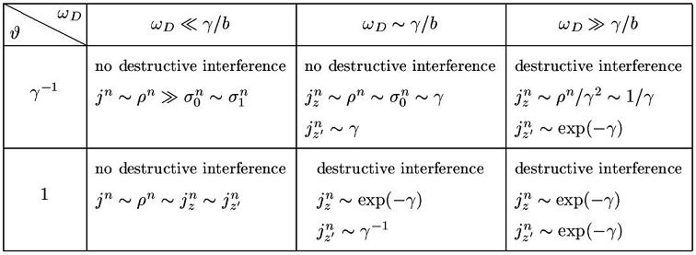
(1)

Slide 18
THE COMPONENTS OF RADIATION
(1)
(1)

Slide 19
4. GRAVITATIONAL BREMSSTRAHLUNG IN M₄ X T^{d}
DIFFERENCES: GRAVITATIONAL RADIATION POLARIZATIONS
COUPLING TO THE PARTICLES GRAVITATIONAL
For d=0 see also K. Thorne and S. Kovacs, 1975 – 78
But e.g. ACV:

Slide 20
5. REGION OF VALIDITY OF THE APPROXIMATION
◆ Mode sums to integrals
◆ Particle trajectories
(Δθ<<θ, Δb<<b)
Weak field |h|<<1, and
small scattering angle
◆ Classical radiation field –
Number of emitted quanta
DEPENDS ON THE RADIATION CHARACTERISTICS
AND THE KINEMATICS OF THE COLLISION

Slide 21
AN EXAMPLE
(NOT GOOD FOR m=0 !!)
b
SATISFIED in a window
depending on s, d, m, M*
e.g. d=2
FOR A ROUGH ESTIMATE OF ΕFFICIENCY: TAKE

Slide 22
6. CONCLUSIONS – DISCUSSION - SPECULATIONS
A classical calculation shows that in ultraplanckian collisions there
may be extreme gravitational bremsstrahlung with ε=Ο(1) for b>>r_{S}.
Back Reaction in such computations should be very important.
Valid for M_{D} as well as M₄ x T^{d}.
Reliable for collisions of massive particles and important for γ>>1.
Strictly speaking not reliable for collisions in the LHC.
Improvement necessary (e.g. to remove b_{c}).
A potential test for computer simulations or limits of other
analytical computations.
A final state of 10-20 50 GeV gravitons lost in the QCD background.
No BHs in LHC?? Maybe the cross-section is much smaller….
Affect bounds on extra dimensions.
“Classicalization” (Dvali et al) ??
Hadron multiplicity in AdS/QCD (Gubser et al, Taliotis) ??
….. IN PROGRESS

