Slide 1
Operational Geometry and Natural Noncommutativity
Chryssomalis Chryssomalakos
Instituto de Ciencias Nucleares
UNAM
Joint work with D. Sudarsky, P. Aguilar, and Y. Bonder (ICN)

Slide 2
The Nature of Noncommutativity
Intrinsically Noncommuting Manifolds
Physical interpretation?
Probe independent ?
LI?
NC t?
.
.
.

Slide 3
Operational Geometry:
(quantum) particles/fields as probes
Classical geometry fuzzyfied
|ψ|
A
B
s

Slide 5
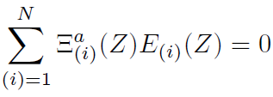
CM in GR
p
p
U
Ξ
y
x

Slide 6
Not associative (never mentioned)
Effective geometry?
CoM worldline not geodesic of g.
No effective G
CoM worldline
same?
CoM worldline
ξ
Problems:
probe “sameness”
Observer attached to object
(ok in SR, but not here)

Slide 7
Relacional CoM: observer worldline dependent
Associative
Should check:
effective geometry?
{ X,Y } = Sz/M^2+ curvature corrections

Slide 8
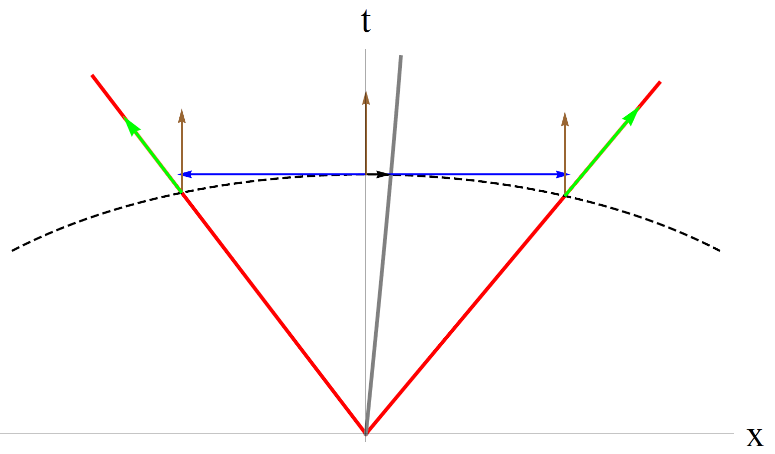
Point “hot” probe

Slide 9
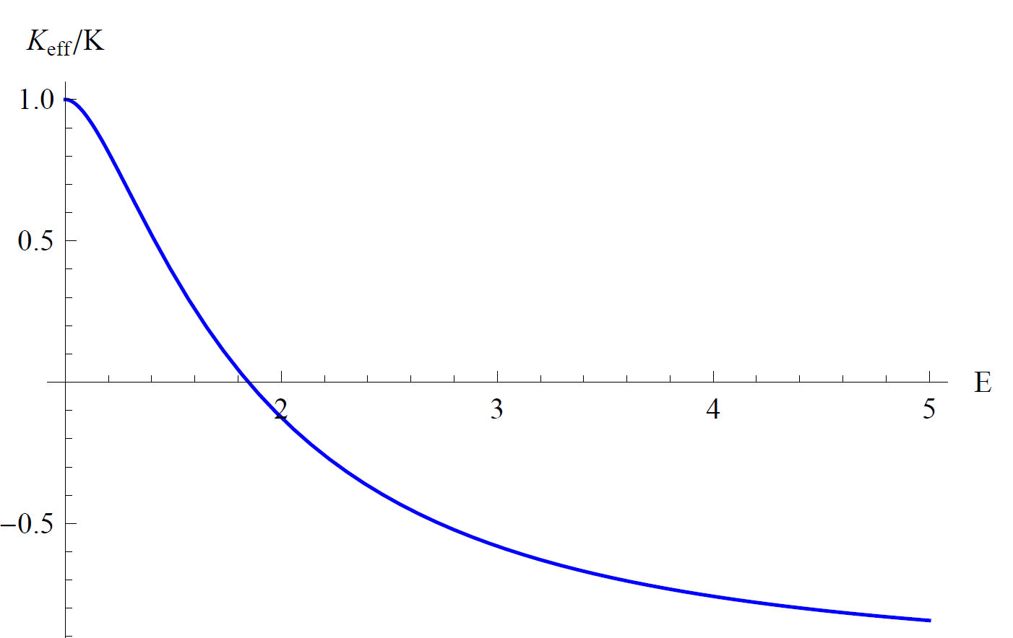

Slide 10
Summary
Relativistic QM implies NC position ops for extended objects
Classical extended objects as probes: effective geometry
Standard GR CoM nonassociative, nothing works
Proposal: relational CoM
Point “hot” probe: effective sectional curvature
Extended, spinning, quantum probes ???

