Slide 1
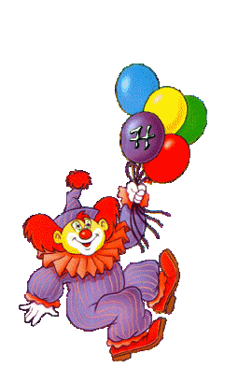
CLOWN S & BLACK HOLES
The canonical conjugate to
black hole entropy
in general theories of gravity
Ram Brustein, Merav Hadad
Phys. Lett. B718 (2012) 653-656

Slide 2
Motivation
Black hole entropy counts the degrees of freedom of something unclear
Investigate common characteristics
of general theories of gravity
Building blocks of quantum gravity.

Slide 3
Entropy of black holes in general theories of gravity
Wald entropy:

Slide 4
Identifying the canonical conjugate of Wald entropy from the action
Brown :gr-qc/9506085
Black hole:
radial direction
Time - second normal direction.
Integration over the surface area of the horizon

Slide 5
Geometric meaning :
The opening angle at - plane

Slide 6
Quantum picture
In the classical limit (specific heat )
Non zero uncertainty at
the opening angle

Slide 7
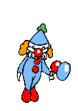


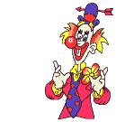
Physical meaning
Quantum black hole is expected to be super-position of metrics with conical singularities.

Slide 8
Example of quantum gravity - Strings
String theory identifies the “microstates “ of a (extremal) black hole as modes of different vibrations of the strings. (hep-th/9602043)
These vibrations create metrics with conical singularities at the horizon with (N integer ). (hep-th/0212210)
In string theory the “microstates“ of the black hole are metrics with (quantized) conical singularities at the horizon.

Slide 9
Summary
In any theory of gravity the entropy of a black hole is canonical to the opening angle in
Prediction - a quantum black hole is a superposition of metrics with conical singularities.
The prediction fits quantum gravity of string theory.

