Slide 1
Holographic Superconductors with Higher Curvature Corrections
Sugumi Kanno (Durham)
work w/
Ruth Gregory (Durham)
Jiro Soda (Kyoto)
arXiv:0907.3203, to appear in JHEP

Slide 2
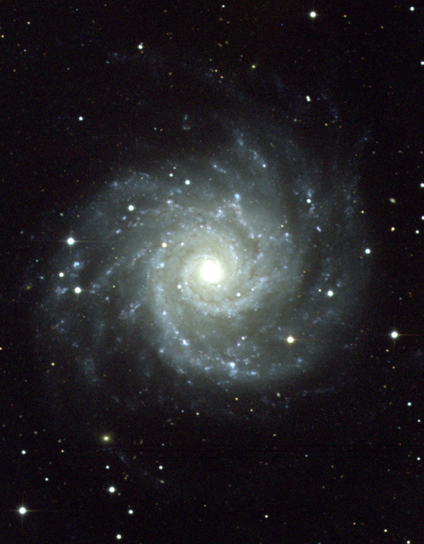
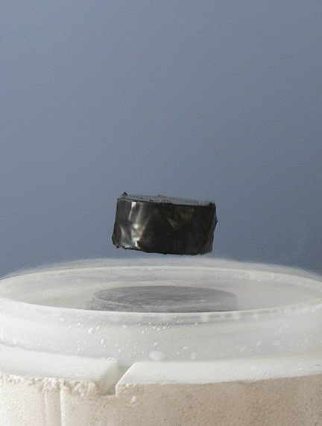
Introduction
Hartnoll, Herzog & Horowitz (2008)
It would be very exciting if we could explain high temperature superconductivity
from black hole physics.
Holographic Superconductors
According to holographic superconductors, scalar condensation in black hole system
exists. This deserves further study in relation to the “no-hair” theorem from gravity
perspective.
What we are interested in is if
・the critical temperature is stable under stringy corrections.
・the universal relation between and : is stable under stringy corrections.
: The gap in the frequency dependent conductivity
Horowitz & Roberts (2008)
Since the stringy corrections in the bulk corresponds to the fluctuations from large N
limit in holographic superconductors, it is expected the stringy corrections make
holographic condensation harder.
We verify this numerically and analytically.

Slide 3
Gauss-Bonnet Black Hole
Coupling constant >0
Action
BH solutions
Gauss-Bonnet term
Constant of integration related to the ADM mass of BH
Asymptotically vanishes.
… Chern-Simons limit
Horizon is at
Hawking temperature
When rH (=M ) decreases, temperature decreases
(This is a nature of AdS spacetime)

Slide 4
Gauss-Bonnet Superconductors – probe limit
Action (Maxwell field & charged complex scalar field)
Mass of the scalar filed
Static ansatz:
EOMs
Need 4 boundary conditions
EOMs are nonlinear and coupled
Const. of Integrations
determined
Asymtotic behaviors
Regularity at Horizon (2) :
Boundary condition in the asymptoric AdS region (2) :
However…
According to AdS/CFT, we can interpret , so we want to calculate
We calculate this numerically first.
Solutions are completely determined

Slide 5
Numerical Results
increase
Chern-Simons limit
Critical Temperature
decrease
The effect of is to make condensation harder.

Slide 6
Towards analytic understanding
E.g.) The numerical solution for
Near horizon
b.c.
Matching at somewhere
Near asymptotic AdS region
b.c.

Slide 7
Analytic approach
Change variable :
Region :
EOMs
Boundary Condition
Near horizon (z=1)
Solutions in the asymptotic region
Near asymotoric AdS region (z=0)
Boundary Condition
Now, match these solutions smoothly at

Slide 8
Results of analytic calculation
Go back to the original variable :
Solutions
Hawking temperature
: Critical temperature
Numerical result
AdS/CFT dictionary gives a relation :
Condensation is expressed by
Good agreement!
at
for
Typical mean field theory result for the second order phase transition.

Slide 9
Conductivity of our boundary theory
Gauge field
in the bulk
AdS/CFT
Four-current
on the CFT boundary
Consider perturbation of
and its spatial components
Electromagnetic perturbations
If we see the asymptotic behavior of this solution,
Arbitrary scale,
which can be removed by an appropriate boundary counter term
: General solution
B.c. near the horizon : ingoing wave function
The system is solvable.
The conductivity is given by
Need to solve numerically with this b.c. to
obtain , asymptotically.

Slide 10
Conductivity and Universality
imaginary
real
pole exists
pole exists
pole exists
pole exists
As increases, the gap frequency becomes large.
The universal relation is unstable in the presence of GB correction.

Slide 11
Summary
The higher curvature corrections make the condensation harder.
The universal relation in conductivity is unstable under the higher curvature
corrections.
We have found a crude but simple analytical explanation of condensation.
In the future, we will take into account the backreaction to the geometry.

