Slide 1
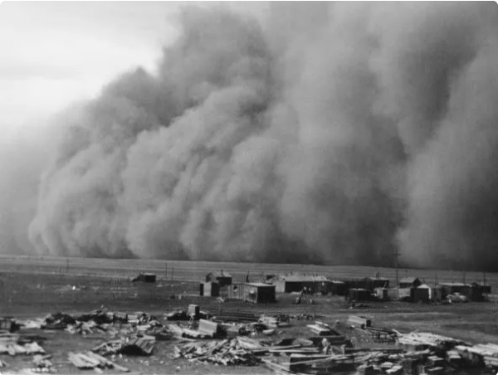
19th century weather: a new data set for Canada
Victoria Slonosky, Open Data Rescue
Contributions from Antoine Rehberg and Christopher Holland
ACRE Drought and Flood meeting, Corfu Sept 2024
Notes:
© Copyright PresentationGO.com – The free PowerPoint template library

Slide 2
The Data
Notes:
© Copyright PresentationGO.com – The free PowerPoint template library

Slide 3
Canadian Data Rescue project, 2019-2024
Scope of Data Rescue project
Transcribing Historical Canadian Weather Data
Originally Canadian observations from the Smithsonian records. Expanded to include other overseas archives, including the UKMO
Funded by Climate Research Division, Environment and Climate Change Canada (ECCC)
Undertaken by Open Data Rescue (ODR)
Notes:
© Copyright PresentationGO.com – The free PowerPoint template library

Slide 4
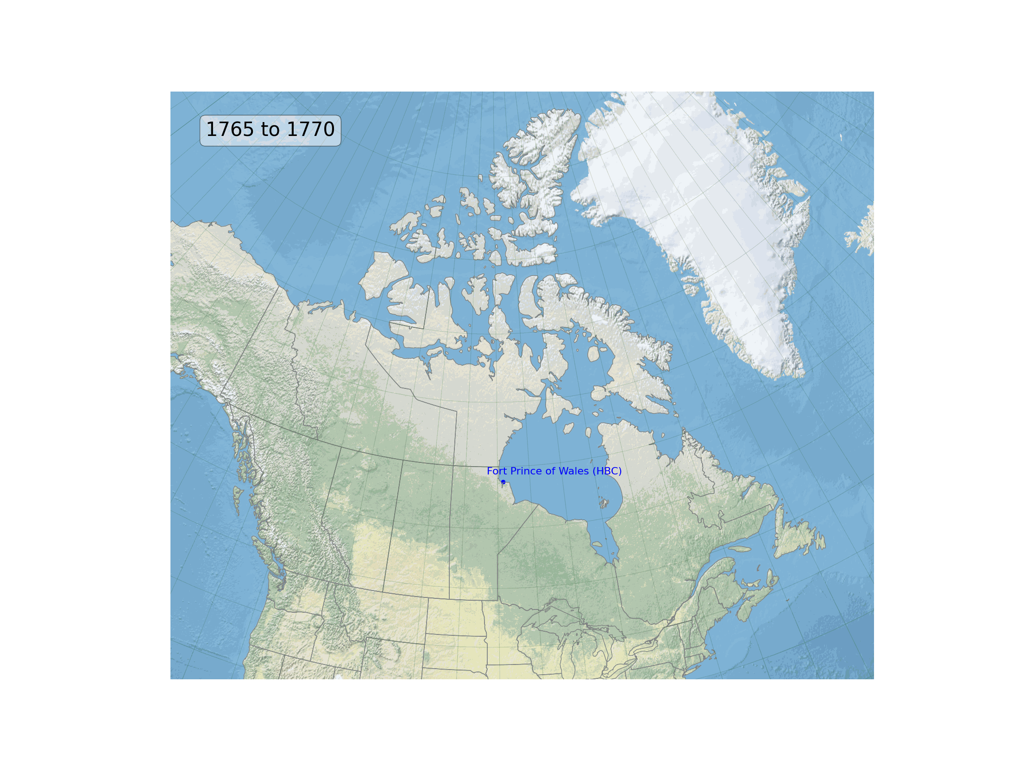
The Stations
Notes:
© Copyright PresentationGO.com – The free PowerPoint template library

Slide 5
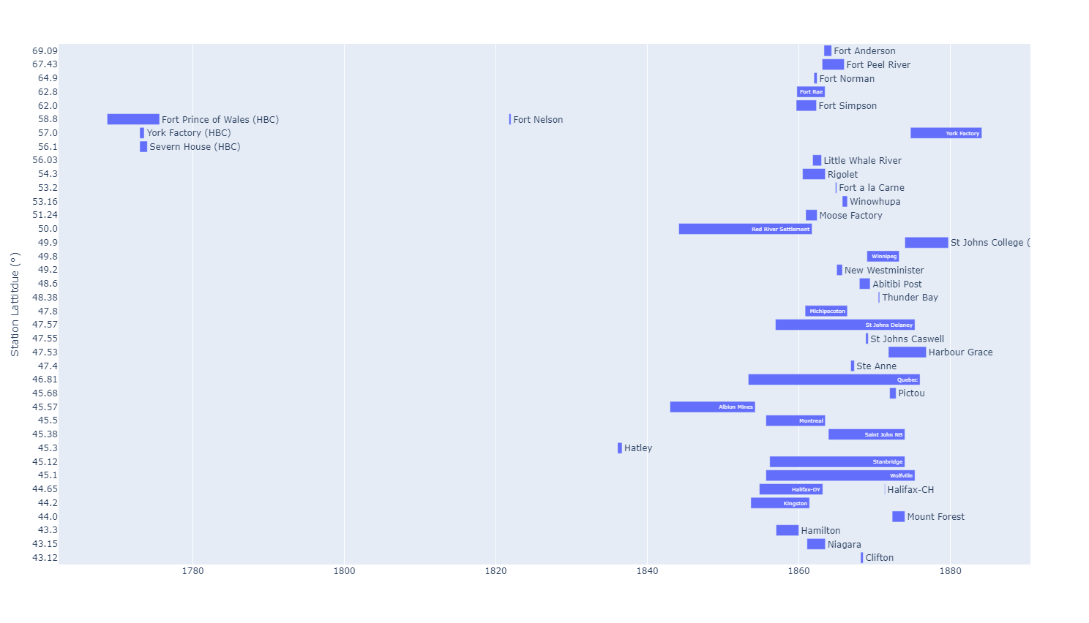
The Stations
Notes:
© Copyright PresentationGO.com – The free PowerPoint template library

Slide 6
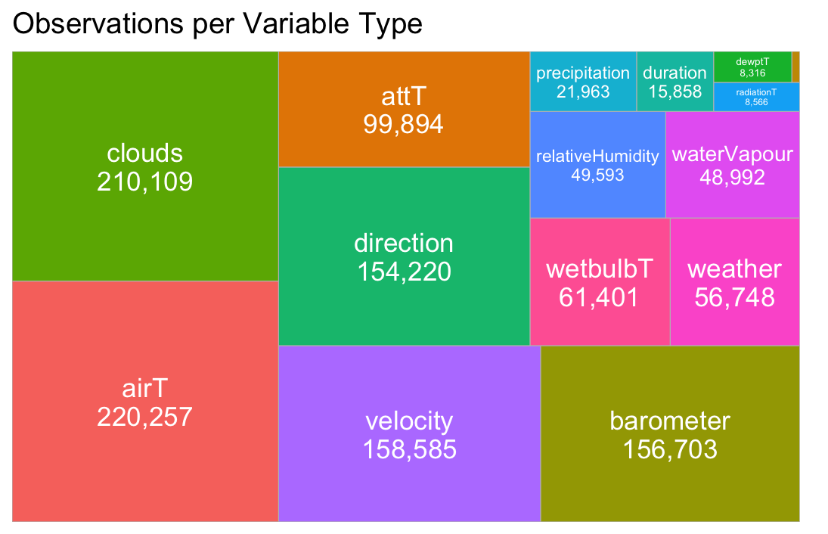
Data overview
Notes:
© Copyright PresentationGO.com – The free PowerPoint template library

Slide 7
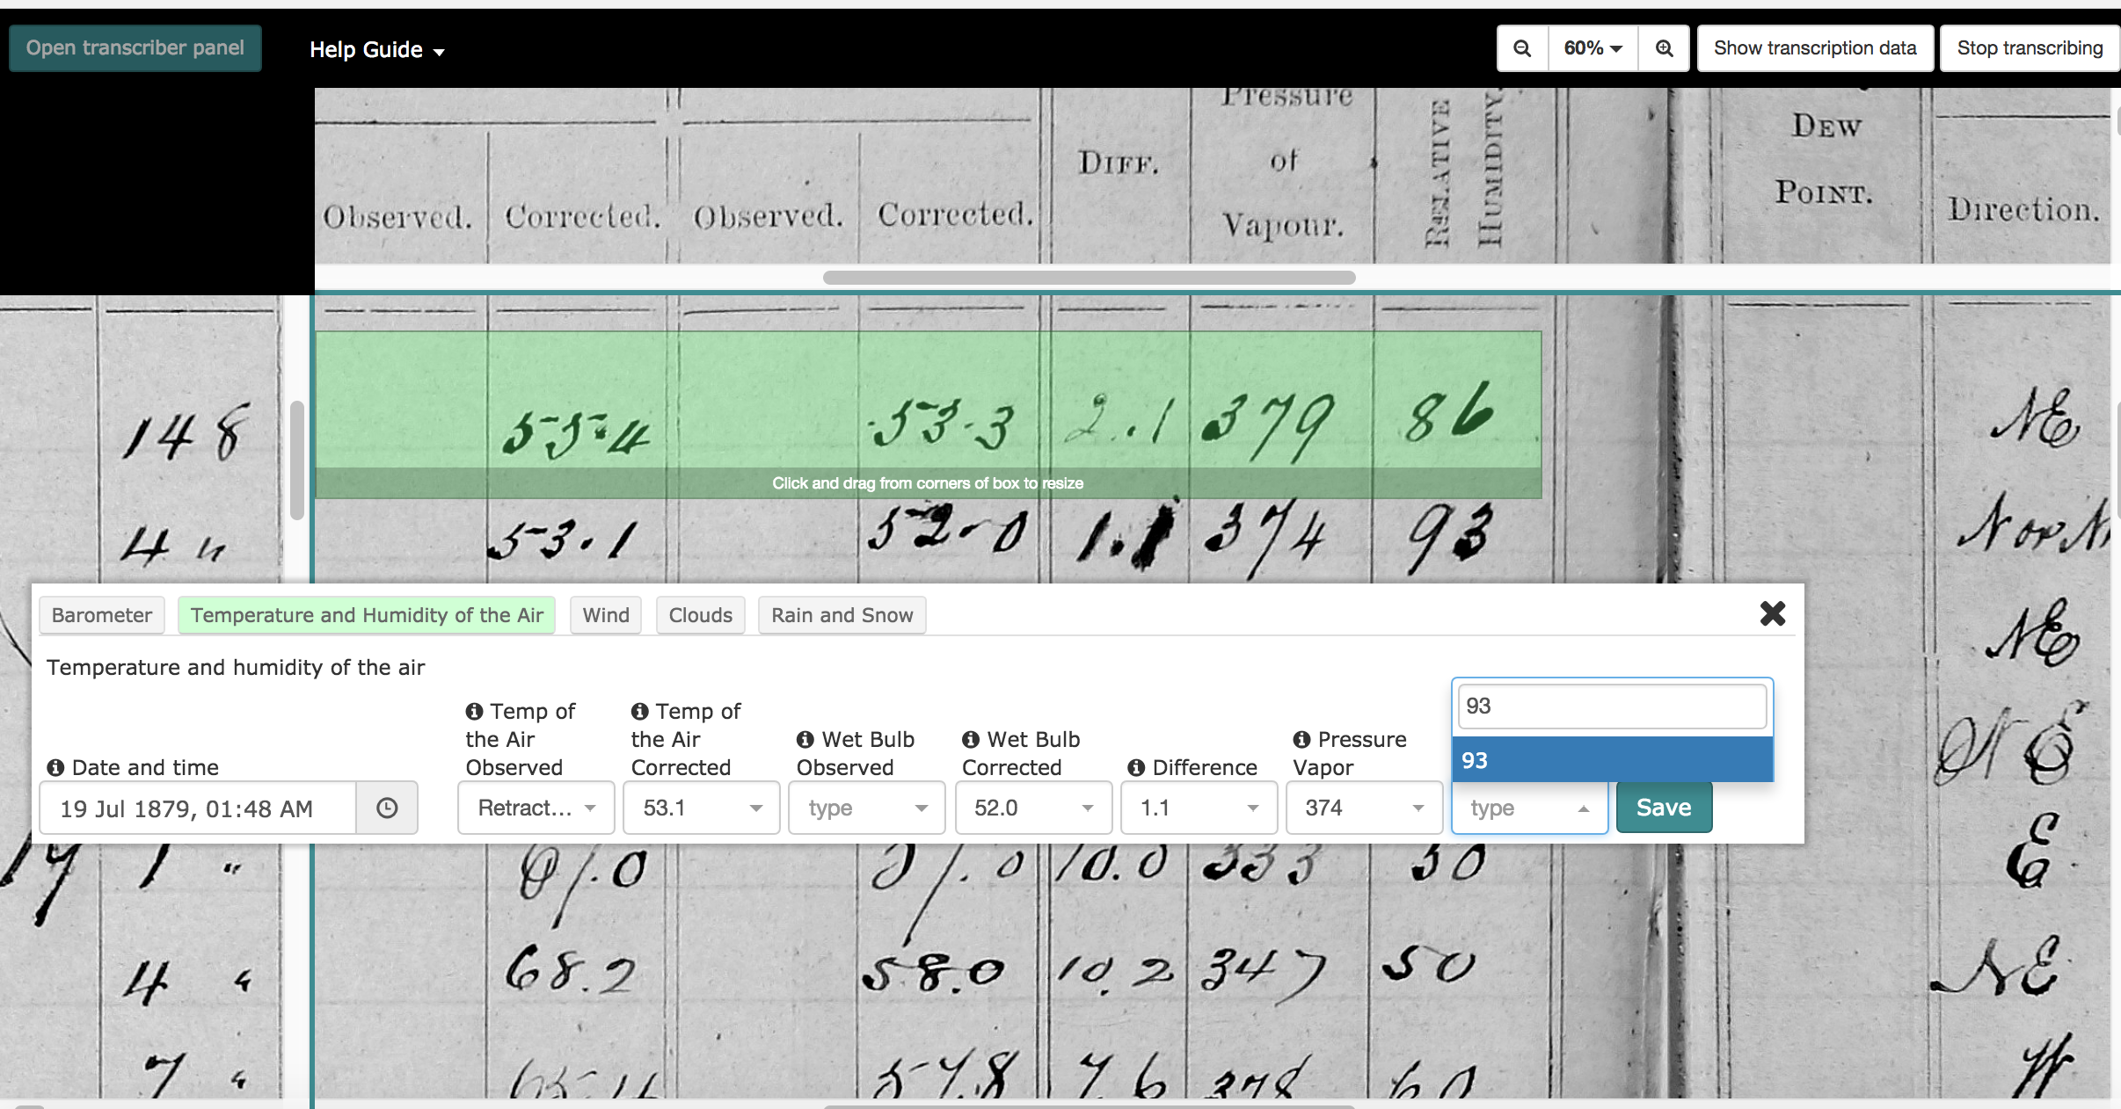
Transcribing: using a web app with a custom Transcription Environment
Window above transcription bar allows users to keep the column headings of the page above text entry boxes, to avoid getting “lost” on the page
Fields on the page are grouped into tabs which match groupings on the page
Bar form allows a straight-line reference point for users to follow along an entry line
Notes:
The technical core of how we do this is our web based app. We ask our citizen science transcribers to type the numbers and other values they see on the screen into the boxes in the transcription environment. There are at least three presentations’ worth of technical details behind making the entire process transparent and traceable, from scanning the register books and naming the images files to the database design that I won’t get into here. From the point of view of the citizen scientists, the important thing is to make it as easy, pleasant and error-free as possible to transcribe the weather observations.

Slide 8
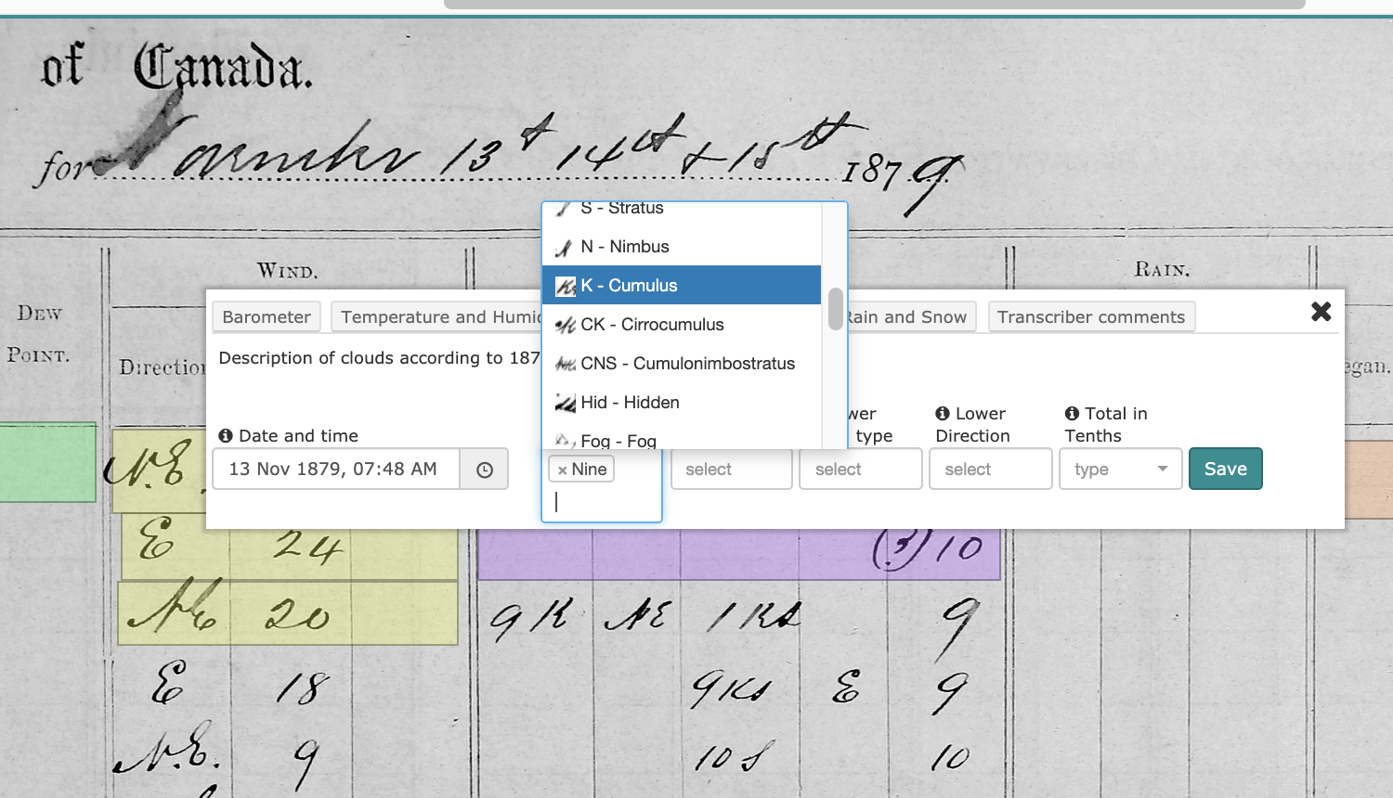
Reassuring the transcribers: you can check your entries
Data table to go over values
Drop down menus to select
an option
It’s still okay to make a mistake
Notes:
Over time, with suggestions from our citizen scientists and our student investigators and researchers, we’ve added features and improvements to help make the process easier and reduce errors. One is the drop down menus for certain variables such as wind directions or cloud types. Another, requested by several citizen scientists, is the review tables to inspect the data entered. There are also pop ups, help texts and more general help features such as videos, tutorials and blog posts explaining certain historical aspects such as weather symbols. Still, it’s ok to make mistakes, as we check all the data in post processing and have found that the error rate is actually very low, often less than 1%.

Slide 9
Database structure

Slide 10
Data processing cycle
Initial transcription
As originally entered by transcriber
Page check
Correct dates in right row
Entry format
unexpected characters,
Field format
correct number of decimal places
Data entered in correct field
decimals (period, comma)
Convert to SI
Check outliers
temporal continuity
inter-variable consistency

Slide 11
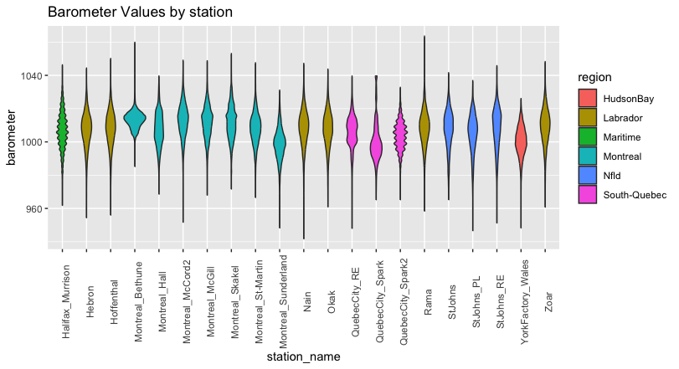
Data views: Barometer

Slide 12
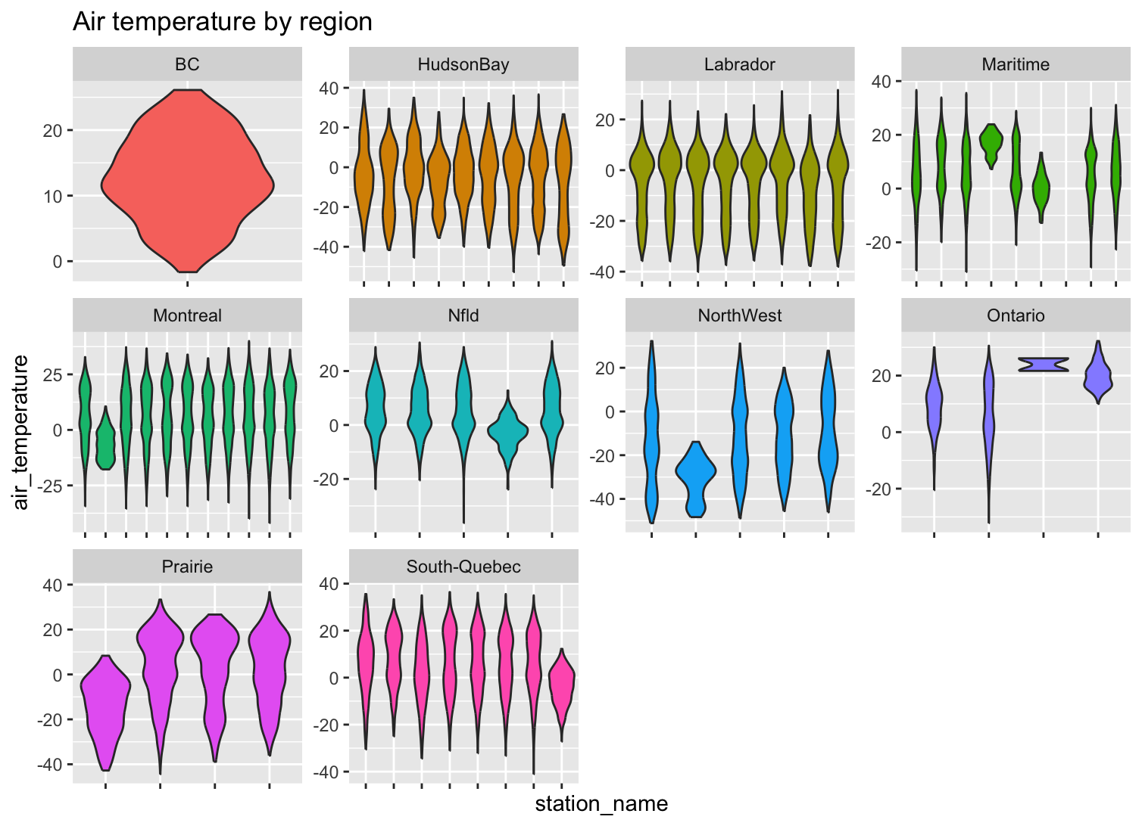
Data views: Thermometer

Slide 13
Extreme values: Station observations vs 20CR
20CR temperatures damped compared to observations
Could this affect detection statistics in 20CR?
Notes:
Hot days: Max temp above 32 degrees or min temp bigger than 21. Cold days: Min temp colder than -25 and max temp colder than -15.

Slide 14
Fort Peel River Observations - 20CR

Slide 15
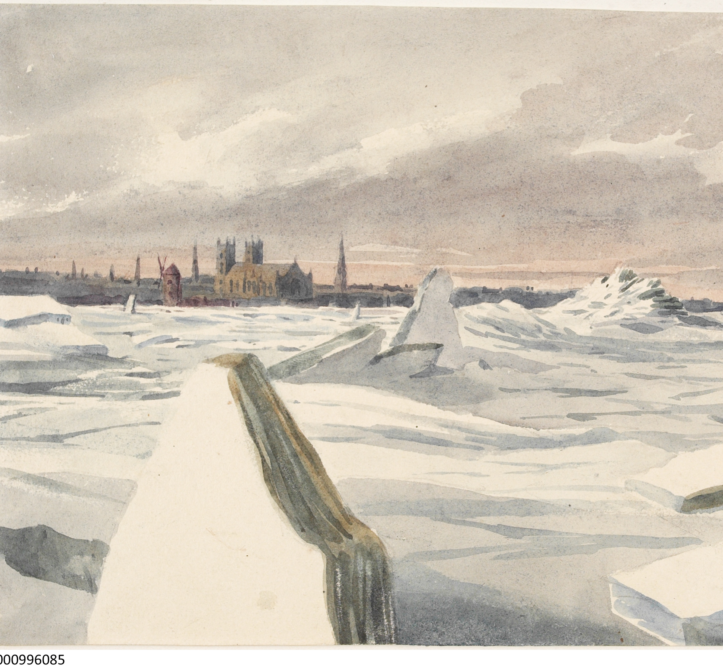
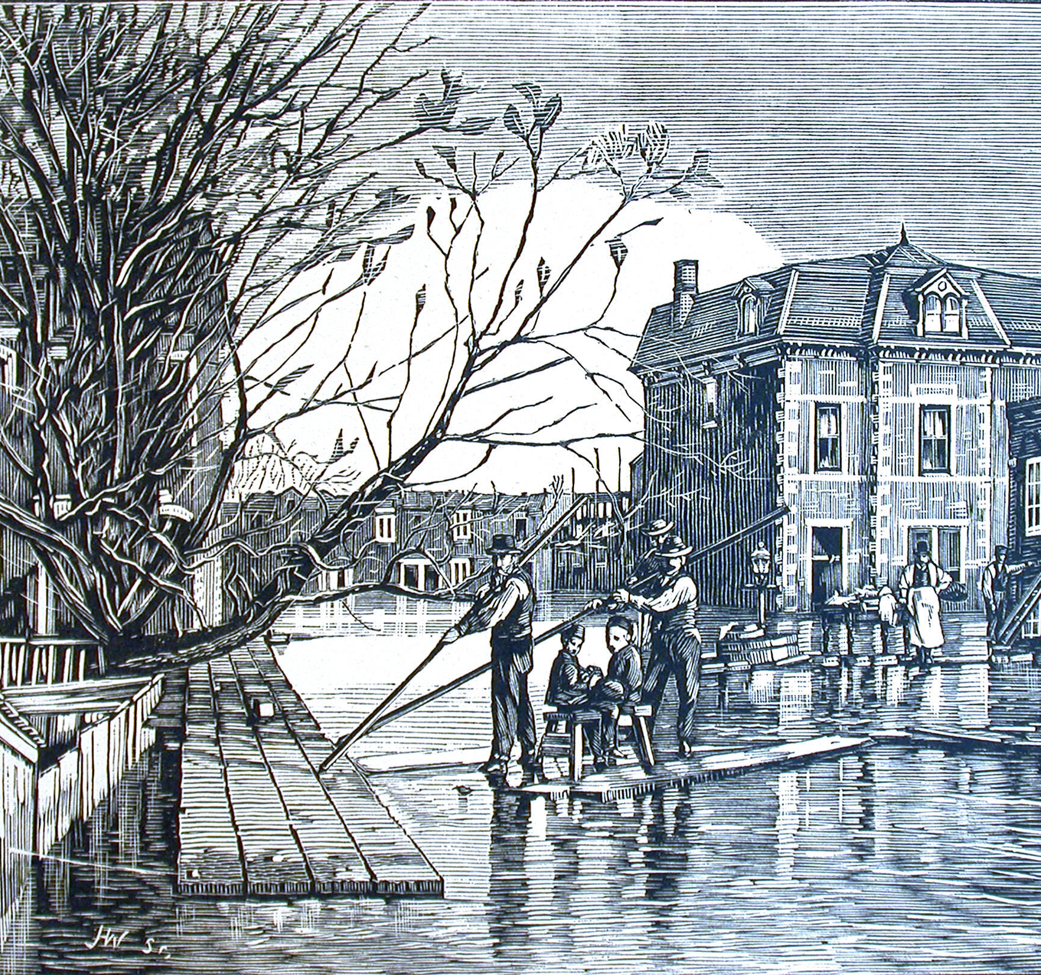
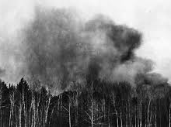
Droughts and Floods
Notes:
© Copyright PresentationGO.com – The free PowerPoint template library

Slide 16
Floods more commonly reported in newspapers than droughts More severe, widespread immediate impacts

Slide 17
Event Detection Method 1: SQL Queries

Slide 18
Relatively few words relating to extreme events in weather descriptors
flood, inund, surge
drought, parch, scarce

Slide 19
Droughts and dry conditions

Slide 20
Floods and wet conditions

Slide 21
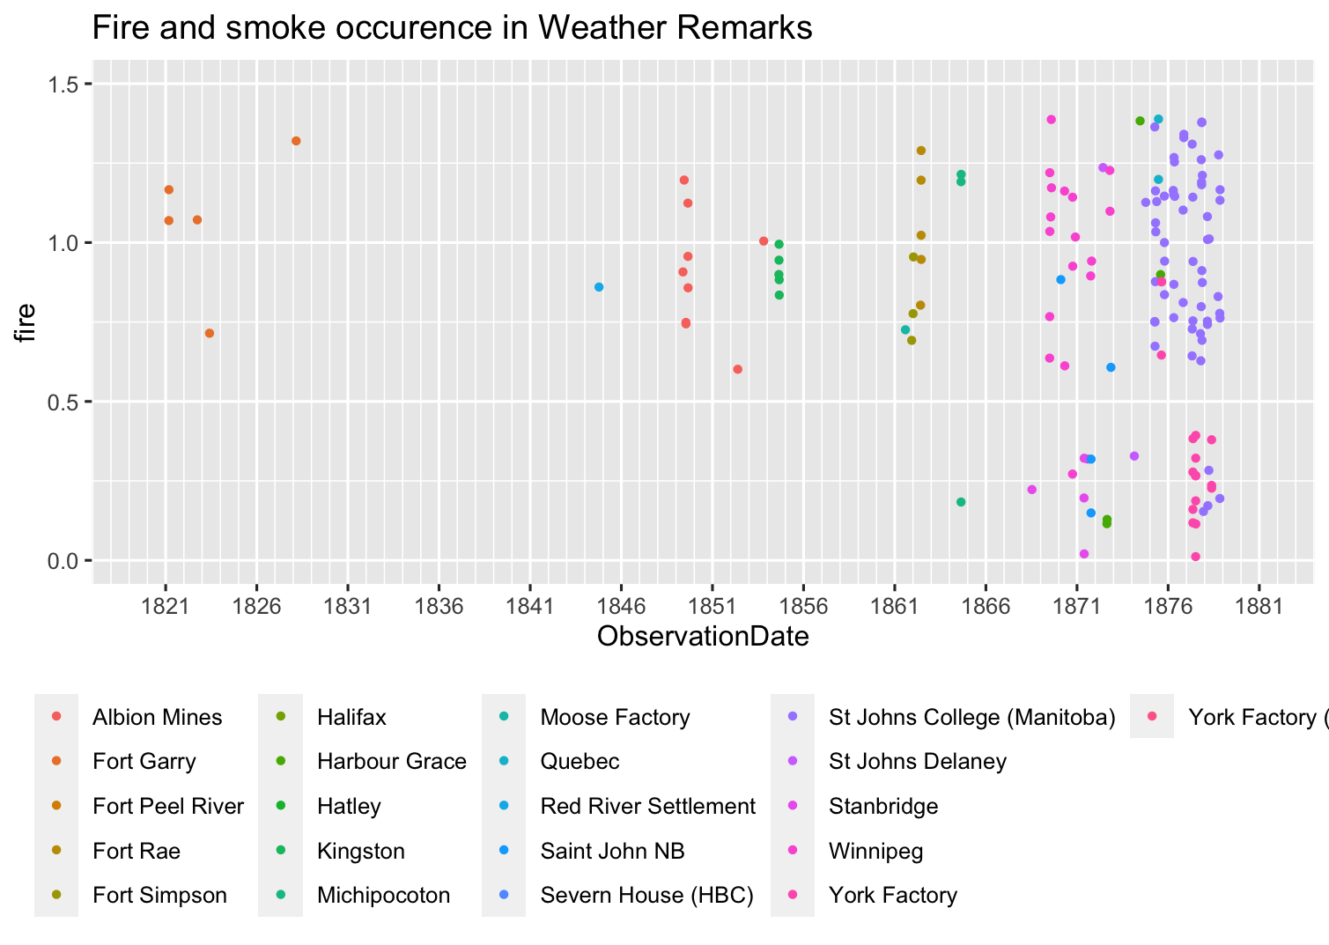
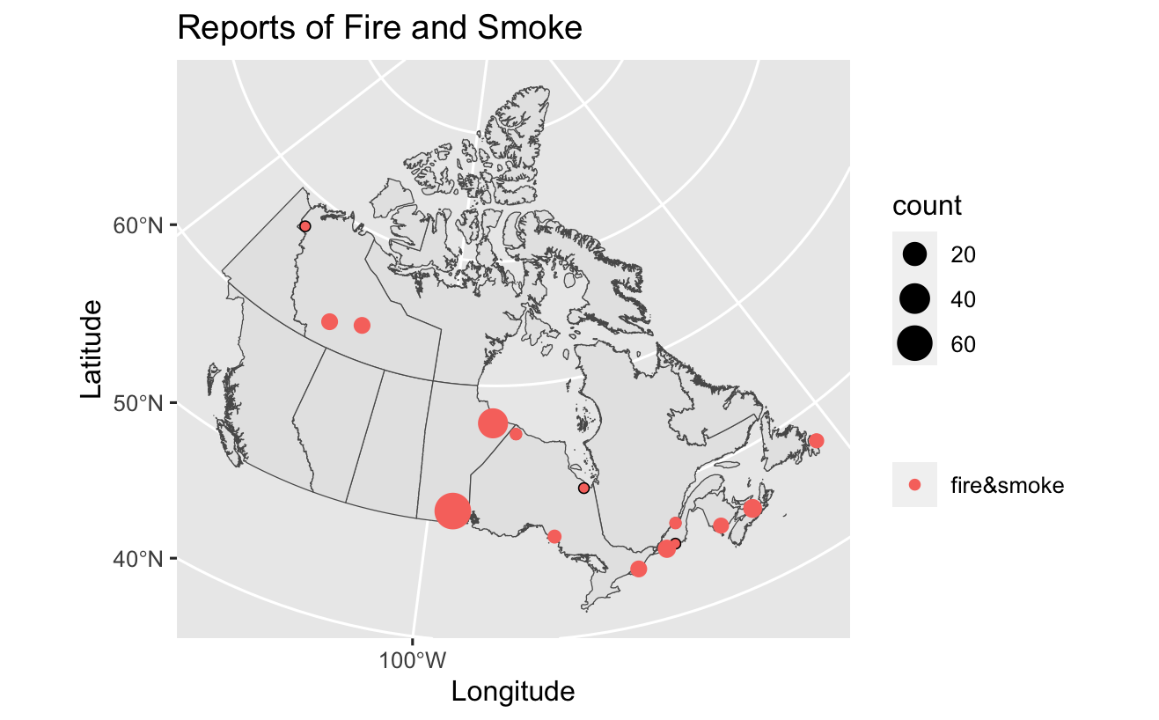
Fire and Smoke

Slide 22
Event Detection Method 2: Data Analysis

Slide 23
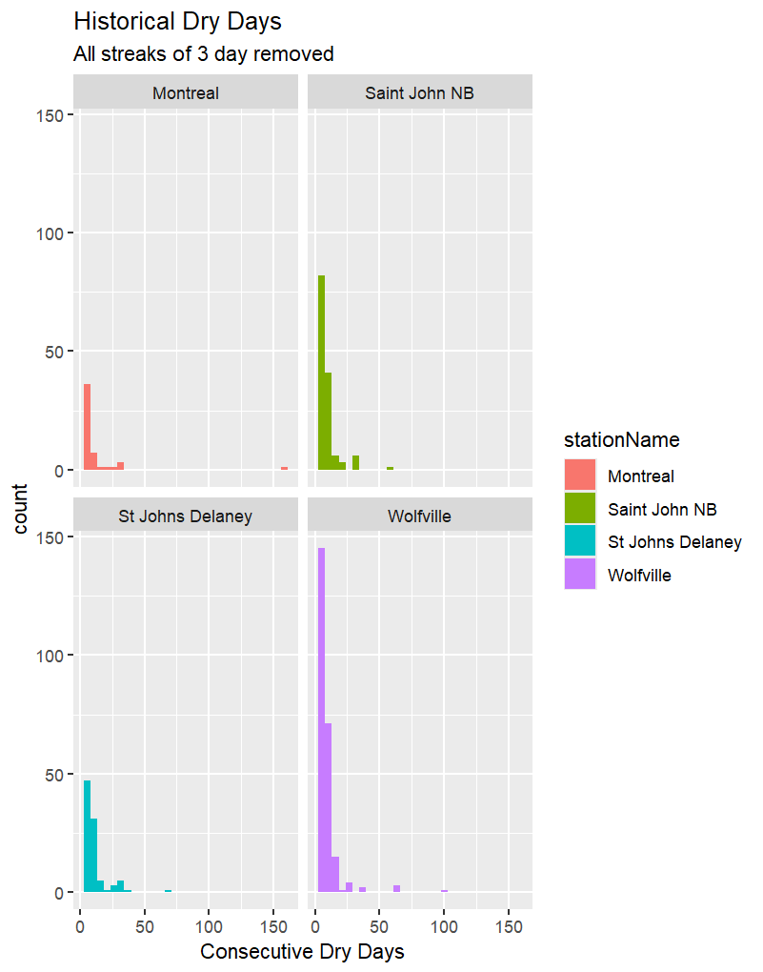
Consecutive Dry Days

Slide 24
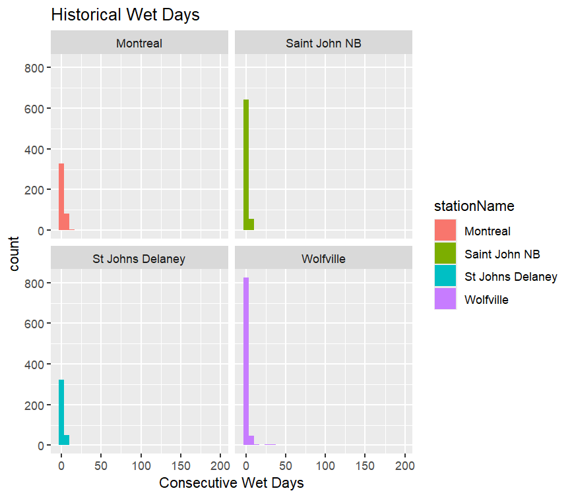
Consecutive Wet Days

Slide 25
Observations and 20CR, part 2
Fires from station data (red) and precipitation events from 20CR (blue): Oct 1877

Slide 26
Impacts: newspapers
Notes:
© Copyright PresentationGO.com – The free PowerPoint template library

Slide 27
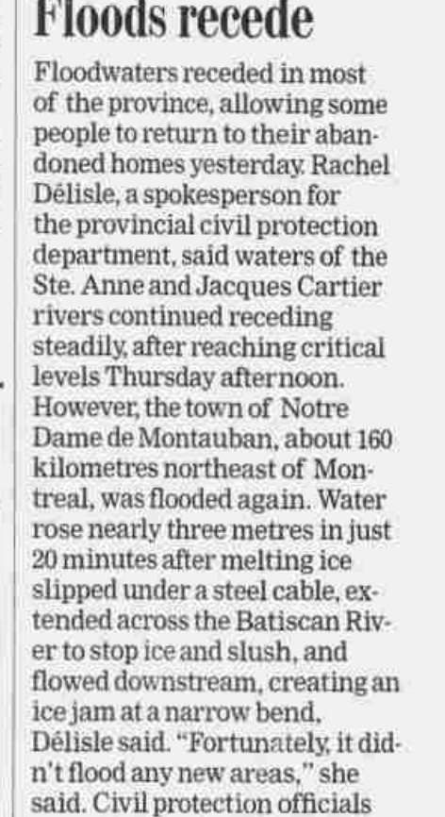
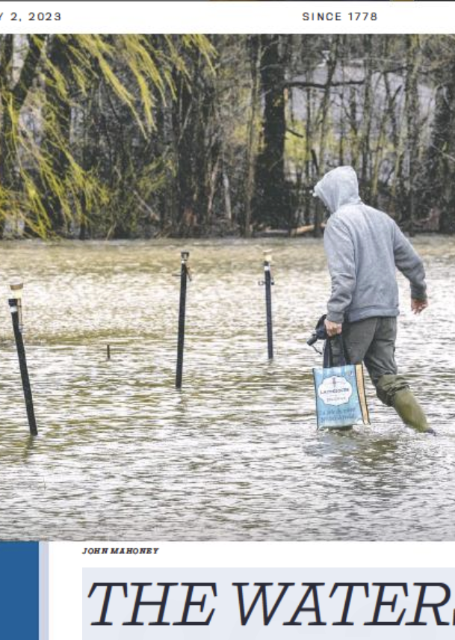
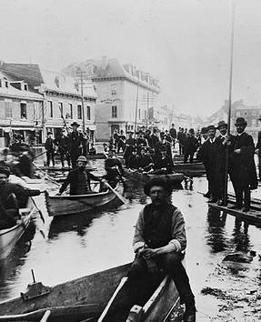
Event Detection 3: newspapers
Keyword search
Timelines
Corpus building for AI classification
This Photo by Unknown Author is licensed under CC BY

Slide 28
Two problems with keyword searching
OCR errors
Metaphorical use of weather terms
AUDACE project funded by the Fondation du recherche du Québec

Slide 29
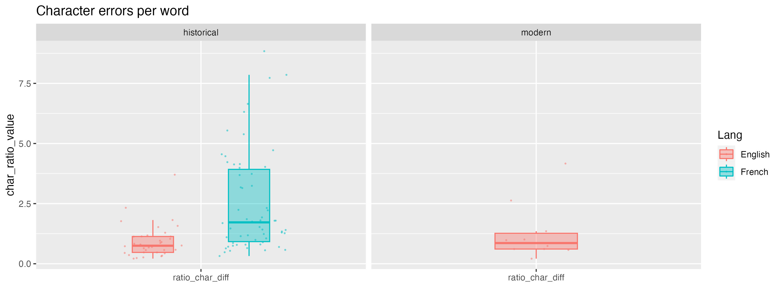
How to assess OCR fidelity to original text?
Ratio of character differences per word, transcribed vs OCR
Notes:
Is it possible to quantify the effect of these OCR errors on our article searching, selecting, and corpora building? To this end, we transcribed a selection of newspapers articles, most from the historical period from the original newspaper images. (We couldn’t do this for the French modern as we didn’t have access to the original images). Here are plots with the ratio of differences detected in characters in a text to the total number of words in that text. For the English historical, the mean is about 1.5, with relatively little spread. Similarly for the English modern, the mean is less than 1 character per word. The French text has a higher mean and more spread: a mean of about two characters per word.
The higher number of French articles with character errors could be due to several factors: the work was undertaken earlier, with less sophisticated language recognition models than exist in more recent times. The higher use of diacritical marks in French could also play a role, not just for character recognition but also for character or word interpretation in the language models.

Slide 30
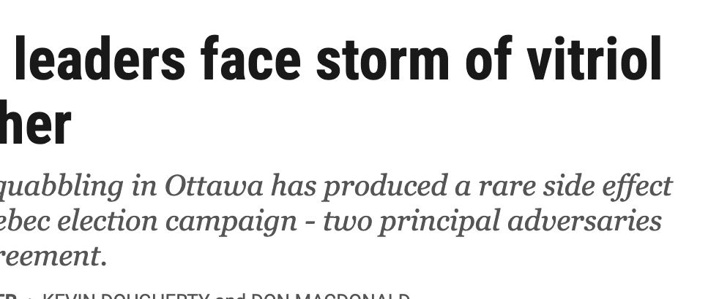
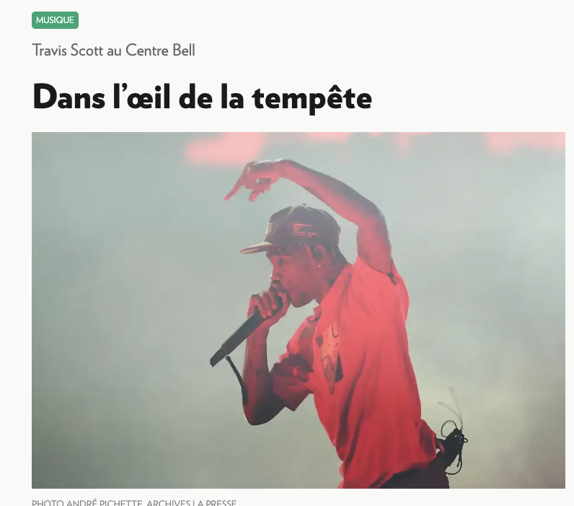
Word and phrase searches: weather as metaphor
Notes:
A huge problem for us as we try to build our corpora is the use of weather-related words as metaphors. Until this project, I hadn’t realized quite how much weather vocabulary prevails in our everyday language! Similes (“like a flood”) and metaphors (”storm of vitriol”) abound, as well as expressions, in both languages, such as ”in the eye of the storm.” This does not even touch on the number of sports teams names after weather phenomena- the Blizzards, the Hurricanes, Lightning, Storm, Avalanche …

Slide 31
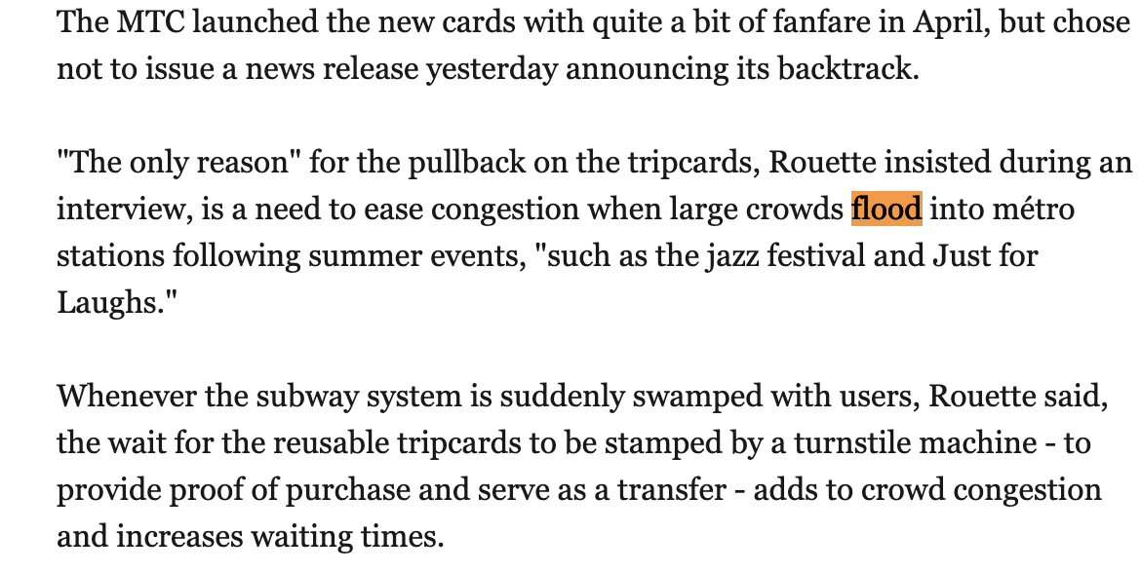
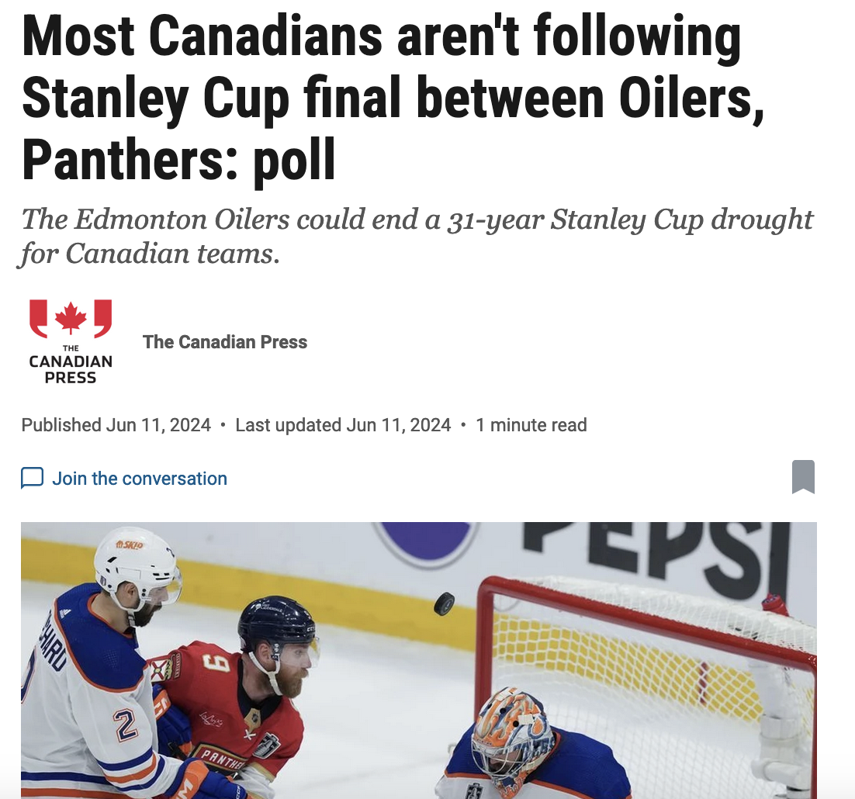
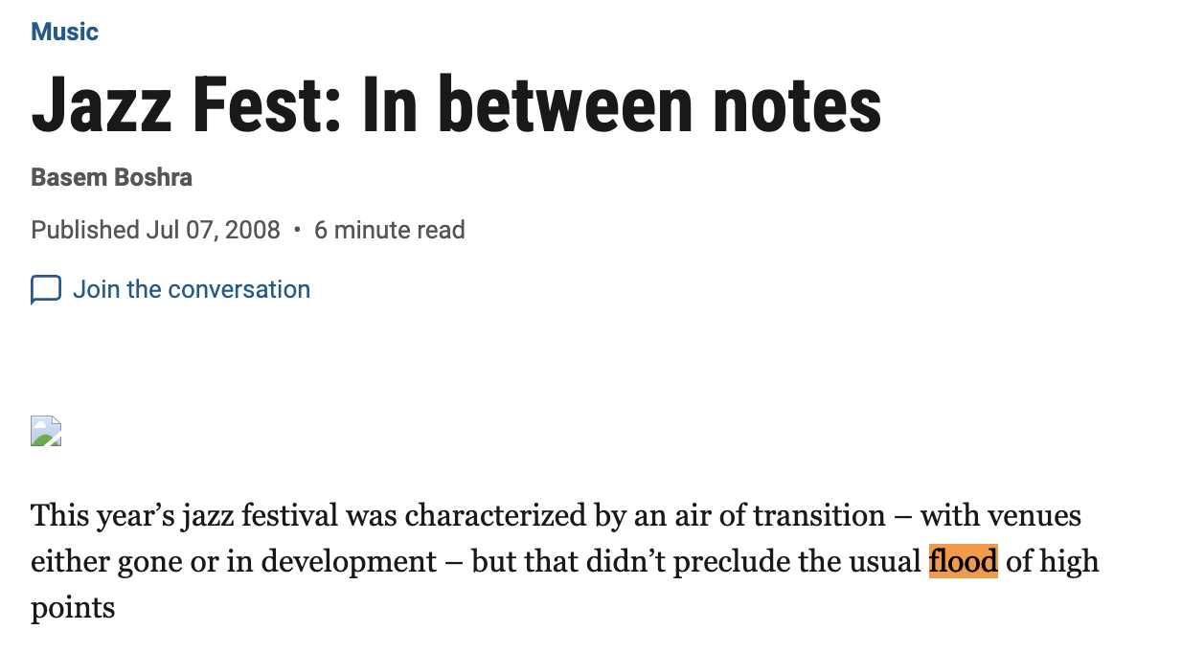
Word and phrase searches: weather as metaphor

Slide 32
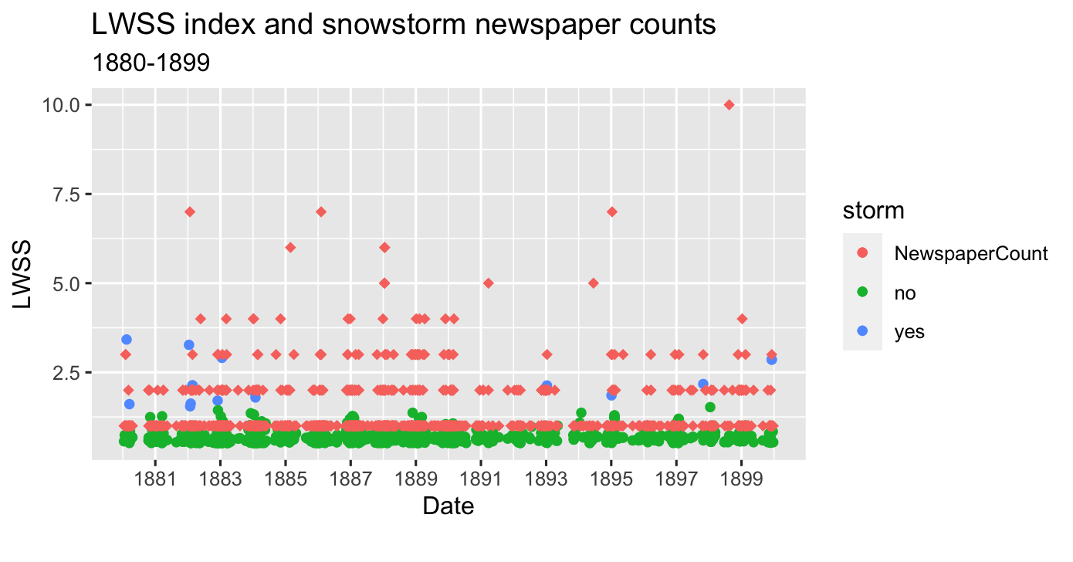
Comparing Meteorological data to newspaper counts – historical storms

Slide 33
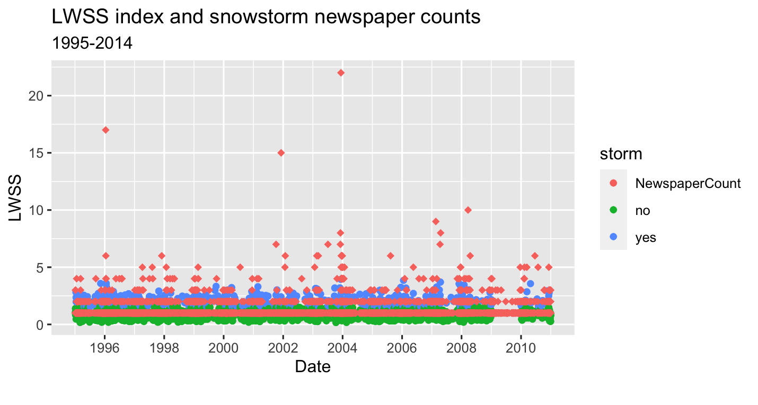
Comparing Meteorological data to newspaper counts – modern storms

Slide 34
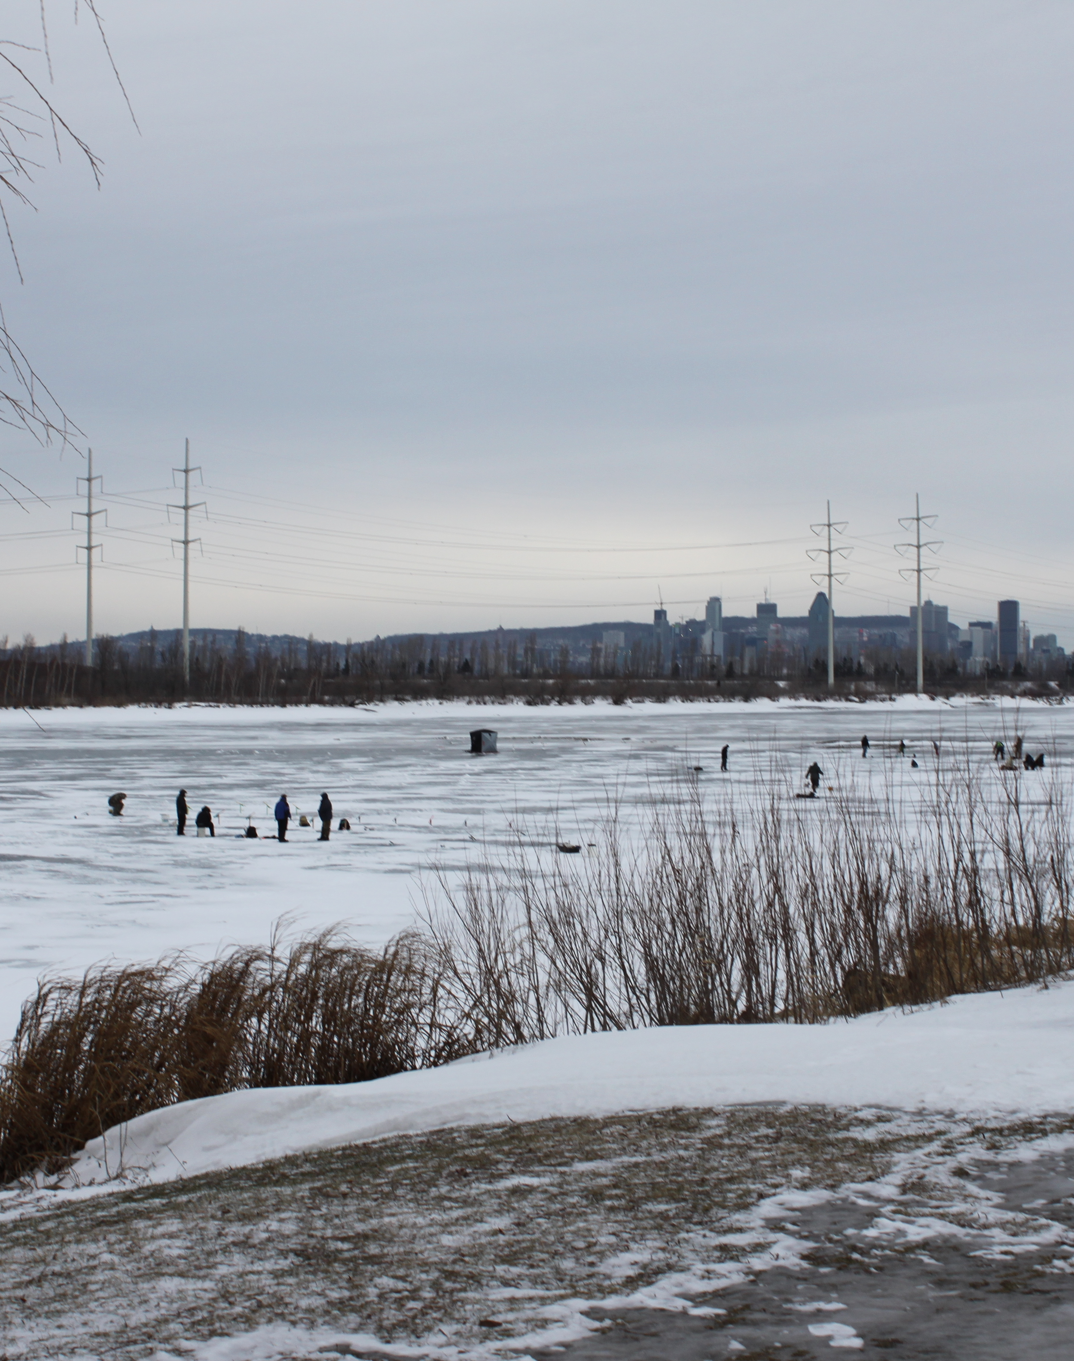
Results and Reflections on newspapers
Material not always provided in friendly formats for medium to large scale projects
Considerable resources needed to clean and pre-processing data
Automatically generated text can’t be used naively
Notes:
What have we learned from these experiences? One major challenge is that the material for medium to large scale text processing, rather than individual reading, is not always provided in the friendliest of formats. This means that considerable resources are needed for obtaining, cleaning, organizing and pre-processing the information prior to analyze it .
Automatically generated text, from machine learning or OCR, can’t be used unquestioningly; investigations should be made to see how errors will impact the analysis. For AI and ML and other text-based projects, corpus building from newspapers is not a trivial task. All in all, we can say that’s it’s a challenge to get large scale, rather than anecdotal, social narratives.

Slide 35
Summing Up
Data rescue projects:
1
1 -Volunteer
2- Smithsonian Weather Obs (ECCC)
1.8 million values
72 stations
15 categories of variables
1744-1888
Combining station data with ReAnalysis
2
20CR: overview of circulation, weather patterns
Station data: small-scale features and extreme events
Detecting extreme and disruptive events
3
Statistical analysis
Vocabulary analysis
Supporting social documentation from newspapers

Slide 36
Acknowledgments
ECCC:
Transcribing Historical Canadian Weather Data: the Smithsonian
Records
Rachel Black (ODR), Vincent Cheng (ECCC), Xioalan Wang (ECCC)
+ our transcribers
+ our quality control experts
AUDACE:
Fonds de recherche du Québec (FRQ)
Breaking the equation “disruptive weather events are extreme ones” with artificial intelligence and social narratives from the past and present
Frédéric Fabry, Renée Sieber, Gordon Burr, Yumeng Zhang, Alysssa Conlon, Antoine Rehburg, Oliver Wang
Canadian Volunteer Data Rescue (ACRE-Canada),
DRAW (Data Rescue Archives and Weather)
our volunteer transcribers
our volunteer coders Henry Balen, Hervé Hacot, Rob Smith

Slide 37
Social Repercussions
*PowerPoint SmartArt graphic
Notes:
© Copyright PresentationGO.com – The free PowerPoint template library

Slide 38
Word clouds from historical newspapers
Notes:
© Copyright PresentationGO.com – The free PowerPoint template library

Slide 39
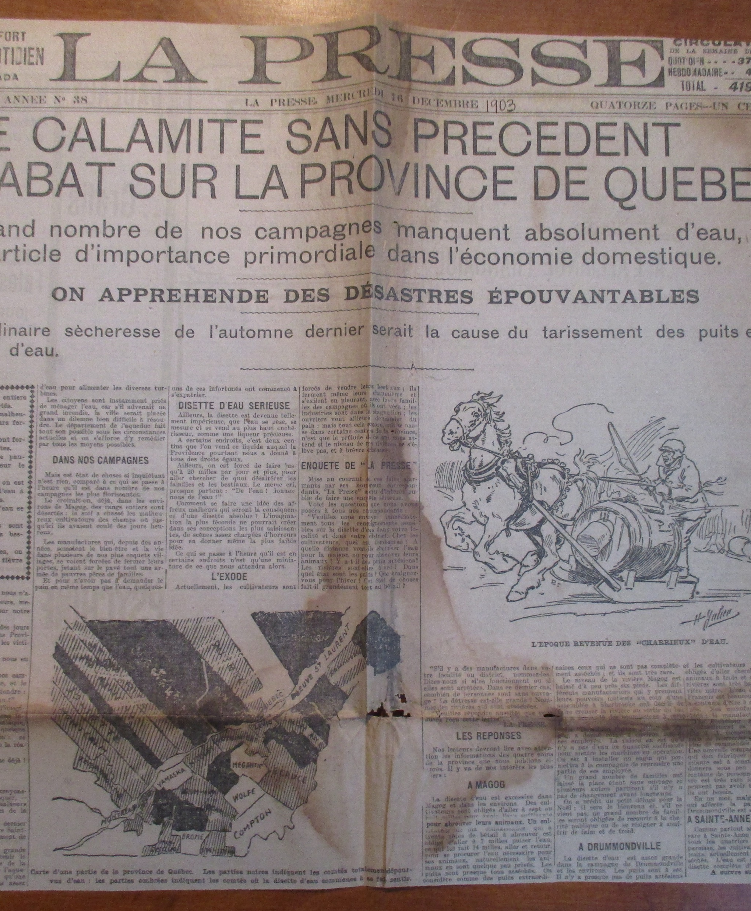
Extreme Drought: Quebec 1903
Notes:
© Copyright PresentationGO.com – The free PowerPoint template library

Slide 40
Coldest Spell in Southern Canada? Jan 1859
Notes:
© Copyright PresentationGO.com – The free PowerPoint template library

