Slide 1






Modeling reconstruction of weather conditions during historical events. The examples of Salamis Battle in 480 B.C. and Arachova battle in 1826.
Stavros Solomos
Research Center for Atmospheric Physics and Climatology
Academy of Athens
International Atmospheric Circulation Reconstructions over the Earth (ACRE) Drought and Flood Conference
Corfu, September 23 - 27, 2024

Slide 2

Climate change threats the monuments of cultural and natural heritage
Kapsomenakis et al., 2022

Slide 3

Unique climate and weather patterns in Greece
All cultural heritage monuments in Greece are integral parts to the natural surroundings
Heritage monuments and historical sites in Greece carry centuries of history

Slide 4
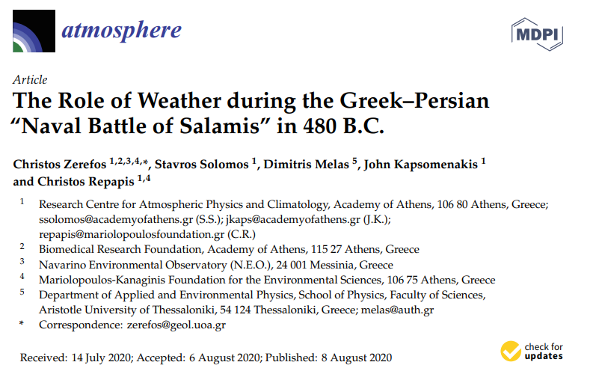
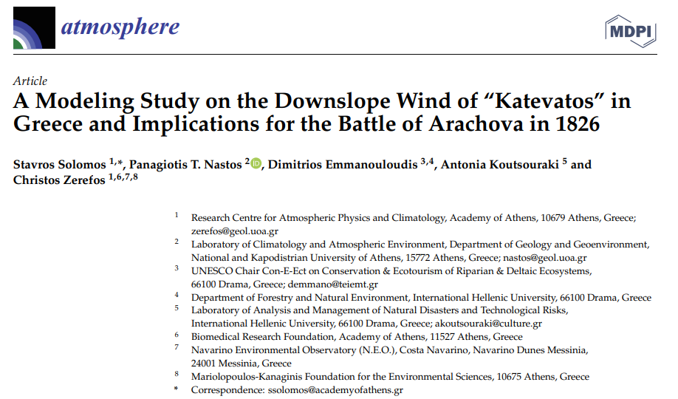
The examples of Salamis sea breeze and Arachova “katevatos”

Slide 5
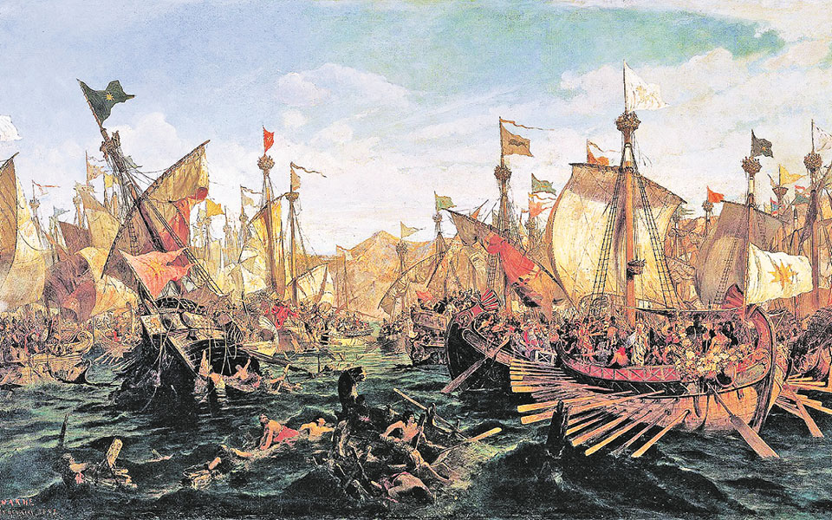
September 480 B.C.
Constantinos Volanakis, «The Battle of Salamis»

Slide 6
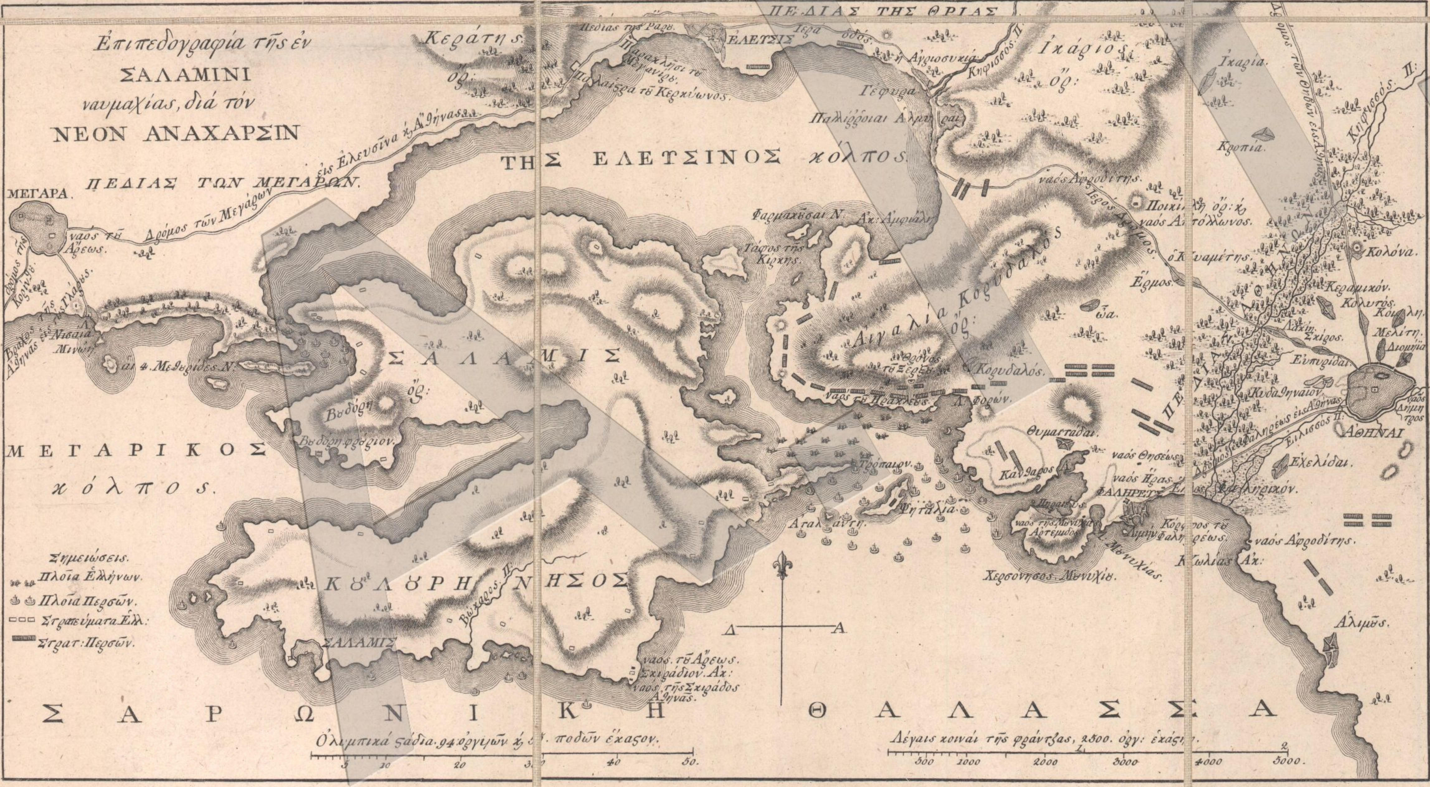
Fleet Positions (abstract from Rigas Fereos Velestinlis Charta, 1797)
Greeks

Slide 7
Fleet Positions (abstract from Rigas Fereos Velestinlis Charta, 1797)
Persians
Persians

Slide 8
Analysis of 50-years wind measurements at
Elefsina and Piraeus stations
Significant Sea Breeze component from south directions during daylight

Slide 9
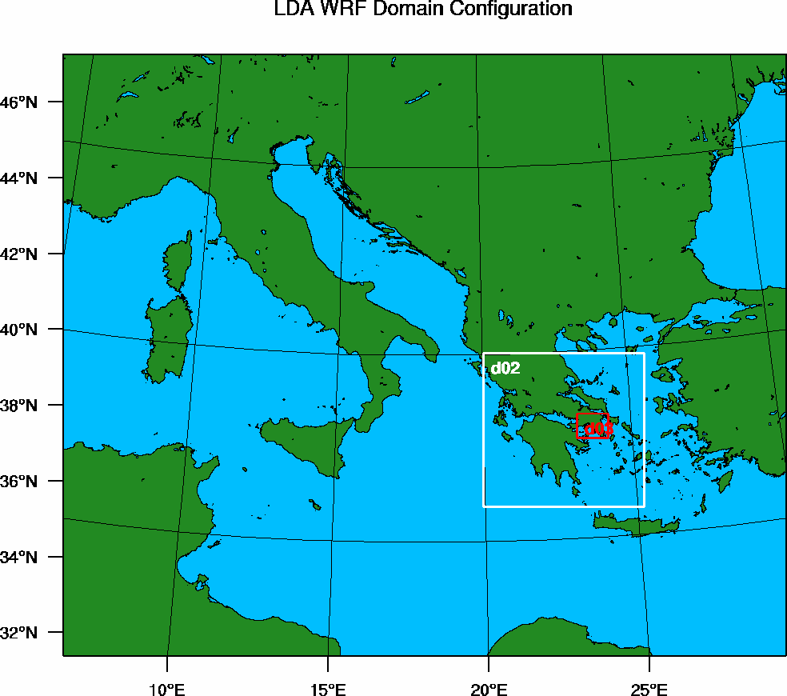
Weather Research and Forecasting (WRF) model setup
12 × 12 km
The high-resolution nested grid at 1×1 km over Attica is necessary to resolve the local sea breeze cell
Each run is driven by the climatological monthly average ERA5 atmospheric fields for the month of September of each particular year, from 2007 to 2016.
The output of each run contains 24 hourly values (00:00–23:00 UTC) that are also averaged by hour to produce the hour–average wind maps
3 × 3 km
1 × 1 km

Slide 10
WRF – ERA5: ten-year monthly average wind speed for September (2007–2016)
The north Etesian winds explain the catastrophes encountered by the Persian fleet before the battle of Salamis and the failure of Corfu fleet to join the Greek forces due to adverse weather at the channel between Cape Maleas and Kythera
m/s

Slide 11
Ten-year average wind for September (2007–2016) from WRF-ERA5
The onset of sea breeze is at 10:00 LST and the convergence line is found across Salamis Straits

Slide 12
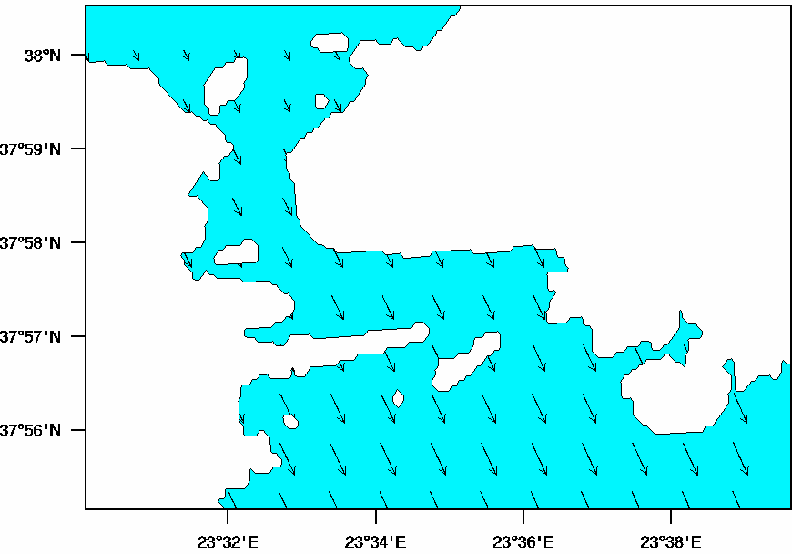
Night hours (00:00-07:00 LST). Arrival of Aristides from Aegina, The Persians block the channel
Greeks
Persians
(Herodotus 70.) (… So when they passed the word to put out to sea, they brought their ships out to Salamis and quietly ranged themselves along the shore in their several positions…. )
(Herodotus 81) (….. Aristides accordingly came forward and told them that he had come from Aegina and had escaped with difficulty without being perceived by those who were blockading them ….)

Slide 13
Early in the morning (07:00-09:00 LST). Fleet preparations, religious acts, speeches
Greeks
Persians
(Hdt.83.) (….at the break of dawn, they made an assembly of those who fought on board the ships and addressed them, Themistocles made a speech which was the most eloquent of all;
[...] and thus having wound up his speech, he ordered them to board their ships. These then proceeded to embark, and in the meantime, the trireme which had gone away to bring the sons of Aiacos came from Aegina ...)

Slide 14
09:00-10:00 LST. Paean and attack of the Greek fleet towards the Persians
Greeks
Persians
(Aeschylus, Persae 386) (….Advance, ye sons of Greece, free your country, free your wives, your children, the temples of your gods and the sacred tombs of your ancestors; now the fight is for all of them….)
“Ὦ παῖδες Ἑλλήνων ἴτε,
ἐλευθεροῦτε πατρίδ’, ἐλευθεροῦτε δὲ
παῖδας, γυναῖκας, θεῶν τέ πατρῴων ἕδη,
θήκας τε προγόνων· νῦν ὑπὲρ πάντων ἀγών.”

Slide 15
09:00-10:00 LST. Tactical retreat of the Greek fleet towards Salamis coast
Greeks
Persians
(Hdt. 84.) (…Now the other Hellenes began backing their ships and were about to run them aground […] Madmen, how far will you still back your ships?”….)
“Ὦ δαιμόνιοι, μέχρι κόσου ἔτι πρύμνην ἀνακρούεσθε;”

Slide 16
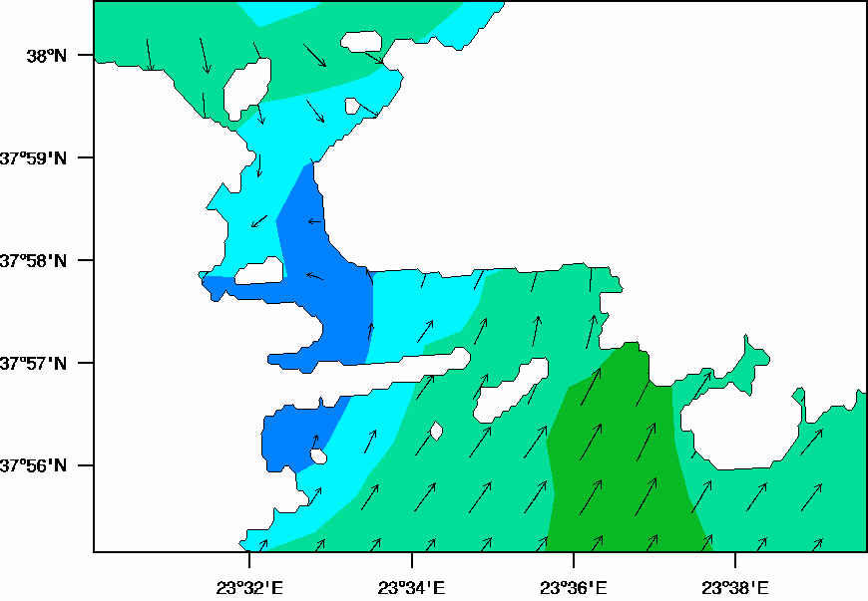
~10:00 LST. The Greek counter-attack begins simultaneously with the onset of the sea-breeze
Greeks
Persians
(Plut. Them. 14.) (…Themistocles made sure that the Greek ships were lined up opposite the Persian ones at the specific time when a strong wind blew from the sea bringing waves to the straits…)
“ἢ τὴν εἰωθυῖαν ὥραν παραγενέσθαι, τὸ πνεῦμα λαμπρὸν ἐκ πελάγους ἀεὶ καὶ κῦμα διὰ τῶν στενῶν κατάγουσαν”

Slide 17
11:00 – 19:00 LST. The battle takes place under sea breeze conditions
Greeks
Persians
(Hdt. 86.) (… because the Hellenes fought in order and ranged in their places, while the Barbarians were no longer ranged in order nor did anything with design …)
(Pl. Them. 14) (…The wind falling on the higher Persian decks steered them and offered their sides to the attacking Greek ships…)
“ καὶ τοῖς καταστρώμασιν ὑψορόφους καὶ βαρείας ἐπιφερομένας ἔσφαλλε προςπίπτον, καὶ παρεδίδου πλαγίας τοῖς Ἕλλησιν ὀξέως προςφερομένοις ”

Slide 18
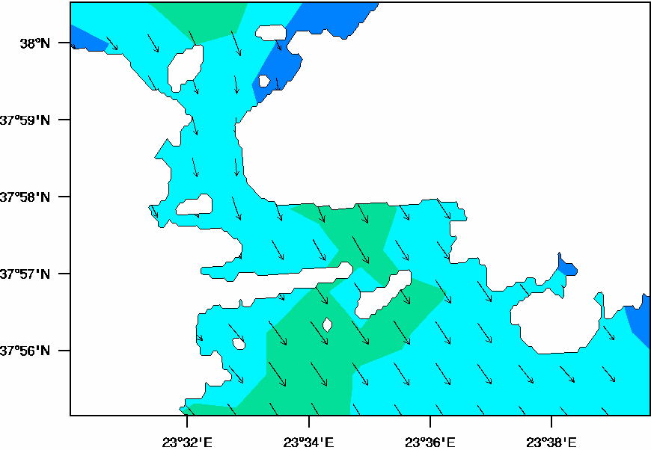
Evening hours (after 19:00 LST). The Persians manage to retreat when the wind turns to“Zephyr”
Greeks
Persians
(Hdt.96.) (…. many of the wrecks were taken by Zephyrus and brought to that strand in Attica which is called Colias…)
“τῶν δὲ ναυηγίων πολλὰ ὑπολαβὼν ἄνεμος ζέφυρος ἔφερε τῆς Ἀττικῆς ἐπὶ τὴν ἠιόνα τὴν καλεομένην Κωλιάδα”

Slide 19
Modeled diurnal variation of the wind inside Salamis Channel from the WRF inner grid (1 × 1 km)
The red numbers denote Local Standard Time (LST)

Slide 20
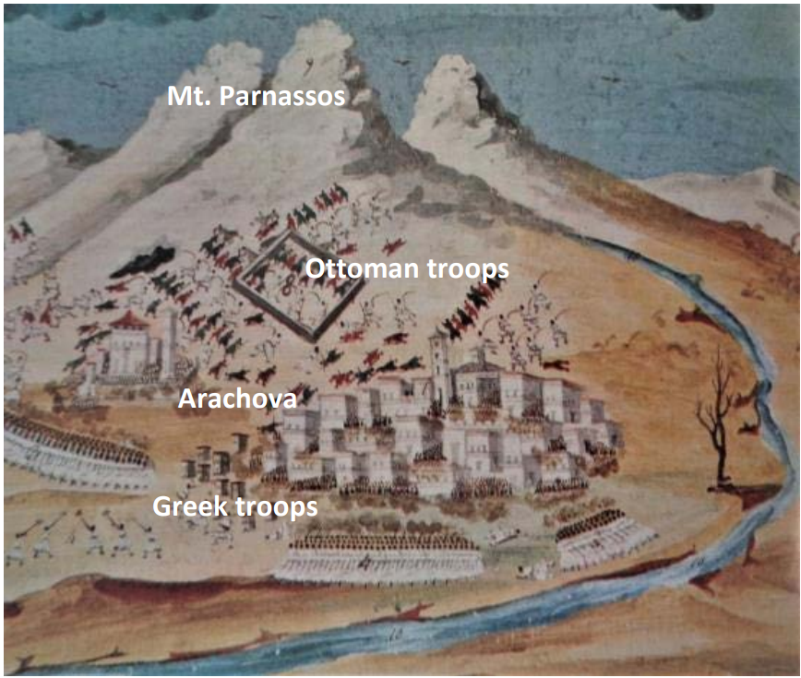
Katevatos and the battle of Arachova in 1826
Schematic plot for the battle of Arachova in November 1826 (Batte at Arachova, D. Zografos—I. Makrigiannis, The American School of Classical Studies at Athens, Gennadius Library).

Slide 21
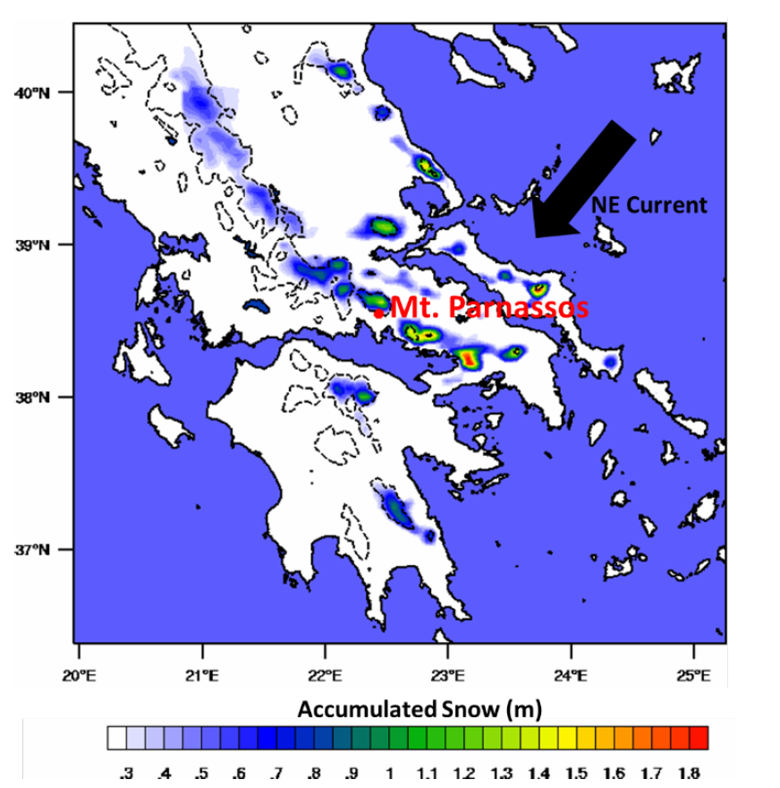
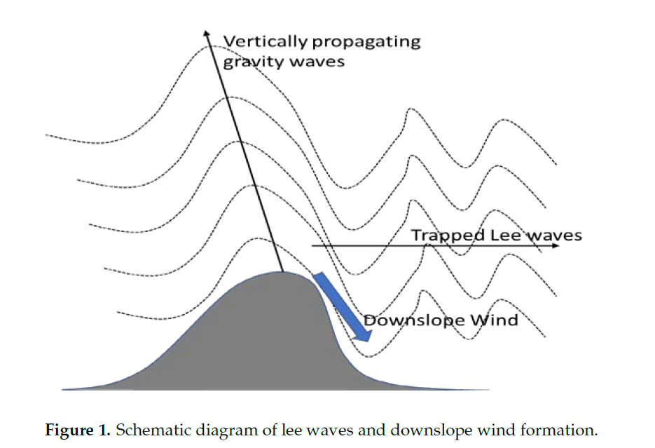
The extreme weather type of “Katevatos” is a downslope wind formed due to gravity wave structure above Parnassos
Downward wave reflection at critical point
Solomos, S.; Nastos, P.T.; Emmanouloudis, D.; Koutsouraki, A.; Zerefos, C. A Modeling Study on the Downslope Wind of “Katevatos” in Greece and Implications for the Battle of Arachova in 1826. Atmosphere 2021, 12, 993

Slide 22
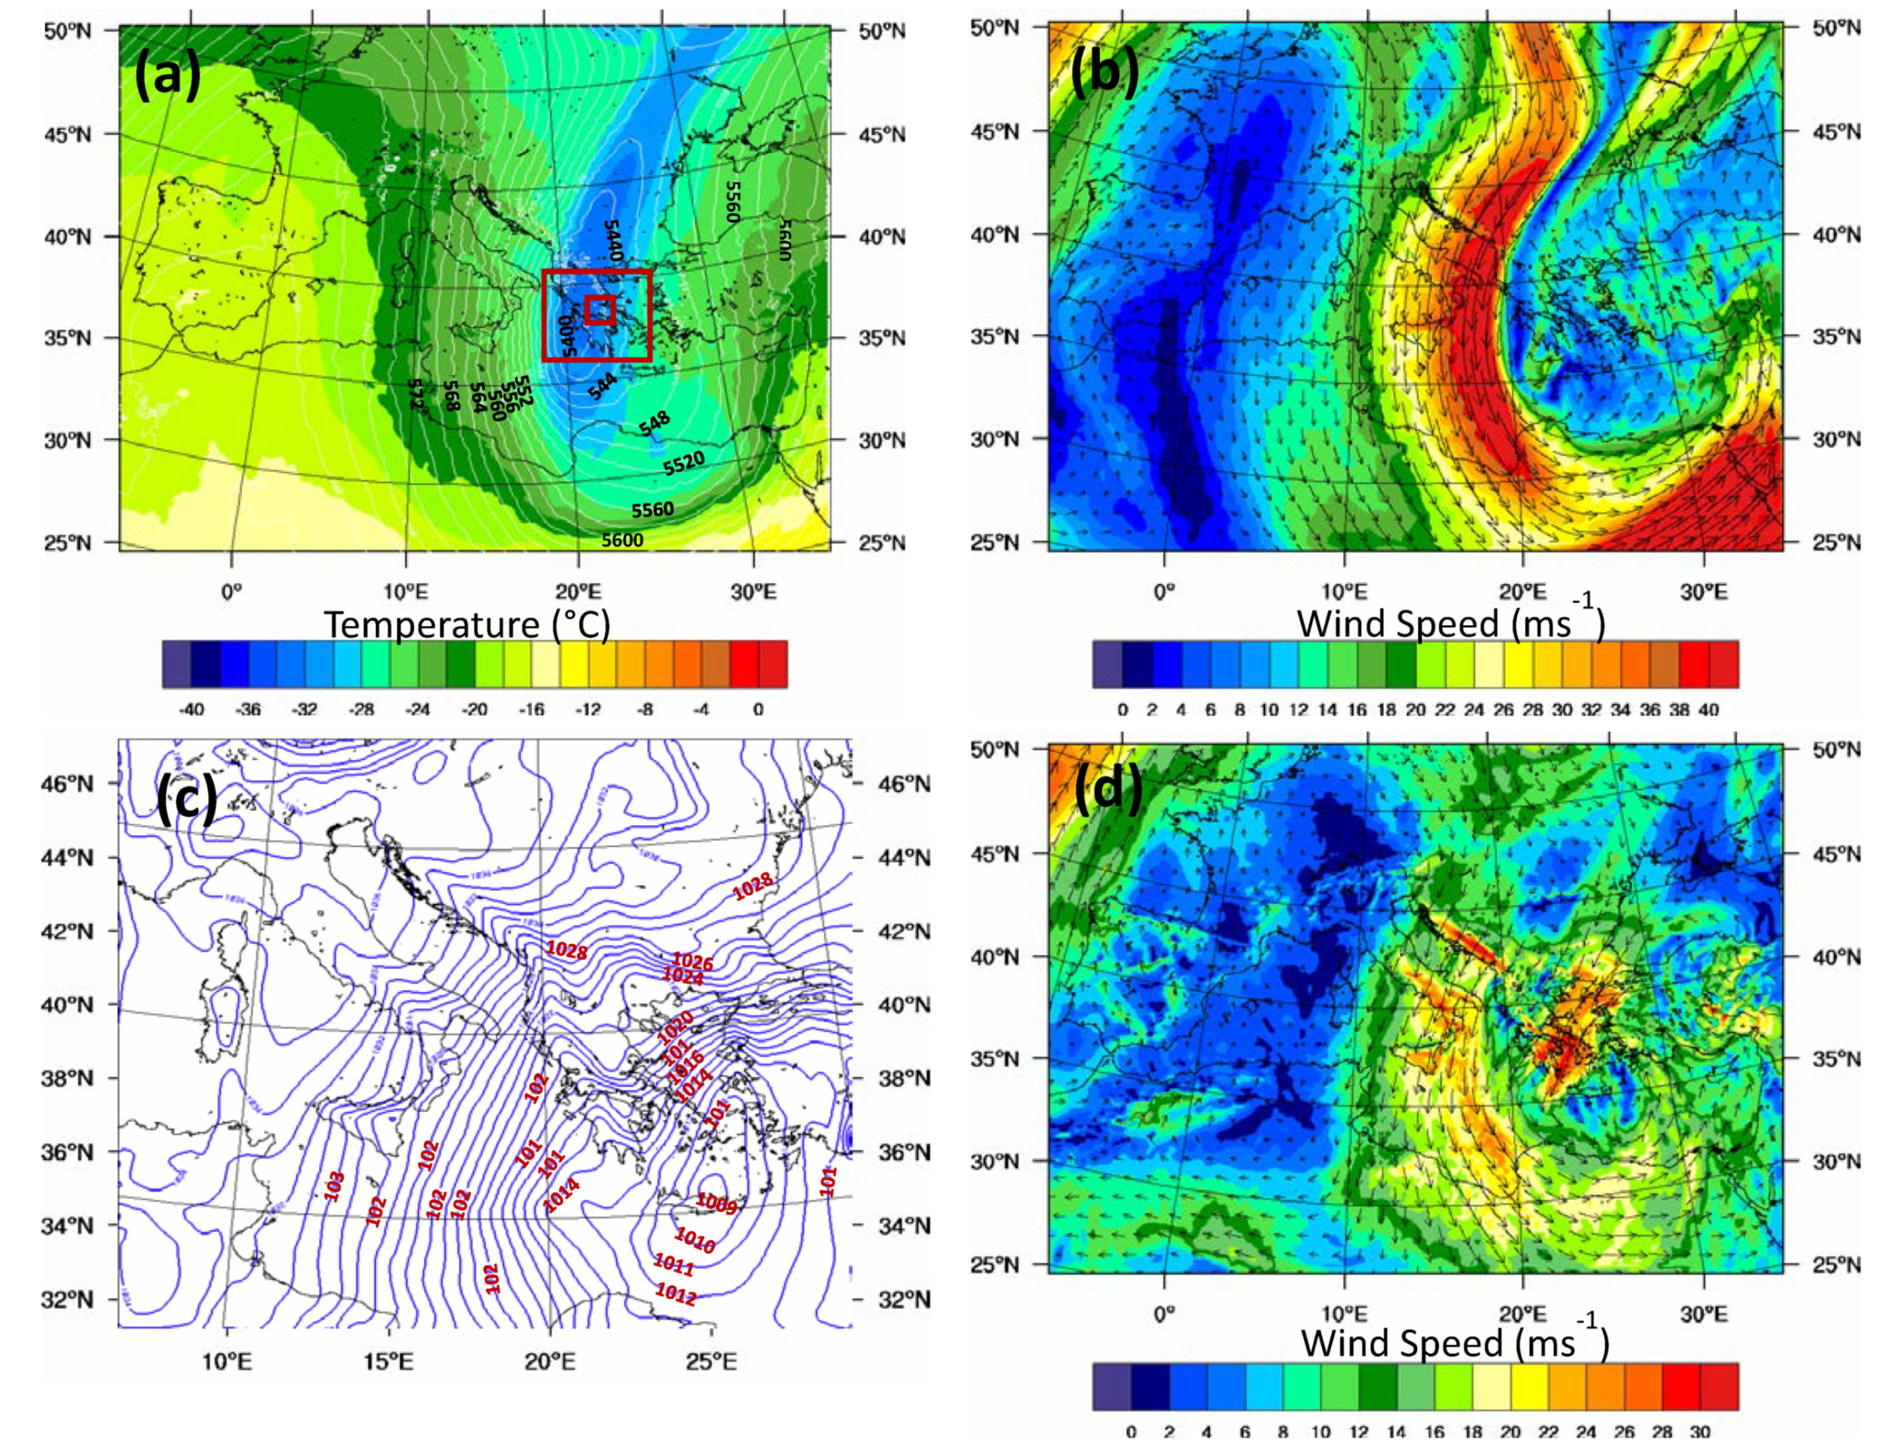
Formation of a critical flow layer at about 500 mb level
850 mb
500 mb
The wind over Central Greece shifts from NE at 850 mb to SE at 500 mb
A critical level is formed at the interface layer between the two flow regimes

Slide 23
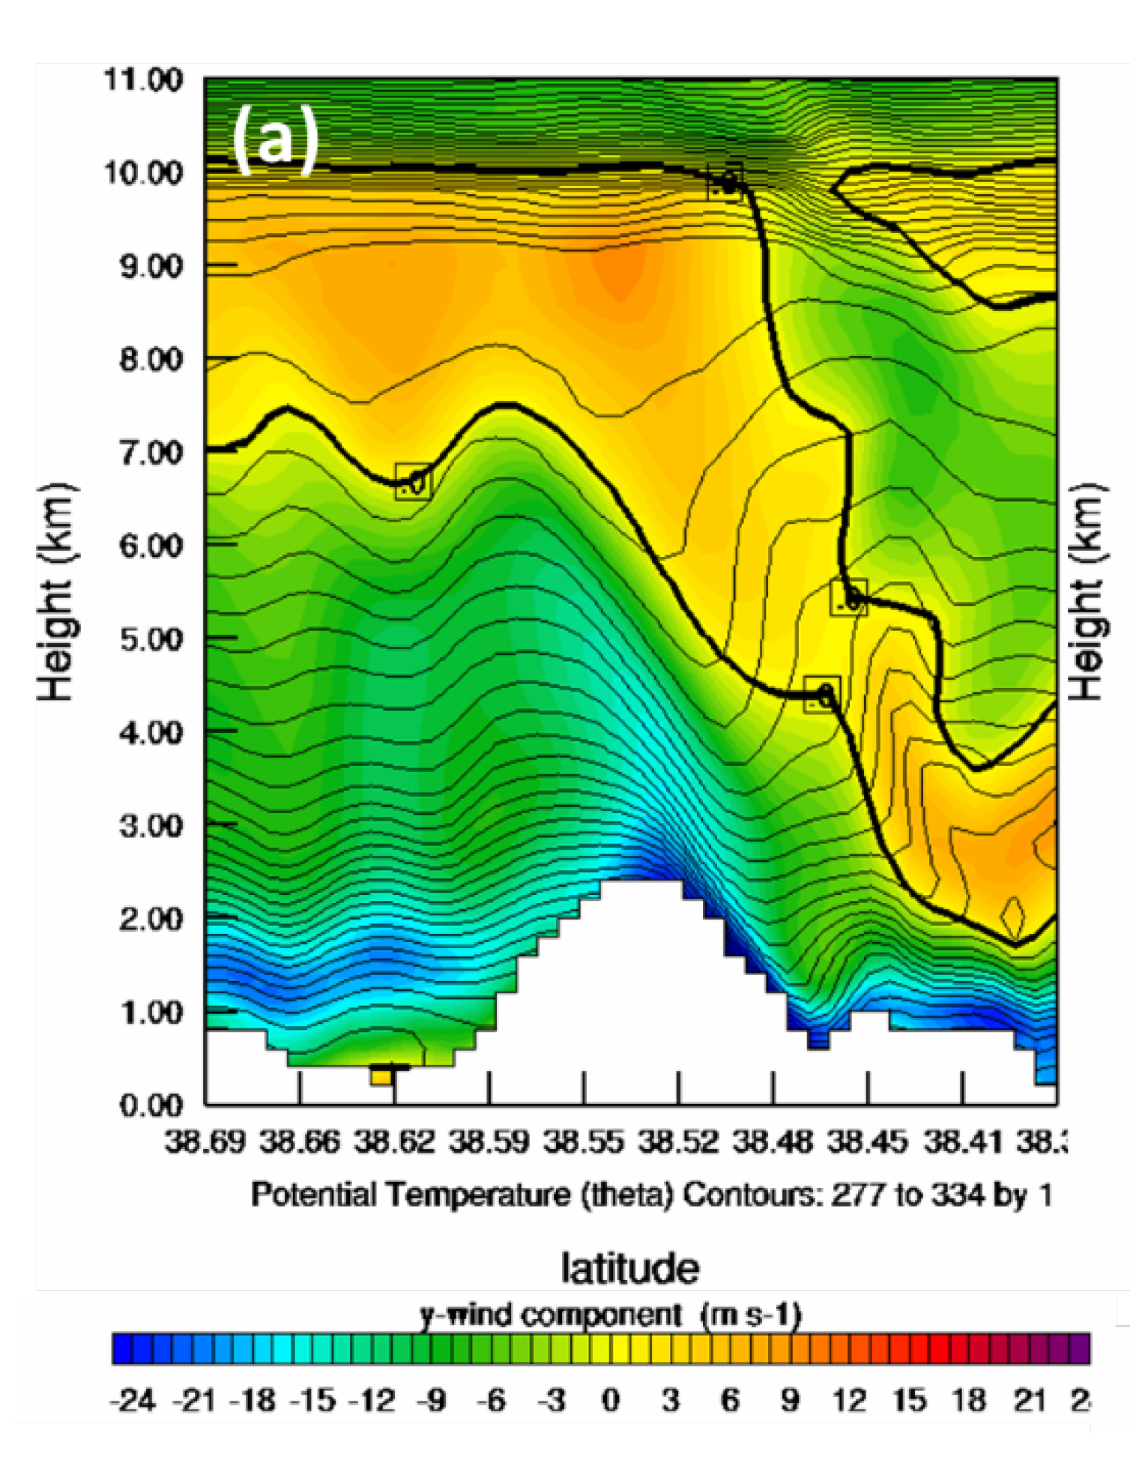
Formation of mountainous gravity waves above Parnassos
Atmosphere – topography tuning results in the generation of mountainous gravity waves
Potential Temperature contours (color scale) indicate the vertical oscillation of the propagating air mass
Critical level
(zero cross-barrier wind component)
Parnassos

Slide 24
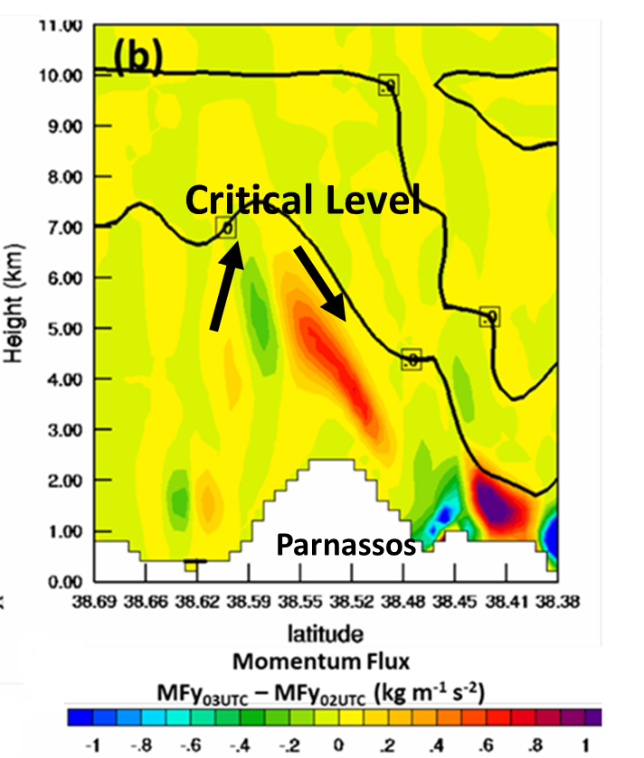
Reflection of the upward propagating waves at the critical level
Reflection of wave energy and momentum occurs at the critical point (~7 km) that separates the lower troposphere NE flow from the upper troposphere SE flow

Slide 25
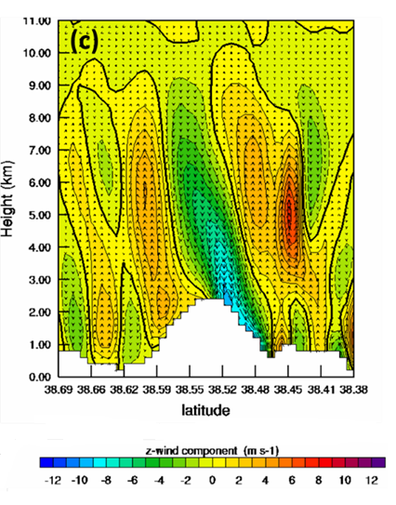
Formation of the extreme downslope wind “Katevatos”
Upward motions (w>0)
Downward motions (w<0)
Downward mixing occurs at the lee side of the mountain leading to severe snowfall, windstorm and temperature drop
Parnassos
Vertical wind component (w)

Slide 27
Concluding Remarks
Historical atmospheric conditions can be reproduced in numerical models if they are attributed to air-sea differential heating or topographic effects.
Climatological measurements and sea-breeze modeling in Salamis are consistent with the battle descriptions reported by ancient writers (Herodotus, Aeschylus, Plutarch, etc.).
The historical “Katevatos” pattern in Arachova is found to result from gravity wave reflection caused by the steep mountain topography of Parnassos.
Downscaling of the international Atmospheric Circulation Reconstructions over the Earth (ACRE) could provide more insight to historical weather events

