Slide 1
Historical rainfall observations in SE Asia
Praveen Teleti, NCAS/SMU
Fiona Williamson, SMU

Slide 2
Overview
Introduction
Rainfall Variability in Singapore
ACRE-SE Asia past-present activities
New project launched
Learning from past projects

Slide 3
Approx 3 billion people live in SE Asia + Far East
Dependant on rainfall for agriculture
Monsoonal climate systems,
any change causes pressure on food-water security, socio-economic stability
SE ASIA
Far-East
Malaysia and SG

Slide 4
Introduction
1820
SE Asia was made up of several colonies and native kingdoms
Instrumental observations started in 1820s
Focusing on maritime route e.g. Singapore, Malaysia and Sumatra

Slide 5
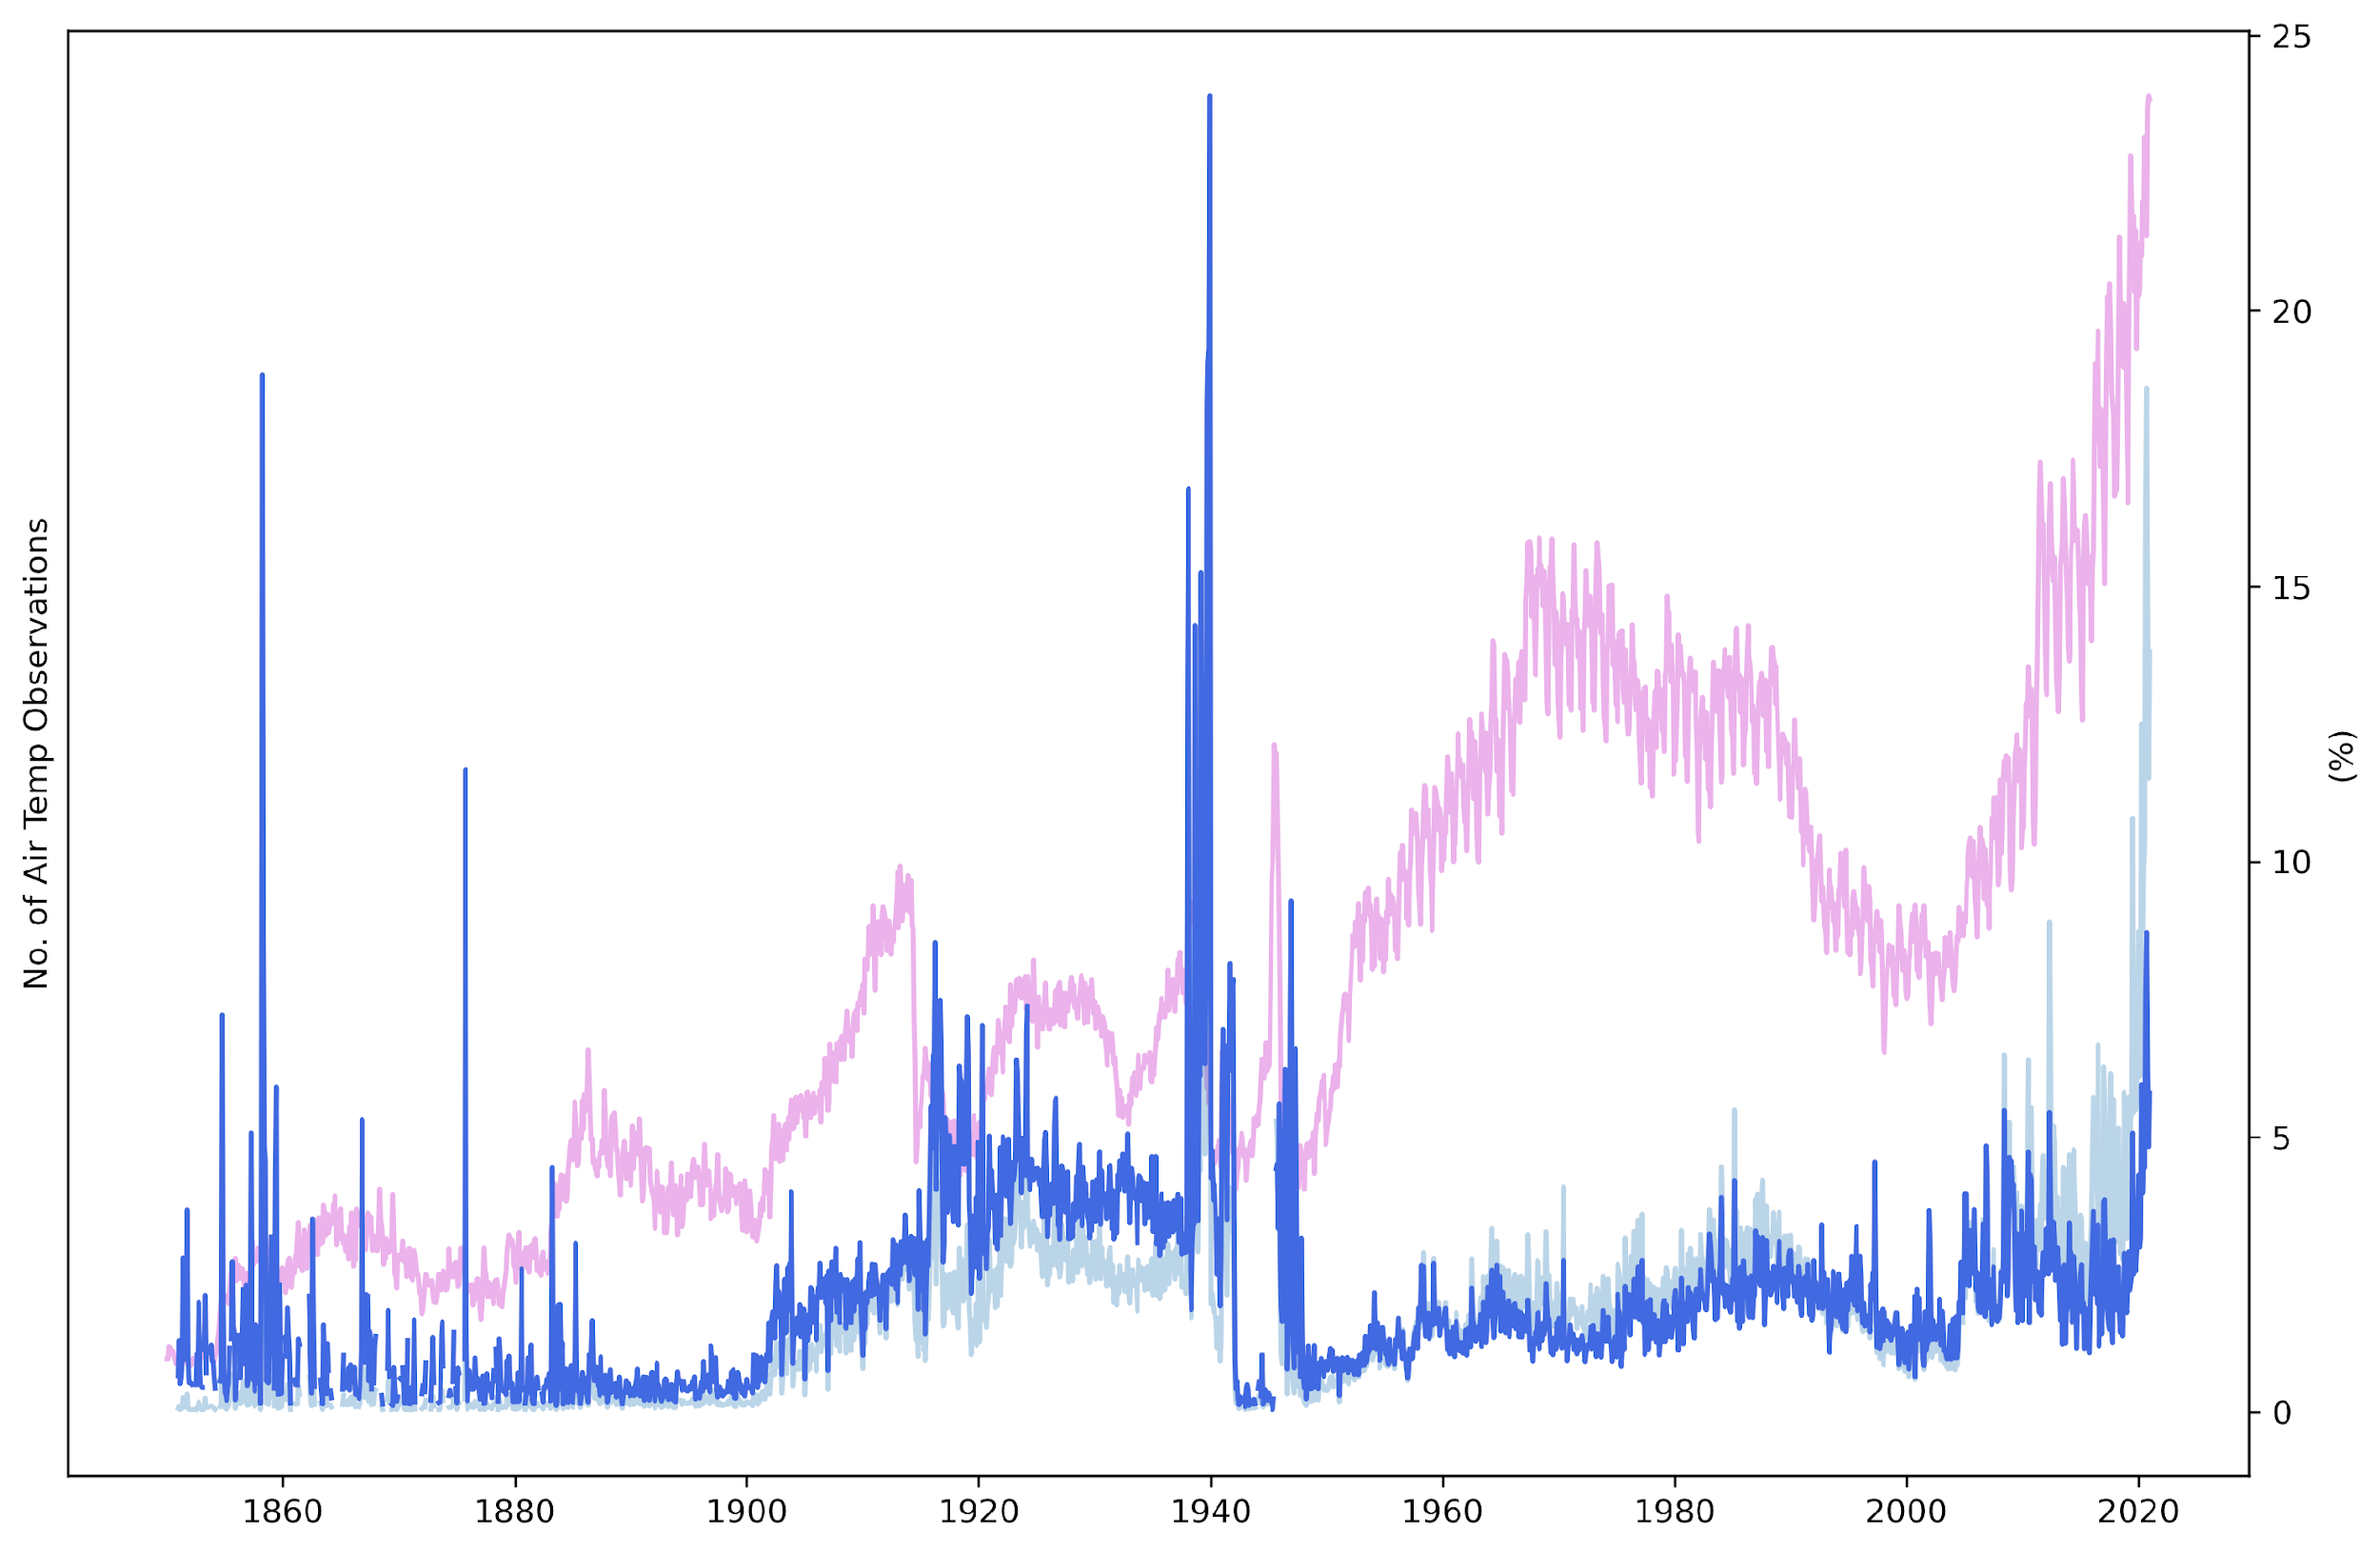
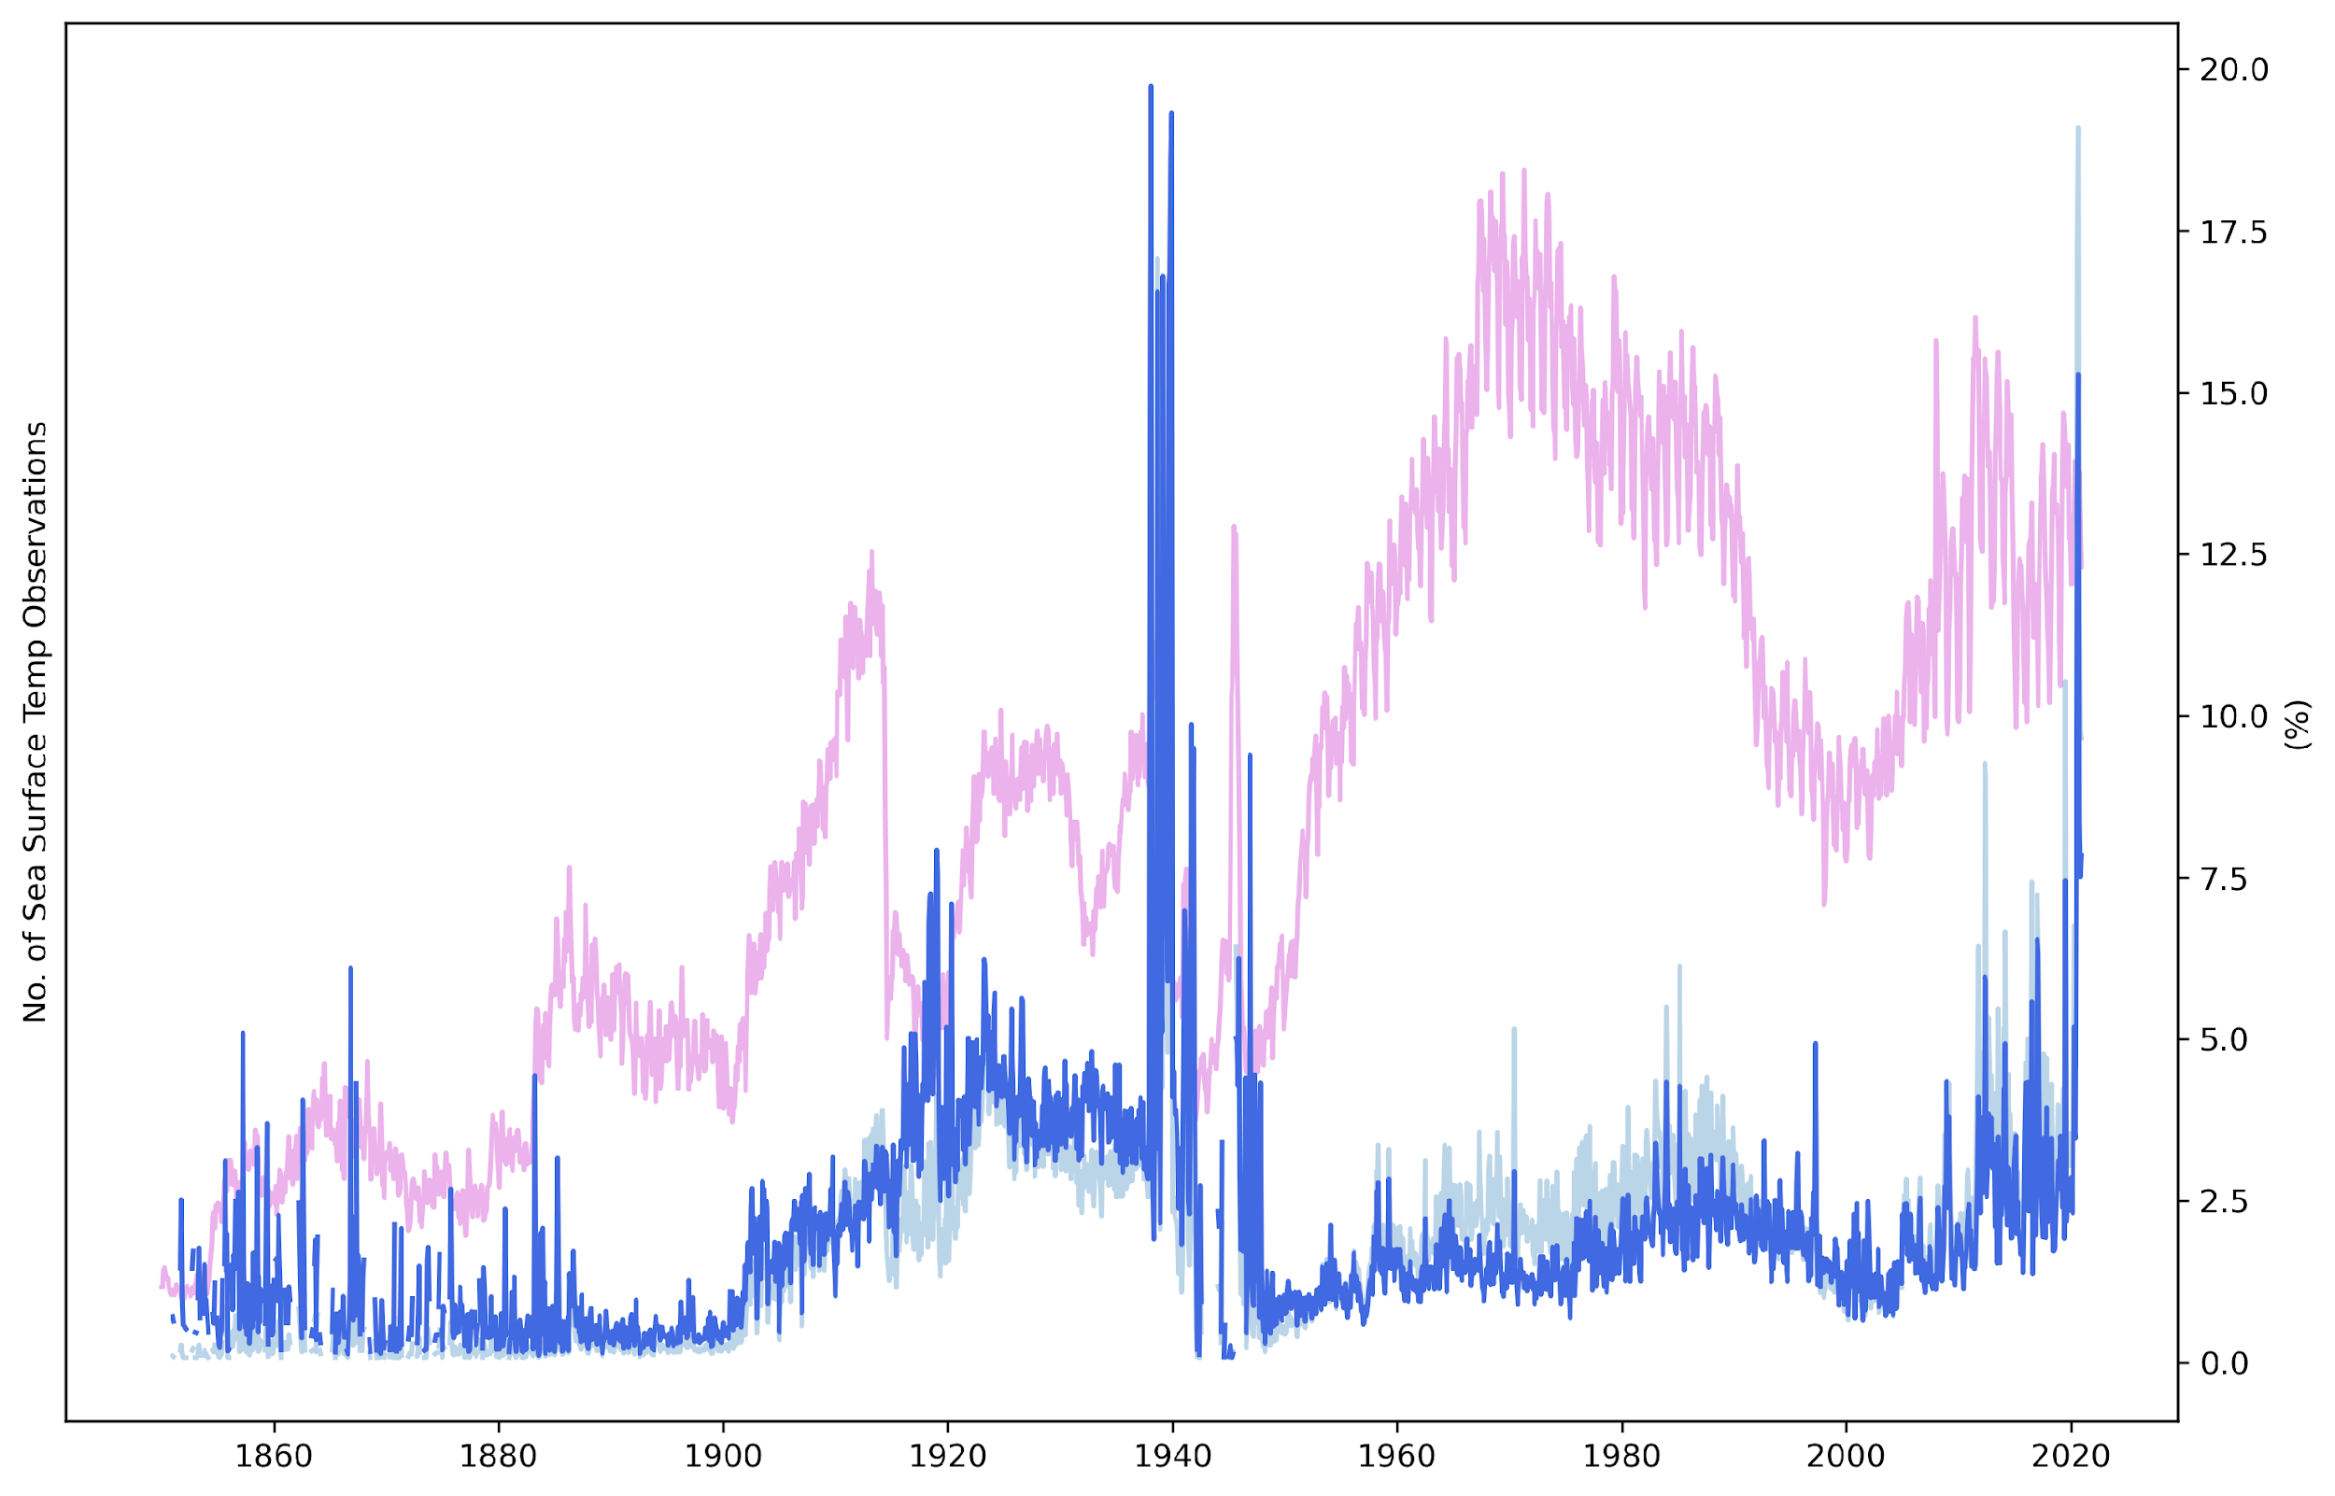
ICOADS Observations
AT
SLP
SST

Slide 6
ISPD dataset
Singapore grid-box

Slide 7
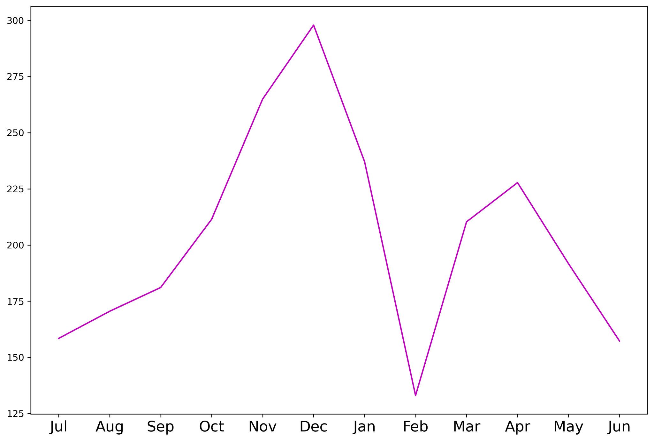
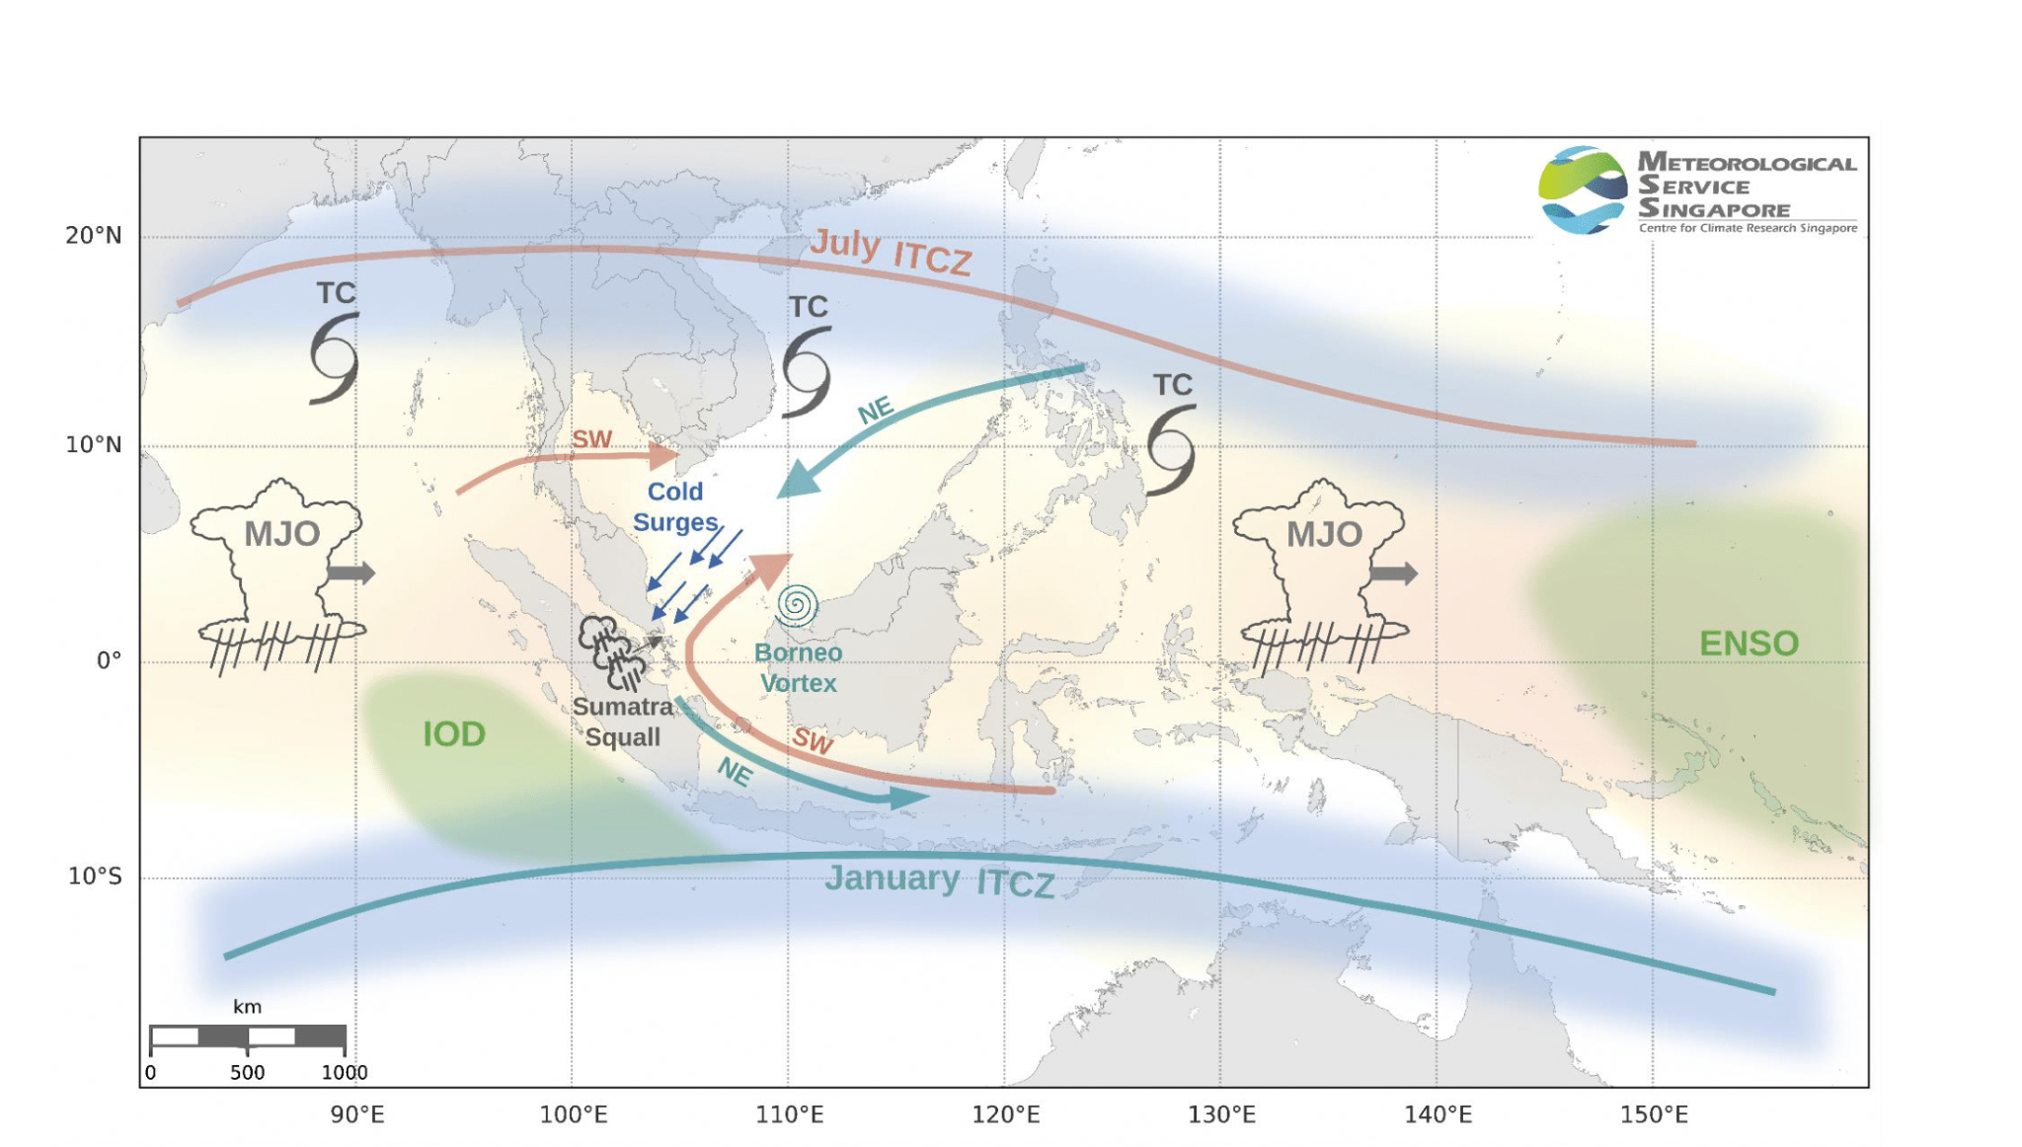
Singapore Rainfall
seasonality
Bi-annual
movement of
ITCZ
ENSO and Indian Ocean Dipole (IOD) impact the seasonal and inter-annual timescales,
MJO impacts rainfall at weekly to monthly timescales

Slide 8
Historical Rainfall in SG
Source GCPP

Slide 9
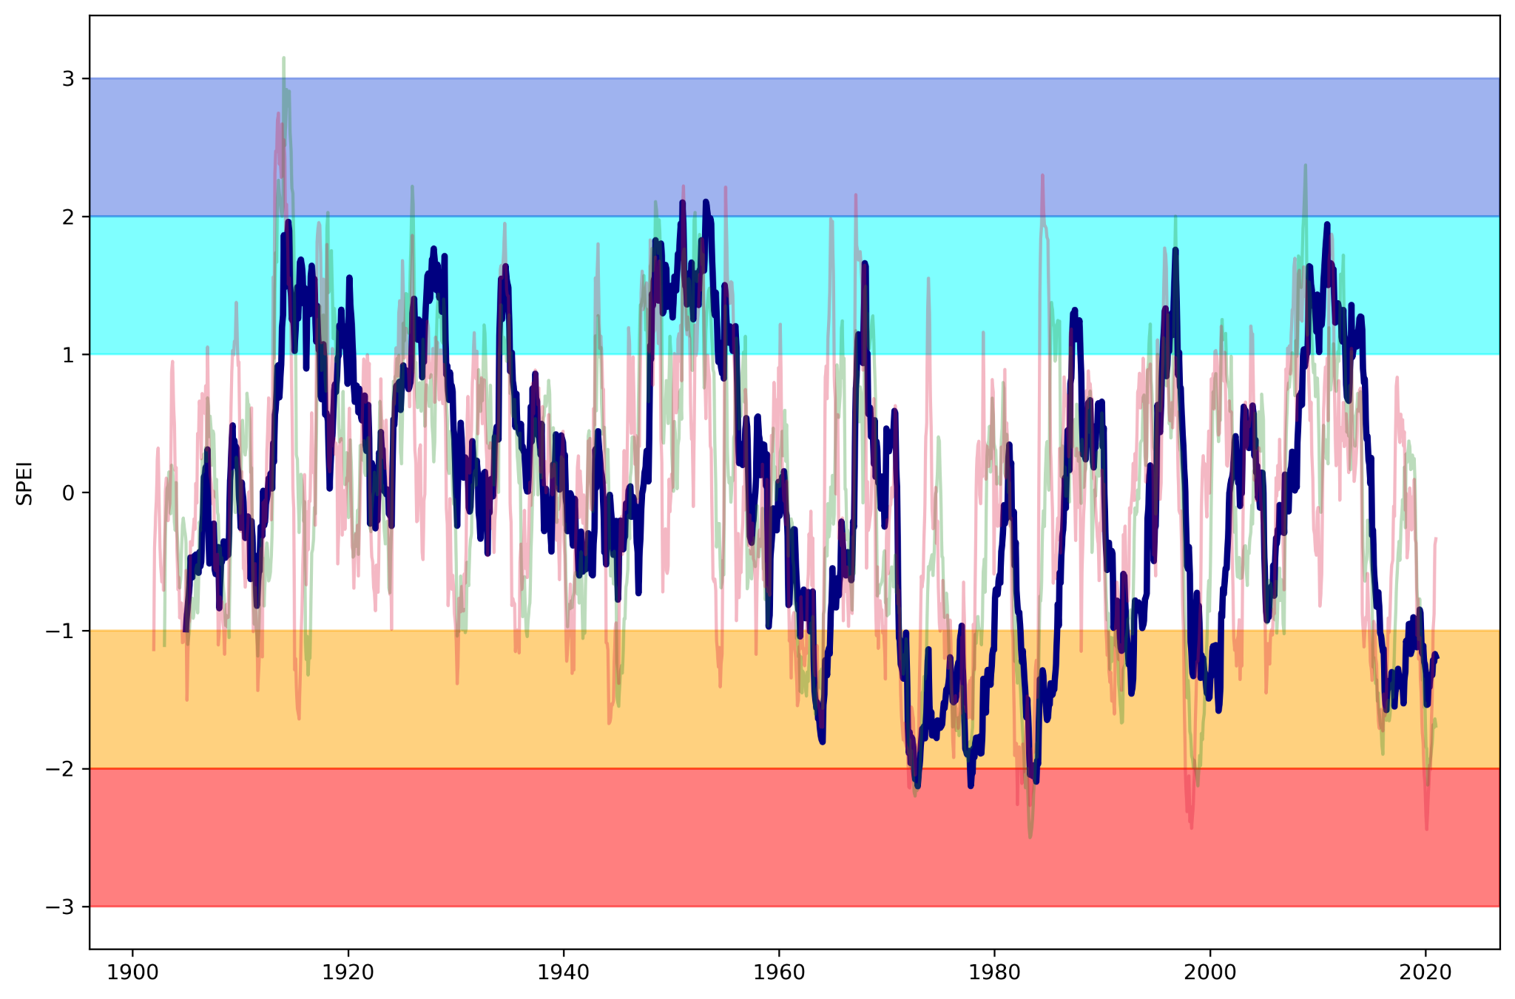
Drought
Index
SPEI-48
Dry
Very Dry

Slide 10
ACRE-SE Asia
ACRE SEA has been running for a decade.
In this time, the focus has been mainly on West and East Malaysia, Singapore and Hong Kong, with Indonesia, Christmas Island and scattered other observations
An almost complete collection has been made of available observations from Malaysia, Singapore and Hong Kong, from the 1820s to the 1930s.

Slide 11
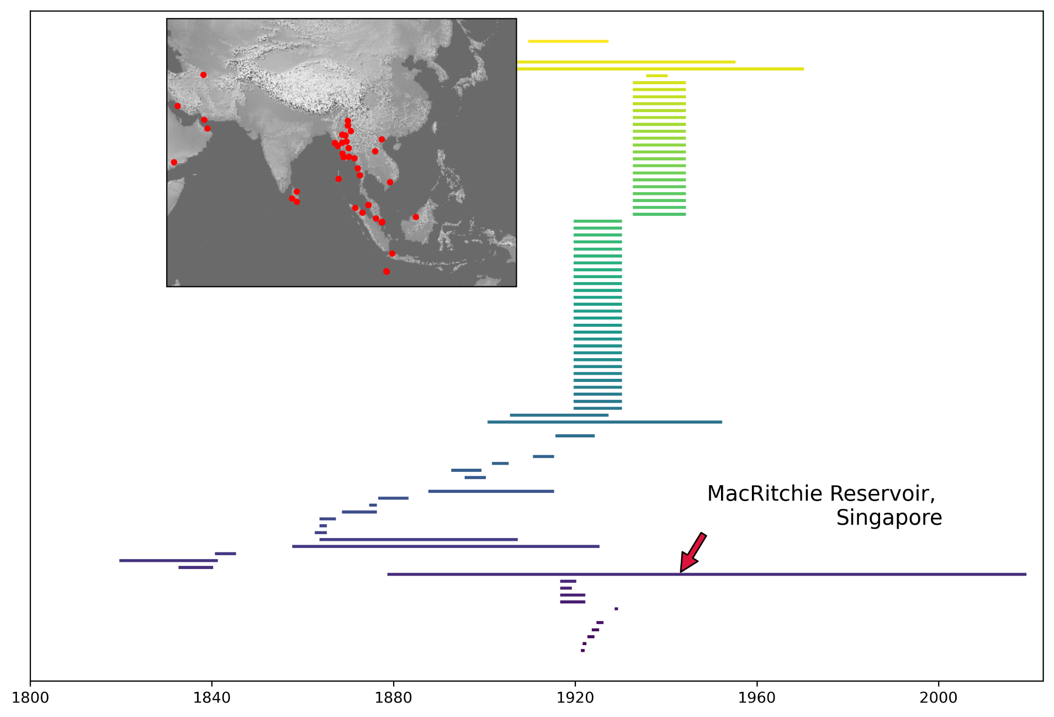
Work
so far
~100,000 observations
but not standardised, or QC-ed

Slide 12
Data sources to be used
Ship logbooks
Meteorological station observations
Agricultural Bulletins
Rubber plantation weather records
Missionary reports
Private diaries, newspapers

Slide 13
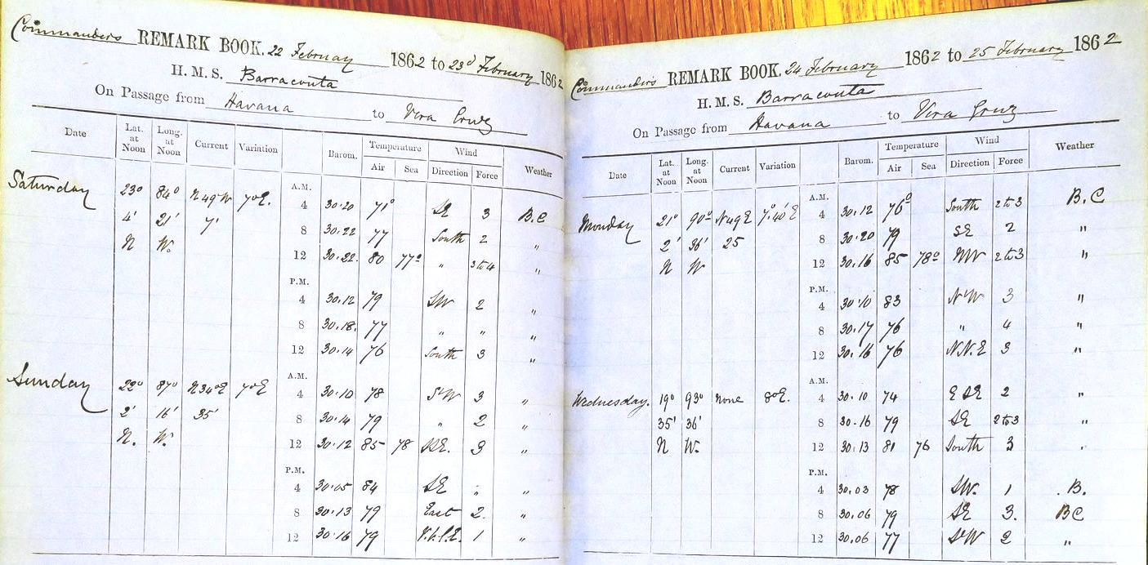
Merchant ship logbooks

Slide 14
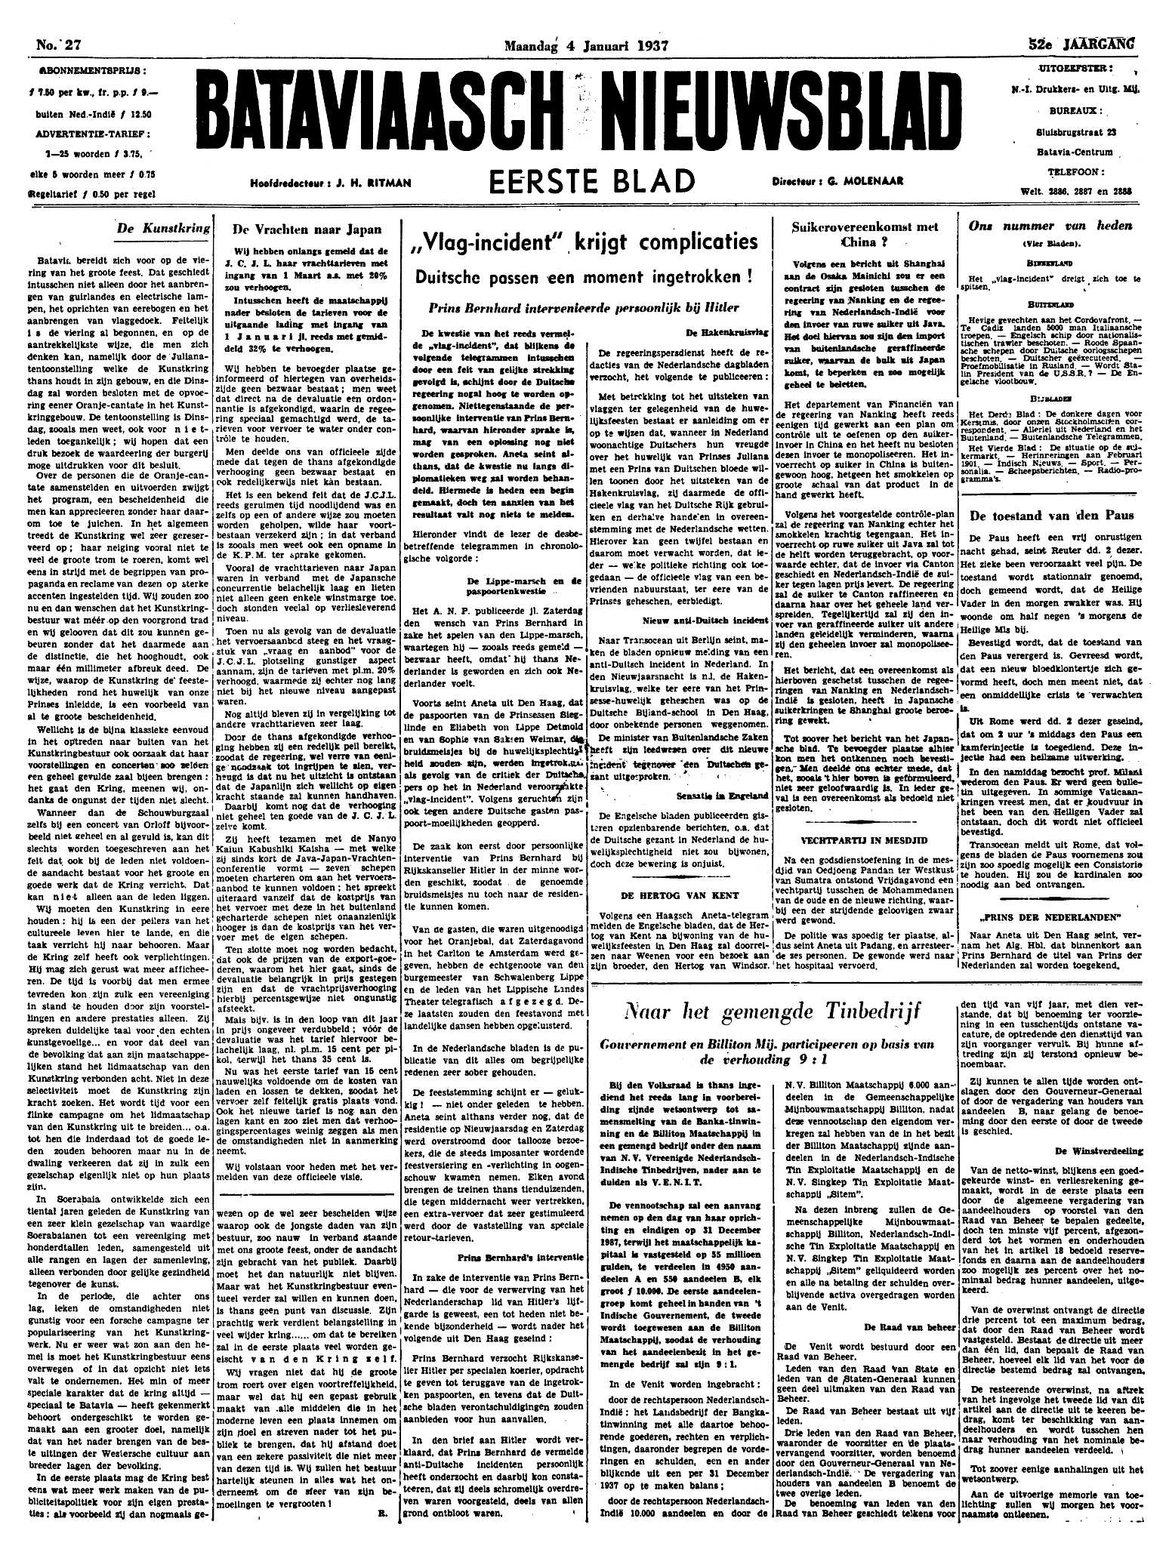
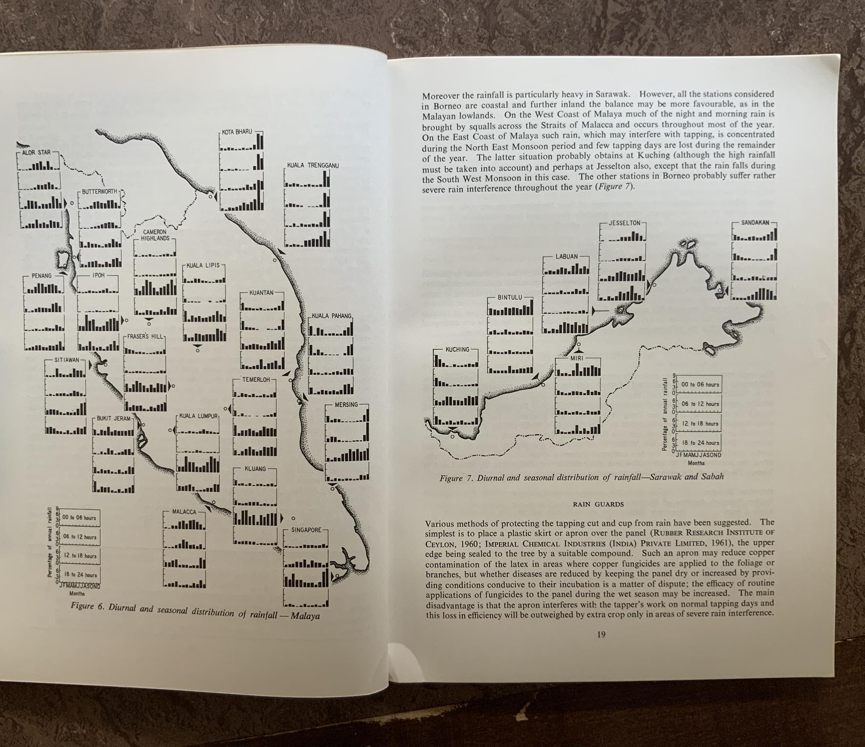
page photos
Rubber Institute Report

Slide 15
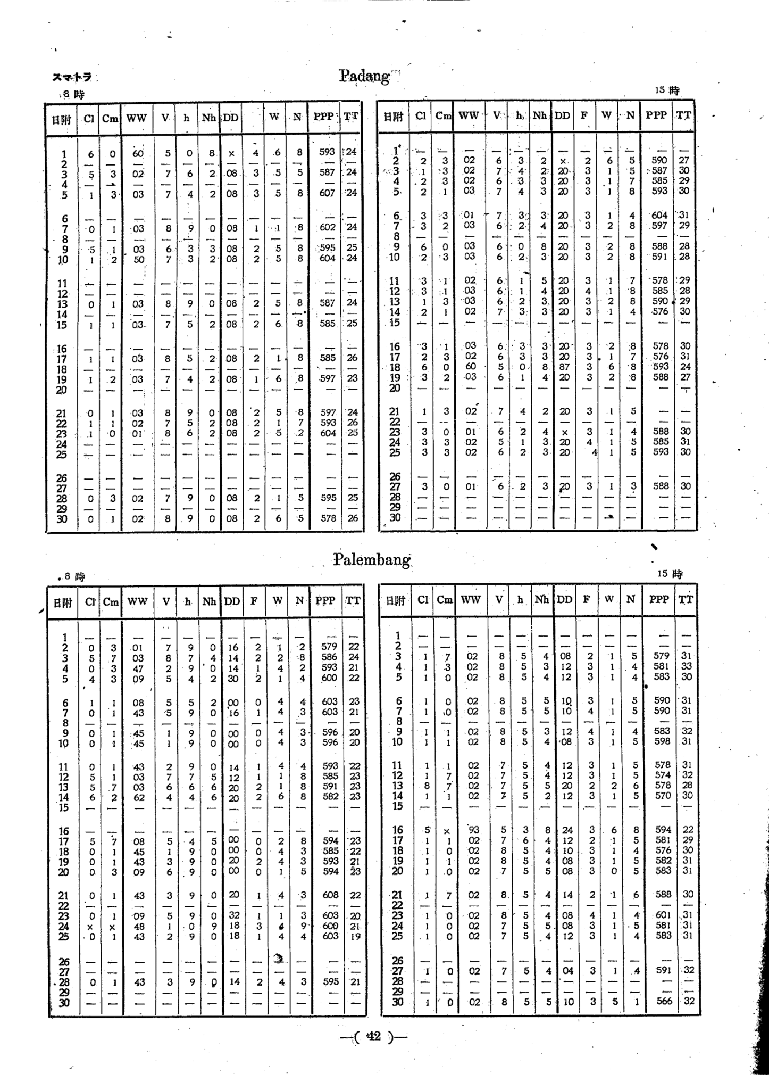
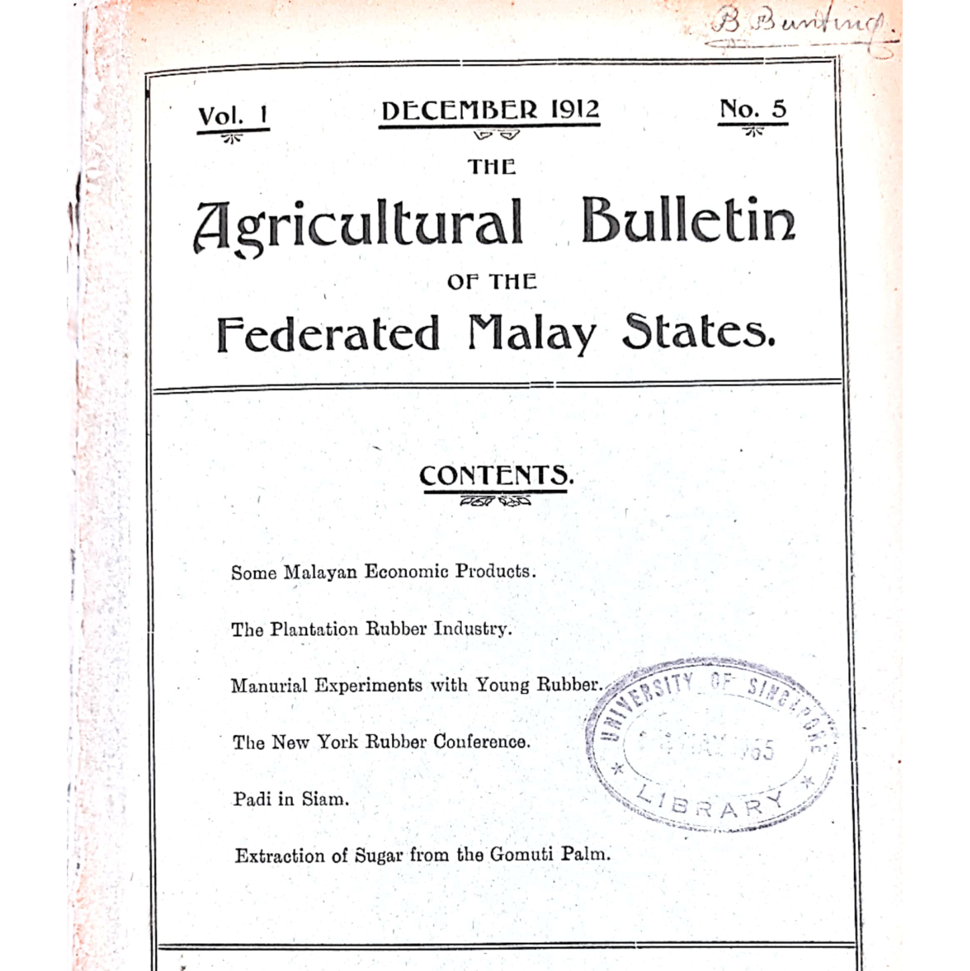
Station data

Slide 16
Understanding Long-Term of Rainfall Trends in Singapore
Collate fragmented transcribed weather records
Discover and transcribe new land and marine weather records from historical documents.
Reconstruct rainfall variability across Singapore, Malaysia and Sumatra

Slide 17
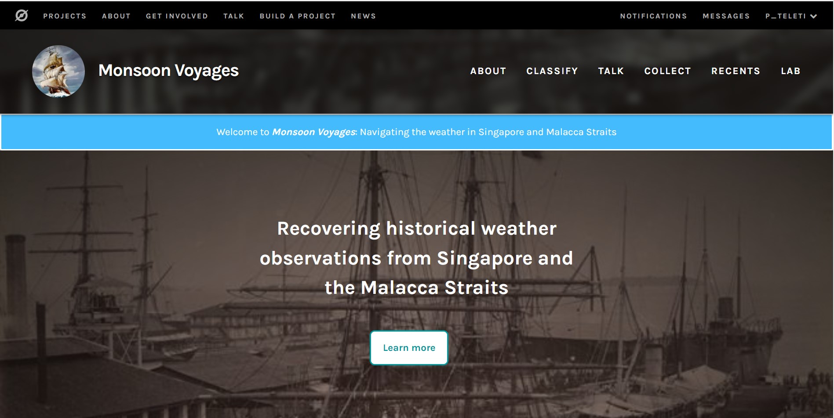
Monsoon
Voyages
A citizen-science based Zooniverse project - launched
Aims to extract data from a selection of log-books from British-merchant ships from the 1880s to the 1950s
In the beta-testing phase
Any feedback would be appreciated

Slide 18
Learning from past projects - 1

Slide 19
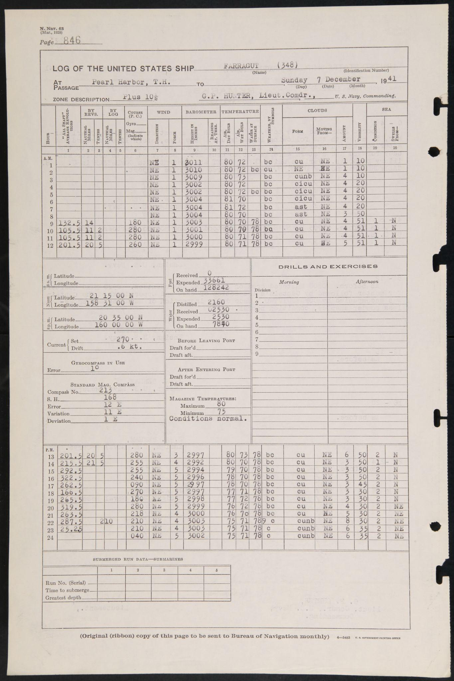
Old Weather: WW2
Citizen-science project with over 3000 volunteers
69 ship logbooks over 5 year period (1941-45)
2.4 million met. observations, hourly
Atlantic, Pacific ocean basins
Data paper published: https://doi.org/10.1002/gdj3.222

Slide 20
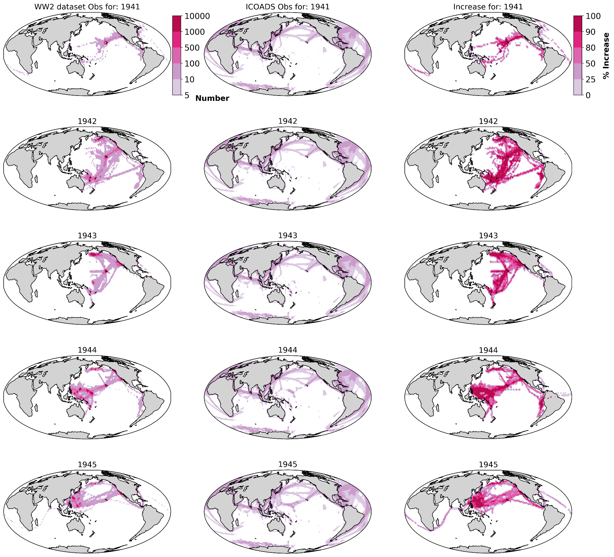
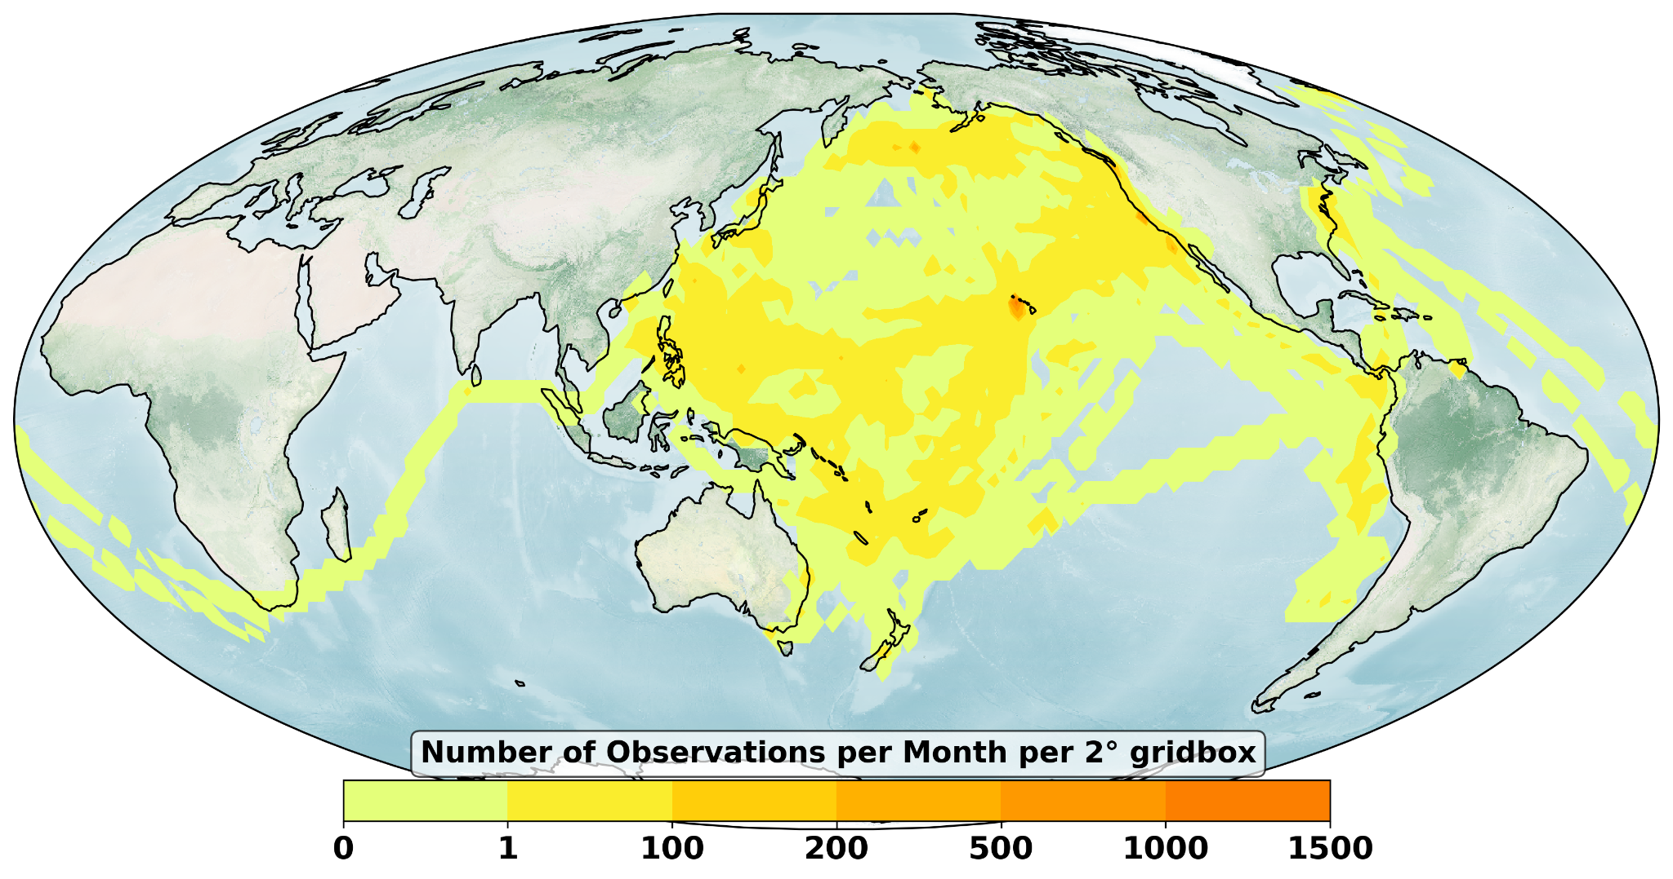
1941-1945

Slide 21
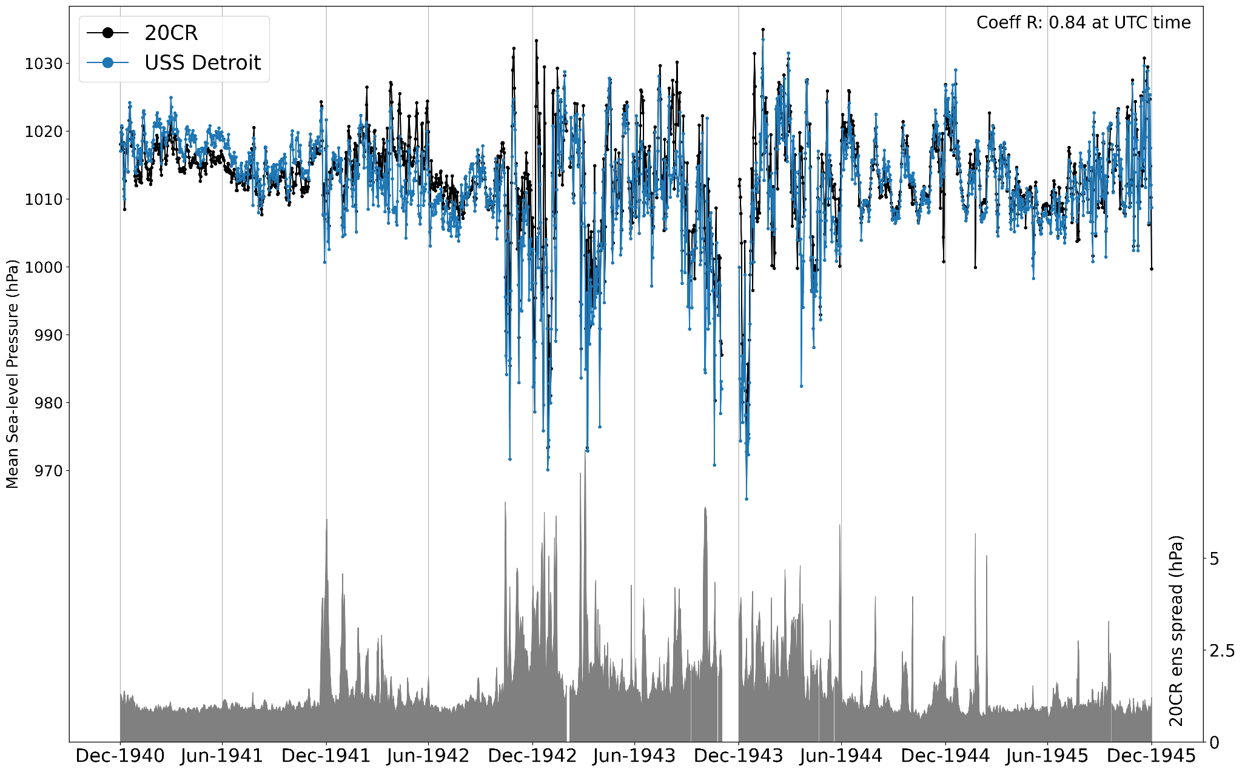

Slide 22
Learning from past projects - 2

Slide 23
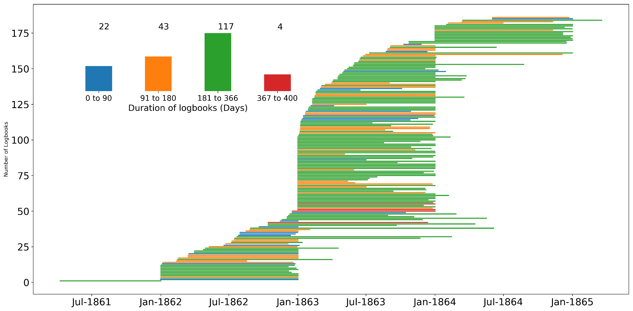
Weather Rescue at Sea
Data rescue component of GloSAT project - over 4000 volunteers
British merchant ships from 1860s, UKHO
4-hourly weather observations
5 million observations generated
Data paper in preparation

Slide 24
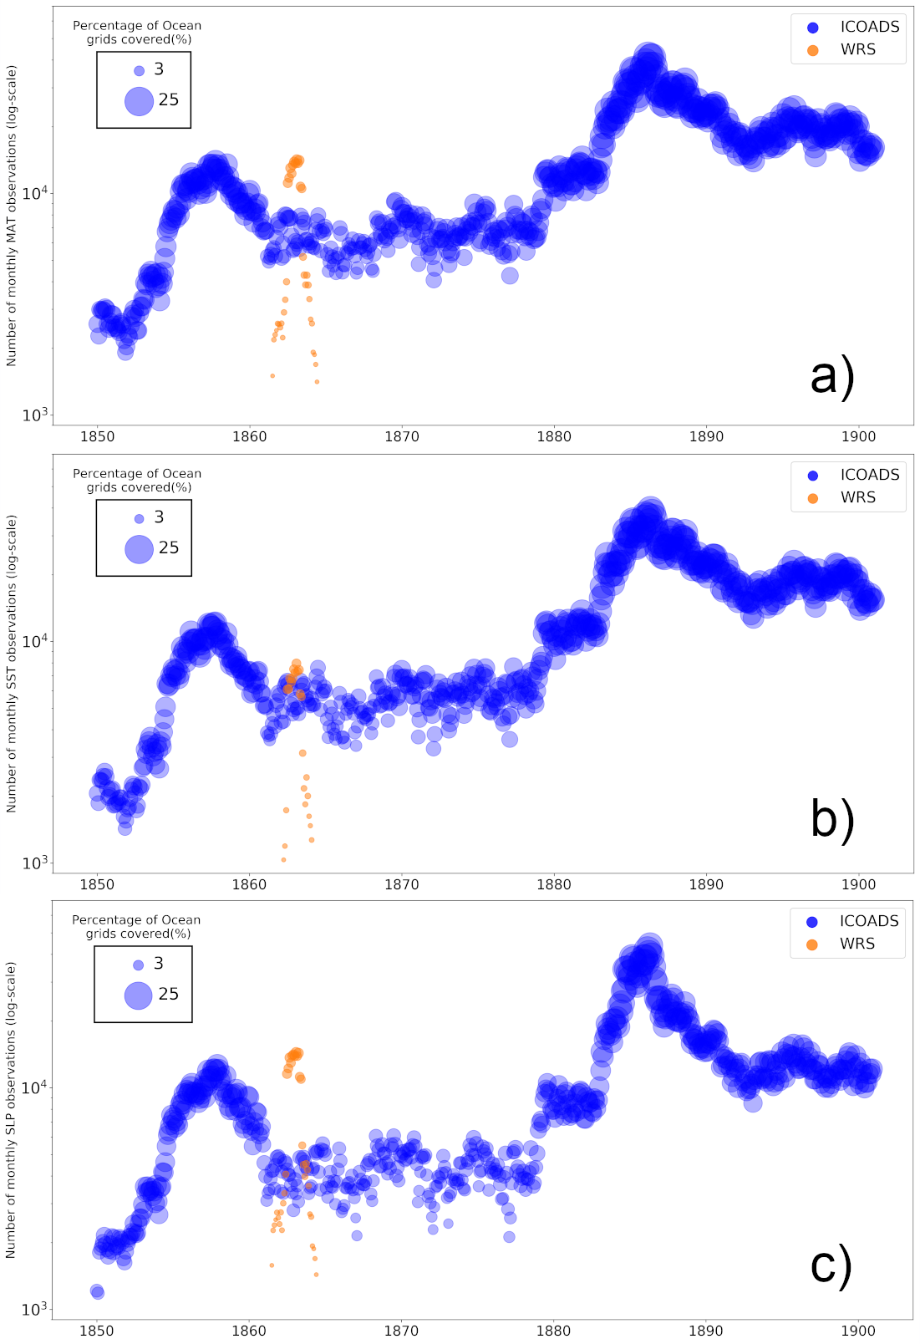
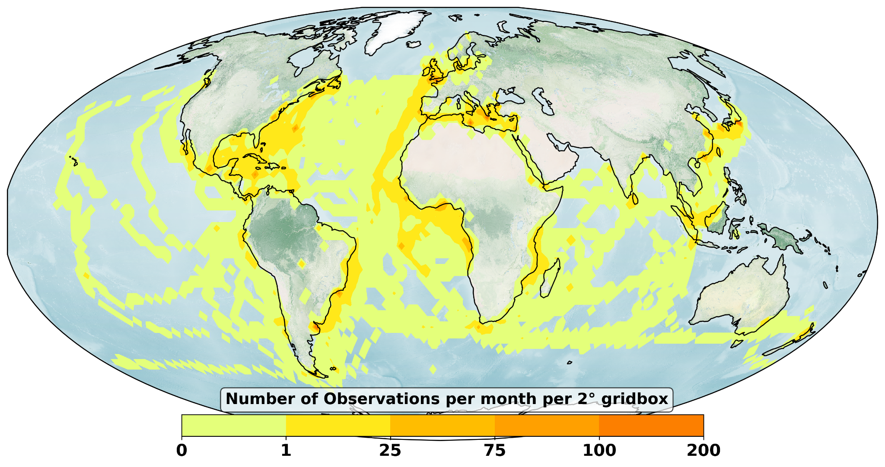
1861-1865

Slide 25
How can
we do
BETTER
Making citizen-science (Zooniverse) projects intuitive
Regular interaction with volunteers, sometimes A.M.A-style QnA
Constantly share updates, e.g. number of classifications done, plots of observations etc.
For typeset/printed tabular data, use ML to parse and extract data - promising
Focus needs to be not only data generation but also consumption
Out-of-box thinking, let LLMs digest set of logbook pdfs and query any information in human language. Theoretically possible but…

Slide 26
Submit your abstract for EGU25 session CL2
Thank you

