Slide 1
How to tame an evil variable.
Far more than you wanted to know about
observed precipitation.
Precipitation being evil
(via ChatGPT)
Philip Brohan – 2024-09-24

Slide 2
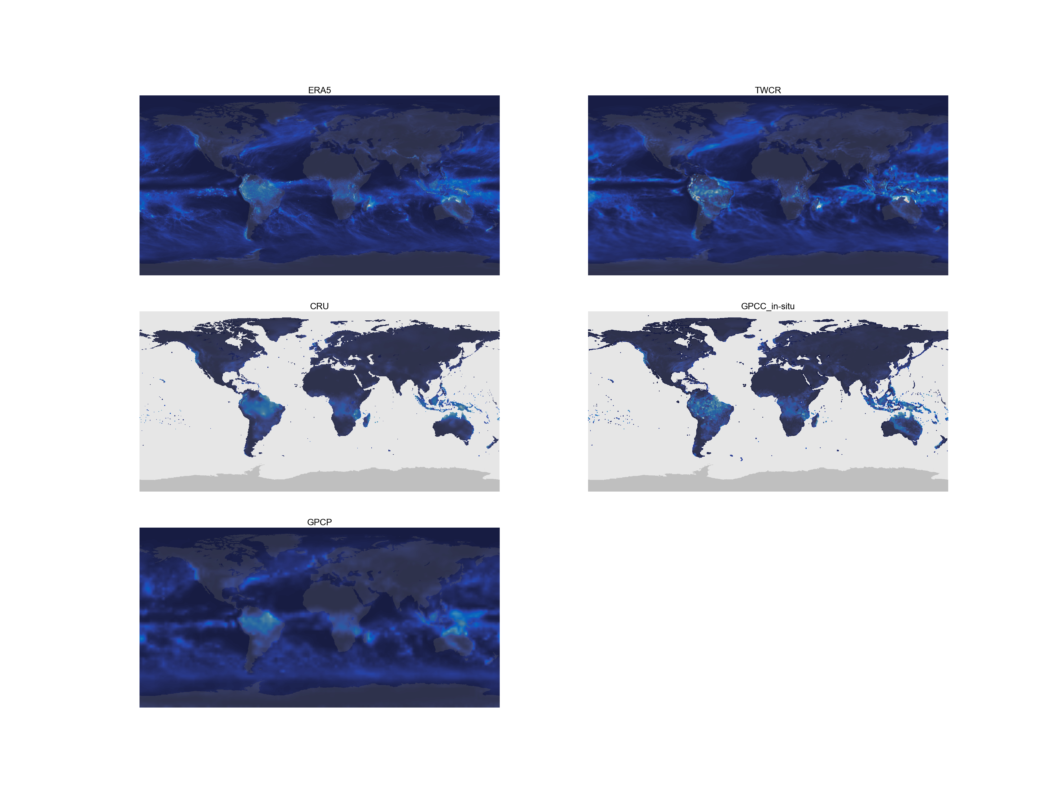
1989-03
Notes:
Gridded monthly-mean precipitation from 5 datasets: Two reanalyses, two in-situ observations based, and one blended in-situ and satellite.
Uses the cmocean ‘balance colour scale (red-blue) but you can’t see any red unless you look really closely at the tropical storm off Madagascar.

Slide 3
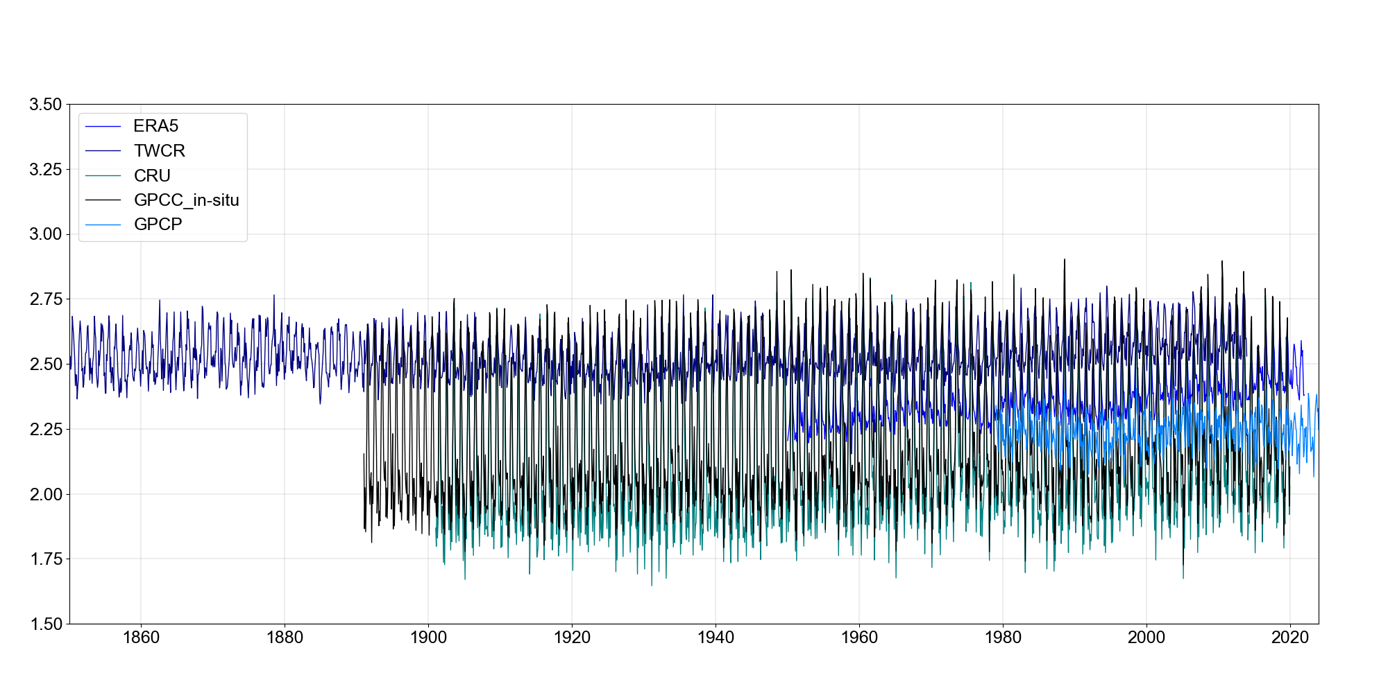
Global mean monthly-mean (mm/day)

Slide 4
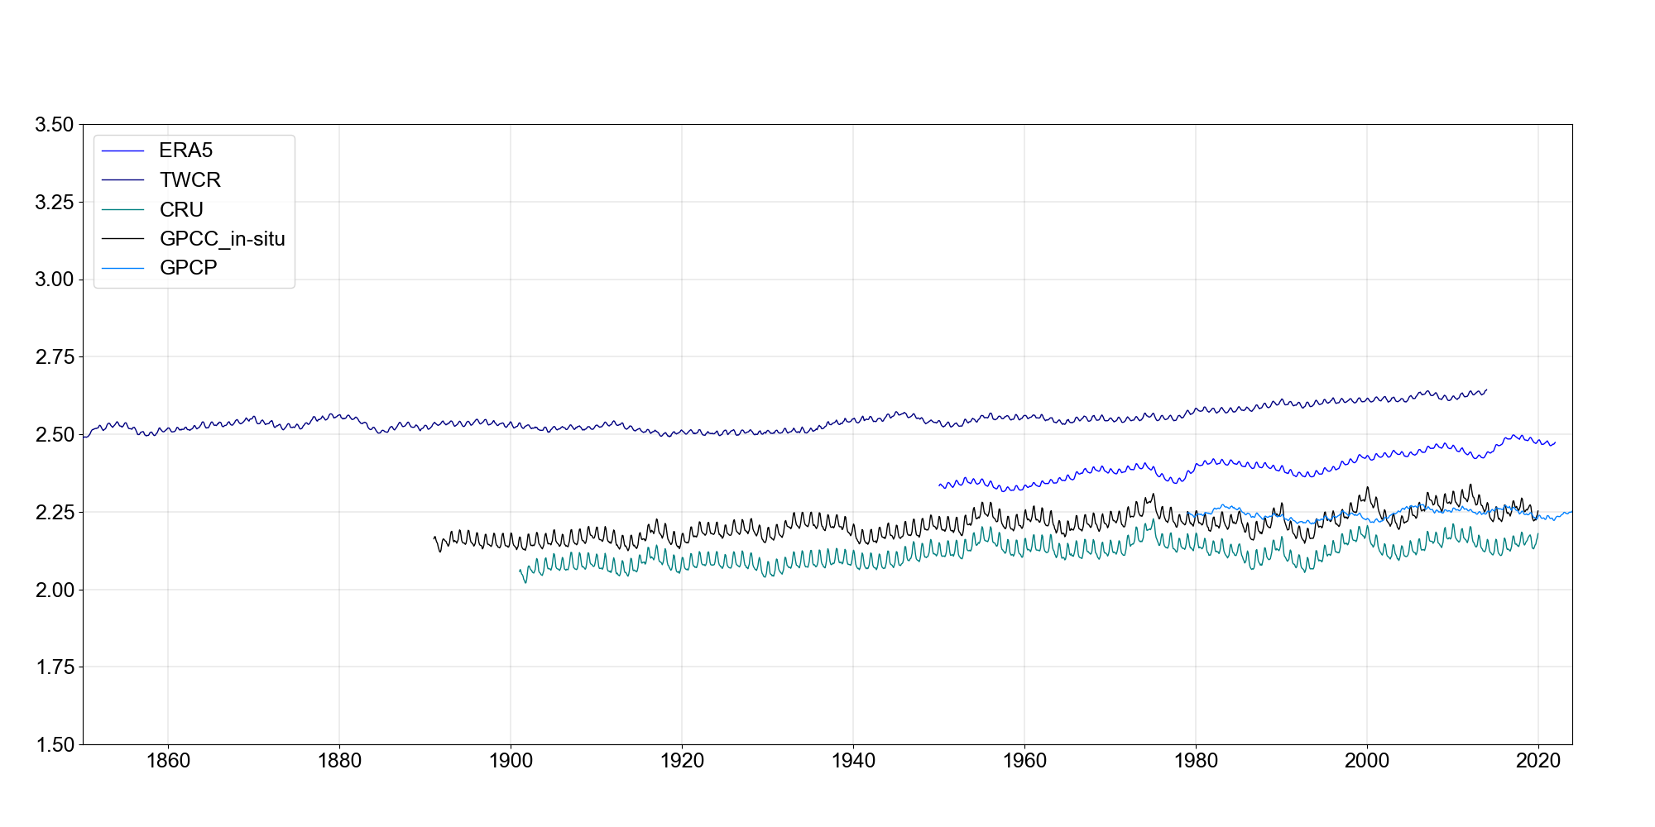
Global mean monthly-mean (mm/day) 13-month smoothing

Slide 5
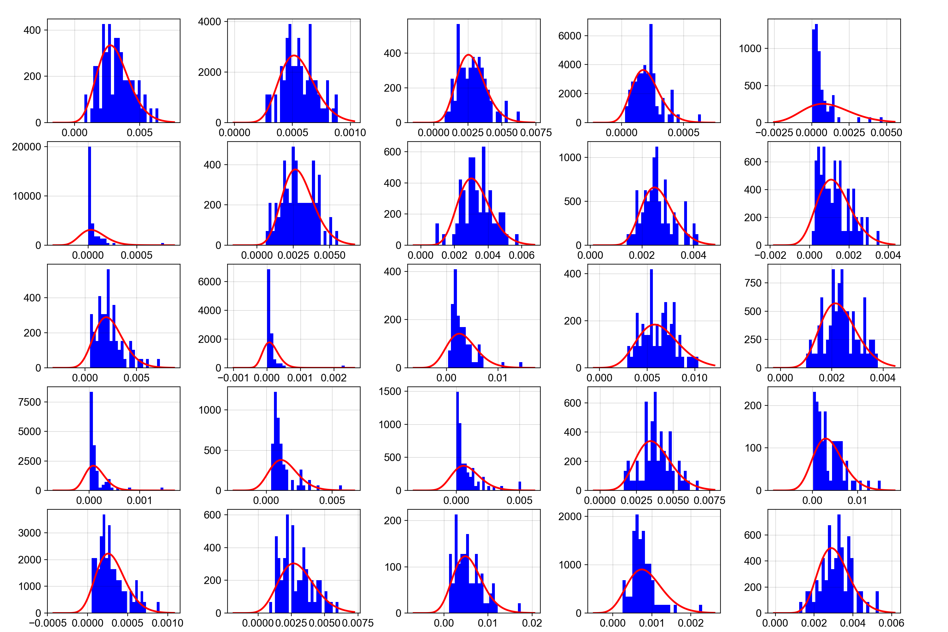
Notes:
Gamma distributions fitted to data from 1 month (March) for 25 randomly-selected grid points in ERA5.

Slide 6
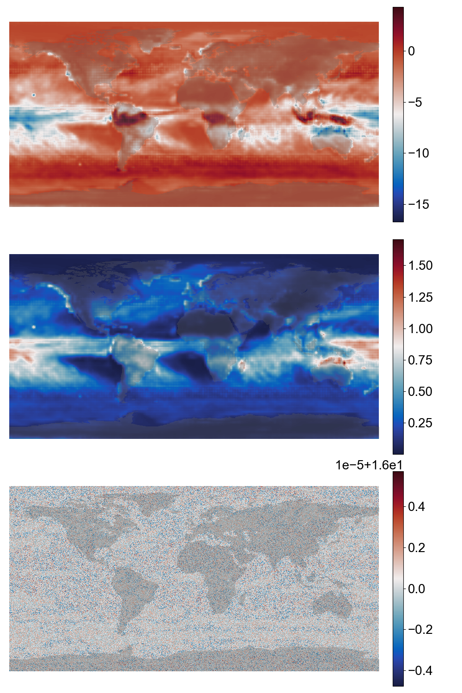
Location
Scale
Shape
(Fit to GPCP, March)
Notes:
Three-parameter gamma fit to the GPCP dataset (March) : Location(top), Scale (middle) and Shape(bottom). Shape constrained to approx. 0, and scale to > ~0.1 by fitting choices. (Some places have precip always 0).

Slide 7
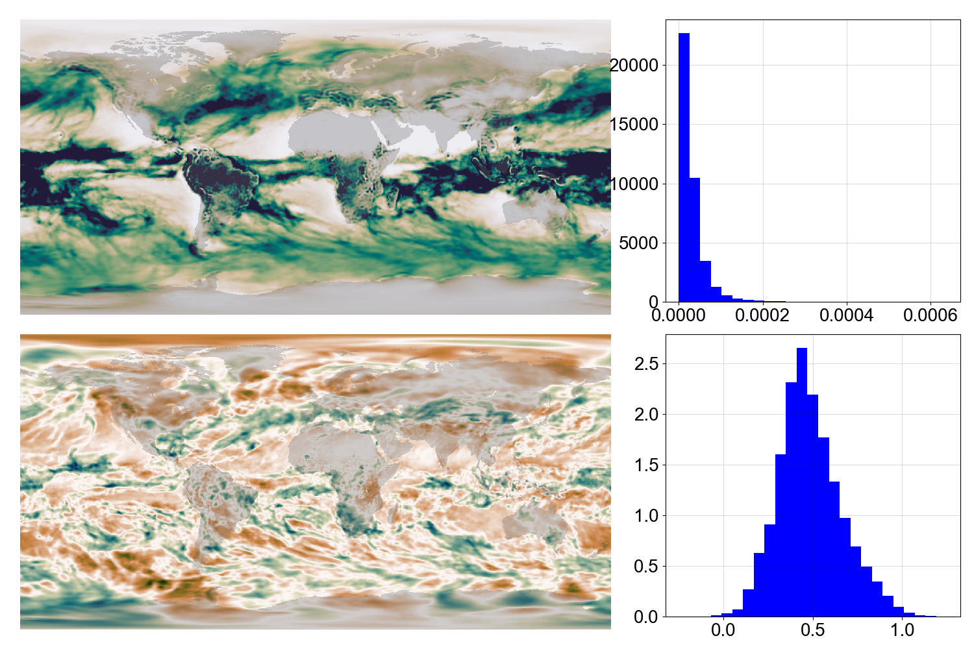
20CRv3
PRATE
1969-03
Notes:
Raw precipitation (top), and quantile-normalised precipitation (bottom). For the same month in 20CR.

Slide 8
1989-03
Notes:
Gridded monthly-mean precipitation from 5 datasets: Two reanalyses, two in-situ observations based, and one blended in-situ and satellite.
Uses the cmocenal ‘balance colour scale (red-blue) but you can’t see any red unless you look really closely at the tropical storm off Madagascar.

Slide 9
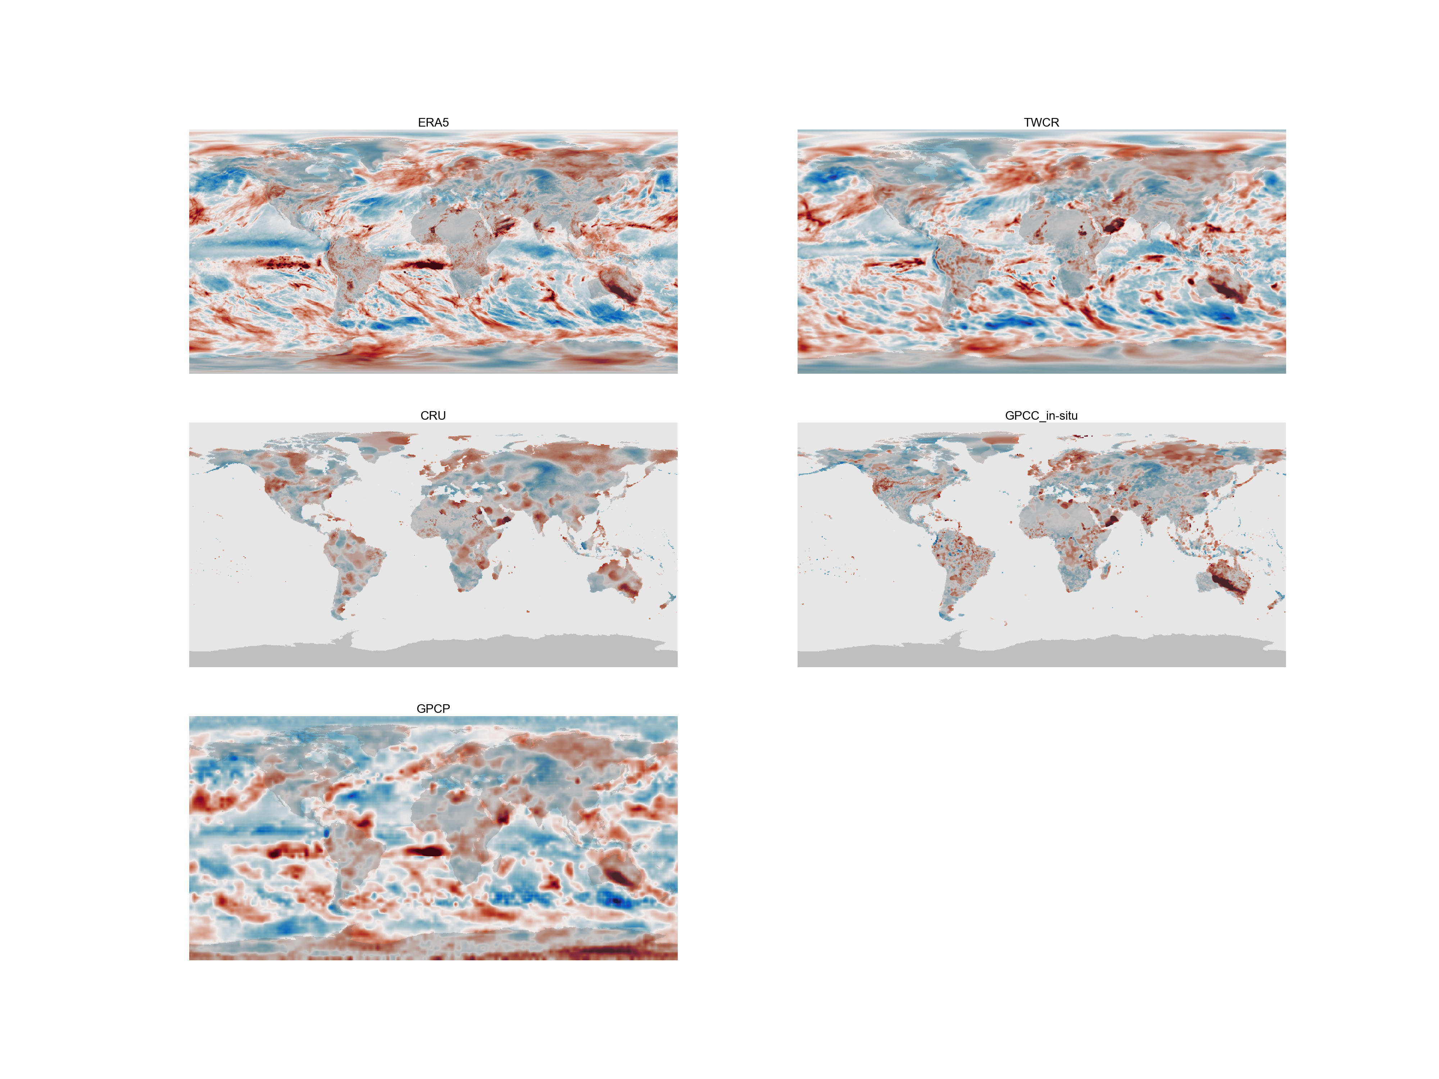
1989-03

Slide 10
Global mean monthly-mean (mm/day) 13-month smoothing

Slide 11
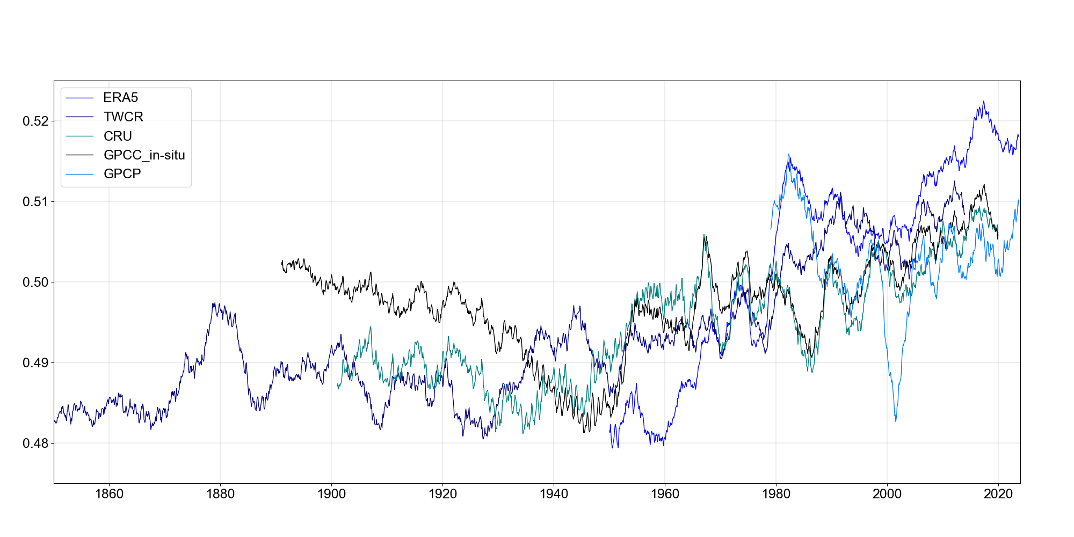
Global mean monthly-mean (mm/day) 39-month smoothing

Slide 12
20CRv3 PRATE
Resolved in latitude & time
Sample in longitude
No smoothing

Slide 13
20CRv3 PRATE
Resolved in latitude & time
Sample in longitude
11x13 convolution

Slide 14
Notes:
ERA5 (top) 20CR (bottom)

Slide 15
Notes:
20CR (bottom) v CRU (top)

Slide 16
Notes:
20CR (bottom) v GPCC (top)

Slide 17
Notes:
20CR (bottom) v GPCC (top)

Slide 18
Global mean monthly-mean (mm/day) 39-month smoothing

Slide 19
Always normalise your data.
Precipitation data is all crap, but we do have a nice clear picture of the major problems.
There is a consistent upward trend in recent precipitation – caused by global warming.
(Should look at some GCM runs).
Best current advice is ‘Use 20CR, but steer clear of sea-ice and the 19th century tropics’.
We should pretend that the period 1920-1950 never happened. 🙂
Best prospect for a reliable dataset is to fix the sea-ice issues and build a reanalysis-like (with ML?). Using pressure and temperature data mostly and precip for verification? Precip observations might be more trouble than they’re worth.
Next: Use an ML tool to model arbitrary relationships between datasets (e.g. convert GPCC<->ERA, or make CRU precip from pressures and temperatures).

Slide 20
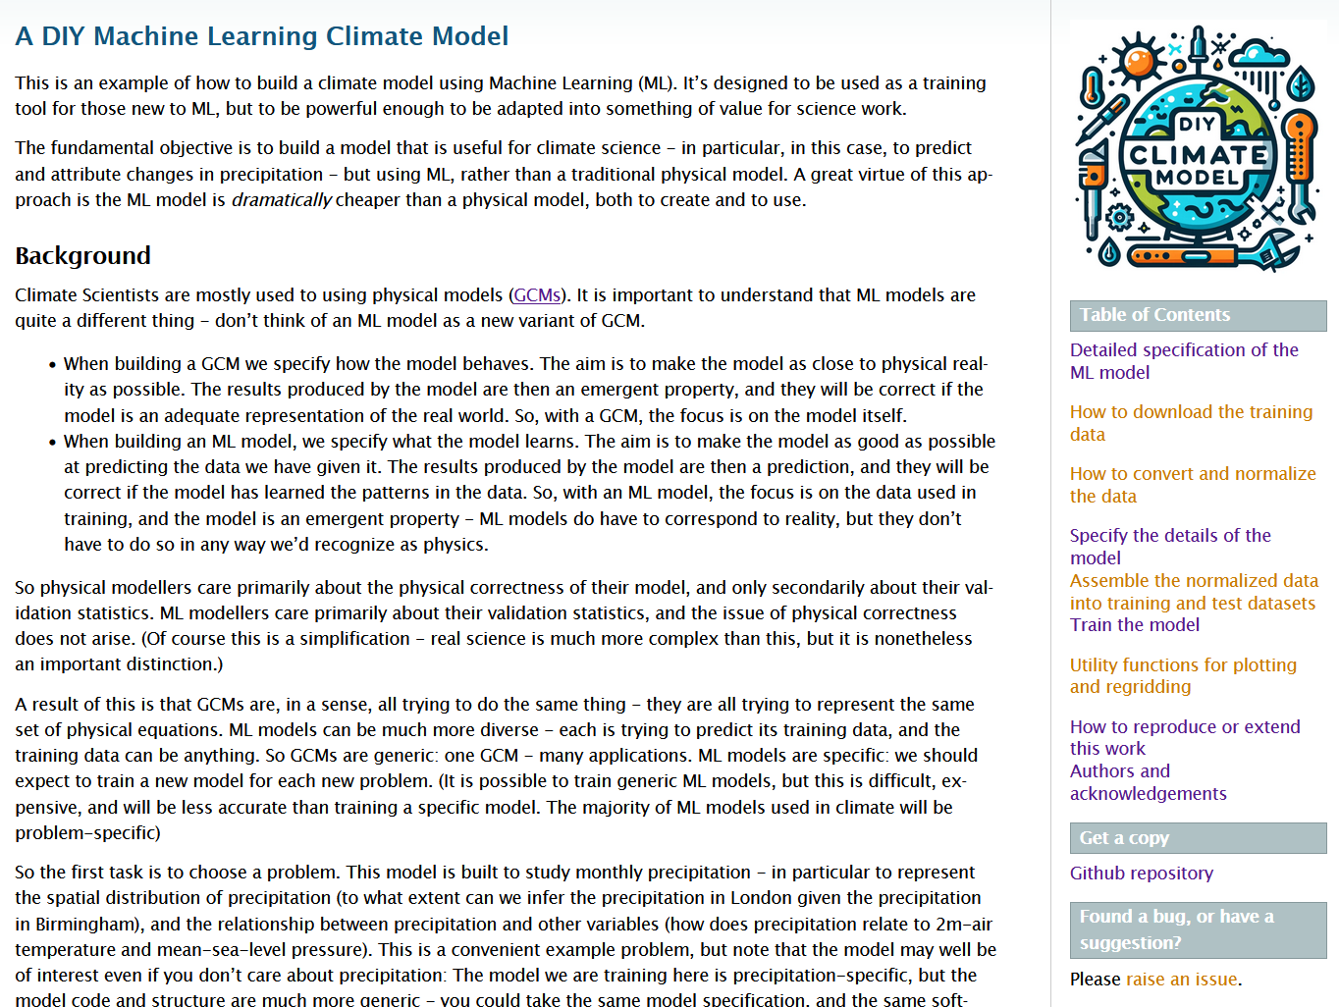
https://brohan.org/DCVAE_Climate

