Slide 1
New integrated Data Rescue Portal – and other Copernicus activities
Marlies van der Schee, Gerard van der Schrier, Martijn Majoor, Kirien Whan,
Peer Hechler, Paul Poli, Maria Antónia Valente, Stefan Brönnimann, Stefan Grab,
Rob Allan, and Peter Thorne .

Slide 2
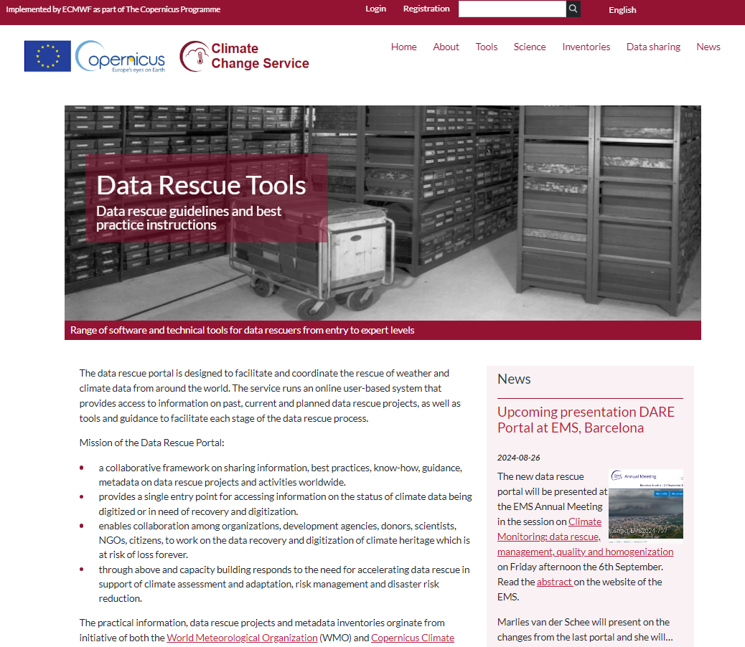
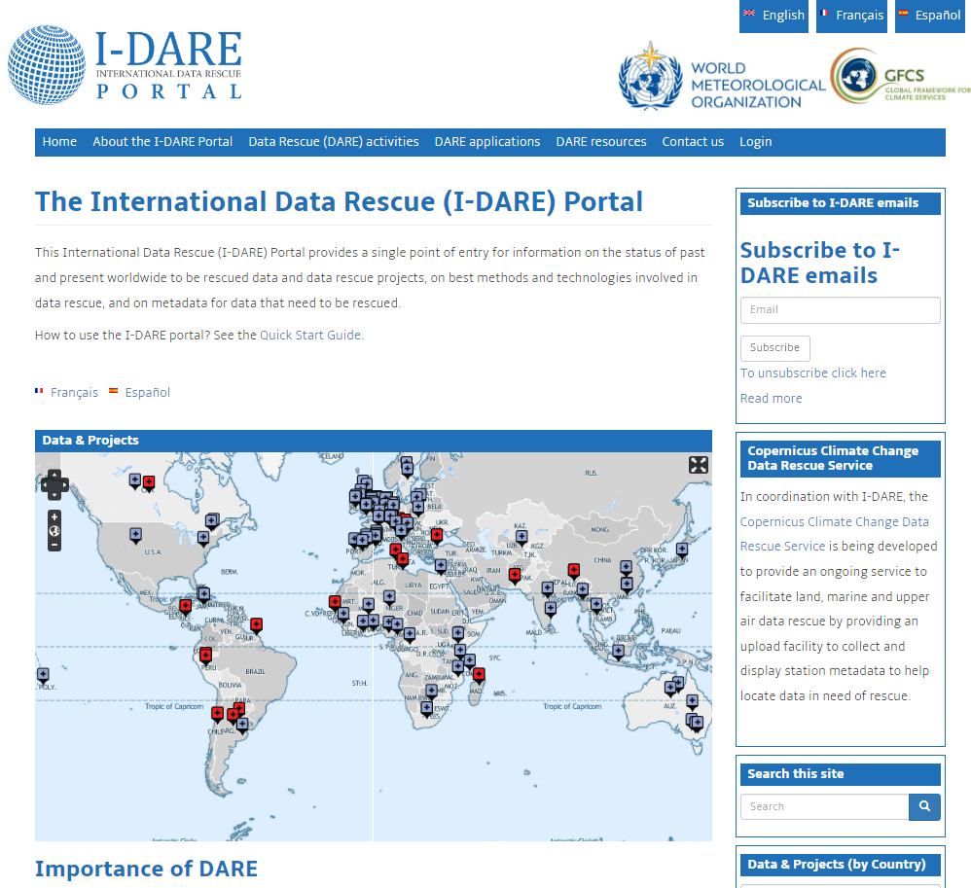
Data Rescue Portal
Homepage DARE portal
Mission :
Share information as guidance
Single entry point on current data rescue projects
Enabling collaboration among organizations, development agencies, donors, scientists NGOs, etc.
Accelerate data rescue in support of climate assessment and adaptation
Old WMO I-DARE portal

Slide 3
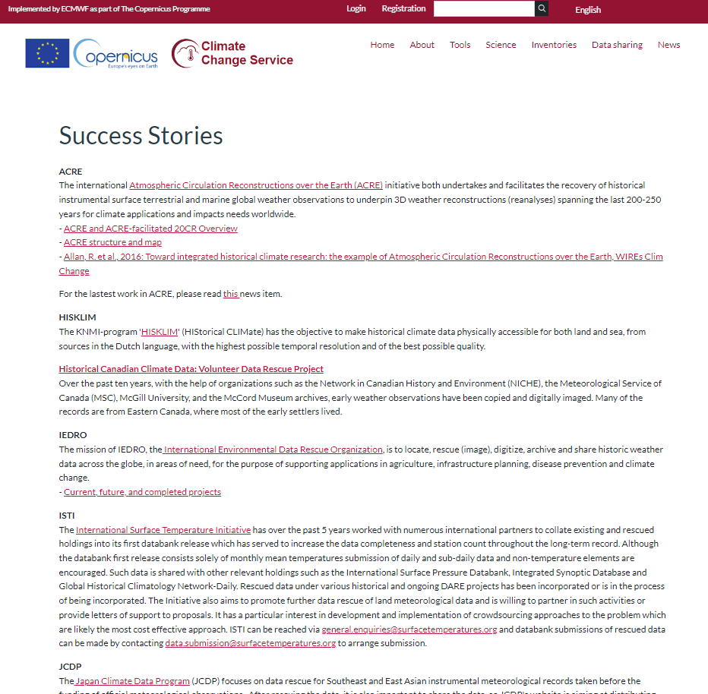
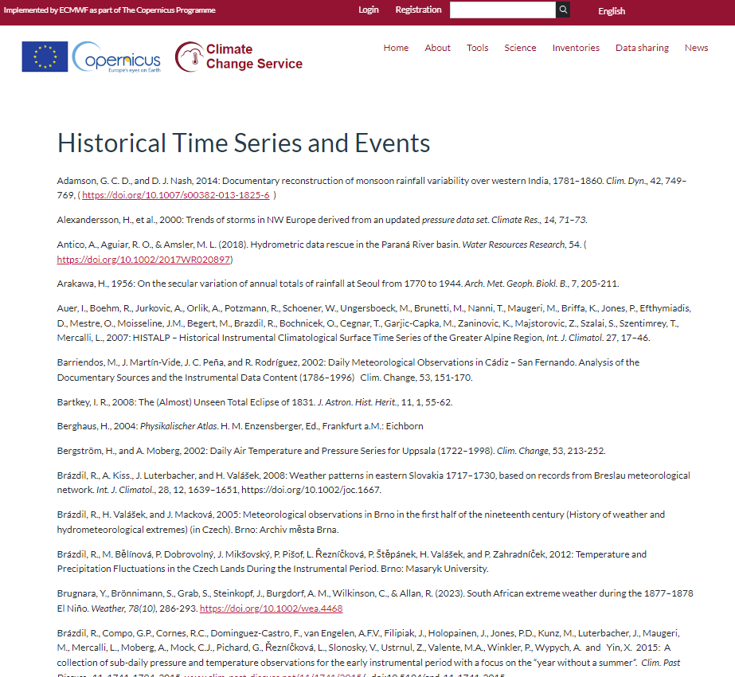
Share information as guidance
References to success stories, including citizen science projects
References to current scientific data rescue projects and advances
Software tools
Links to important guidelines on data rescue, including the update DARE guidelines
News items on DARE events or project highlights
Updated WMO guideline on DARE (2024 edition)

Slide 4
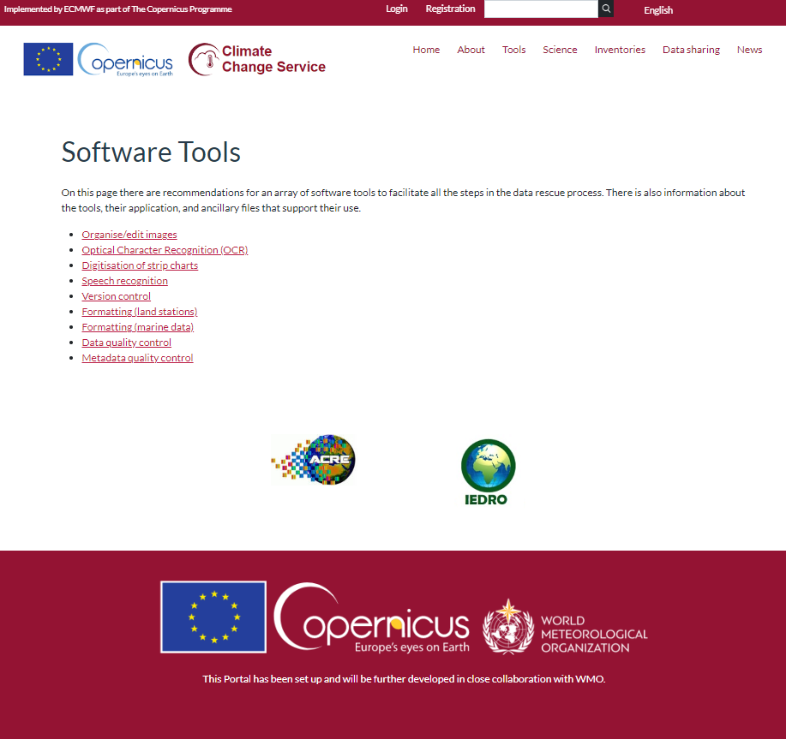
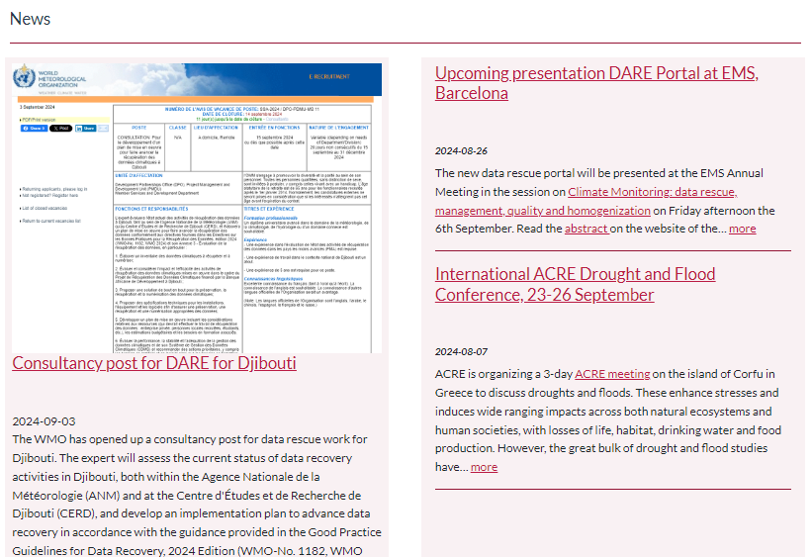
Share information as guidance
References to success stories, including citizen science projects
References to current scientific data rescue projects and advances
Software tools
Links to important guidelines on data rescue, including the update DARE guidelines
News items on DARE events or project highlights
News items at DARE portal
Updated WMO guideline on DARE (2024 edition)

Slide 5
Share information as guidance
References to success stories, including citizen science projects
References to current scientific data rescue projects and advances
Software tools
Links to important guidelines on data rescue, including the update DARE guidelines
News items on DARE events or project highlights
News items at DARE portal
Updated WMO guideline on DARE (2024 edition)

Slide 6
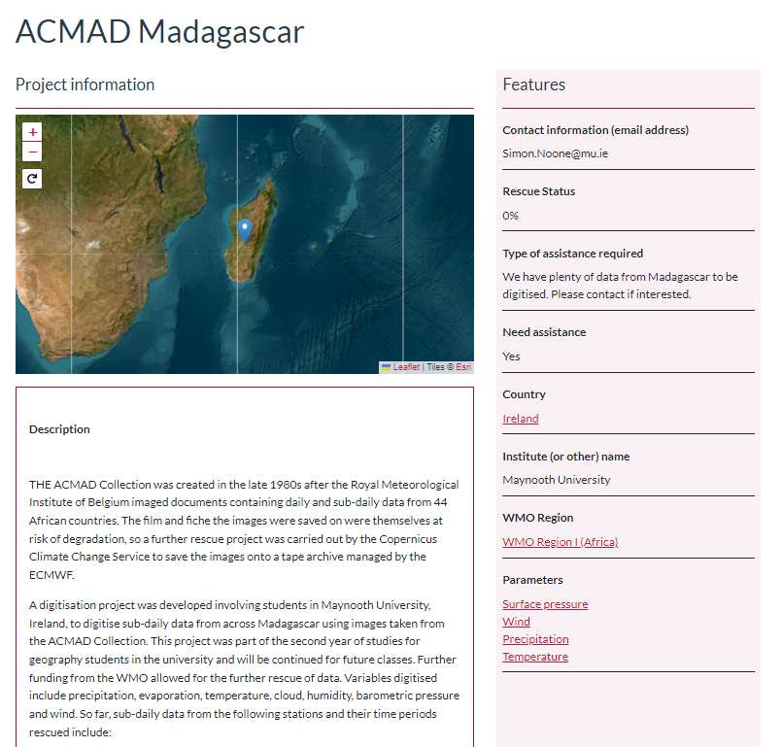
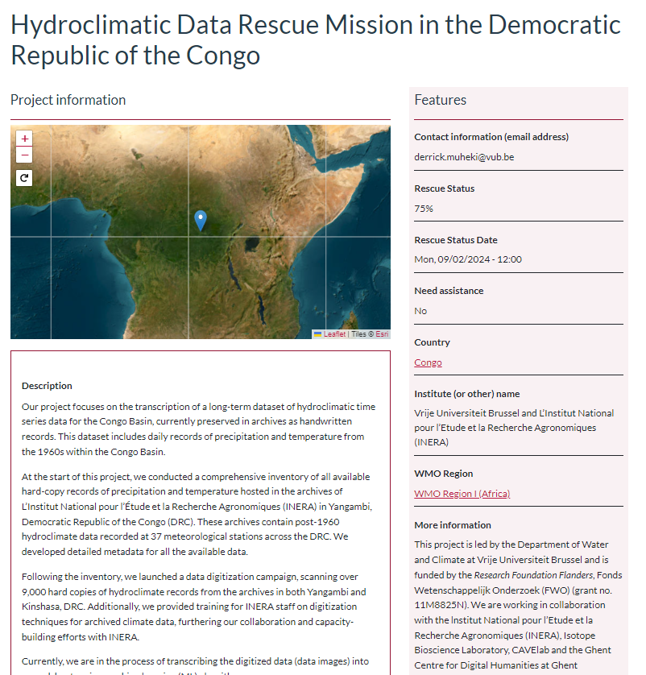
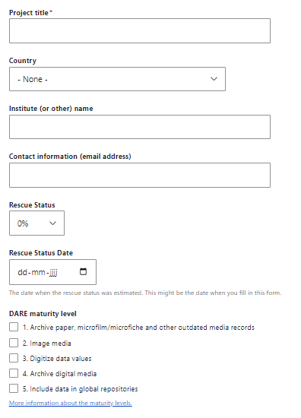
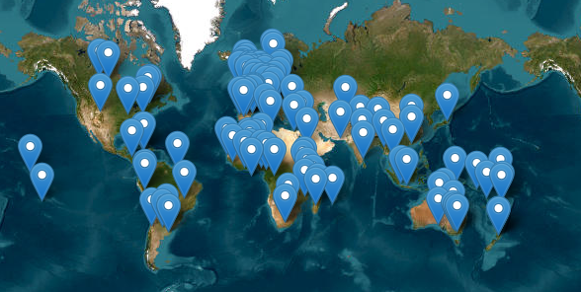
DARE projects
Share your project, ensures rescuing data only once!
Let the world know on your project
Make sure data is not recued twice
Ask for assistance
Reference for your project and find possible donors
139 projects are available in the portal

Slide 7
Conclusion
Visit the website at https://datarescue.climate.copernicus.eu/en/
Include your data rescue project to the portal
Stay tuned on this important topic by following the News item

Slide 8
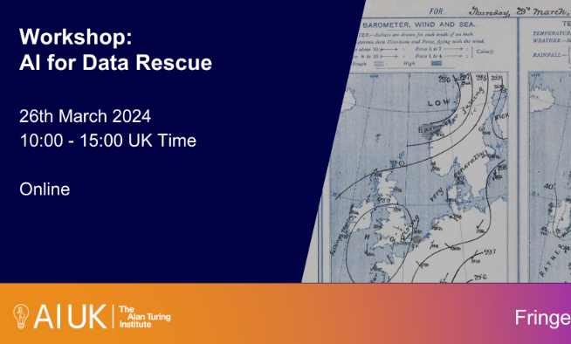
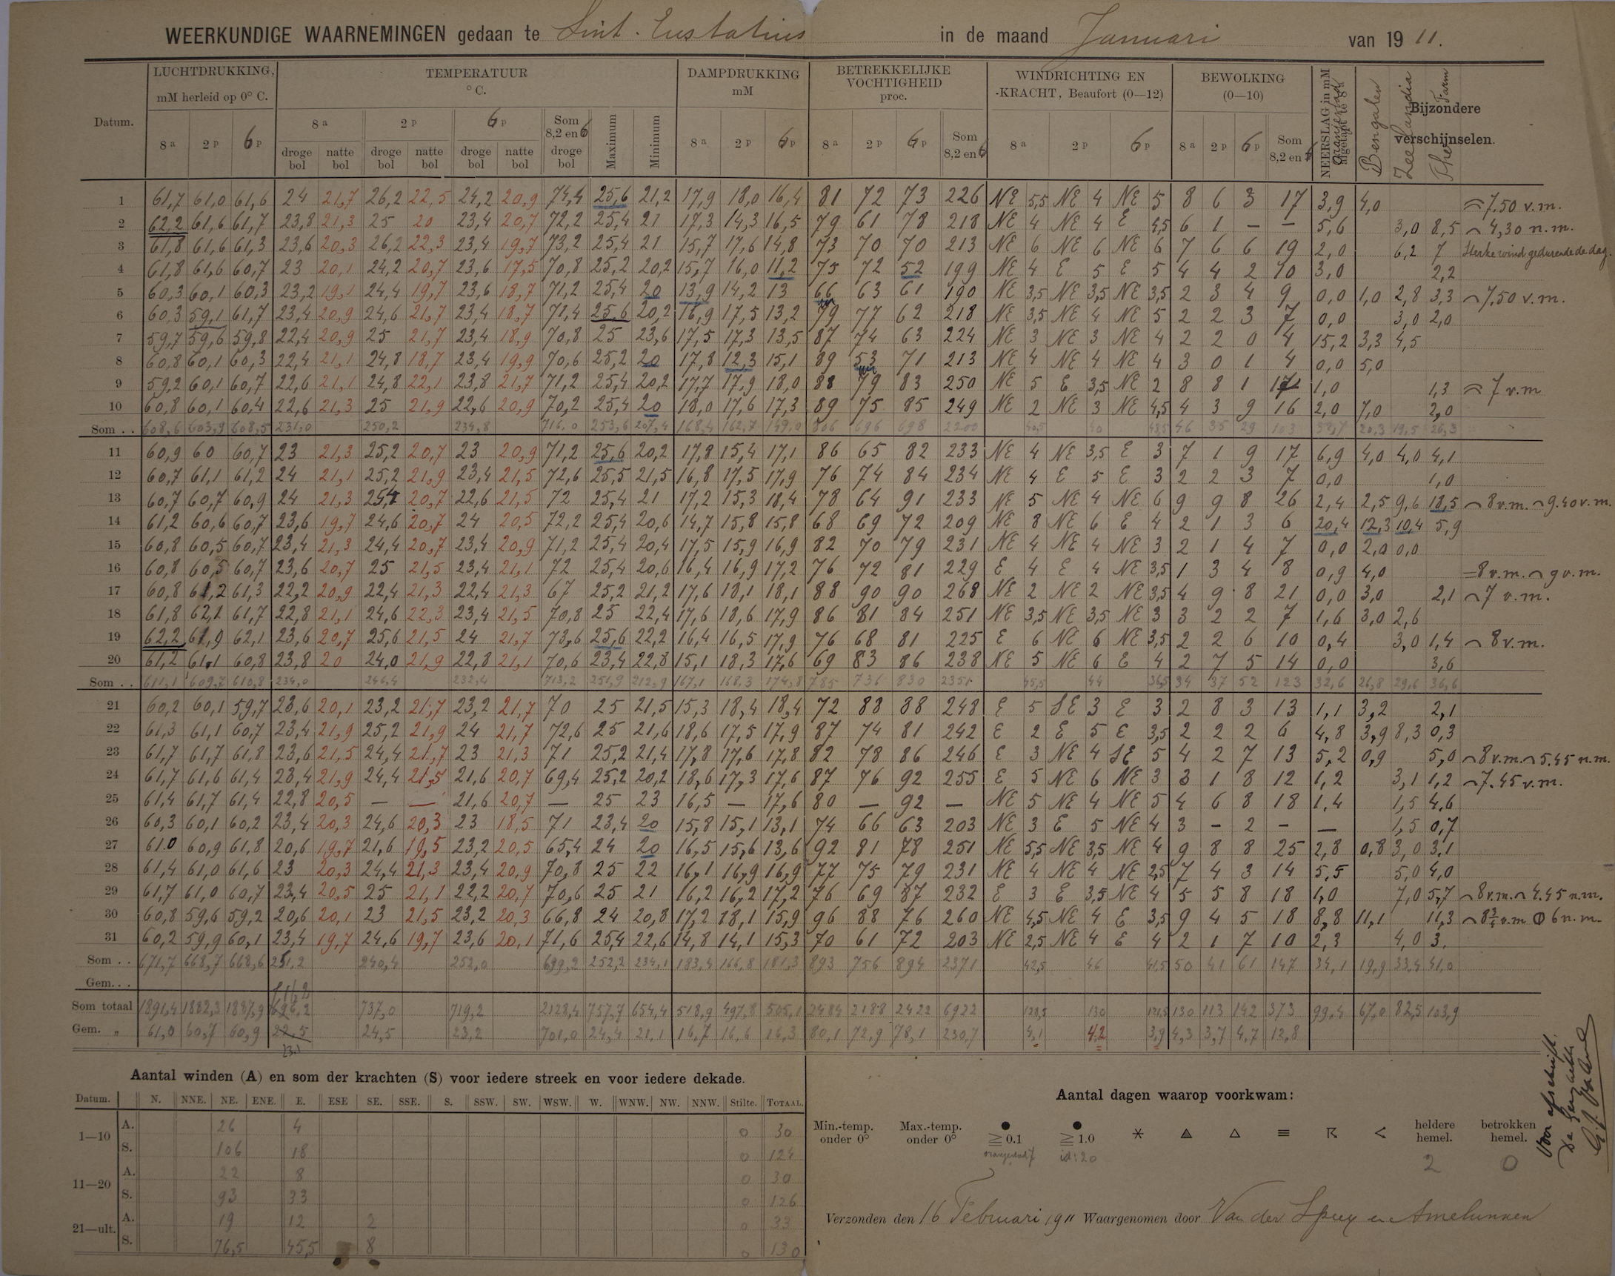
Monitoring AI/ML and datarescue
Workshop AI for Data Rescue (March 2024):
Commercial AI/ML tools were presented which made too many mistakes to be useful
Source code are not available open source to tailor to DARE needs
KNMI 2-week hackathon:
Team of Scientist and Developers people working part-time on the problem to retrieve data from meteorological observation sheets from (former) Dutch Caribbean islands by using AI/ML

Slide 9
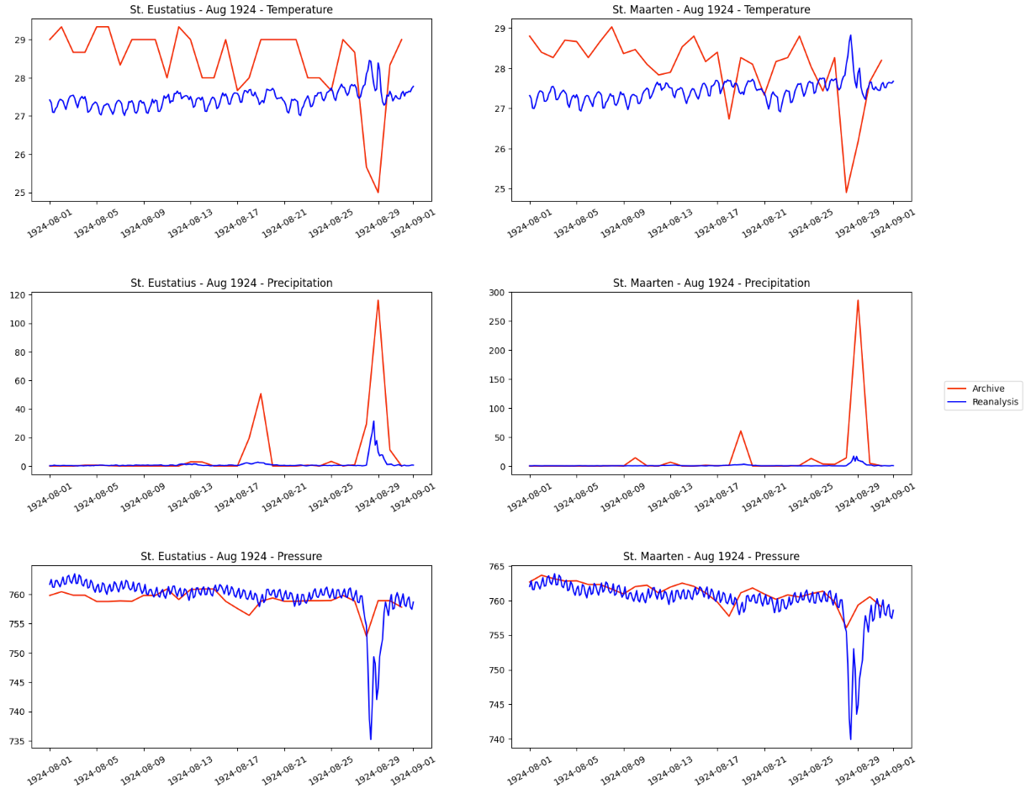
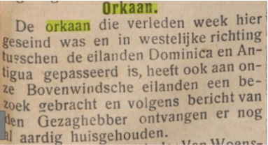
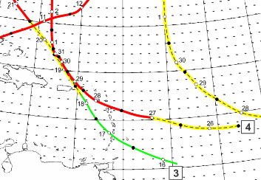
DARE Motivation
Demonstrating value
Identified hurricanes: August 1924
Comparison 20th century reanalysis and data from archive

Slide 10
AI/ML Workflow – DAWSONIA (SMHI)
SMHI’s Dawsonia
Python package DAWSONIA, developed by SMHI for automated workflow – open source and customizable

Slide 11
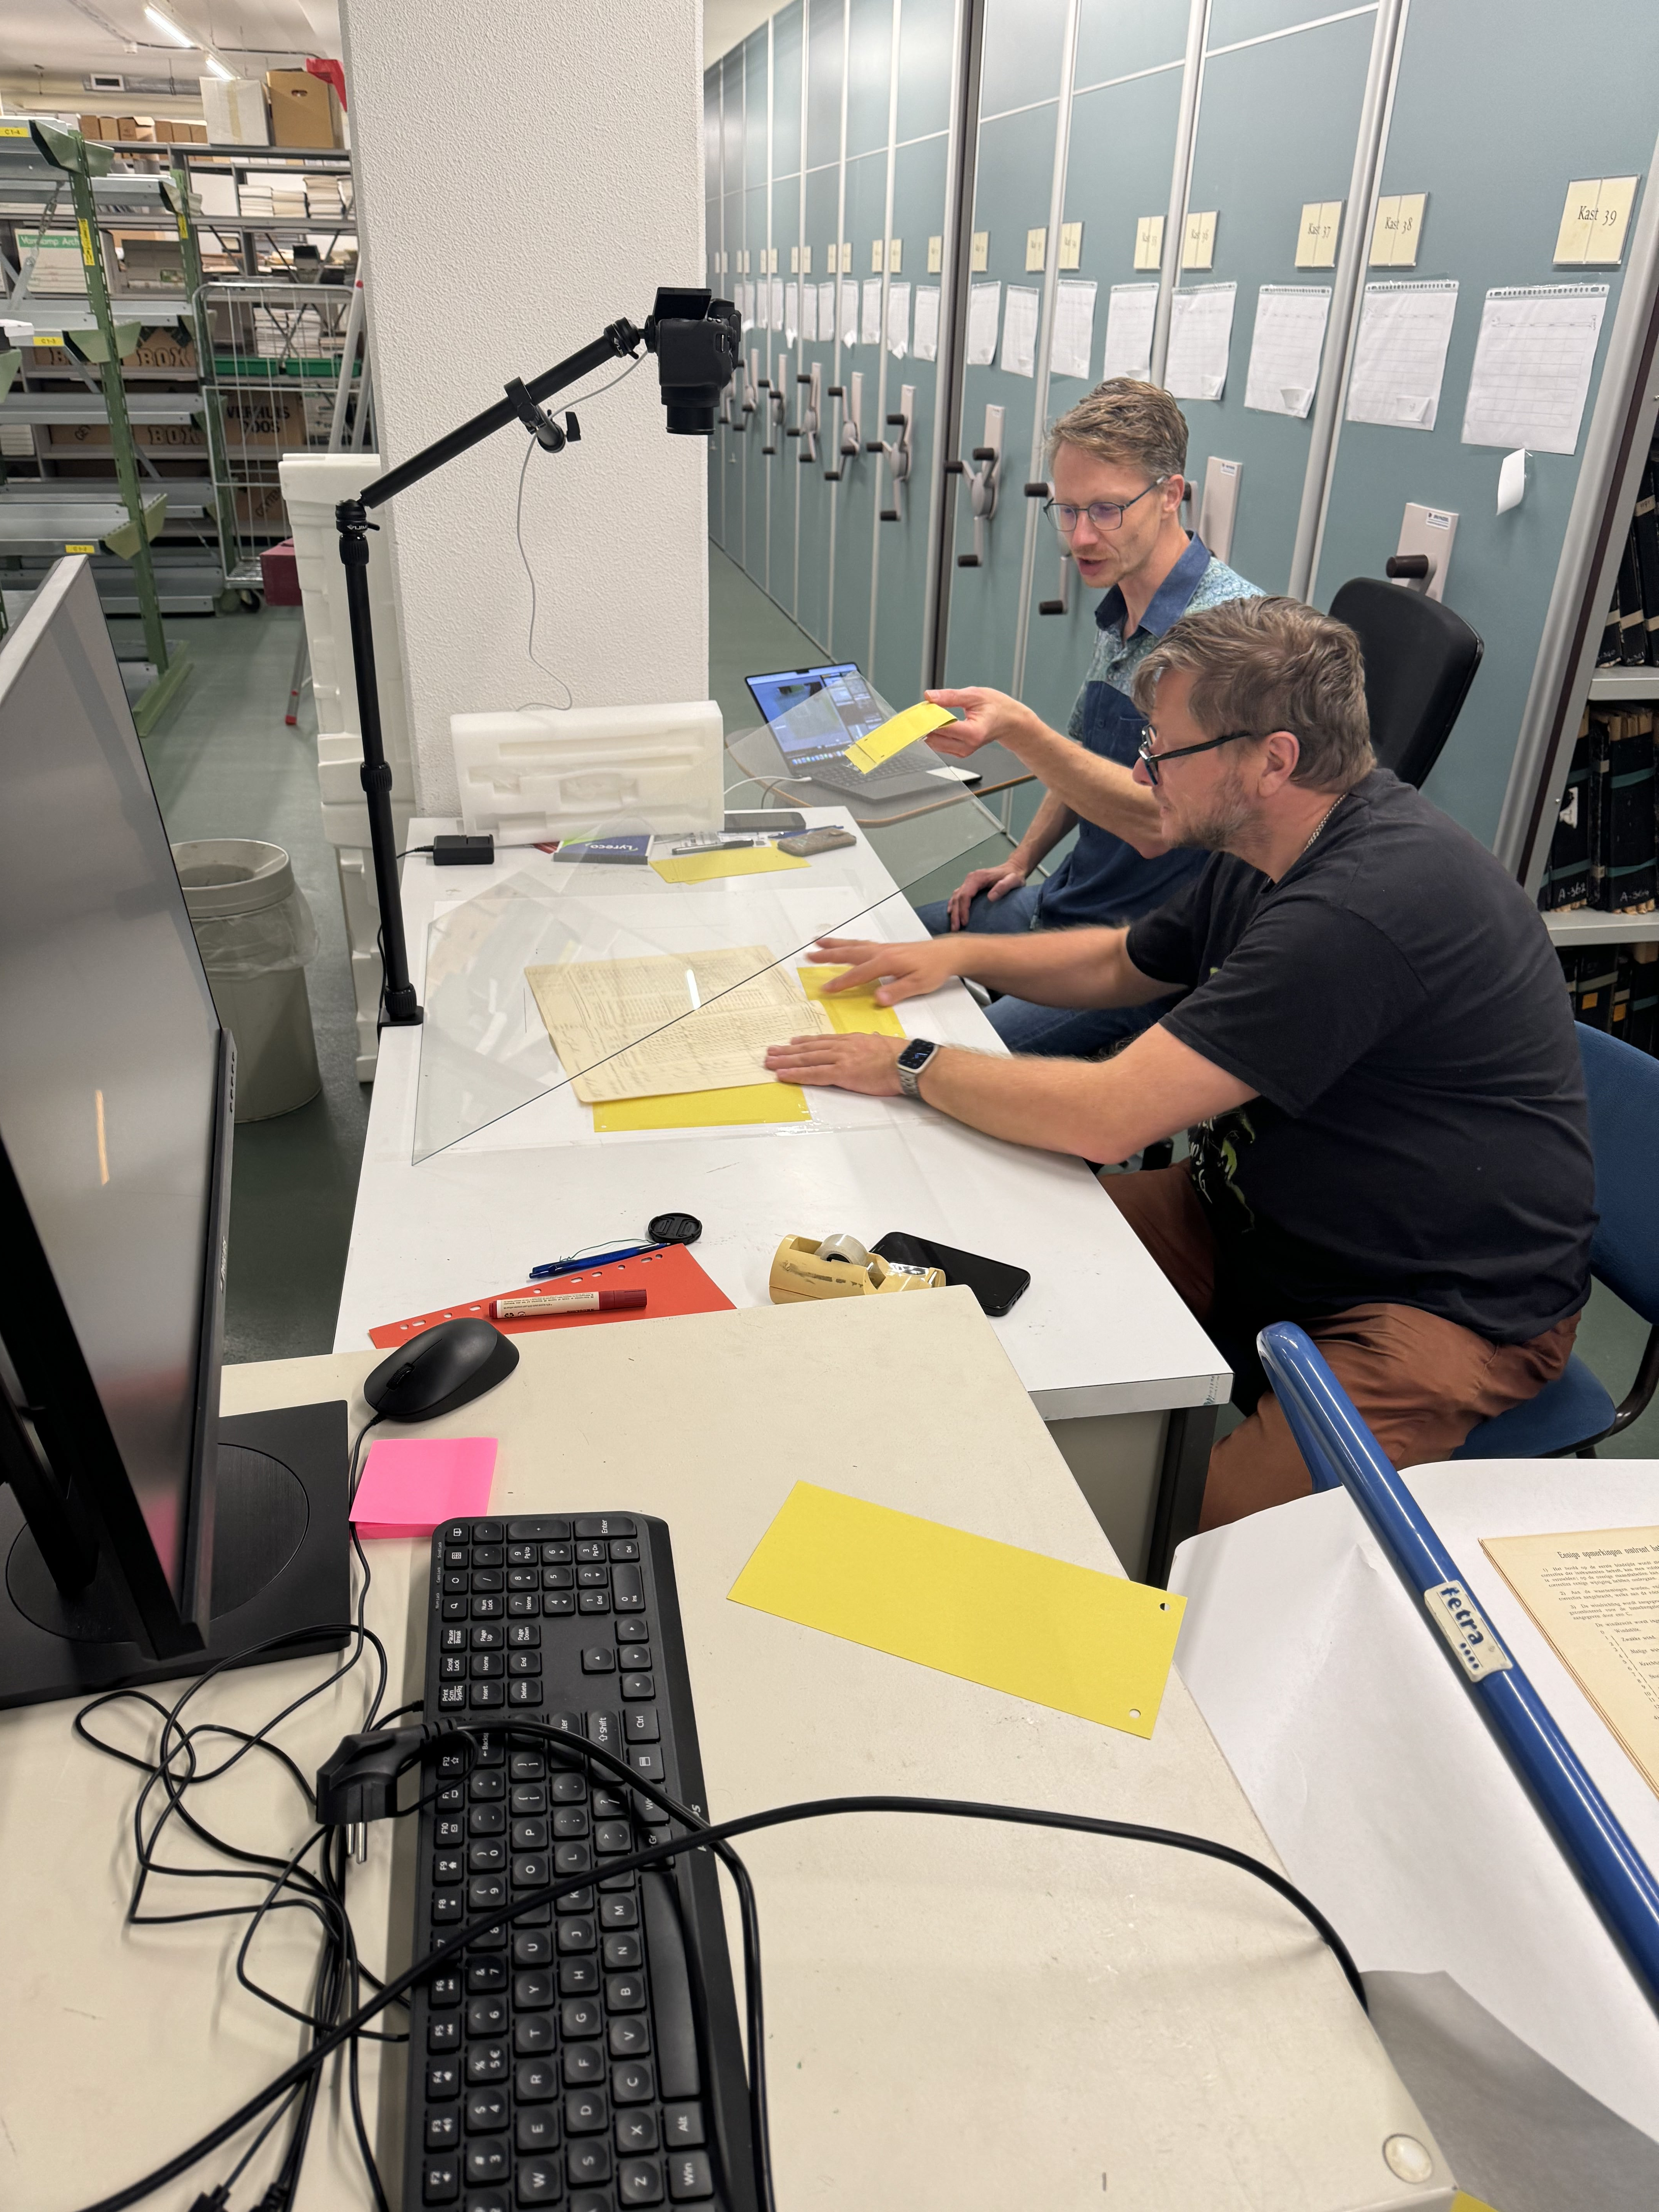
RDWD Innovation Weeks
Camera set-up according to WMO data rescue best practices
Imaged 2887 sheets from observations from St. Eustatius, St. Maarten, Bonaire, Curacao
Imaging set-up

Slide 12
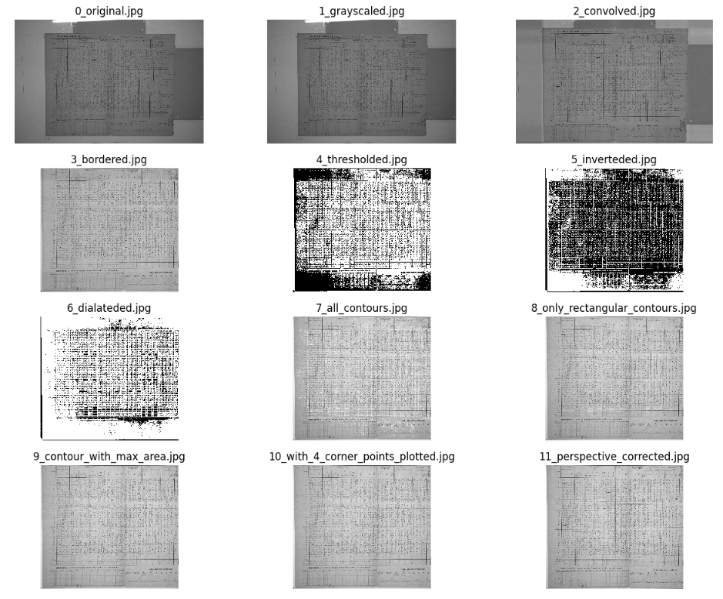
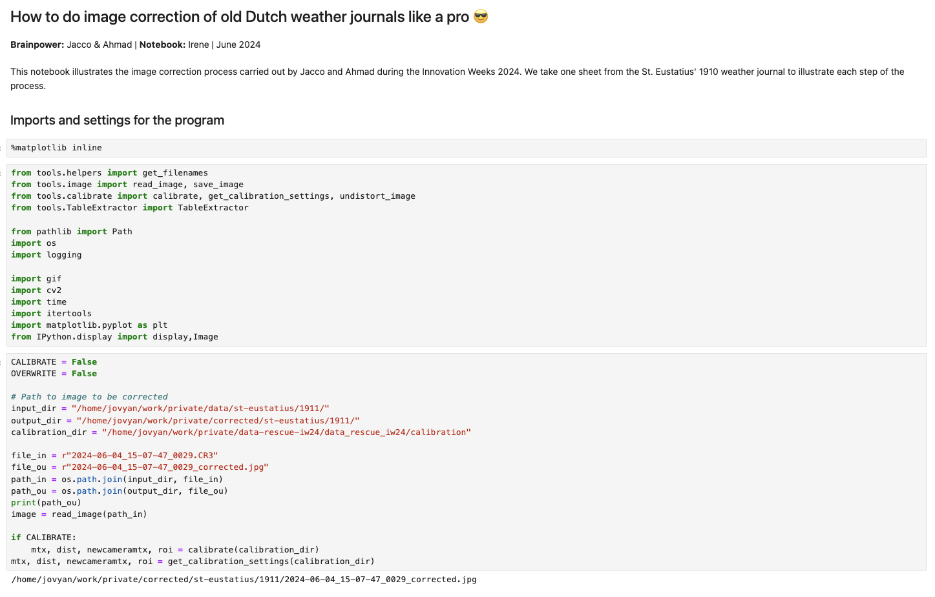
Image preprocessing
Semi-automated preprocessing:
Image improvement with contrast etc.
Illustrative notebooks in public VRE

Slide 13
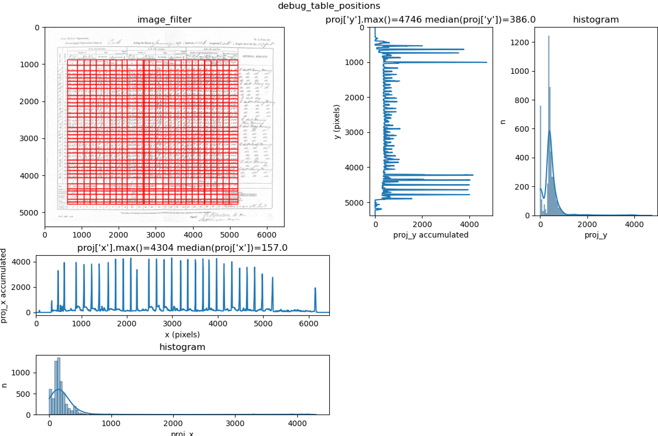
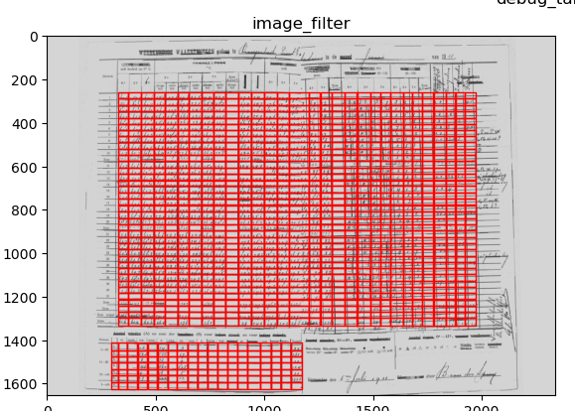
Table recognition
Problems:
Table thickness is not constant or absent
Image may have curves from a fold in the page or at the sides
Solution:
Manually selecting table outline
Manually include number of rows and columns
Overlay grid

Slide 14
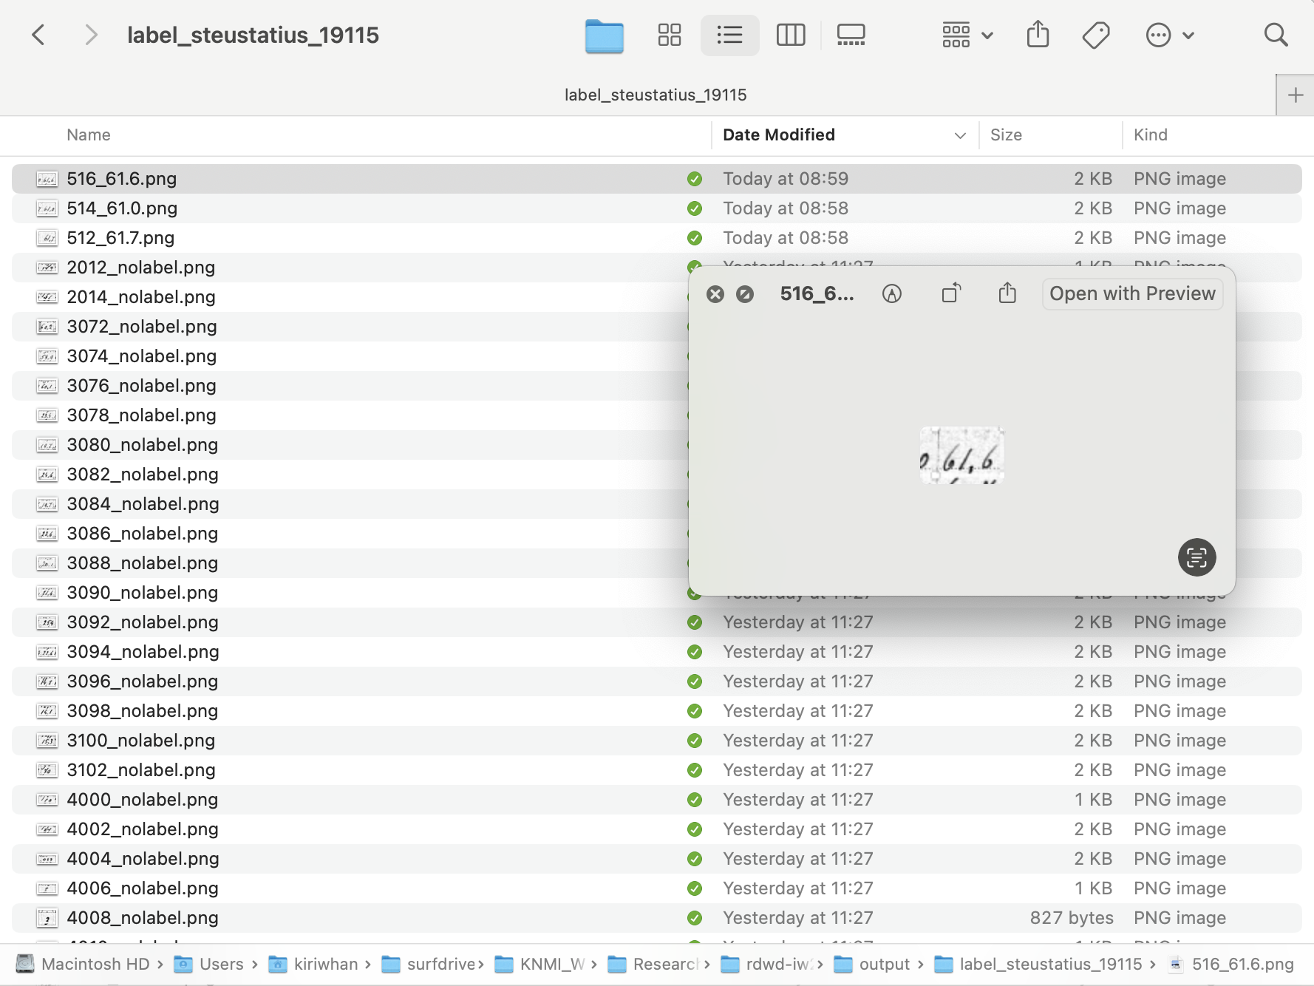
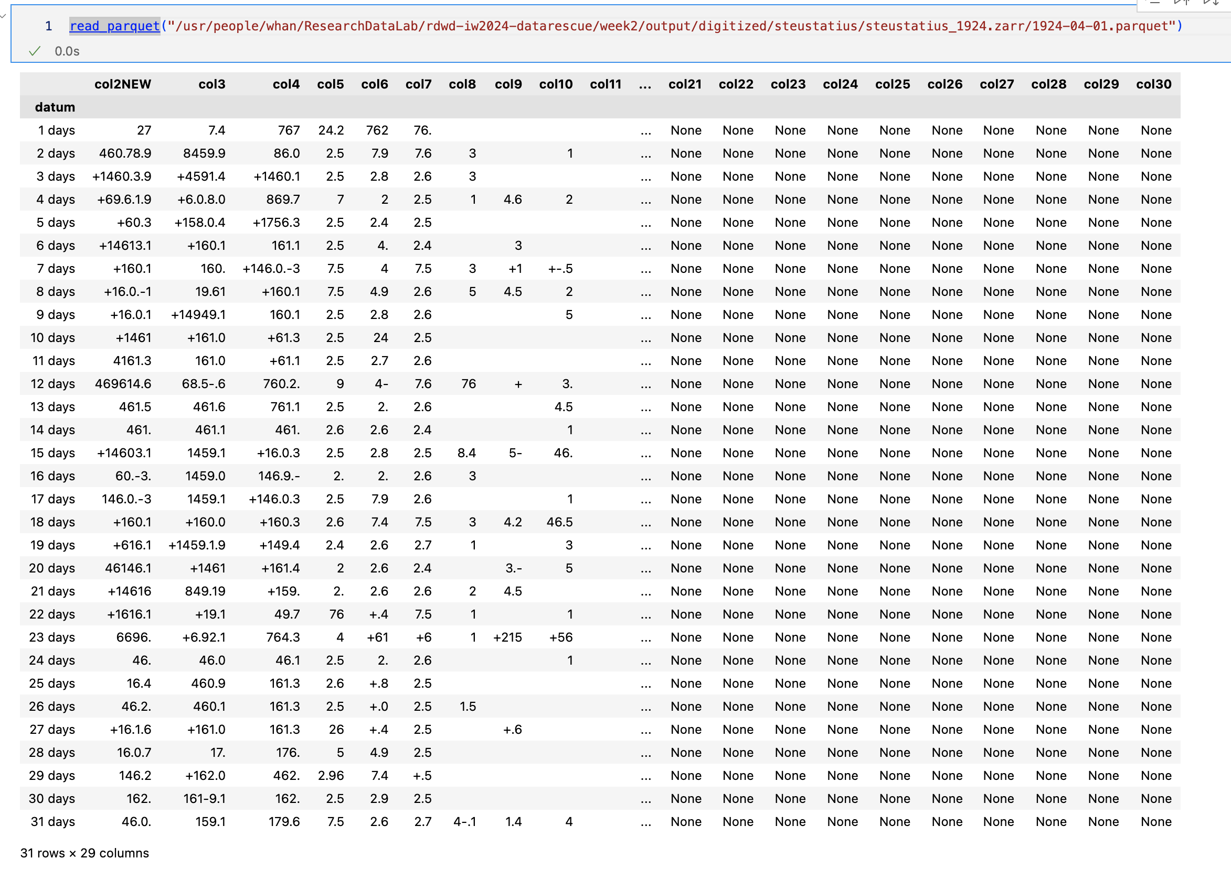
AI/ML workflow – DAWSONIA (SMHI)
Original image
Pre-processing and table identification
Labelling
Fine-tuning
Predictions
Better predictions
Tailored for handwritten data only

Slide 15
DAWSONIA - SMHI

Slide 16
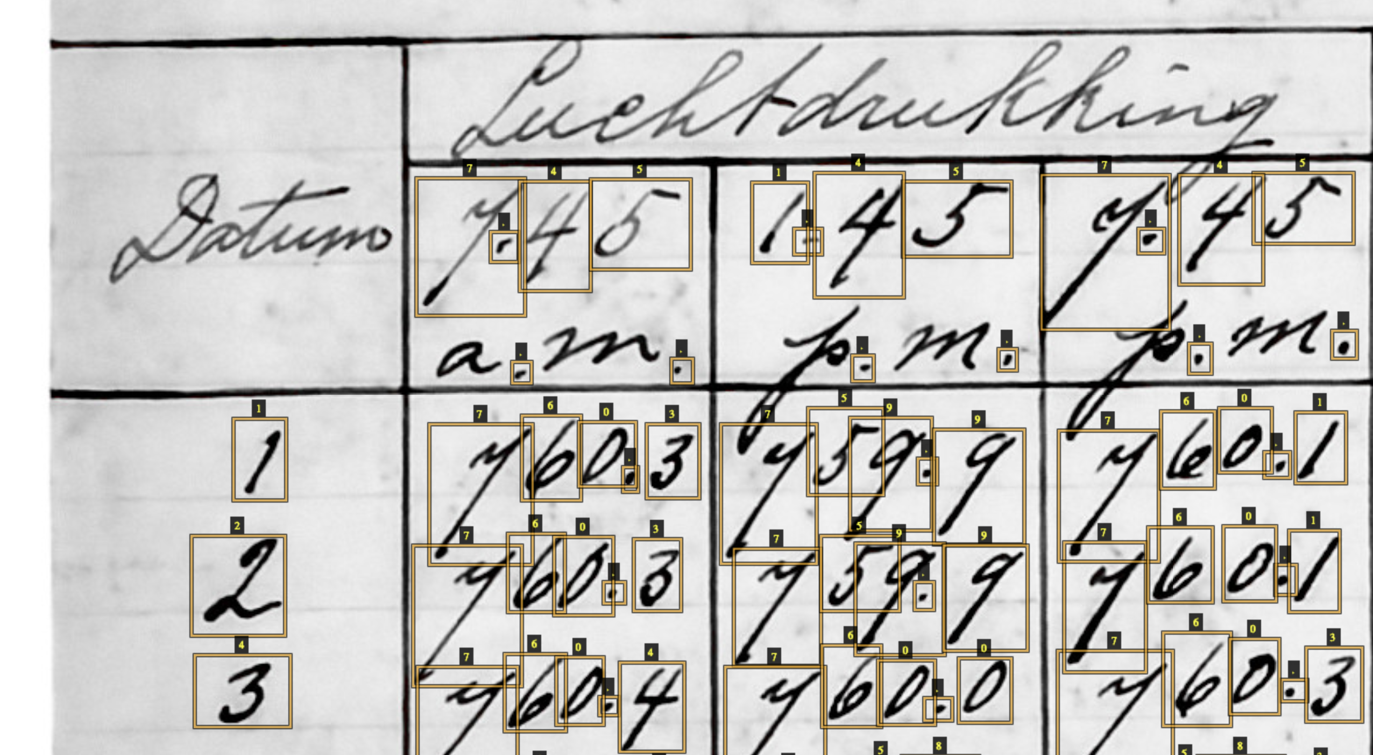
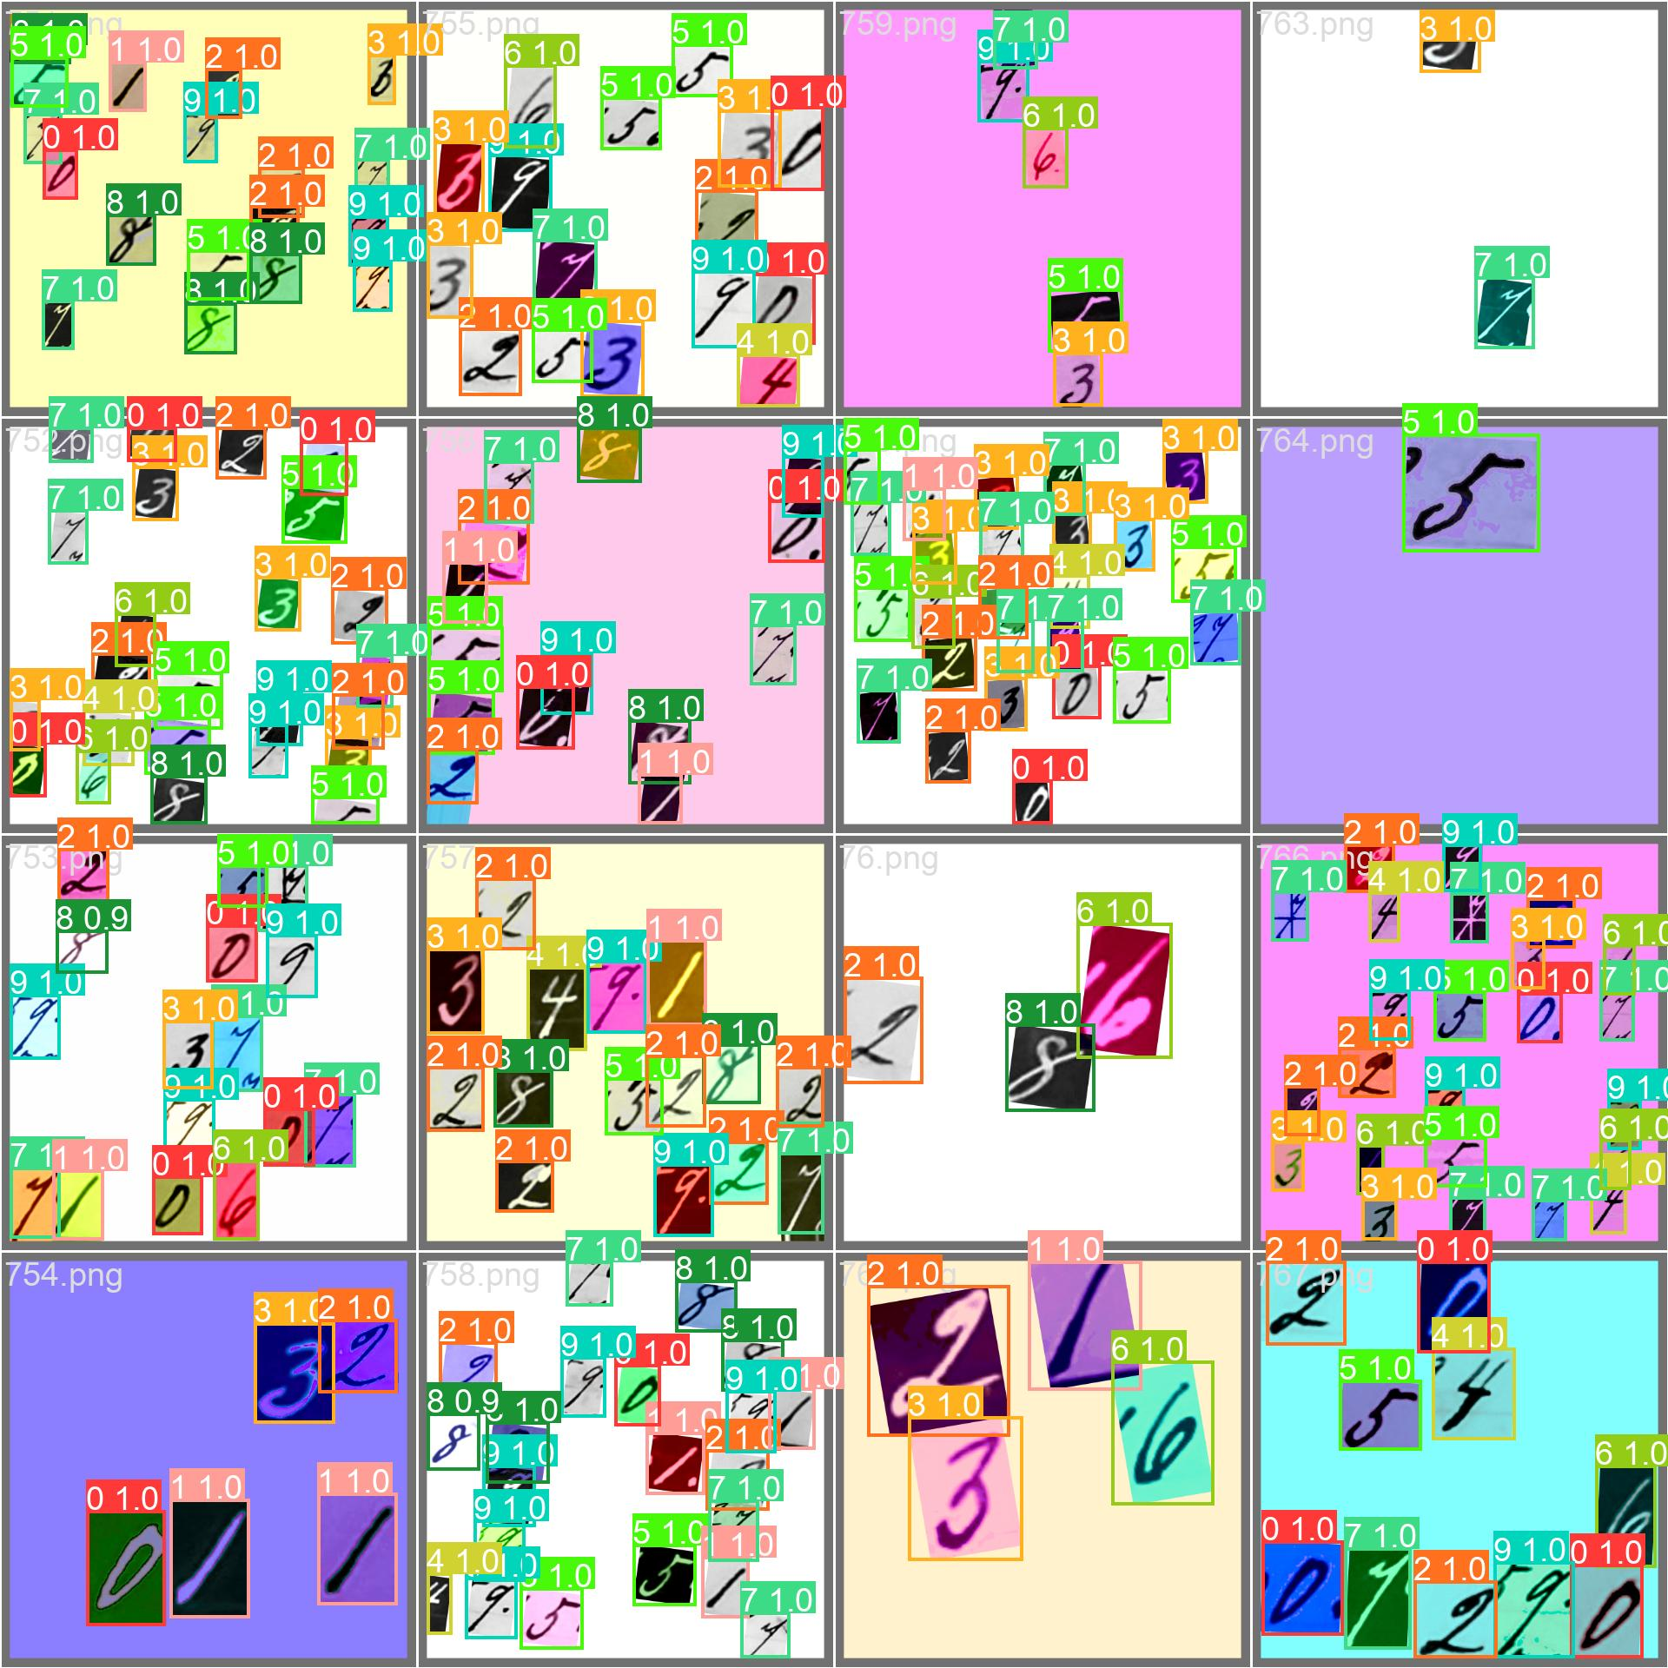
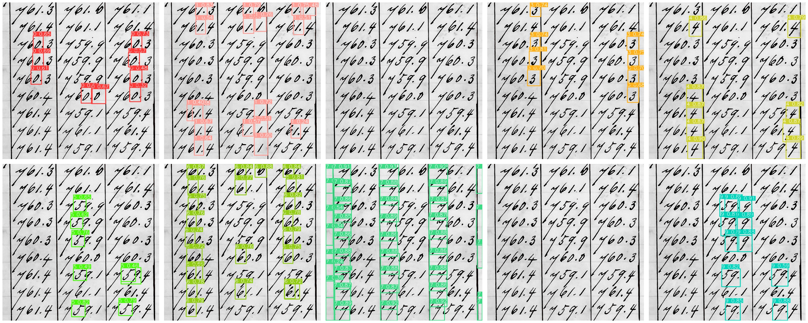
Digitizing individual characters
Quick test for finding digits with object recognition (YOLOv8)
Trained on images created
from the labels
Prediction results per digit

Slide 17
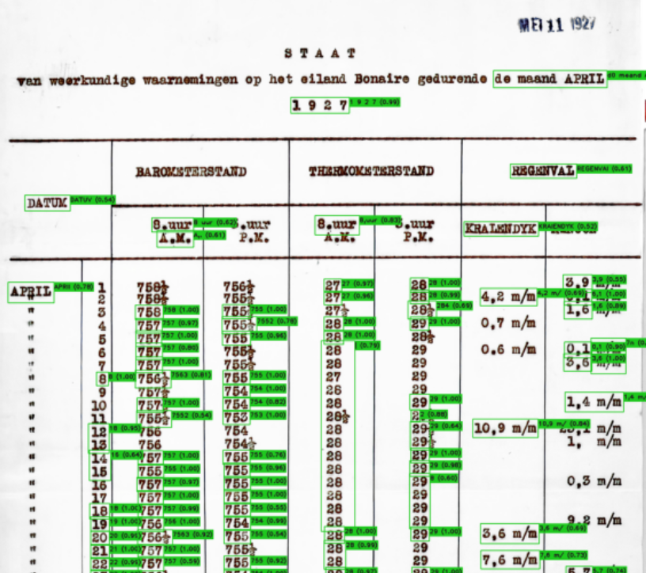
Digitizing individual characters
Quick test for finding typed digits with easyOCR

Slide 18
Challenges AI/ML
Need for high accuracy in meteorological data
Table identification:
Problem in wide, faint and dense tables
Solution in an approach with human input such as nr. of columns
Recognition of characters:
Training model helps for the recognition
Steep learning curve for users
Promising results, but needs more work

