Slide 1



Adjusting Standardized Precipitation Index to reconstruct 0.5° x 0.5° drought data from documentary records in the Chinese dynasties since the mid-14th century
Chang Chih-Hsuan¹, Elaine Kuanhui Lin¹, Yu-Shiang Lin¹ and Wan-Ling Tseng²
¹ Graduate institute of sustainability management and environmental education, National Taiwan Normal University, Taipei, Taiwan
² International degree program in climate change and sustainable development, National Taiwan University, Taipei, Taiwan

Slide 2


Introduction: Drought
One of the most devastating natural disasters
  serious threat to food and ecological security
  one of the main factors limiting the sustainable development of socio-economic systems
Climate change is expected to raise the frequency and severity of droughts in most parts of the world.
Why do we choose China?
  droughts are both frequent and highly impactful
  more comprehensive and long-standing historical records
2

Slide 3
Introduction: Research Objectives
Research gap of previous study
  Modern data (e.g. CRU): observational, precipitation data, only starting from 20th century
  → too short to capture long term trend of drought and variability at
  lower frequency such as multidecadal or multi-centennial scales
  Paleo data (e.g. REACHES): documentary, descriptive about rain and drought, mostly starting from the last millennium
  → qualitative or semi-quantitative, lack of scientific legency
Using SPI to connect two data sets
  To produce long-term drought data → expand the geographic coverage and temporal length of existing historical climate databases
3

Slide 4
Database
Climatic Research Unit gridded Time Series, CRU
Reconstructed East Asian Climate Historical Encoded Series, REACHES
Databases | Data Source | Spatial Resolution | Data Type | Time Period
CRU (Harris et al., 2020) | Monthly Precipitation Data | 0.5°*0.5° | Precipitation | 1901-2023
REACHES (Wang et al., 2018) | Humidity Data | 0.5°*0.5° | Index Data (2 ~ -2) | 1368-1911
4

Slide 5
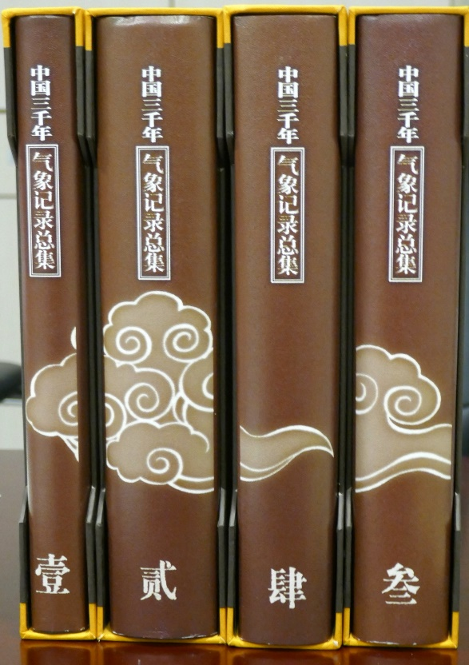
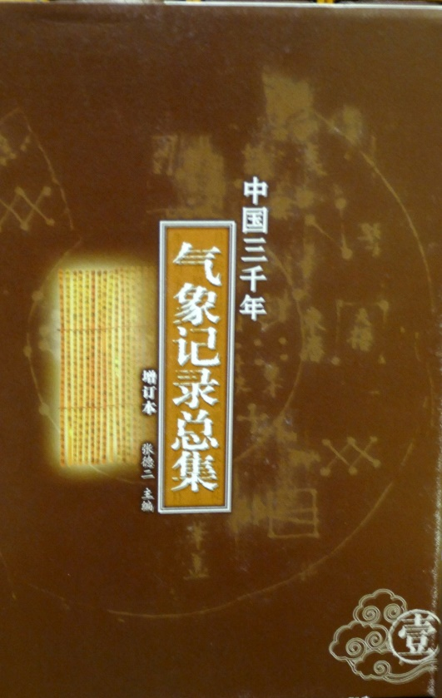
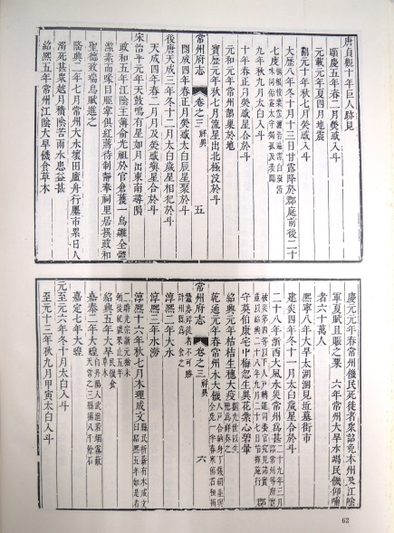
Database : REACHES
A Compendium of Chinese Meteorological Records in the last 3,000 years(Zhang De’er, 2004, 2013)
Recording mostly abnormal events
Drought & Locust
flood
Famine
Qing dynasty 1644-1911
1000BC-1368
Ming dynasty 1368-1644
1100-1200CE Southern Song Dynasty
5

Slide 6
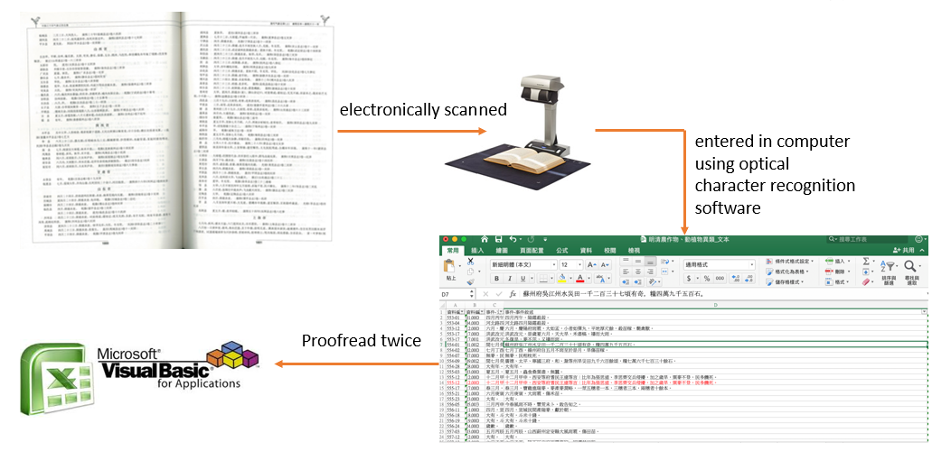
Database : REACHES
Digitization
Time information is converted to Gregorian calendar system
The location (latitude, longitude, altitude) is determined from the historical GIS system of Academia Sinica
6

Slide 7
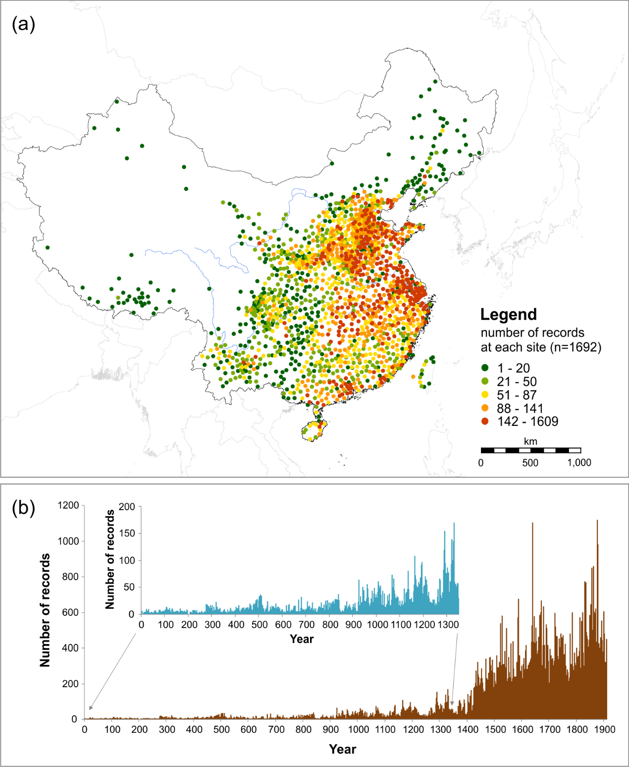
Database : REACHES
Total number of digitized records >170,000
Spatial distribution of REACHES records 1368-1911
Nash et al. (2021) Climate of the Past, Lin et al. (2022)
7

Slide 8
Database : REACHES
Domain | Main Category | Subcategory (some examples)
Meteorology | Precipitation code:10 | Rain/Snow/Hail
 | Temperature | Warm/Sultry/Freezing/Cold
 | Visibility | Haze/Fog/Darkness
 | Thunder, Lighting | Thunder/Lighting
 | Optical | Corona/Rainbow/Halo
 | Wind | Typhoon/Tornado/Wind
Hazard | Drought code:1001 | Drought/Dry riverbank/Dry well
 | Flood | Flood/Tidal Surge/ Surge/Tsunami/Debris/
 | Pest/Vermin | Locust/Other pests
 | Crops | Bumper/Harvest failure Different species distinguished.
 | Disease | Plague/Malaria/Herpes/Dysentery
Unusual | Geophysical events | River course change/Land cover change
 | Odd precipitation: color | Black rain/Red rain/Yellow rain
 | Odd precipitation: plants | Rain grains/Rain nuts/Rain flower
 | Odd precipitation: animal | Rain fish/Rain bugs
 | Odd precipitation: e.g., metal | Rain Sulphur/Rain black particles
 | Sun-related | Solar eclipse/Solar prominence/Sunspot
 | Moon-related | Lunar eclipse/Red moon
 | Astronomical phenomena | New star (Nova or supernova)_
 | Peculiar plant-related | Growing condition of plants, e.g. peach, bamboo, orange. Species are distinguished.
 | Socioeconomic | Battles/Unrest/Migration/Relief/Human Trafficking
Others | Unrecognized vocabularies | Unclear ‘dragon’ description
6

Slide 9
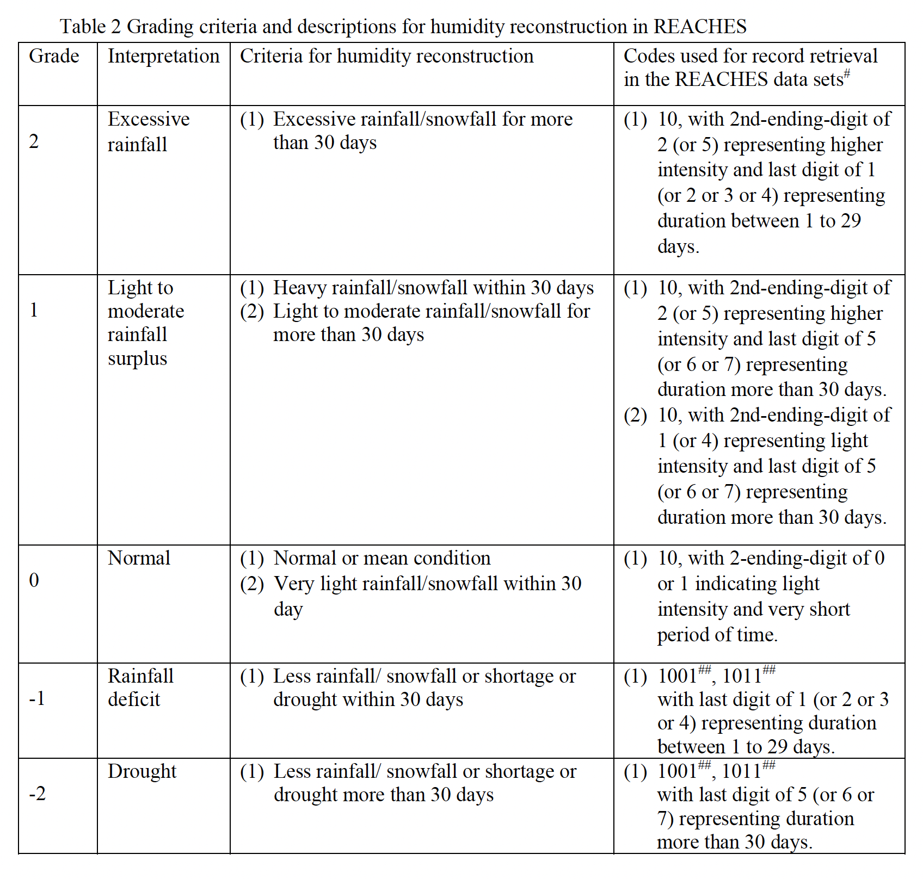
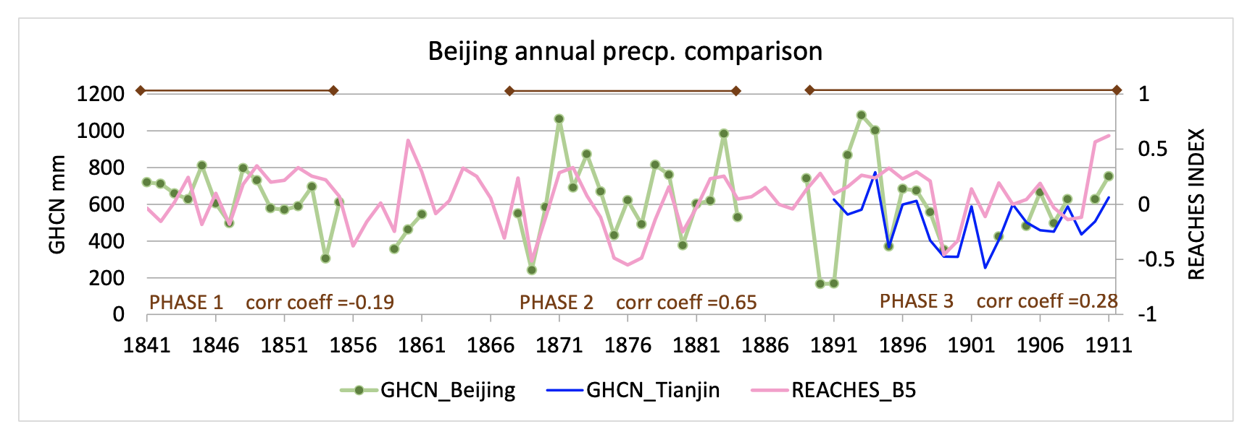
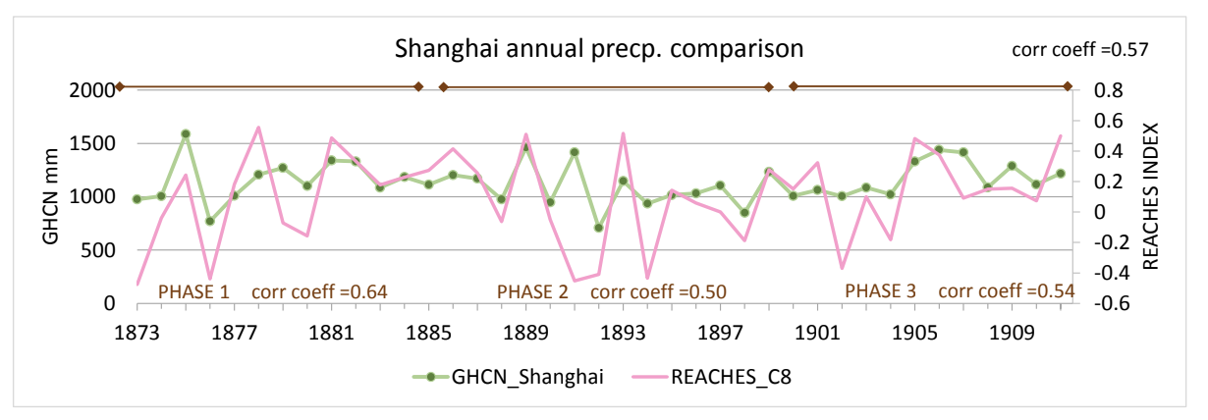
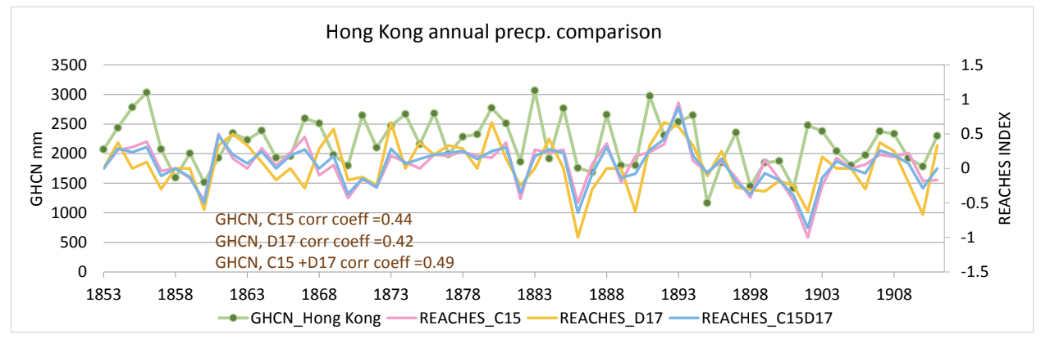
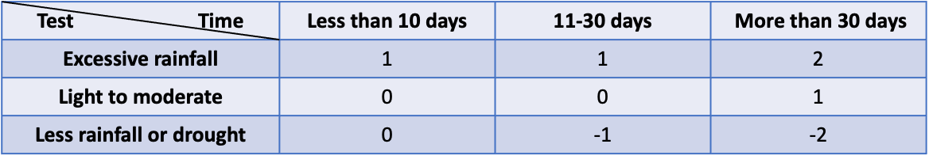
REACHES precipitation reconstruction
Wang et al. (2023) Scientific Data, submitting
9

Slide 10
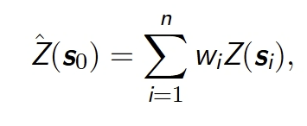
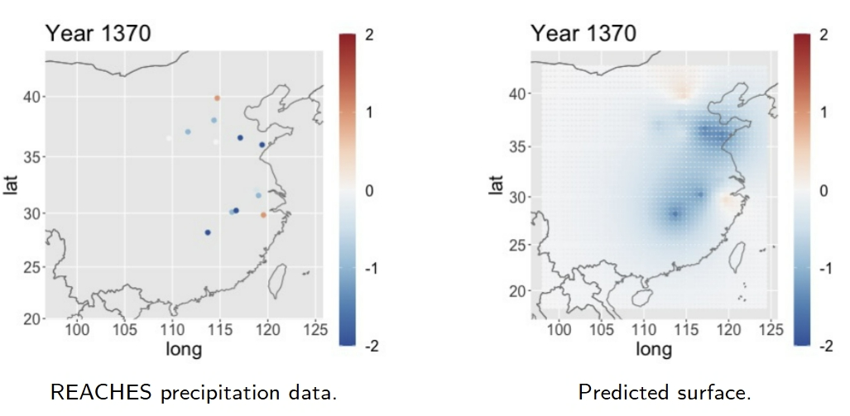
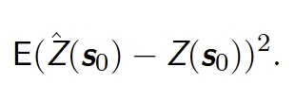
From point to grid: Simple Kriging
A geostatistical method for estimating values at unsampled locations using nearby observed data
Apply the simple kriging predictor with mean 0 to predict values at unobserved locations.
Formula of Simple Kriging
(Sun, 2024)
10

Slide 11
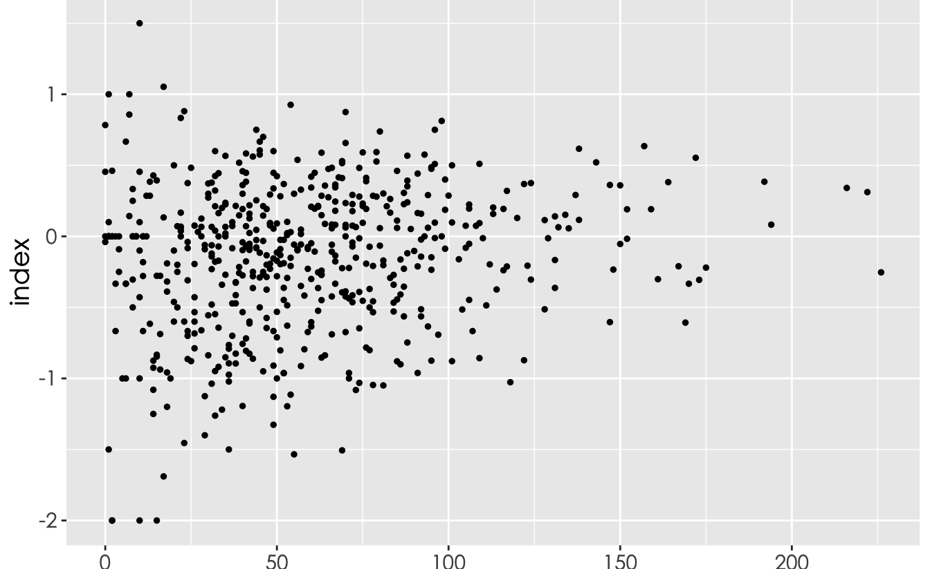
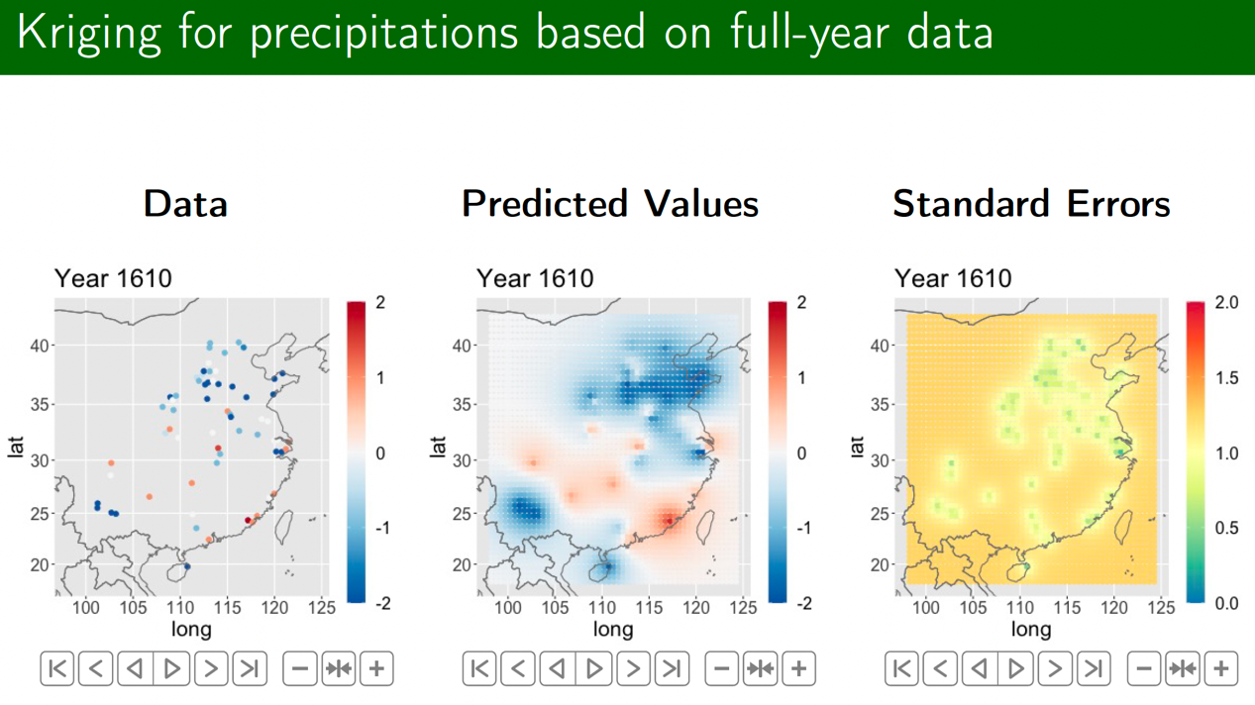
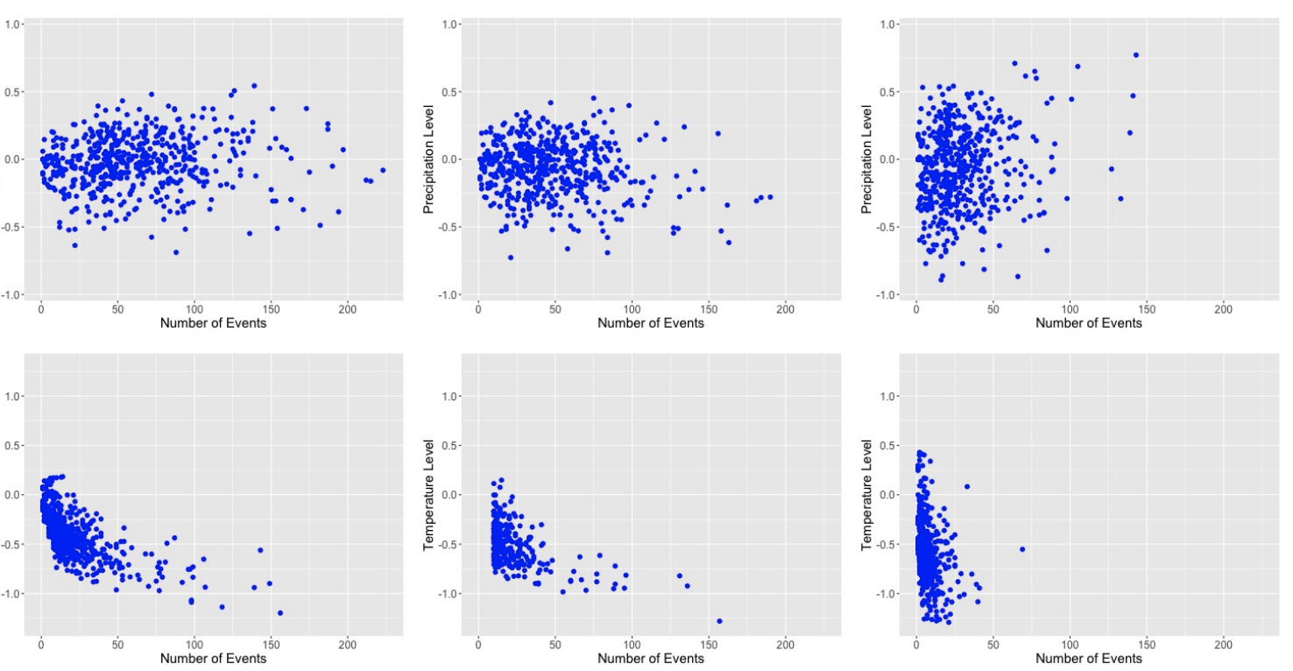
After Simple Kriging
Humidity Annual Original Data
Standard Errors and Distribution
  → the predictions are fairly precise with moderate confidence
SIMPLE KRIGING gridded data
Before
Humidity Annual Interpolated data
After
(Lin et al., 2023)
11

Slide 12

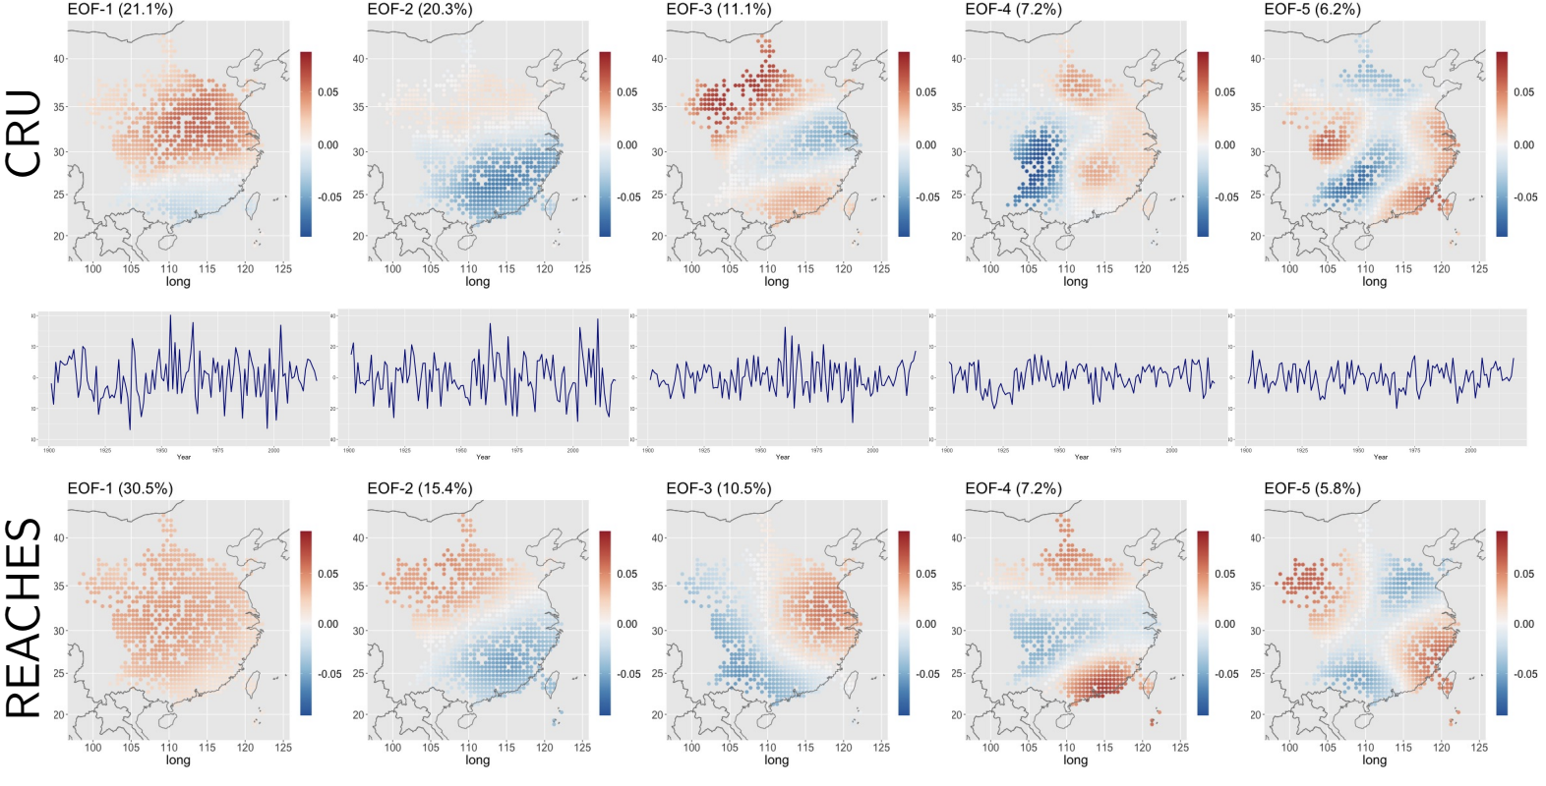
Validation of Simple Kriging data: EOF (empirical orthogonal function) comparison with CRU TS4
to check whether the model results accurately reflect observed climate variability
Humidity annual index EOF comparison (Masked by REACHES data points)
12

Slide 13

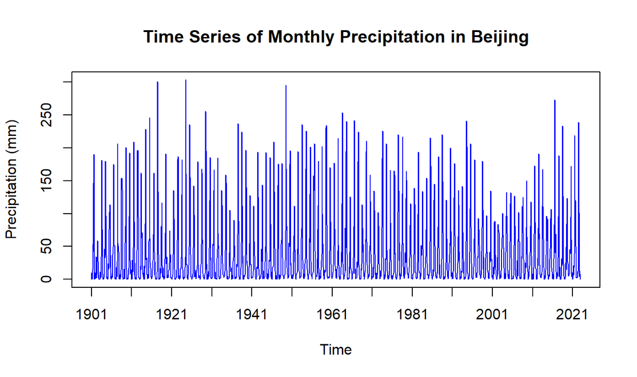
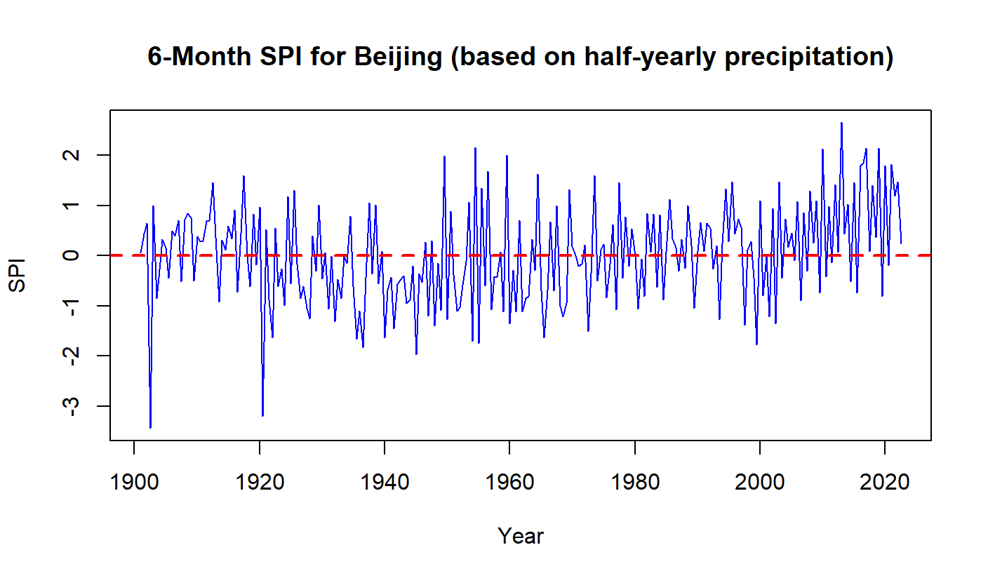
Result 01: Processing gridded data through SPI
Standardized Precipitation Index (SPI)
Turn CRU data into index data
precipitation in millimeters
Index value
Standardized Precipitation Index (SPI)
13

Slide 14
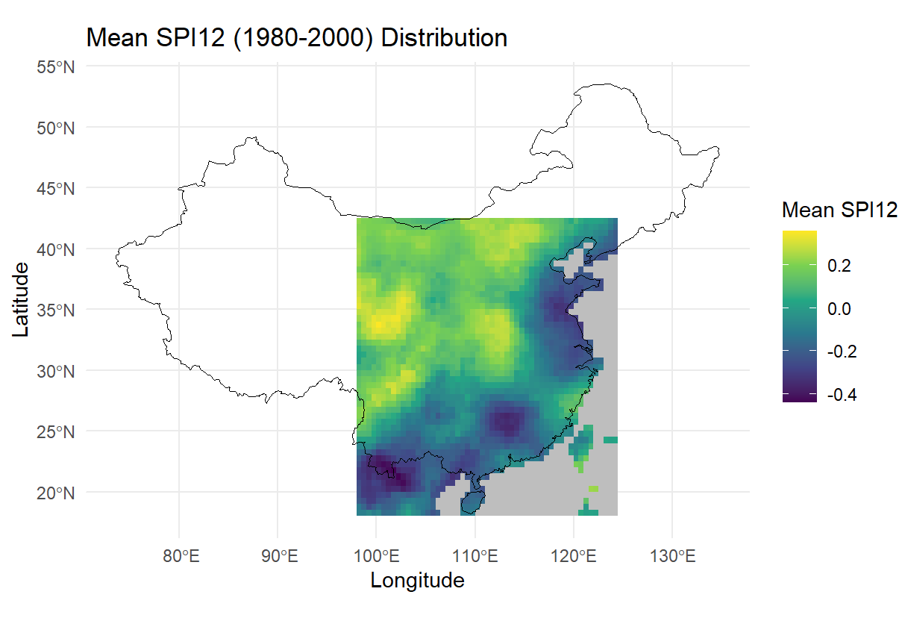
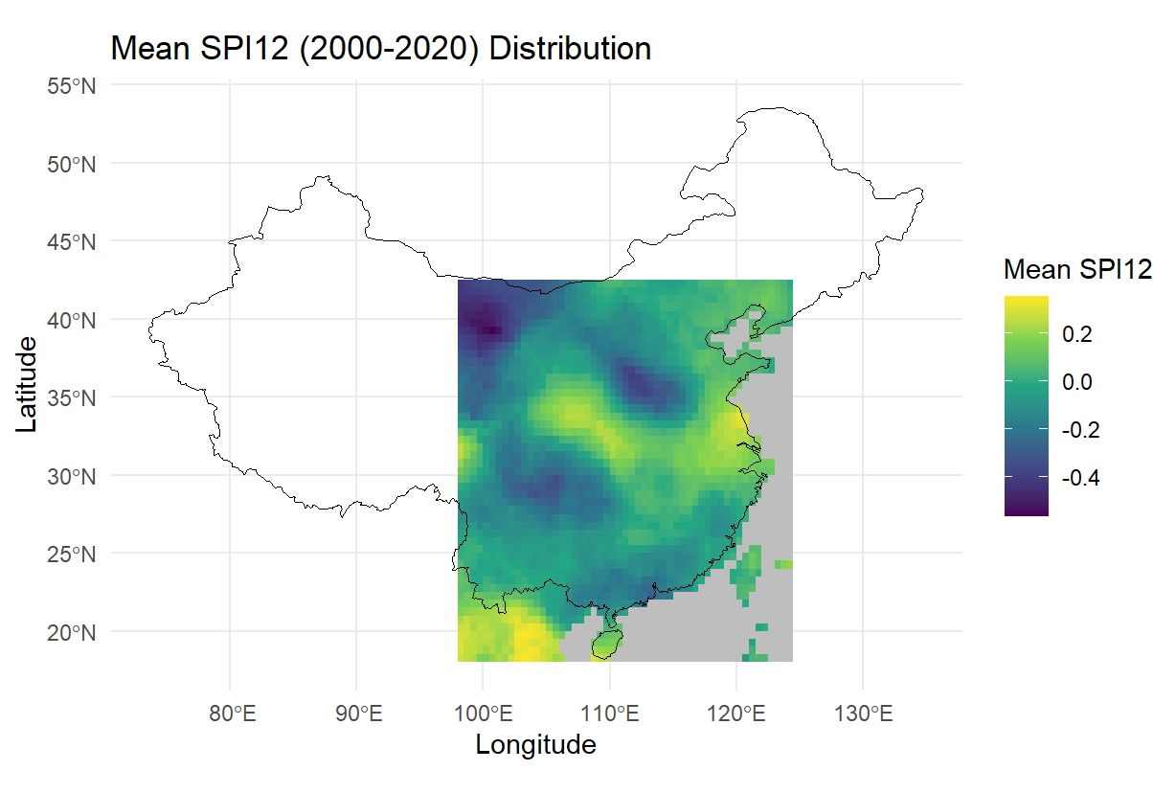
Result 01: Processing gridded data through SPI
compare changes in SPI values over different time periods
Coastal areas become wetter and inland areas become drier
14

Slide 15
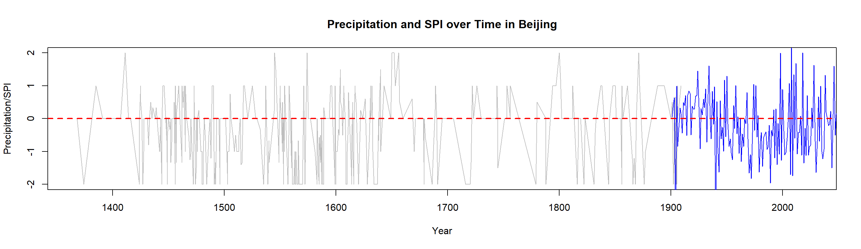
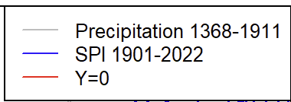
Result 01: Processing gridded data through SPI
apply the SPI method to REACHES
Combine 2 data sets
REACHES: 1368-1911
CRU: 1912-2023
Value
REACHES
CRU
15

Slide 16
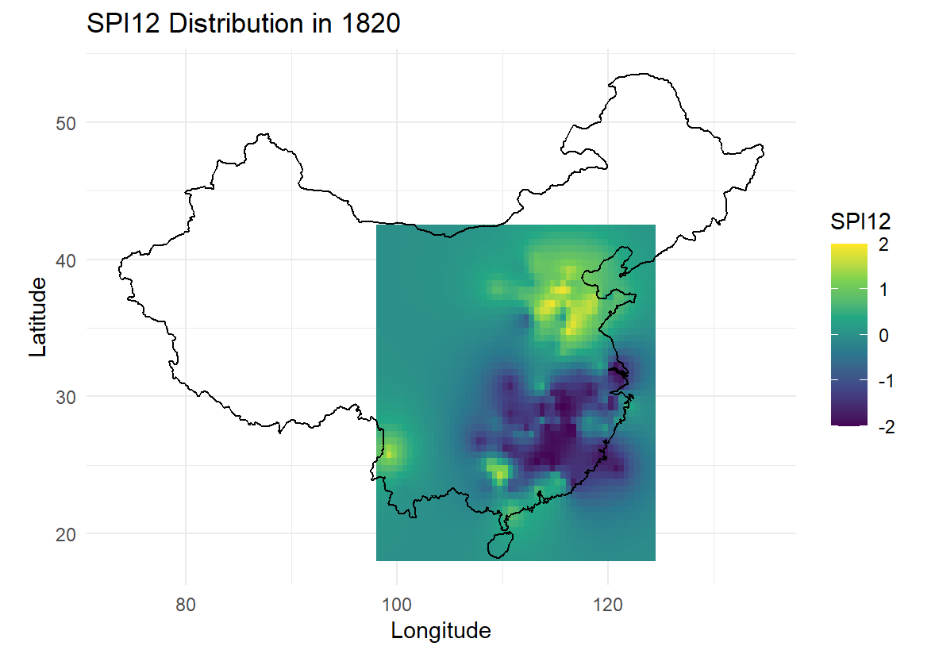
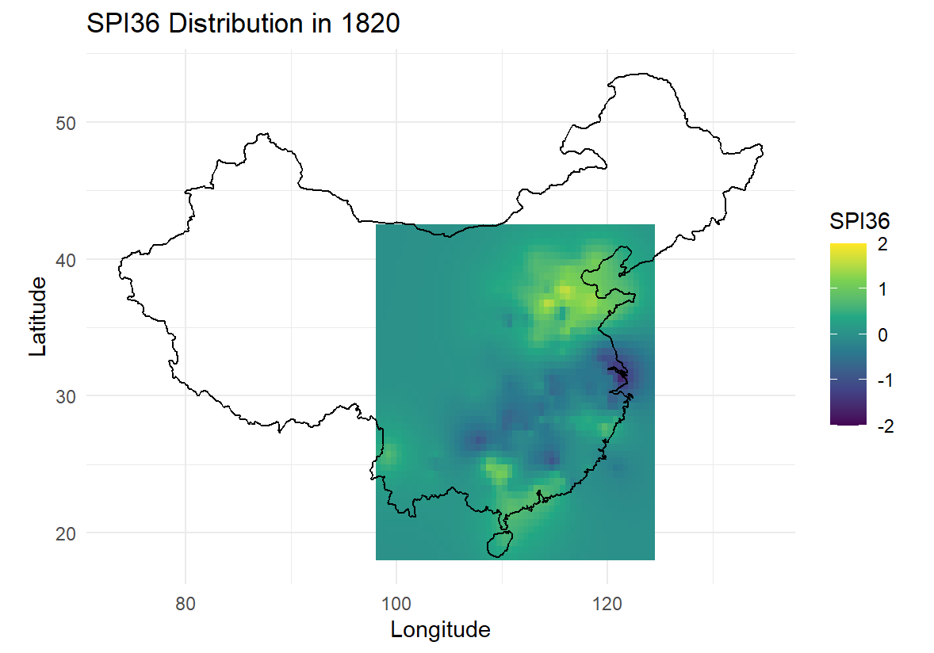
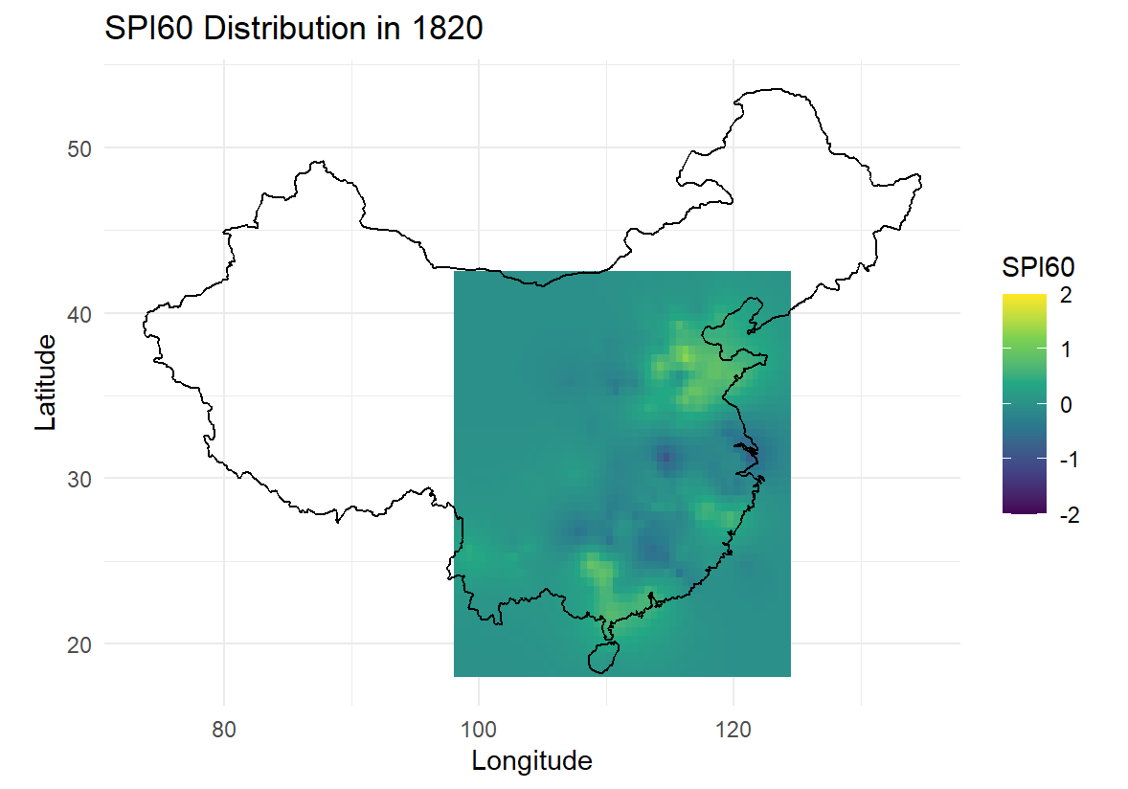
Result 01: Processing gridded data through SPI
compare SPI values across different time scales of SPI
    analyze the development of long-term drought trends (smoothened)
    Conduct an analysis of the development of long-term drought trends, with the data smoothed to highlight overarching patterns while minimizing short-term variability.
longer time scales of drought
16

Slide 17
Result 01: Processing gridded data through SPI
method would be apply to all the gridded data
expand the geographic coverage and temporal length of existing historical climate databases
various types of comparisons will help in understanding the changes in drought conditions
17

Slide 18
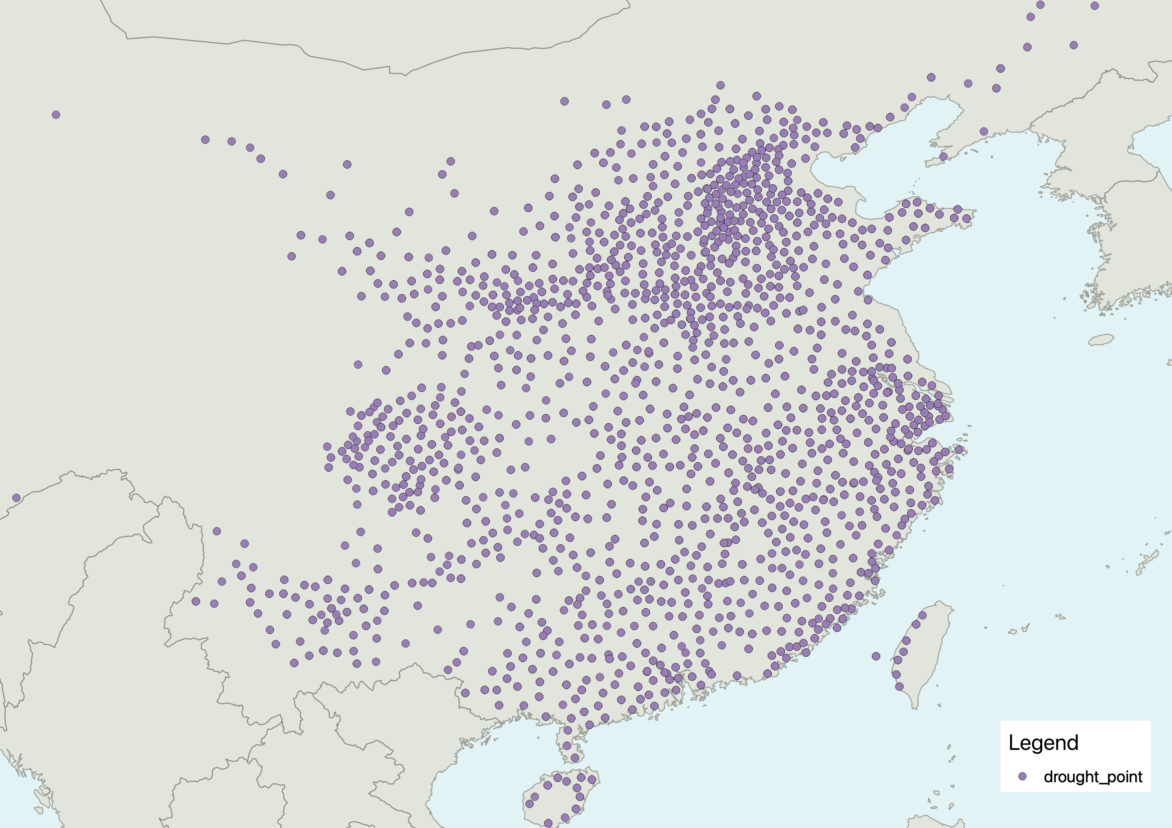
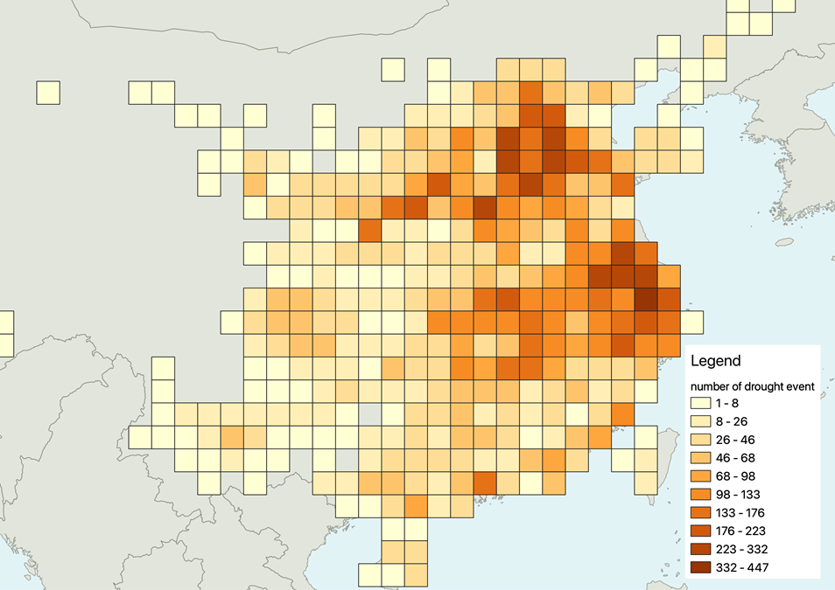
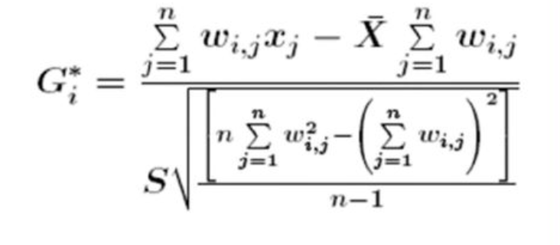
Result 02: spatio-temporal analysis of drought
Getis’ Ord (Gi*)
Formula of Gi*
Drought events in 1368-1911
Hot spot
18

Slide 19
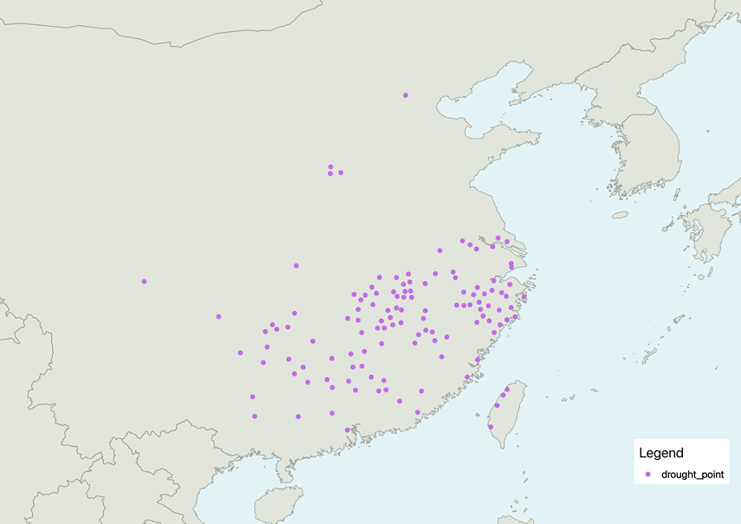
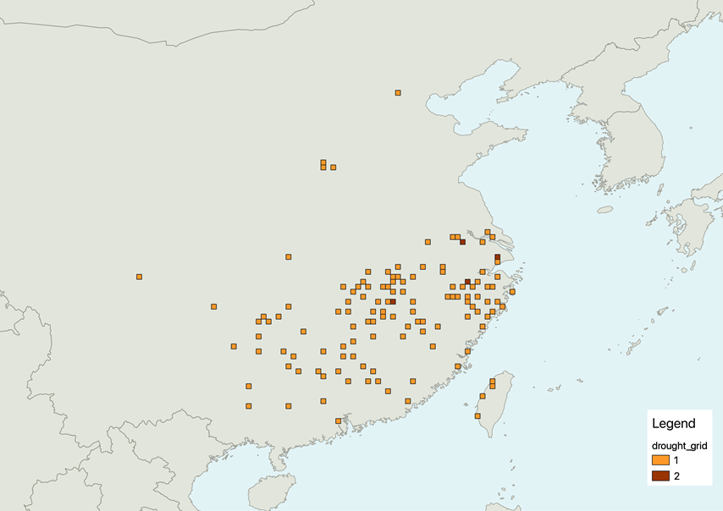
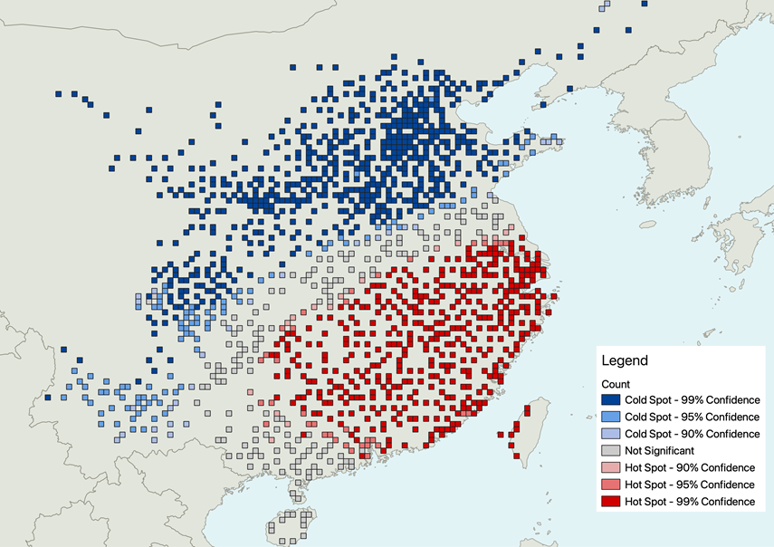
Result 02: spatio-temporal analysis of drought
Take 1820 for example
Drought Events in 1820
Gridding for Drought Event in 1820
Hot Spot of Drought Event in 1820
Set up grid on point data
and count point in grid
Getis-Ord
19

Slide 20
Result 02: spatio-temporal analysis of drought
Compare the results of 2 different analysis ways
Based on gridded data
Based on drought events
20

Slide 21
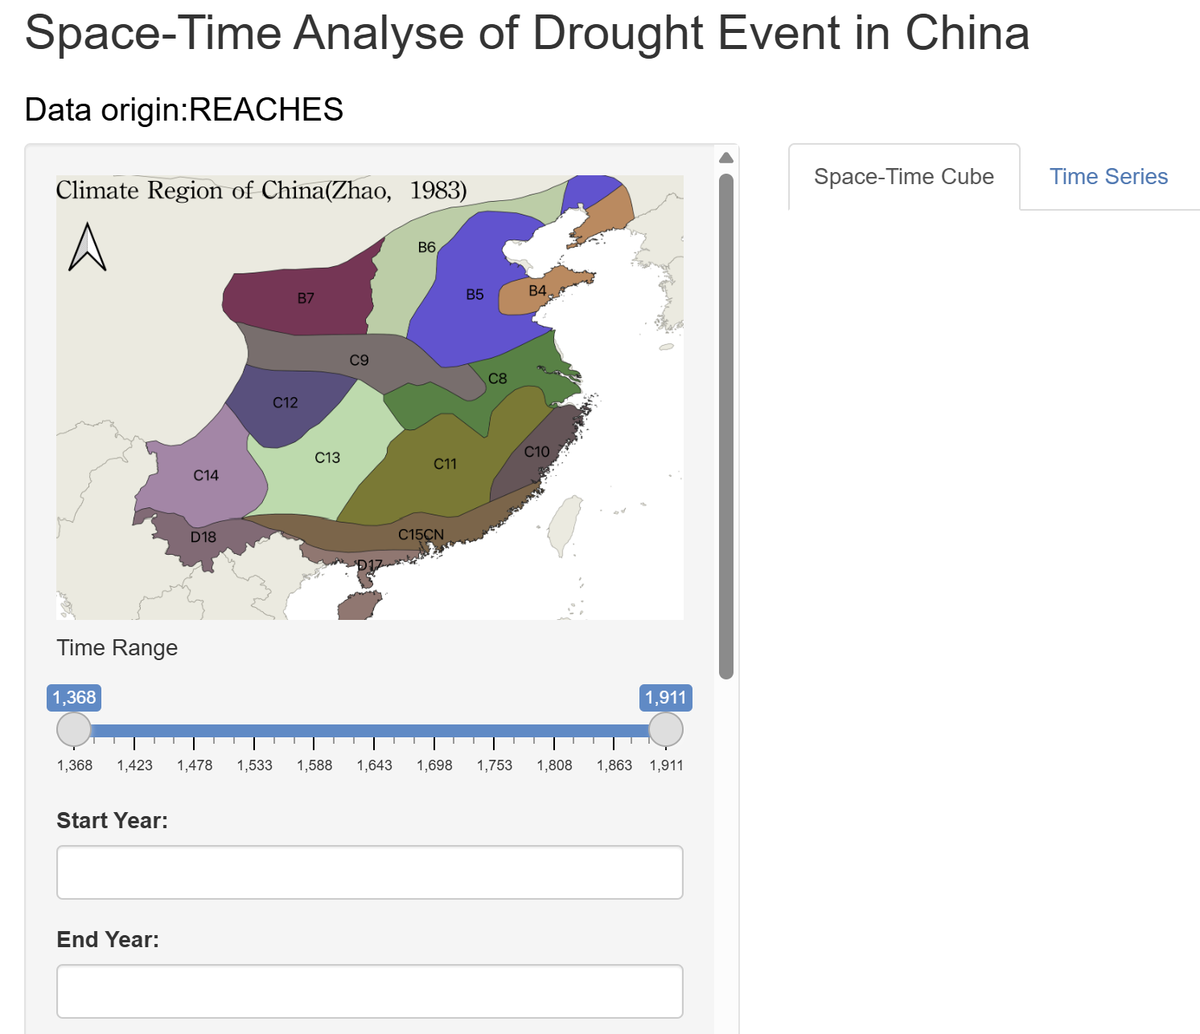
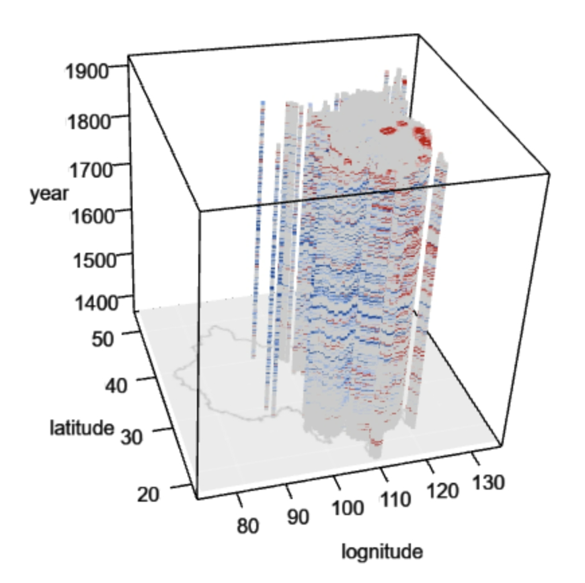

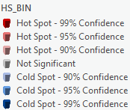
Result 02: spatio-temporal analysis of drought
Space-Time cube
https://reaches.shinyapps.io/Drought_Event_STAnalyse/
21

Slide 22
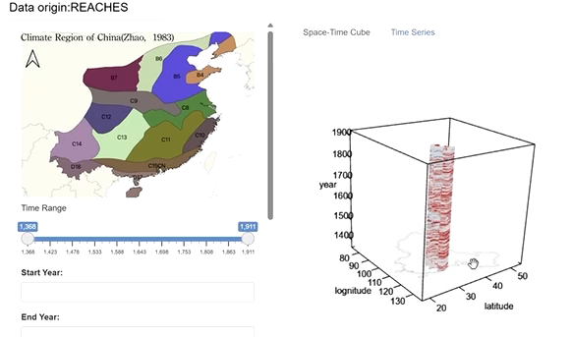
Result 02 : spatio-temporal analysis of drought
Trend in different area
22

Slide 23
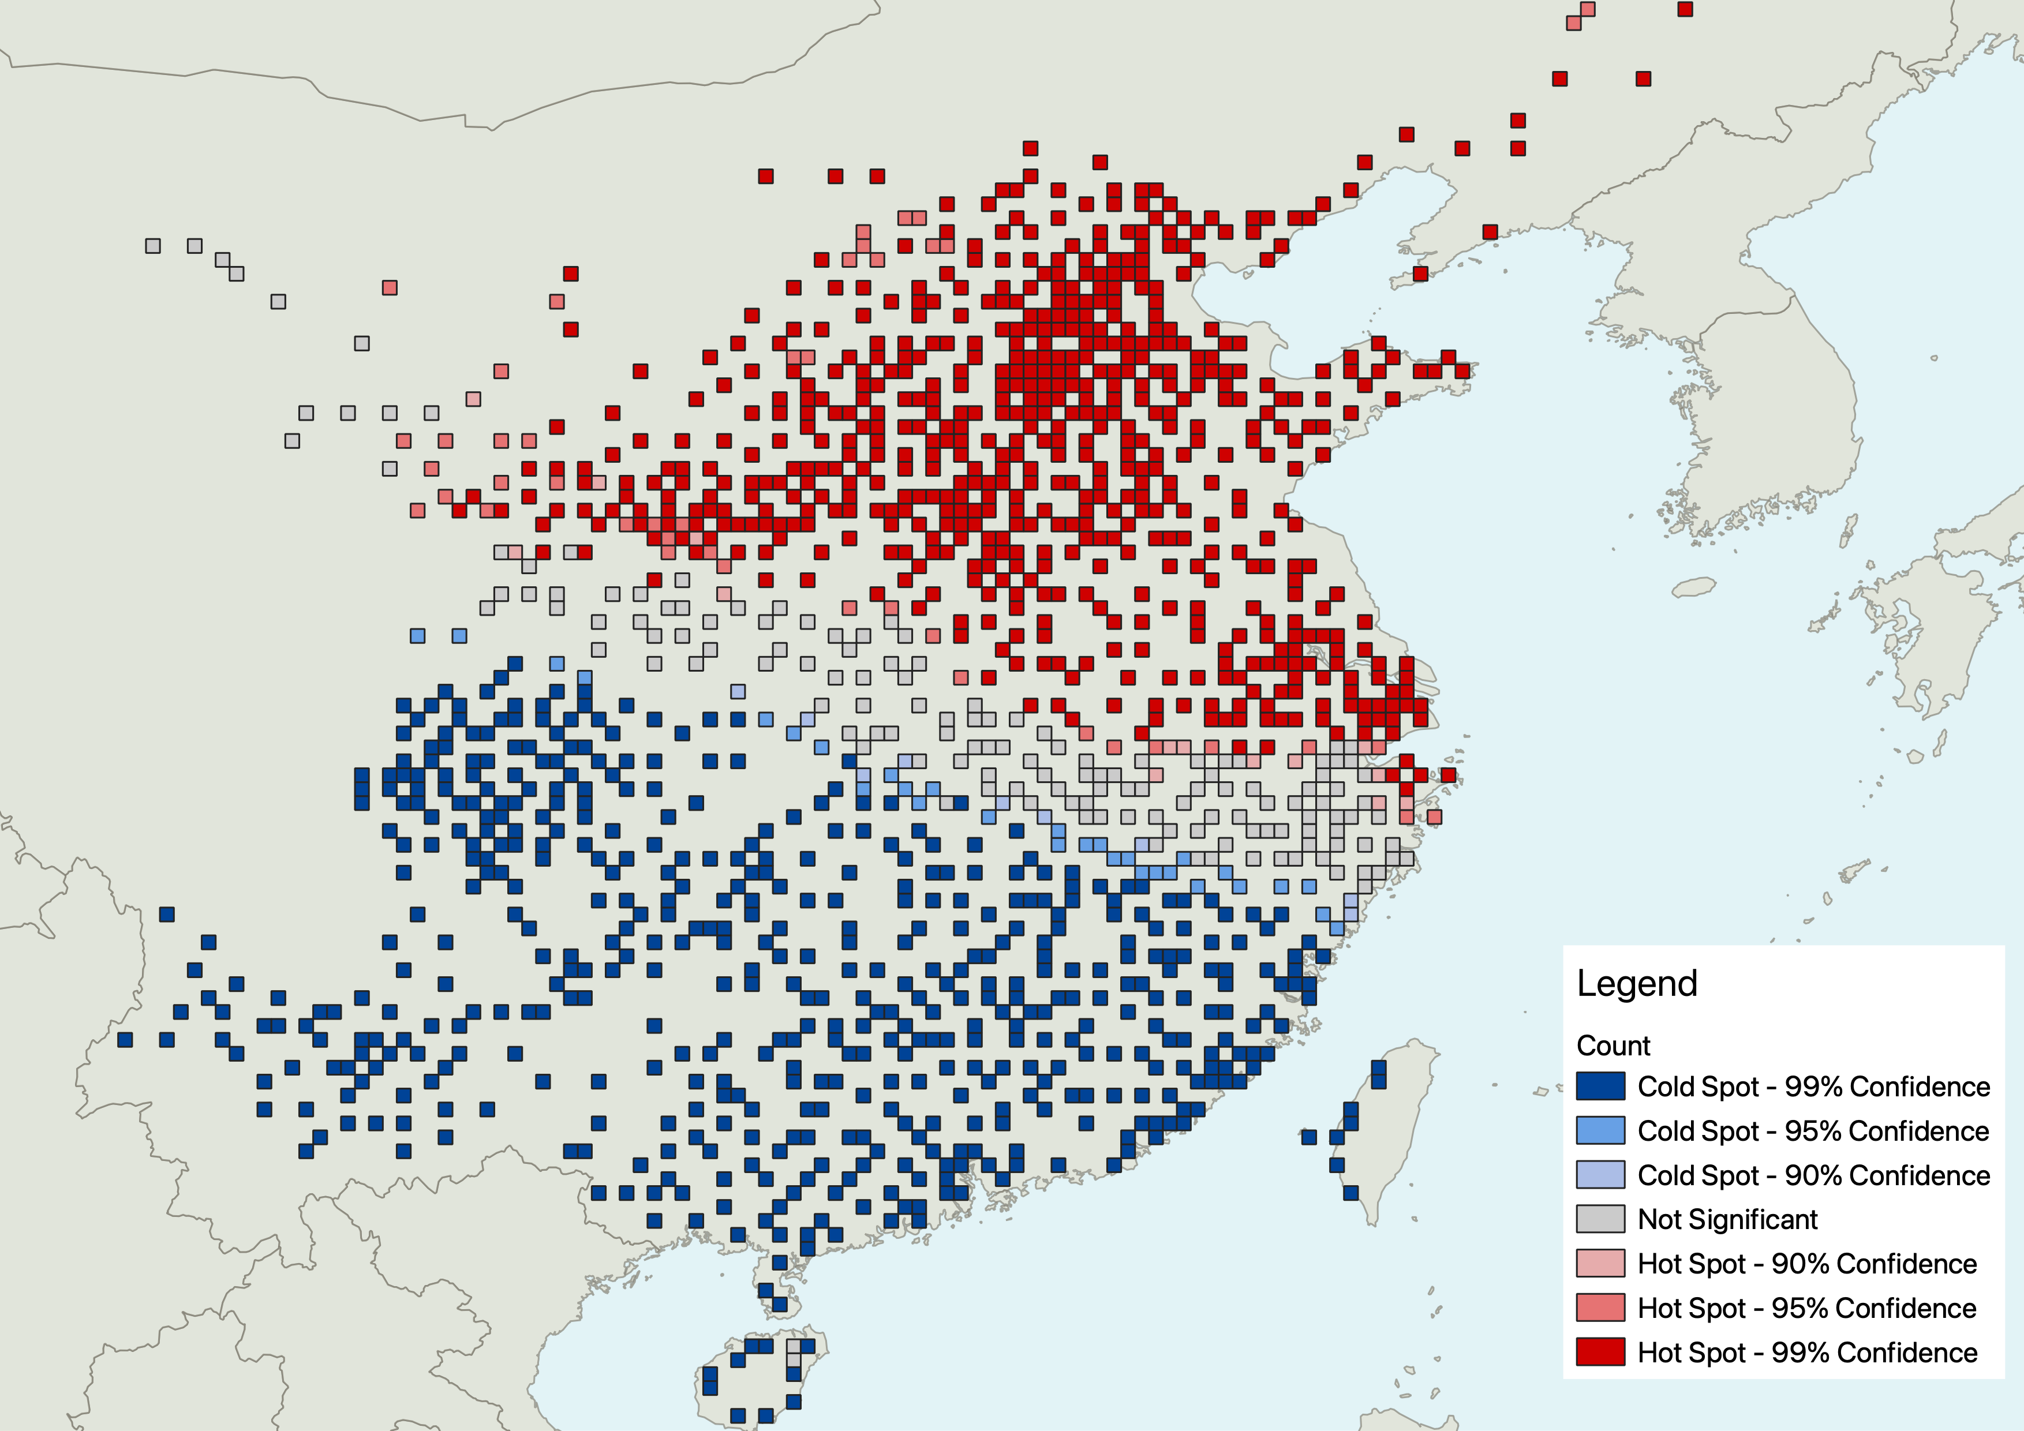
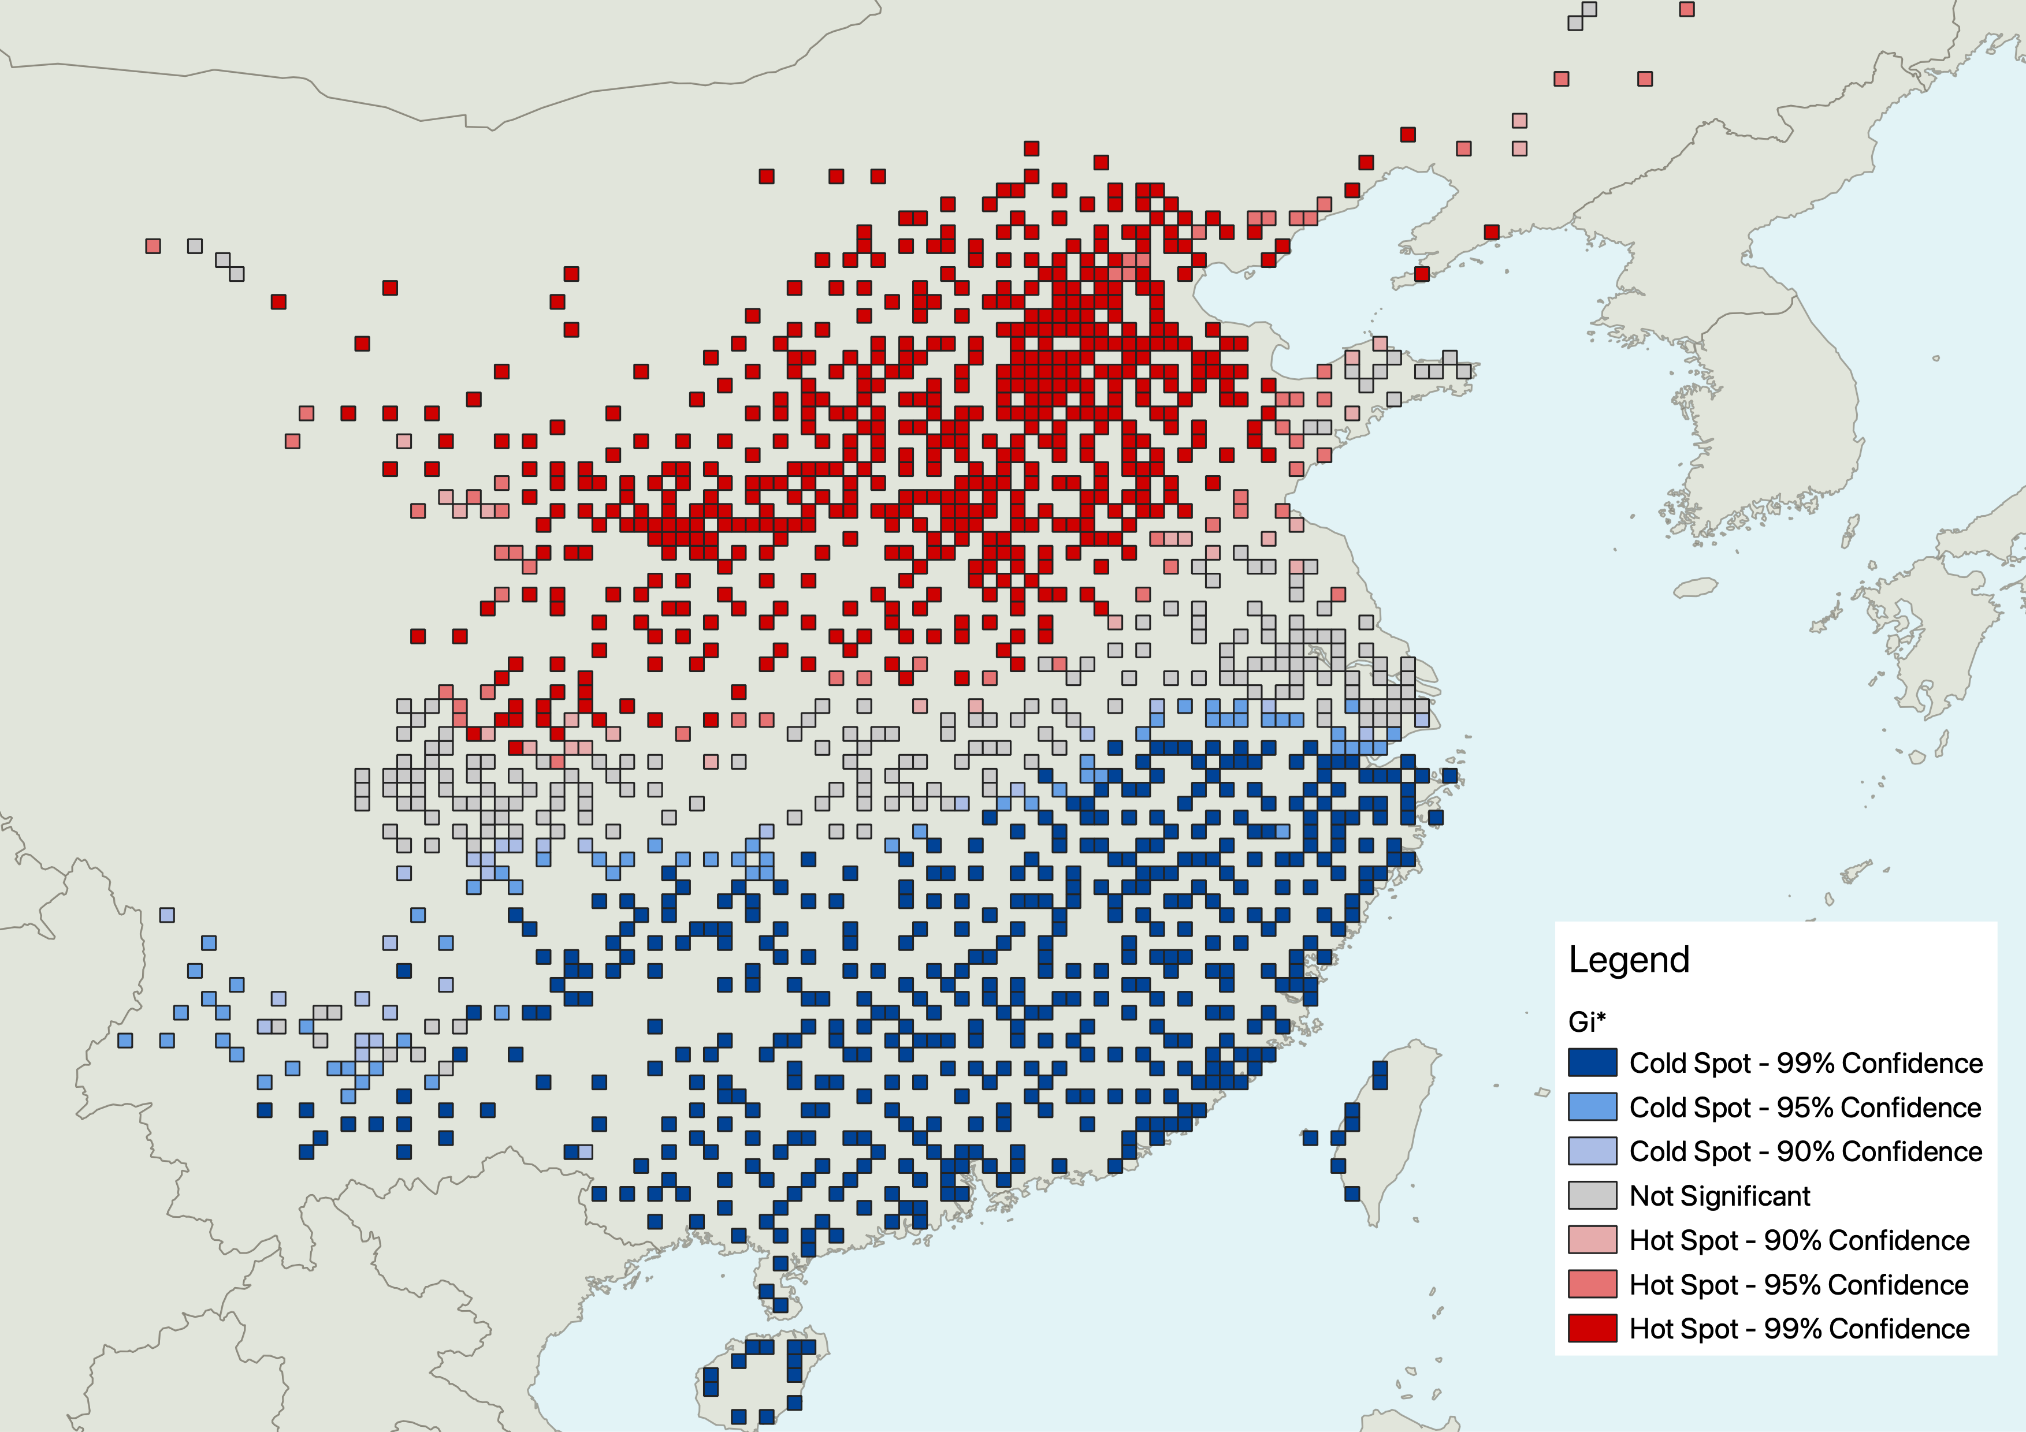
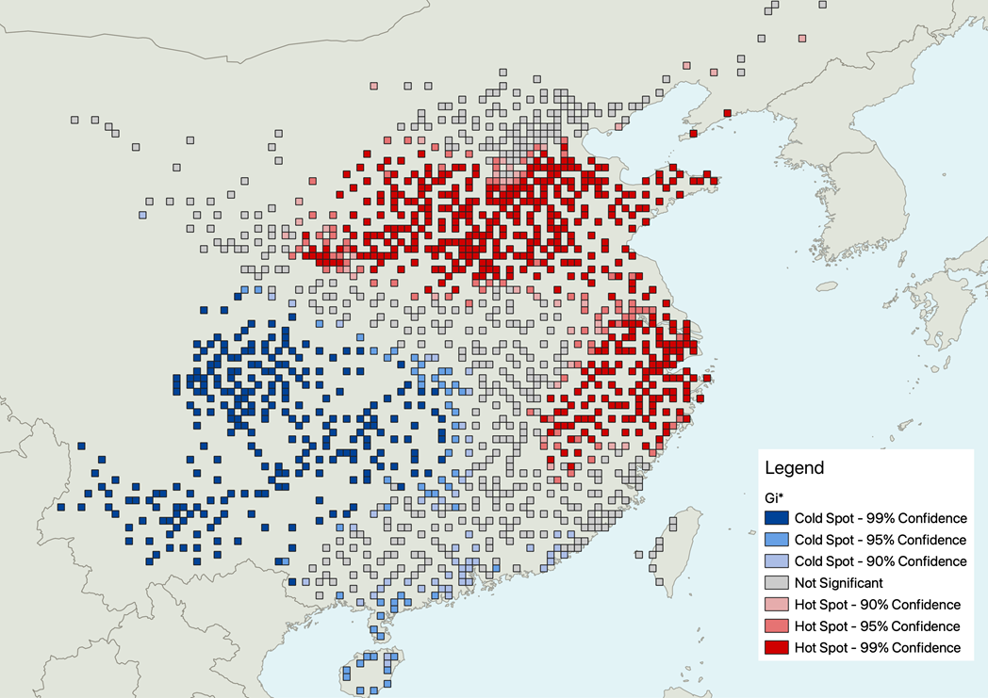
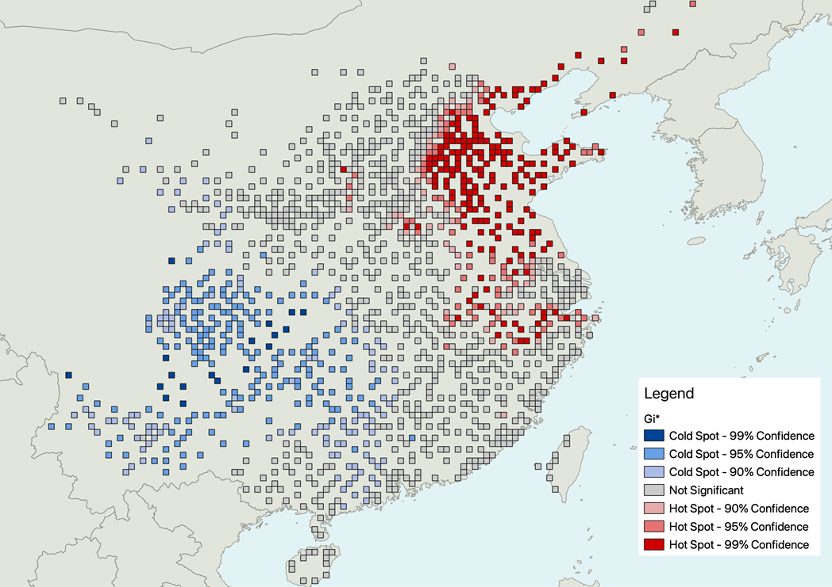
Result 02 : spatio-temporal analysis of drought
1640
1877
1721
1875
the severe drought periods
  in the Qing dynasty (1644-1911): 1665–1691, 1720–1740, 1770–1790, 1830–1850, 1850–1870, and 1870–1890 (Lin et al., 2020)
  decadal scale megadroughts occurred regularly in northern China, including during 1146–1155 CE, 1240–1249 CE, 1483–1492 CE, 1578–1587 CE, and 1634–1643 CE (Cook et al., 2022)
23

Slide 24
Conclusion
This work demonstrates the power of combining historical records with modern statistical methods to reconstruct and analyze drought patterns.
By leveraging the REACHES database, simple kriging, and SPI, we have reconstructed a detailed view of drought events in China over the centuries, contributing to our understanding of historical climate change
Email: keepgoingjustdoit@gmail.com
Space-Time cube
24

