Slide 1




Towards Twentieth Century station-based reconstructions of the Amundsen Sea Low
Richard J. Hall¹, Julie M. Jones¹, Ryan L. Fogt², Tom Bracegirdle³
University of Sheffield, UK; Ohio University, USA; British Antarctic Survey, UK

Slide 2
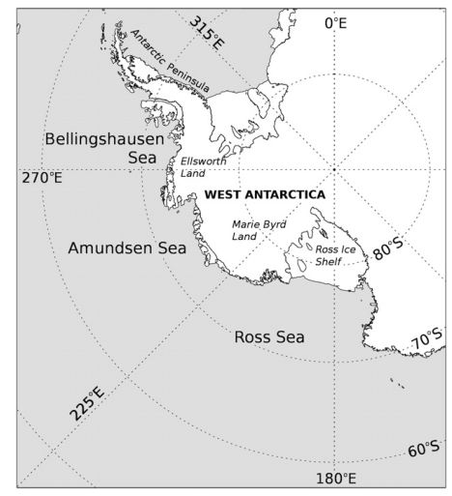
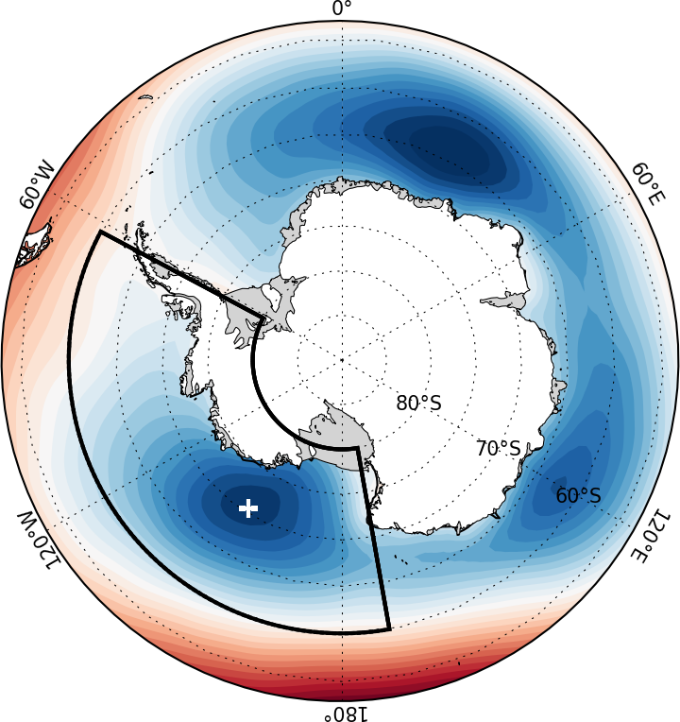
The Amundsen Sea Low (ASL): what is it and why are we interested?
Quasi-stationary area of climatological low pressure in the South Pacific Sector of the Southern Ocean – has deepened in recent decades
Exerts a strong influence on the climate of West Antarctica
Linked to SAM and to variability in the tropical Pacific
SON MSLP in the ABS region (Hosking et al. 2013)
Notes:
One of three climatological lows around the Antarctic. High frequency of cyclones, either forming along the coast, or moving southward.

Slide 3
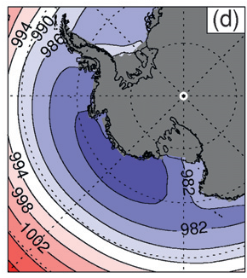
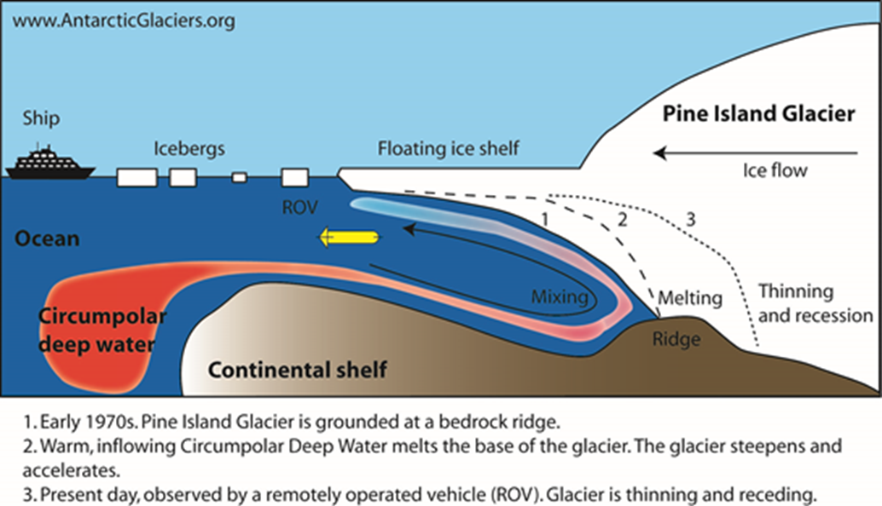
The Amundsen Sea Low: what is it and why are we interested?
As well as influencing temperature and sea ice in West Antarctica, winds along the ice shelf in the Amundsen Sea linked to inflow strength of warm circumpolar deep water on to the ice shelf, influencing ice-shelf mass loss
Cold, dry air advection,
northward movement of sea ice
Warm, moist air advection,
southward movement of sea ice
SON MSLP in the ABS region (Hosking et al. 2013)
Notes:
One of three climatological lows around the antarctic

Slide 4
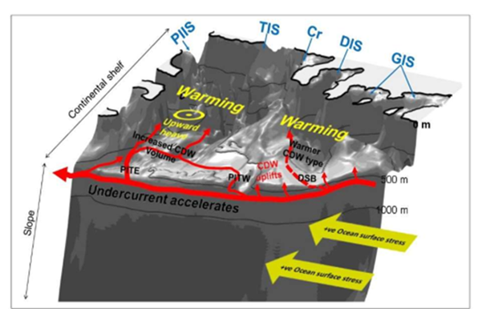
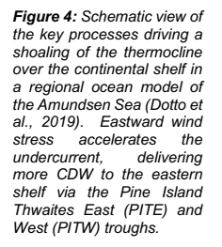
DecADeS (Decadal Changes in the Amundsen Sea)
NERC project DecADes (Decadal Changes in the Amundsen Sea) - PI Adrian Jenkins, Northumbria University
The project is exploring the hypothesis that ice sheet change in the Amundsen Sea sector is an accumulating response to a series of oceanic warm episodes (1940s and 1990s) when rapid ice-sheet loss was initiated
Holland et al. (2022) suggest these caused by anticyclonic wind anomalies during these decades
So we are exploring ways to extend the record of the ASL back through time. Can we use tropical-extratropical teleconnections with station pressure observations at lower latitudes to reconstruct the ASL?
To do this we need
1) Data
2) Data in locations where SLP is related to the ASL
3) An idea of whether the teleconnections are likely to be
stable through time
Notes:
We realise there are palaeo assimilation indices – but they are annual…

Slide 5
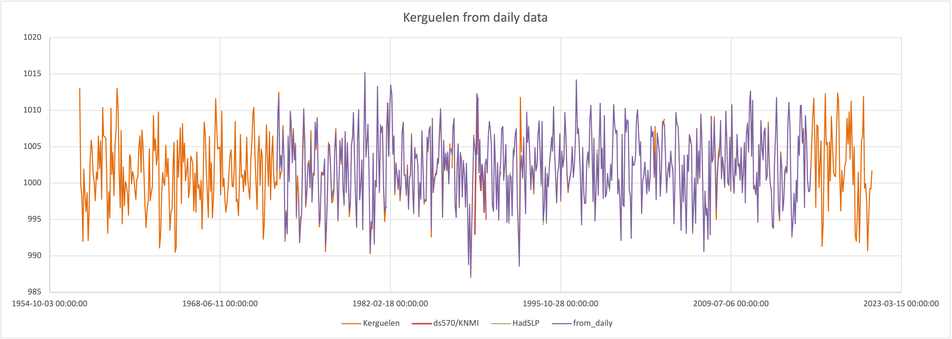
The Station SLP data
Ryan Fogt provided monthly series for 62 southern hemisphere stations and a further 15 Antarctic stations, predominantly using RDA-NCAR ds570.0. Patching has been conducted on these data, however gaps still exist. In addition we include data from Isla de Pascua (Easter Island), which fits in a large data gap in the Pacific, also READER database.
Additional patching has been carried out using:
- Ds570 from KNMI Climate Explorer which sometimes contains additional months
- ISPDv4 contains subdaily data. We process this to create monthly mean data, only for months where >50% of days have a daily mean value. We remove extreme outliers (+/-5SD) datapoints prior to processing
HadSLP2 data for stations
Meteostat python package allows direct access to subdaily, daily and monthly data from WMO stations. Here we calculate daily averages, and monthly data as for ISPDv4.
Patching is only applied if the patch data fit the patterns overlapping either side of the gap in the timeseries.
An example of patching the
station data. The ISPD daily data
when processed closely matches
the monthly timeseries and fills
the gaps.

Slide 6
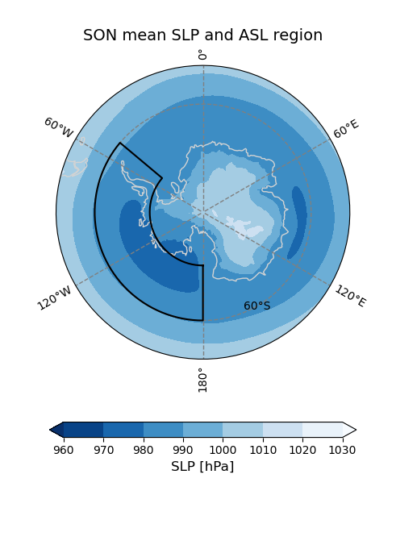
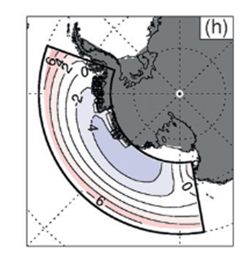
ASL Indices
Area-averaged ASL as defined in O’Connor et al (2021):180-310º E, 60-75º S (left hand figure)
Relative Central Pressure (RCP): anomalies relative to seasonal average background pressure as in Hosking et al. (2013), -60-75ºS, 170-290ºE (right hand figure)
ASL Latitude: latitude of minimum pressure in a given season
ASL Longitude: longitude of minimum pressure in a given season
To explore which of these indices may be best to reconstruct from a practical perspective, calculated regression maps between these indices (from ERA5) and ERA5 SLP
SON relative central pressure (Hosking et al. 2013)

Slide 7

Need to do analysis seasonally, as there are shifts in latitude and longitude of the ASL with season
Centred west of Antarctic Peninsula in summer, moves westward to Ross Sea by winter
Farthest north (south) in summer (winter)
Reconstructions need to be done seasonally
–(d) seasonal mean SLP (hPa) for the different seasons, ERA-Interim, 1979-2011.
(e)-h), the relative central pressure in the ASL sector. The area averaged SLP is
subtracted from the seasonal MSLP field. (Hosking et al., 2013).

Slide 8
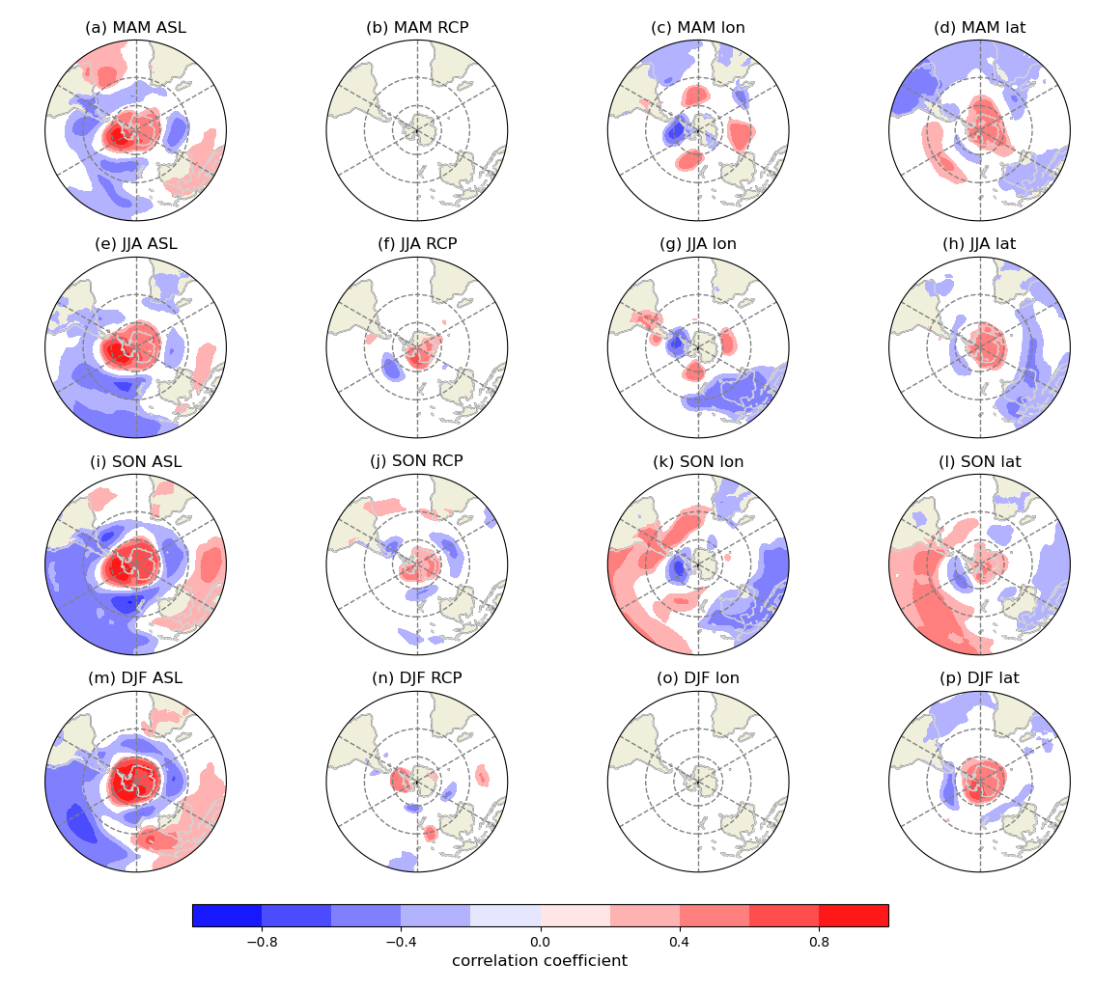
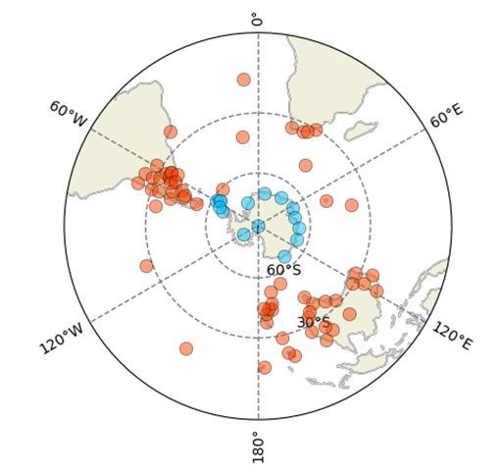
Correlation maps between ASL indices and ERA5 SLP
Area-averaged ASL looks most promising
Relative central pressure cannot be reconstructed using SLP station data
Longitude and latitude indices may be worth trying, especially in SON, but note correlations are weaker
Significant correlations between seasonal
mean SLP and various ASL indices, ERA5,
1979-2023. Only significant (p<0.1)
correlations are shown. ASL = area-averaged
index, RCP = Relative Central Pressure

Slide 9
Method
Calculate seasonal means of station SLP and ASL area-averaged index (seasonal mean is only calculated if >= 2 months have data).
Correlate stations with ASL for each season (1979-2023). Select only those that are significant at certain (p<0.1; p<0.05) thresholds
Calculate the EOFs of these stations
Correlate the principal components (PCs) of the EOFs with the ASL. Only retain those that show significant (p<0.1;p<0.05) correlations with ASL.
Use retained PCs in Principal Component Regression, for the fitting period 1979-2023. Leave-one-out cross-validation is used, leaving out two points either side of the validation timestep to guard against autocorrelation
We repeat the procedure for different subsets of stations, according to length of record: start dates are 1905, 1941 and 1957. We also repeat the 1957 models with and without Antarctic stations.
Notes:
We also tried using the Bayesian Information Criterion to select the number of PCs to use in regression. This tended to be more liberal, increasing the number of PCs, which in some cases led to overfitting. Our approach is more conservative.

Slide 10
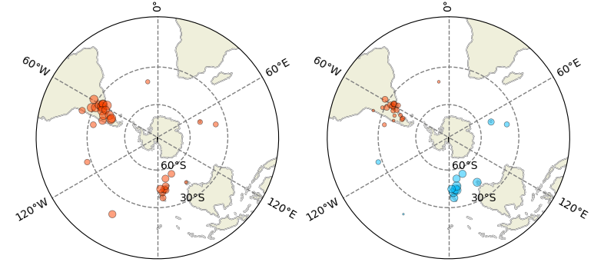
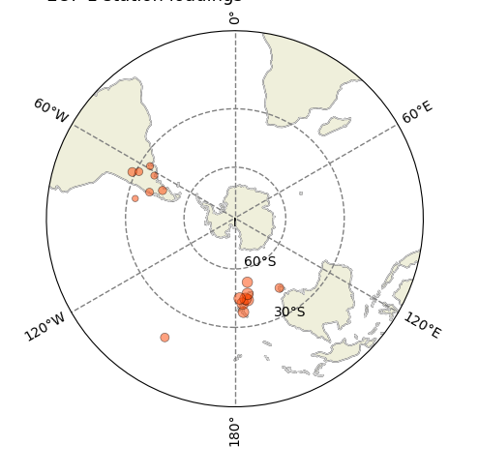
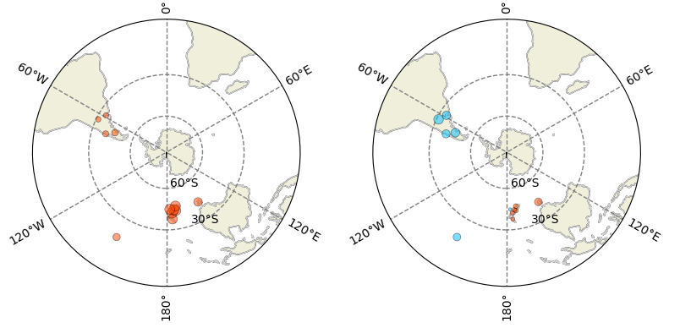
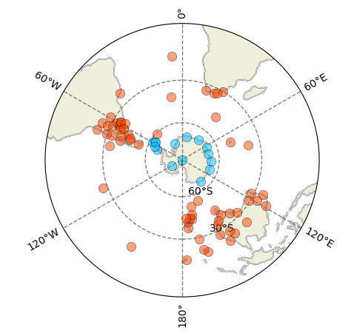
Station loading patterns for SON, p<0.1, significant EOFs only (no Antarctic stations)
(a) 1957 station loadings, EOFS 1 and 2
(b) 1941 station loadings, EOF1
(c) 1905 station loadings, EOFS 1 and 2
(d) All available stations
In (d) Antarctic
Stations (blue)
are only available
from 1957
Notes:
Shown without Antarctic stations to show like for like – so point this out for the animation

Slide 11
Validation statistics for fitting period (1979-2023), using LOOCV
model | R² | correlation | MAE | RMSE
1957 p<0.1 | 0.57 | 0.75 | 0.48 | 0.65
1957 p<0.05 | 0.56 | 0.75 | 0.48 | 0.65
1957 ANT p<0.1 | 0.75 | 0.87 | 0.36 | 0.49
1957 ANT p<0.05 | 0.68 | 0.82 | 0.42 | 0.56
1941 p<0.1 | 0.56 | 0.75 | 0.5 | 0.66
1941 p<0.05 | 0.47 | 0.68 | 0.56 | 0.72
1905 p<0.1 | 0.55 | 0.74 | 0.5 | 0.66
1905 p<0.05 | 0.54 | 0.73 | 0.51 | 0.67
Range | 0.47-0.75 | 0.68-0.87 | 0.36-0.56 | 0.49-0.72
Adding Antarctic stations improves model fit (obviously…)
Comparing 1957 (without Antarctic stations) and 1905 models, the statistics show little difference despite the lower number of stations

Slide 12
SON ASL Area Averaged Pressure in Reconstruction, 20CRv3 and ERA5
20Cv3 ASL is systematically higher than the reconstructions pre-1950
This early part of 20CRv3 shows reasonable interannual match
with reconstruction (r=0.61,
1905 -1950)
Reconstructions of the SON area-averaged ASL. Individual models are light grey, the mean reconstruction is red. Shading is +/- 1.96 standard deviations of the residuals over the fitting period (1979-2023). The ASL from ERA5 is black(1940 onwards) and that from 20Cv3 is dashed blue.
Notes:
Point out that only 2 reconstructions prior to 1941

Slide 13
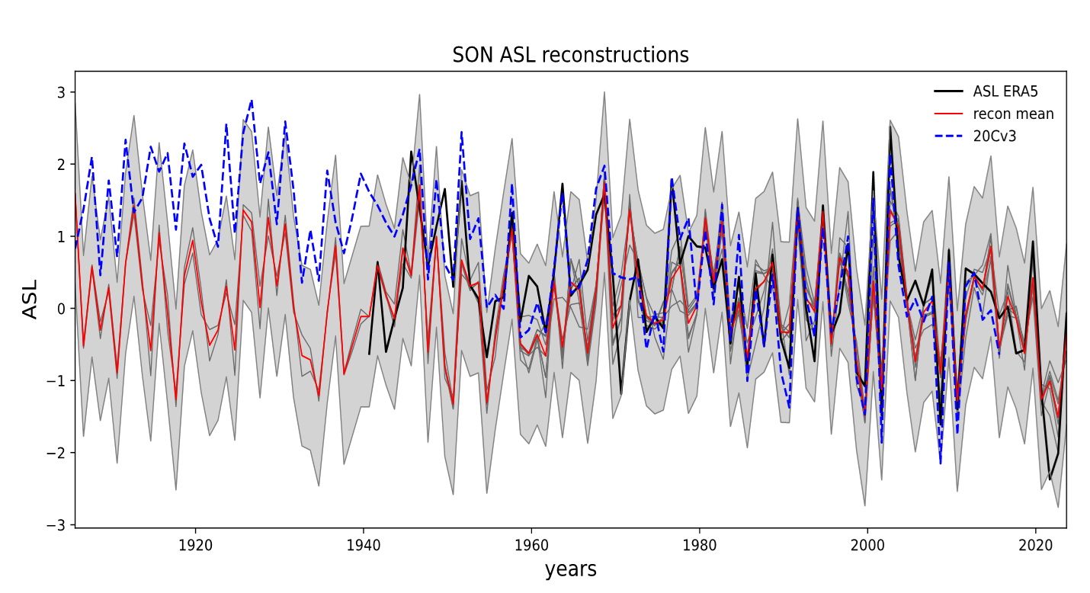
SON ASL Time-varying trends
Minimum time window 30 years
Minimum time window 20 years
ASL trends /decade
NB with a minimum time widow of 20 years, the decadal scale variability shows up more, especially with 20CRv3,
but caution here with statistical significance due to small sample sizes in the shorter windows
Systematically more positive reanalysis ASL results in mostly negative trends
Notes:
Diagonal cross hatching and stippling = significance at p<0.10 and p<0.05

Slide 14
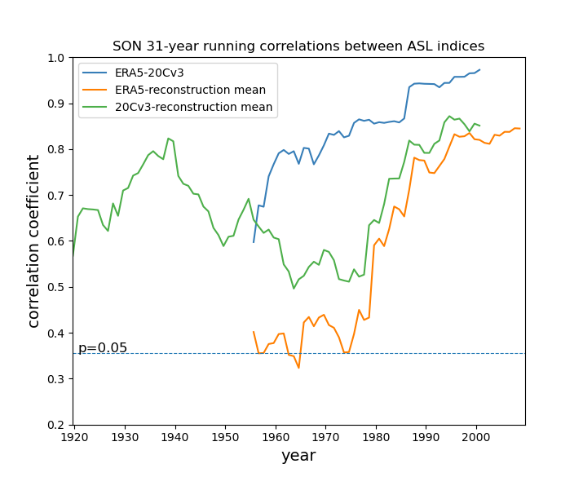
Correlations between the reconstructed SON ASL mean and indices from reanalyses
Both reanalyses show high correlation
with reconstruction after 1985 (r~ 0.8 or more).
1955-1980: correlations are low, especially
between ERA5 and reconstruction
Note increase in correlation with 20CRv3 prior
to 1955
The mid-century dip may be related to:
Fewer data points ingested by reanalyses
Possible changes in teleconnections-weaker
predictability for NAO in this period has been
attributed to changes in Pacific tropical
teleconnections (Weisheimer et al., 2016;
O’Reilly et al., 2017)

Slide 15
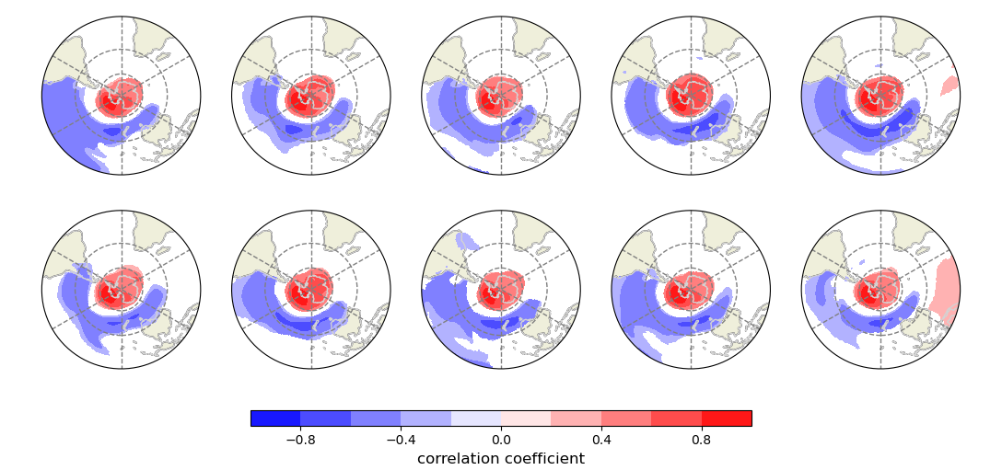
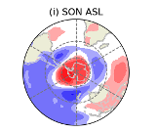
Looking at stability of SLP-ASL associations over time using the CESM2 Pacific Pacemaker Ensemble
10 ensemble members, 1880-2014, 1º horizontal resolution, historical forcing
Eastern tropical Pacific SST anomalies are time-evolving but nudged to observations
Area averaged ASL from ensemble members do show significant correlations with ERA 5 ASL
ERA5 1979-2023
For comparison
Significant corrrelations between SLP field and the ASL for each member, SON. Only significant (p<0.1) correlations
are shown

Slide 16
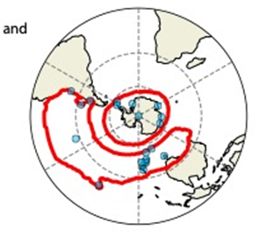
Stability of significant correlations over time
At each grid point a 31-year moving-window
correlations are calculated
The red contour encloses the region where 70% of running correlations are significant (p<0.1) for at least 7 of the models
Stations are shown that occur within the regions of stable correlations: here a maximum 14 stations are available outside Antarctica
A next step is to calculate some reconstructions based on
‘stable’ stations only

Slide 17
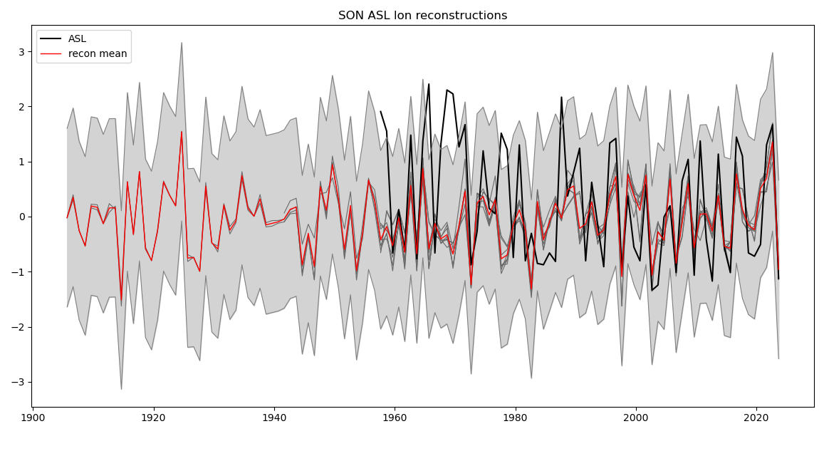
A first look at the longitude and latitude indices
Longitude
Much lower r² values, greater errors
than for area-averaged index.
Some improvement when Antarctic
stations added, but not as great as
area-averaged
Series excluding Antarctica have
very similar statistics, irrespective
of length
model | R² | correlation | MAE | RMSE
1957 p<0.1 | 0.29 | 0.54 | 0.7 | 0.83
1957 p<0.05 | 0.29 | 0.54 | 0.71 | 0.84
1957 ANT p<0.1 | 0.37 | 0.61 | 0.64 | 0.78
1957 ANT p,0.05 | 0.37 | 0.61 | 0.65 | 0.78
1941 p<0.1 | 0.29 | 0.54 | 0.71 | 0.85
1941 p<0.05 | 0.26 | 0.51 | 0.71 | 0.85
1905 p<0.1 | 0.29 | 0.54 | 0.71 | 0.83
1905 p<0.05 | 0.27 | 0.53 | 0.72 | 0.84
range | 0.26-0.37 | 0.51-0.61 | 0.36-0.56 | 0.49-0.72
Latitude has even lower r-squared,
From a first look, it appears that our method/data doesn’t allow for robust reconstruction of the ASL latitude and longitude indices

Slide 18
Summary and next steps
It is possible to produce reconstructions of the area-averaged ASL which explain 47-75% of the variance of the observed timeseries for SON, using Principal Components Regression.
The reconstructions are based on the existence of teleconnections from the tropical Pacific which influence SLP
patterns over a wide area
The reconstruction does not show such a positive ASL in the early 20th century as 20CRv3, which makes the latter potentially unreliable for analysing longer-term trends
This approach will not work for indices which do not show associations with SLP across the Southern Hemisphere e.g. RCP
While there is some reconstruction skill for the longitude and latitude indices, this is too small to make these reconstructions useful, without identifying other sources of predictability.
Correlations between reanalyses and the reconstruction vary over time and are particularly low in the mid 20th century
The use of the Pacemaker simulations suggests that a number of stations should show stable associations with the ASL over time
Next steps
Explore extension to all 4 seasons
Reconstructions based on ‘stable’ stations only
Try and incorporate data from additional sources, particularly for the ‘stable’ regions, e.g ships’ logbooks
Investigate whether the approach is suitable for reconstructing other Antarctic indices of interest e.g.
Amundsen Sea wind indices

Slide 19
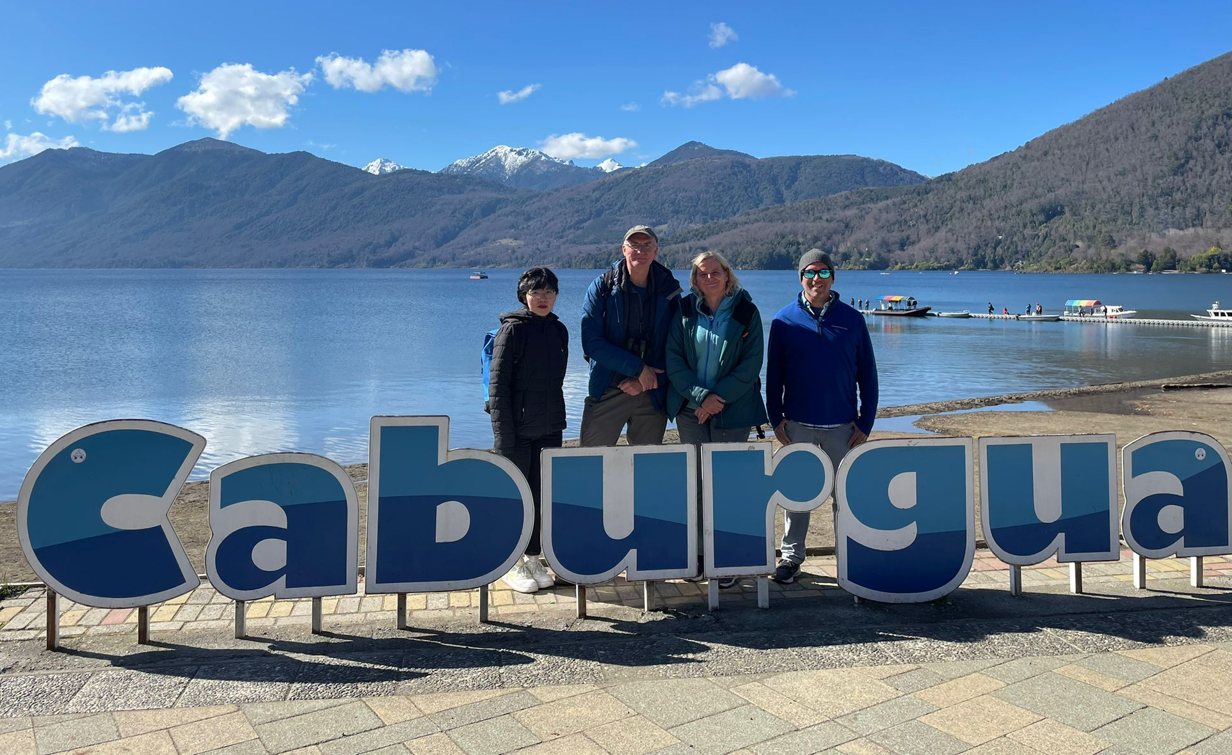

Slide 20
Extra Slides

Slide 21
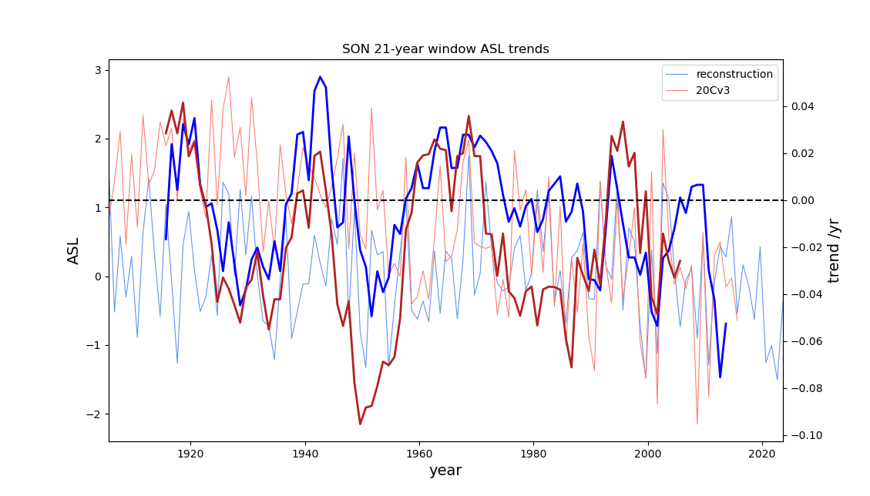
21-year moving window trends, 20Cv3 and the reconstruction
Generally in phase decreses and increases in trend especially pre-1970
20Cv3 dominated by negative trends, at least in part due to early high-pressure bias
Most negative trends for 20Cv3 are around 1950, whereas for the reconstruction they are in the most
Recent period

Slide 22
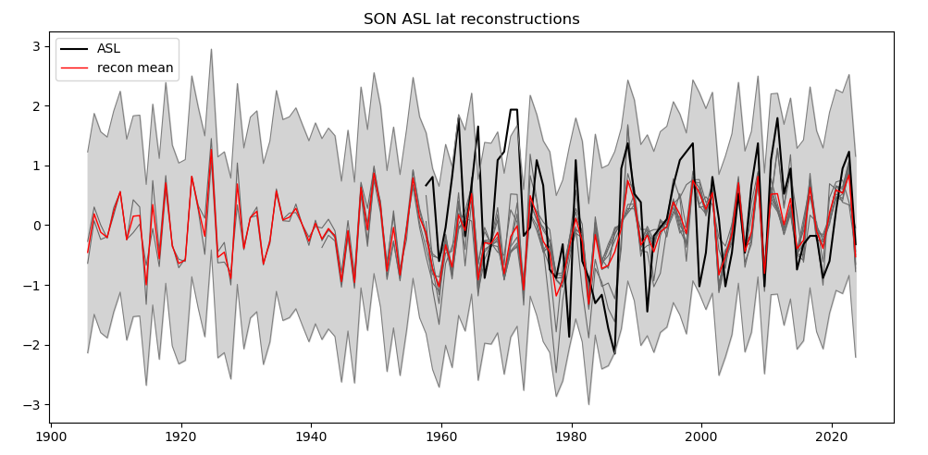
(b) Latitude
Even lower r² than longitude except where Antarctic stations included
When Antarctic included,
statistics are similar to some of the area-averaged models
model | R² | correlation | MAE | RMSE
1957 p<0.1 | 0.16 | 0.41 | 0.75 | 0.91
1957 p<0.05 | 0.17 | 0.42 | 0.74 | 0.9
1957 ANT p<0.1 | 0.39 | 0.62 | 0.64 | 0.77
1957 ANT p,0.05 | 0.44 | 0.66 | 0.59 | 0.74
1941 p<0.1 | 0.23 | 0.48 | 0.72 | 0.87
1941 p<0.05 | 0.18 | 0.43 | 0.73 | 0.9
1905 p<0.1 | 0.23 | 0.48 | 0.71 | 0.87
1905 p<0.05 | 0.2 | 0.45 | 0.72 | 0.89
range | 0.16-0.44 | 0.41-0.66 | 0.36-0.56 | 0.49-0.72
From a first look, it appears that
Southern Hemsiphere station SLP data
Does not allow for robust reconstruction
of the ASL latitude and longitude indices.
While the teleconnections explain a small
part of the variability, other unknown
factors are more relevant

Slide 23
Stability of significant correlations over time
At each grid point a 31-year moving-window
correlations are calculated
The red contour encloses the region where 70% of running correlations are significant (p<0.1) for at least 7 of the models
Stations are shown that occur within the regions of stable correlations
A next step is to calculate some reconstructions based on
‘stable’ stations only

Slide 24
Time-varying trends
Systematically more positive reanalysis ASL results in mostly negative trends

