Slide 1
Activities of ACRE Japan 2023-2024 -Ships around Japanese waters during the 18th and 19th centuries and new climate reanalysis “OCADA”-
Hisayuki Kubota (Hokkaido University)
and
Masayoshi Ishii (Meteorological Research Institute)

Slide 2
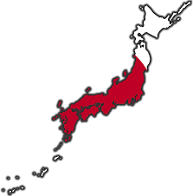
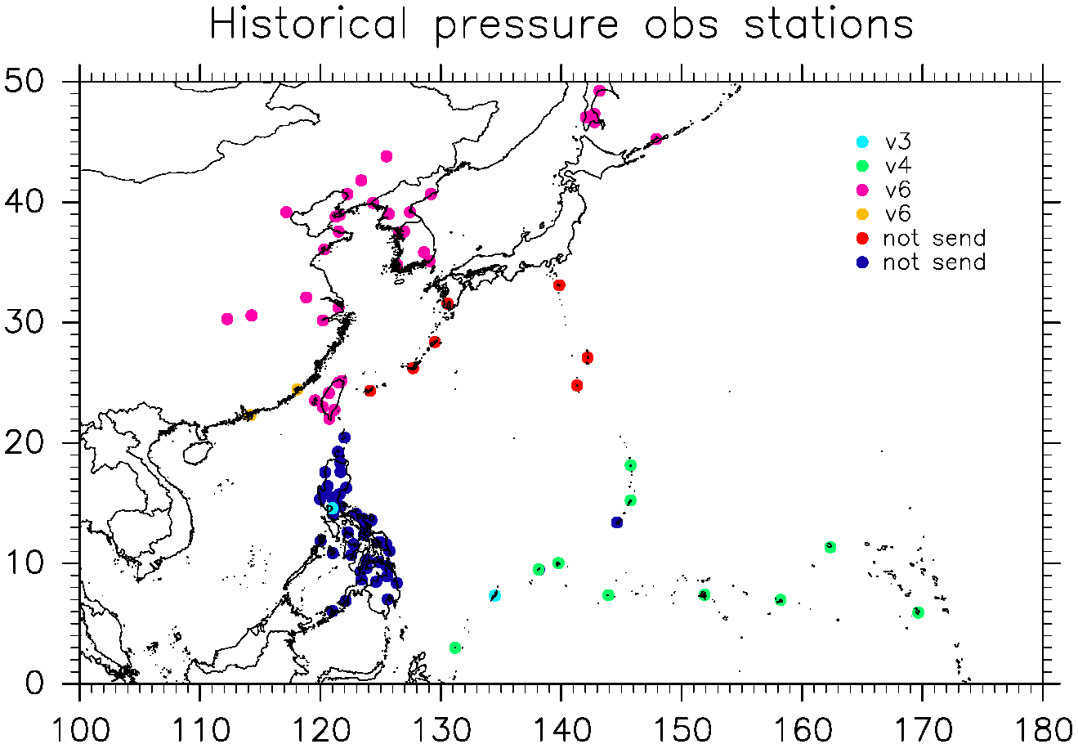
ACRE Japan
A joint network of Japanese Universities and Institutes aims to expand the understanding of climate change and variability in the Asian monsoon region through the data rescue of instrumental meteorological observations since the 19th century.
Digitized meteorological data have been provided to ISPD (The International Surface Pressure Databank) and contributed to the improvement of the 20th century reanalysis dataset. Japan-Asia Climate Data Program (JCDP) is one of the active programs under ACRE Japan.
Japanese KAKENHI Project:
Asian monsoon variability during the past 120 years (PI: Jun Matsumoto)
Accelerating international research collaboration
(PI: Hisayuki Kubota)
Recovery of Lighthouse observation in 19th century
(PI: Masumi Zaiki)
sent
sent
Station pressure data contributed to ISPD (1901-1941)

Slide 3
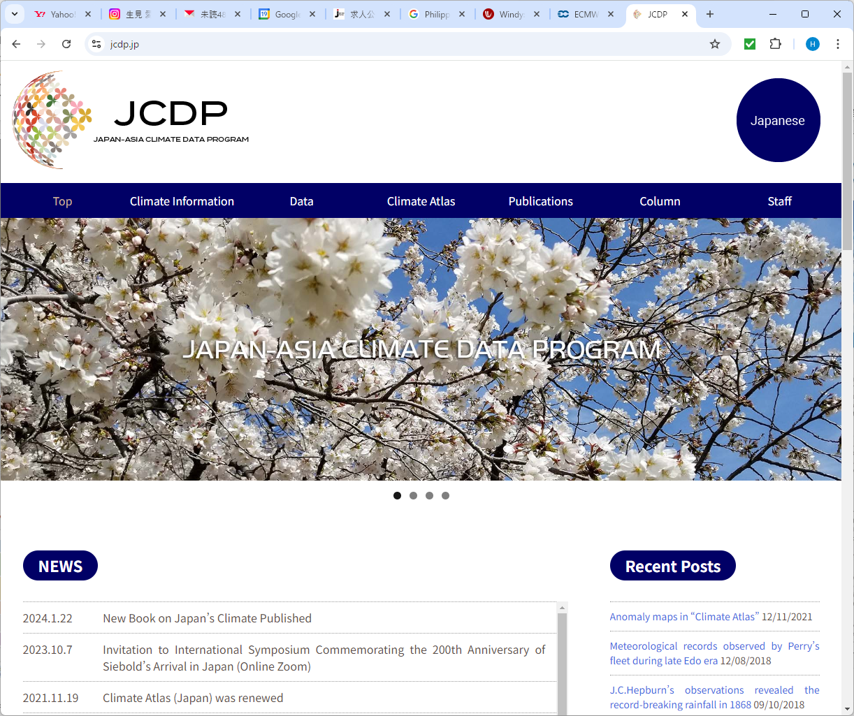

Slide 4
Target activities are:
Data rescue of daily rainfall data in Japan, East, Southeast and South Asian countries back to the late 19th century for Asian monsoon researches.
Data rescue of meteorological data in stations since the 1860s and ship logs sailing along the coastal region of East and Southeast Asia since the 1780s including the tropical cyclone tracks since the 1880s for tropical cyclone researches.
Data rescue of instrumental meteorological data observed in Japan by lighthouses and individual personnel before the official weather station were operated for climate studies in the 19th century. That of former local observatories of the current JMA since the 1880s.
Data rescue of upper air observations in Japan, East, Southeast Asia and Western North Pacific Islands since the 1920s.
Data rescue of civil and military meteorological observations and their history and background during World War II including their historical perspective.
Investigation of early instrumental meteorological observation in Japan deployed by foreign visitors since the 18th century.

Slide 5
Ships around Japanese waters during the 18th and 19th centuries

Slide 6
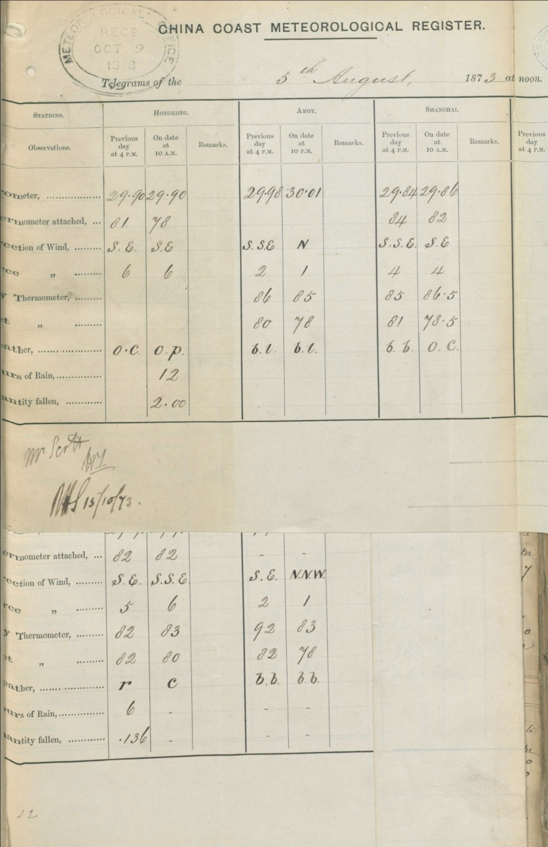
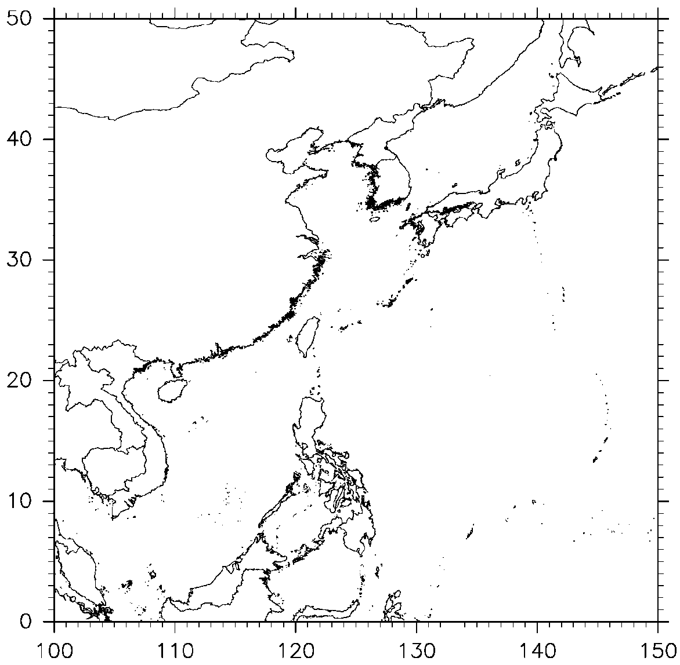
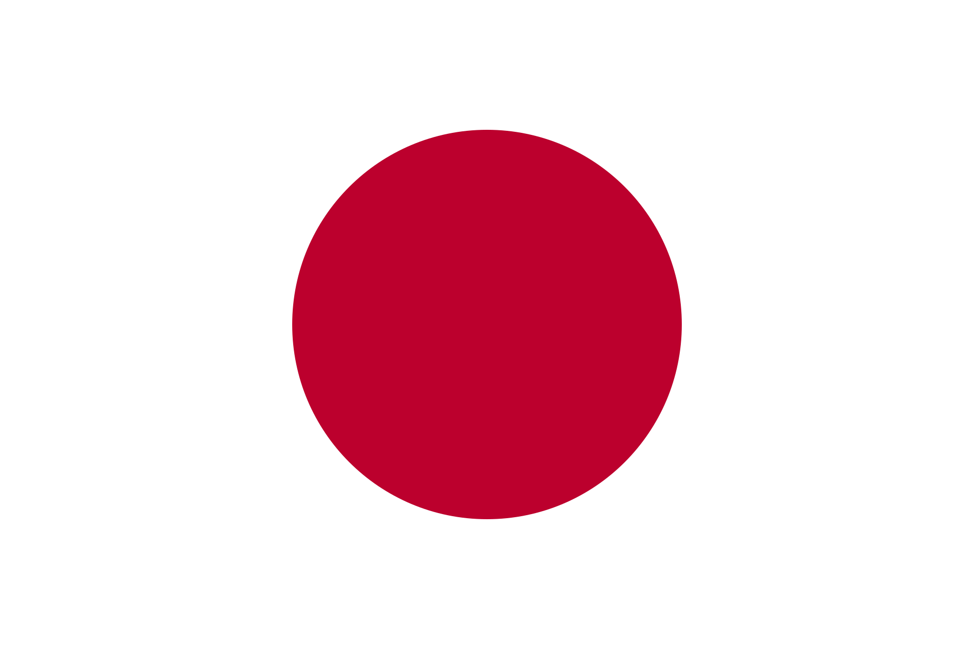
Early meteorological observation in East and Southeast Asia
Hong Kong
Amoy
Shanghai
Hakodate1872
Pressure
Wind
Temperature
Shanghai 1872
Weather
Amoy1873
Hong Kong 1861
Manila 1865
マニラ1865
Jakarta (Batavia) 1866
China coast Meteorological Register 1873.8.6

Slide 7
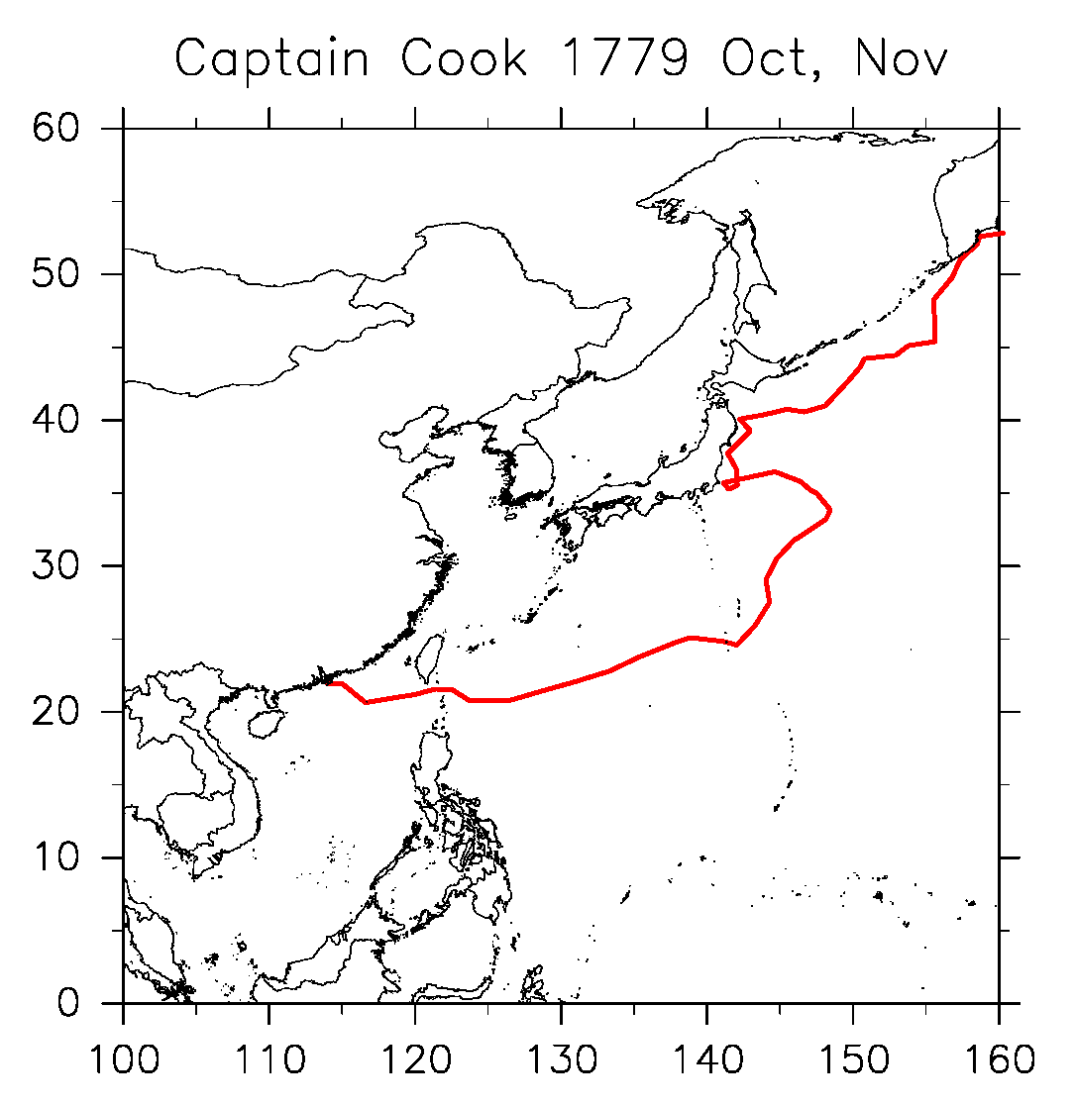
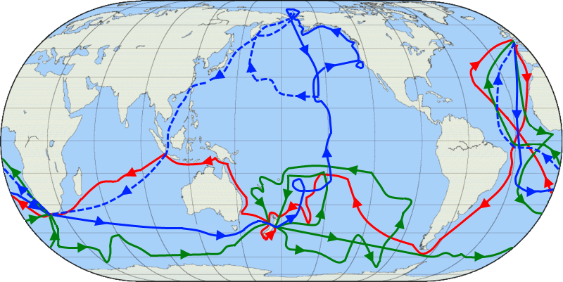
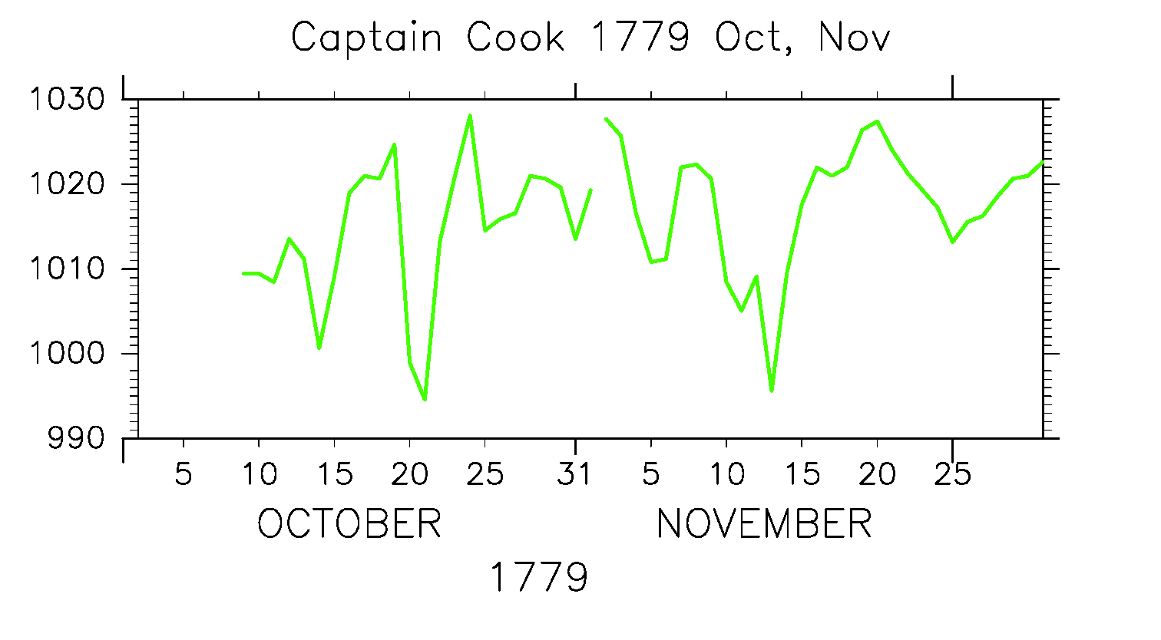
Voyages of Captain Cook
Third expedition after Cook passed away
Foster (2016)
Pressure
First
Second
Third
Wikipedia
Courtesy of Rob Allan

Slide 8
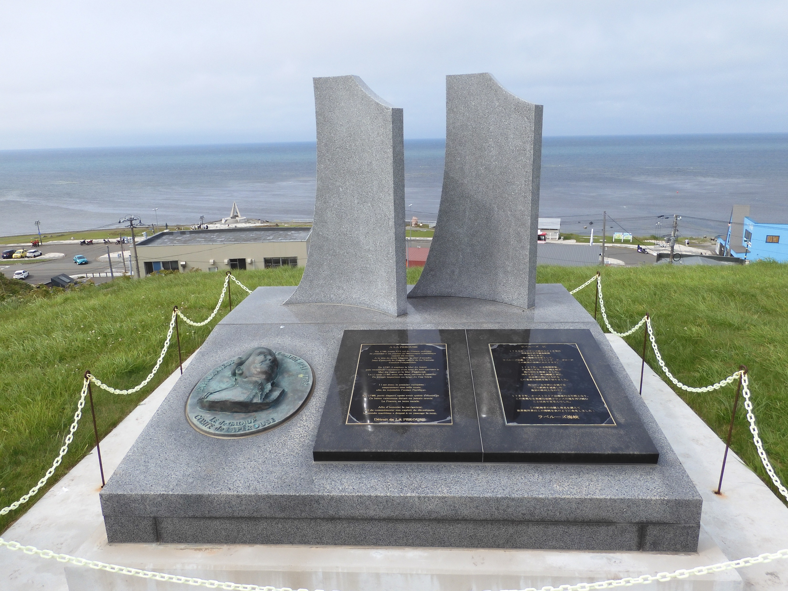
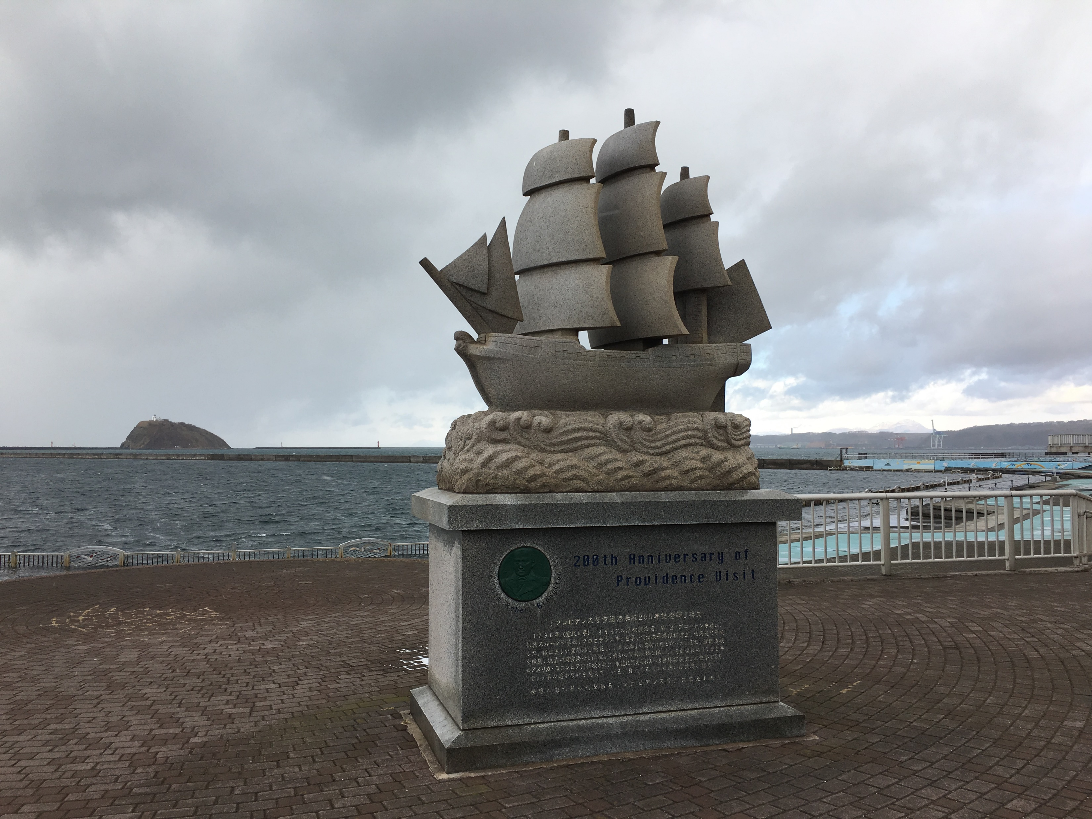
Foreign ships sailing along Japan waters before the 1880s
(Ship logs are collected and digitized the meteorological data）
1779 Captain Cook （UK） (Sailed along Japan waters)
1786-1787 La Perouse（France）（Sailed Sea of Japan and found Soya strait）
1796-1797 HMS Providence （UK） （Arrived Muroran of Hokkaido）
1837 Morrison（US） （Arrived Tokyo Bay but bombarded）
USS Vincennes（US） （Arrived Tokyo Bay but failed to open the country）
1853-1854 Perry’s 10 fleet（US） （Arrived Tokyo Bay and opened the country）
1853-1870 Dutch 4 Naval ships（Netherlands）（Participated in Shimonoseki War）
1855 USS John Hancock（US） （Sailed along Okhotsk Sea）
1863-1864 UK 11 Naval ships （Participated in Bombardment of Kagoshima and
Shimonoseki War）
1872-1877 UK 10 Naval ships （Arrived Japan）
La Perouse
Cape Souya
HMS Providence
Muroran

Slide 9
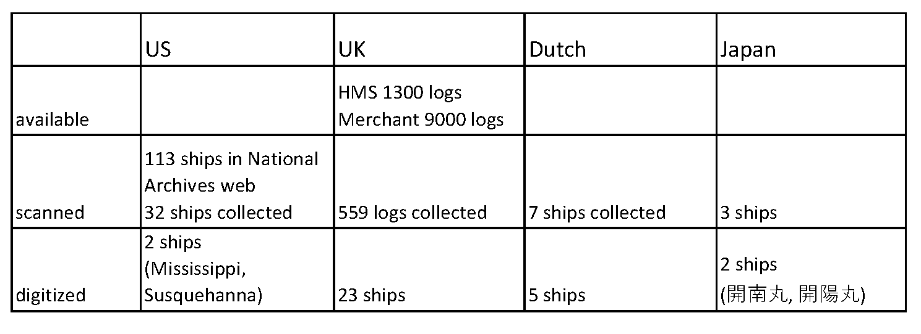
Ship logs during the 19th and early 20th century
US Navy ship logs are contributed by Kevin Wood and Mark Mollan
UK ship logs are mostly contributed by Clive Wilkinson and Sally Wilkinson
Except for ICOADS, Kobe collection, and citizen sciences (Oldweather.org etc.)
ICOADS (International Comprehensive Ocean-Atmosphere Data Set)
Digitized ship logs weather dataset 1662-present
Freeman et al. 2017

Slide 10
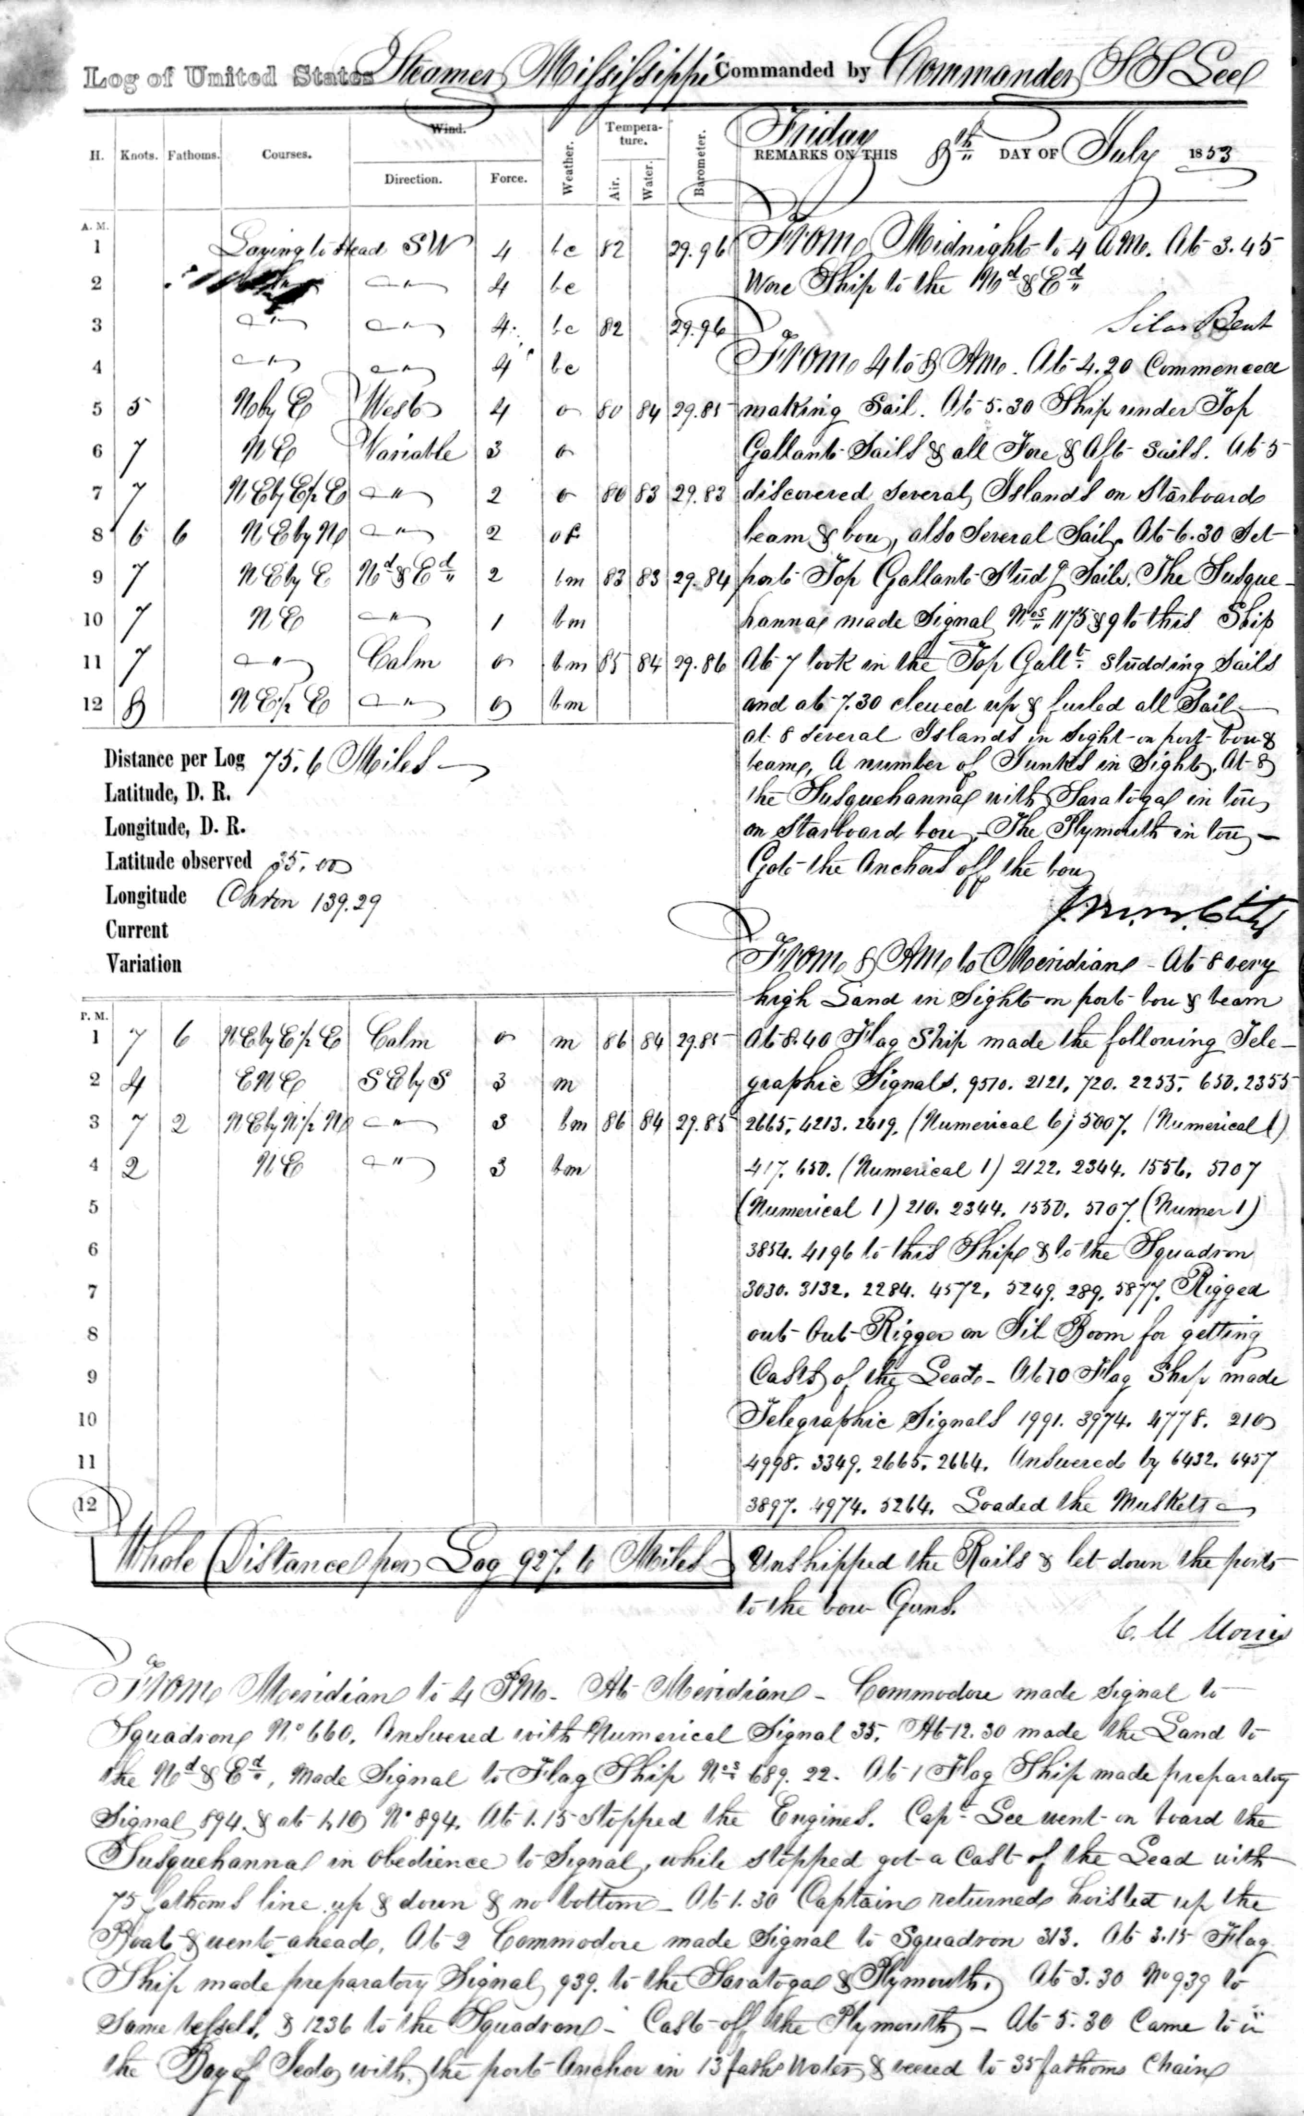
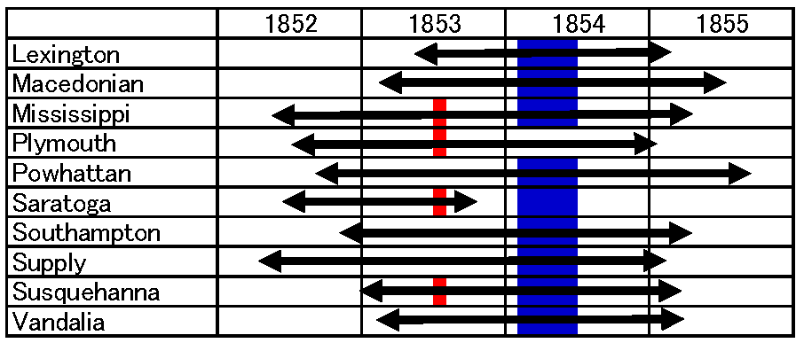
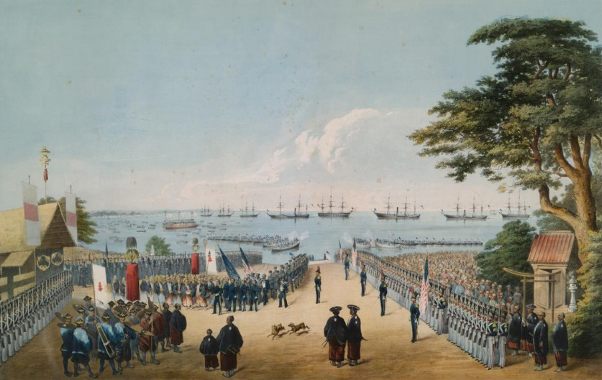
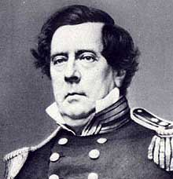
Black Ships arrival to Japan in 1853 and 1854
Ship logs of Perry’s fleet
↑ ↑↑ ↑
Wind, Weather, Temp, Pressure
（Atmos, SST）
Courtesy of Dr. Mark Mollan, Kevin Wood, and Philip Broham
Perry
(Wikipedia)
Yokohama 1854
(Wikipedia)
USS Mississippi
Jul. 8, 1853
Kubota et al. (2021)

Slide 11
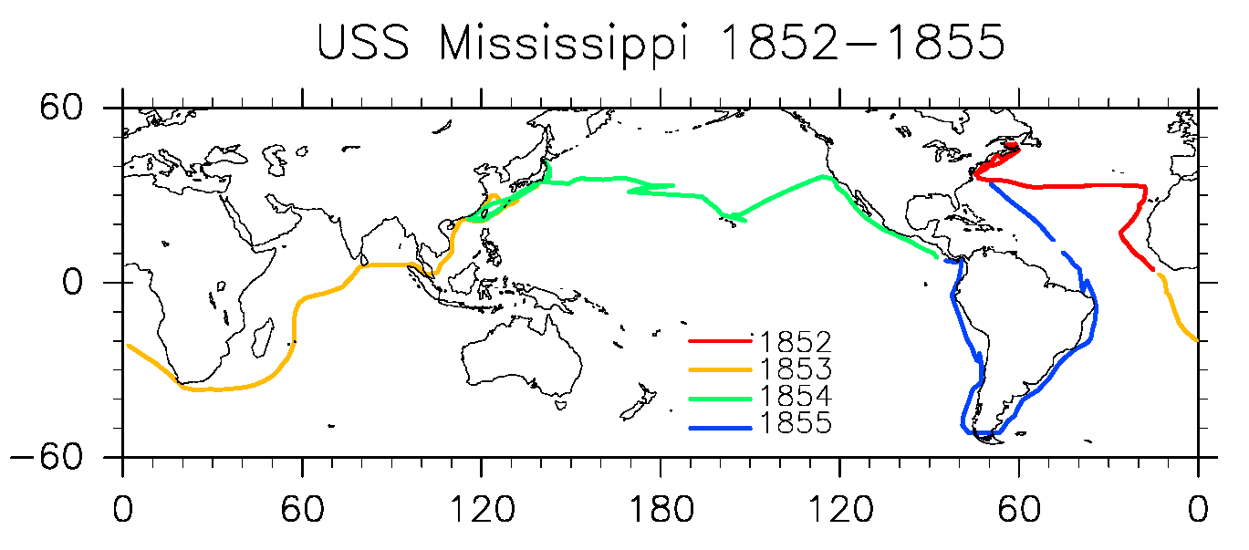
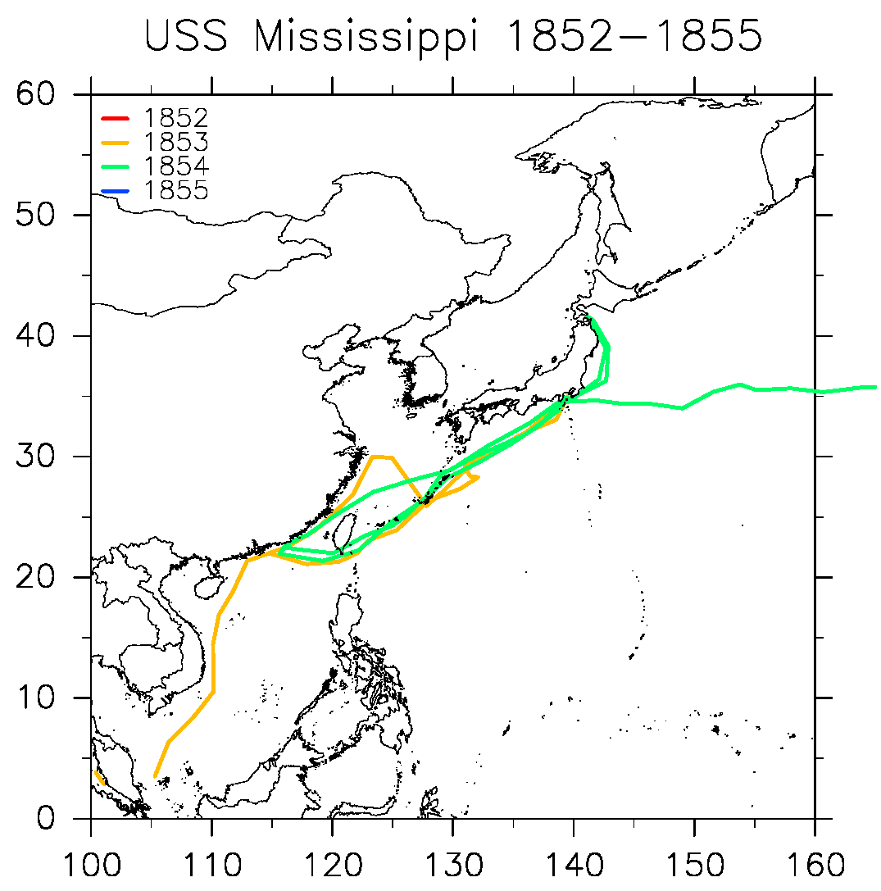
USS Mississippi ship track
Left New York in 1852, sailed to Japan and returned in 1855
Kubota et al. (2021)

Slide 12
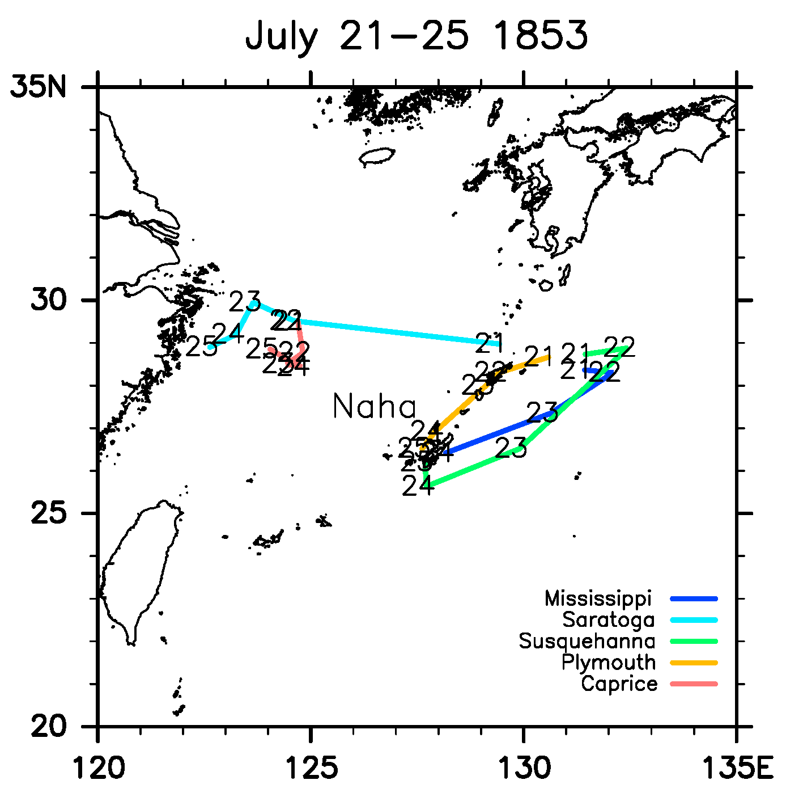
Observed tropical cyclone in East China Sea（July 21‐25, 1853）
Kubota et al. (2021)

Slide 13
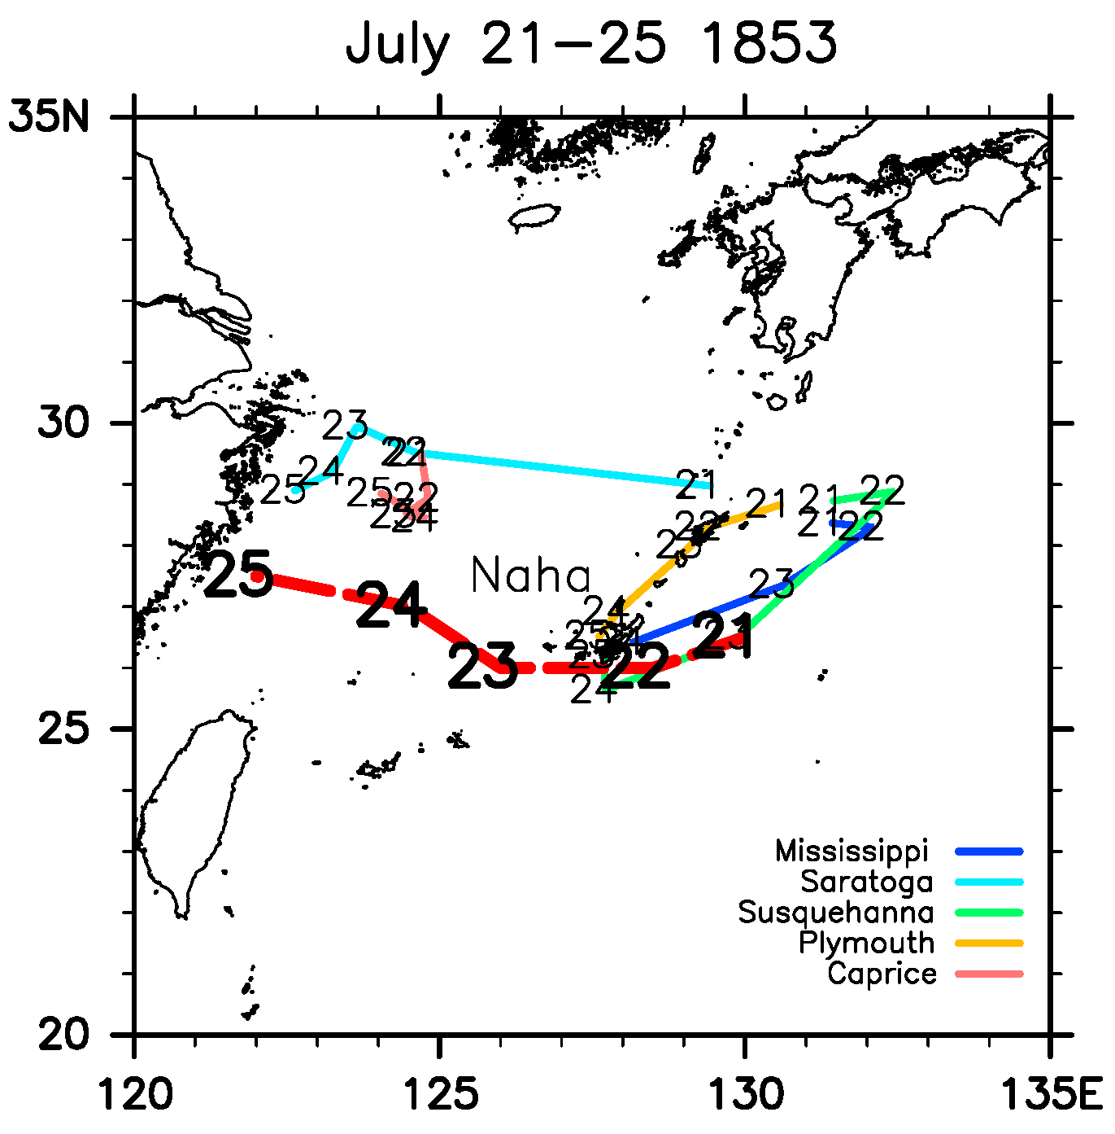
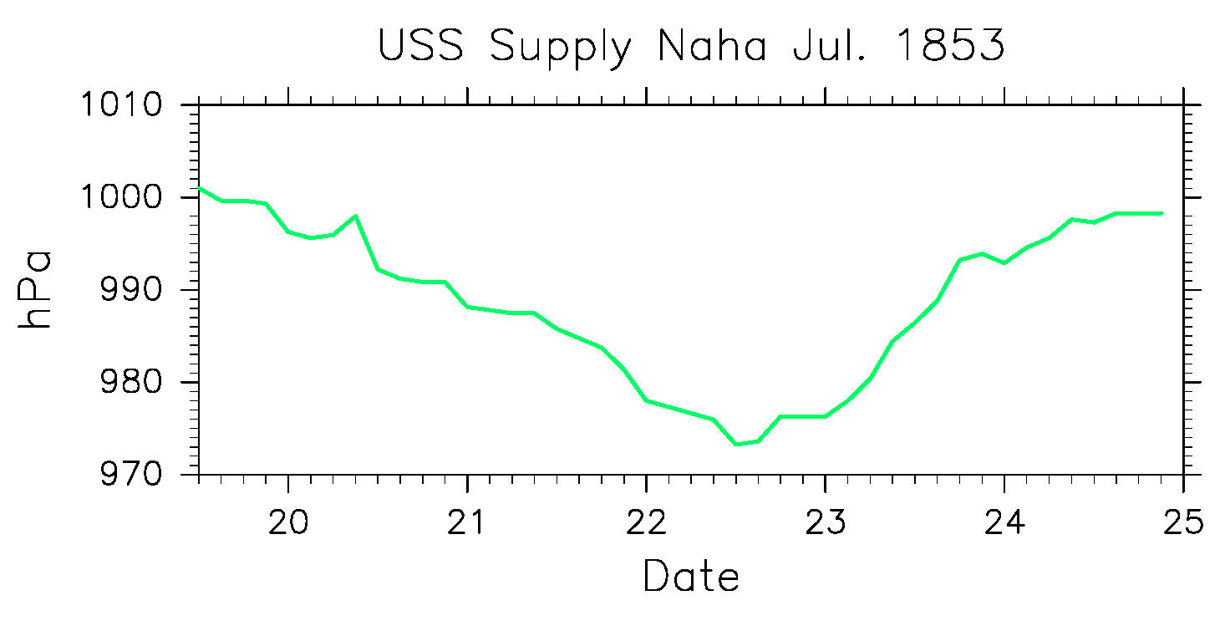
Observed tropical cyclone in East China Sea（July 21‐25, 1853）
USS Supply pressure (Naha）
Tropical cyclone track
Kubota et al. (2021)

Slide 14
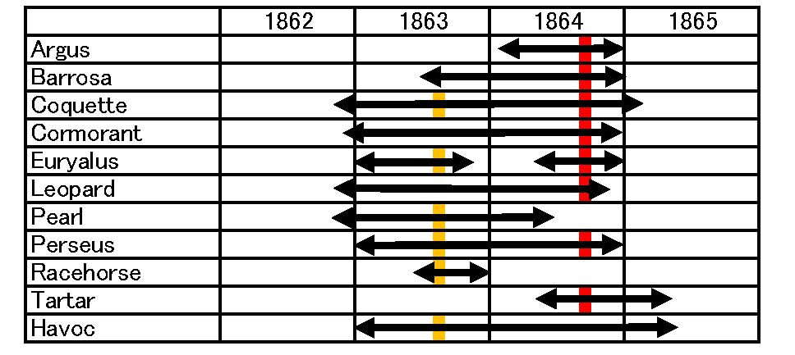
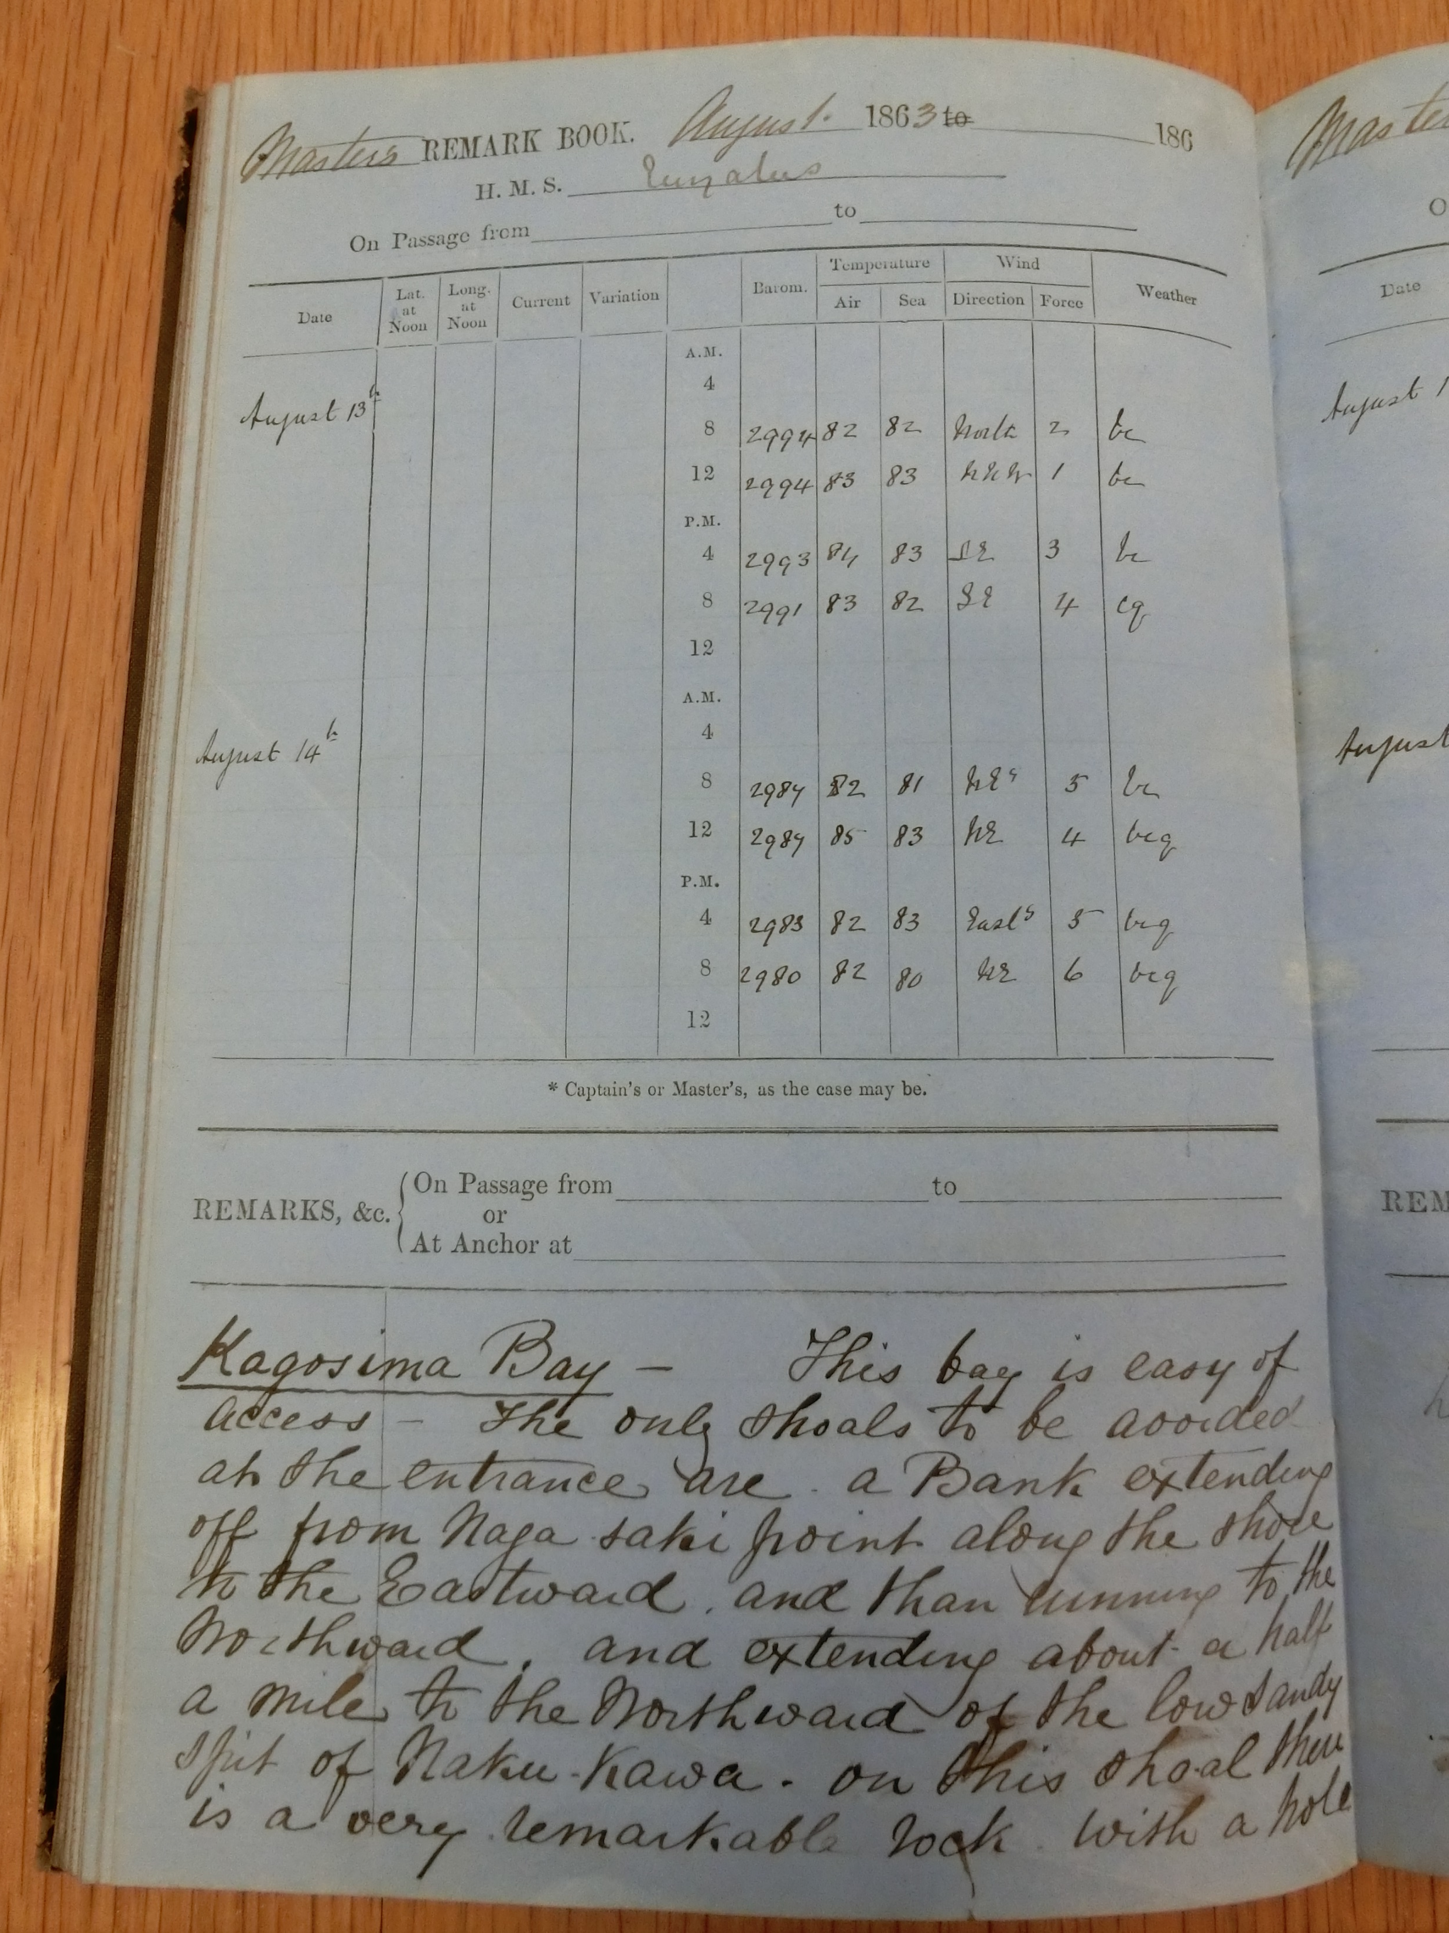
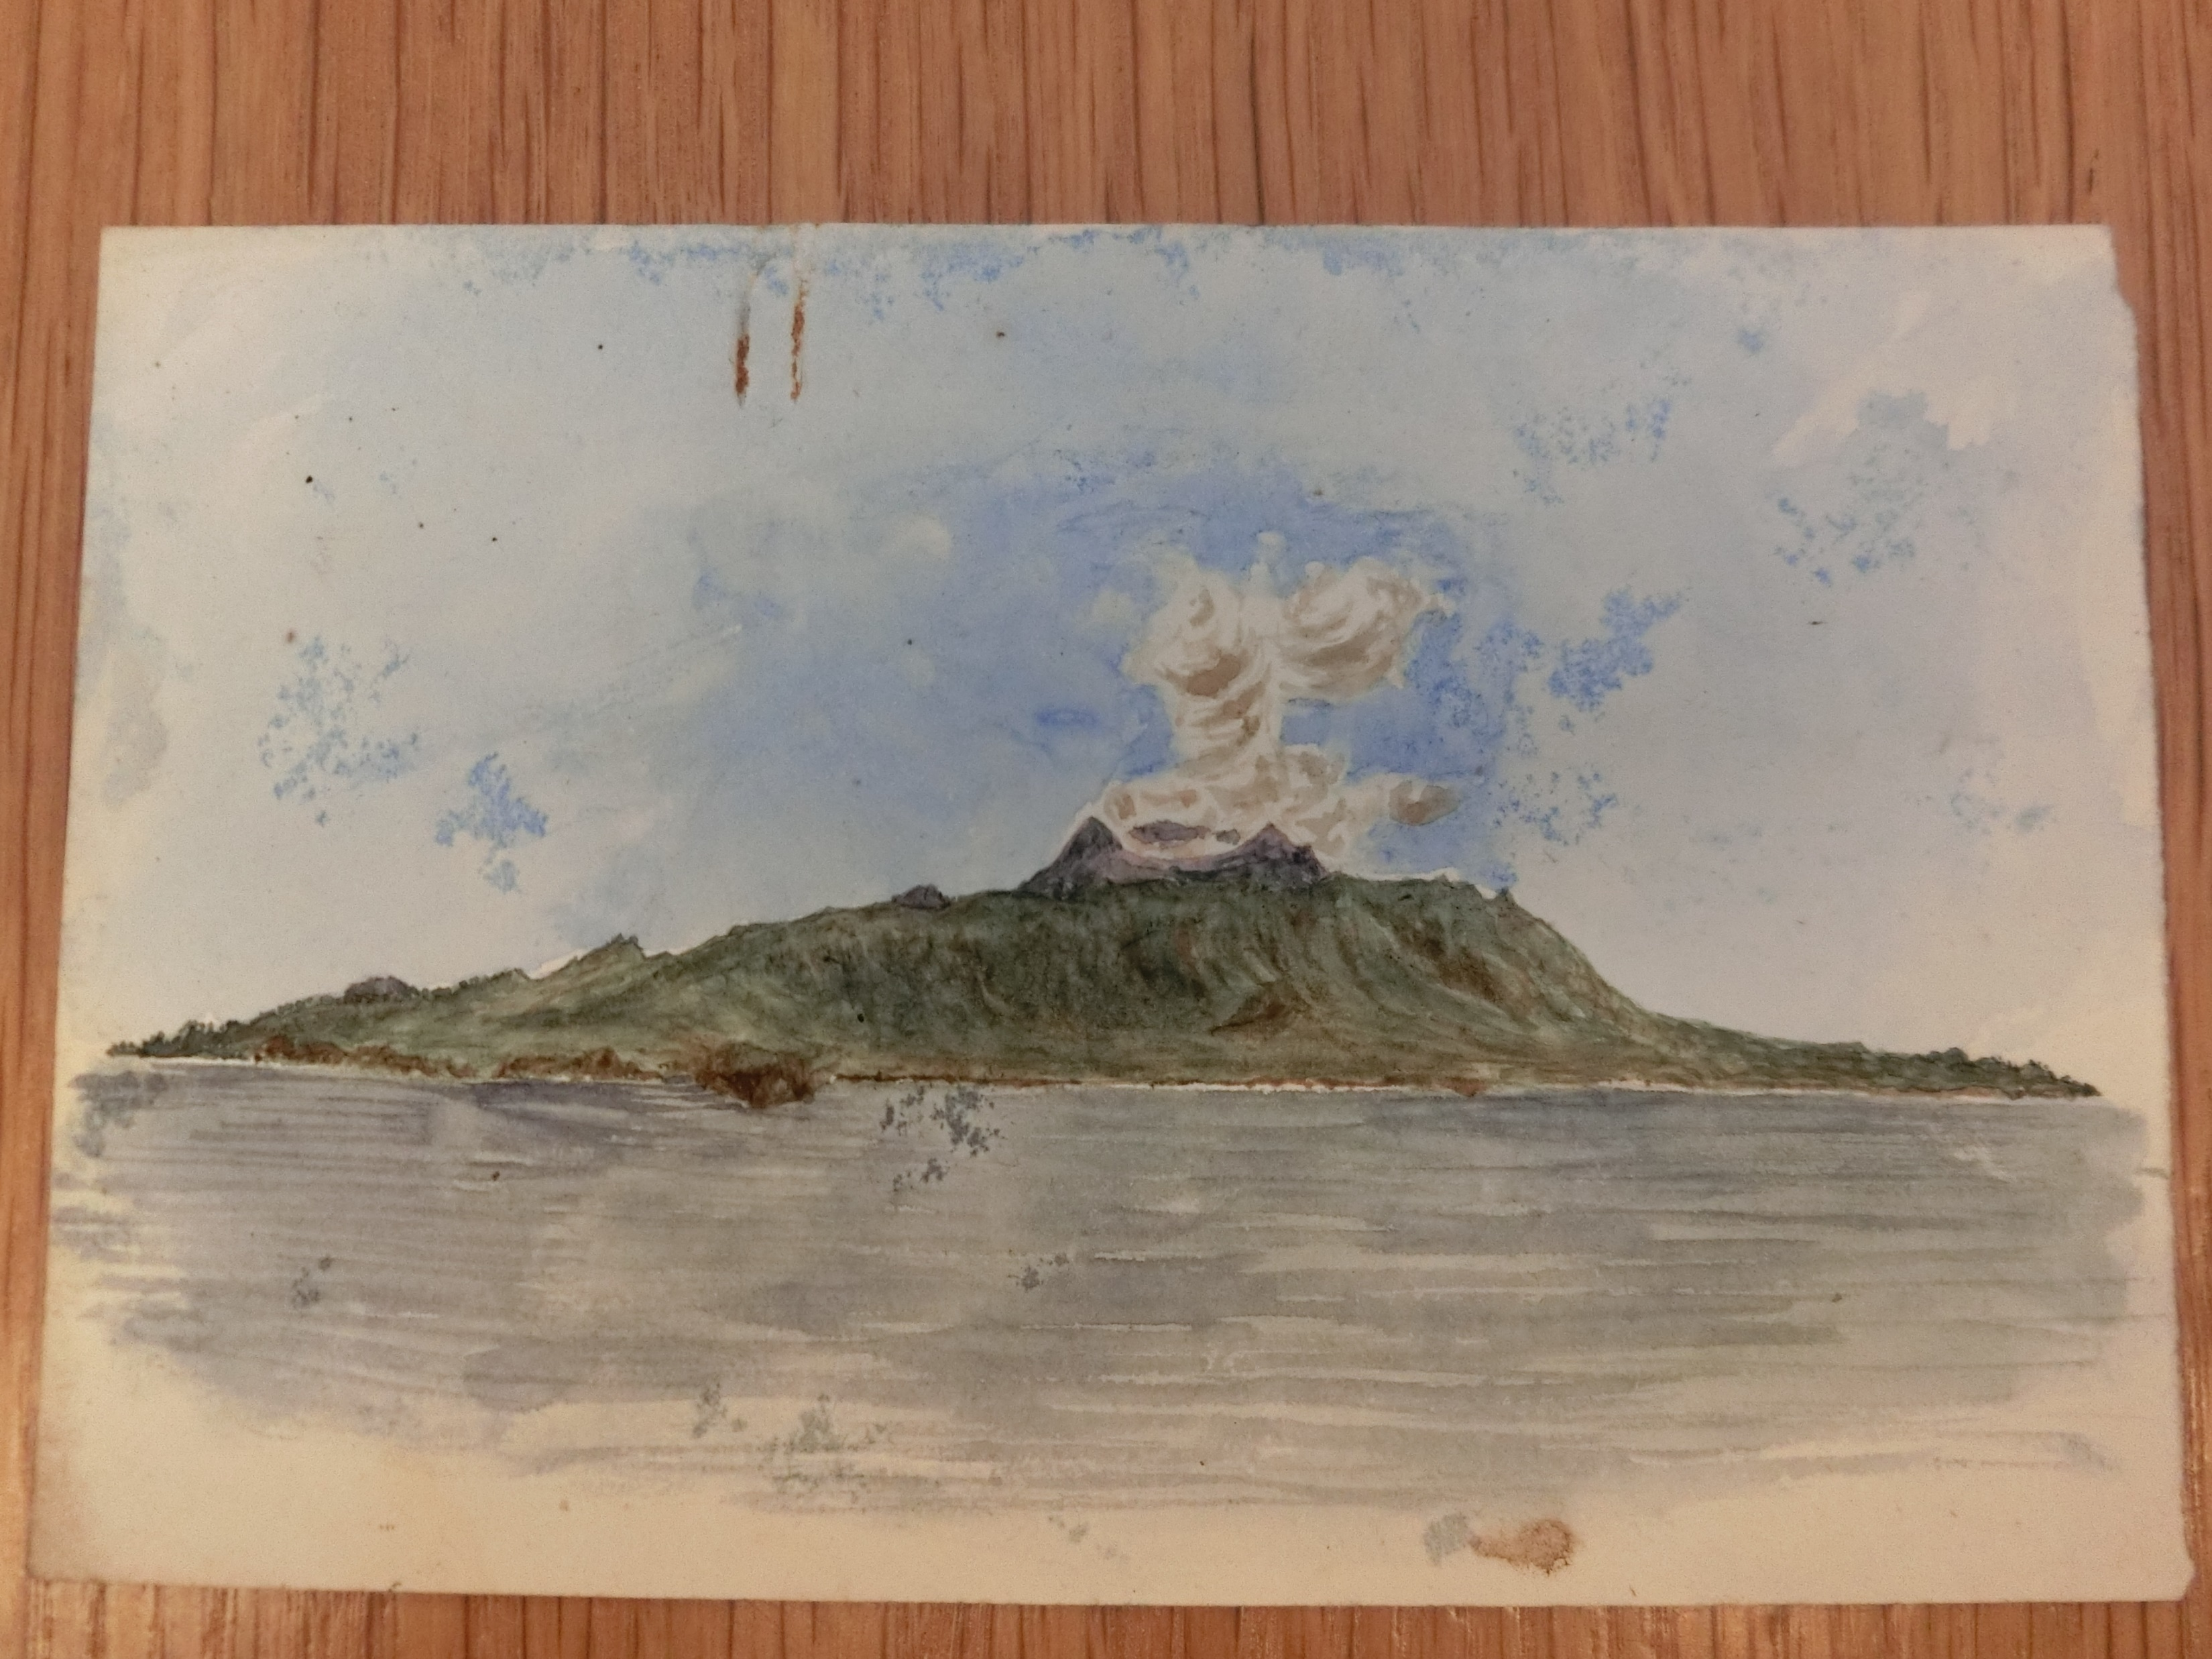
Ship logs of UK Navy participated in Bombardment of Kagoshima and Shimonoseki War
UK Hydrographic Office
UK National Archives
HMS Euryalus Aug. 13-14, 1863
Bombardment of Kagoshima
Shimonoseki War
HMS Euryalus
Sketch of Mt. Sakurajima
Kubota et al. (2021)

Slide 15
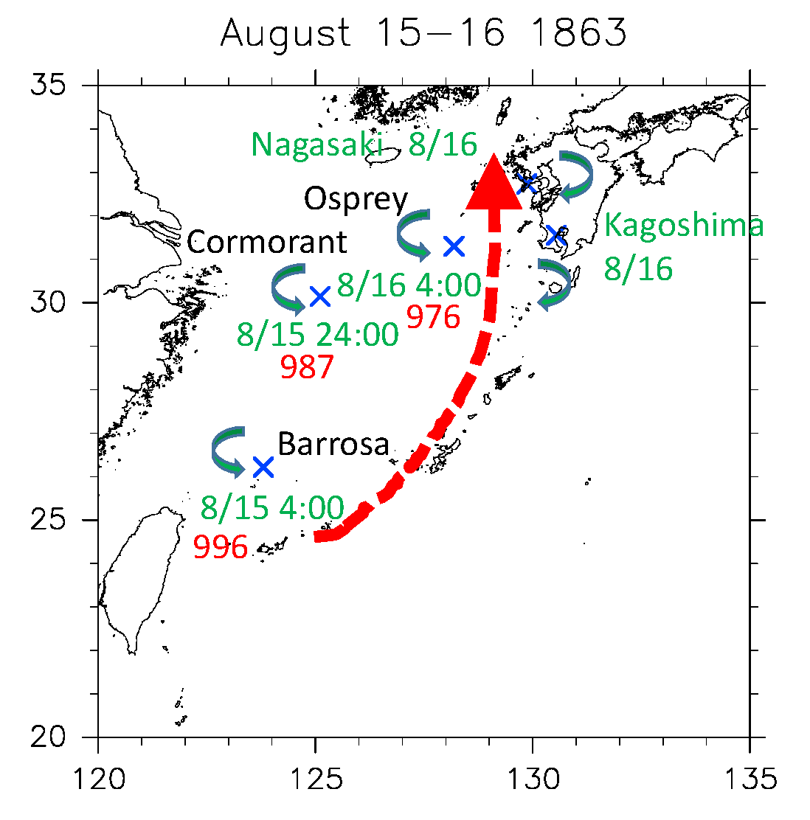
Observed tropical cyclone during Bombardment of Kagoshima
（Aug. 15-16, 1863）
×：Location of ships
Minimum pressure（Local time）
Wind direction change
Estimated typhoon track
Kubota et al. (2021)

Slide 16
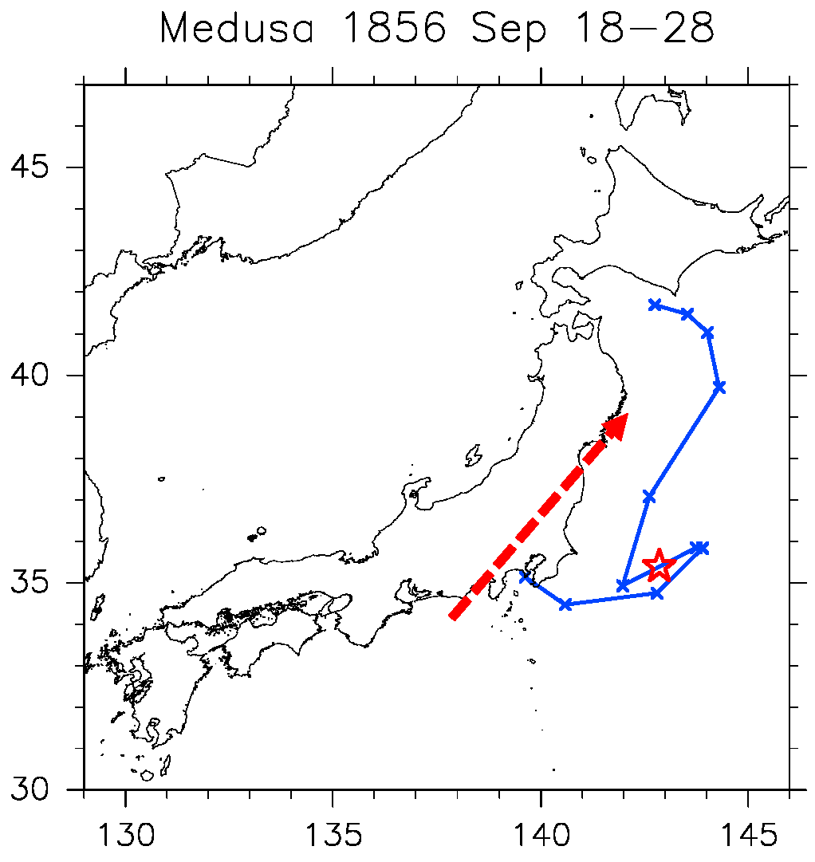
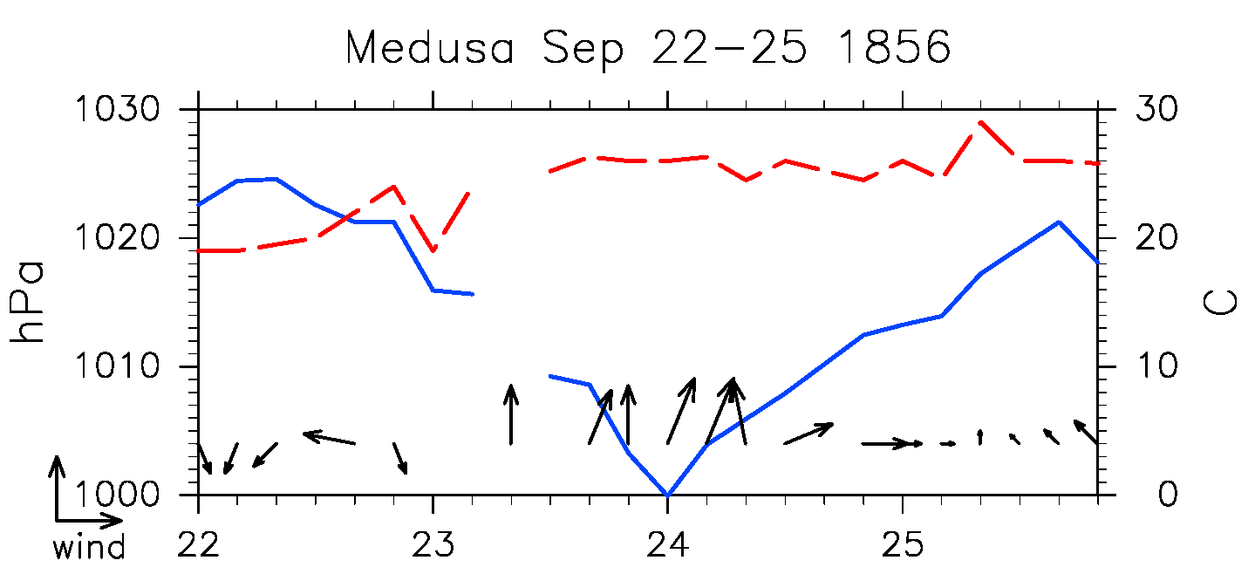
Ansei-Edo typhoon observed by Dutch navy ship Medusa (Sep. 24, 1856)
(Suffered strong wind and storm surge in Tokyo)
Estimated 1000hPa radius of Ansei-Edo typhoon as 359km
Ship track during Sep 18-28, 1856
Estimated Ansei-Edo typhoon track
（Hirano and Zaiki 2020）
☆
Ship location on midnight on Sep. 24, 1856
Time series during Sep. 22-25, 1856
pressure
temperature
Wind speed and wind direction
Kubota et al. (2023)
date(local time)

Slide 17
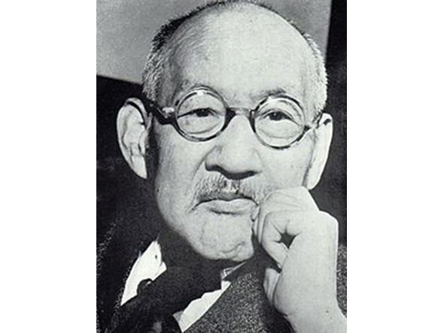
New climate reanalysis “OCADA”
Over-Centennial Atmospheric Data Assimilation
named by the former JMA director general
Takematsu Okada
1874-1956

Slide 18
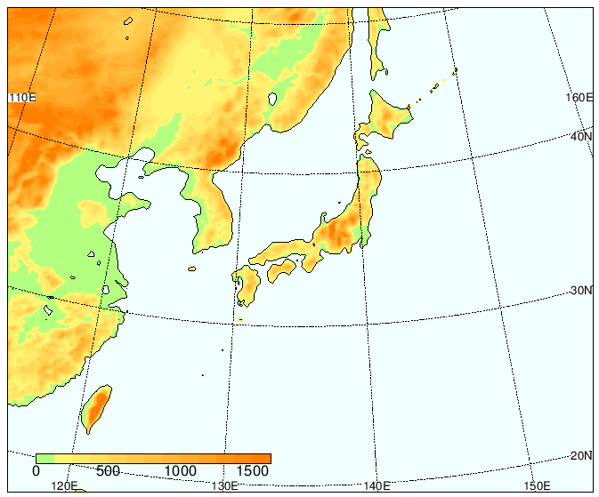
OCADA
60km AGCM
MRI-AGCM3.2 (Mizuta et al. 2012)
20kmregional model
NHRCM (Sasaki et al. 2012)
Ishii et al. (2024)
downscaling
Specifications
LETKF (Hunt et al. 2007)
MRI-AGCM3.2 (Mizuta et al. 2012)
Data assimilation、3 hourly、Ps, U, V, T, q
Period：1845 ～ 2015
Observation data
Sea level pressure (ISPD v.4.7; Compo et al. 2019) + α
TCtracks (IBTrACS v04r00) + α
COBE-SST2 (Hirahara et al. 2014) + SST perturbation
大気
SST・海氷
Mizuta et al. (2012)
database for Policy Decision making for Future climate change (d4PDF)
Mizuta et al. (2017)
Ishii and Mori (2020)
By Ishii

Slide 19
Comparison between other reanalysis data
 | OCADA | 20CR | EARA-20C
Model | AGCM | AGCM | AGCM
Resolution | 60 km, 64 levs (0.01 hPa) | 60 km, 64 levs (0.3hPa) | 30 km, 91 levs (0.01hPa)
D. A. | EnKF (Hunt et al. 2007) | EnKF (Whitaker et al. 2004) | 4DVAR, EDA
Period | 1850 - 2015 | 1836 - 2015 | 1900 - 2010
Atm. Observations | Ps, Best Track | Ps (incl. Best Track Pc) | Ps, U
SST | COBE-SST2, 80 ptb.s | HadISST2.3 (1981-2015), SODAsi.3 (1836-1980), 8 ptb.s | HadISST 2.1.0.0, Hirahara’s ptb.s
Outputs | 6 hrly | 3 hrly | 3 hrly
Note | Ishii et al. (2024) | Slivinski et al. (2019a,b) | Poli et al. (2016)
By Ishii

Slide 20
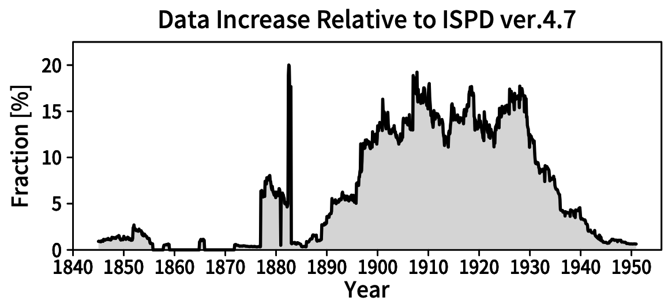
Increase observation data for data assimilation
Edo・Yokohama
Dejima・Nagasaki
Central Meteorological Observatory of Tokyo Japan・South Seas Bureau・Philippines
Lighthouses
Ishii et al. 2024
By Kamahori

Slide 21
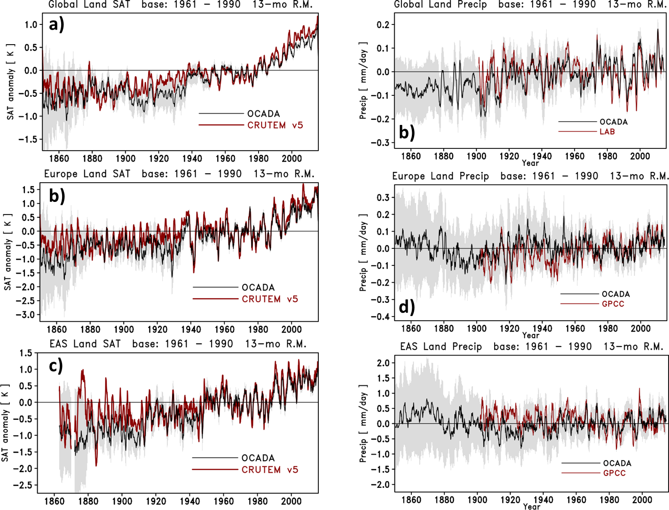
Land air temperature (left) and land precipitation (right) grey: spread
OCADA
Global
Global
Europe
Europe
East Asia
East Asia

Slide 22
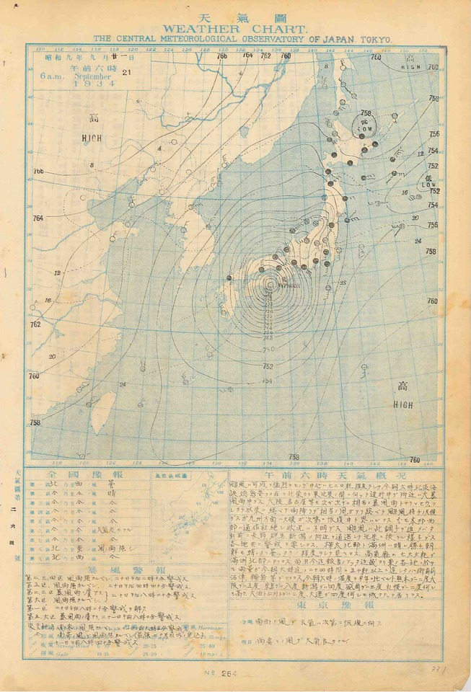
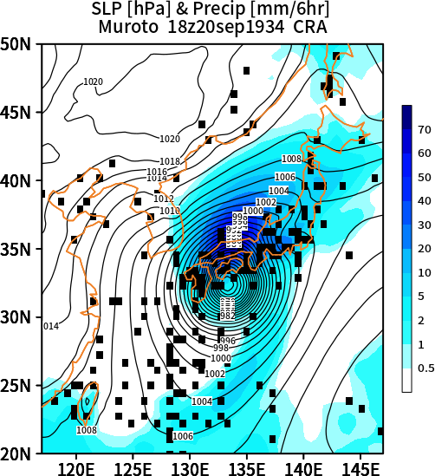
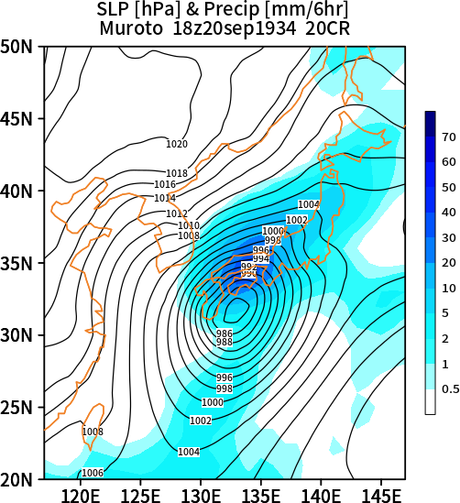
Muroto typhoon Sep. 1934
1934 9 19 9 23.5 128.5 967 76
1934 9 19 12 24.0 128.5 967 76
1934 9 19 21 26.0 129.0 966 77
1934 9 20 0 26.8 129.3 967 76
1934 9 20 3 27.4 130.0 967 76
1934 9 20 4 28.2 130.3 960 83
1934 9 20 9 29.5 130.6 960 83
1934 9 20 12 30.6 131.2 960 83
1934 9 20 15 31.5 132.0 947 97
1934 9 20 18 32.6 133.2 920 122
1934 9 20 21 34.0 134.8 939 105
1934 9 21 0 35.4 136.0 959 84
1934 9 21 3 37.9 138.5 971 71
1934 9 21 9 40.0 142.0 976 65
1934 9 21 21 42.0 150.0 983 56
Before landfall： 960 hPa 1934/9/20 18Z

Slide 23
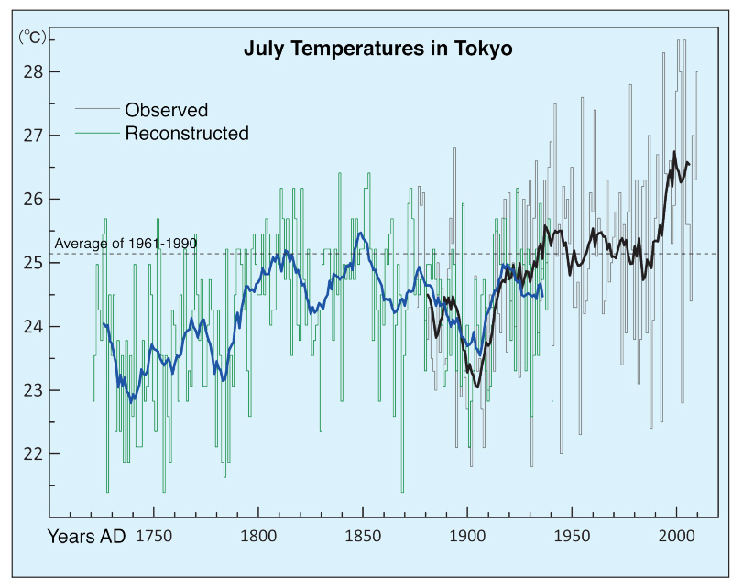
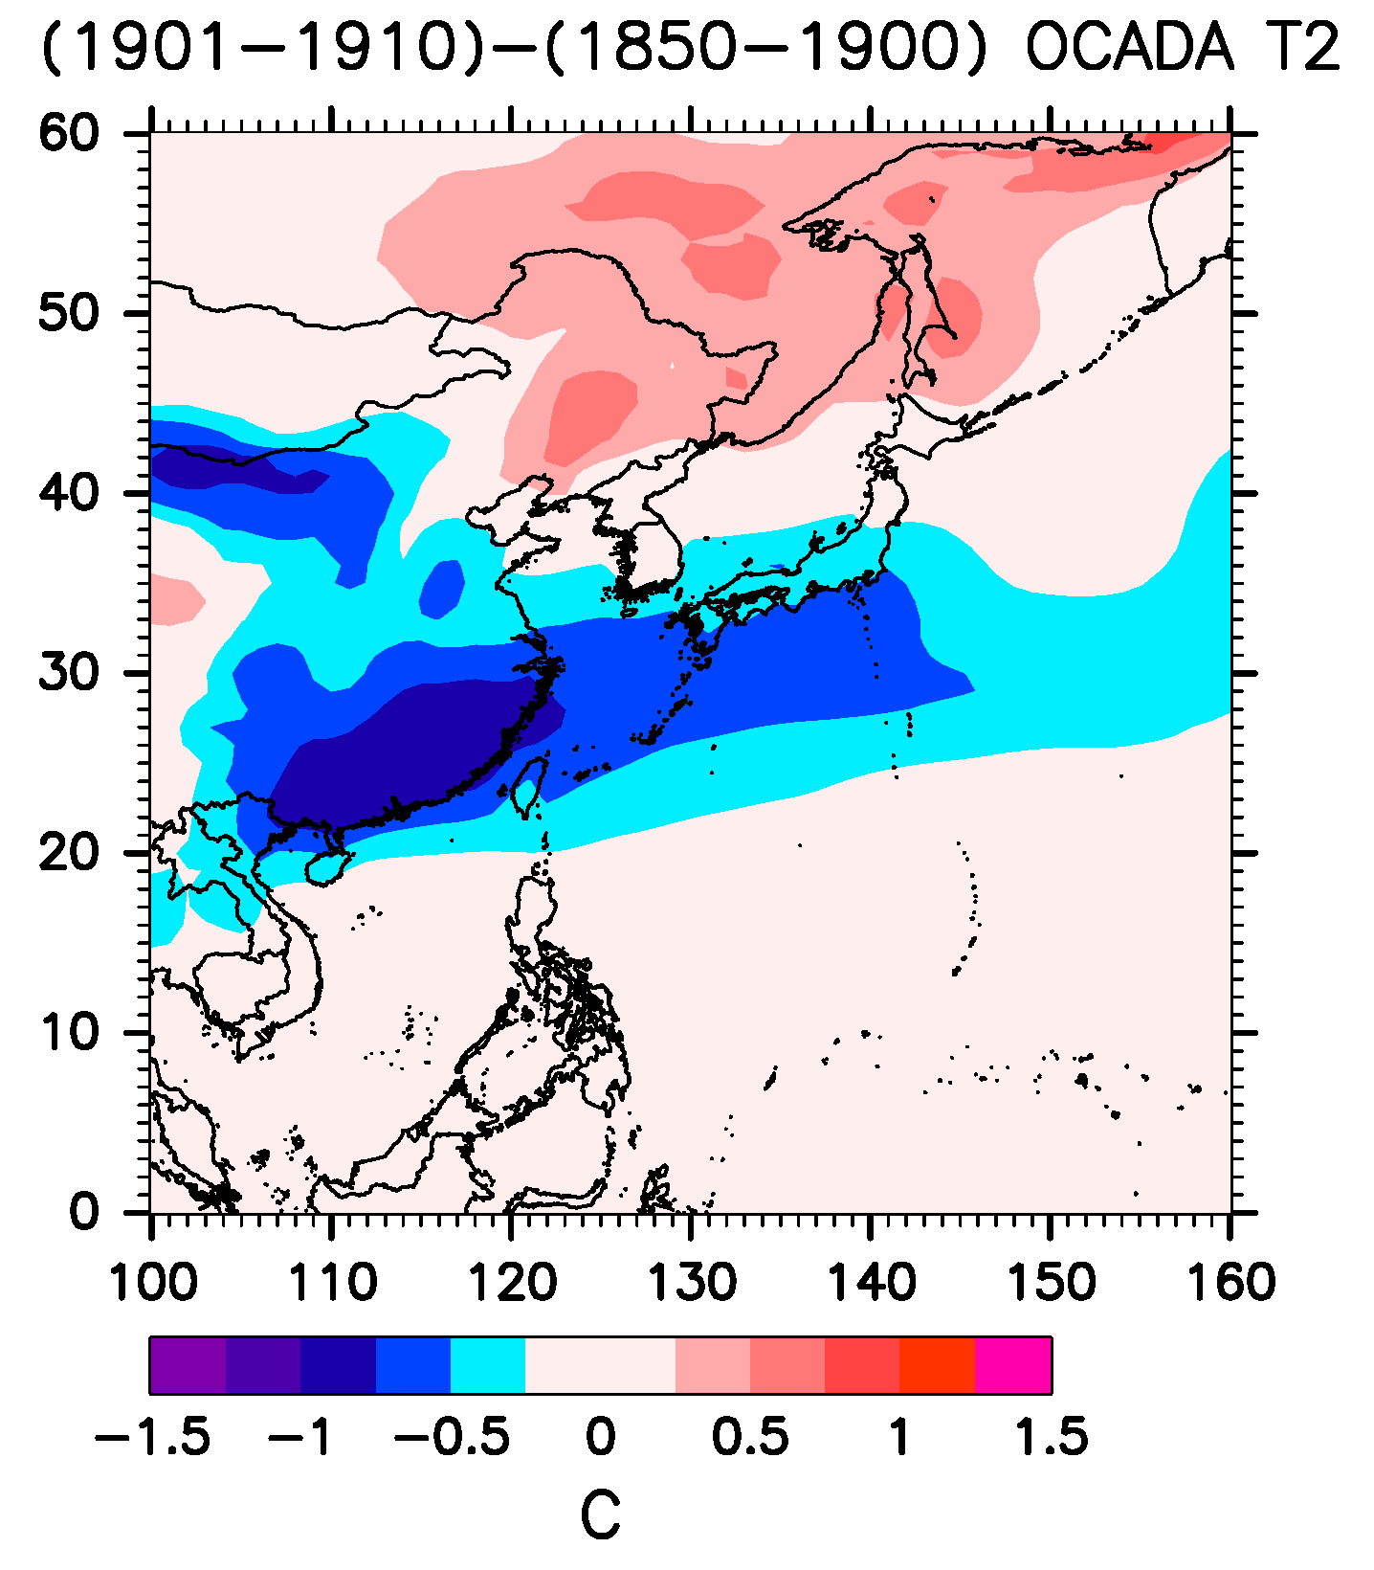
Cold period in Asia during the early 20th century
Difference of air temperature during 1901-1910 from 1850-1900 (pre-industrial revolution)
Tokyo temperature in July (1721-2011)
Zaiki and Mikami 2013

Slide 24
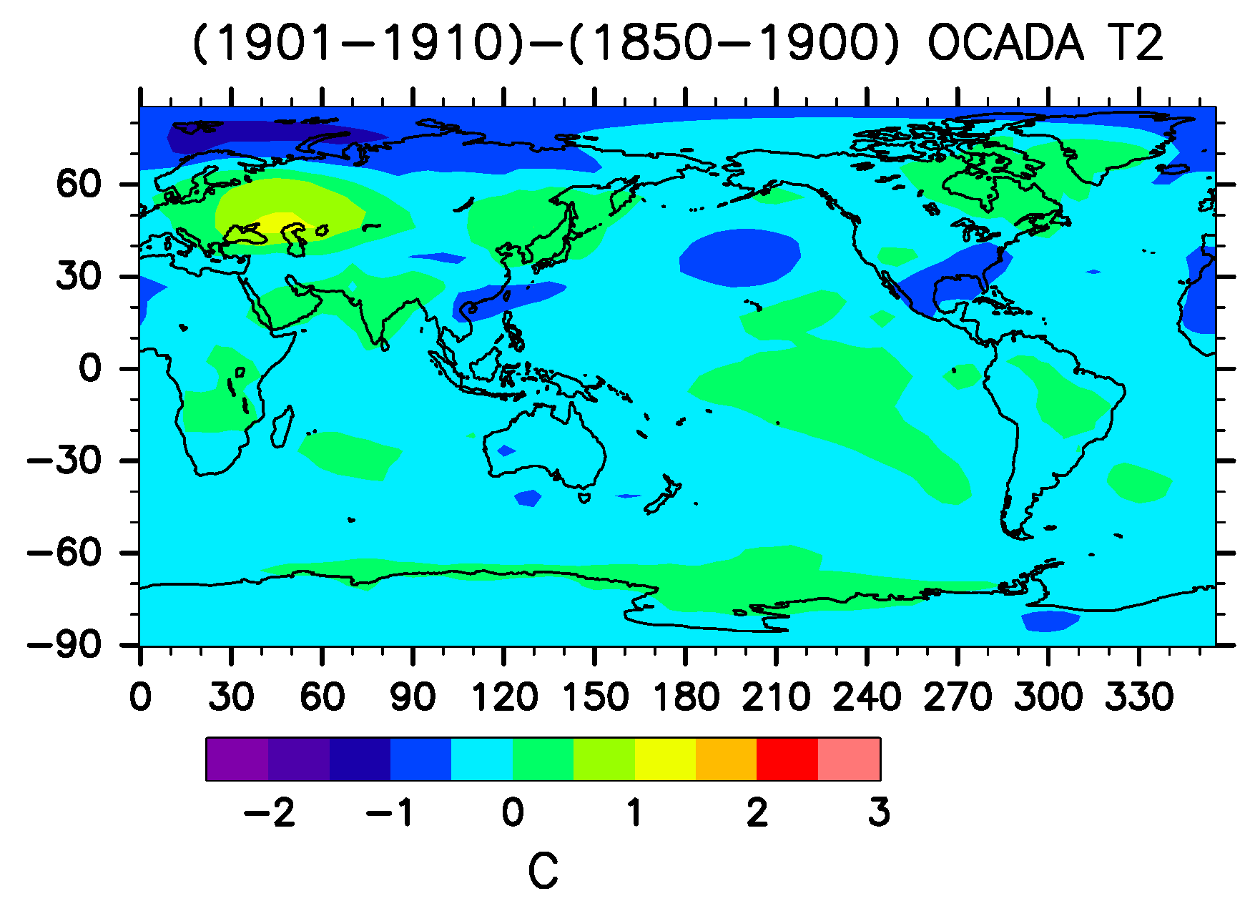
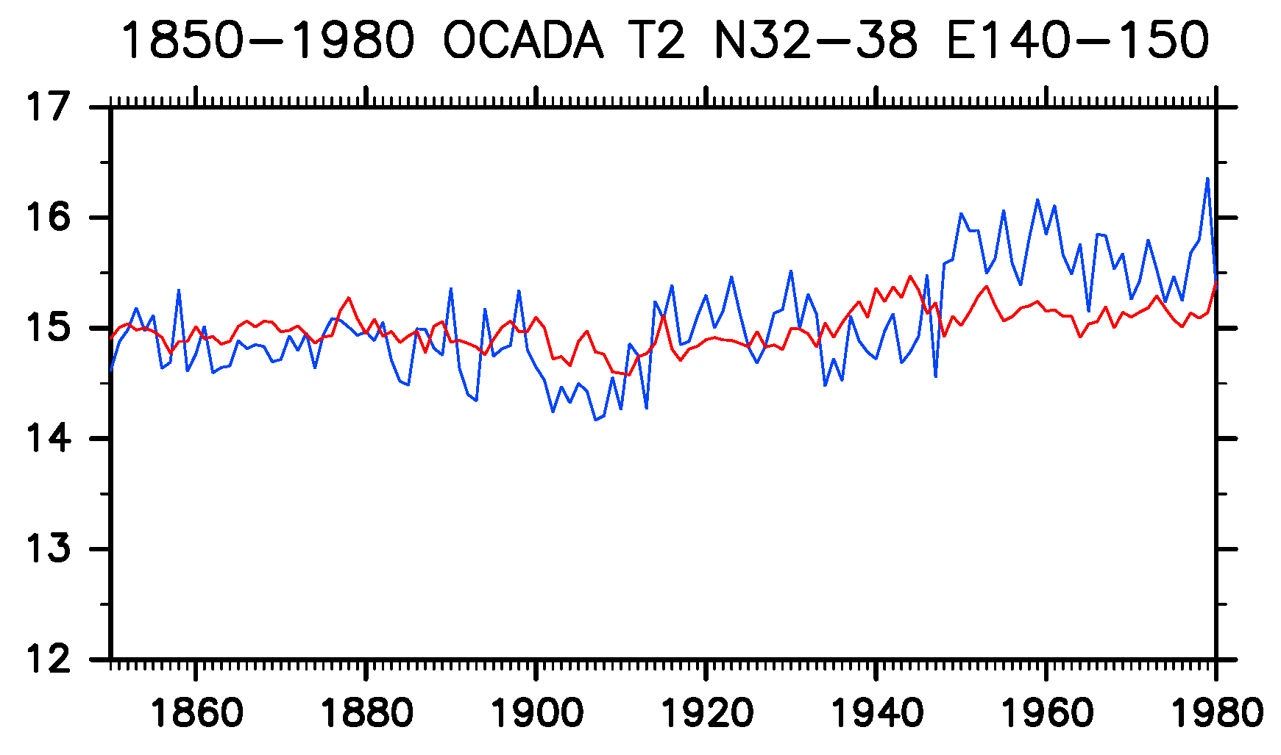
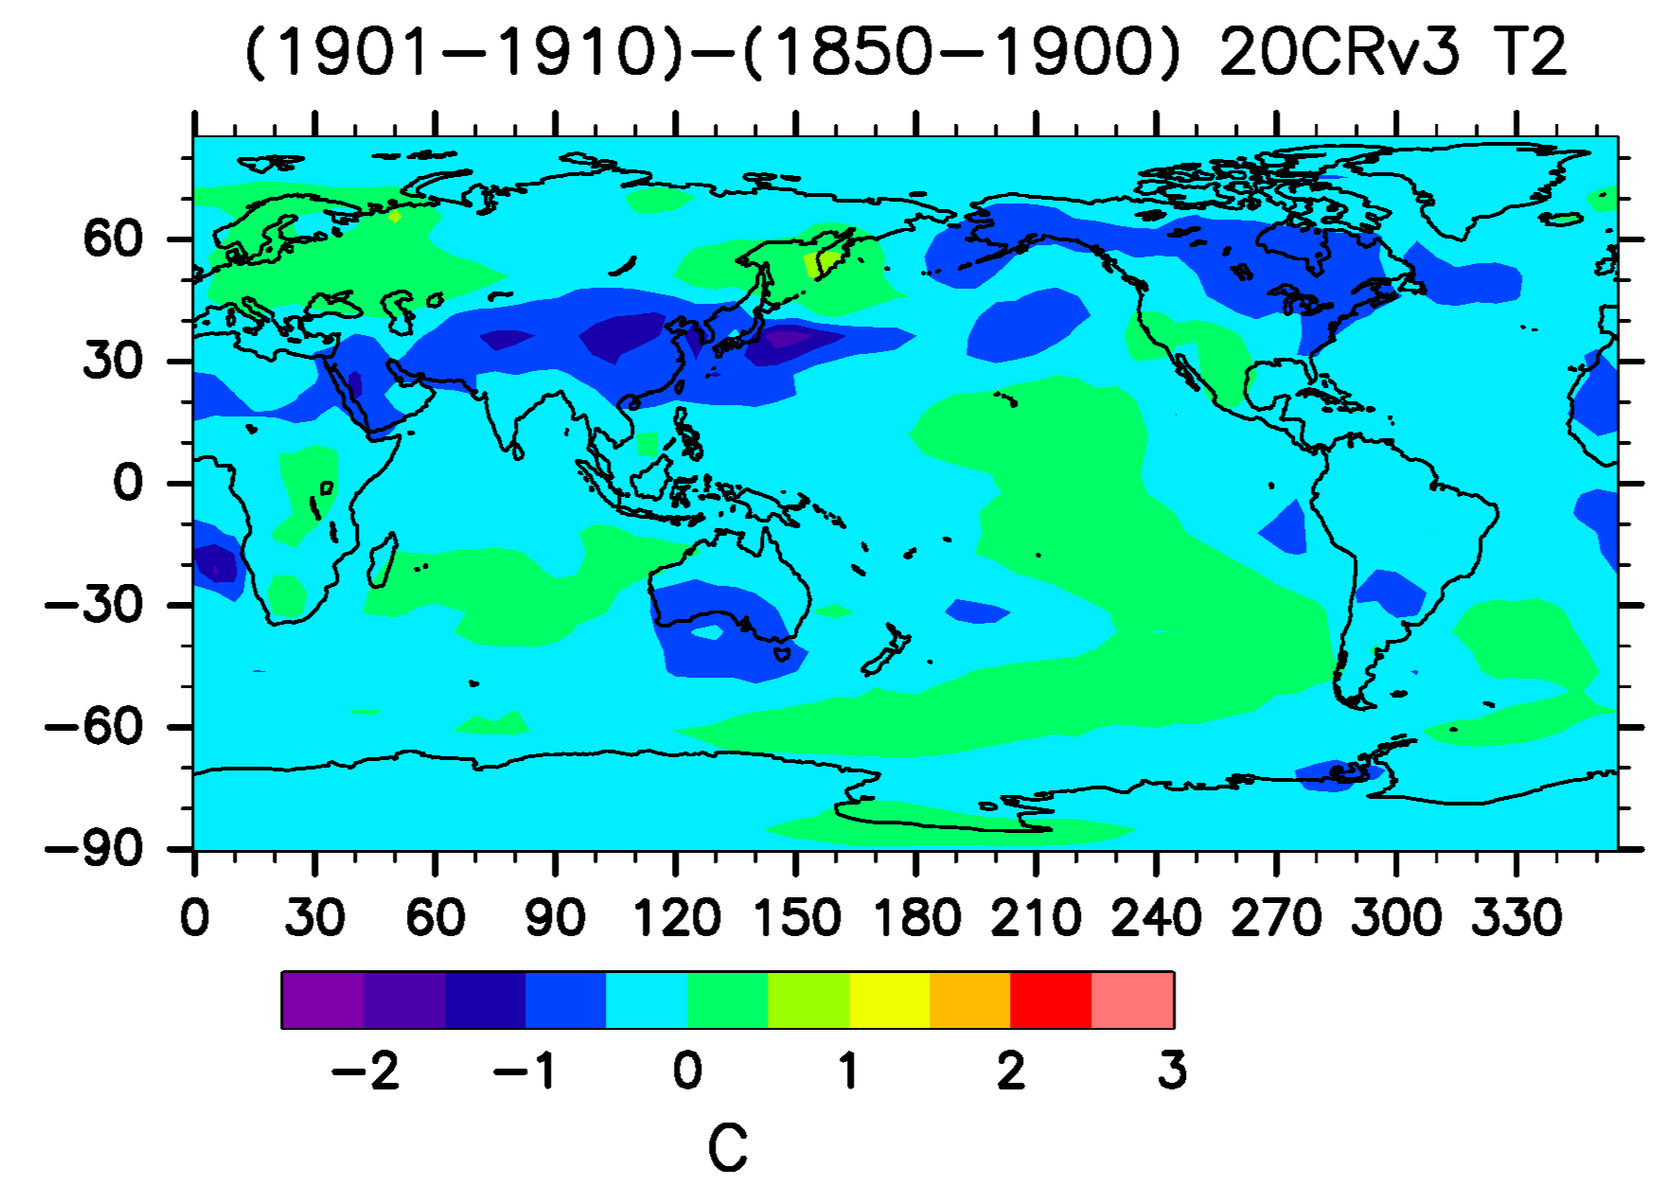
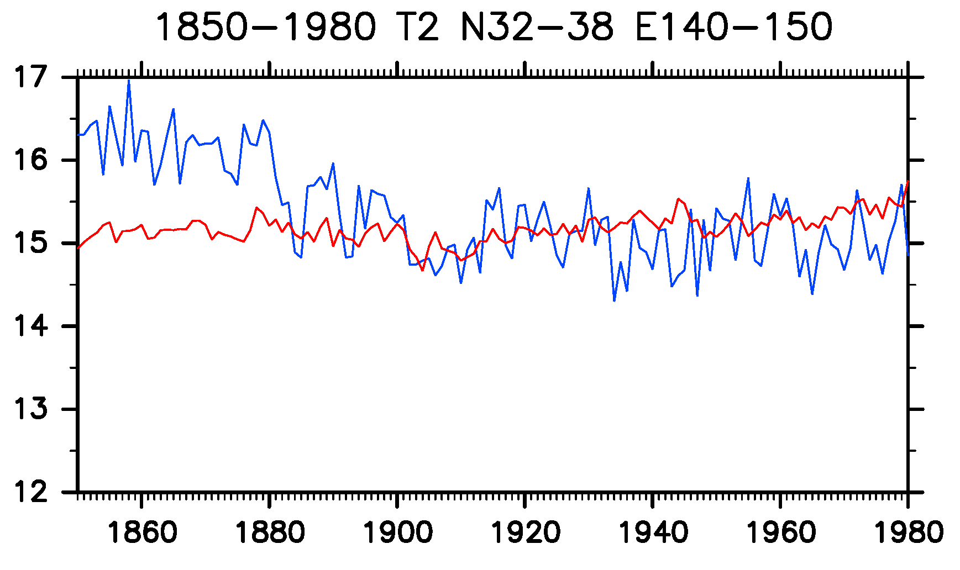
Difference of air temperature during 1901-1910 from 1850-1900 (pre-industrial revolution)
OCADA
OCADA
1901
1910
C
regional
global +10C
20CRver3
20CRver3
C

Slide 25
Summary
ACRE Japan activities during 2023-2024, we recovered meteorological observation data around Japan by US, UK and Netherlands navy ship logs records during the 1850s and 1860s.
We focused on three tropical cyclone (TC) events in the vicinity of Japan during the period from 21 to 25 July 1853 observed by seven US Naval Japan Expedition of Perry’s fleet, on 23 and 24 September 1856 observed by Medusa of Dutch Navy ship, and on 15 and 16 August 1863 during the bombardment of Kagoshima in Japan observed by eleven UK Navy ships. Tracks of TCs are analyzed based on the ship log weather records.
A new climate reanalysis called over-centennial atmospheric data assimilation (OCADA) was created using an atmospheric general circulation model assimilating surface pressure observations archived in international databases from 1850 to 2015.

Slide 26
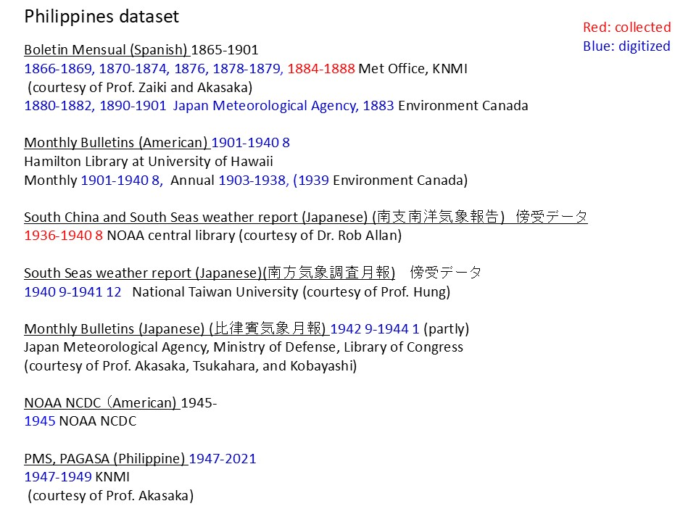
1. Data rescue of daily rainfall data in Japan, East, Southeast and South Asian countries back to the late 19th century for Asian monsoon researches.

Slide 27
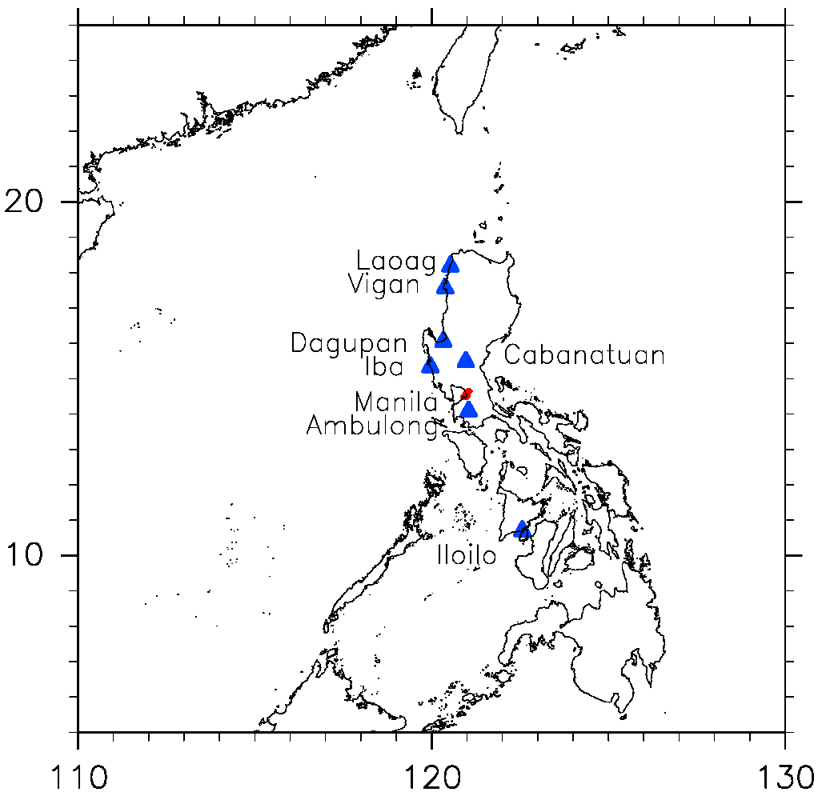
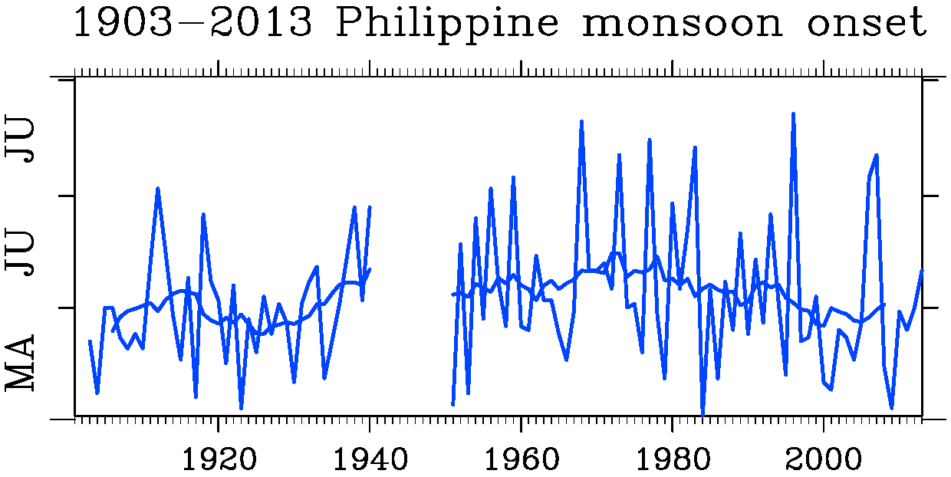
1. Data rescue of daily rainfall data in Japan, East, Southeast and South Asian countries back to the late 19th century for Asian monsoon researches.
Philippine summer monsoon onset defined by daily rainfall data
Kubota et al., PEPS 2017

Slide 28
2. Data rescue of meteorological data in stations since the 1860s and ship logs sailing along the coastal region of East and Southeast Asia since the 1780s including the tropical cyclone tracks since the 1880s for tropical cyclone researches.

Slide 29
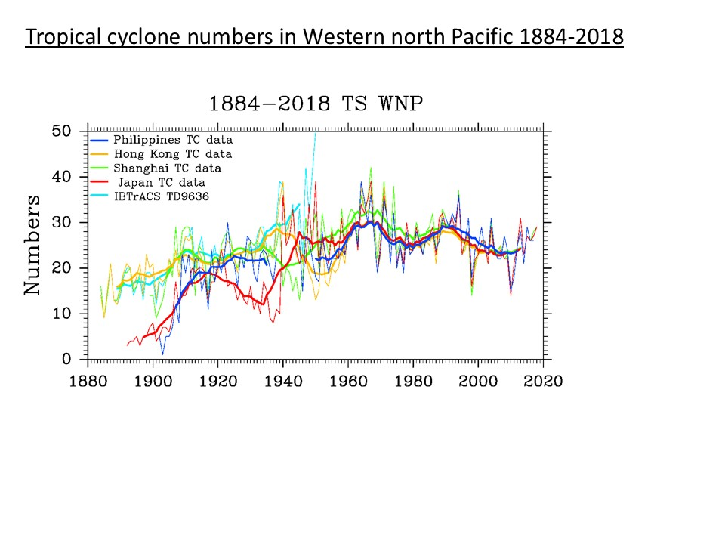
2. Data rescue of meteorological data in stations since the 1860s and ship logs sailing along the coastal region of East and Southeast Asia since the 1780s including the tropical cyclone tracks since the 1880s for tropical cyclone researches.
Kubota et al., CC 2021

Slide 30
2. Data rescue of meteorological data in stations since the 1860s and ship logs sailing along the coastal region of East and Southeast Asia since the 1780s including the tropical cyclone tracks since the 1880s for tropical cyclone researches.

Slide 31
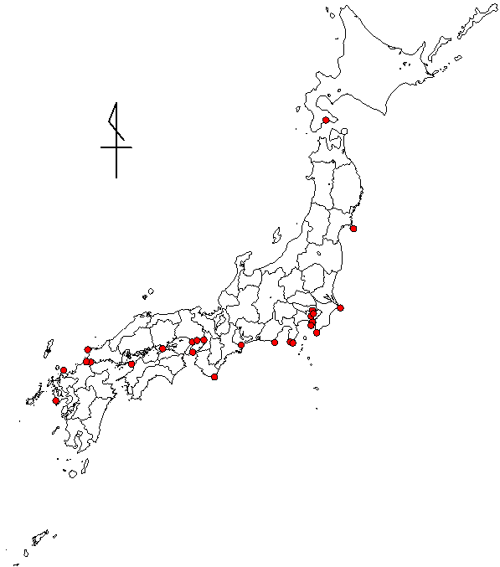
3. Data rescue of instrumental meteorological data observed in Japan by lighthouses and individual personnel before the official weather station were operated for climate studies in the 19th century. That of former local observatories of the current JMA since the 1880s.
Zaiki et al. 2018

Slide 32
4. Data rescue of upper air observations in Japan, East, Southeast Asia and Western North Pacific Islands since the 1920s.

Slide 33
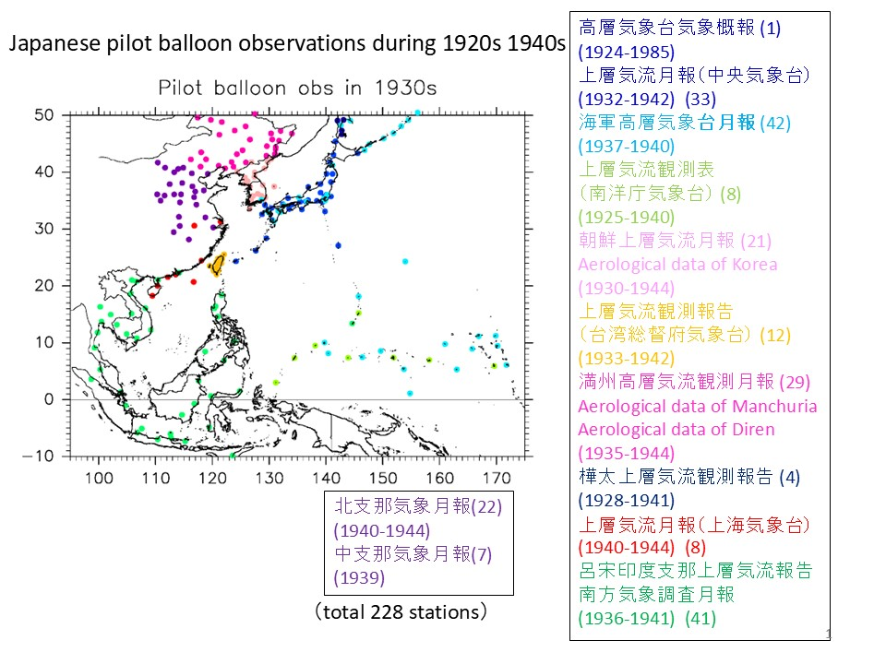
4. Data rescue of upper air observations in Japan, East, Southeast Asia and Western North Pacific Islands since the 1920s.

Slide 34
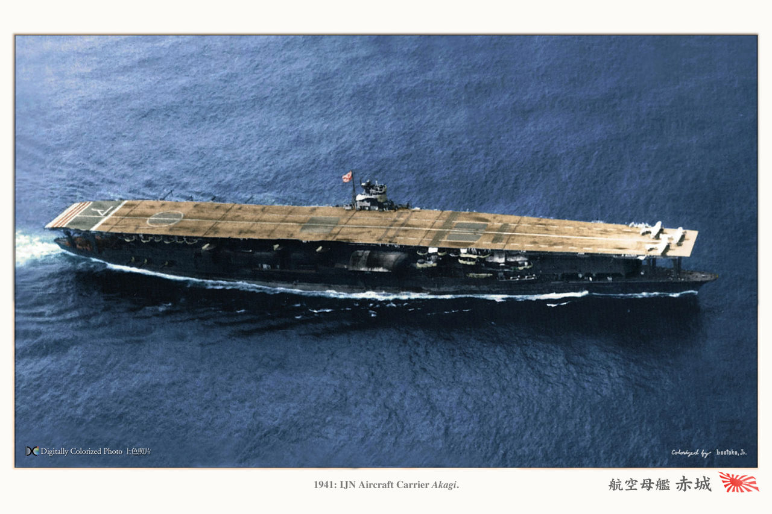
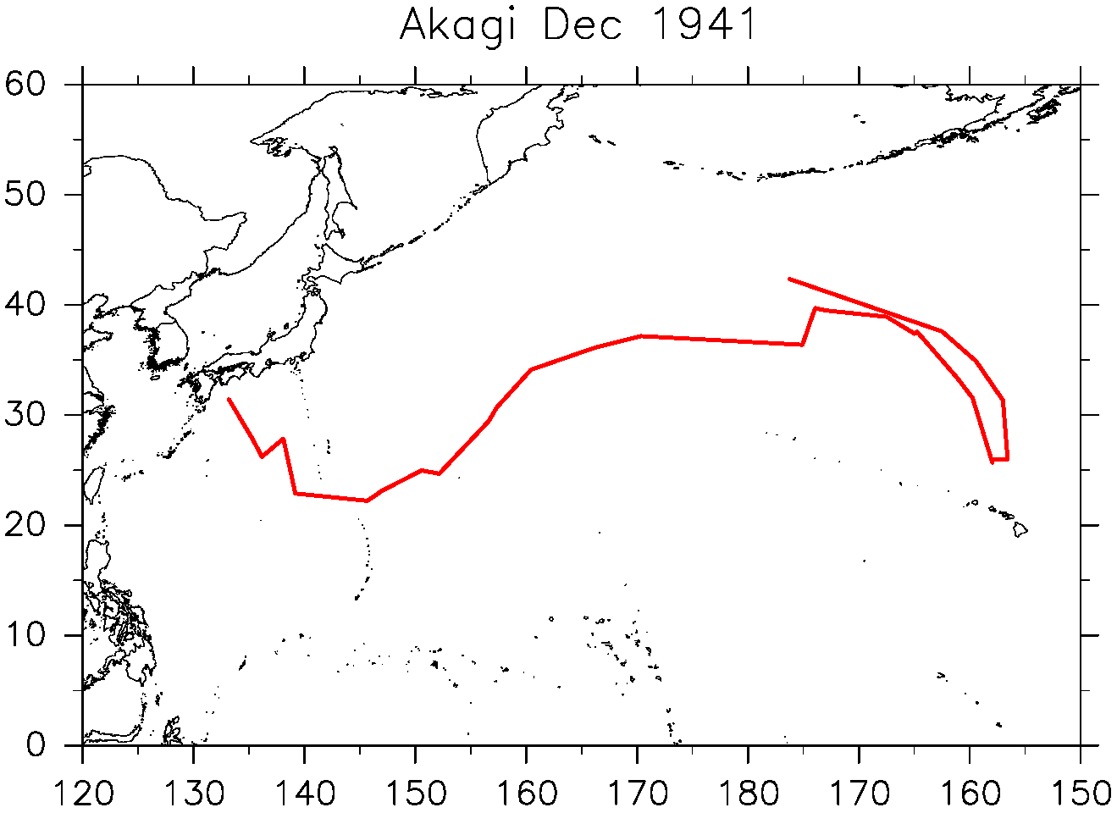
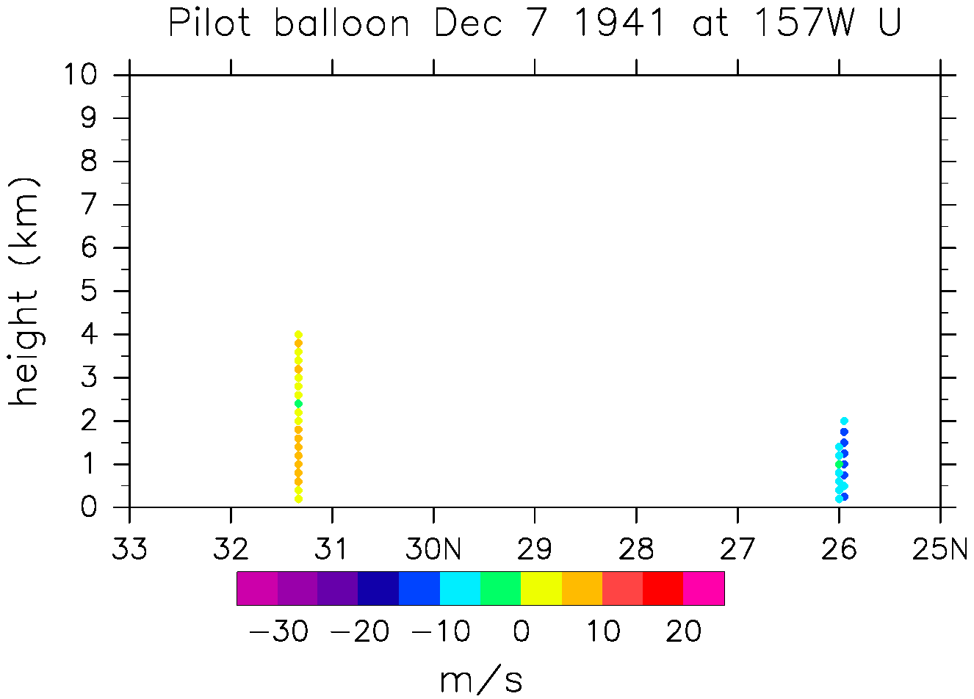
Data rescue of civil and military meteorological observations and their history and background during World War II including their historical perspective.
Japanese Carrier Akagi

Slide 35
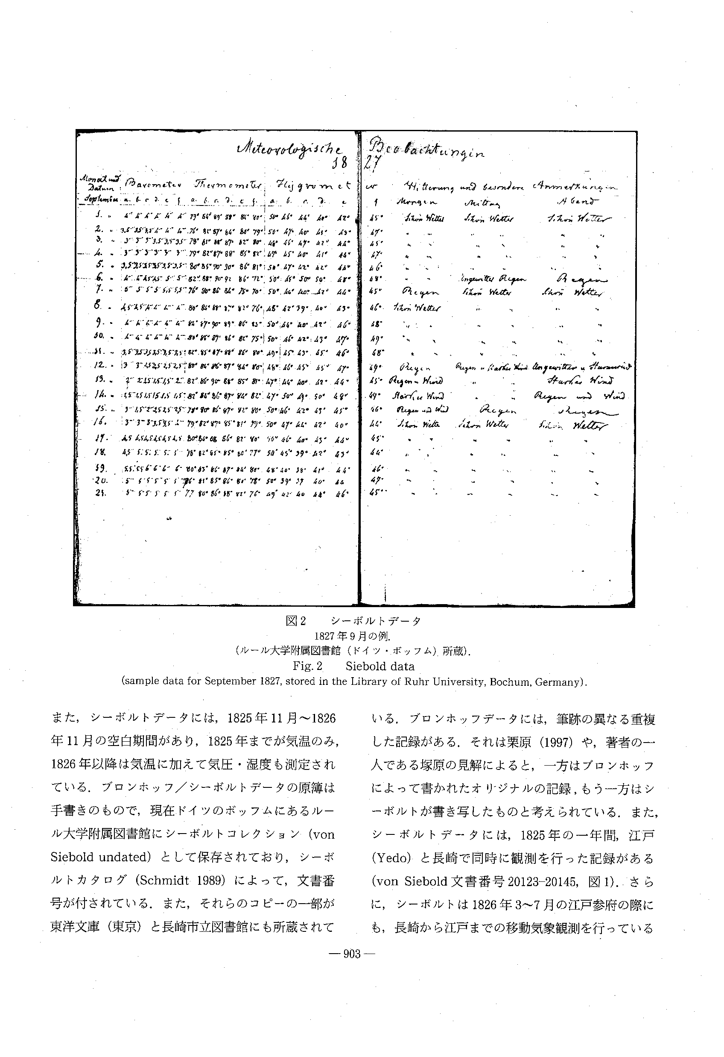
Investigation of early instrumental meteorological observation in Japan deployed by foreign visitors since the 18th century.
Von Siebolt observation at Nagasaki
1819-1828
Typhoon passage in 1828
(Fatalities up to 10,000)
Konishi (2010)
Zaiki et al. (2002)

