Slide 1
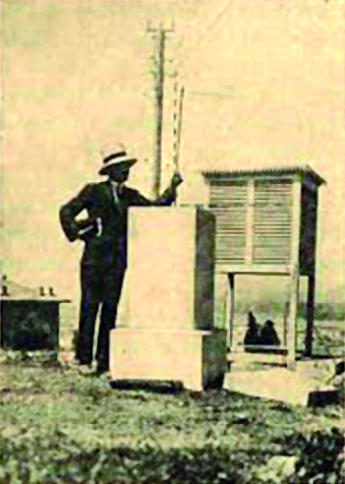
ACRE Drought & Flood Meeting, 23-27 September, Corfu
The historical sub-daily climatic observations in Greece –
Efforts to improve access and exploitation.
Dimitra Founda
Research Director
National Observatory of Athens (NOA)
Institute for Environmental Research & Sustainable Development

Slide 2
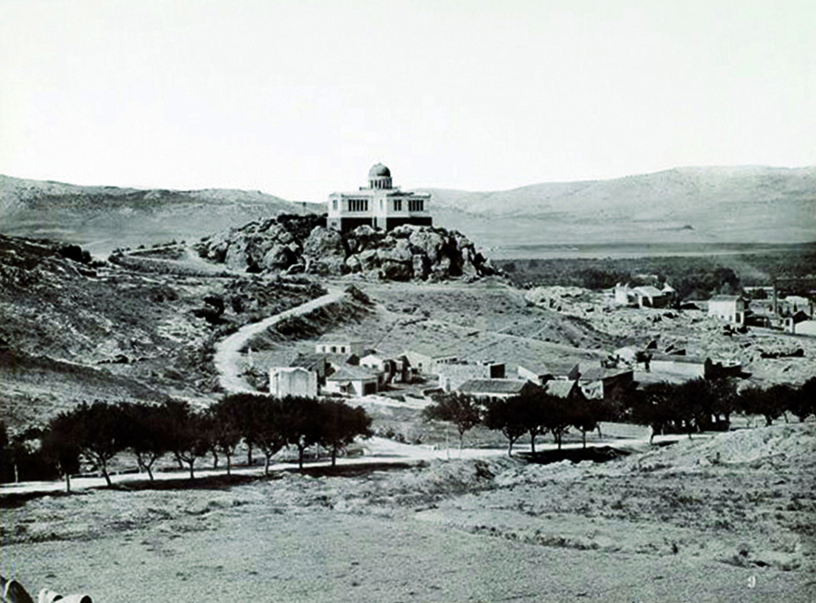
Historical climatic observations in Greece
The climate history in modern Greece is tightly connected with the establishment of the National Observatory of Athens (NOA)
The systematic meteorological & atmospheric observations were initiated during the mid 19th century at NOA
NOA 1875

Slide 3
Historical climatic observations in Greece
Other early climatic observations in Greece (before 1850)
Many investigators in the past showed an interest for the nature of climate in Greece, especially of the Ionia Islands
They kept meteorological observations as early as in the turn of the 18th century
Among the pioneers who made meteorological observations in Corfu are:
Carlo Botta, Lazzaro de Mordo and Lascaris
Carlo Botta (1797) and Lazzaro de Mordo (1808) published a general description of climate of Corfu, but they did not provide any table of the observations
Source: Mariolopoulos et al. 1985, Academy of Athens Publications
Notes:
Academy of science of Austria

Slide 4
Historical climatic observations in Greece
Other early climatic observations in Greece (before 1850)
Corfu
1805-1811 (descriptive weather summaries) (E. Theotokis)
1818 -1821 (T,R, phenomena) (2 obs/day) (E.Theotokis)
1823- 1864 (D. Mackenzie)
1821-1827 (by Dr. Roe, 08:00, 12:00, 15:00) (published by John Davy)
1852-1861 (Royal Engineers, 09:30, 15:30) (published in London)
1869-1875 (Commission für die Adria, by A. Dabovich, 07:00, 14:00, 22:00) (published in Vienna)
Published by Academy of Athens (Pubications N0 10, 15, 42)
Notes:
Imperial Academy of science of Austria

Slide 5
Historical climatic observations in Greece
Other early climatic observations in Greece (before 1850)
Zante
1826-1861: (T, 2 obs/day) (by Varviannis family)
(included in 'Chronografos' manuscripts (Zante Library) (destroyed)
Other places in Greece
Chios (1853-1856, 1898-1917)
Ioannina 1858-1860, and 1866-1870 (digitized by NOA)
Patra (1872-1876) (by Boys, English)
Chania (Crete) 1870-1880 (by Sandwitch, English)
(Source: E. Mariolopoulos, 1936 ‘The climate of Greece’)

Slide 6
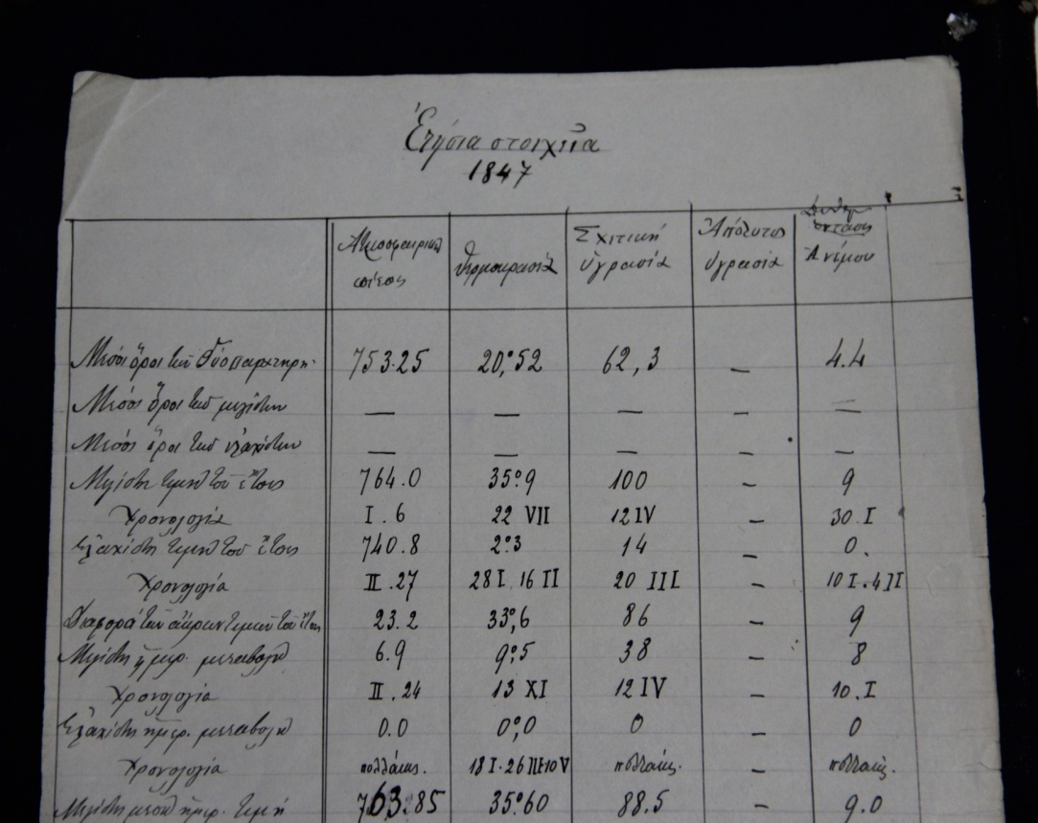
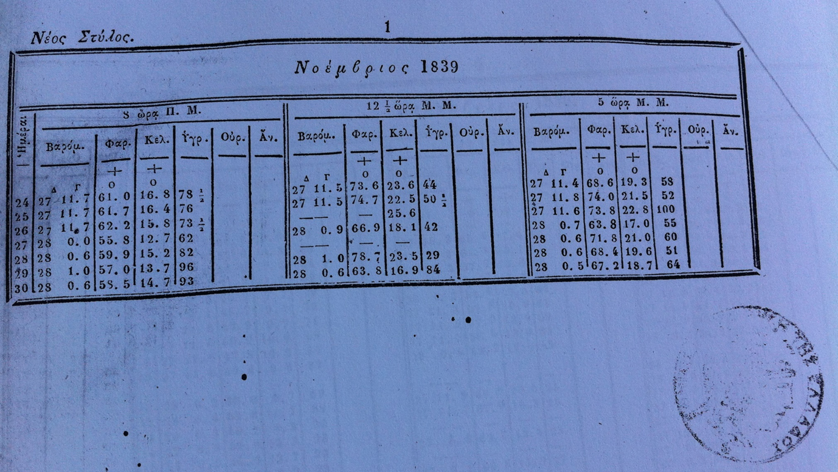
Historical climatic observations in Greece
Other early climatic observations in Greece (before 1850)
Athens
1833-1835 (M. Peytier): 'Sur le cimat de a Grece (Comptes Ren de ' Academie des Sciences de Paris (vol.1 , 1837)
1839-1842, and 1847 (Prof. George Vouris) (Digitized) (08:00, 12:30, 17:00)

Slide 7
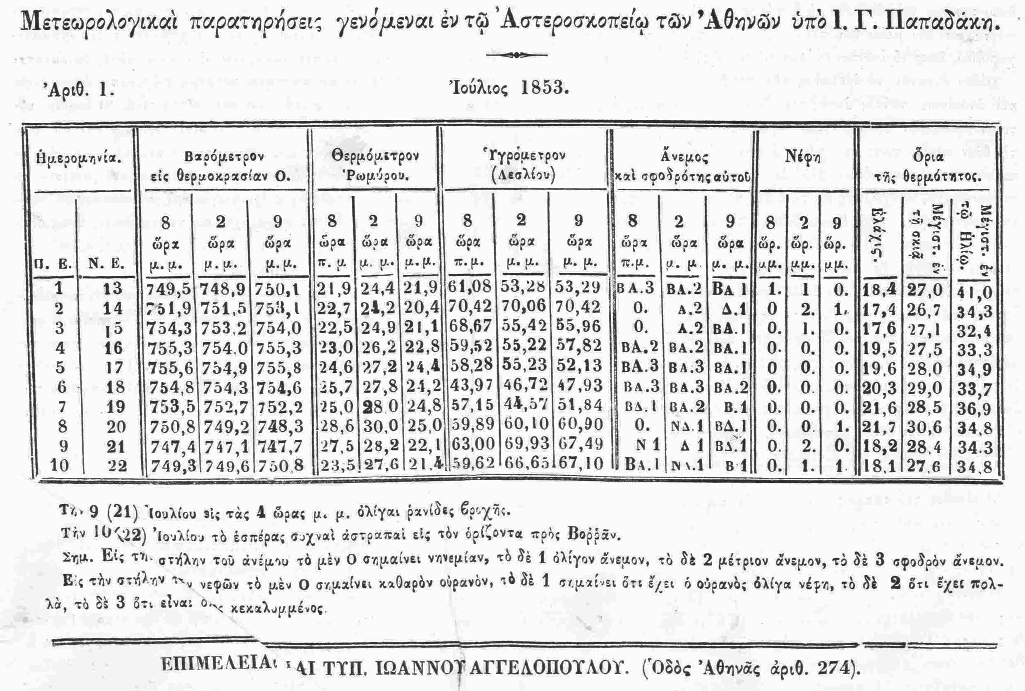
Historical climatic observations of NOA
Systematic meteorological & atmospheric observations were initiated during the mid 19th century under NOA
Several gaps until 1858…..
1858-1890
Complete time series, but several relocations (close to NOA) till 1890

Slide 8
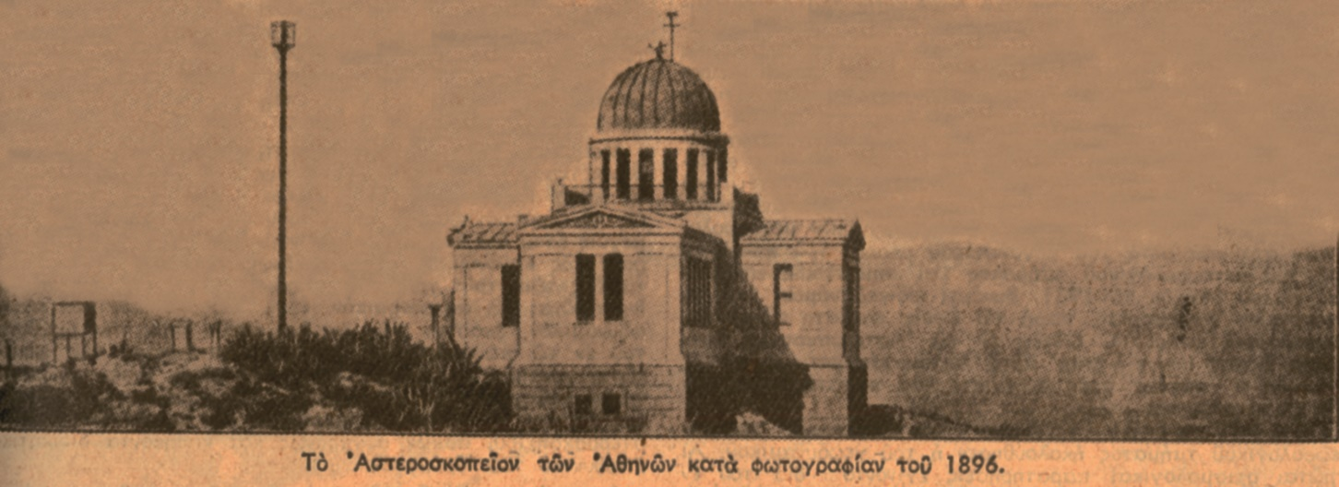
Historical climatic station of NOA
The historical climatic station of NOA was established permanently on the hill of Nymphs (Thission) in the late 19th century (1890)

Slide 9
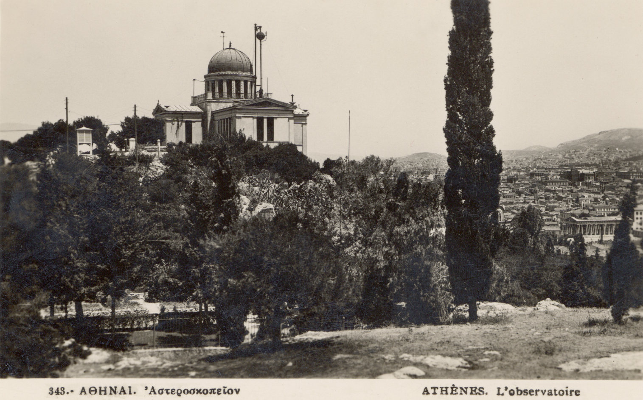
Historical climatic station of NOA
Notes:
Weather staion cage Stevenson screen

Slide 10
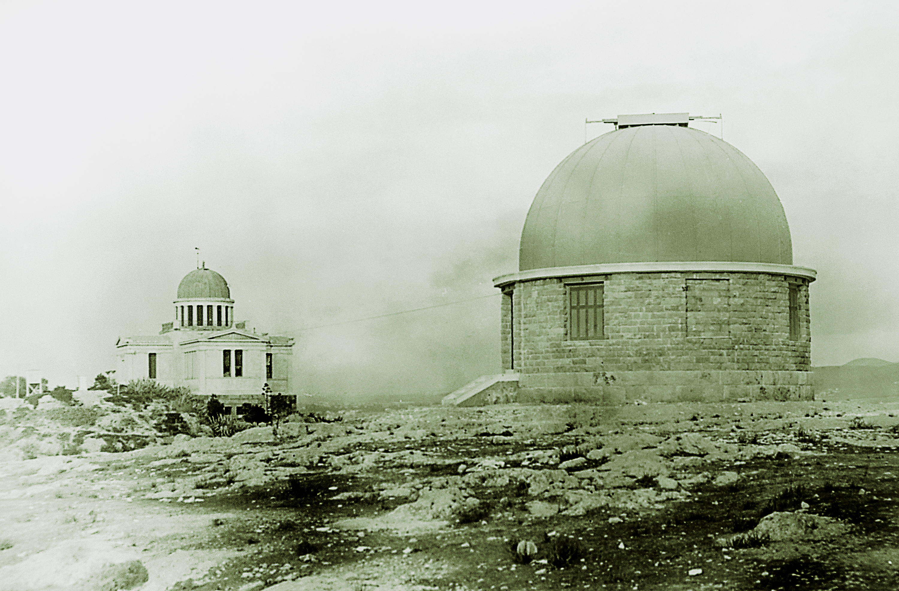
Historical climatic station of NOA

Slide 11
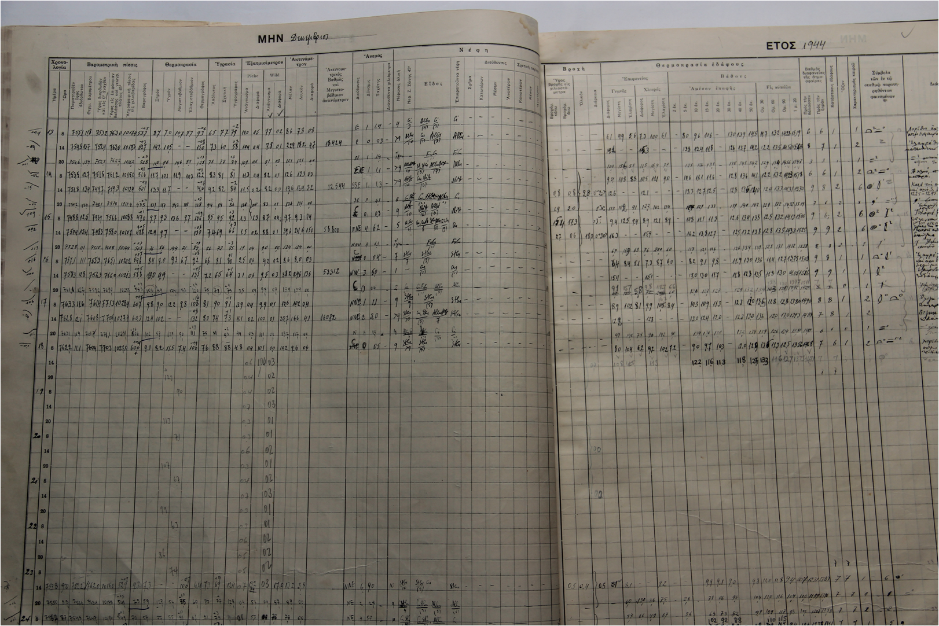
Historical climatic records of NOA
Today, NOA holds the oldest, most complete, reliable and uninterrupted climatic records of Greece, spanning approximately a 180-yr period.
Notes:
Civil war

Slide 12
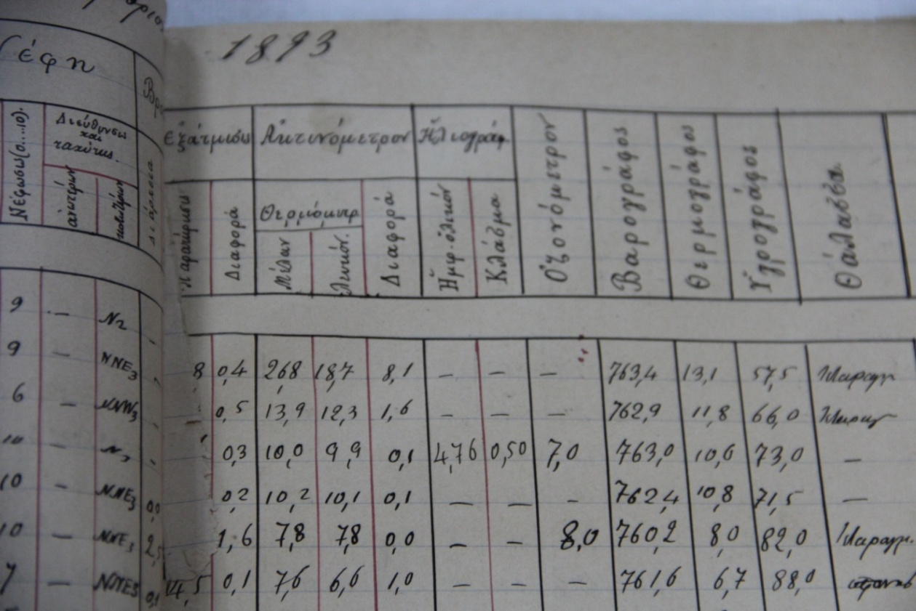
Historical climatic records of NOA
Variety of measured climatic + atmospheric variables
Air temperature
Soil temperature
Wind
Humidity
Sunshine duration
Evaporation
Precipitation
Atmospheric Pressure
Cloud cover
Cloud types
Visibility
Weather codes
Commentary information
Ozone
Systematic solar radiation measurements were added during the mid 20th century (1953)

Slide 13
Historical climatic records of NOA
In 2017, historical climatic station of NOA received formal recognition by WMO, amongst 60 other historical stations worldwide

Slide 14
The only source of climatic information of pre-industrial period
Profound warming after the early 1980s following the general pattern of eastern Mediterranean, at rates almost twice as much as the global average
Notes:
And now lets see some features of the past climate in Greece. This is the longest existing record of air temperature in the country that NOA holds

Slide 15
The only source of climatic information of pre-industrial period
2014-2023: 1.7 °C warmer than the average of the pre-industrial period 1860-1900
2014-2023: 1.20 ±0.12°C globally (WMO, 2024)
Notes:
And now lets see some features of the past climate in Greece. This is the longest existing record of air temperature in the country that NOA holds

Slide 16
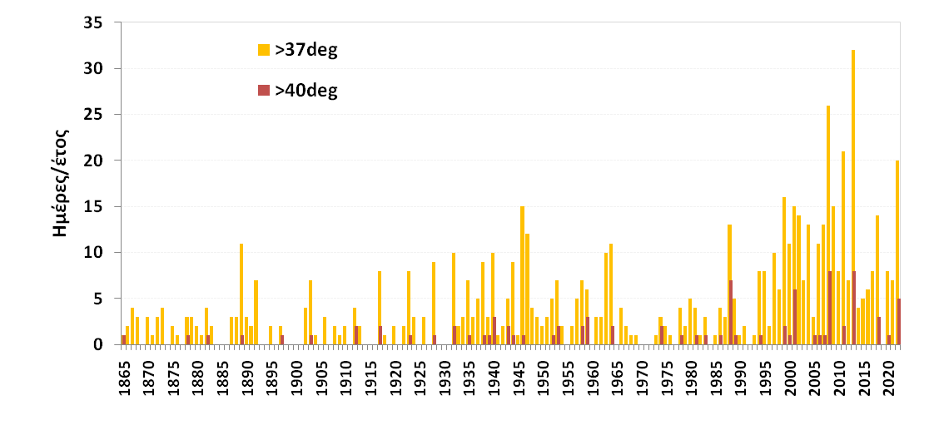
The only source of climatic information of pre-industrial period
The rise of air temperature is accompanied by increased frequency of ‘hot days’ in Athens
37 ⁰C approximates the 90th percentile of summer Tmax distribution (ref. period 1991-2020)

Slide 17
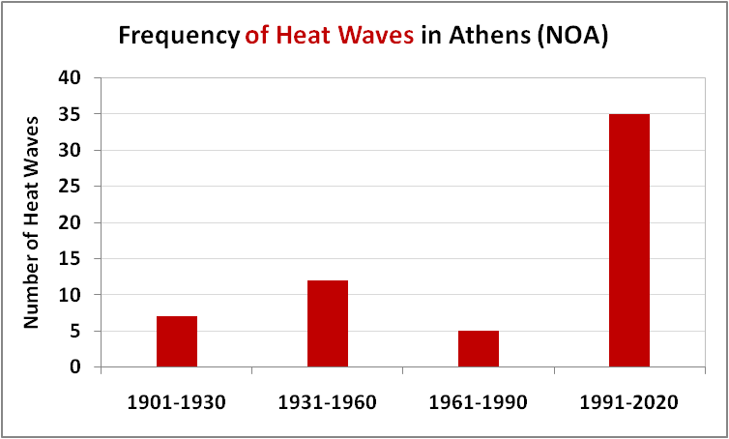
The only source of climatic information of pre-industrial period
A striking increase in Heat Waves (HWs) number is observed during 1991-2020, which is more than four times higher than the average number of the past three sub-periods.
HW: a sequence of at least 3 consecutive days when Tmax > 37 ⁰ C

Slide 18
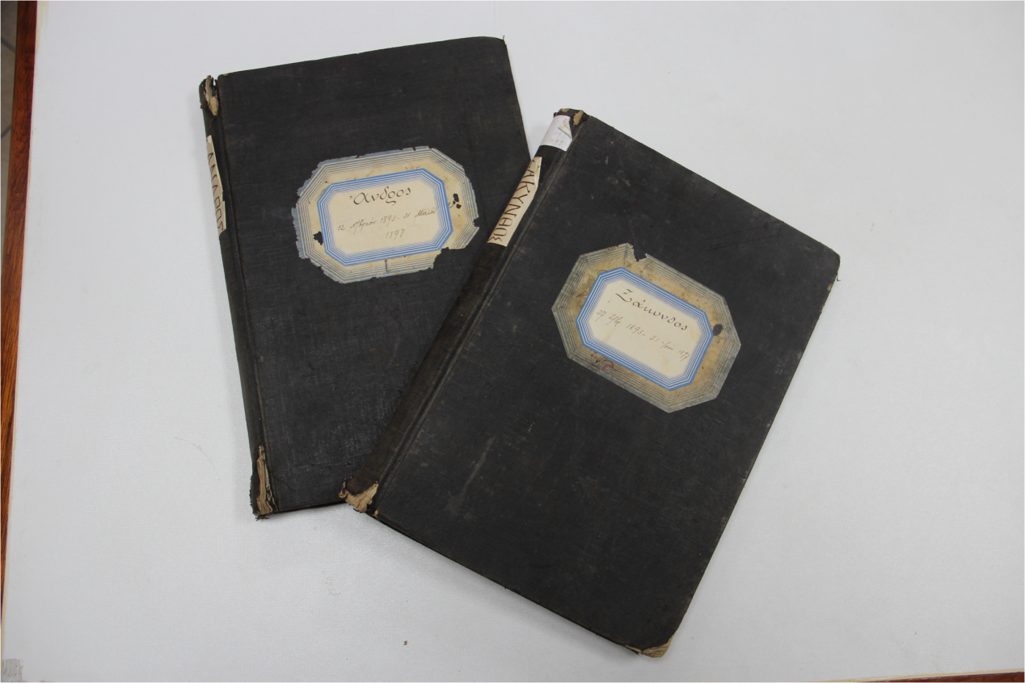
Historical climatic observations- the first Greek network
The first network of meteorological stations in Greece (Eginitis network)
Also, NOA operated a network of about 100 stations in Greece from 1894-1931
B′ Class (Pres,Temp,Rain, RH, Cl, Wind) 3 obs/day
C′ Class Temp,Rain, RH, Cl, Wind) 3 obs/day
D ′ Class or precipitation
In 1931 the network was transferred to the founded Hellenic National Meteorological Service (HNMS)

Slide 19
The first Greek network of climatic stations of NOA (1894-1931)
Reliability of measurements- Supervision- Inspections
Observations were conducted by teachers at schools (gaps in summer holidays)
Observations were sent to NOA via telegraph network
Sparse on-site inspection (one before 1900, 26 after 1920)
According to Mariolopoulos (1936)
～ 50% of B Class stations, reliable atm. pressure measurements
> 80% of B Class stations, reliable air humidity measurements)
100% of B Class stations, reliable air temperature measurements

Slide 20
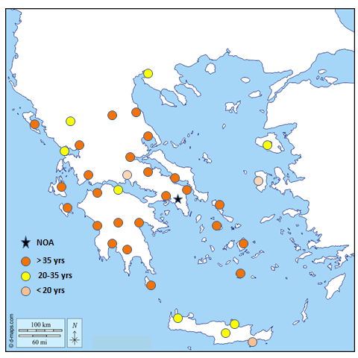
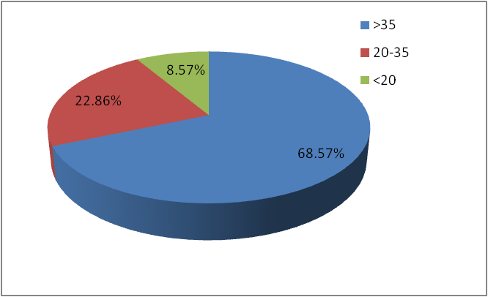
The first Greek climatic network of NOA (1894-1931) -B’ Class stations
Duration of operation

Slide 21
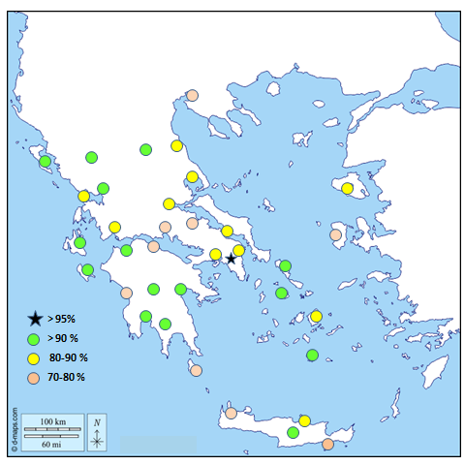
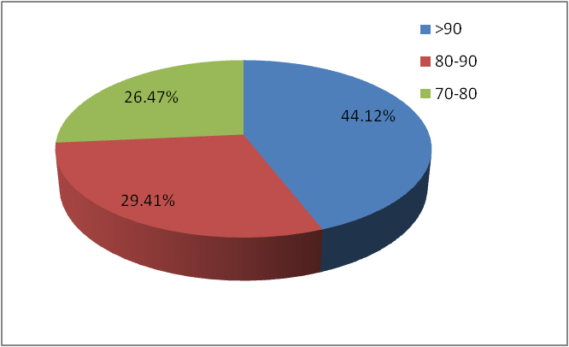
The first Greek climatic network of NOA (1894-1931)
Sub-daily atmospheric pressure Availability

Slide 22
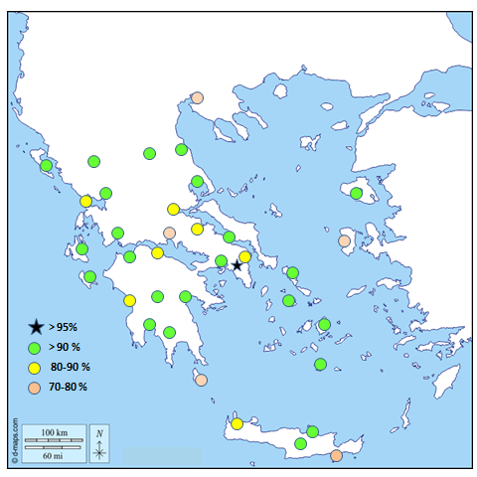
The first Greek climatic network of NOA (1894-1931)
Sub-daily Precipitation Availability

Slide 23
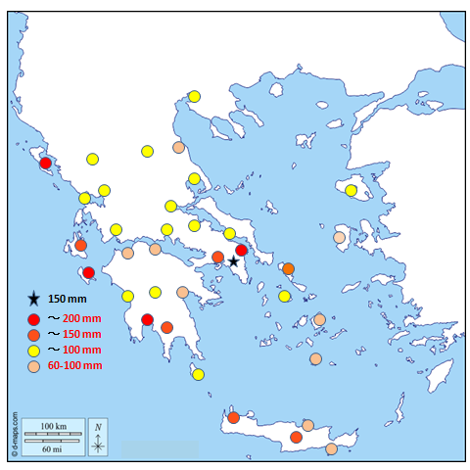
The first Greek climatic network of NOA (1894-1931)
Maximum daily Precipitation

Slide 24
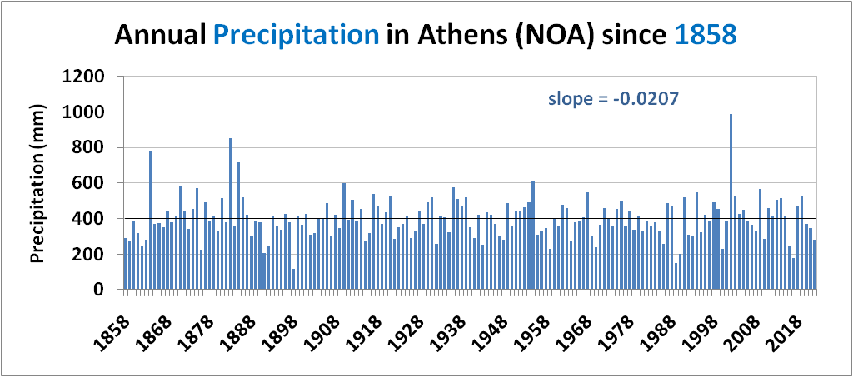
Historical climatic records at NOA - Precipitation
Long-term climatic value: 400mm
Negligible long-term trend

Slide 25
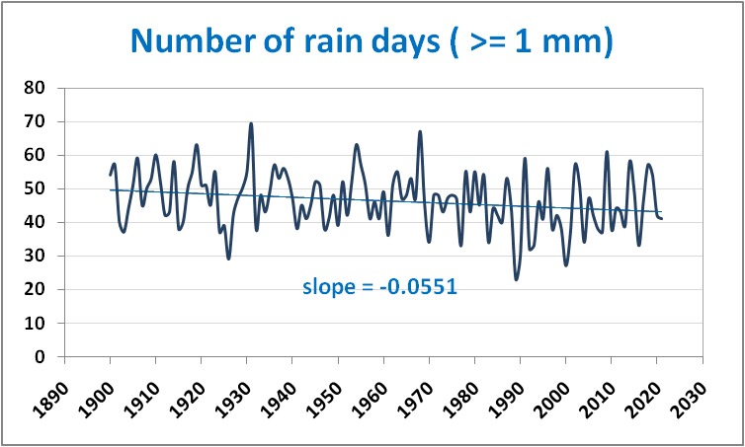
Historical climatic records at NOA – Rainy days

Slide 26
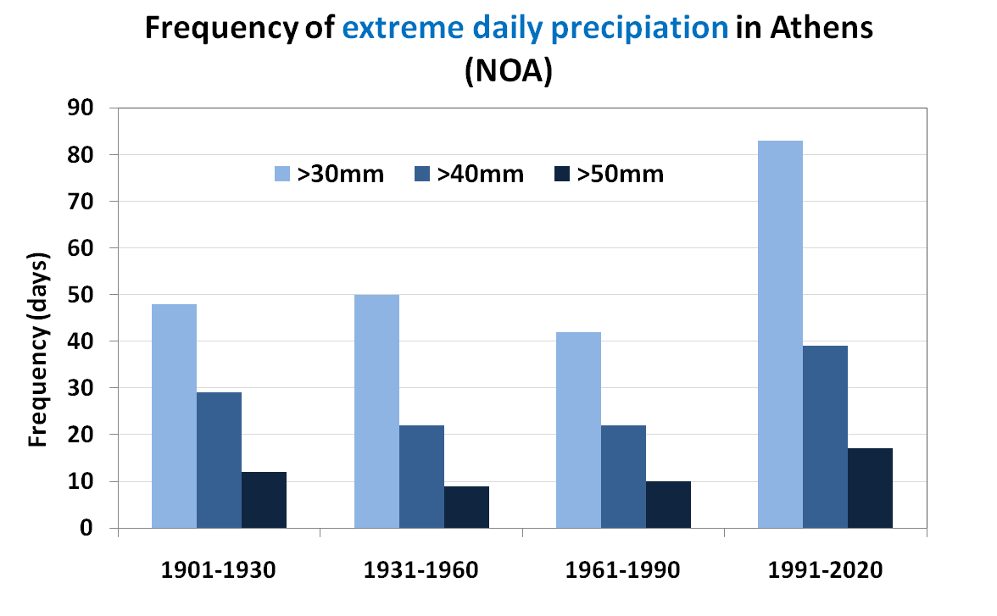
Historical climatic records at NOA – Extreme precipitation
The frequency of heavy precipitation has almost doubled during the last 30 years
Almost 30% of total amount accumulated from episodes > 30mm/day (1991-2020)
Almost 15% of total amount accumulated from episodes >30mm/day (1961-1990)

Slide 27
Historical floods with fatalities in Greece
Year | Date | Death Toll
1895 | November, 14 | 61
1925 | November, 23 | 8
1934 | November, 22 | 6
1961 | November, 6 | 43
1977 | November, 2 | 37
1994 | October, 21-22 | 17
2017 | November , 15 | 24
2020 | September, 17-18 | 4
2023 | September, 5 | 17
Most of floods occur in November
Notes:
Most of floods happen in November
Recently in September …

Slide 28
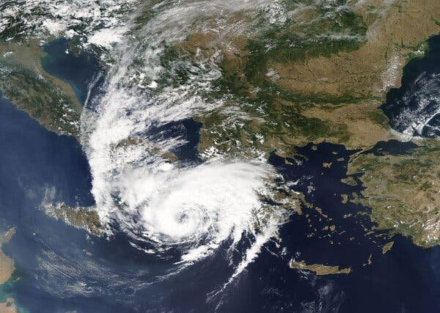
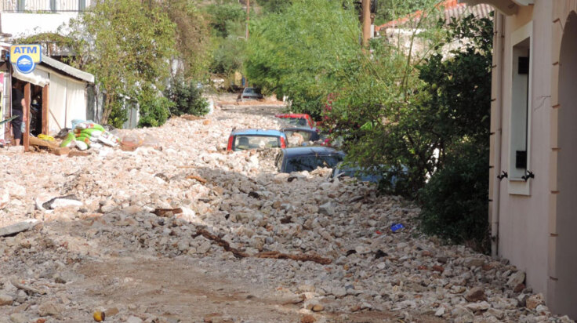
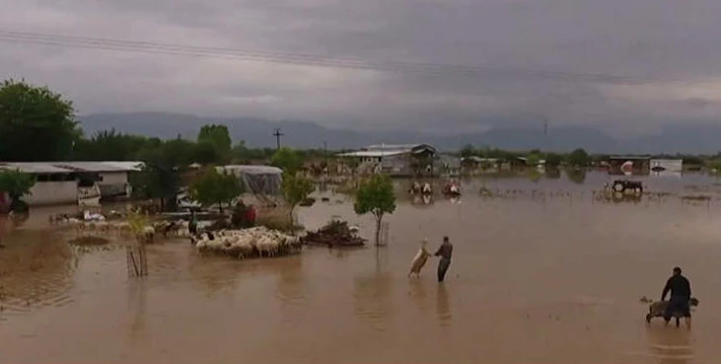
Recent deadly floods (Ianos, September, 2020)
Medicane Ianos, was a rare Mediterranean tropical-like cyclone , that impacted Greece on 17 and 18 September 2020. Ianos developed from an area of low pressure over the Gulf of Sidra that quickly began tropical cyclogenesis while moving over warm waters.
Daily precipitation 664 mm (Cephalonia, Ionion)

Slide 29
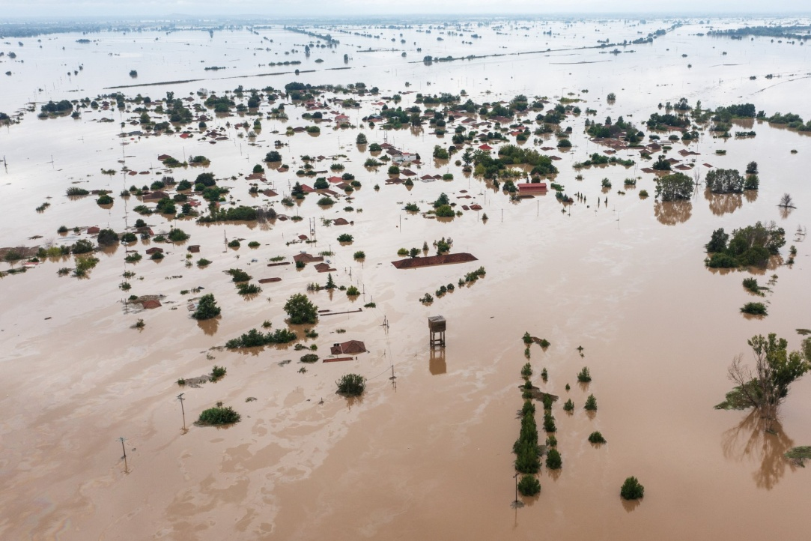
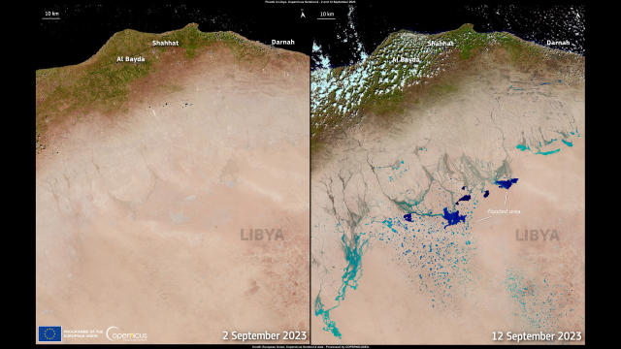
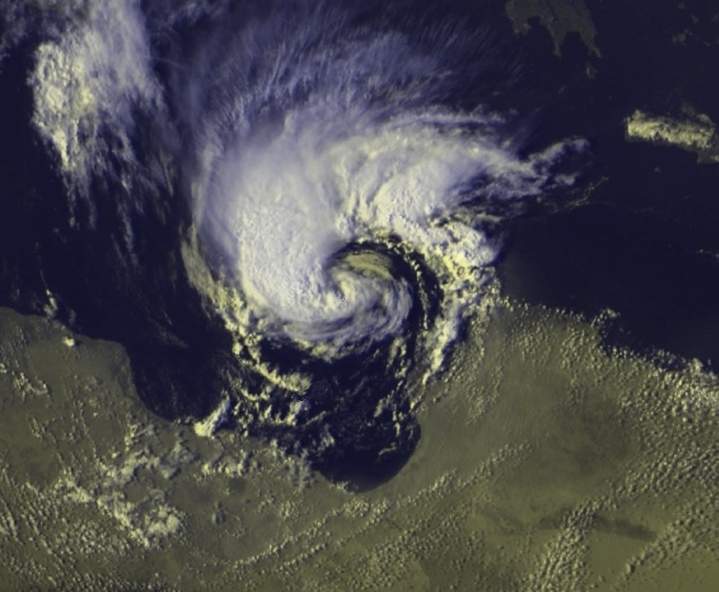
Daniel Medicane in Greece, September 5, 2023
Greece, 5 September
17 deaths
Libya , 9 September
14,000-24,000 estimated deaths
All time record value of daily precipitation in Greece
All time record value of monthly precipitation in Europe

Slide 30
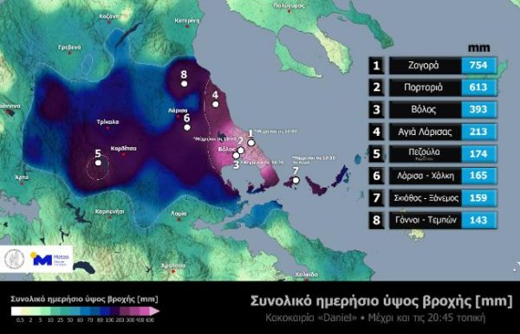
Daniel Medicane in Greece, September 5, 2023
Daily precipitation: 762 mm
2-day precipitation: 910 mm
4-day precipitation: 1096 mm
20 day precipitation: 1235 mm
All time record value of daily precipitation (762 mm) in Greece
All time record value of monthly precipitation (1235 mm) in Europe

Slide 31
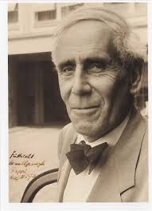
‘Il est impossible que l'improbable n'arrive jamais!’
The improbable is bound to happen one day
Emil Julius Gumbel (1891-1966)

Slide 32
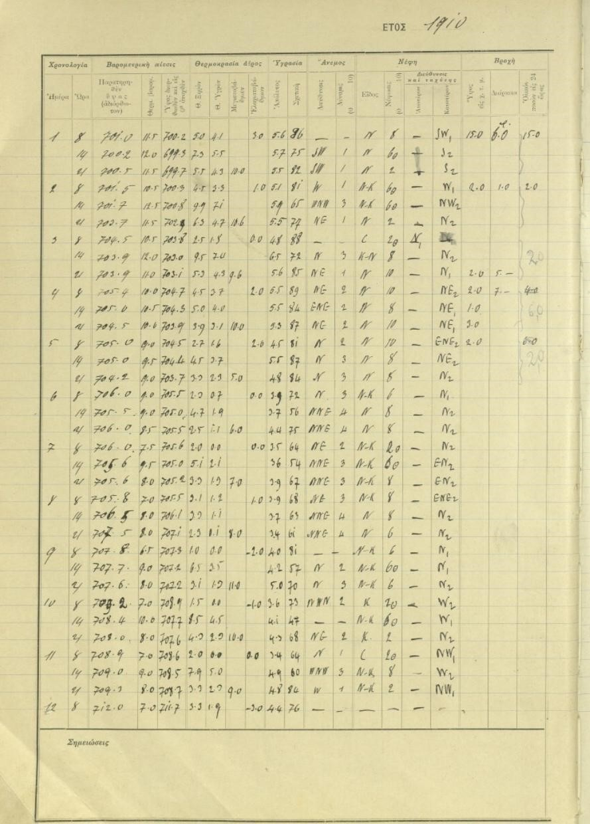
Rescue – Access - Exploitation
Handwritten historical climatic observations/Books

Slide 33
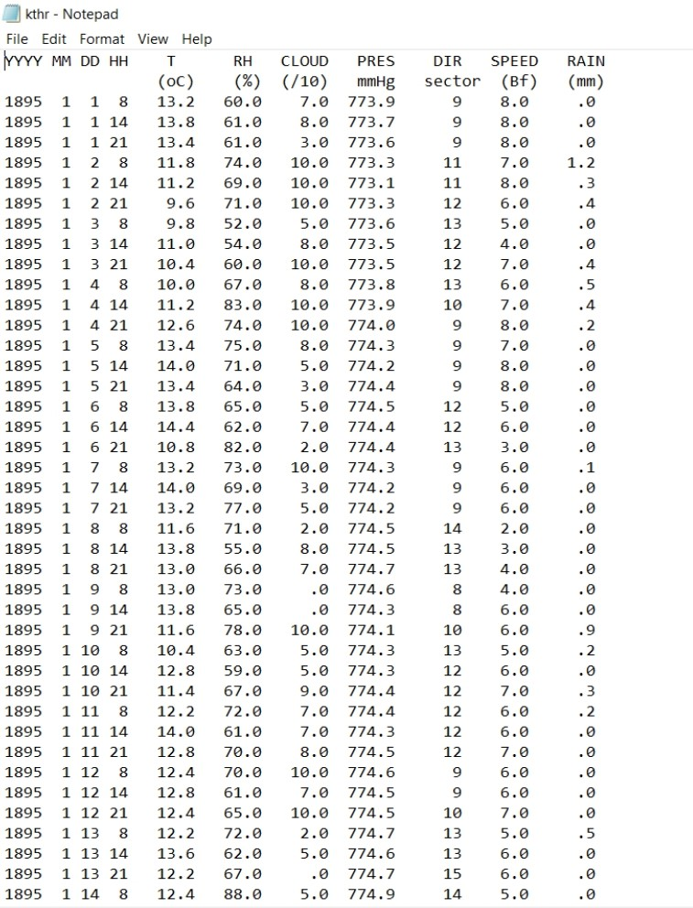
Rescue – Access - Exploitation
The vast majority of historical Greek data (under NOA supervision)
are now in electronic database (A, B Class stations)

Slide 34
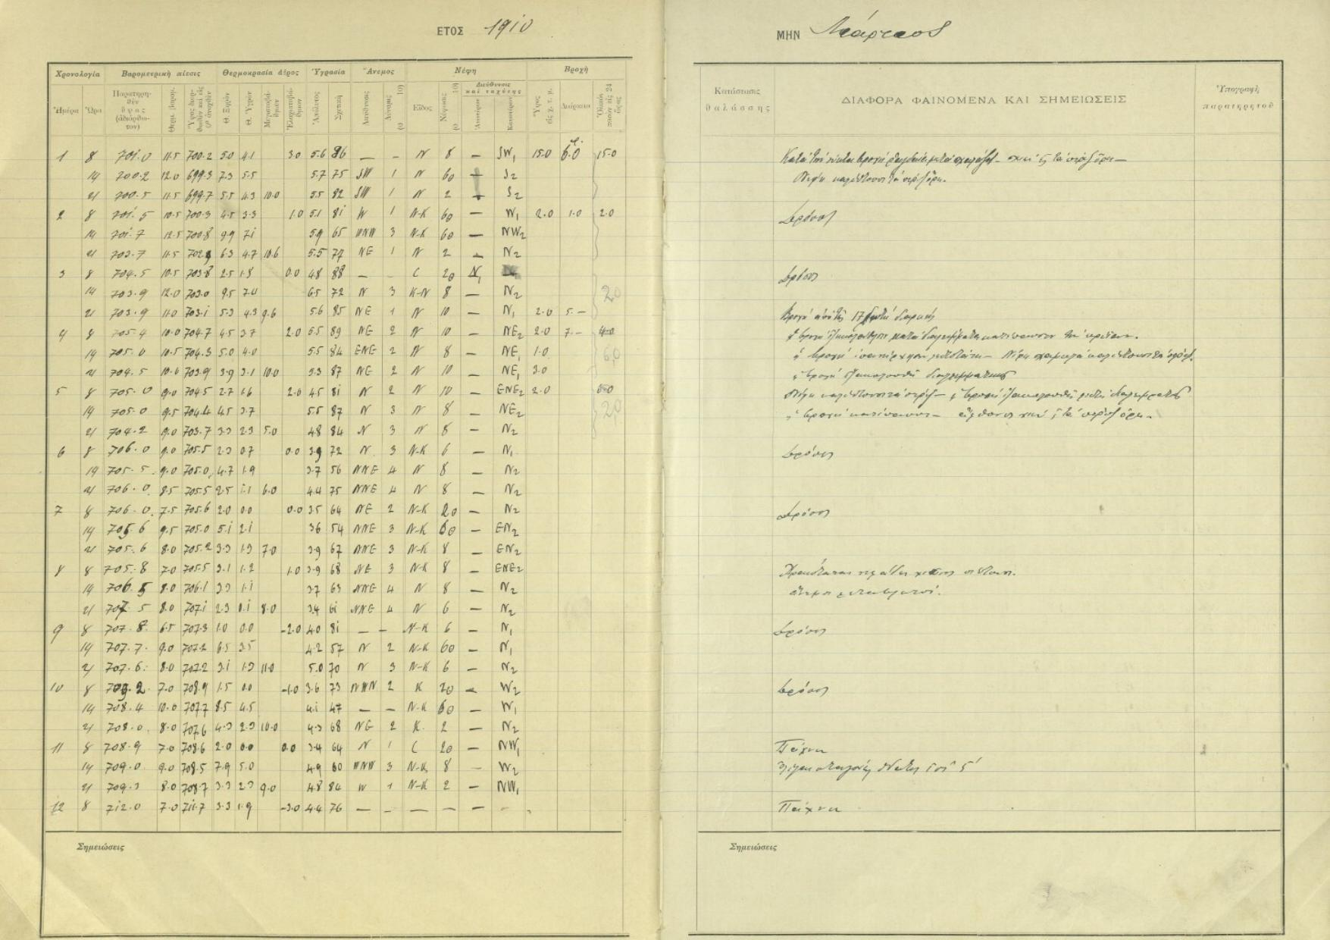
Rescue – Access - Exploitation
Imaging of NOA handwritten historical climatic data (scanned)..commentary info..
Funded by the Academy of Athens (almost completed…)
Αρχική | Ψηφιακό αποθετήριο της Ακαδημίας Αθηνών (academyofathens.gr)

Slide 35
Rescue – Access - Exploitation
Free access of NOA data - National repositories (e.g. CLIMPACT repository)
https://climpact.gr/main/

Slide 36
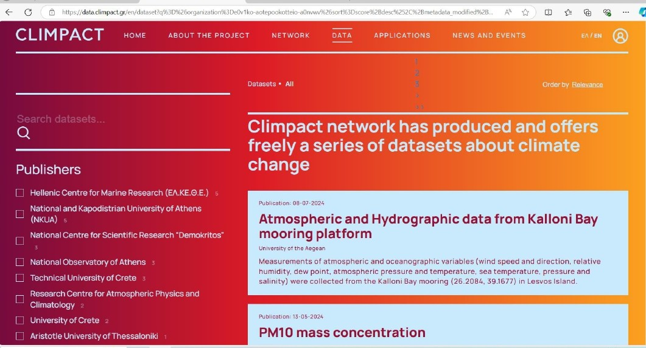
Rescue – Access - Exploitation

Slide 37
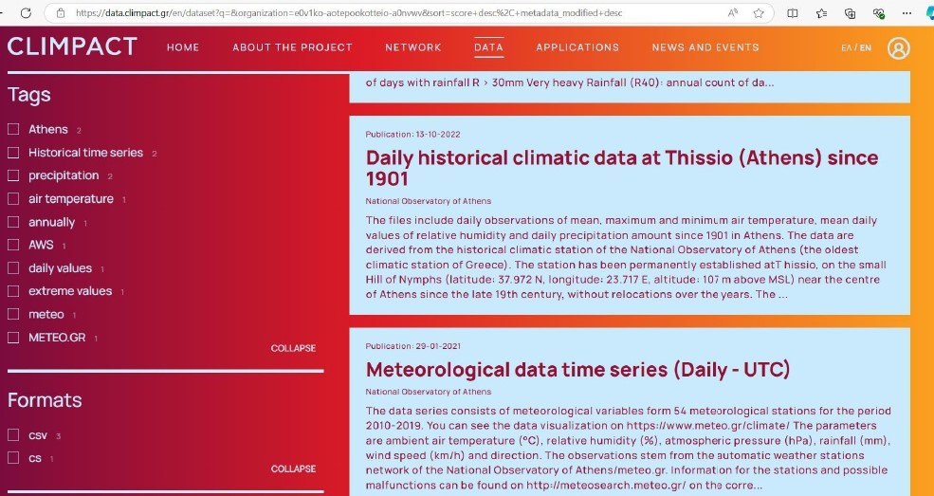
Rescue – Access - Exploitation

Slide 38
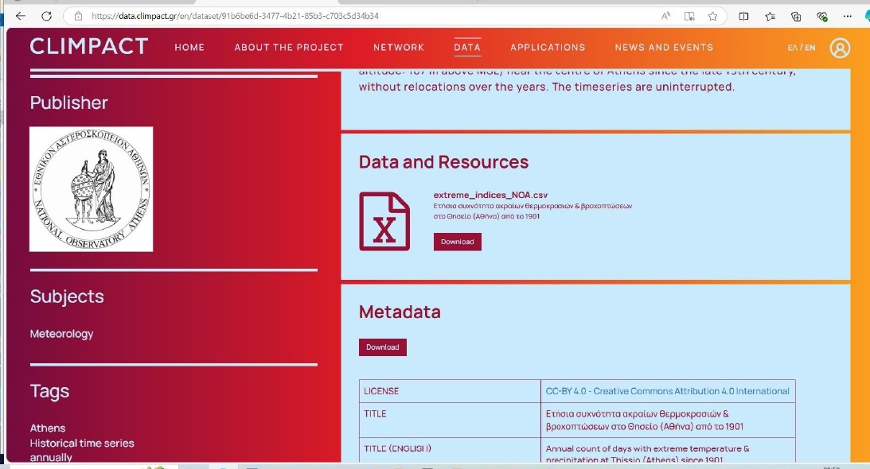
Rescue – Access - Exploitation

Slide 39
Rescue – Access - Exploitation
Greek historical data to feed global repositories… Collaboration with ACRE
GLAMOD (Global Land and Marine Observations Database) where the Greek data can be sent to once recovered, digitised and quality controlled:
https://climate.copernicus.eu/global-land-and-marine-observations-database.
Basic quality control applied for B Class stations (1894-1931)
Additional cross check quality inspection required…
(e.g. daily precipitation >0mm, but daily cloudiness equal to 0..)

Slide 40
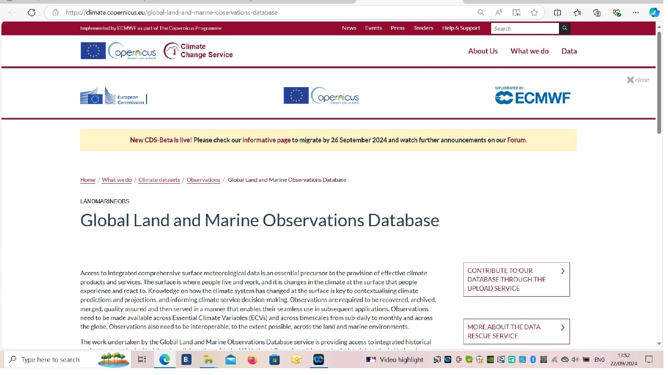
Rescue – Access - Exploitation

Slide 41
Rescue – Access - Exploitation

Slide 42
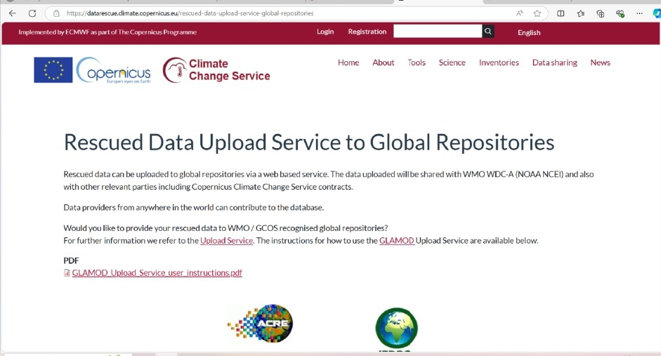
Rescue – Access - Exploitation

Slide 43
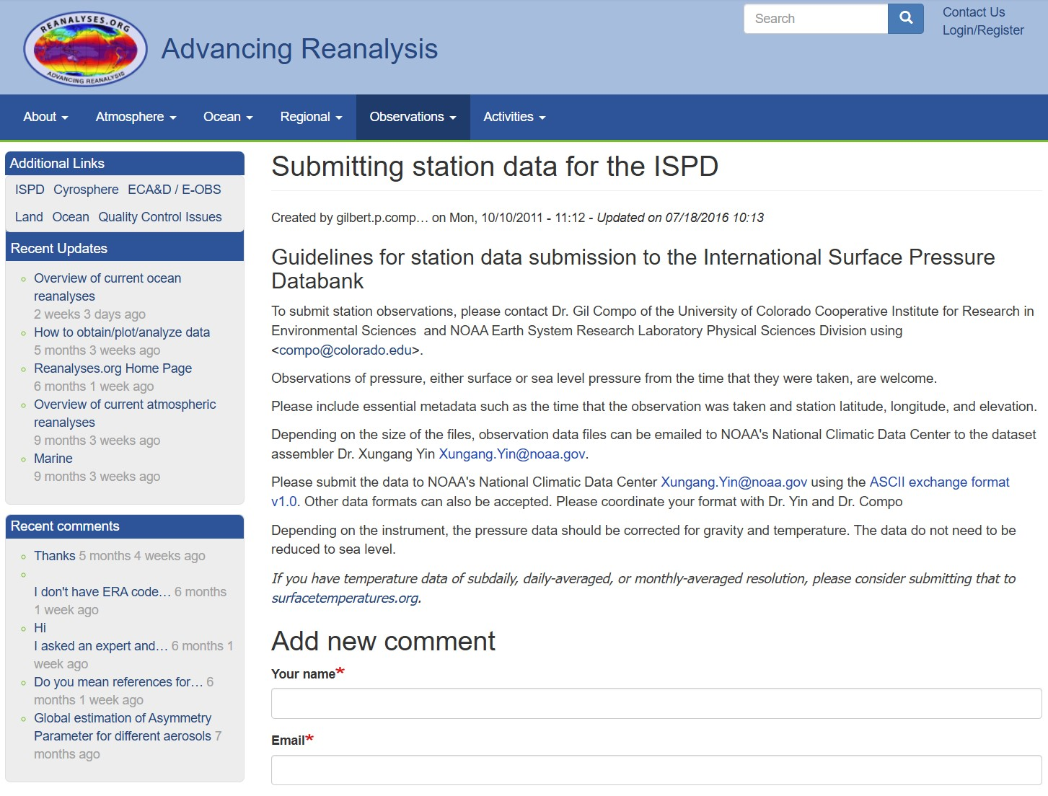
Rescue – Access - Exploitation
International Surface Pressure Databank (ISPD)
https://reanalyses.org/observations/submitting-station-data-ispd

Slide 44
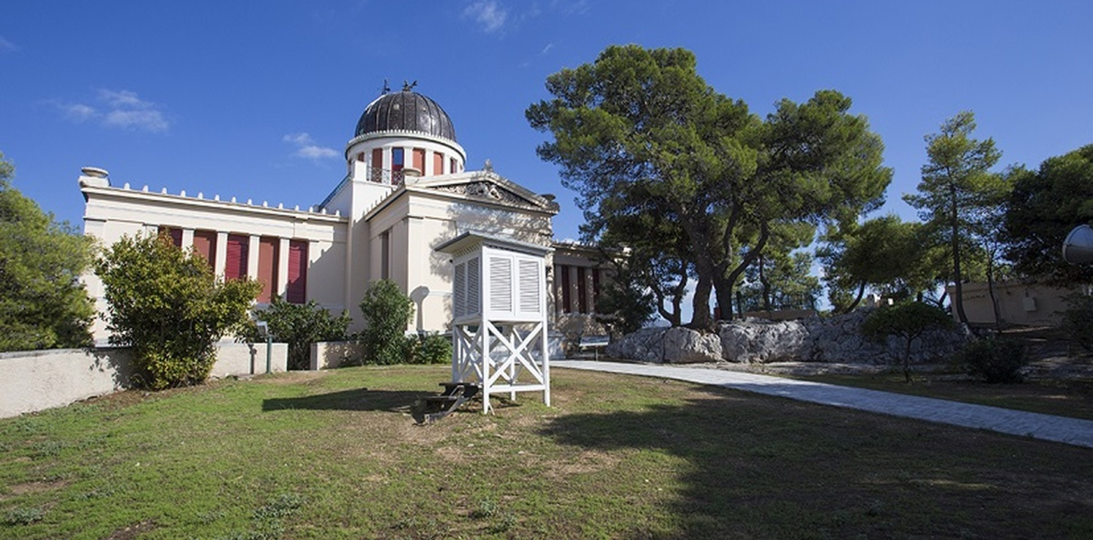
Thank you!

