Slide 1
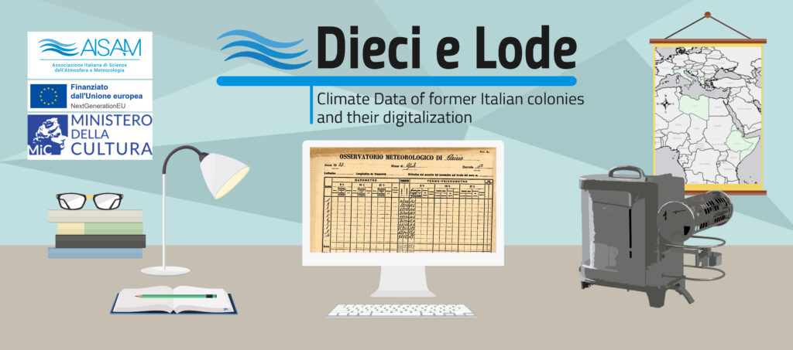

Alessandro Ceppi, Marina Baldi, Maria Carmen Beltrano, Michele Brunetti, Eva De Vecchis, Samuele Giampietro, Luigi Iafrate, Fabio Leali, Veronica Manara, Sergio Pisani, Federico Stefanini, Francesco Sudati, Alessia Tadiello, Dino Zardi, and Maurizio Maugeri
Corfù, 25 September 2024

Slide 2
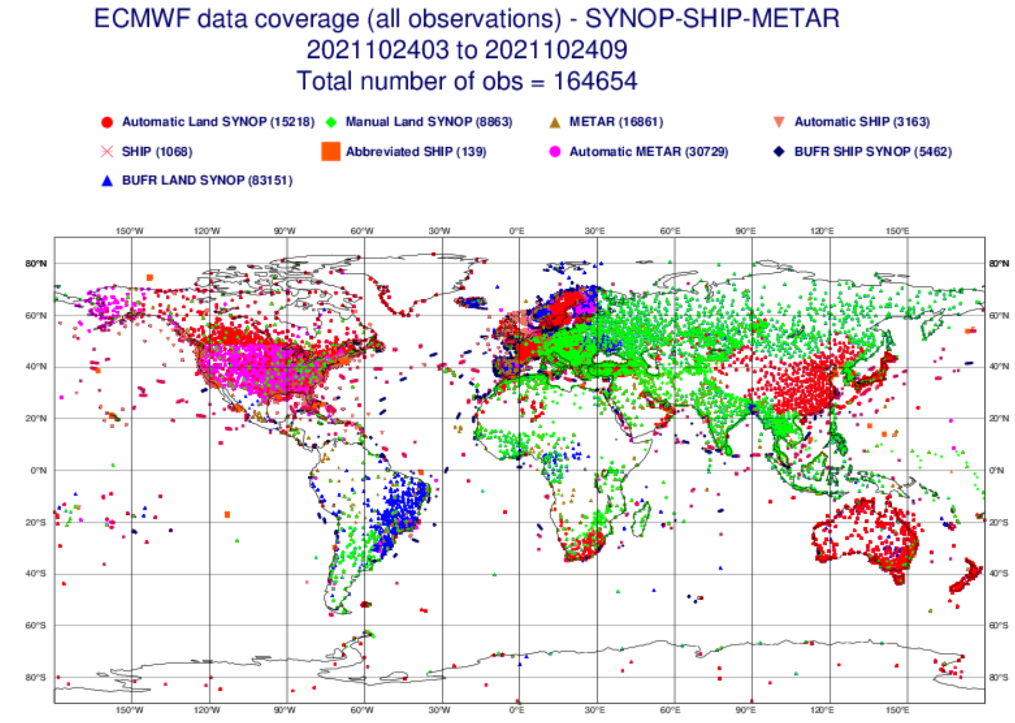
Goals of the Project
Recover observations from former Italian colonies and territories that were for a period ruled by Italy.
Digitise and ensure open access to these data.
Contribute to filling the data gap in areas that are still suffering from being poorly covered by monitoring networks.

Slide 3
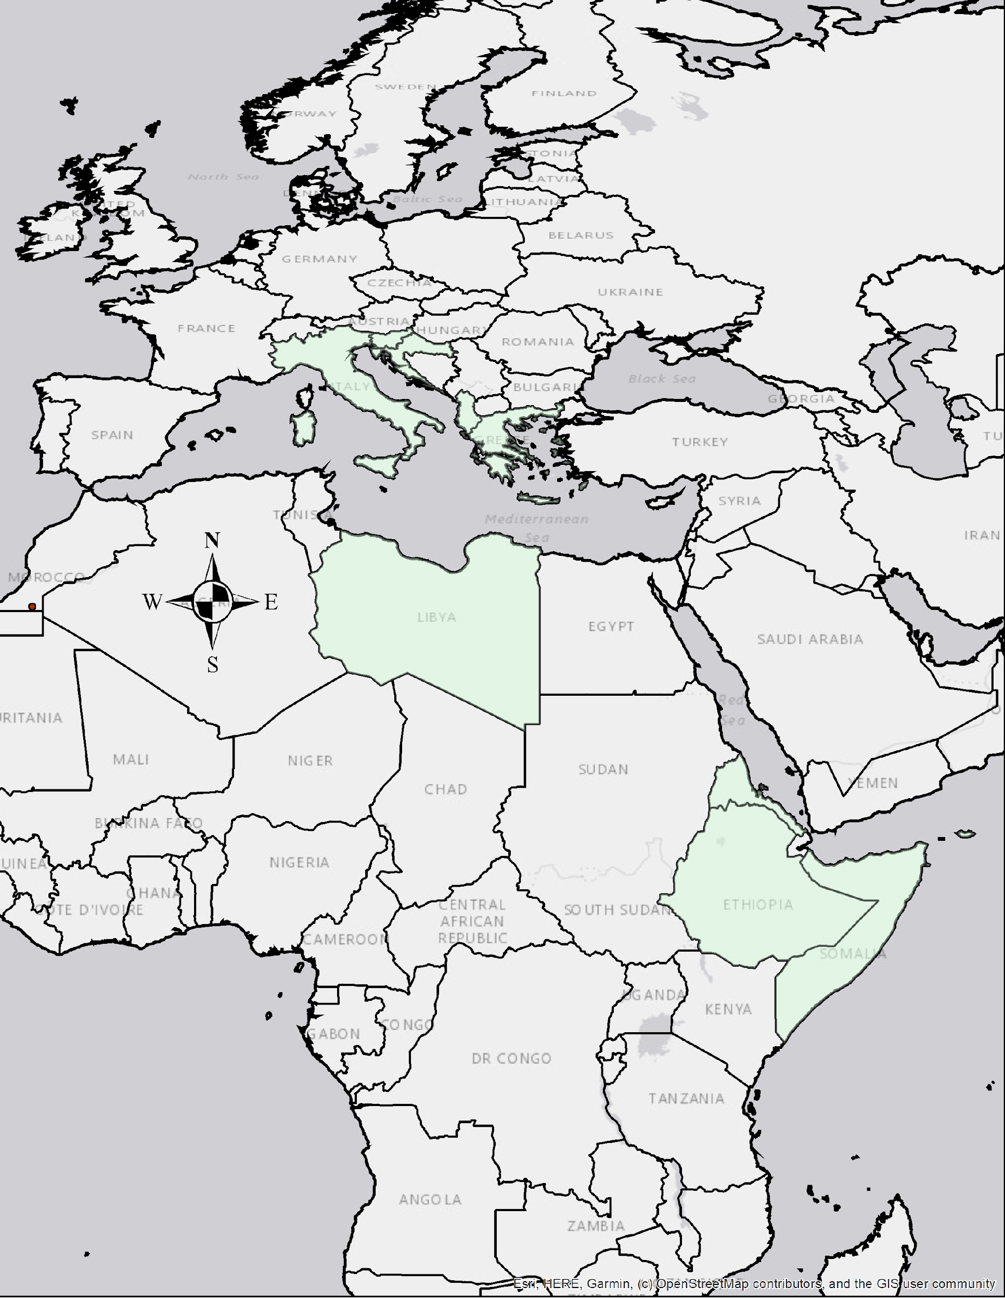
Study area
Among the data to be recovered a significant part was collected in territories formerly ruled by Italy:
Eritrea
Somalia
Ethiopia
Libya
Dodecanese islands
Albania
Dalmatia
Istria

Slide 4

The AISAM association
AISAM aims to promote the development of atmospheric sciences and meteorology through the creation of opportunities and tools for meetings, mutual knowledge, and collaboration among all subjects interested in meteorology.
It also aims to:
- highlight, at international level, the initiatives and results achieved by the national community
promote international cooperation
foster Italian participation in international projects, programs, and organizations in this sector.

Slide 5



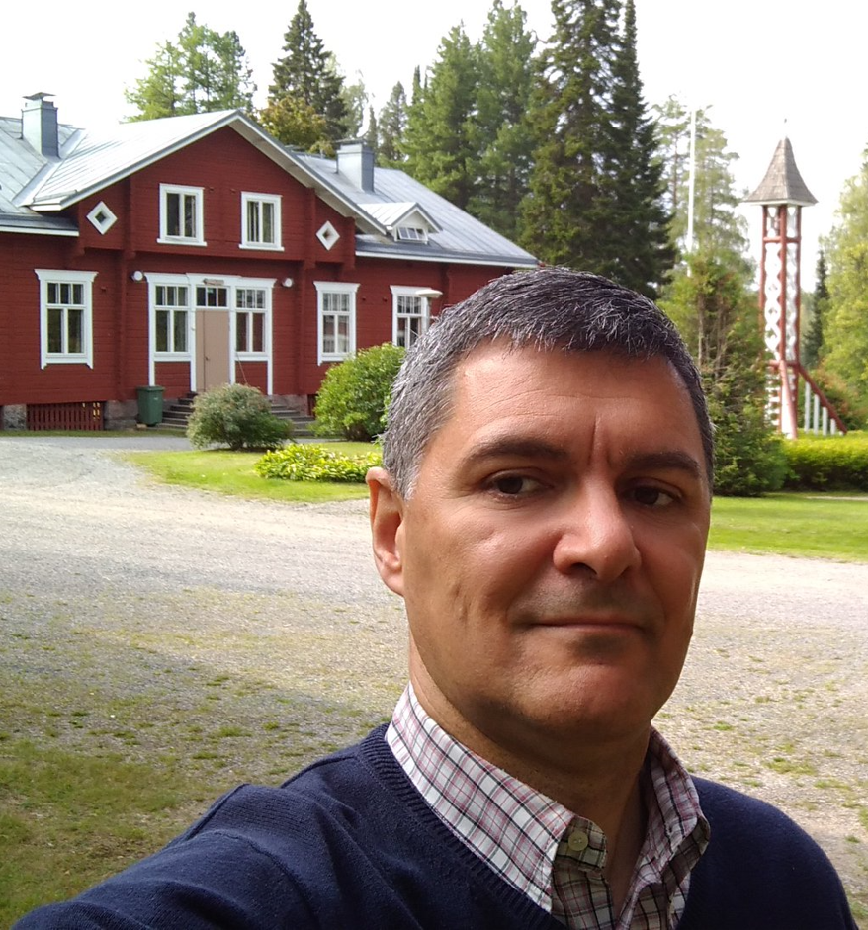












The Team
Principal Investigator
Alessandro Ceppi
(Politecnico di Milano)
Staff Members
Michele Brunetti
(CNR-ISAC)
Dino Zardi
(University of Trento)
Sergio Pisani
(President of AISAM)
Maurizio Maugeri
(University of Milan)
Luigi Iafrate
(CREA)
Francesco Sudati
(Air Force Service)
Maria Carmen Beltrano
(AISAM)
Veronica Manara
(University of Milan)
Marina Baldi
(CNR-IBE)
Samuele Giampietro
(AISAM)
Federico Stefanini
(University of Milan)
Fabio Leali
(University of Trento)
Eva De Vecchis
(AISAM)
Alessia Tadiello
(University of Milan)

Slide 6







Affiliations
The team members are affiliated with various Italian institutions:
University of Milan, Department of Environmental Science and Policy
CNR - Institute of Atmospheric Sciences and Climate (ISAC)
CNR - Institute of Bioeconomy (IBE)
Politecnico di Milano, Department of Civil and Environmental Engineering (DICA)
University of Trento, Department of Civil, Environmental and Mechanical Engineering (DICAM)
Italian Air Force Service (AM)
Council for research in agriculture and the analysis of agricultural economy (CREA)

Slide 7







Project funding
The Project is co-financed by public institutions:
the Italian Ministry of Culture
the European Union – Next Generation EU
the Italian National Agency of Meteorology and Climatology (ItaliaMeteo)
and by private companies:
Hypermeteo
Radarmeteo
SIAP+Micros

Slide 8
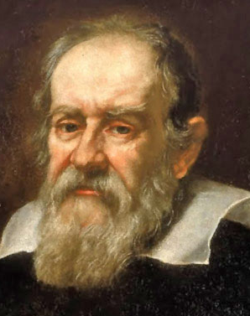
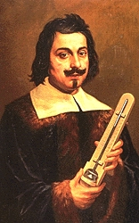

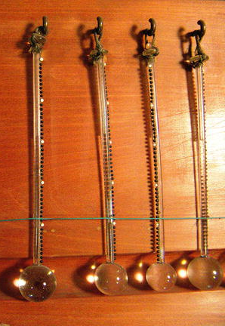

Background
Italy played a very significant role in the early development of modern meteorology.
Moreover, what can be defined as the first international observation network, linked to the Accademia del Cimento, was founded in the Italian country.
Thanks to this unique role, Italy possesses a massive heritage of ancient meteorological data of exceptional value (Camuffo and Bertolin, 2012).
The recovery of this enormous observational archive has been ongoing for a long time (Cottone, 1939; Bossolasco, 1945), and, in recent decades, a significant part of these data has been digitized.

Slide 9
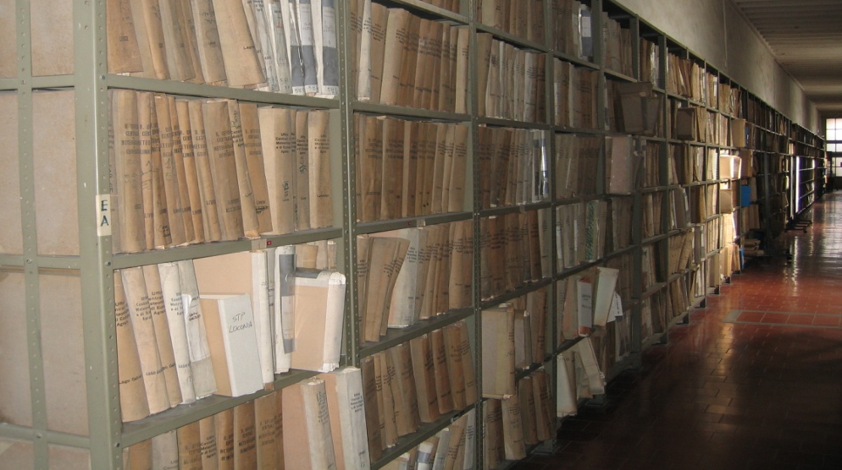
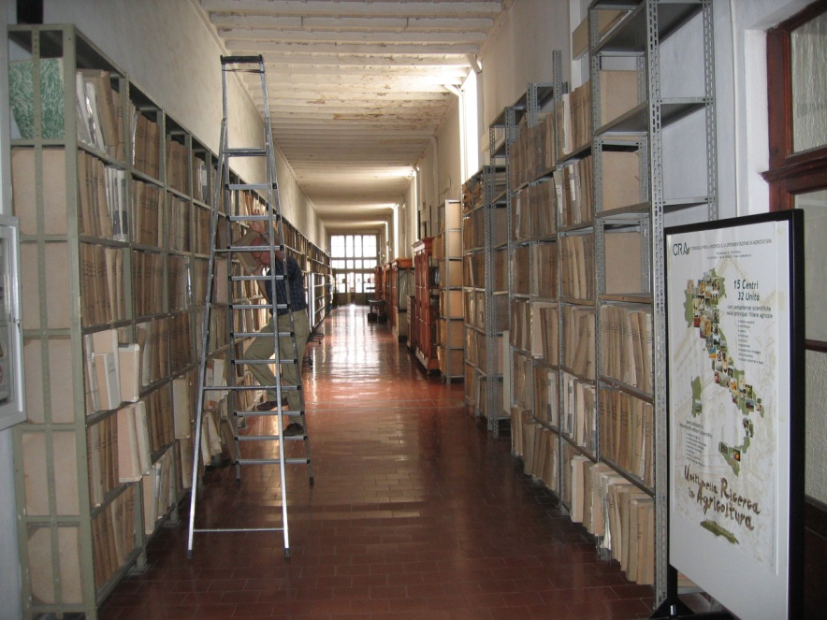
«Dieci e lode»: a Data Rescue Project
https://aisam.eu/progetti/10-e-lode-en/
A substantial part of meteorological data are still available in archives, only on paper!
Among these, there are data from countries of central-northern Africa which were formerly Italian colonies.

Slide 10
Material and data: available digitized and scanned information
To better understand which data only exist in hard copy, and must be recovered by scanning, the «Dieci e Lode» project is creating:
an inventory containing all international datasets which are already available online, such as Copernicus, GHCN (Global Historical Climatology Network), ISPD (International Surface Pressure Databank).
an inventory of many original sources that have been already scanned throughout the years, but not digitized, such as documents from Italian Air Force Service, Meteorological Bulletin of Cyrenaica (1931), Climatological Contribition of Somalia, and Bulletins from the African colonies (some of them are public online by NOAA in the "Meteorological bulletin of the Italian colonies" for the years 1932, 1933, 1934, 1935-1936).
These inventories will be divided per meteorological station: for each set of data variable type (average temperature, precipitation, etc...), frequency (daily, monthly) and period of measurements and its online source will be noted.

Slide 11

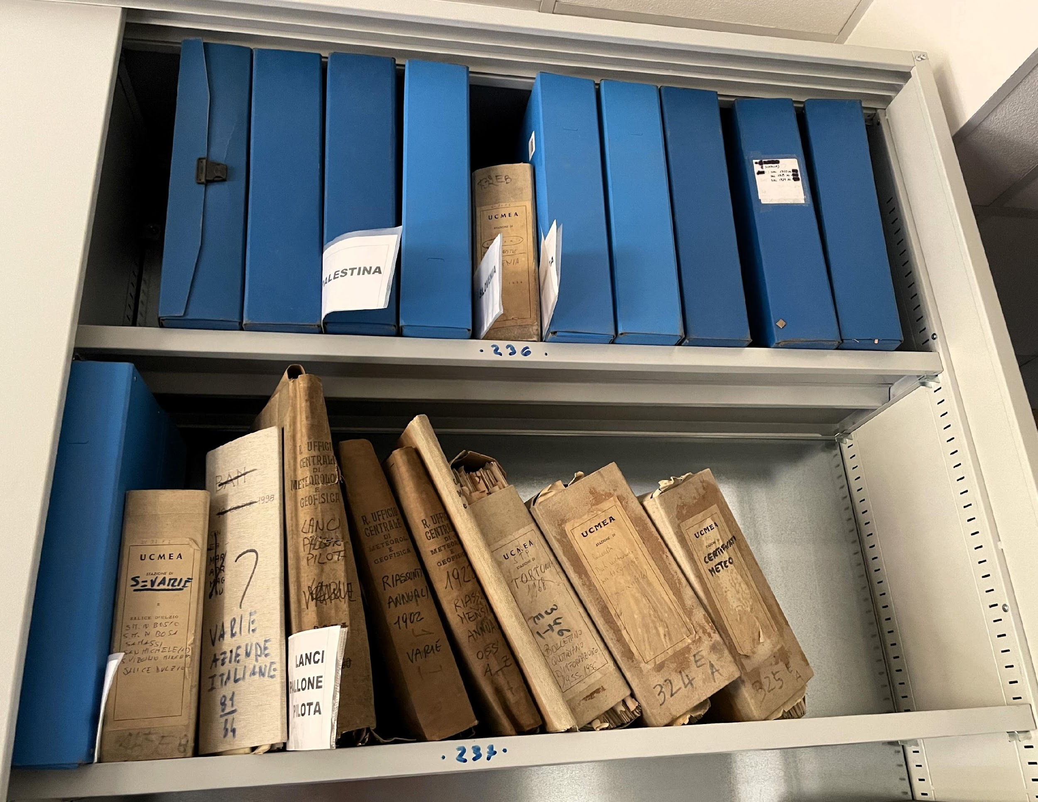
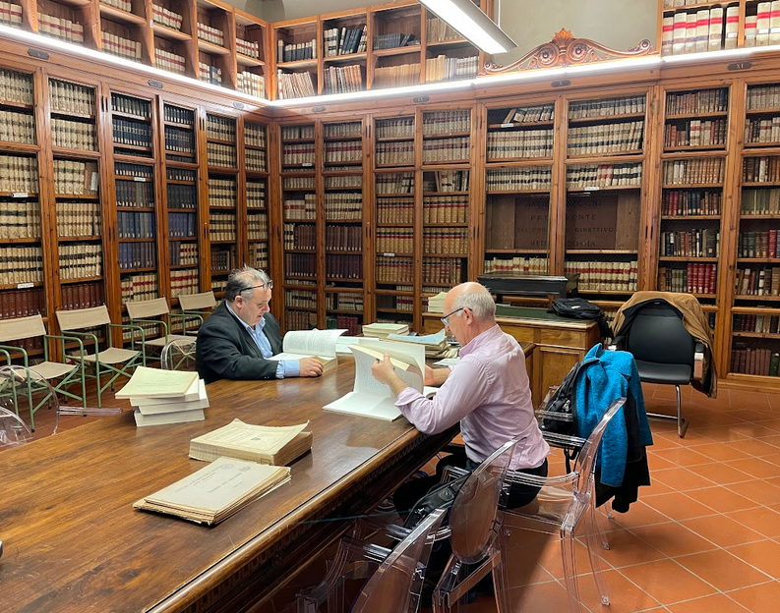
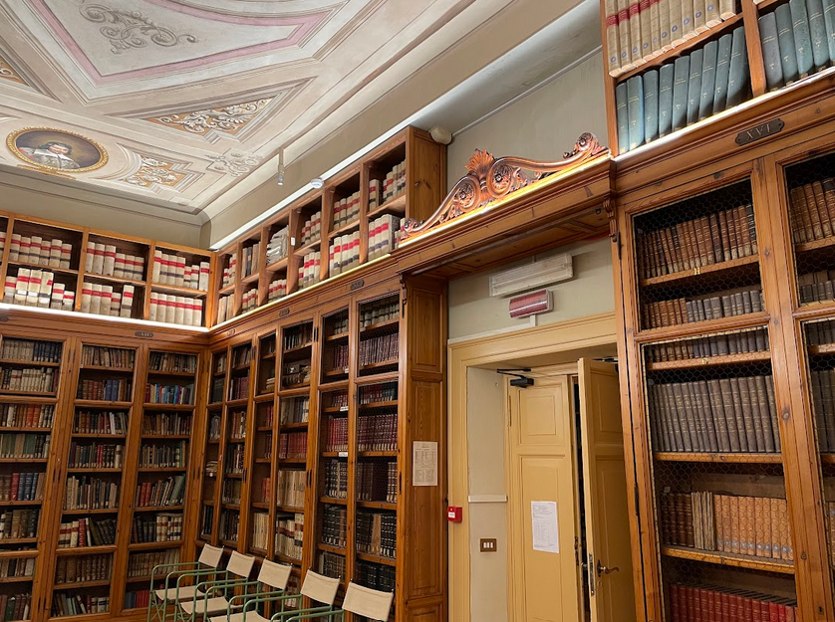
Material and data: the CREA’s treasure
The heritage of meteorological observations from these territories is mostly found in the National Meteorological Archives of the Council for Research in Agricultural and the analysis of Agricultural Economy (CREA)
Tavg, Tmin, Tmax, humidity, precipitation, wind and cloudiness are the most common variables available in these data archives to be scanned.

Slide 12
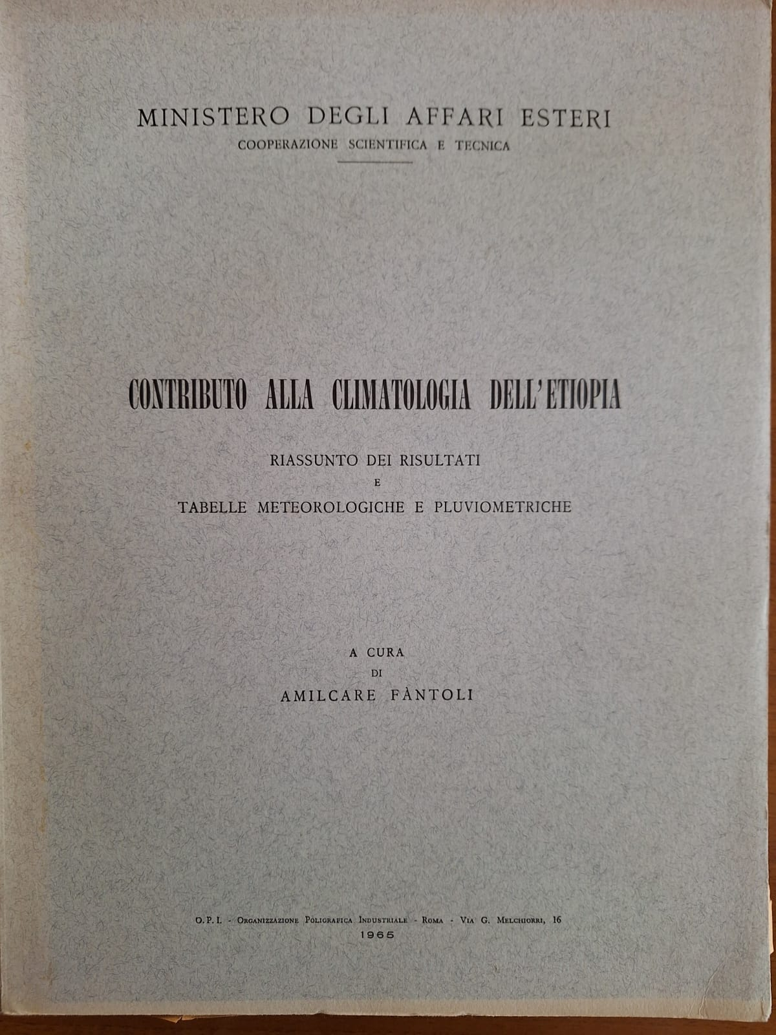
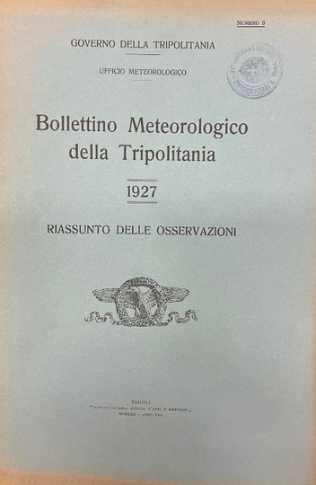
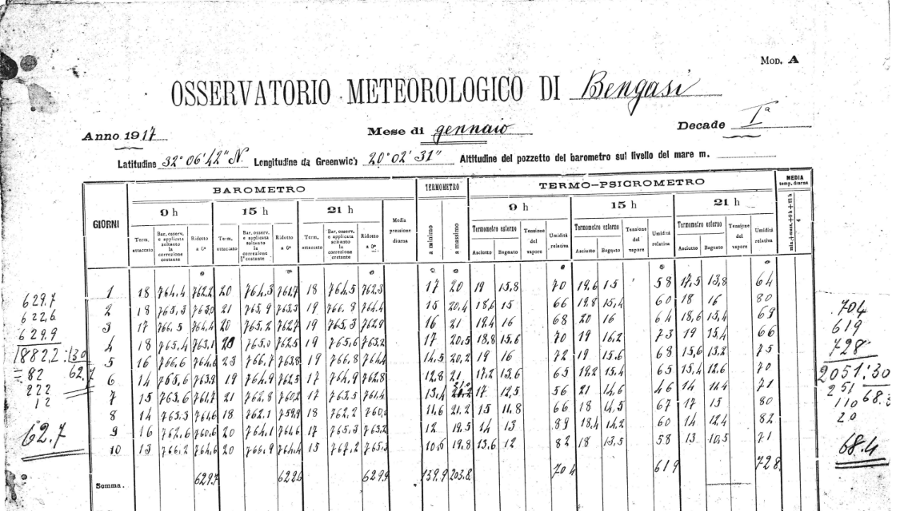
Main volumes to be scanned
Contribution to the climatology of Ethiopia, Tripolitania, Cyrenaica, the internal regions of Libya, the Ethiopian Plateau and Eritrea, “Meteorological observations made in Tripoli with the climograms of that period”: 6 volumes in total, about 2800 pages.
24 volumes of bullettins of data from Tripolitania (1919-1931), Cyrenaica (1923-1931) and Eritrea (1930-1933), about 1500 pages.

Slide 13
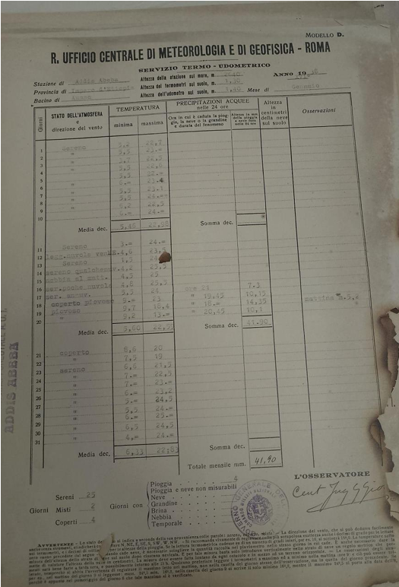
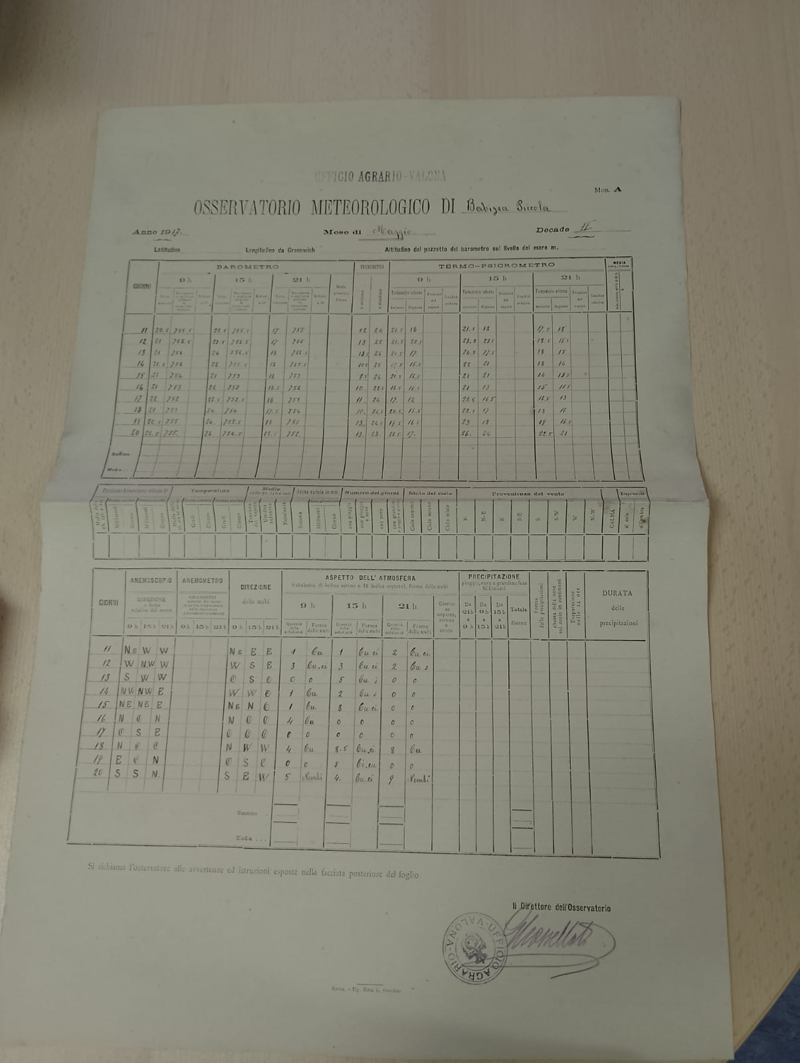
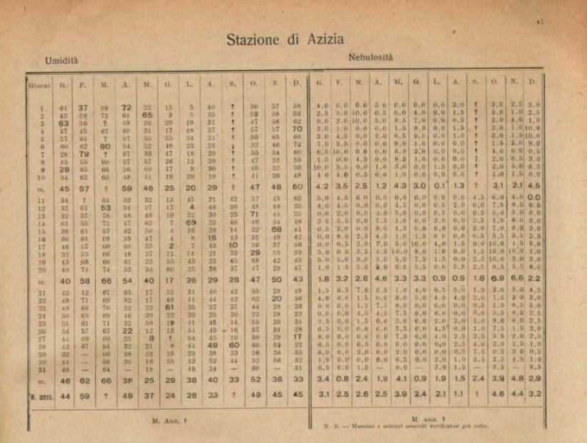
Main volumes to be scanned
Archived paper sheets at CREA data from about 73 stations from different countries: Albania (1), Algeria (2), Croatia (10), Egypt (1), Eritrea (3), Ethiopia (1), Greece (circa 5), Libya (37), Palestine (1), Slovenia (1) and Somalia (11). These data sheets are about 10,000 pages.
Bulletins from Amilcare Fantoli's books on Africa published by the Italian Ministry of Foreign Affairs.
Amilcare Fantoli (1891-1980) founded the meteorological service of former Italian colonies.

Slide 14
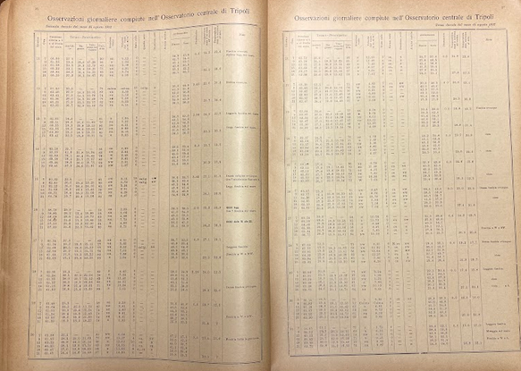
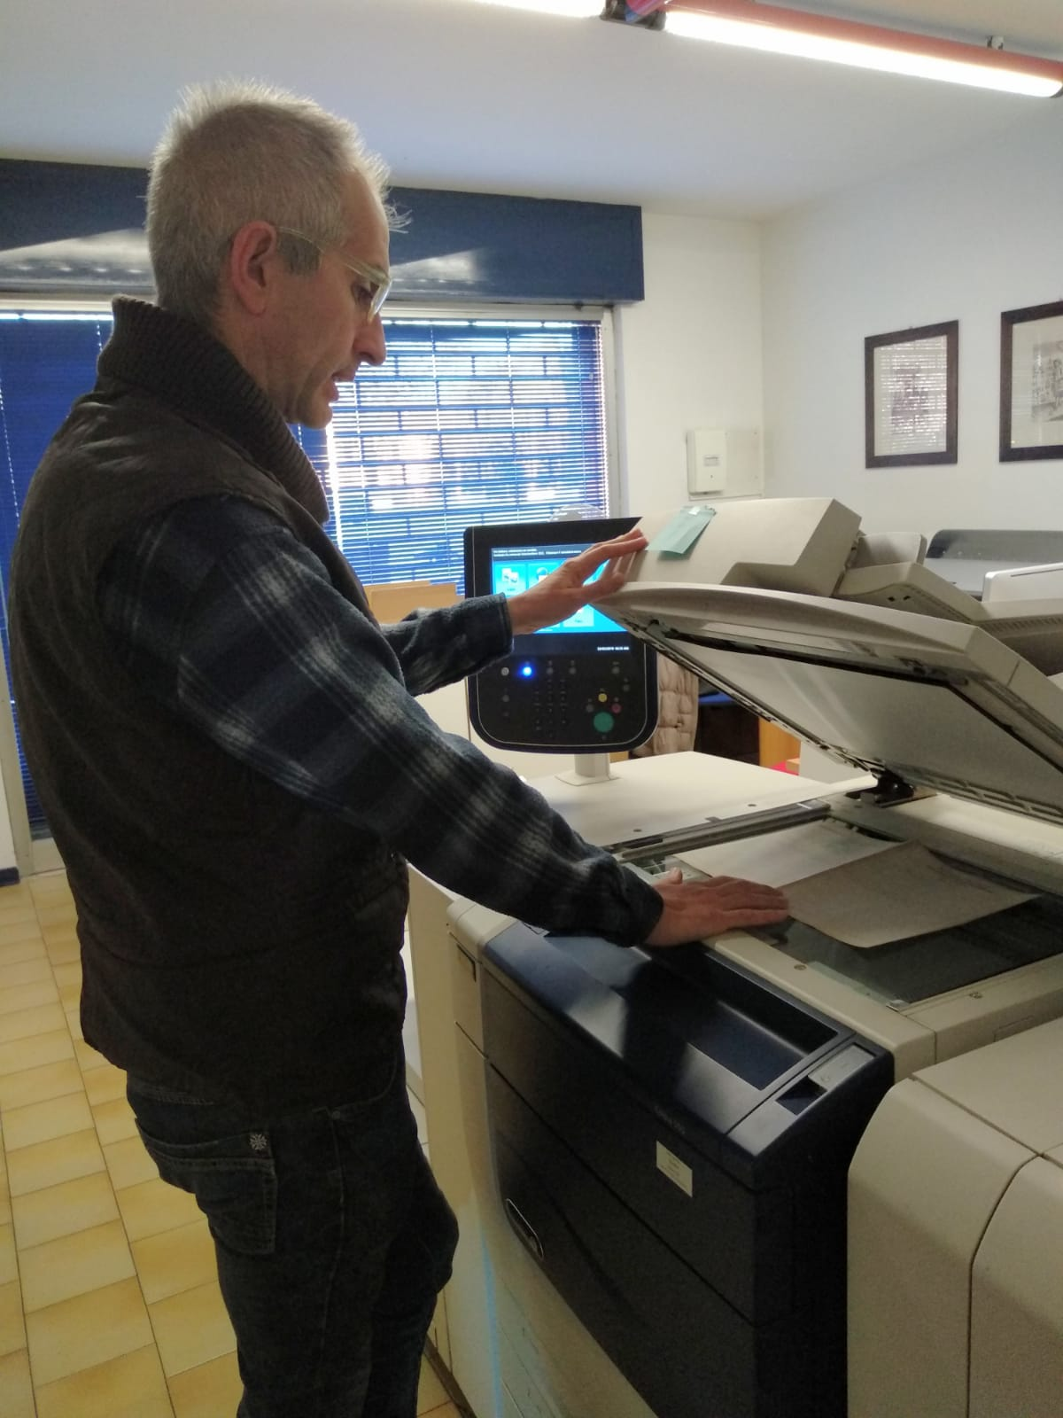
Main activities
Since the most relevant data and other information have been identified, during this month of September, activities have proceeded with photographic scanning, aimed at publishing online images of the data sheets and volumes identified during the inventory conducted in the previous months.
The overall number of pages expected to be scanned is approximately 40,000. The scanning activity, carried out by Ronca Editore (publish company), will be accompanied by detailed indexing work to facilitate the data finding and information of interest.

Slide 15
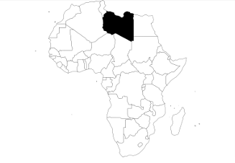
Scanned data
Libya
Period of Italian government: 1912-1943
Stations in the digitized inventory: 67
Stations in the scanned inventory: 70
Stations at the CREA archive to be scanned: 37

Slide 16
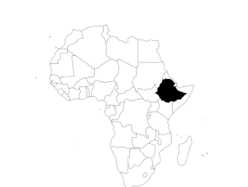
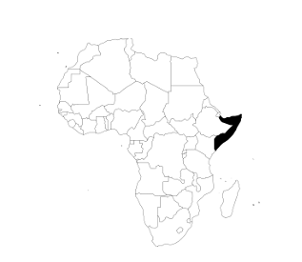
Ethiopia
Period of Italian government: 1935-1941
Stations in the digitized inventory: 190
Stations in the scanned inventory: 24
Stations in the CREA archive to be scanned: 1 (Addis Abeba)
Somalia
Period of Italian government: 1908-1941
Sations in the digitized inventory: 13
Stations in the scanned inventory: 90
Stations in the CREA archive to be scanned: 12

Slide 17
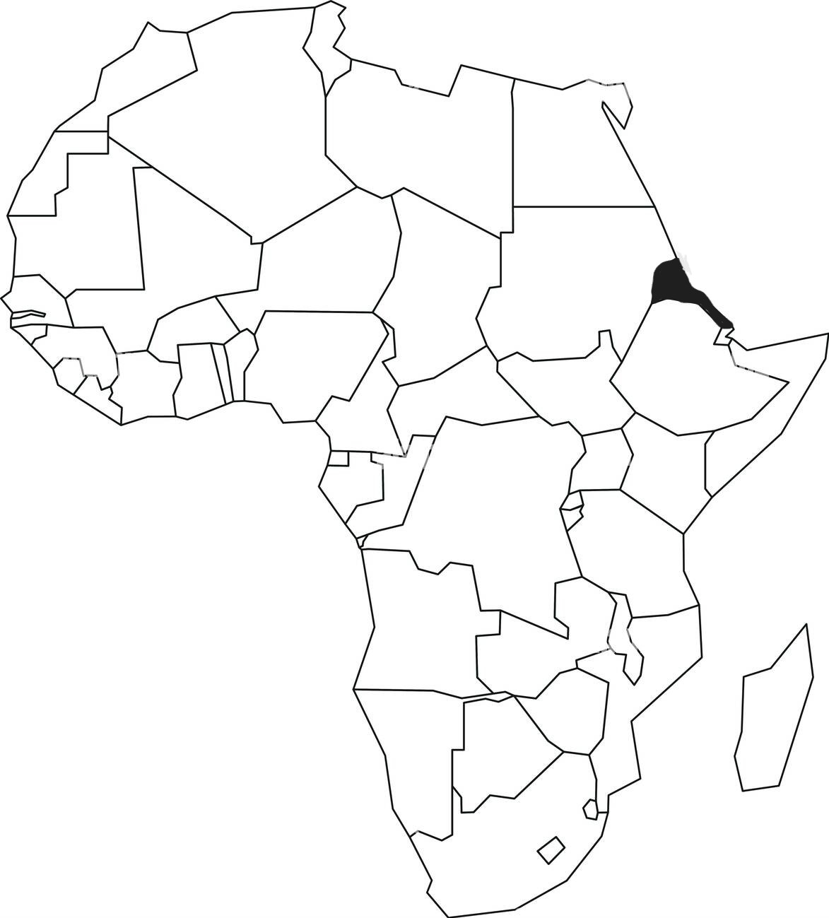
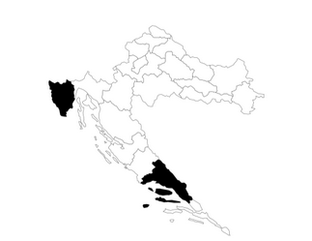
Eritrea
Period of Italian government: 1890-1947
Stations in the digitized inventory: 13
Stations in the scanned inventory: 22
Stations in the CREA archive to be scanned: 3
(Adi Ugri, Asmara, Assab)
Dalmatia and Istria
Period of Italian government: 1941-1943
Stations in the digitized inventory: 67
Stations in the scanned inventory: 0
Stations in the CREA archive to be scanned: 11

Slide 18
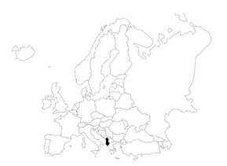
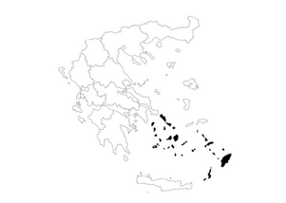
Albania
Period of Italian government : 1918-1920, 1939-1943
Stations in the digitized inventory: 13
Stations in the scanned inventory: 0
Stations in the CREA archive to be scanned: 1 (Babizza Piccola)
Dodecanese islands and Rhodes
Period of Italian government : 1912-1943
Stations in the digitized inventory: 0
Stations in the scanned inventory: 0
Stations in the CREA archive to be scanned: 7

Slide 19
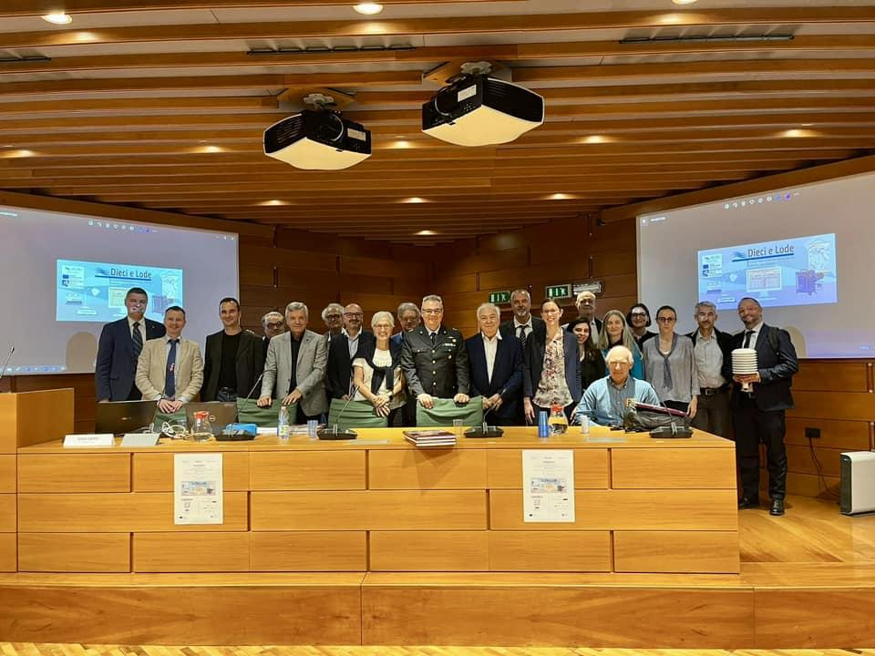
Steps of the project (October 2023-April 2025)
Phase #1: team building, official agreements with partners, and fundraising.
Phase #2: set up the inventory of available climatological datasets to be rescued.
Phase #3: scanning activities.
Phase #4: organization of the archive images, dissemination and publications.
Final meeting project at FAO in Rome (supposed to be in February 2025).
Kick-off meeting: Bologna on 31st May 2024
https://aisam.eu/progetti/10-e-lode-kick-off-meeting-en

Slide 20
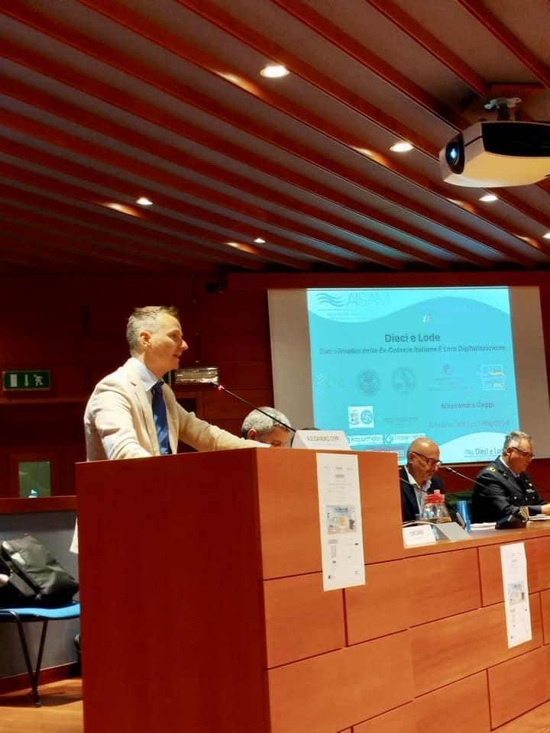
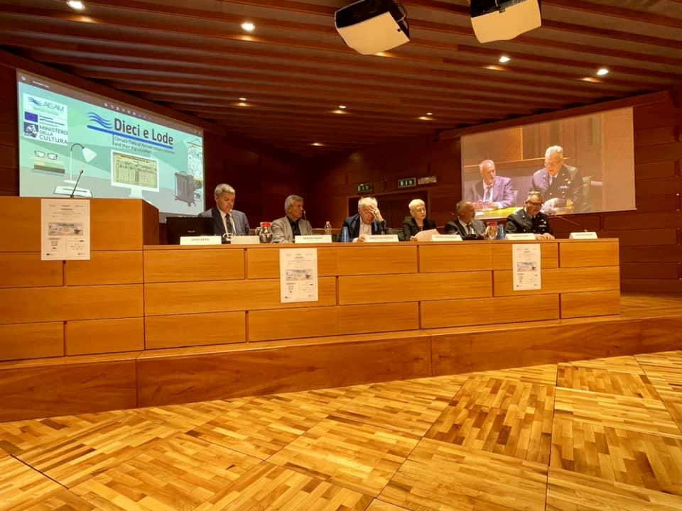
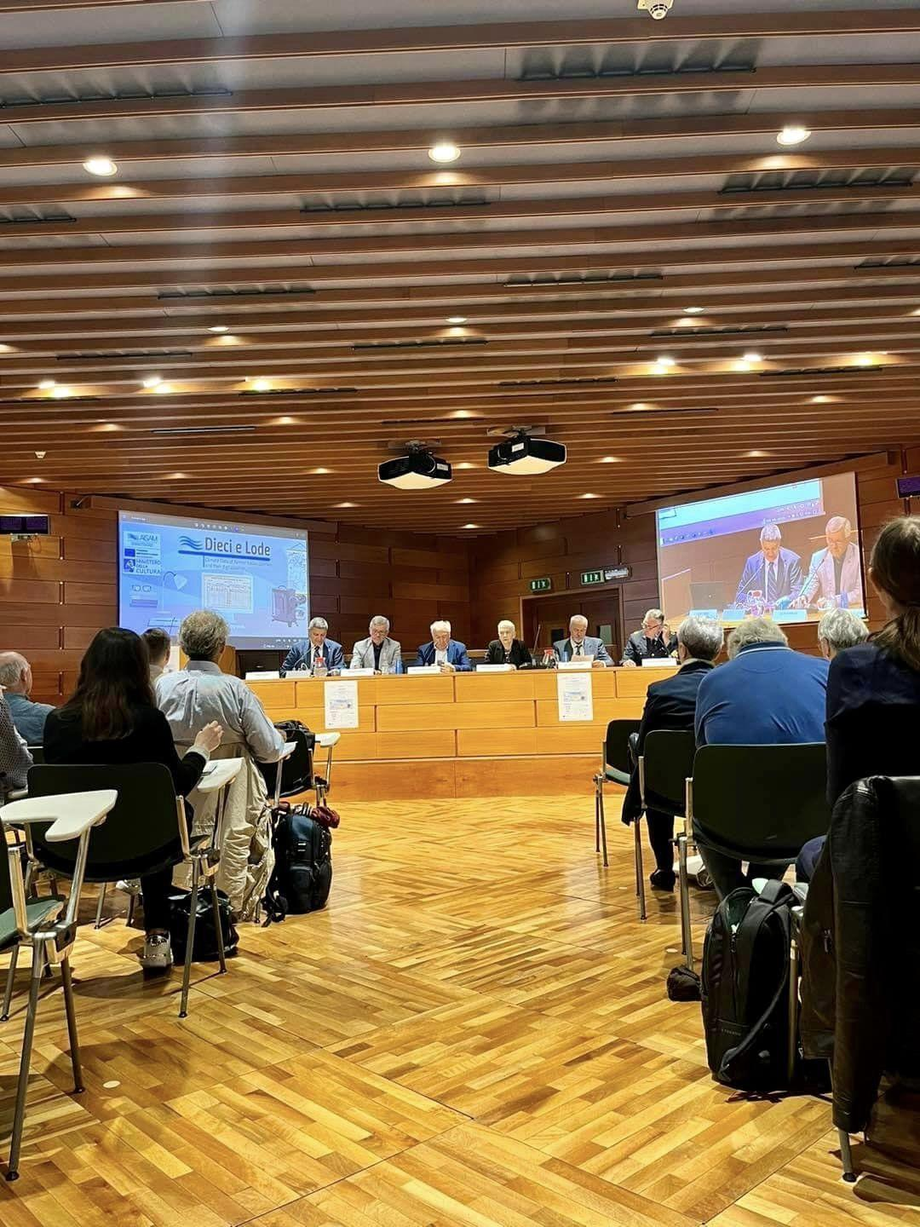
Kick-off meeting
National and International Speakers:
    Sergio Pisani (President AISAM)
    Carlo Cacciamani (Director of the Agenzia ItaliaMeteo)
    Patrizia Bianconi (Emilia-Romagna Region)
    Giuseppe Corti (Director of CREA – Centro di Ricerca Agricoltura e Ambiente)
    Luca Baione (Italian PR WMO)
    Alessandro Ceppi (Politecnico di Milano)
    Luigi Iafrate (CREA)
    Ali Salem Eddanjal (Director of Libya’s National Meteorological Service)
    Massimo Zaccaria (University of Pavia)
    Adriano Raspanti (Aeronautica Militare)
    Peer Hechler (Climate Monitoring and Policy Services Division – WMO)
    Rob Allan (Inst. for Environmental Research & Sustainable Development, National Observatory of Athens)
    Elisa Bortoli (Radarmeteo & Hypermeteo)
    Adriano Fedi (Siap+Micros)

Slide 21
Expected results
The data from measurements in the former colonies can give significant contribution to international climatological research.
The imposing task of scanning that AISAM aims to develop allows to:
preserve a heritage of inestimable value.
consult a significant series of past information, actually on paper only: all the scanned copies will be online and freely available.
benefit a wide range of categories and users: from young students in schools to researchers at universities and institutions, as well as businesses and meteorological services in order to conduct analyses and studies to better understand the climate of the past and its ongoing changes.

Slide 22
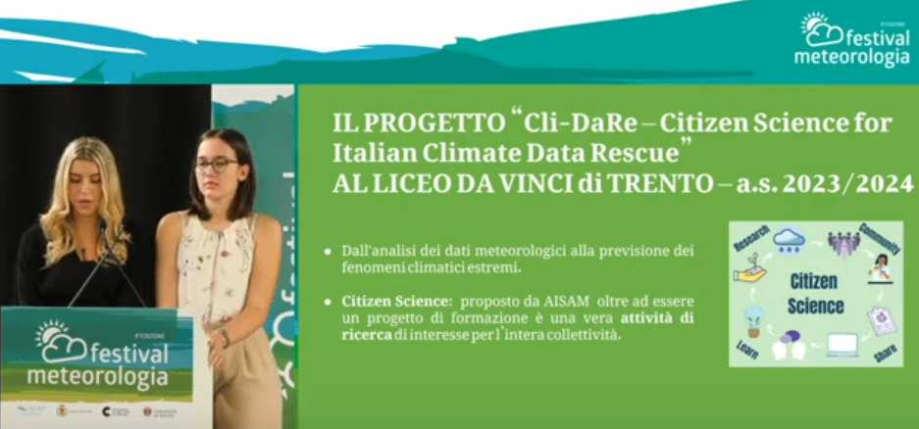
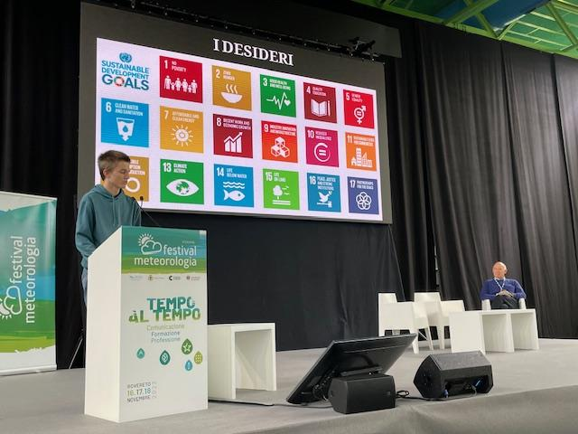
Involving the Citizen Science…
The “Dieci e Lode” project will be complemented by case studies aimed at evaluating possible implementations of Citizen Science activities aimed at extracting numerical series from scanned/digitized data sheets available for climatological research, thus, enhancing a line of activity already present in AISAM.
Currently, AISAM is coordinating the Cli-DaRe@School Project, which involves the participation of many Italian schools and hundreds of teenager students.
A feasibility study will also be conducted to assess how these activities can be supported by the latest Optical Character Recognition (OCR) technology.

Slide 23
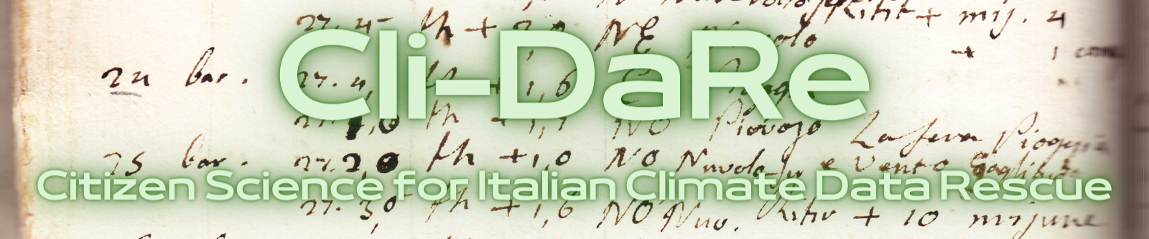
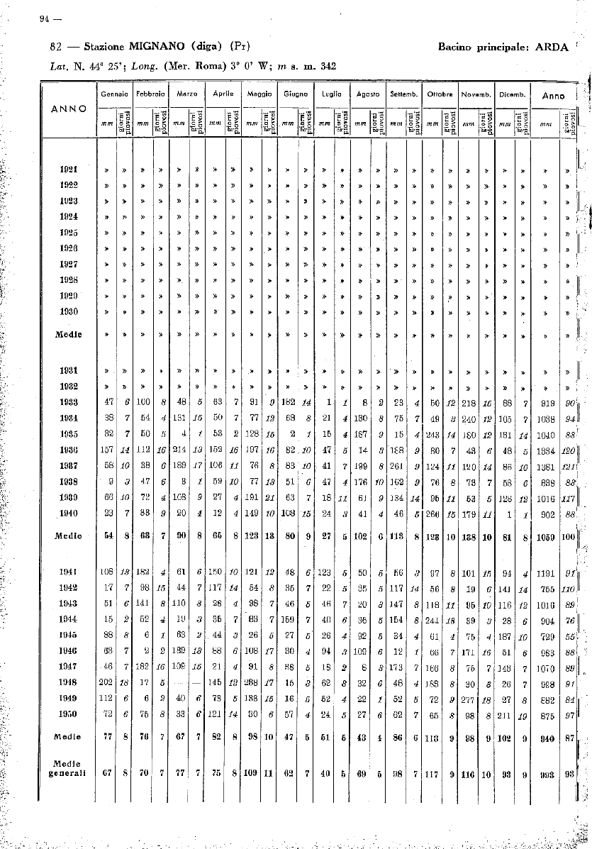
The Cli-Dare Project
Citizen Science for Italian Climate Data Rescue Project
Cli-DaRe has been set up after the Fourth AISAM National Conference held in Milan (February 2022).
Cli-DaRe aims at strengthen Citizen Science activities for the rescue of the heritage of Italian old meteorological data. These datasets include values that are still available only on paper or in digital format (as images, only).
The final goal of Cli-DaRE is to set up an open access archive of old Italian meteorological observations.

Slide 24
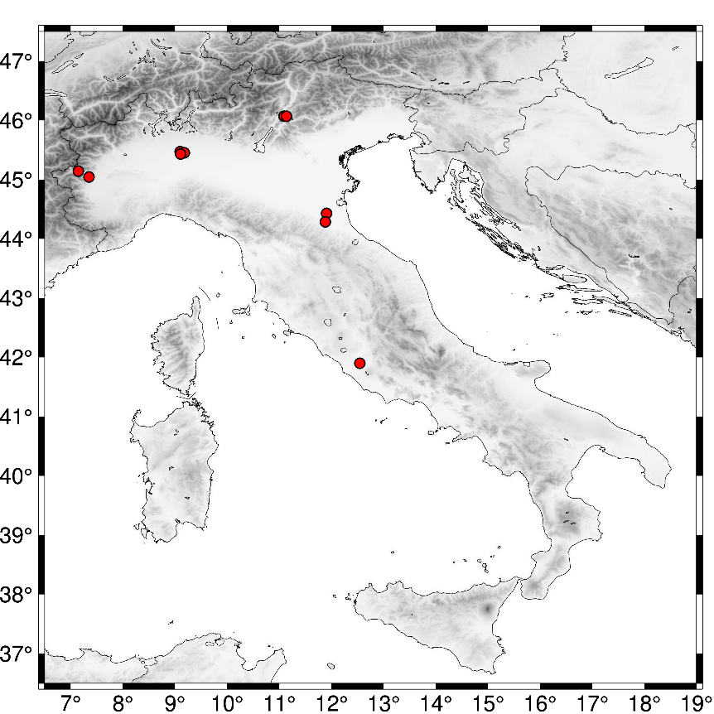
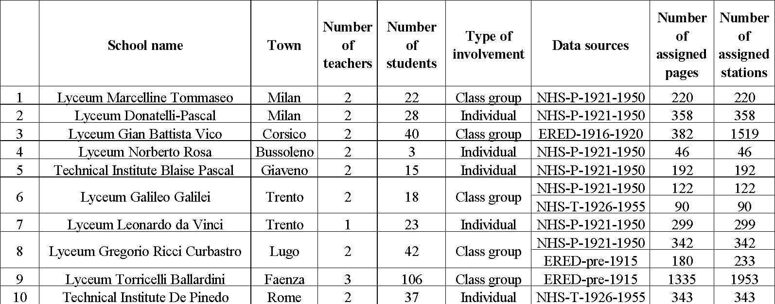
Under Cli-DaRe@School about 4000 pages of meteorological data were digitized by high-school students. Manara et al., (2024), Submitted to BAMS.
Lyceum Donatelli-Pascal (Milan)
Lyceum Marcelline Tommaseo (Milan)
Lyceum Leonardo da Vinci (Trento)
Lyceum Gian Battista Vico (Corsico)
Lyceum Galileo Galilei (Trento)
Lyceum Norberto Rosa (Bussoleno)
Lyceum Gregorio Ricci Curbastro (Lugo)
Technical Institute Blaise Pascal (Giaveno)
Lyceum Torricelli Ballardini (Faenza)
Technical Institute De Pinedo (Rome)

Slide 25
Conclusions
The project of digitizing climatological data from former Italian colonies represents a significant step towards understanding the climate of the past in areas that still lack a dense monitoring network for detecting (and recording) meteorological phenomena.
The availability and accessibility of data in international databases will allow a full utilization of the recovered values, which will be important for a better understanding of climate change in the areas covered by the project.
The cultural content of this project will benefit a wide range of categories and users: from young students in schools to researchers at universities and institutions, as well as business and meteorological services in those nations that were once Italian colonies.

Slide 26

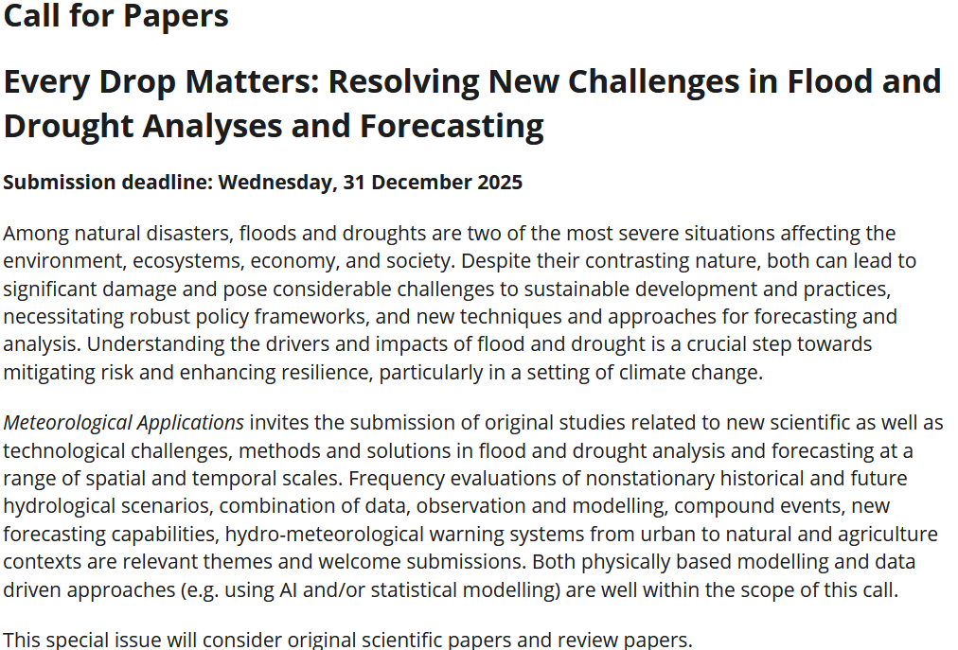

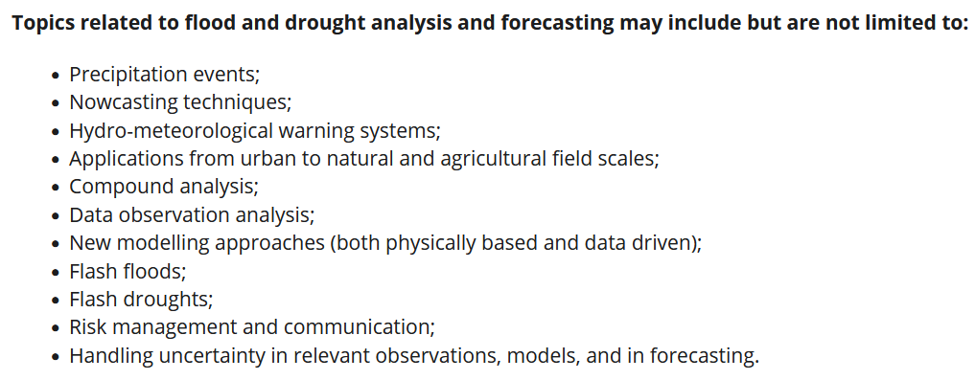
Special issue about floods and droughts

Slide 27
Thank you for your attention!
diecielode@aisam.eu
alessandro.ceppi@polimi.it
https://aisam.eu/progetti/10-e-lode-en/

