Slide 1
Great California Flood of 1861-62
And
Great Mississippi Flood of 1874
Gilbert P. Compo^{1,2}, P.D. Sardeshmukh^{1,2}, C. McColl^{1,2} , Larry Spencer^{1,2} , P.Brohan³, and C. Smith^{1,2},
Laura C. Slivinski^{1,2} , J.S. Whitaker²
¹University of Colorado at Boulder, CIRES
²NOAA Physical Sciences Laboratory
³UK Met Office
compo@colorado.edu
go.usa.gov/XTd
Slivinski, Compo, Whitaker, Sardeshmukh, et al., 2019: Towards a more reliable historical reanalysis: Improvements for version 3 of the Twentieth Century Reanalysis system. Q J R Meteorol Soc. ; 145; 2876– 2908. doi:10.1002/qj.3598.

Slide 2
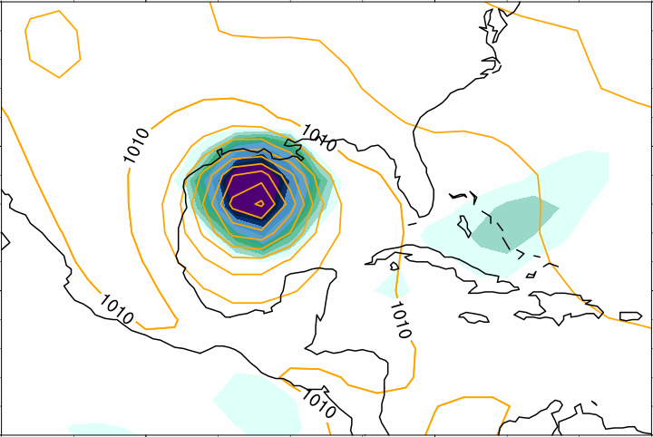
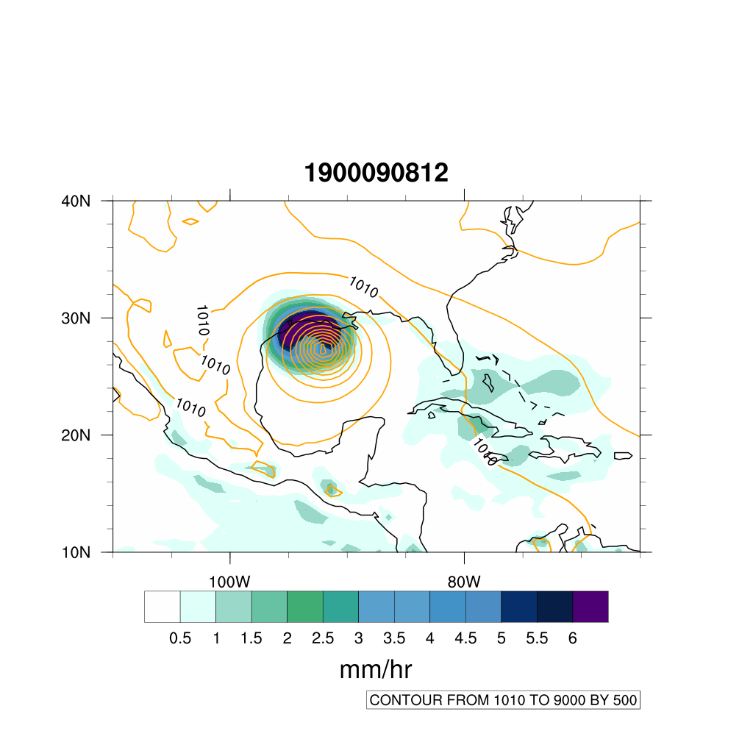
The 20th Century Reanalysis version 3 (1806-present)
Summary: As part of the international ACRE initiative, NOAA and CIRES are using DOE supercomputers to produce 4-dimensional reanalysis datasets extending back to the 19th century using an Ensemble Kalman Filter and analyzing only surface pressure observations.
New Version 3 has higher resolution (~$0.7°$), more realistic extremes and quantified uncertainties.
Sea Level Pressure and Precipitation Rate
20CRv2c
20CRv3
1900 Galveston Hurricane:
deadliest in US history (6,000-12,000 dead)
New 20CRv3 analyzes a stronger hurricane.
go.usa.gov/XTd
8 September 1900 12UTC
mm/hr
SLP C.I. 5 mb
The NOAA-CIRES-DOE 20CRv3 reanalysis dataset provides:
-First-ever estimates of global near-surface to tropopause 3-hourly fields extending back to 1806;
-80 members for uncertainties in the basic fields and in derived quantities (e.g., storms tracks).
Goals of global climate reanalyses:
Create a long dynamically-consistent record of the mean climate, variability, and trends.
View individual extreme weather and climate events in a long-term historical context.
Assess the significance of any trends in the mean, variability, and statistics of extremes.
Verify and validate climate model simulations of the mean climate, variability, and trends.
Notes:
ACRE initiative=Atmospheric Circulation Reconstructions over the Earth initiative

Slide 3
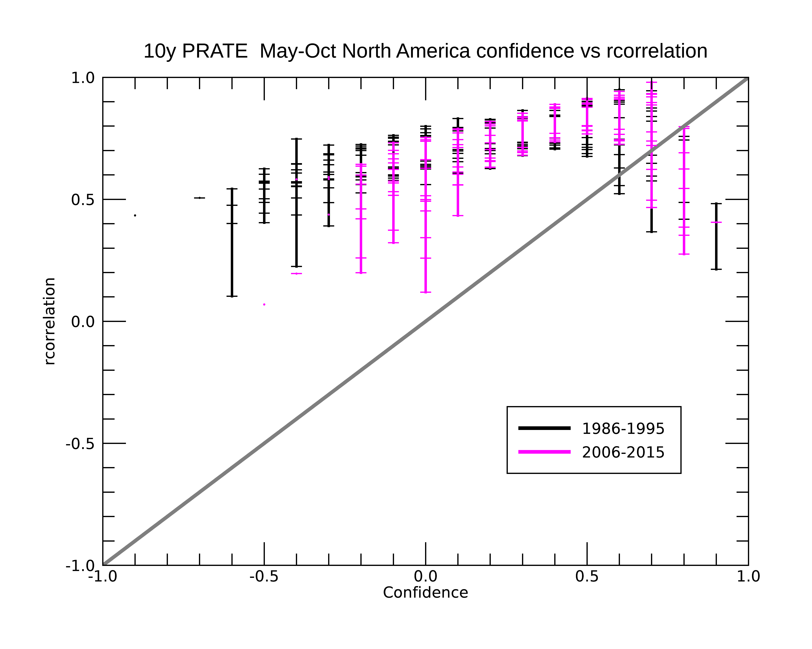
Rank Correlation between Precipitation from 20CRv3 and ERA5 for May – Oct as a function of 20CRv3 Confidence

Slide 4
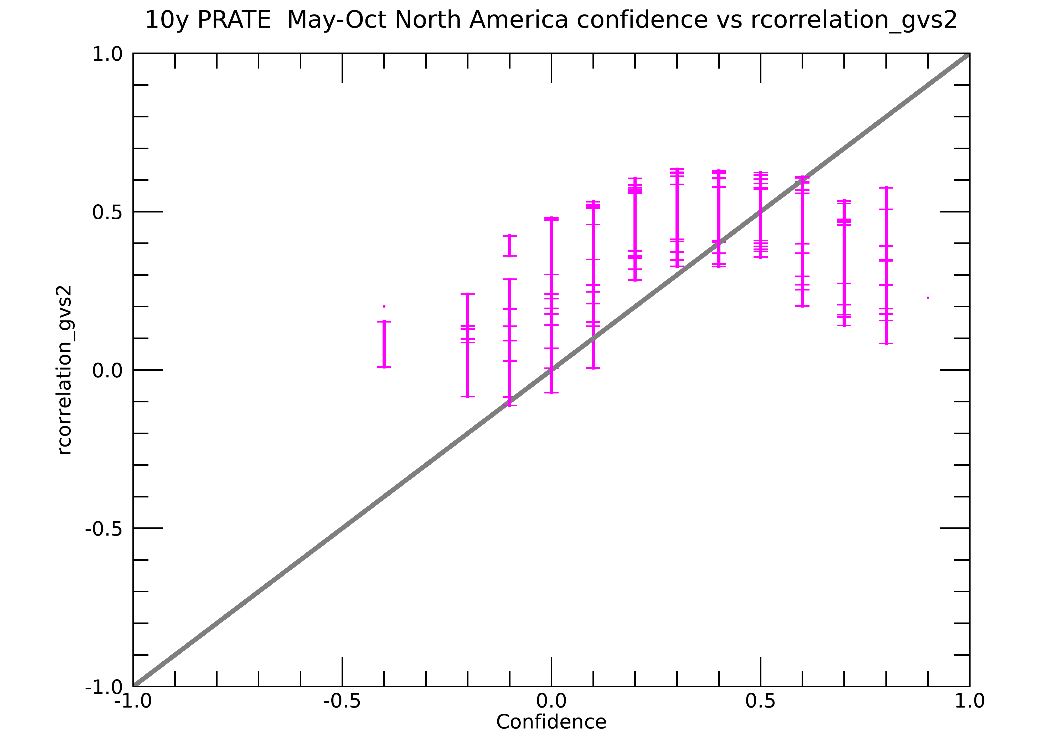
Rank Correlation between Precipitation 20CRv3 and
GPCP-Daily for May – Oct as a function of 20CRv3 Confidence

Slide 5
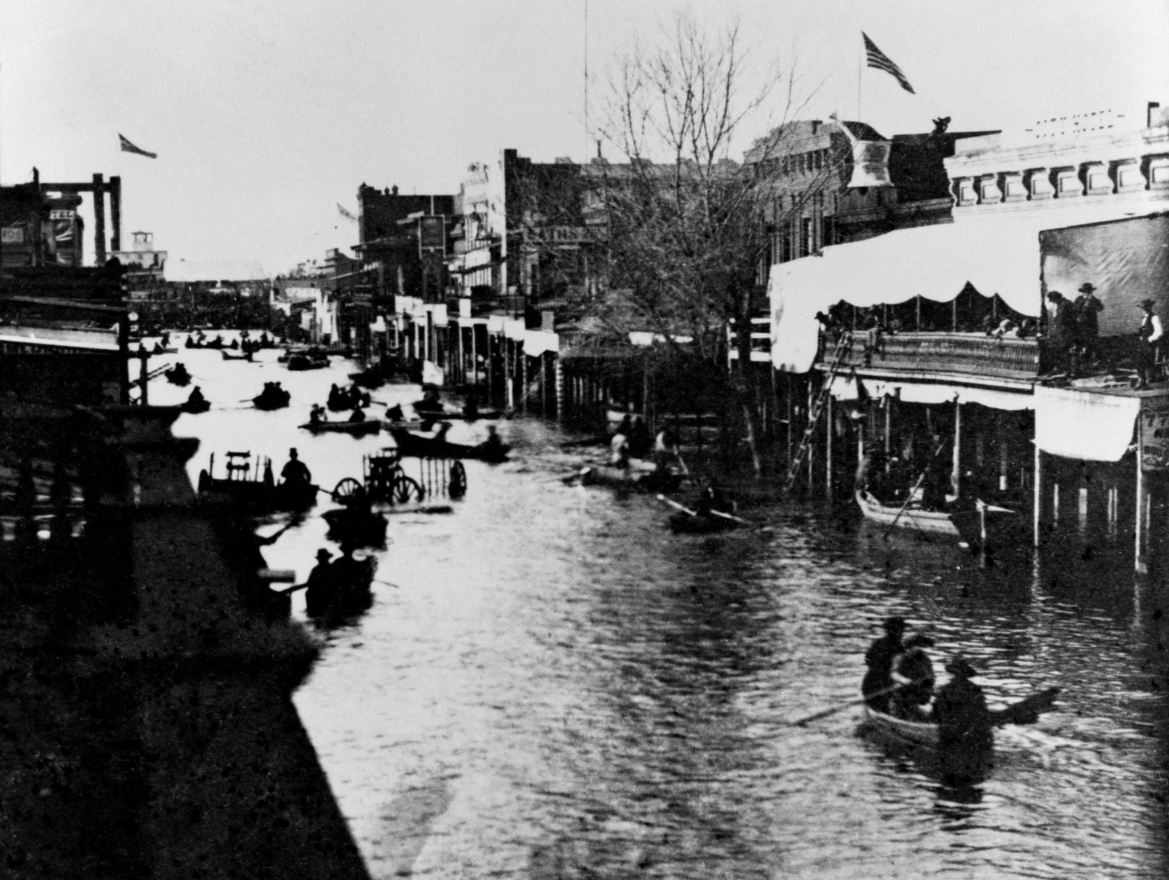
Great California Flood of Dec 1861- Jan 1862
Floodwaters in Sacramento, California in January 1862. Courtesy: California State Library

Slide 6
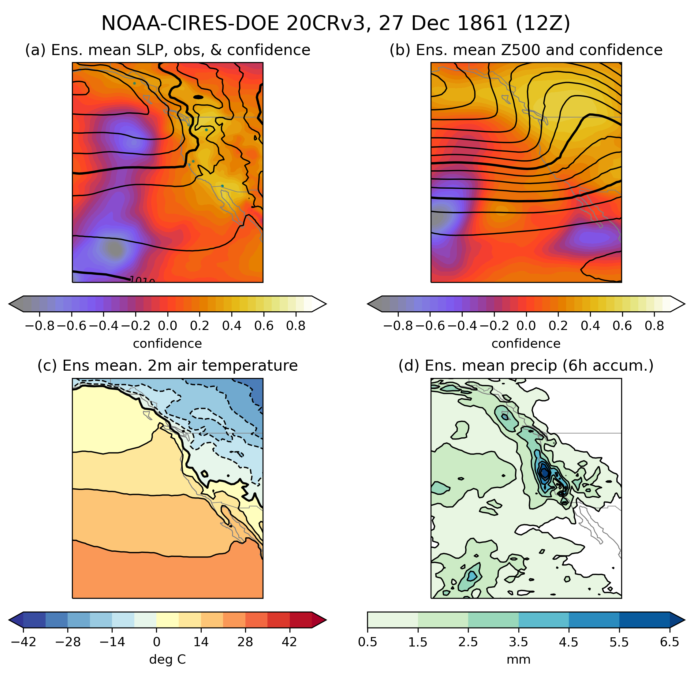

Slide 7
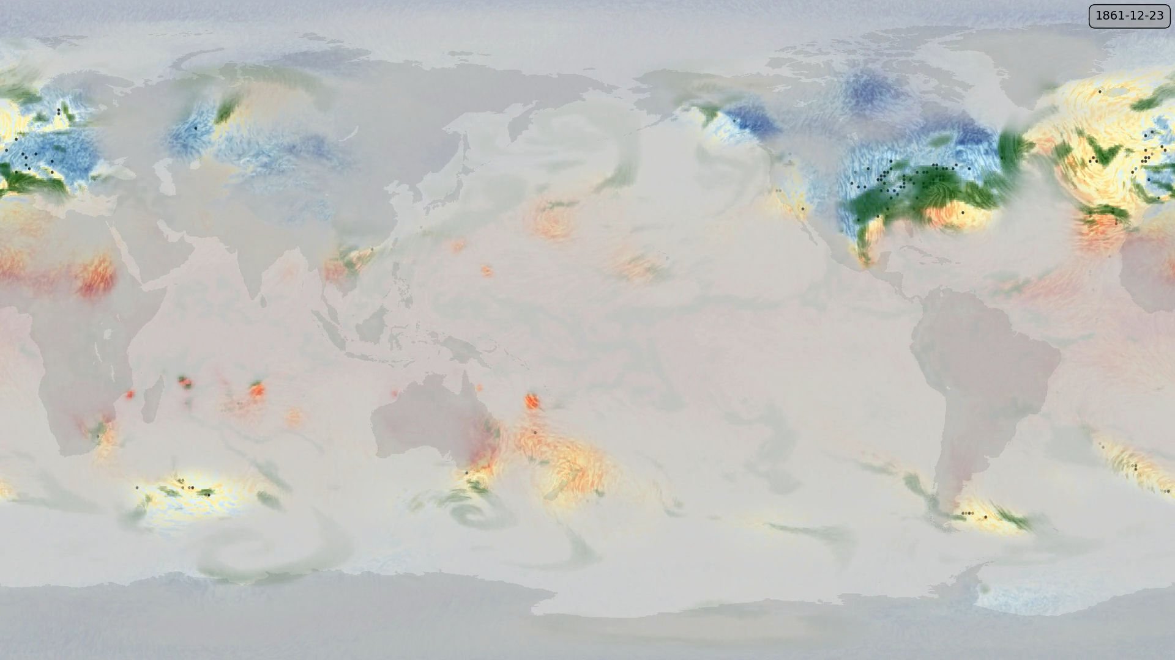
20CRv3 near surface winds, temperature, and precipitation
“Fog of ignorance” shows where ensemble spread is large

Slide 8
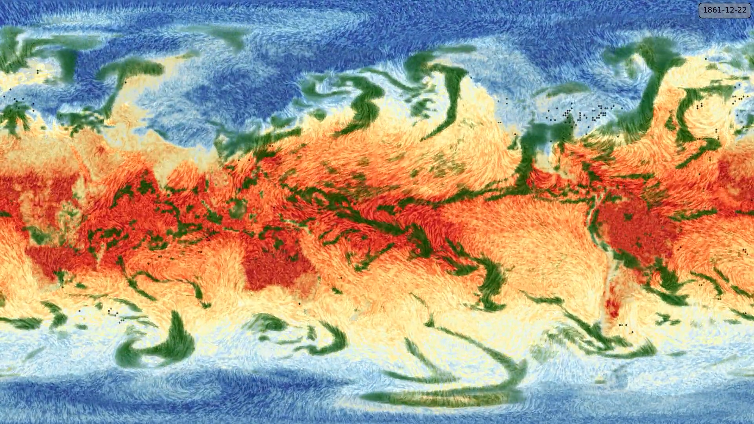
20CRv3 near surface winds, temperature, and precipitation
Black dots show location of observations from stations and ships.

Slide 9
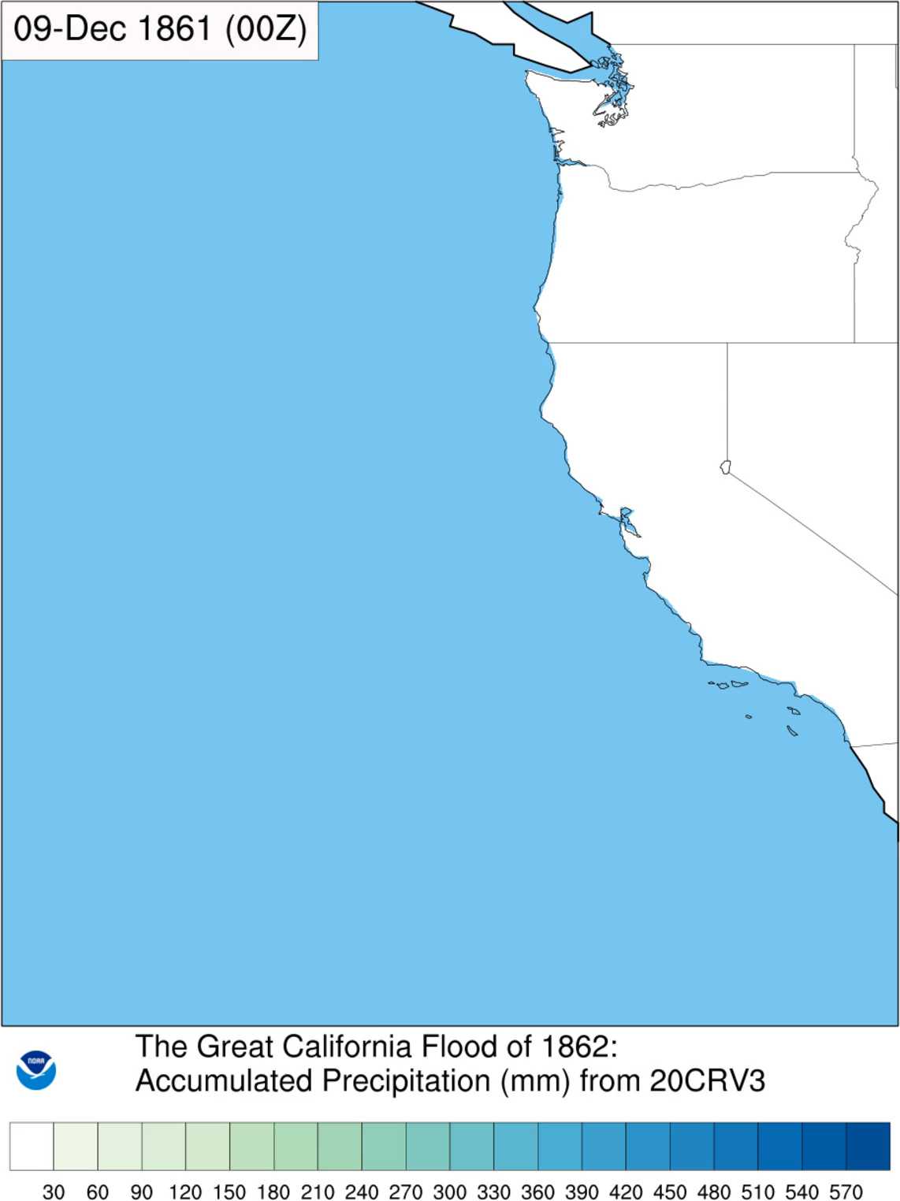

Slide 10
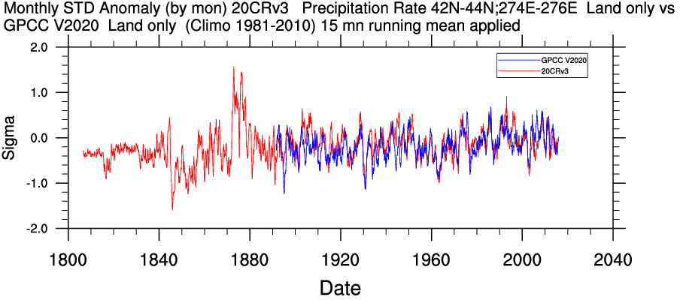
20CRv3 and GPCC Standardized Anomaly Precipitation
(15 month running mean)
R=0.67
20CR shows a very wet period for 1874

Slide 11
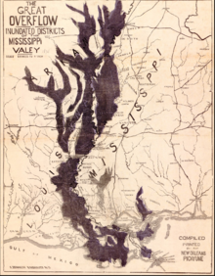
Great Mississippi Flood of 1874
Courtesy Wikipedia

Slide 12
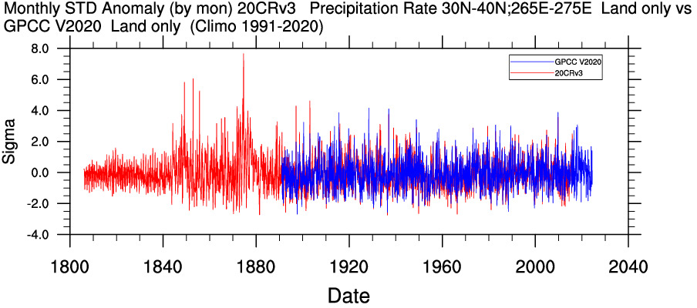
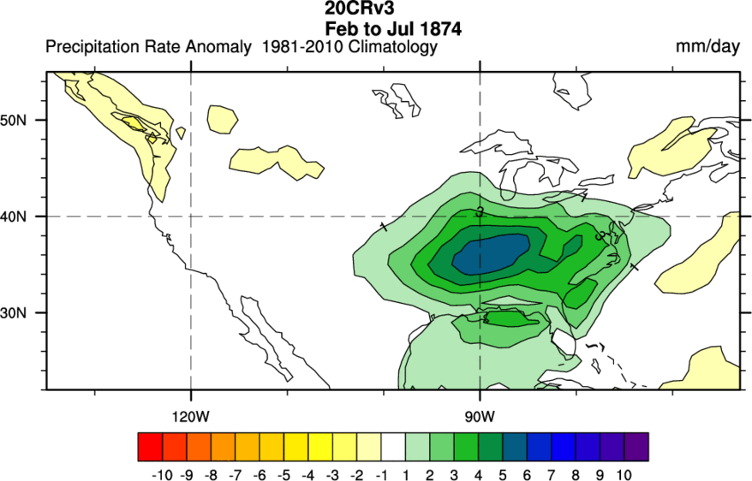
R=0.8
Longer historical reconstructions and records are
essential to understand risks of extremes

Slide 13
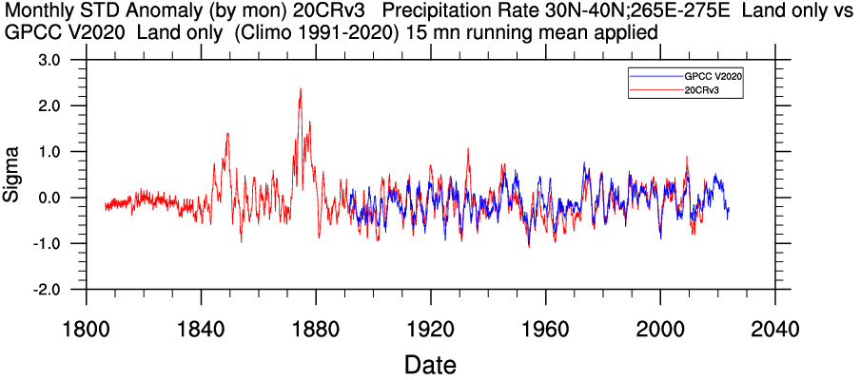
go.usa.gov/XTd
Select Tools

Slide 14
go.usa.gov/XTd , Select Tools

Slide 15
20CRv3 precipitation from 19th century extremes suggests US record flood events need more than 50-100 years to characterize anomalies 7 standard deviations or more.
20CRv3 provides useful information for further examination of extreme event cases.

