Slide 1
Developing reliable drought monitoring indices from a 200-yr atmospheric reanalysis dataset and
future plans for the 20th Century Reanalysis.
Gilbert P. Compo^{1,2}, P.D. Sardeshmukh^{1,2}, C. McColl^{1,2} , Larry Spencer^{1,2} , Andrew Hoell², Rochelle Worsnop², and C. Smith^{1,2},
Laura C. Slivinski^{1,2} , J.S. Whitaker²
¹University of Colorado at Boulder, CIRES
²NOAA Physical Sciences Laboratory
compo@colorado.edu
go.usa.gov/XTd
Slivinski, Compo, Whitaker, Sardeshmukh, et al., 2019: Towards a more reliable historical reanalysis: Improvements for version 3 of the Twentieth Century Reanalysis system. Q J R Meteorol Soc. ; 145; 2876– 2908. doi:10.1002/qj.3598.

Slide 2
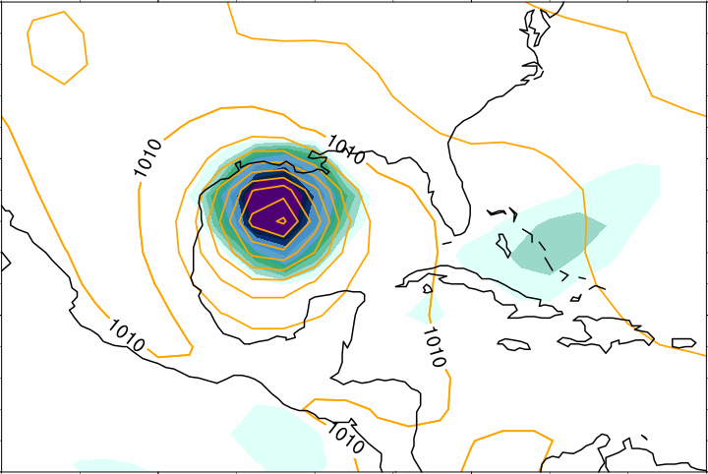
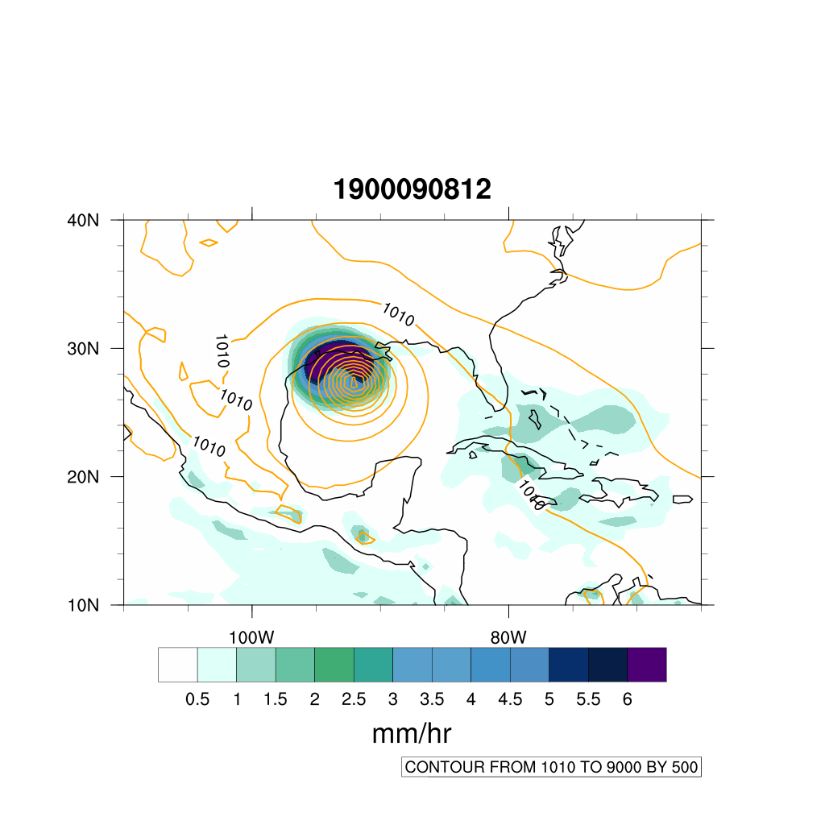

The 20th Century Reanalysis version 3 (1806-2015)
Summary: As part of the international ACRE initiative, NOAA and CIRES are using DOE supercomputers to produce 4-dimensional reanalysis datasets extending back to the 19th century using an Ensemble Kalman Filter and analyzing only surface pressure observations.
Version 3 has (~$0.7°$), realistic extremes and quantified uncertainties.
Sea Level Pressure and Precipitation Rate
20CRv2c
20CRv3
1900 Galveston Hurricane:
deadliest in US history (6,000-12,000 dead)
20CRv3 analyzes a stronger hurricane.
go.usa.gov/XTd
8 September 1900 12UTC
mm/hr
SLP C.I. 5 mb
The NOAA-CIRES-DOE 20CRv3 reanalysis dataset provides:
-First-ever estimates of global near-surface to tropopause 3-hourly fields extending back to 1806;
-80 members for uncertainties in the basic fields and in derived quantities (e.g., storms tracks).
Goals of global climate reanalyses:
Create a long dynamically-consistent record of the mean climate, variability, and trends.
View individual extreme weather and climate events in a long-term historical context.
Assess the significance of any trends in the mean, variability, and statistics of extremes.
Verify and validate climate model simulations of the mean climate, variability, and trends.
Notes:
ACRE initiative=Atmospheric Circulation Reconstructions over the Earth initiative

Slide 3
Disaster Relief Supplemental Act (DRSA): Weather-S2s-Climate Fire Weather Research by Developing Reanalysis-based Wildfire Monitoring Capabilities
PI (Non-NOAA /CIRES): Gilbert P. Compo
Co-PI (Non-NOAA / CIRES):Prashant. D. Sardeshmukh
US Congress authorized NOAA “to improve wildfire research, prediction, detection, forecasting, monitoring, data management, and communication and engagement” (Disaster Relief Supplement Appropriations Act, 2021).
NOAA Plan: “Explain the climatic causes of increased wildfires in the West (including Alaska) in recent years and explore whether climate is affecting fire frequency and intensity, and if so, what are the expectations for the future and investigate how these causes relate to wildfire weather forecasting.”
Use the Twentieth Century Reanalysis (20CR) Version 3 for Wildfire monitoring indices

Slide 4
Basic elements for “Fire Weather”
Hot: High temperatures
Dry: connection to drought
  Vapor Pressure Deficit
  Evaporative Demand
3. Windy: strong winds can mix down from 100s of meters in atmosphere to surface

Slide 5
Two important quantities for Drought and Fire Weather
Vapor Pressure Deficit (VPD)=
saturation vapor pressure(T) – actual vapor pressure
Evaporative Demand = Potential Evapotranspiration
How “thirsty” is the atmosphere
Mahrt and Ek (1984) modified Penman to account
for atmospheric stability
It is a function of
net radiation & surface heat flux,
moisture (VPD), temperature, and wind speed
Link of Evaporative Demand and other Drought measures (Hobbins et al. 2016)

Slide 6
Rank Correlation between 20CRv3 and ERA5 3-hourly data
compared to 20CRv3 Confidence from 80-member ensemble
2 m Air Temp
10 m Wind Speed
10 m Vapor Pressure Deficit
C.I. 0.2
Confidence is defined as the difference of the normalized ensemble standard deviation (𝞼_{ens} / 𝞼_{clim}) from 1
Confidence = 1 - 𝞼_{ens} / 𝞼_{clim}

Slide 7
Rank Correlation between 20CRv3 and ERA5
for May – Oct as a function of 20CRv3 Confidence
2 m Air Temp
10 m Wind Speed
10 m Vapor Pressure
Deficit
Suggests that the 20CRv3 confidences are reliable and can be used to estimate the quality of derived fire-weather indices.

Slide 8
Rank Correlation between 20CRv3 and ERA5
for May – Oct as a function of 20CRv3 Confidence
10 m Vapor Pressure Deficit
Suggests that the 20CRv3 confidences are reliable and can be used to estimate the quality of derived fire-weather indices.

Slide 9
List of 20 biggest fires in the U.S.
Great fire of 1910, Idaho and Montana – 3,000,000.
North and South Carolina wildfire complex, 1898 – 3,000,000.
Great Michigan Fire, 1871 – 2,500,000.
Great Fire, Oregon, 1845 – 1,500,000.
Taylor Complex Fire, 2004, Alaska – 1,303,358.
Peshtigo Fire, 1871, Wisconsin – 1,250,000.
Ruby Fire, 1940, Alaska – 1,250,000.
Kateel River, No. 5, 1957, Alaska – 1,161,200.
Smokehouse Creek Fire, 2024, Texas – 1,058,482.
August Complex, 2020, California – 1,032,648.
Thumb Fire, 1881, Michigan – 1,000,000.
Unalakleet, 1941, Alaska – 1,000,000.
Dixie Fire, 2021, California – 963,309.
East Amarillo Complex, 2006, Texas – 907,245.
Little Black River Fire, 1950, Alaska – 892,900.
Lime Complex, 2022, Alaska – 892,900.
Miramichi Fire, 1825, Maine – 832,000. (An additional 3 million acres
burned in New Brunswick, Canada.)
18. Solstice Complex, 2004, Alaska – 812,771.
19. Holanada Creek Fire, 1969, Alaska – 803,470.
20. Northwest Oklahoma Complex, 2017 – 779,292.
USA Today, 29 April 2024

Slide 10
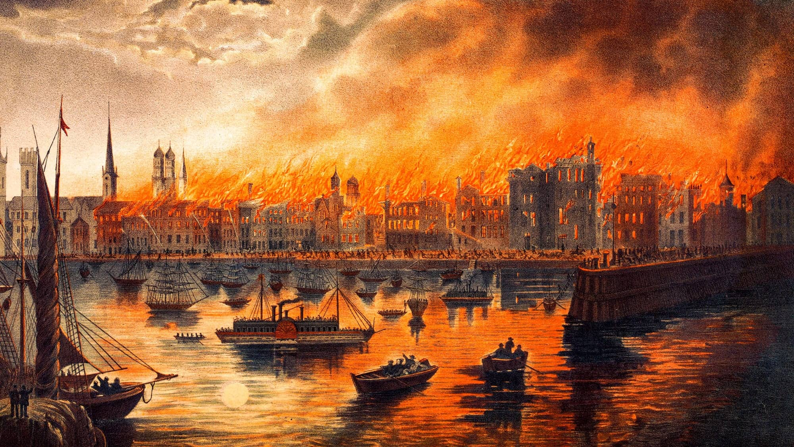
Great Chicago Fire 8 to 10 October 1871
Courtesy https://interactive.wttw.com/chicago-stories/chicago-fire

Slide 11
On October 8, 1871, there were a series of simultaneous forest fires in the Great Lakes region, collectively knows as the Great Fire of 1871. These fires burned the several cities, towns, and villages in Michigan.
The Peshtigo Fire in Wisconsin was the deadliest forest fire in recorded history, also destroying several towns in Michigan’s Upper Peninsula. The fire crossed the Menominee River and burned in Menominee County. (1500-2500 deaths)
Later that night the Great Chicago Fire erupted and burned for 2 days. It destroyed roughly 4 square miles killing approximately 300 people.
Courtesy https://northernmichiganhistory.com/the-great-fire-of-1871/

Slide 12
8 October 1871
Simultaneous forest fires in Great Lakes Region
Great Fire of 1871

Slide 13
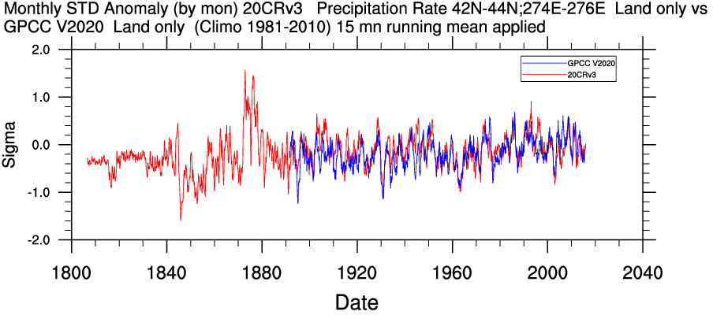
20CRv3 and GPCC Standardized Anomaly Precipitation
(15 month running mean)
R=0.67
20CR shows a weak dry period for 1871

Slide 14
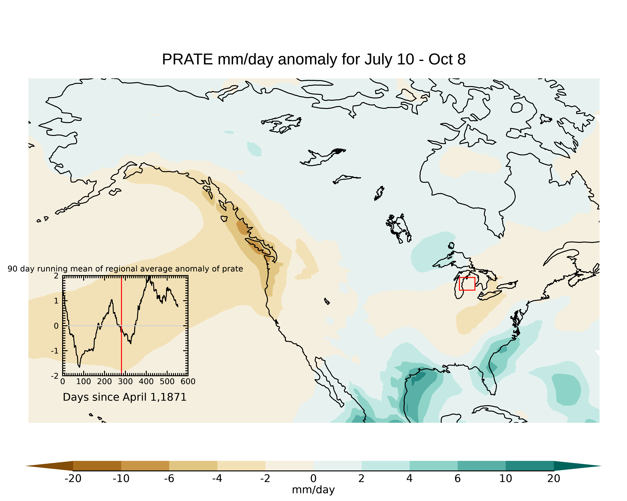
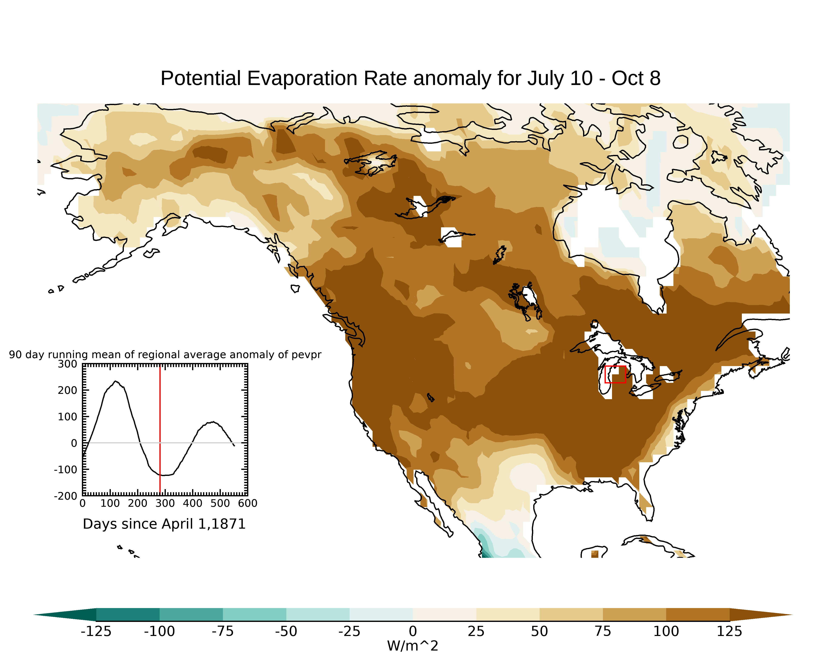
20CRv3 90-day average anomalies before Great Fire of 1871
Evaporative Demand
aka Potential Evaporation
Precipitation
Large Evaporative Demand anomaly in season before the
fire consistent with extensive fire

Slide 15
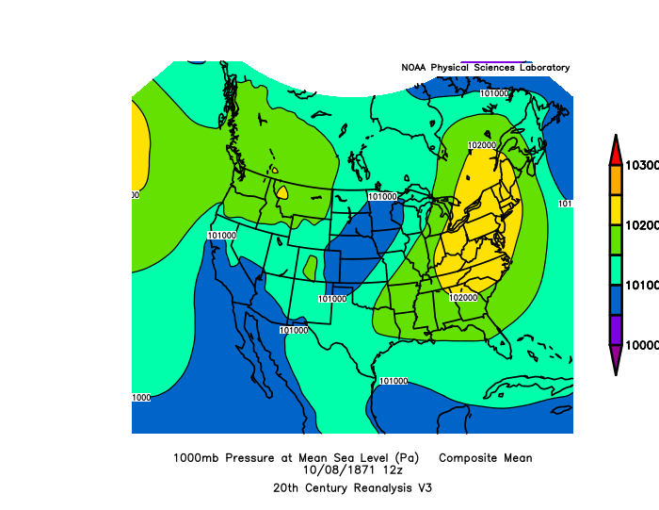
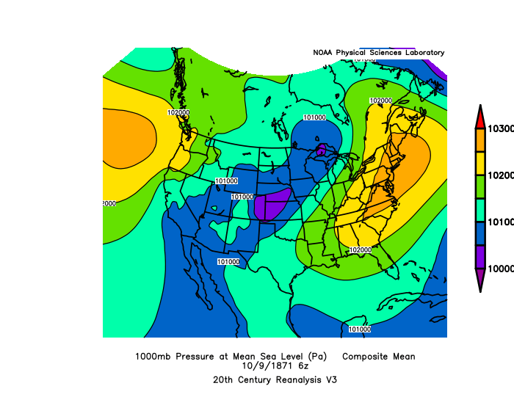
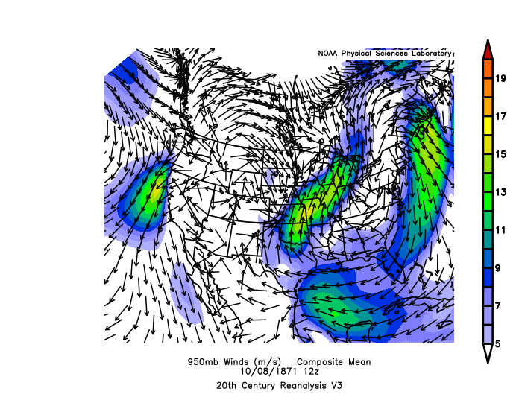
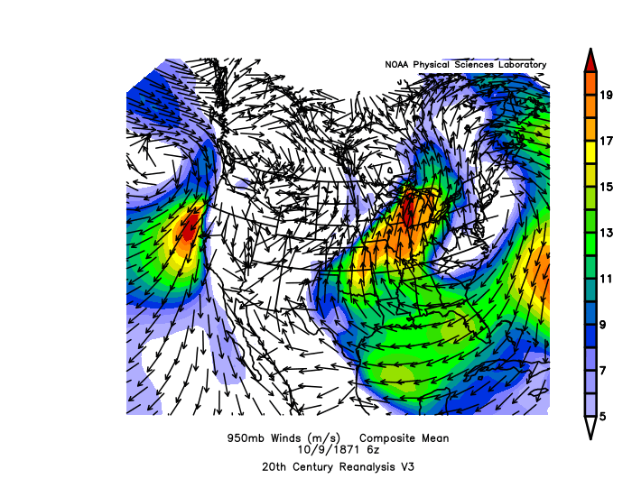
Expected high winds captured in 20CRv3

Slide 16
Ongoing project to verify 20CRv3 for drought and fire weather
monitoring applications
Examining both high and low frequency variability
Determining whether any predictive capability exists from 20CRv3 Evaporative Demand and other “fire weather” indices, e.g., Vapor Pressure Deficit

Slide 17
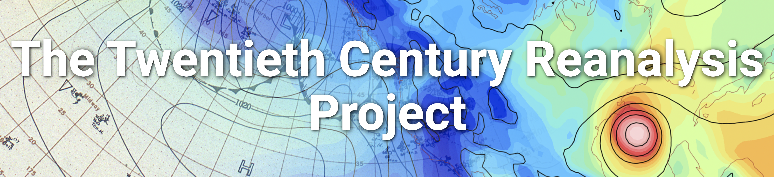
Historical Reanalysis Status and Plans
20th Century Reanalysis Project
http://go.usa.gov/XTd
20CR version 3: 1806-2015
Jan 2020: 1806-2015 (includes time-varying CO2, volcanic aerosols, GFS from NCEP). Ensemble mean and spread and individual member variables online now.
  go.usa.gov/XTd (NOAA ESRL)
  http://dss.ucar.edu/datasets/ds131.1 (NCAR)
  http://portal.nersc.gov/20C_Reanalysis Every member (US Dept of Energy, NERSC)
  NERSC High Performance Storage System Tape Gateway Every member
  Continue to expand available variables at NERSC
Boundary conditions:
SST: SODAsi.3 (20CRv3si: 1815-1980), HadISST2.2 (20CRv3mo: 1981-2015), Sea ice: HadISST2.3; Volcanic aerosols; Solar cycles; CO₂

Slide 18
Future plans for 20CRv3 and ISPD
International Surface Pressure Databank version 5
  Becomes a “read” from GLAMOD (Thorne, Noone, et al.)
  NOAA Global Historical Climate Network – Hourly
  International Comprehensive Ocean Atmosphere
  Data Set (ICOADS)
20CRv3 – Extend to 2023 +
  Hawkins and George (U. of Reading)
  Need to select a boundary condition (SST, sea ice)
  post 2015
20CRv4 ?
  More Observations!
  Other variables : wind direction?
  Coupled-Ocean Atmosphere NOAA Unified Forecast System?
  Hybrid, with a statistical ocean and ice ?
  Machine-learning emulator?

Slide 19
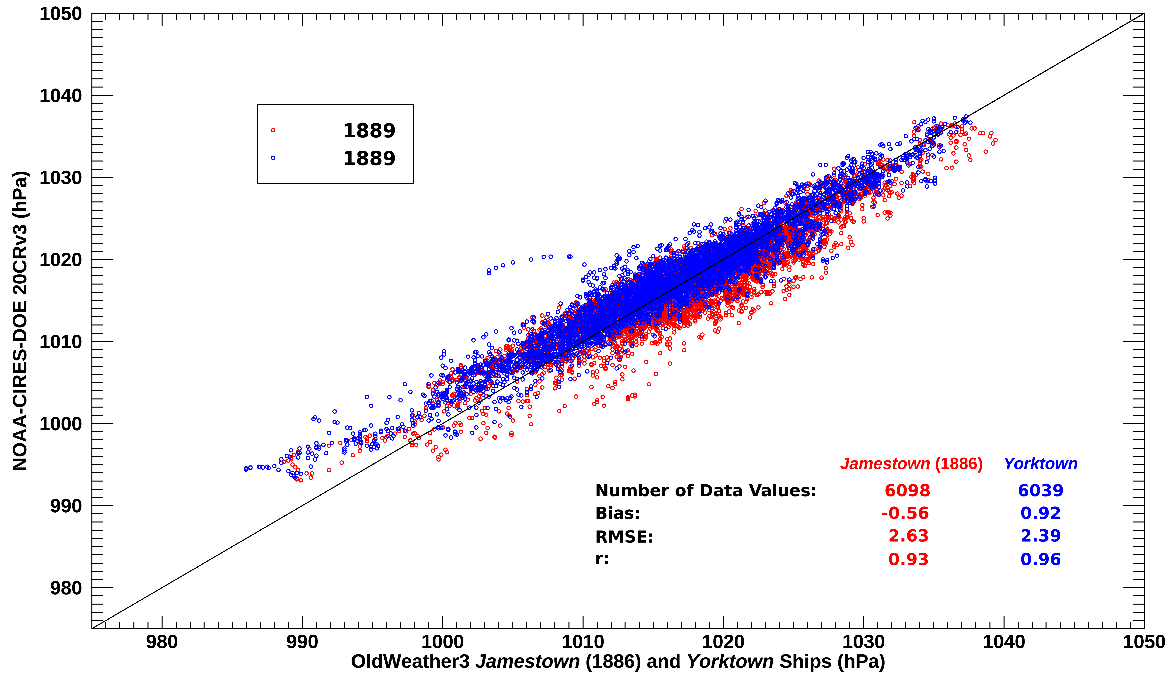
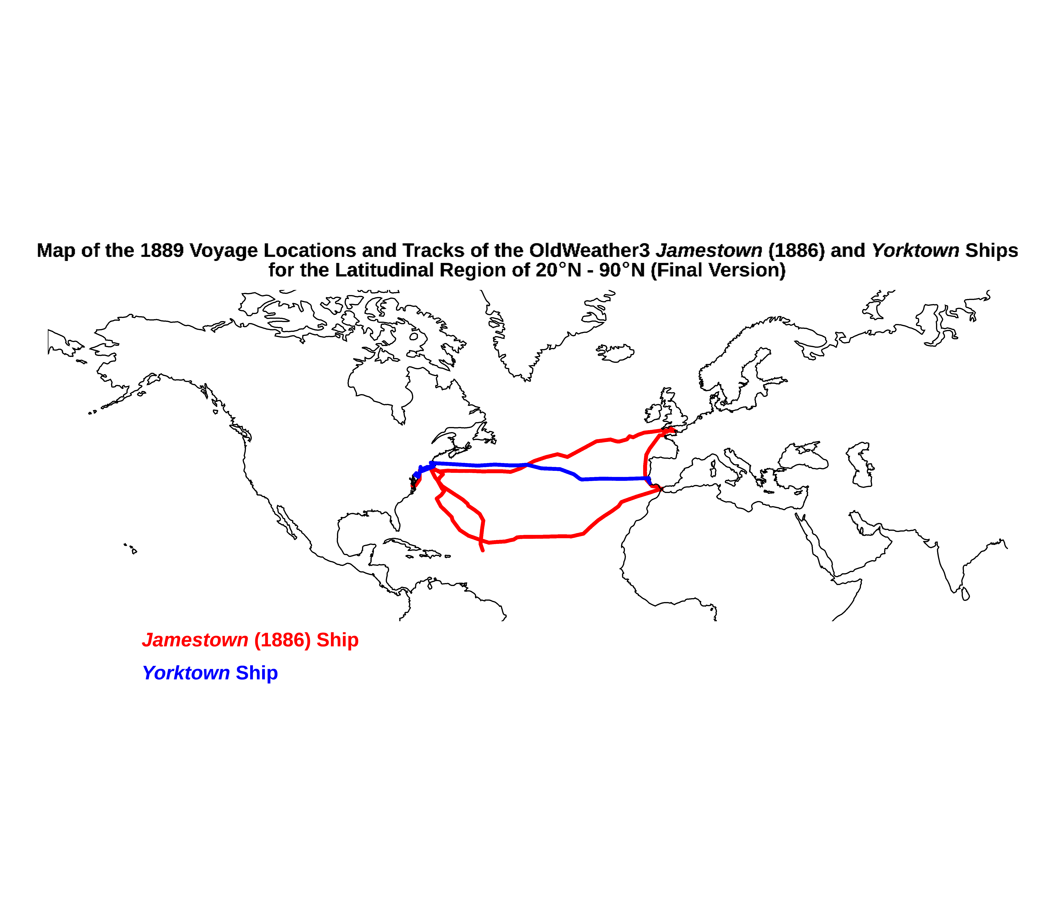
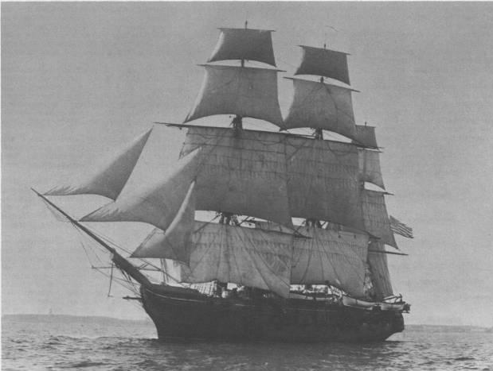
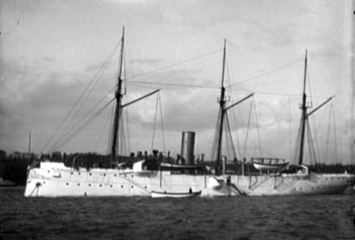
Newly rescued Oldweather.org MSLP OBS in 1889 compared to 20CRv3
R=0.93
R=0.96
Spencer, Compo, McColl, Wood, Brohan, et al. (2020)

Slide 20
Wintertime North Atlantic Oscillation Index (5-yr running mean)
1
Standardized
SLP(Iceland)
minus
SLP(Azores)
1981-2010
reference
0
-3
1900
2000
Low-frequencies from independent monthly EKF400 (paleo, early instrumental)
agree well with 20CRv3 back to 1806

Slide 21
Wintertime North Atlantic Oscillation Index (5-yr running mean)
1
Standardized
SLP(Iceland)
minus
SLP(Azores)
0
-3
1800
1900
2000
Climate models (CMIP5) underestimate NAO variability. No evidence of any
radiatively-forced trend.

Slide 22
Thank you to organizations contributing observations to ISPD:
All Russia Research Institute of Hydrometeorological
Information WDC
Atmospheric Circulation
Reconstructions over the Earth (ACRE)
Australian Bureau of Meteorology
Australian Meteorological Association, Todd Project Team
Bejing Climate Center
British Antarctic Survey
Canadian Volunteer Data Rescue Project
China Meteorological Agency
Cook Islands Met Service
Danish Meteorological Institute
Deutscher Wetterdienst
EMULATE
Environment Canada
ERA-CLIM
ETH-Zurich
European Reanalysis and Obs for Monitoring
GCOS AOPC/OOPC WG on Surface Pressure
GCOS/WCRP WG on Obs Data Sets
Hong Kong Observatory
Icelandic Meteorological Office
IBTrACS
ICOADS
IEDRO
JAMSTEC
Japan Meteorological Agency
Jersey Met Dept.
Lamont-Doherty Earth Observatory
KNMI
MeteoFrance
MeteoFrance – Division of Climate
Meteorological and Hydrological Service, Croatia
National Center for Atmospheric Research
Nicolaus Copernicus University
Niue Met Service
NIWA
NOAA Climate Database Modernization Program
NOAA Earth System Research Laboratory
NOAA National Climatic Data Center
NOAA National Centers for Environmental Prediction
NOAA Northeast Regional Climate Center at Cornell U.
NOAA Midwest Regional Climate Center at UIUC
NOAA Pacific Marine Environmental Laboratory
Norwegian Meteorological Institute
Oldweather.org
Ohio State U. – Byrd Polar Research Center
Portuguese Meteorological Institute (IM)
Proudman Oceanographic Laboratory
SIGN - Signatures of environmental change in the observations of the Geophysical Institutes
South African Weather Service
Southern Weather Discovery
UK Met Office Hadley Centre
U. of Bern, Switzerland
U. of Colorado-CIRES/Climate Diagnostics Center
U. of East Anglia-Climatic Research Unit
U. of Giessen –Dept. of Geography
U. of Lisbon-Instituto Geofisico do Infante D. Luiz
U. of Lisbon-Instituto de Meteorologia
U. of Mebourne
U. of Milan-Dept. of Physics
U. of Porto-Instituto Geofisca
U. Rovira i Virgili-Center for Climate Change
U. of South Carolina
U. of Toronto-Dept of Physics
U. of Washington
WeatherRescue.org
World Meteorological Organization - MEDARE
ZAMG (Austrian Weather Service)

Slide 23



Mahrt and Ek (1984)

Slide 24
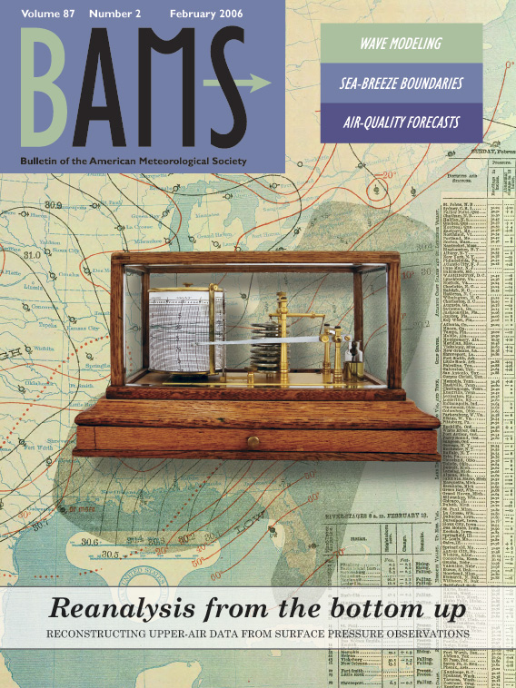
Goal of the 20th Century Reanalysis project and the international Atmospheric Circulation Reconstructions over the Earth initiative:
To produce the longest possible
Instrument-based estimates of
global weather and climate for comparison to paleoclimate reconstructions and
climate model simulations
Using a scientific process called Data Assimilation,
we have just released 1806-2015! go.usa.gov/XTd

Slide 25
What is Data Assimilation?
Method to combine an uncertain first guess with uncertain observations to form an “analysis” of the state of the system.
We want the state of the atmosphere at a particular time: a weather map
Sea Level Pressure and confidence
1 January 1925 0UTC
Low
High Confidence
Analysis = First Guess + K ( Observation – First Guess )

Slide 26
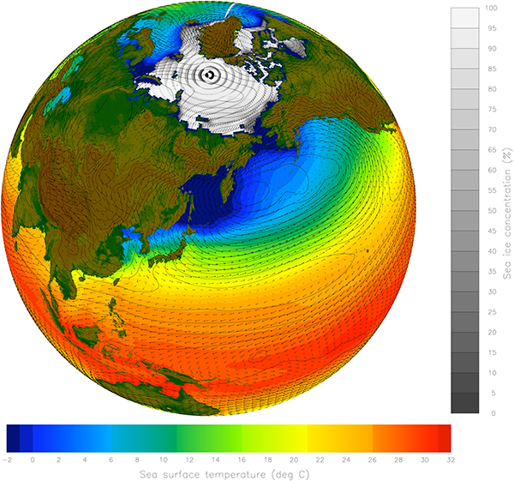
First guess comes from an
Atmospheric General Circulation Model –
Coupled Equations describing the time evolution of, e.g.,
momentum, heat, and moisture around the planet (pressure, winds, temperature, humidity, clouds).
Need a supercomputer to solve these equations!
The two color scales show sea surface temperatures and sea ice concentrations; sea level pressure and low-level winds are also illustrated, including warmer air moving north on the eastern side of low-pressure regions and colder air moving south on the western side of the lows. (©UCAR)

Slide 27
What is Reanalysis?
Performing data assimilation on historical or past observations.
Before our dataset released in 2011, previous datasets spanned at most 1948 to present.
The new NOAA-CIRES-DOE 20th Century Reanalysis version 3 provides 80 estimates of the global weather every 3 hours from 1806 to 2015.
The 20CR increases the time period available for comparing historical storms and extreme weather to the present.
Analysis = First Guess + K ( Observation – First Guess )

Slide 28
Ensemble Data Assimilation
Analysis is a weighted average of the first guess x^{b} and observation yº
xª = x^{b} + K(yº – x^{b})
xª, x^{b}: 3-dimensional
state of the atmosphere
yº
xª
xª
x^{b}
x^{b}
ensemble of forecasts
the weight K varies with the atmospheric flow and the observation network
analysis time
analysis time
analysis time

