Slide 1


Weather Detective: An Australian Citizen Science Project
Christa Pudmenzky
International Centre for Applied Climate Sciences
University of Southern Queensland • Toowoomba • Queensland • Australia
Phone: +61 7 4631 2504, email: christa.pudmenzky@usq.edu.au
C3S Data Rescue Workshop & 10th ACRE Meeting
4 - 8 December 2017
NIWA, Auckland, New Zealand

Slide 2






ABC Science’s National Science Week Citizen Science Project 2014

Slide 3
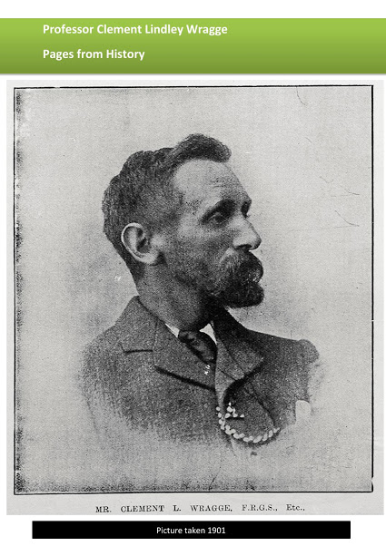
Rescue of Historical Ship Logbooks
Clement Wragge (1892 – 1903)
Clement Wragge, known for his "mop of flaming red hair and explosive temper to match”, was the first person to produce weather forecasts in Australia.
1887-1902: He was appointed Government Meteorologist in Queensland.
By 1893 Wragge had established 97 meteorological stations and 398 rain gauge stations throughout Queensland and in the Pacific region.
He was the first person to introduce the naming of storms and cyclones. His original idea was to name them after the names of ‘annoying’ politicians.
Wragge collected extracts of ship log books which have been archived at the National Archives in Brisbane.
I photographed more than 8,000 extracts which cover the period from 1892-1903 and most of them have being digitised as part of the Weather Detective project.

Slide 4
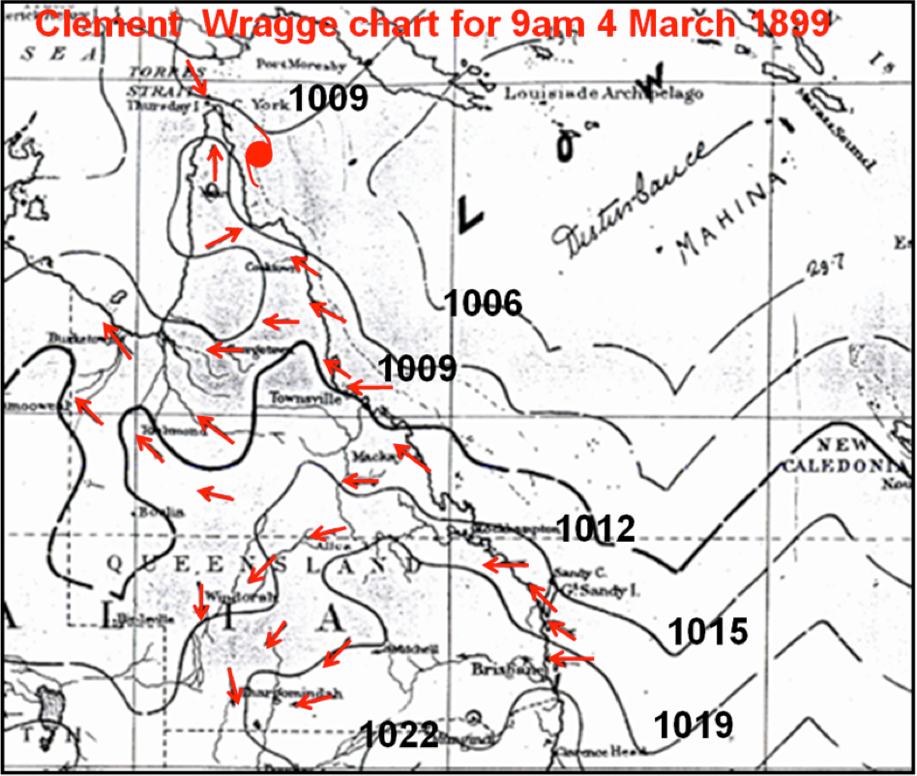
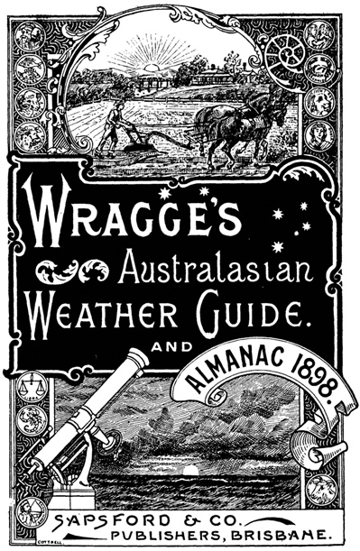
on Wickham Terrace, Brisbane, ca. 1900
Clement Wragge
Wragge’s Australasian Weather Guide and Almanac 1898 contains a wide range of information on weather, meteorology and astronomy. As well as a focus on the weather, there is also interesting information on:
- Agriculture
- Horticulture
- Botany
- Australian Seasons
- Cookery
- Medical Hints
- Artesian Water Supply
- Development of Mining
- Shipping Interests
About 300 people died when Tropical Cyclone Mahina made landfall at Bathurst Bay, a popular spot for pearling fleets on Queensland's Cape York, in March 1899.

Slide 5
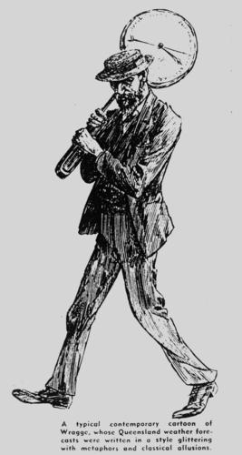
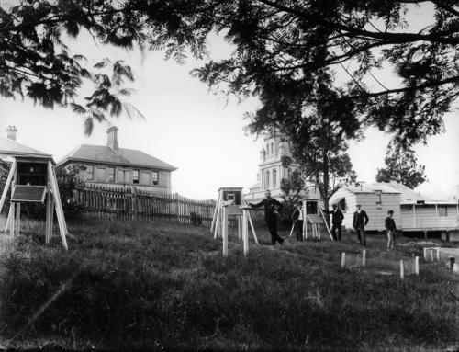
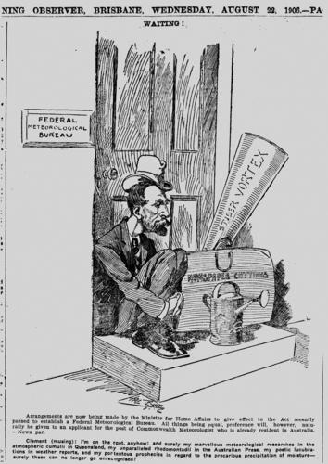
Clement Wragge
Meteorological observatory on Wickham Terrace, Brisbane, ca. 1900
Cartoon of meteorologist, Clement Wragge, 1906

Slide 6
Meteorological observatory on Wickham Terrace, Brisbane, ca. 1900
ABC Citizen Scientists Project - Statistics
The project started on the 14 August 2014.
It ran for 3 years and 2 months – normally these ABC Citizen Science projects run for only 6 to 8 weeks.
8 radio interviews within the first week and a large number of newspaper article followed shortly after.
By the end of August that year, 10,576 volunteers had signed up and 135,217 observations were transcribe.
By mid November 2017, the number of volunteers had increased to 11,183 and 549,619 lines of weather data have been digitised.

Slide 7


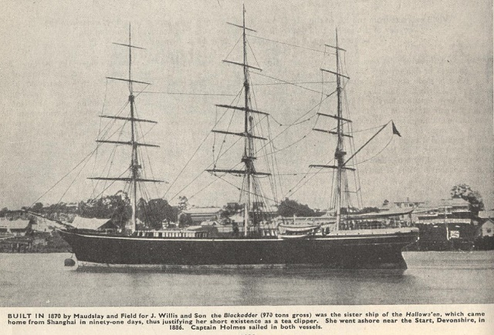


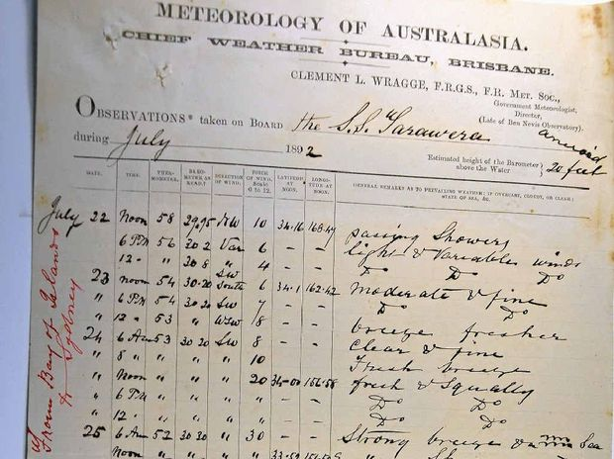
Old ship logbooks offer look into climate future
Old Ship Logs Reveal Weather Patterns
Weather Detectives wanted!
Posted by Kylie Andrews | Tuesday 12 August 2014, 01:14 PM (EST)
Ahoy there! You and your school can help forecast the future by becoming Weather Detectives. Kylie Andrews from ABC Science explains how.
Science Art and Technology Festival in Townsville
24 – 25 October 2014
Weather Detectives Workshop
Help us uncover important weather records hidden in the log books of ships that sailed the seas around Australia in the 1890s and 1900s. Weather Detective is seeking the assistance of citizen scientists to search through old ships' log books for weather observations and - using a simple web interface - transcribe those observations into a global database of weather over the centuries.
Old ship logbooks offer look into climate future

Slide 8
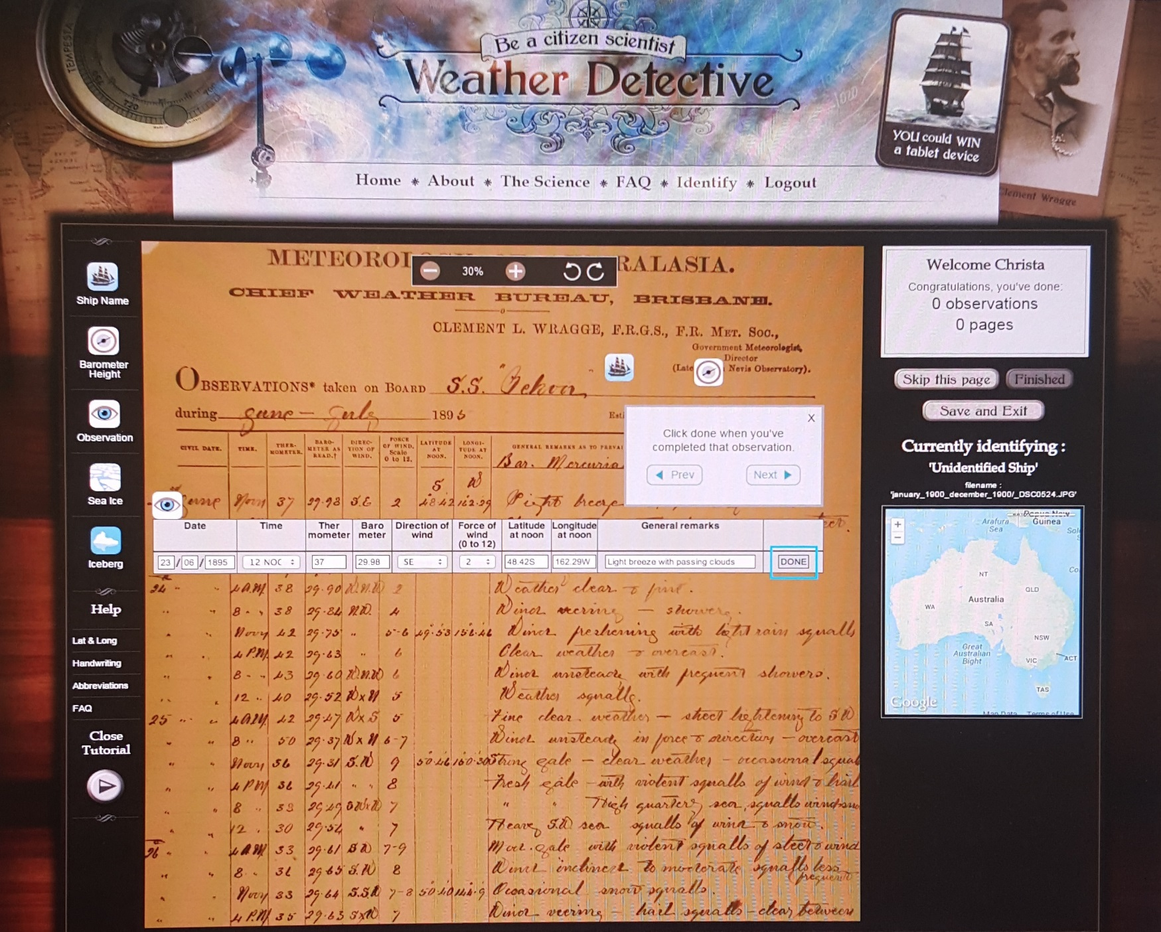

Slide 10
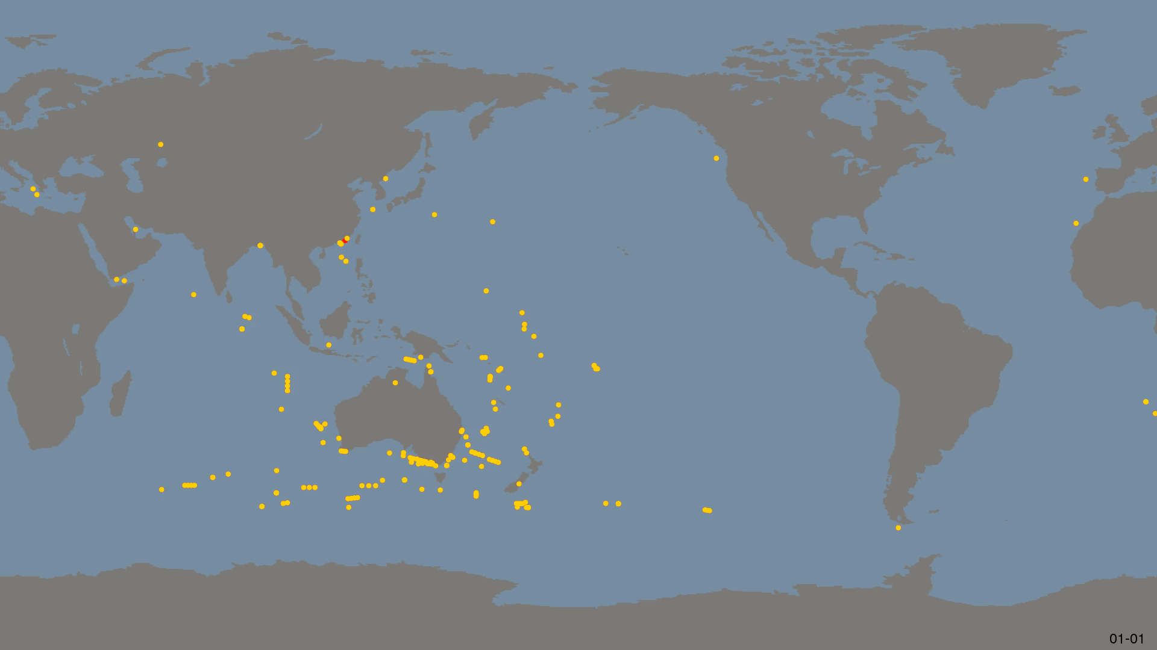
Weather Detective Observations: 1893 - 1902
78,845 new records based on 547,407 transcriptions

Slide 11
Weather Detective Project
Data Source | Date Range | Total # of Images | Digitisation completed by Weather Detective | # of Images still to be done
Clement Wragge | 1893 - 1902 | 7749 | approx. 5250 | approx. 2500
Queensland State Archives – part of the Weather Detective Project
Data Source | Date Range | Total # of Images | Digitisation completed by Weather Detective | # of Images still to be done
Moreton Bay Settlement | Apr - Aug 1829 | 22 | yes
Log of Police Boat 'Vigilant' | 10 Nov 1882 - 31 Aug 1883 | 100 |  | 100
Log of Qld Gov Schooner 'Mavis' | 15 Jul 1884 - 5 Aug 1885 | 71 | yes
Log of Qld Gov Steamer 'Albatross' | 22 Jan - 4 Aug 1890 | 76 | yes

Slide 12
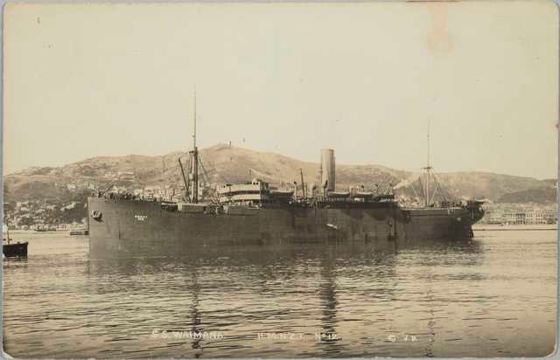
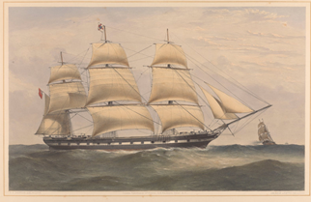
New Historical Logbooks from the ABC Citizen Scientists Project
Lady Nelson voyage from Sydney to the River Derwent 1803 and Port Jackson to Port Dalrymple 1804.
Captain Joshua Fergusson sailed from Ireland to Hobart in 1816 in his own ship the Brigantine Jupiter. The log are from the Bengal to Hobart leg.
Clipper Lincolnshire voyage from Tilbury, Essex to Melbourne
(26 April – 18 July 1871)
S. S. Waimana voyage from England to Australia
(16 July – 21 August 1912)
S.S. Waimana
Clipper Lincolnshire 1858

Slide 13
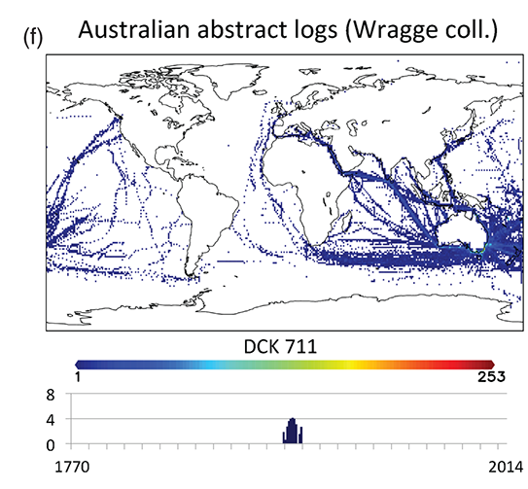
ICOADS Release 3.0:
A major update to the historical marine climate record
International Journal of Climatology
27 JUN 2016 DOI: 10.1002/joc.4775
http://onlinelibrary.wiley.com/doi/10.1002/joc.4775/full#joc4775-fig-0001

Slide 14
20th Century Reanalysis Project
20CR Version 3 (under construction) 1851 to 2015

Slide 15
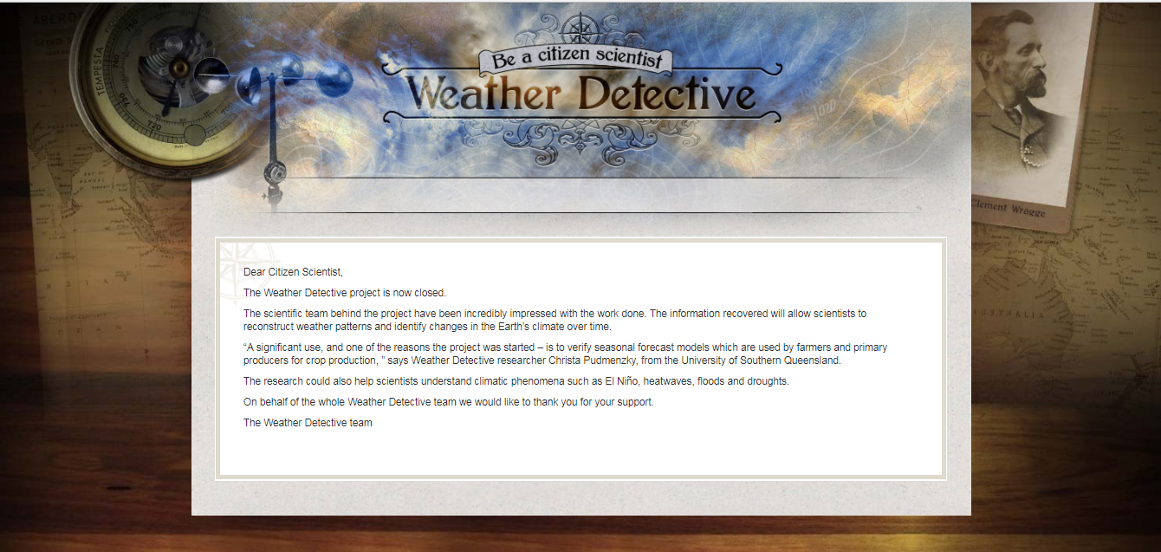

Slide 16
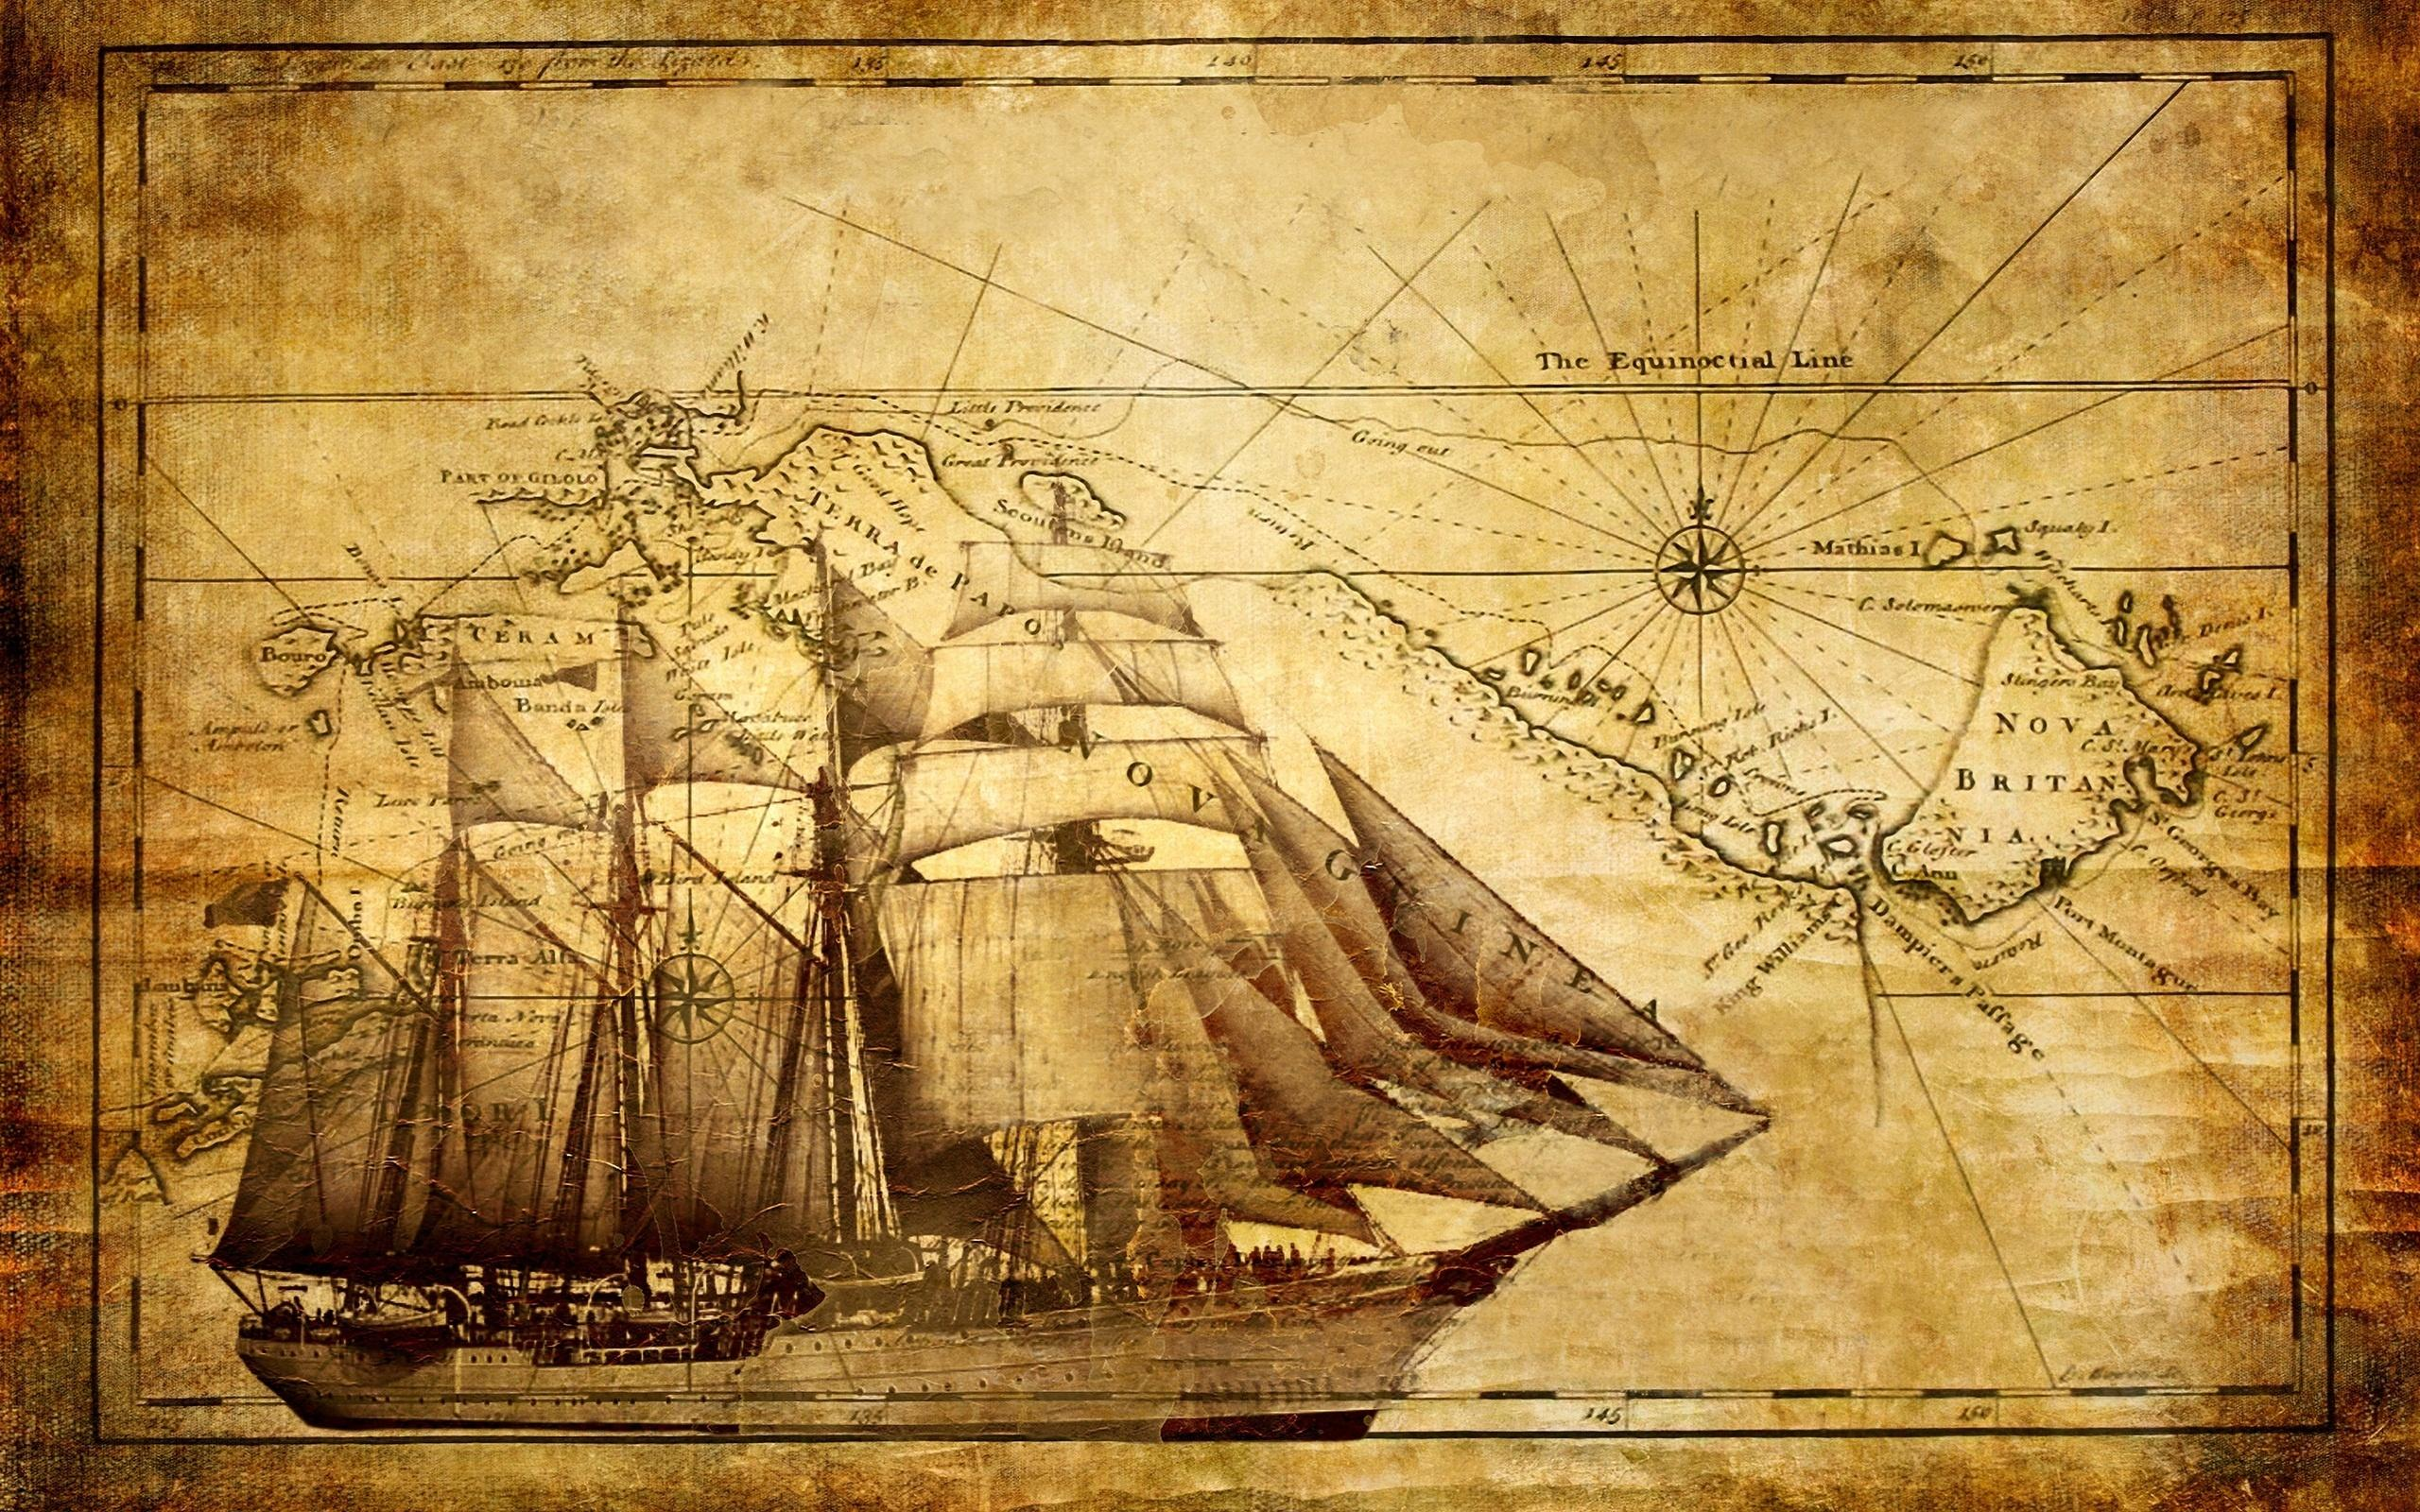
Thank you

