Slide 1

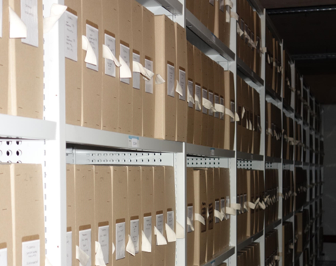
Rainfall Data Rescue activities at the UK Met Office National Meteorological Archive – current activities, use in climate monitoring, and next steps.
Abstract
The UK National Meteorological Archive holds a vast collection of environmental data. Whilst much is for the UK we also hold significant published and unique datasets from around the world. This talk will highlight some of the varied data and metadata resources in the archive, the range of data rescue activities we are undertaking, how the UK Met Office National Climate Information Centre is using rescued datasets to improve long term climate monitoring for the UK, allowing identification of trends in drought and flood through improved historic rainfall datasets, and where we hope to take this exciting work next
Notes:
This talk will highlight some of the varied data and metadata resources in the archive, the range of data rescue activities we are undertaking, how the UK Met Office National Climate Information Centre is using rescued datasets to improve long term climate monitoring for the UK, allowing identification of trends in drought and flood through improved historic rainfall datasets, and where we hope to take this exciting work next

Slide 2
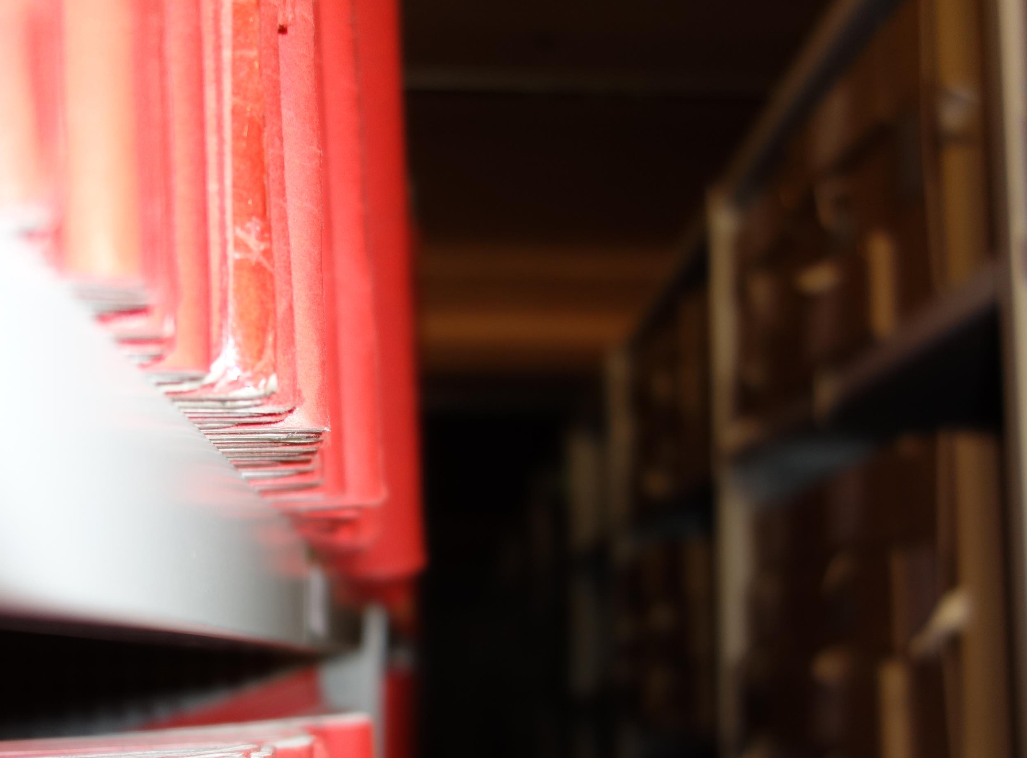
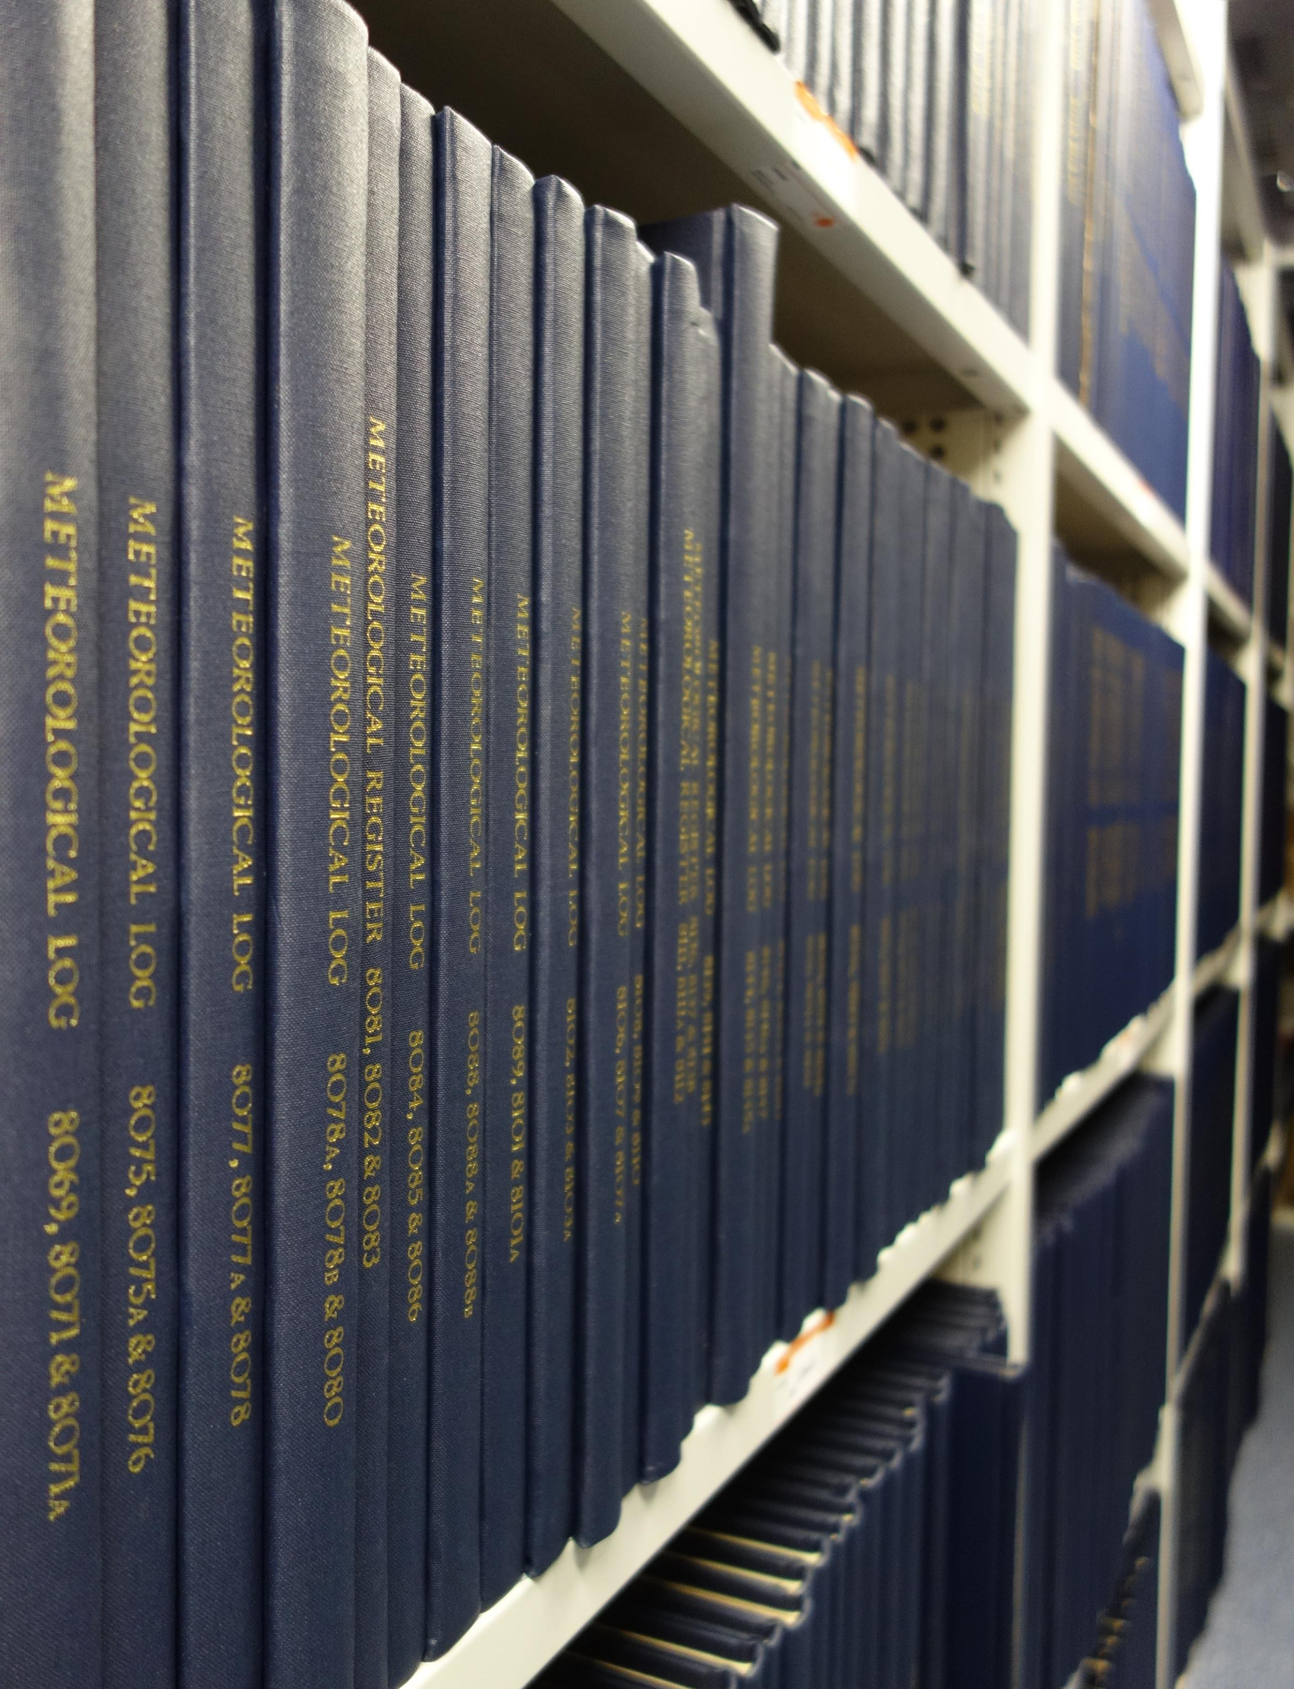
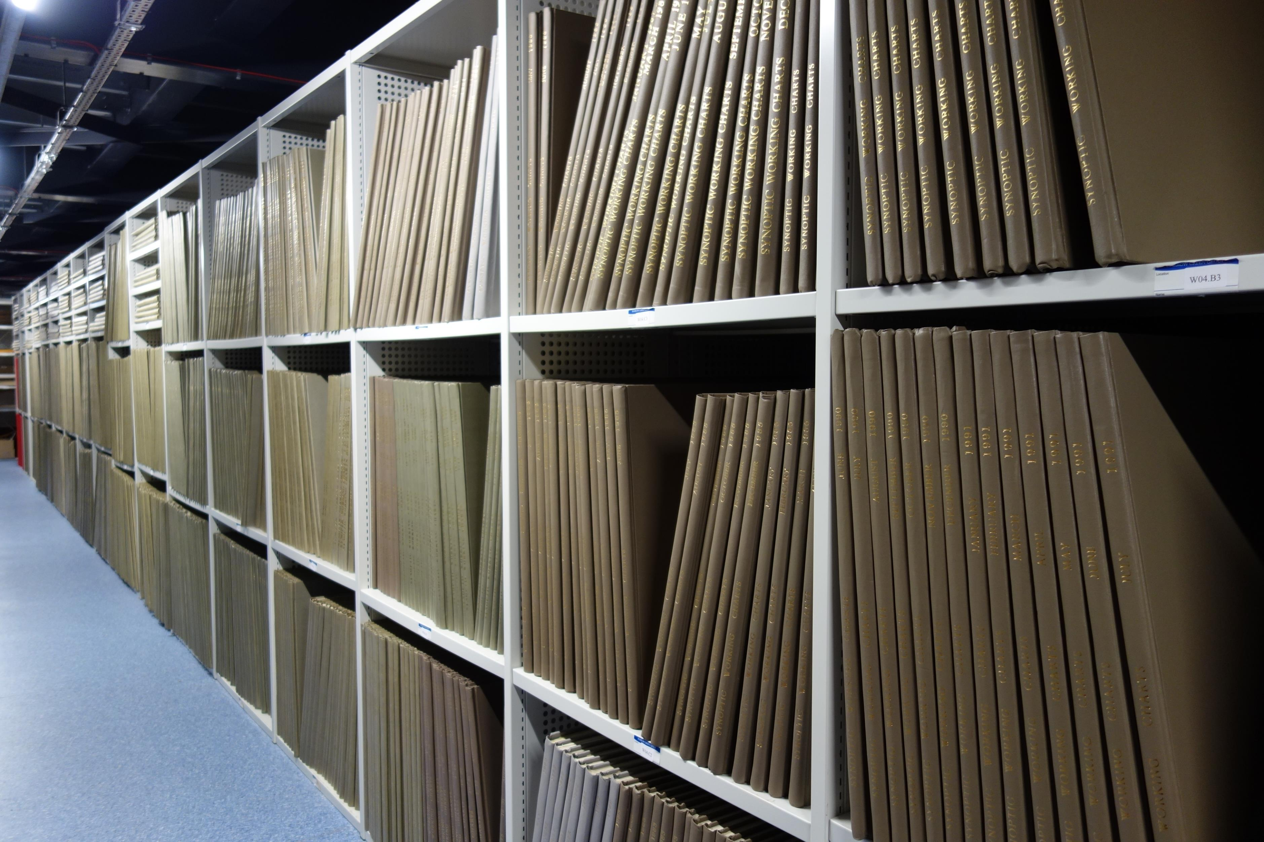
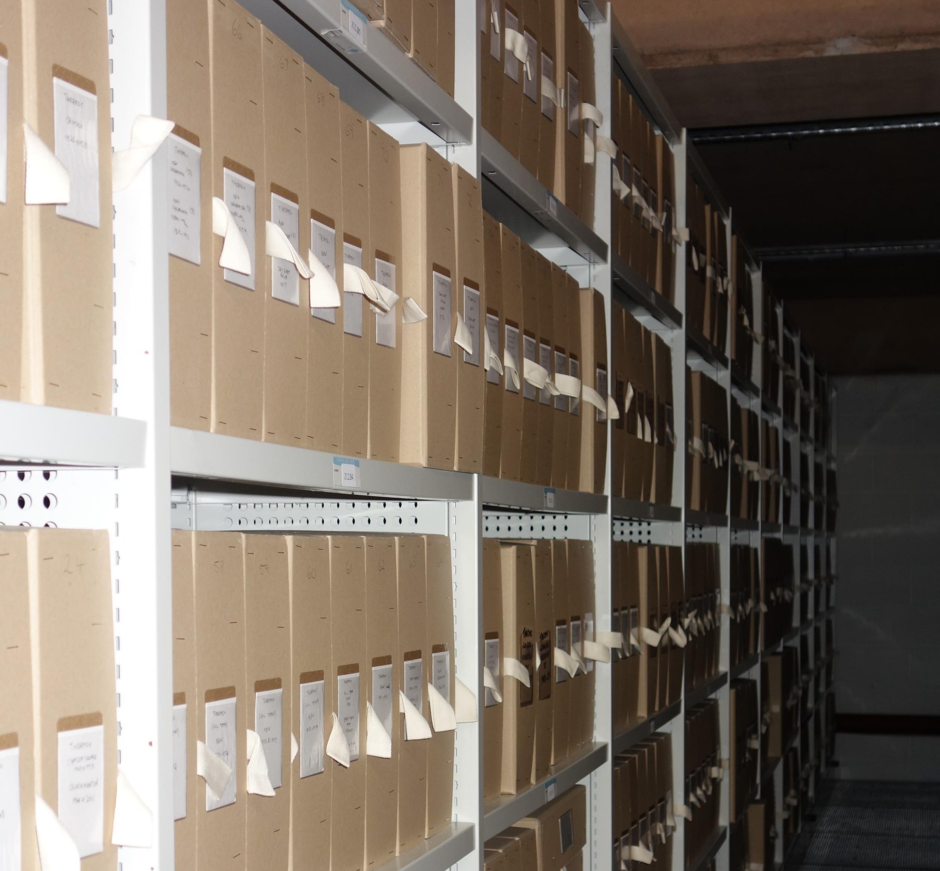
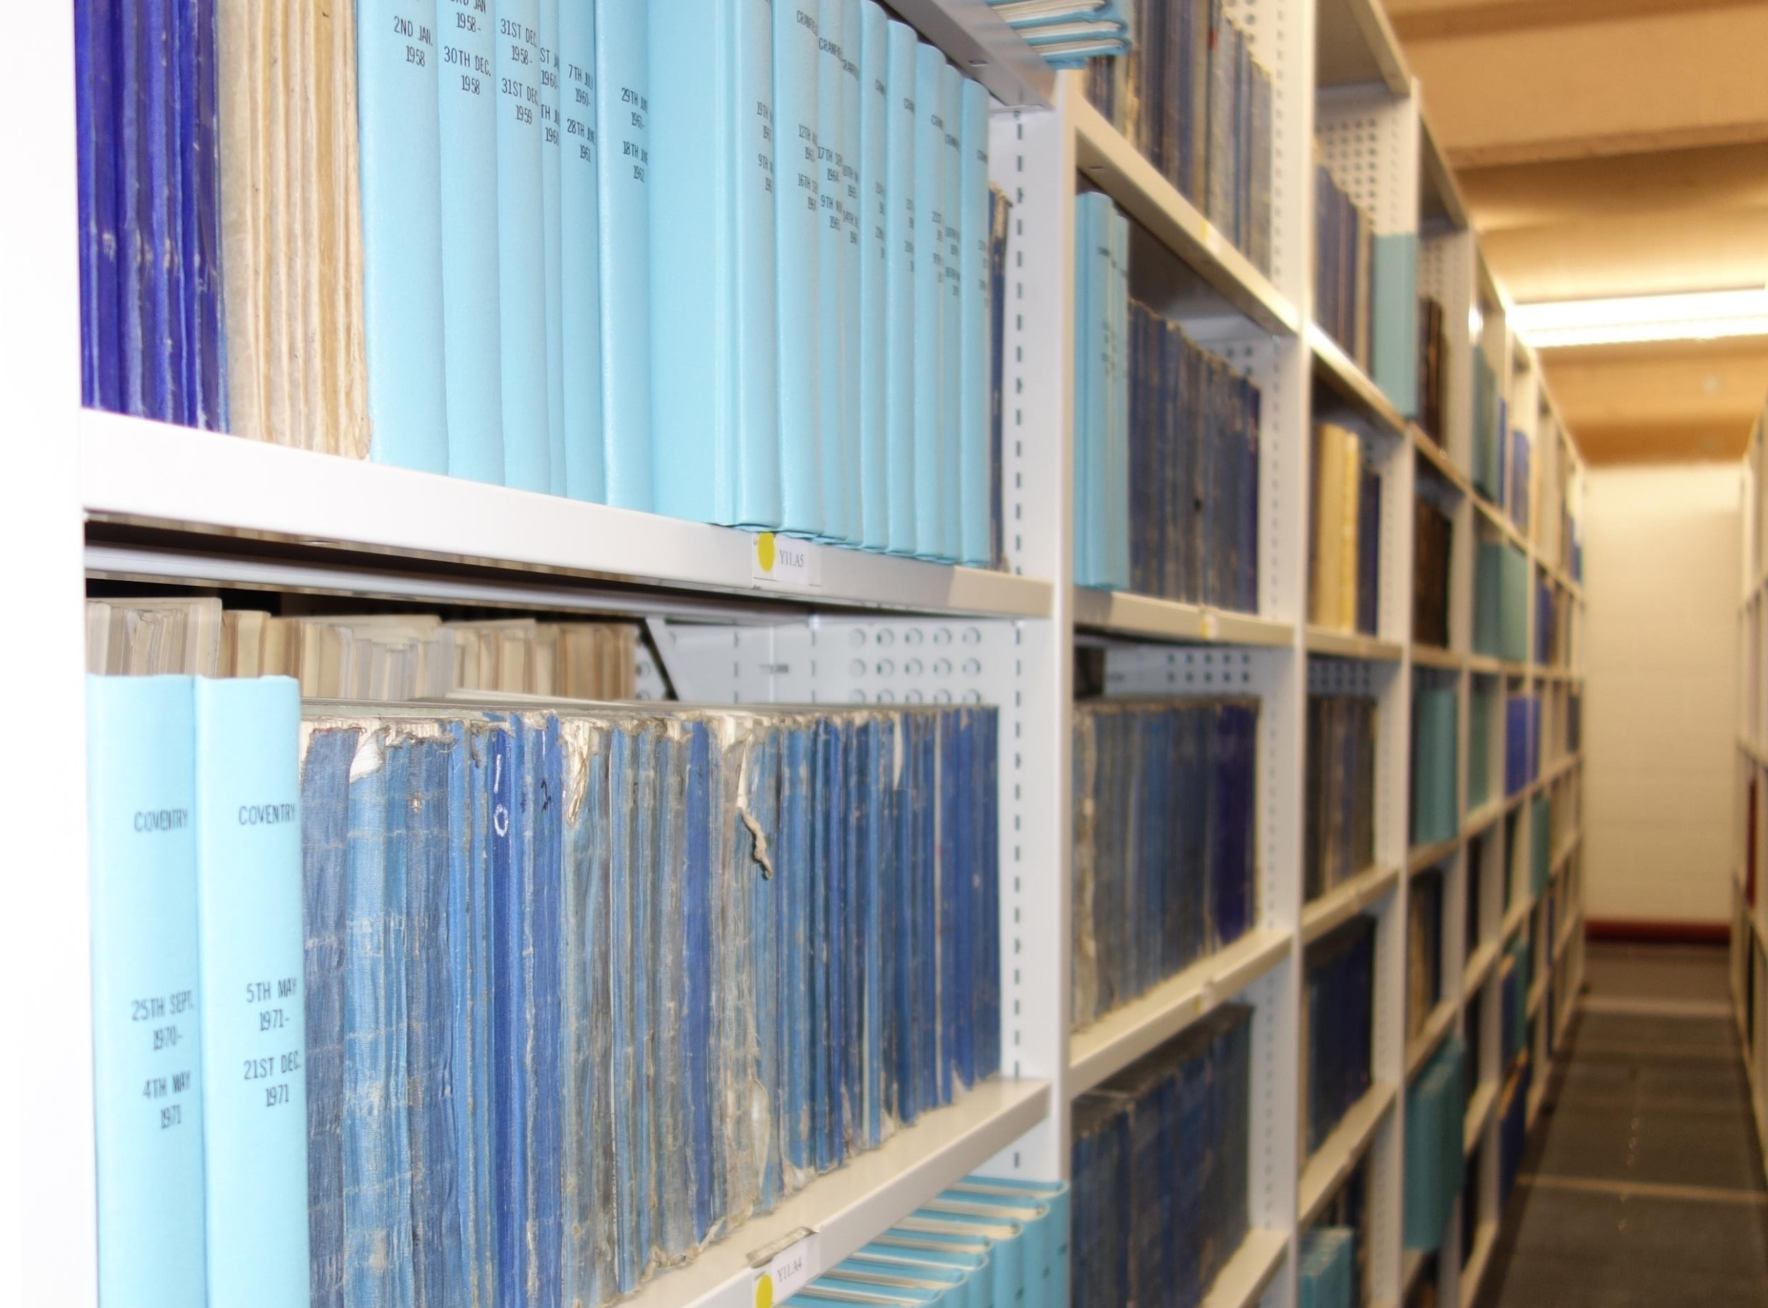
What do we hold?
National Memory of the Weather
Data
Metadata
International data which places the UK data in context
Earlier data including private weather diaries
In recent years there has been significant interest in recovering information from a number of our most important and long running collections.
www.metoffice.gov.uk/research/library-and-archive
Notes:
The National Meteorological Archive (aka the Met Office Archive) holds the National Memory of the Weather for the UK– which in short consists of UK data, metadata and a large collection of international data
We fulfil the Statutory requirement of the Met Office under the Public Records Act – so we have everything produced by the office from its foundation in 1854 and now we handle of lot of digitized and born digital material.
We also hold the Royal Meteorological Society archive which is a really valuable resource for early data, private weather diaries and rare books.
Private Weather Diaries and also Ship Logs help us to extend the series before the foundation of the Met Office and broaden out the network in the early period whilst the number of official stations was still expanding.
We also hold a vast amount of international data (largely published but not always easily available elsewhere) it helps to place the UK data in context but is also very useful for global reanalysis work and we have supported a number of data rescue initiatives covering elements of our international data collections.
You can explore our collections via our online catalogue, our web pages, our Google Arts and Culture partnership stories and our digital library and archive – you can just google us or follow the URL on this slide.

Slide 3
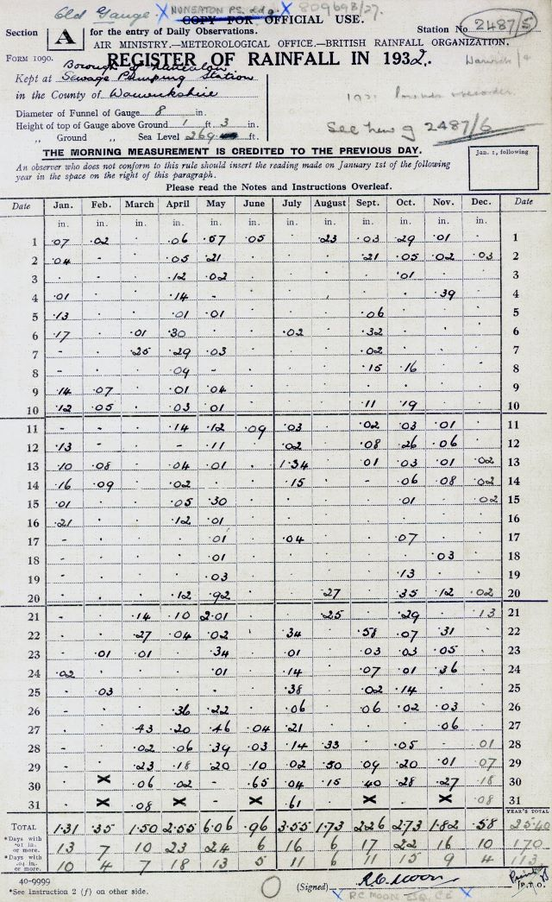
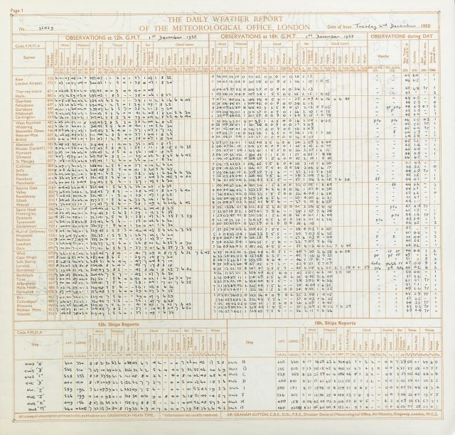
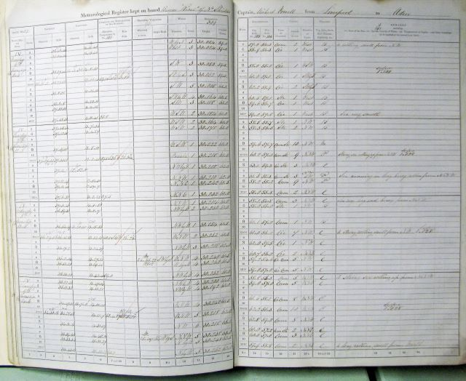
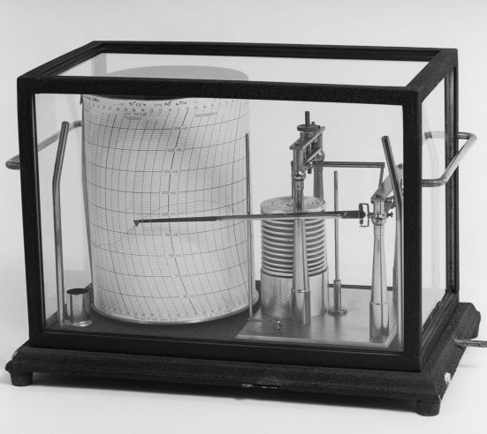
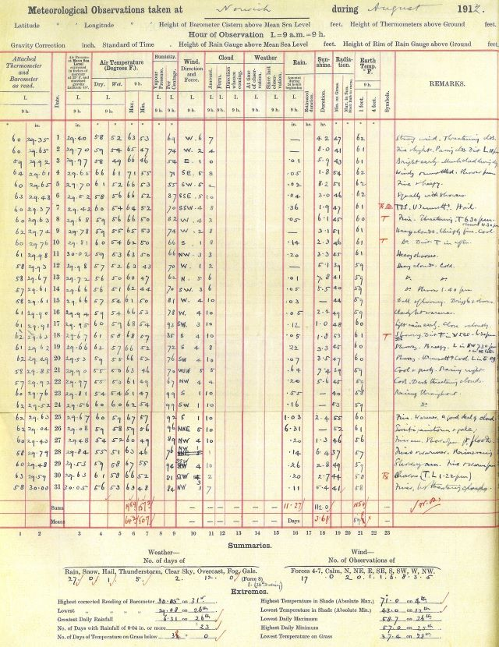
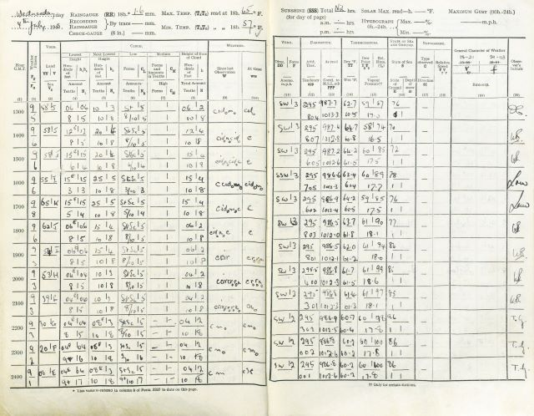
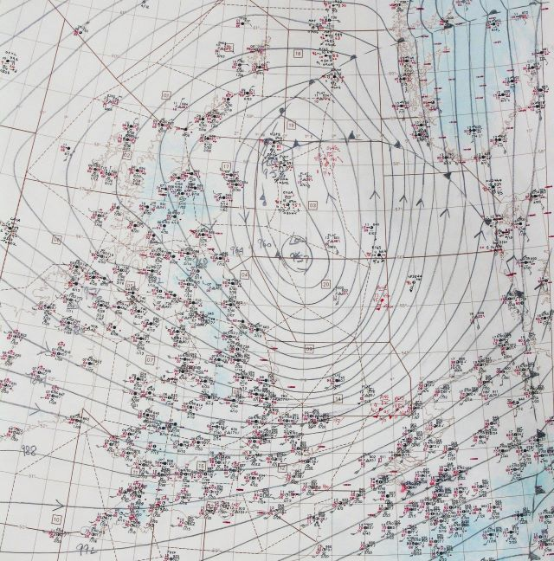
Notes:
The key global data collections in the archive –
Ship, lighthouse and light vessel logs
Climate returns from the UK and a number of locations around the world reflecting the history of the UK
Published data series covering a vast number of global locations
The key UK data series are
Rainfall series (daily and monthly rainfall data)
Daily weather reports and daily aerological reports (which gives us upper air observations)
Daily registers – sub daily data
Autographic data for every weather element
and Charts! Many, many charts!
We are also very aware of our key metadata series including Station Histories and instrument manuals

Slide 4

NMA scanning priorities and strategy
In recent years the NMLA have been scanning a range of data series with a focus on materials most useful to the UK public and to the Met Office and wider scientific communities.
  Monthly rainfall – more later
  Daily Weather Reports – partly rescued via citizen science
  Daily rainfall – scanned – already attracting attention
  UK Climate returns – 99% complete – waiting on AI advances
  Station Histories – metadata for many long running sites now scanned but cannot be made publicly available due to GDPR legislation (personal information in the documents)
Notes:
In recent years the NMLA have been scanning a range of data series with a focus on materials most useful to the UK public and to the Met Office and wider scientific communities.
Monthly rainfall – of which more later
Daily Weather Reports – partly rescued via citizen science
Daily rainfall – scanned – already attracting attention
The Monthly rainfall data rescuers are investigating the daily rainfall and have found that they can use AI techniques to match monthly and daily station data using the monthly totals which enables them to join up all of the metadata information but recovering the data itself it is likely to require further AI advances and is probably beyond human led data rescue as there is just so much of it!
UK Climate returns – 99% complete – this will definitely require AI advances for complete data recovery
And
Station Histories – these contain metadata for many long running sites and a number of the key longer running stations have now been scanned but unfortunately these images cannot be made publicly available due to GDPR legislation as there is personal information in the documents

Slide 5
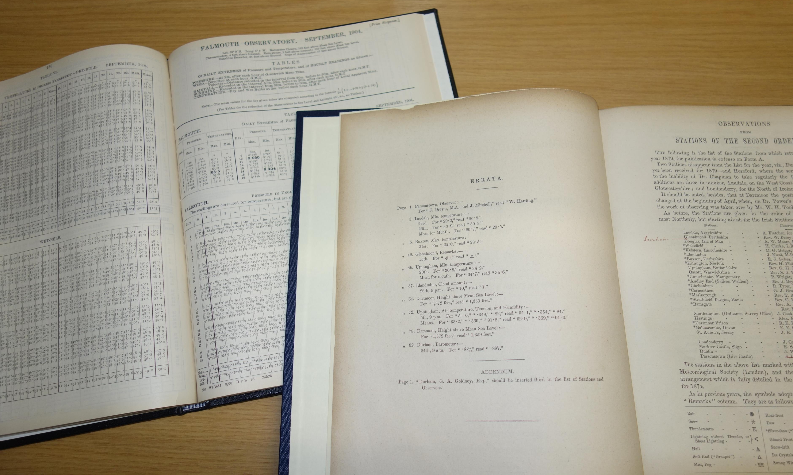
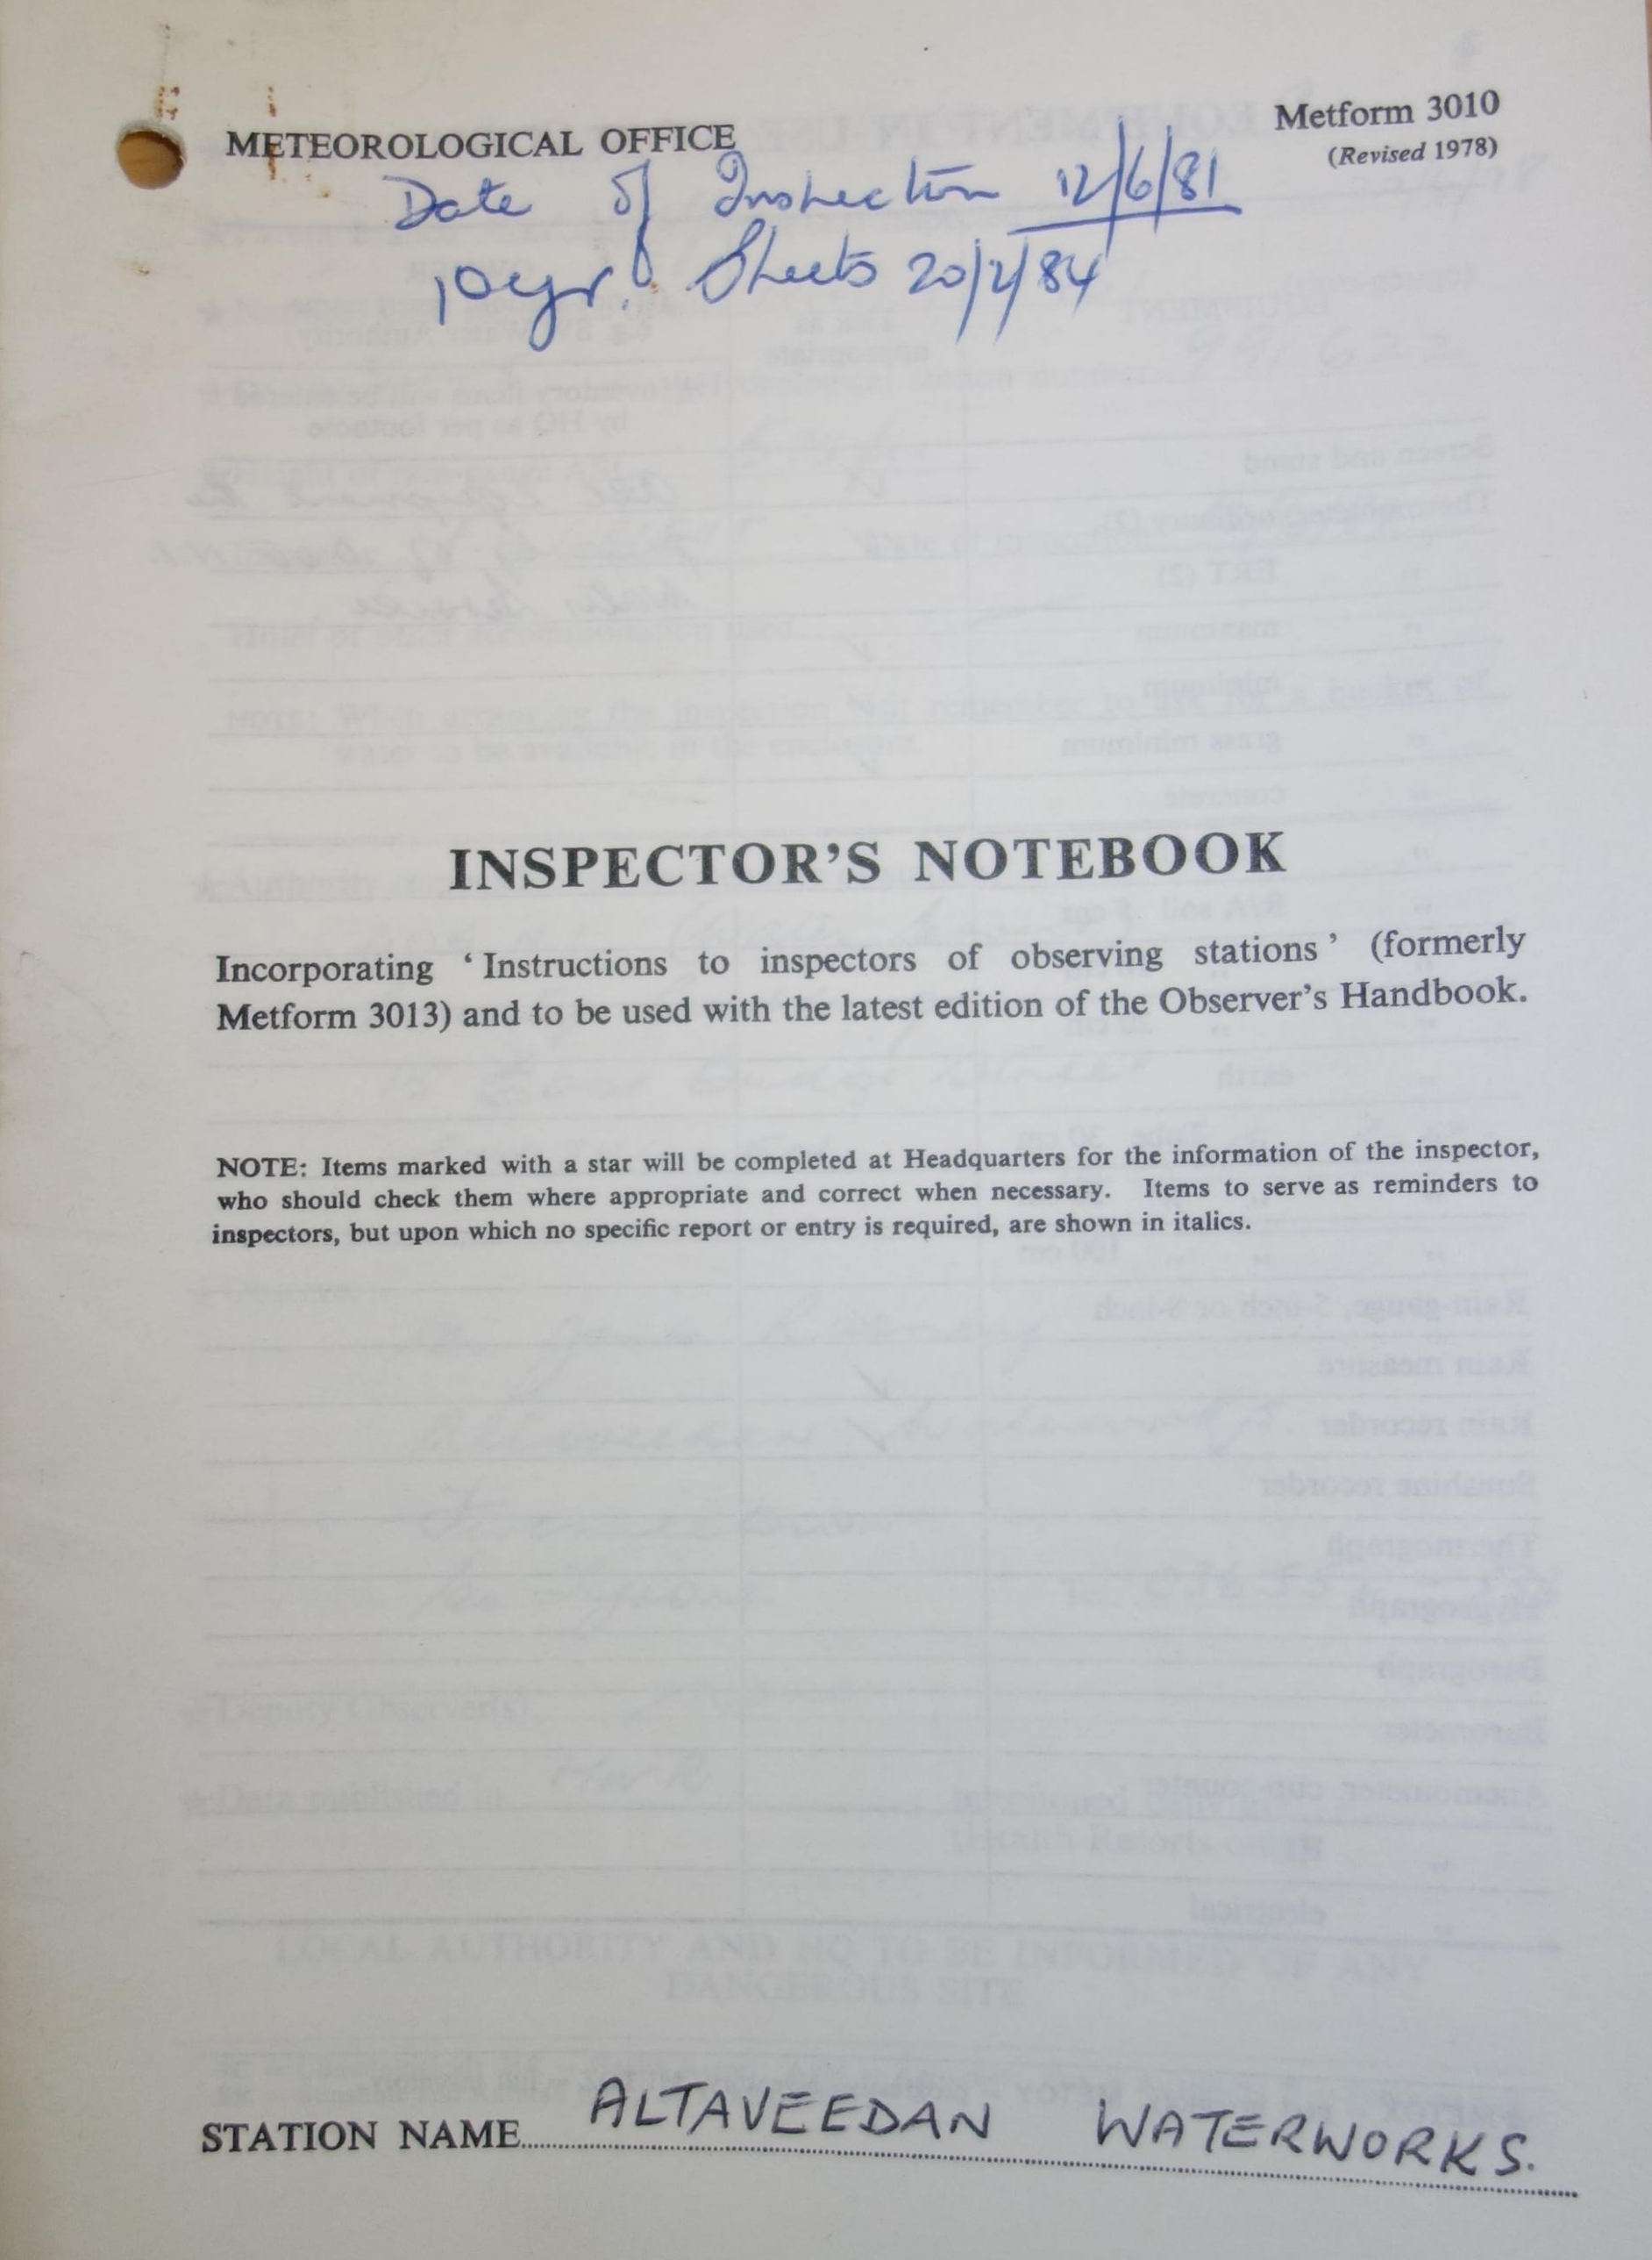
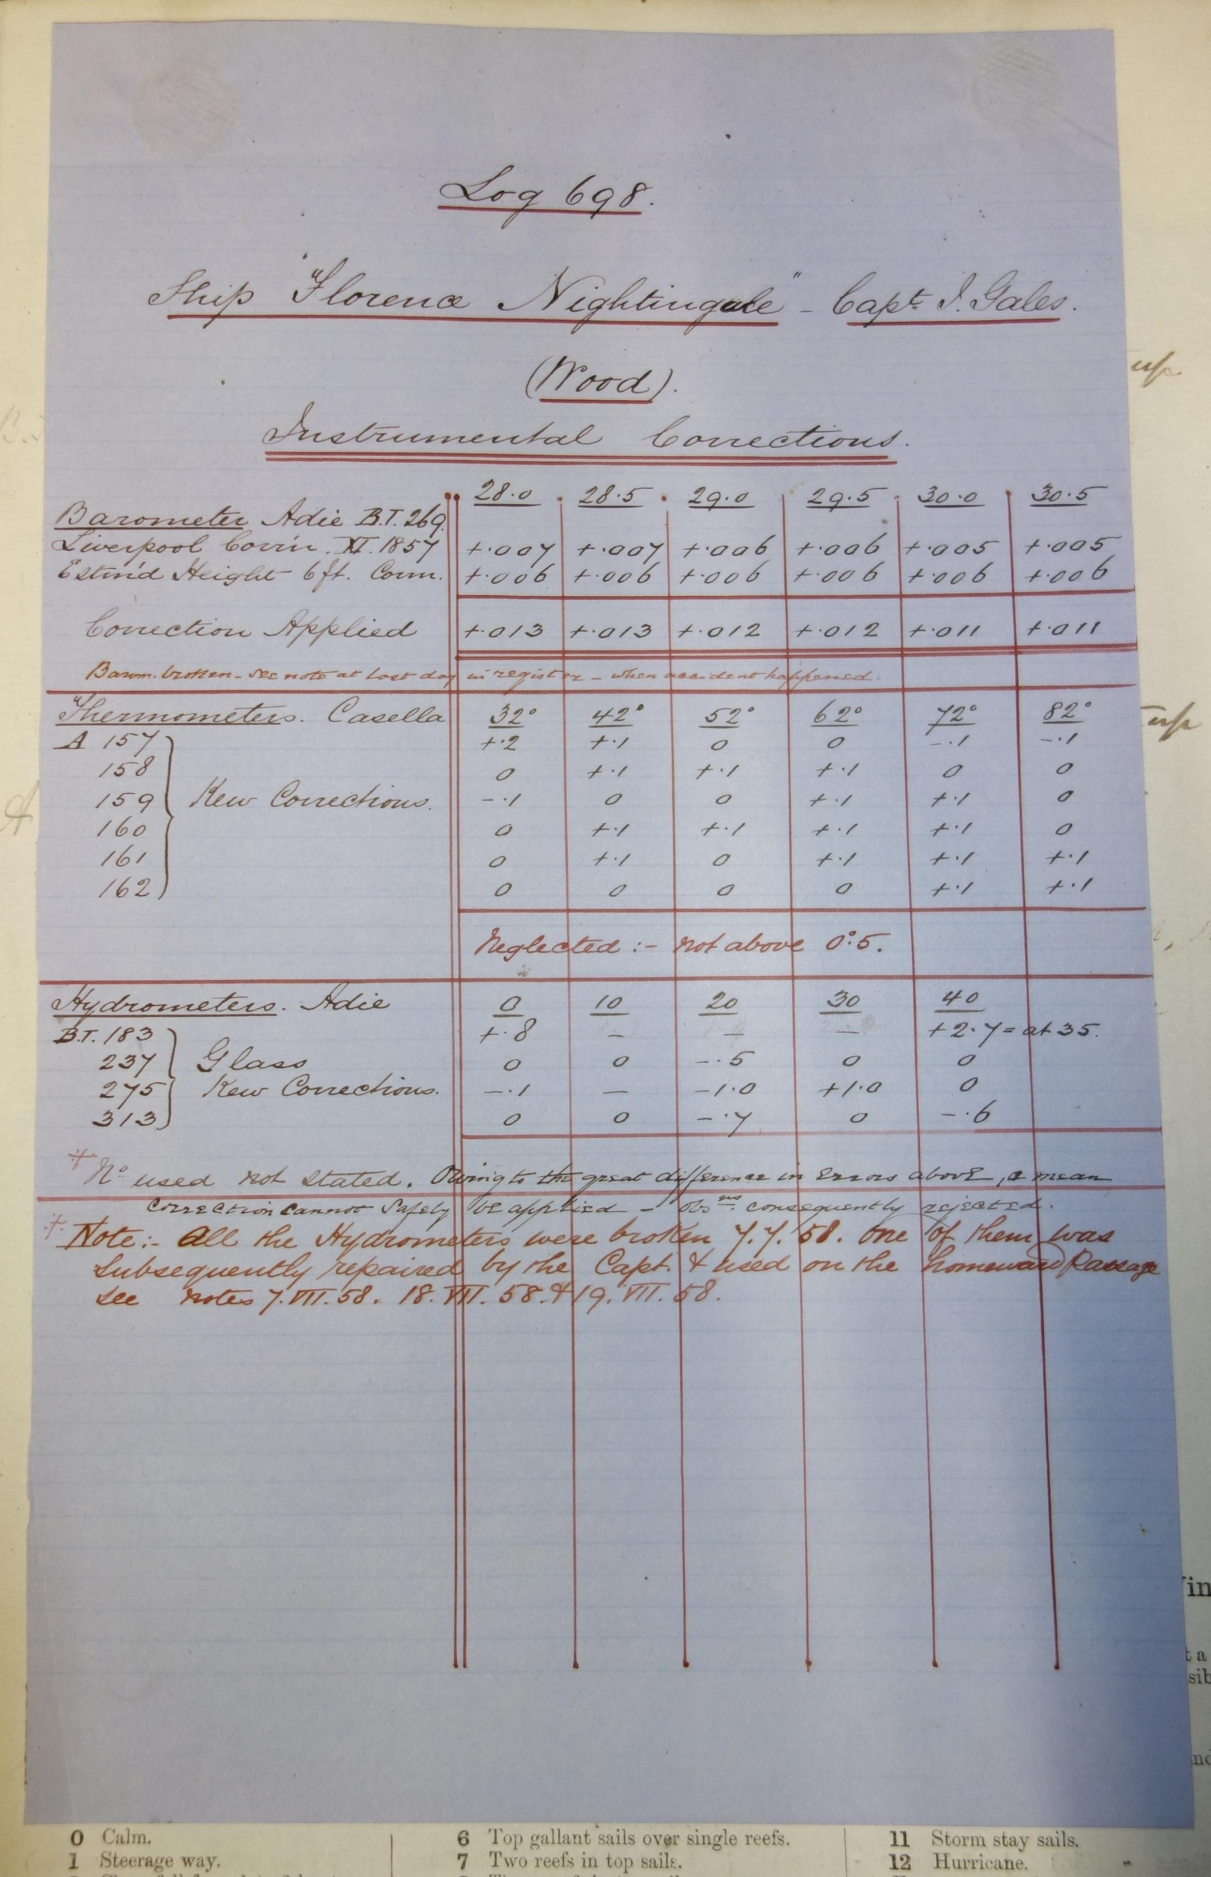
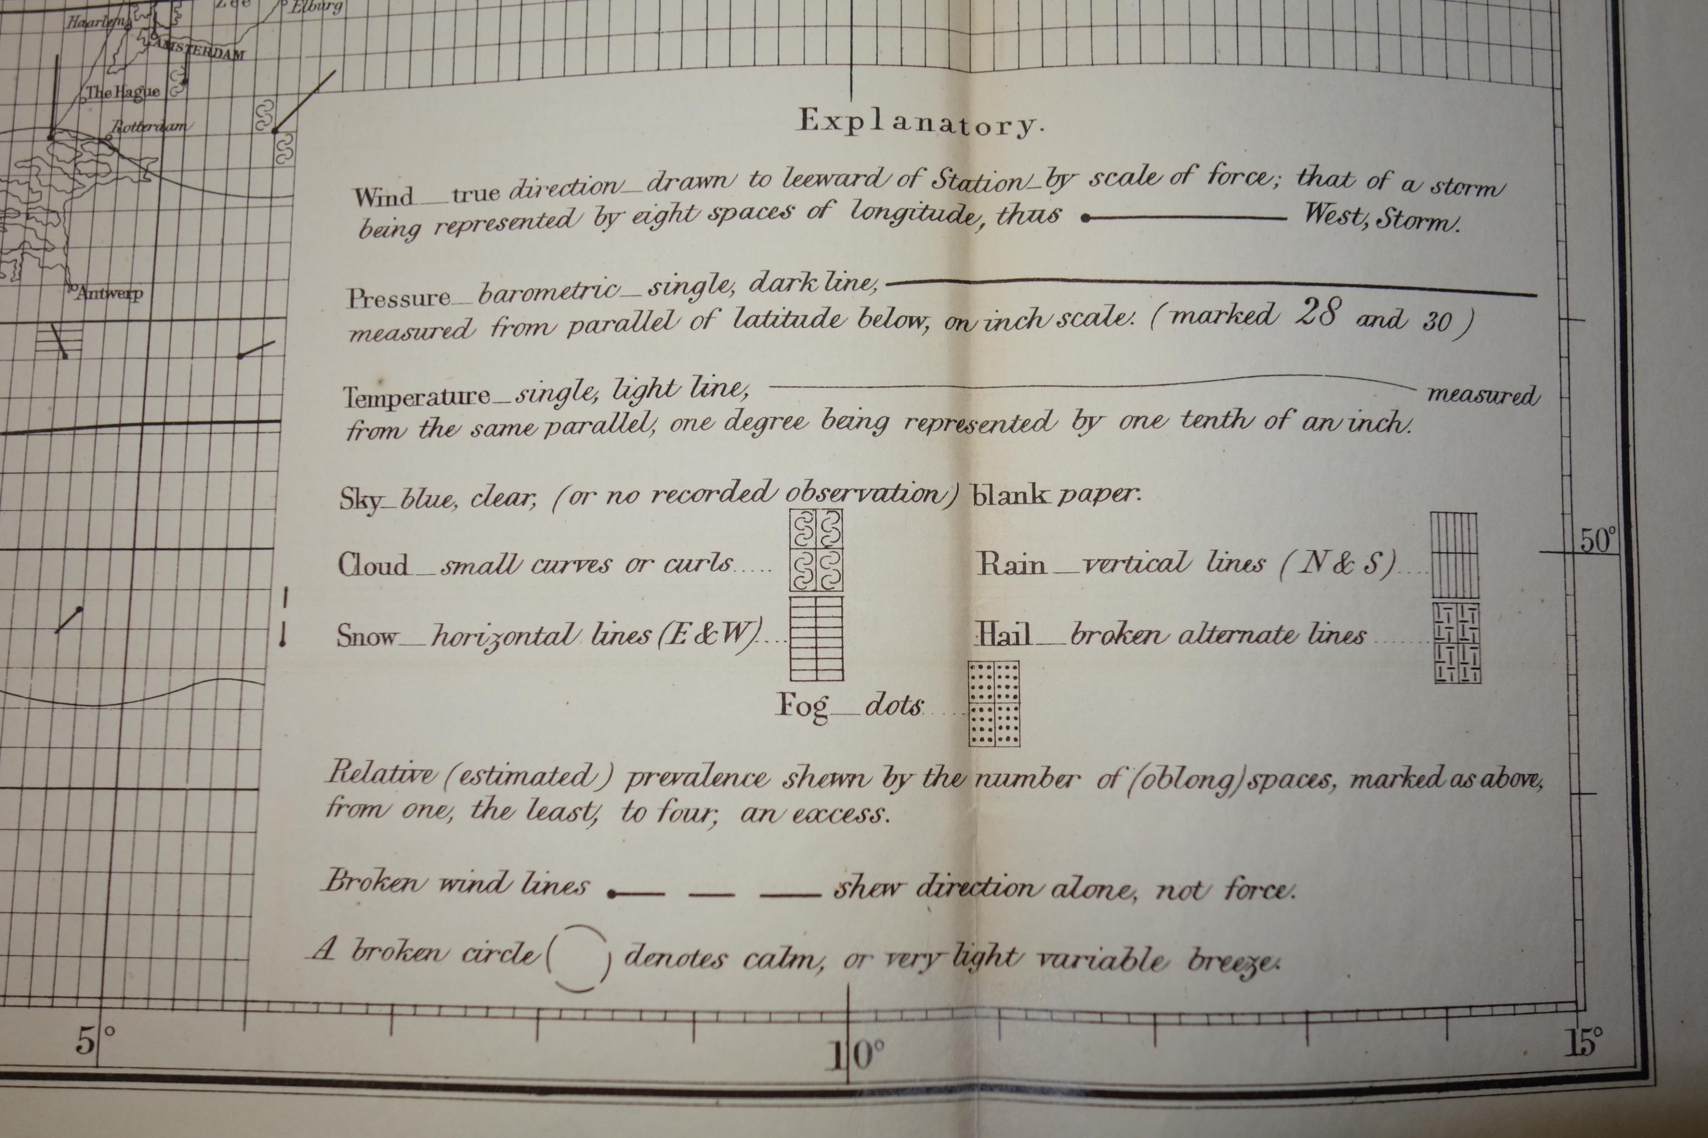
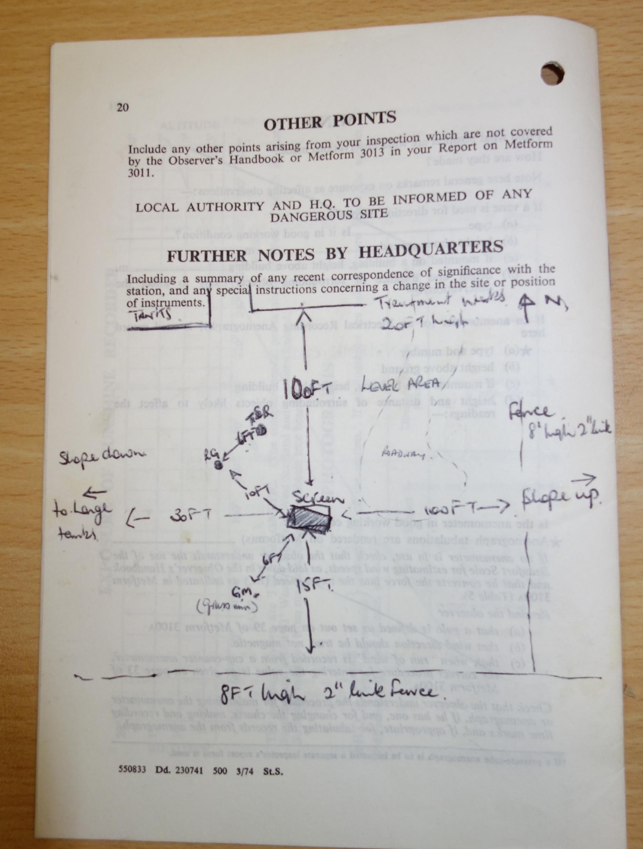
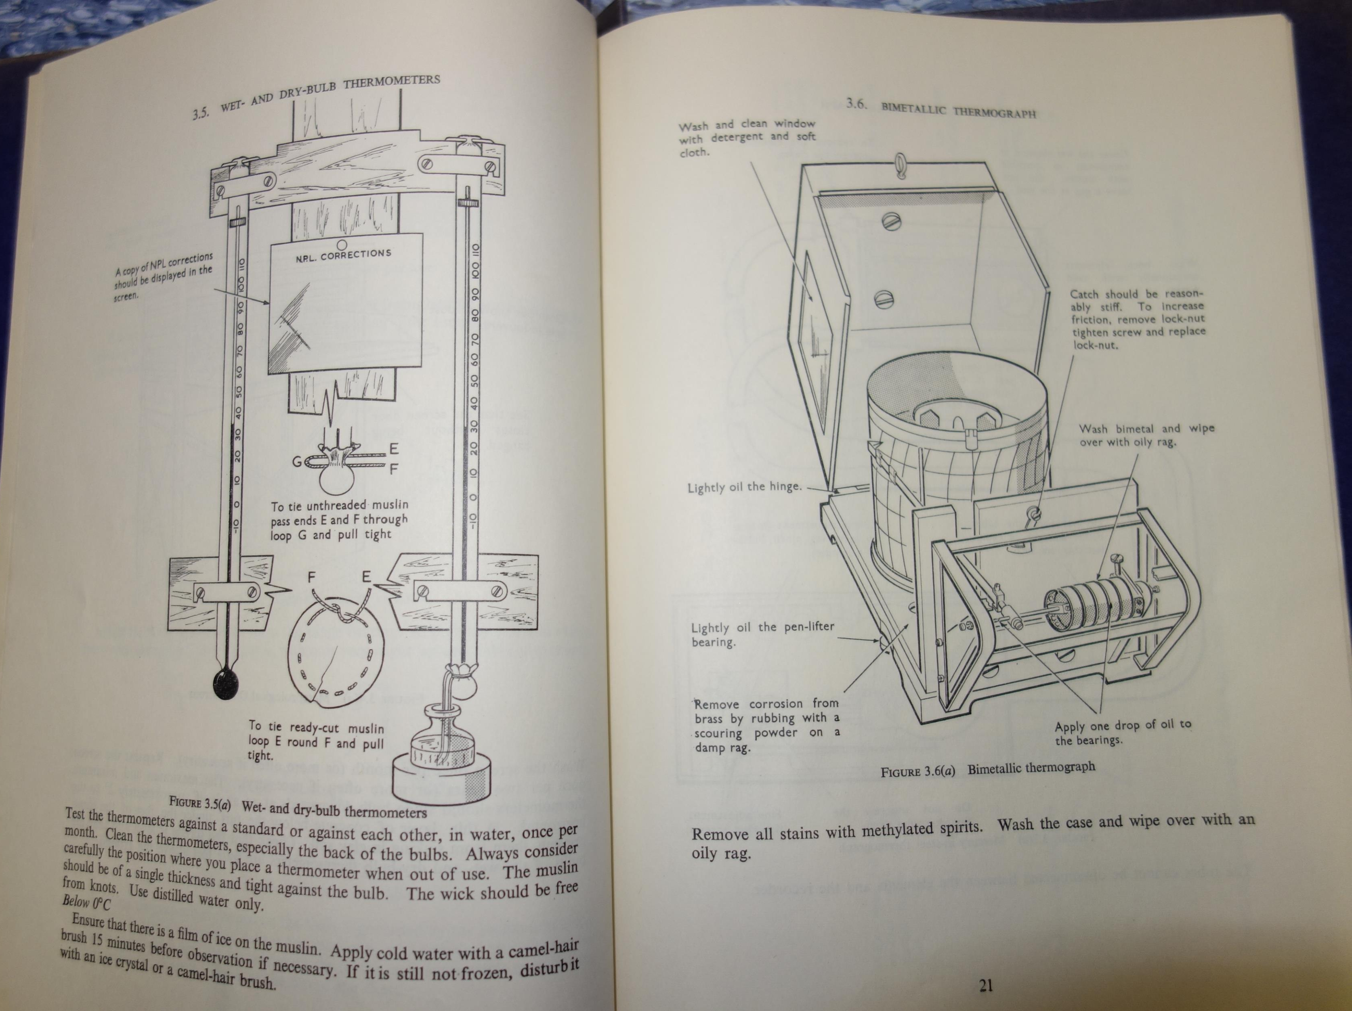
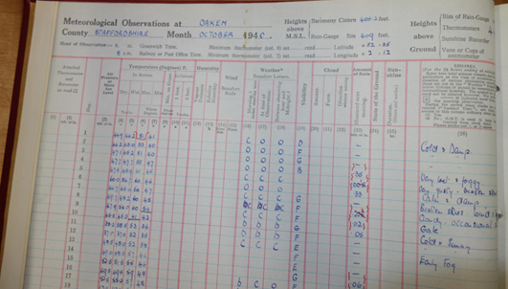
Recovering metadata
Metadata can be found in many places in an archive
Station Inspection documents
On the data itself
Covers and inside pages
Manuals, keys decodes and publications
Notes:
In weather and climate science Metadata is crucial to explaining, understanding and having confidence in the data sets and series. Some questions that metadata can help with:
Where is the instrument/site? Did it stay there or move around? How often and how much?
What instruments were in use, how they worked and when they changed?
How and when were the observations were made? – practices have changed over time – everything from time of day to which units were in use
A step change in data might be because an instrument or process changed not the climate
In a long data series you need to consider if all the data you are looking at was collected at the same time in the same way – because it almost certainly wasn’t
And finally we have the human element how reliable was the observer?
Inspection reports can indicate whether the observer was accurate or tended to over/under read instruments
If you know all these things you can smooth your datasets and allow for them. Without it you can make wildly incorrect assumptions
Metadata can be found in many places –
Station inspection documents
On the data itself
On covers and inside pages
and in manuals keys decodes and publications
As you might expect station inspection documents are perhaps the most obvious source of information – but sometimes metadata can be found where you lease expect

Slide 6
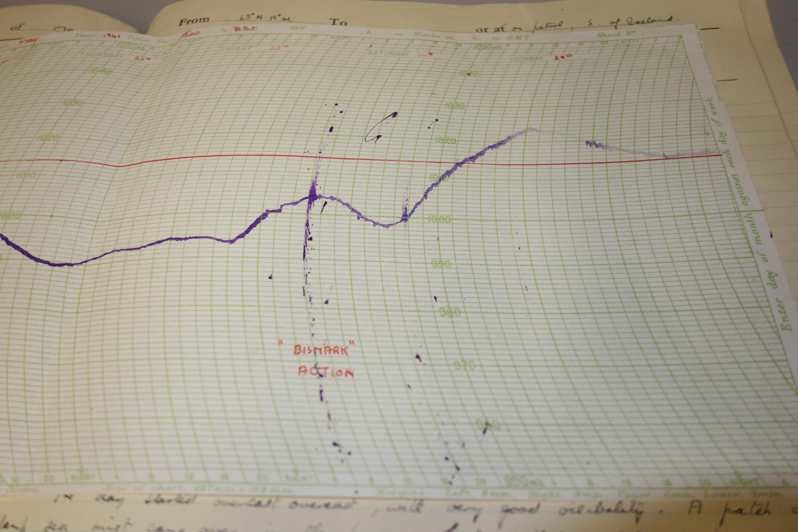
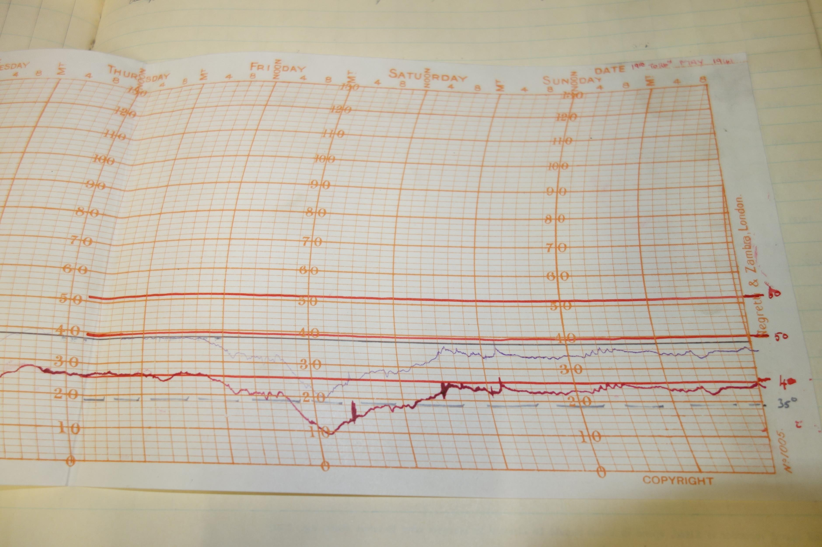
Notes:
Seen in isolation the thermogram trace from HMS Prince of Wales (on the right) might look somewhat suspect and make you question the accuracy and calibration of instrument and therefore the usefulness of the resulting data
CLICK
That is until you look at the corresponding barogram trace (on the left) and discover that the cause of the anomaly is neither calibration, atmospheric or geological, it was caused by the shaking of the vessel whilst firing upon the German Battleship Bismark. With that understood we know that other data from both instruments should be reliable.
We are scanning our station histories, manuals and other metadata to help the research community ensure their new climate datasets are as accurate as possible.

Slide 7
The Rainfall recovery project
The NMA has been scanning data for around 10 years focusing on series which will be most help to the public, and to climate and weather science
2019 - Recognising the value of rainfall records for UK climate monitoring we scanned a lengthy and significant series of monthly rainfall records known as the ‘10 year rainfall’ because the monthly forms were organised into decadal files.
January 2020 – we put all of the scans onto our Digital Library and Archive
March 2020 – the world locked down

Slide 8
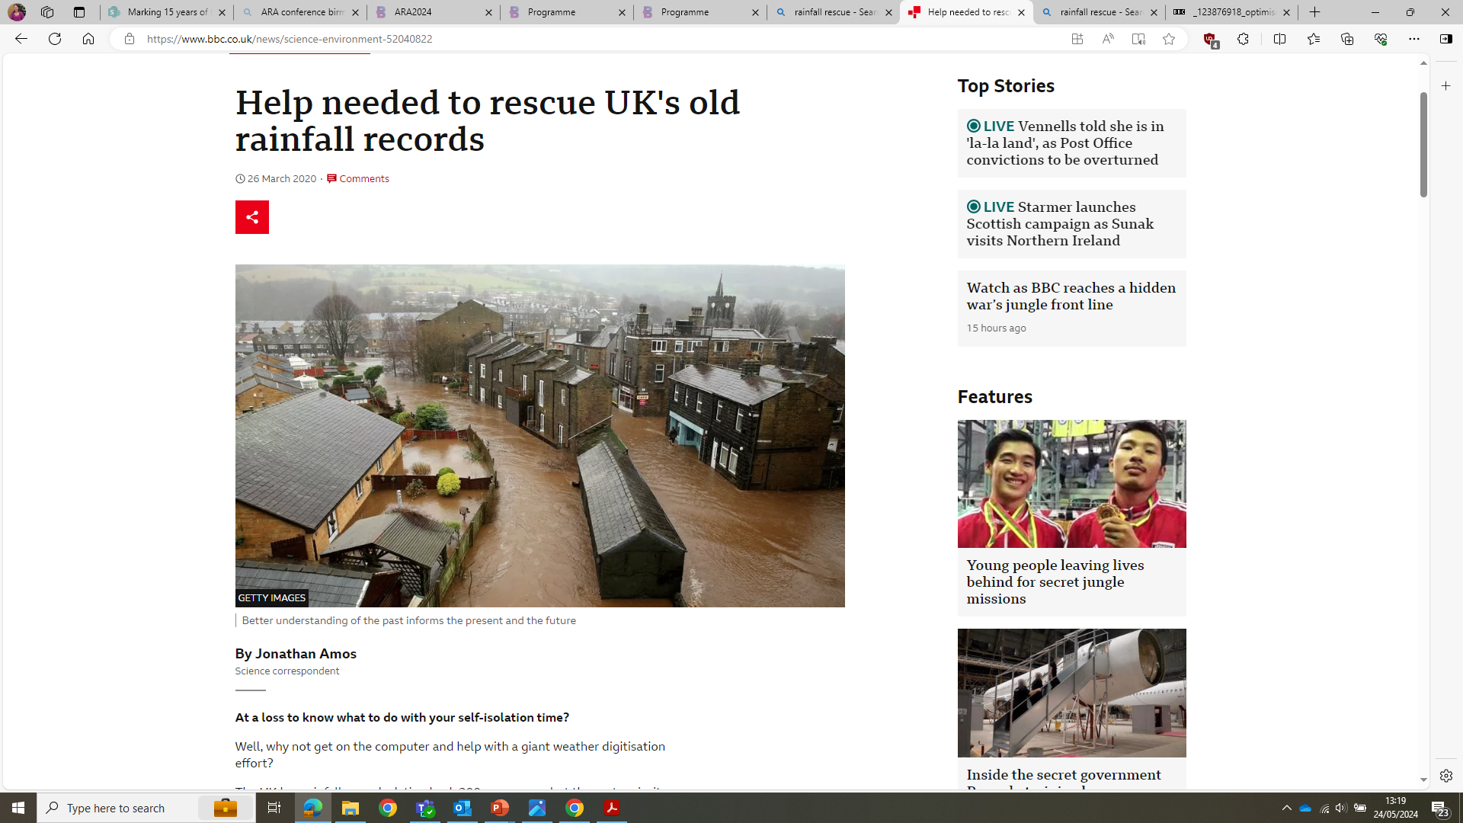
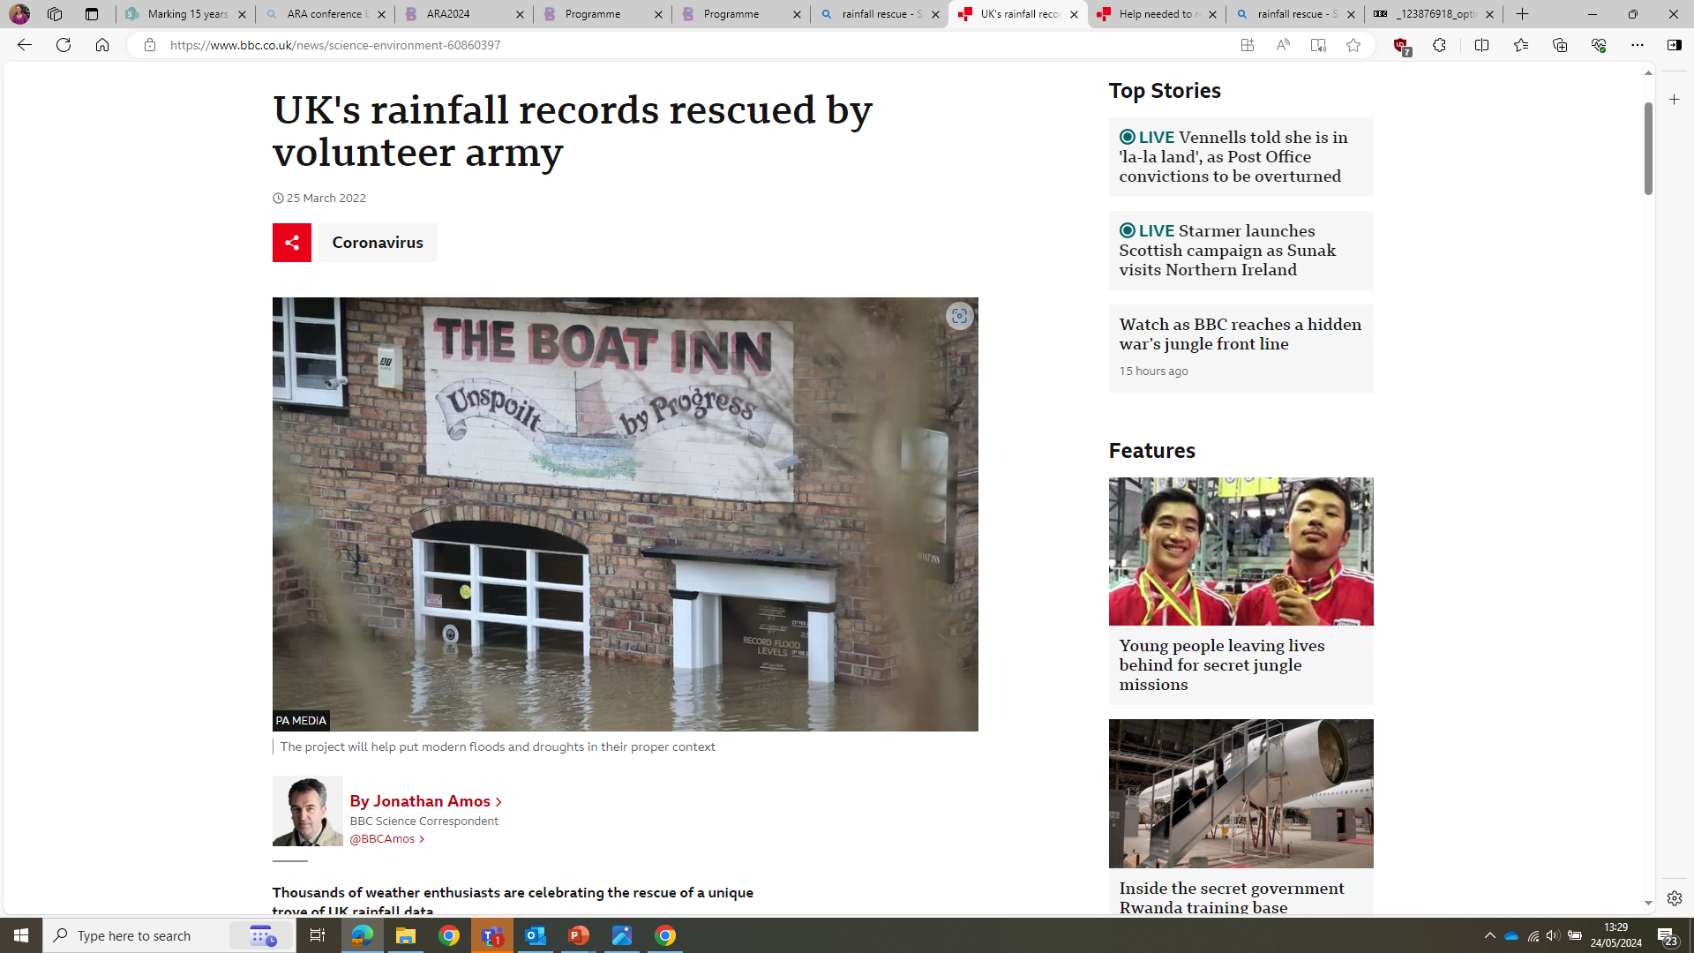
Citizen Science in a pandemic
In March Professor Ed Hawkins at Reading University asked if we could supply the scanned images for a citizen science project
In the wake of the global lockdown the BBC featured the rainfall rescue project as something for people to do whilst isolating at home
16000 volunteers recovered 5.2 million observations, four times each for QC purposes (which makes over 20 million individual observations) in just 16 days!!! Adding in the data keyed by volunteers recovering the metadata that gives the incredible total of 100 million keystrokes.
Notes:
Victorian rainfall data rescued - Met Office

Slide 9
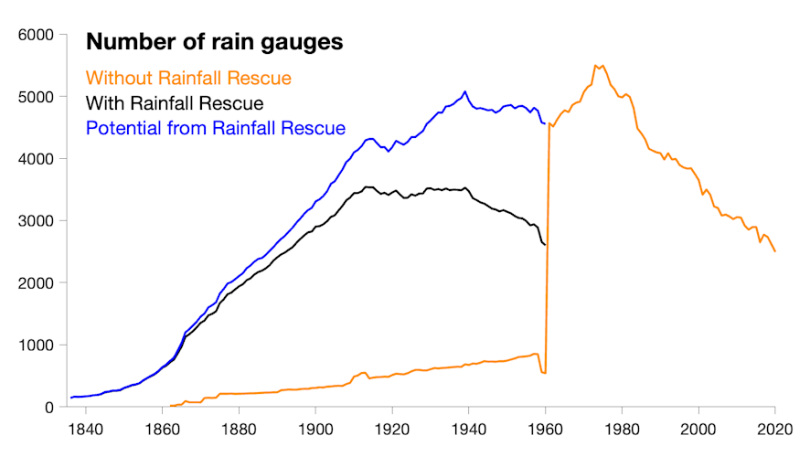
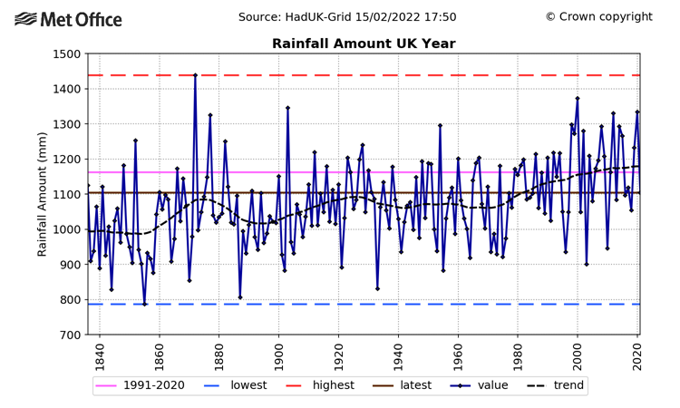
What happened next
Over the next 2 years eight dedicated volunteers and a team from Reading University put the data and metadata through an exacting quality control process and the data sets were released in two batches.
The data was then made available to the global scientific community and immediately started to have impacts in understanding more about historical weather extremes – the major floods and droughts, how likely they are and how often they might happen.
This in turn helps us to put modern extremes into context.
Notes:
Over the next 2 years eight dedicated volunteers and a team from Reading University put the data and metadata through an exacting quality control process and the data sets were released in two batches.
The data was then made available to the global scientific community and it immediately started to have impacts
The data enables us to significantly improve analysis of long term rainfall series – the graph at the top shows the amount of data available before rainfall rescue (the orange line) with a clear difference before and after 1960, the step change with rainfall rescue data included (the black line) and the further potential data yet to be included (the blue line) which would bring the pre and post 1960 data much more on a par.
One clear trend it has helped us to identify is the increase in summer rainfall in the UK from 1840 to present.

Slide 10
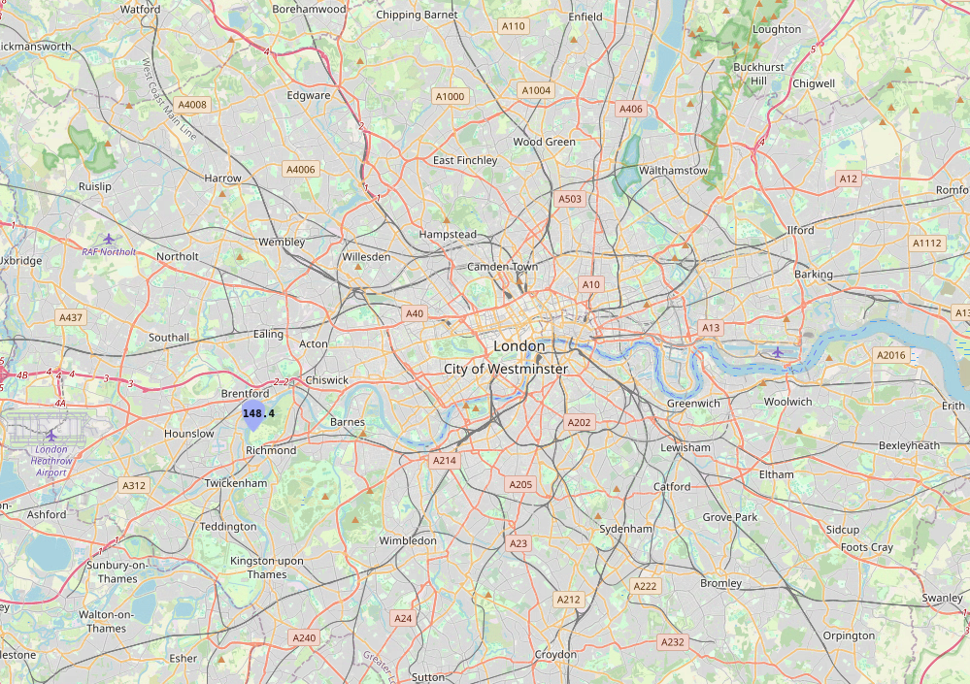
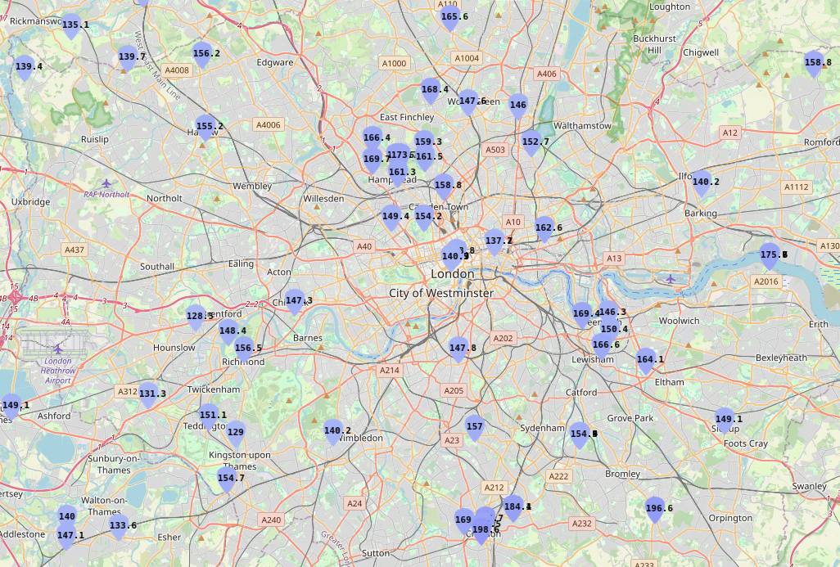
The Met Office National Climate Information Centre is using the rescued rainfall datasets to improve long term climate monitoring…..
Notes:
I’m going to focus on the rainfall rescue work for the remainder of this presentation and thanks to Stephen Packman of the Met Office for all of the graphics here.
As an example of how the rainfall rescue work has helped us here is a map showing the data available for a particularly wet month – December 1876 before and after the addition of data from the new blended rainfall database created from the rainfall rescue work.
…. The rainfall led to some extensive flooding events around the Thames in London. The two maps of London show the current coverage with Met Office Land network gauges only and after including Rainfall Rescue gauges. With the new data, we can identify some areas of South London which had nearly 200mm of rainfall in December 1876, over three times the average expected for this area during December.

Slide 11
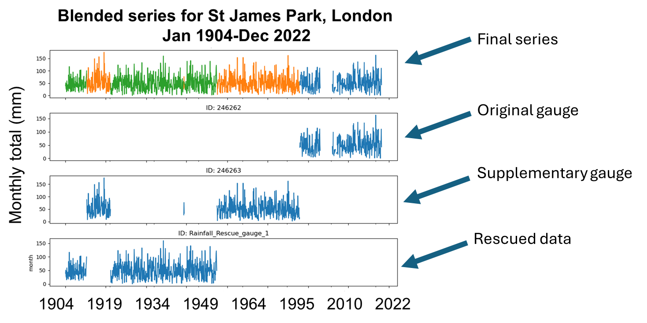
Blended rainfall database: matching existing and Rainfall Rescue rain gauge data using site metadata and rainfall trends
67% of station series extended by blending additional rainfall data
19% of station series extended by more than 25 years
25% of stations have a new monthly rainfall record as a result of the blending process
Image credit: Stephen Packman, Met Office
Notes:
To give some further detail on how the blended rainfall database works and how it was produced
The new database took rescued data from the rainfall rescue citizen science project and matched it with pre-existing Met Office data by using the three metrics of location data, station name and checking that where the new and old data overlapped they matched to ensure the data series were definitely from the same station.
If a data set had same name/location but data didn’t match we could tell these were not the same stations – and therefore we didn’t blend them
You can see an example of how this was done here for St James Park London where the rescued data was overlaid with the supplementary gauge and the original gauge data to ensure it mapped correctly and to create the final series from January 1904 – December 2022.
The blended rainfall series uses a new matching technique developed by – Stephen Packman and Phil Whybra of the Met Office (look out for an upcoming paper)
It has a flexible approach – you can change the thresholds so for example for location you can vary the distance threshold so you can decide how far apart you are happy for your location parameters to be; names can also be matched up to a set level so for example you can set a 5 letter match. This is very helpful because many stations go through multiple very similar names like example rose cottage and rose house
By setting requirements for all 3x metrics – name, location, data – Stephen and Phil could ensure that the correct data was attributed to the correct station but the coding is really flexible. For this project it was important to identify and match exact stations, but if you just wanted to match within a valley or catchment area you could do that too.
Once the blending process was complete 67% of stations had extended series, 19% of them by more than 25 years and 25% of stations had a new monthly record – now that is transformative!

Slide 12
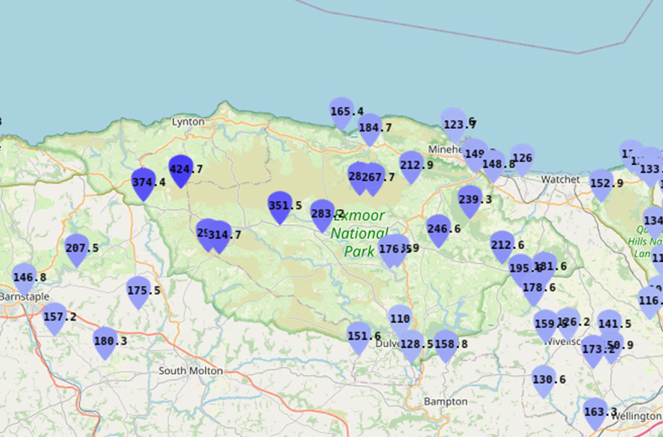
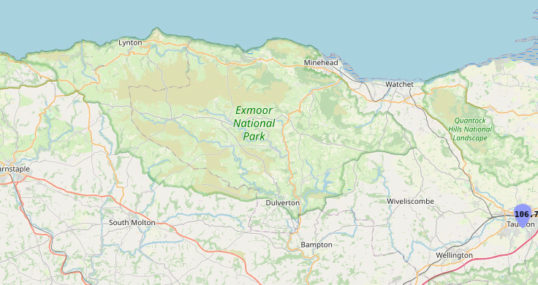

Lynmouth Flood, North Devon, UK
15 August 1952
With and without addition of data from blended rainfall product
Notes:
Our understanding of extreme rainfall events can also be improved using the rescued monthly data. I should note we already have daily rainfall data for these events which is not shown on these charts so we do know what happened, but these maps show how much more detail we can add now that we have rescued all of the monthly data.
Friday 15th August 1952 – Lynmouth Floods
This was described as the worst river flood in English history. In a period of more than 18 hours incessant heavy rainfall 230mm of rain fell ontop of already saturated ground on Exmoor and was almost entirely funnelled down the tributaries of the east and west Lyn. It is estimated that 90million tones of rain fell in North Devon and West Somerset on the day. Tonnes of that water funnelled down the valley of the River Lyn reshaping the valley, ripping out soil, boulders and vegetation and carrying all of these down the valley at high speed towards the town of Lynmouth. The water combined with the materials it carried along blocked and demolished bridges and a wall of water and rubble hit Lynmouth in the late evening. 28 people were killed and the town was practically demolished overnight.
Blended rainfall product contains a number of additional gauges in Exmoor National Park including some near Lynmouth with significant monthly rainfall totals
Includes monthly rainfall total of 424.7mm at Longstone Barrow, which is over 4 times as high as the expected August monthly rainfall total for Devon – and of course most of that fell on the 15th August
The Blended rainfall helps us to see much more clearly the amount of rain that fell across the area and to understand the extreme nature of this event. ….

Slide 13
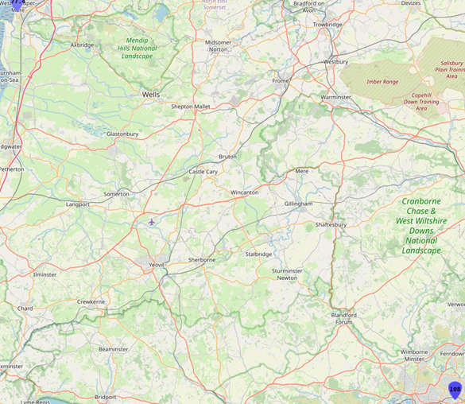
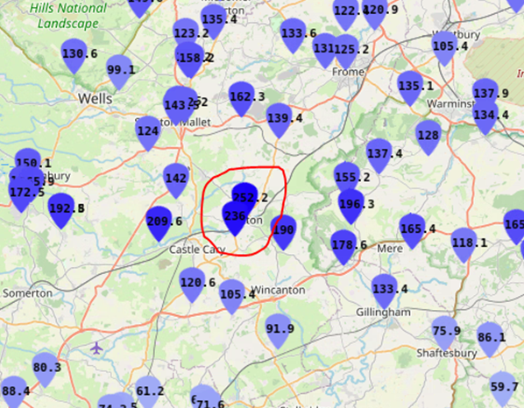
High rainfall at Bruton, Somerset, UK
28 June 1917
With and without addition of data from blended rainfall product
Notes:
As a different example this is a high rainfall event at Bruton in Somerset on 28th June 1917
During the morning an area of heavy rain and thunderstorms developed across parts of Somerset, Dorset and Wiltshire. Bruton saw 242.8 mm of rainfall in 24 hours and over a large area of Somerset, Dorset and Wiltshire rainfall totals were between 100 and 150 mm. The rain was accompanied by thunder and lightning and rainfall measurements exceeding 25 mm were recorded over nearly all the south and southwest of England.
The rainfall led to significant flooding and structural damage.
Blended rainfall product contains a significant increase in coverage of Somerset for this historic period, including high monthly rainfall totals around Bruton
The Monthly rainfall totals of 236mm and 252.2mm recorded at rain gauges near to Bruton in June 1917 were each nearly 4 times as high as expected for Somerset in June
Again gives us a much better picture of the rainfall event …..
Both of these examples evidence how rainfall recovery has given the National Climate Information Centre more spatial detail – a feature which is particularly relevant given the high spatial variability of rainfall.
This ability to understand historical rainfall events can feed into understanding changes in return periods and other work such as attribution studies to see whether extreme rainfall events that lead to flooding are the result of natural climate variability or can be attributed to anthropogenic climate change.
This is relevant for subjects such as loss and damage where companies or countries can be held accountable for disasters caused by climate change – an emerging topic of interest in the global south.
Without really good, granular historical observations we couldn’t carry out any of these types of analysis

Slide 14
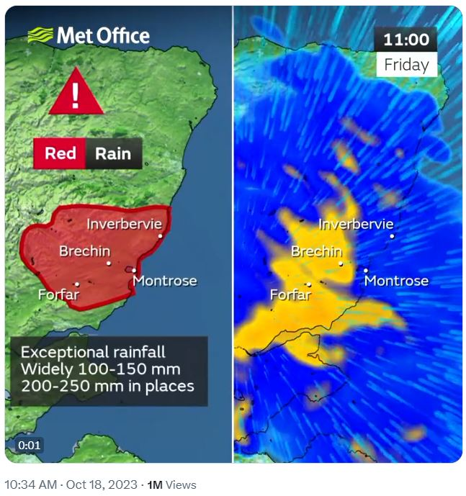
Where we are now – e.g. Storm Babet October 2023
Notes:
On a forecasting point I just wanted to note that in both cases the communities of these towns would be much better warned and prepared today.
We have:
Higher resolution models including convection permitting models (modelling convective rain)
Ensemble forecasting
New nowcasting tools
Web and App that can provide instant access to information
The Flood Forecasting Centre – opened in 2009 this is a partnership between the Met Office and the Environment Agency which operates 24/7 and combines meteorology and hydrology expertise to forecast for river, tidal and coastal flooding, as well as flash flooding from extreme rainfall.
As an example this is the red warning and visual cortex modelling for Storm Babet which brought significant flooding to an area of NE Scotland in October 2023. Modelling and forecasting techniques enabled the communication of clear and accurate early warnings to the public and the emergency responder community on all channels including social media – this enabled people to prepare and to evacuate particularly vulnerable areas minimising loss of life and damage to property as much as possible.
And just to touch on the world of reanalysis the rescued data is also an extremely helpful independent dataset when evaluating reanalyses results to check accuracy. Ed Hawkins knows far more about that then me!

Slide 15
What’s next
Recovering Daily Rainfall and Climate data with AI – hopefully in the next 5 years
At the moment AI cannot accurately and consistently recover numbers from tabulated data sets. There are projects around the world working on it. We’ve come a long way in the last five years, in the next I really think we will crack it and our data rescue strategy is working towards just that.
The National Meteorological Archive is are just the starting point in a global collaborative network and its incredibly exciting to see what science is already happening using our archive materials and to think about what achievements in understanding historical weather and climate variations are just around the corner
Notes:
So what is next
The rainfall project has shown us just how valuable data rescue is for improving our understanding of how our rainfall is changing and more about extreme rainfall events but there is a limit to what human data rescuers can do.
We are currently scanning our climate returns (millions of observations) and our daily rainfall observations (more millions of observations) – and we’re doing this knowing that right now there is no practical way to get the numbers into useable electronic data sets….
its too big for citizen science
too expensive for commercial recovery
and too complex for AI as it stands right now…… we’ve come a long way in just a few years and seen improvements in the ability to recover tabulated data but the accuracy levels aren’t there yet. However I don’t think it will be long now and when AI is ready we will be too, with tens of millions of observations imaged and waiting to be transcribed.

Slide 16
ANY QUESTIONS?
Get in touch:
metlib@metoffice.gov.uk
catherine.ross@metoffice.gov.uk
ncic@metoffice.gov.uk

