Slide 1
Preliminary result of research into Dutch Naval Logbook and weather related datasets.
Togo Tsukahara, Hisayuki Kubota, Jun Matsumoto, Alice de Jong, Masumi Zaiki, Ikumi Akasaka and Atushi Ota
ACRE Drought and Flood meeting program. 2024sep.25, 10:30-
@Korfu, Greece. (Thanks to Prof. C. Zerefos, this is an island of Nausicaa )

Slide 2
Implications of (and suggestions from) our research project.
Terrestrial/Marine, land/sea, Fixed point/Moving Observation.
Regional/Global, National/Internatinal
Science/Humanities (meteorology/history), Nature/Culture/Human

Slide 3
Dutch Naval Logbooks.
Mundetary for ALL Navy ship, from 1854 onward.
(background)
International Maritime Conference at Burussels, organized by Adolphe Quetelet, with US Navy M. F. Maury.
Buys Ballot established Royal Dutch Meteorological Institute (KNMI) in 1854. (Buys Ballot became the fist chairperson of International Meteorological Organization in 1874, that is WMO later.)

Slide 4
Japanese study of Dutch navy logbooks: Our trans-boundary cooperation work is in-progress.
We are trans-boundary in two senses:
1) Dutch-Japanese cooperation: regional/global, local/international, geographical/planetary?
2) Two cultures of Science(s) and Humanities.
Nature/Culture devision? Data/meta-Data problem?

Slide 5
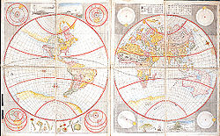
Japanese working on Dutch historical materials, between 17th-19th century.
Special historical contact between Japan and the Netherlands, during Japan’s closed nation period.
Public imaginary reference: between Shogun (around 1600) and Last Samurai (1960-70s).

Slide 6
Time between Shogun (1975, 1980 dramatized, 2024 disney) and Last Samurai (2003).

Slide 7
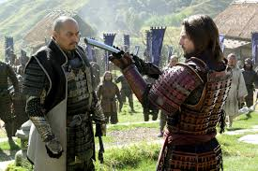
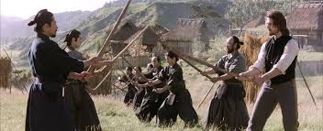
Historical elements: Fear of Christianity, Civil War in US traumatized soldier and merchat of death, Japanese anti-modernization movement.

Slide 8
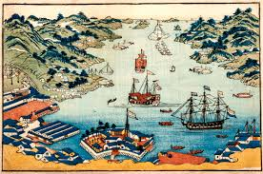
Dutch were the only European. Yet confined in small island at the bay of Nagasaki

Slide 9
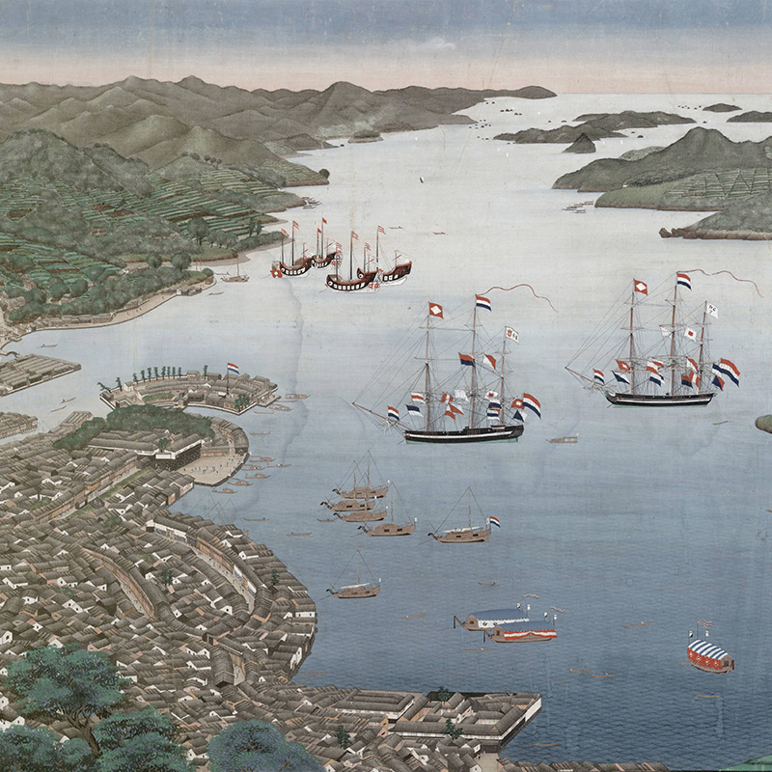
Dutch impact on Japan: science and technology

Slide 11
Growth of the world network of regular observation with meteorological instruments
Lamb (1995): “CLIMATE HISTORY and the MODERN WORLD”より

Slide 12
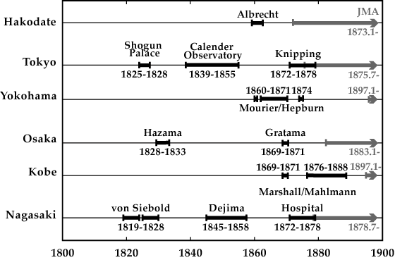
Instrumental Meteorological records in the 19th century in Japan
Medical

Slide 13
現存する日本の気象観測記録

Slide 14
図１：シーボルト・データ（１８２５年８月）、ドイツ・ボッフムに収蔵のもの

Slide 15
Homogenization
❐ Height changes for temperature
h is the station height in meters.
T(h) is the temperature at station level.
T(H) is the temperature at reference level.
❐ Uneven distribution of the observation hours through the day for temperature and pressure
Meteorological records
in the 19th century
Digitization
Correction
-Temperature
-Sea level
-Gravity
Homogenization
-Height for temperature
-Observation schedule
Quality check
-Data distribution
-Homogeneity test
+
19th century Database
JMA since 1870’s
Analyses for climatic variations

Slide 16
表３ 東京・横浜・大阪・神戸・長崎の年平均値の時系列 （財城・塚原他、『地球』、2005, vol.27, No9より）

Slide 17
Time series before/after
Annual mean pressures
Annual mean temperatures
Corrected data
19th century original
JMA data
11-year running mean

Slide 18
West-Japan Temperatures vs. Central England Temperatures
Annual mean temperatures

Slide 20
Current research project: Ship Log
Dutch Navy Ship log, and construction of data set.
Discovery at NA, by Togo, 2018.
1 from Fixed point data to Moving data.
2 Big Data into studies of climate change
3 local to global

Slide 21
At Nationaal Archief in the Hague, I have discovered a number of logbooks of Dutch Navy in 2018. Logbooks of Gedeh, Medusa(1856) and Soembing

Slide 22
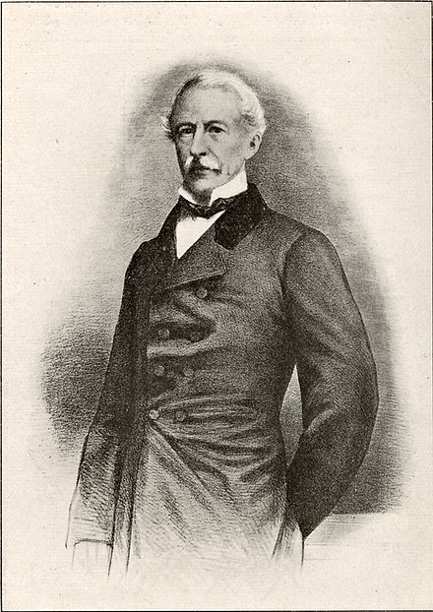
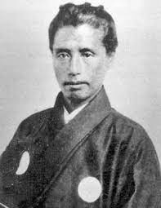
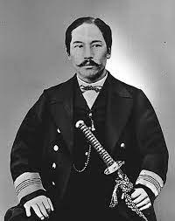
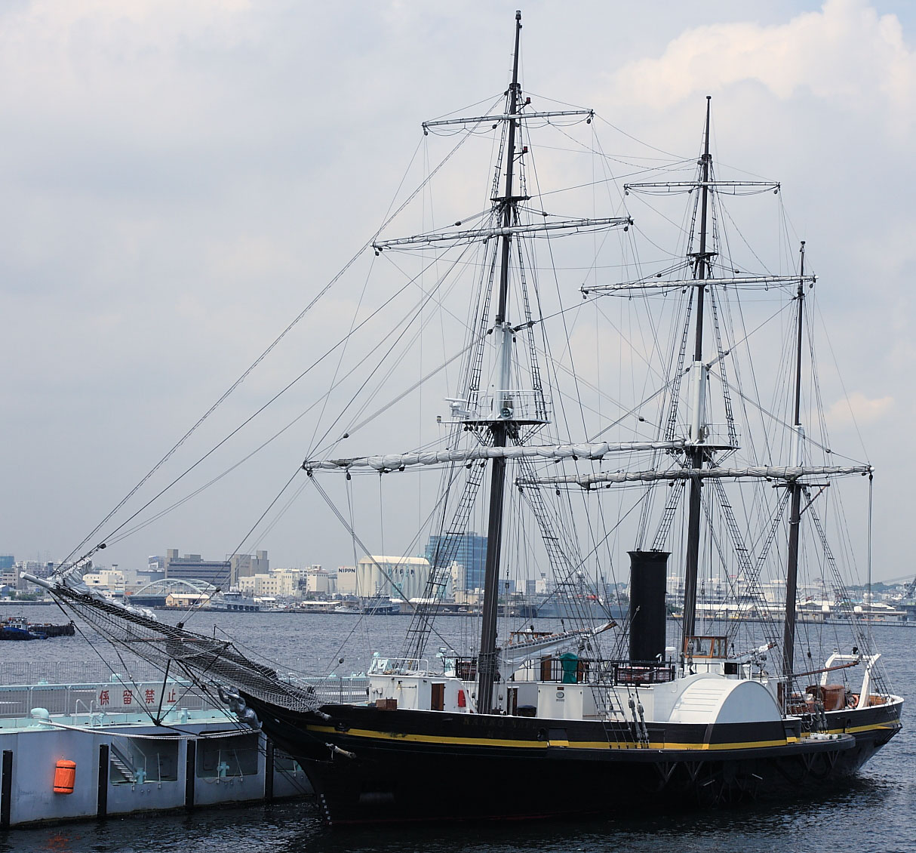
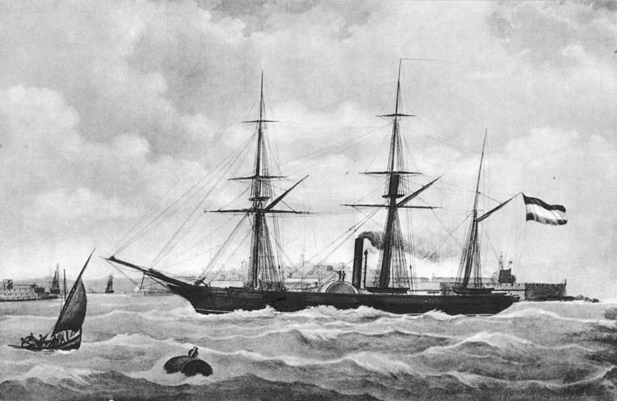
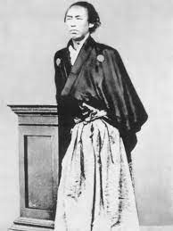
Unique exchange between the Netherlands and Japan: Soembing became Kanko-Maru
Logbooks of Gedeh, Medusa(1856) and Soembing were included.
(画像はスンビン号、右は復元されたもの.グデ号はその時の随伴船)

Slide 23
Sample of location（Japansche Zee)

Slide 24
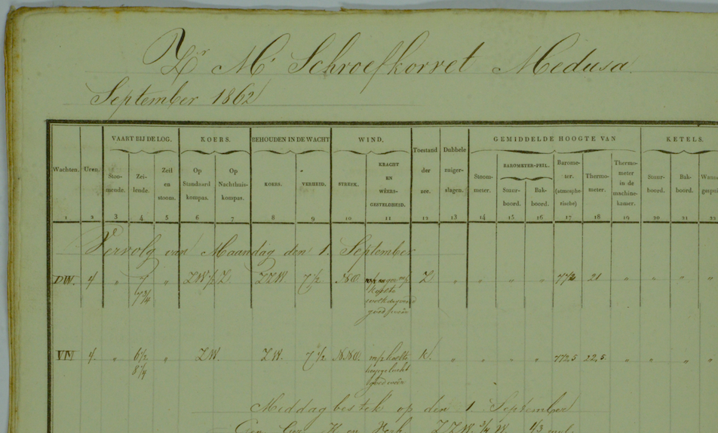

Slide 25
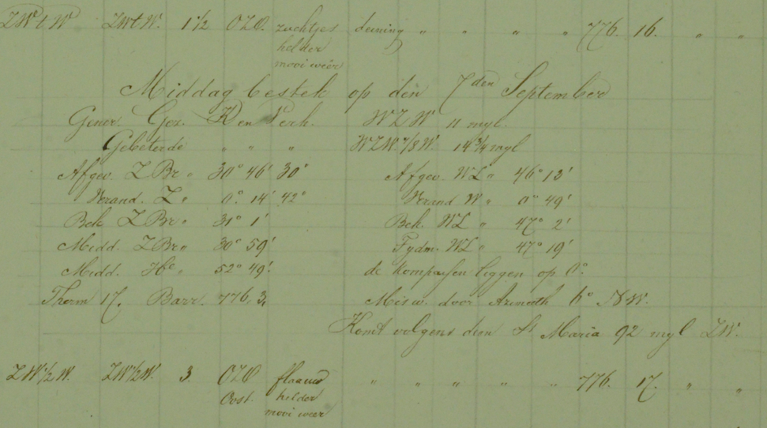

Slide 26
For this digitization, see the attached de Jong's “how to read (Dutch Navy) logbooks”, which shows a set of technical terms and abbreviations used for these shiplogs. Data format are as follows (This is Excel format column, that is also noted as “ReadMe” in Open Date file of JCDP web-site)
1. image file name
2. ship name
3. year
4. month
5. day
6. H (hours)
7. (column number 1) watch they are divided in to 6 watches (details see 2019sep.(Alice)How to read Scheepsjournalen 2019-2)
8. (column number 2) hours how many hours a certain rows of measurement is valid
9. (column number 3) steaming (hours)
10. (column number 4) sailing (hours)
11. (column number 5) sail + steam (hours)
12. (column number 6) ship course (compass) standard
13. ship course (compass) nighthouse
14. (column number 7) ship course during watch
15. (column number 8) ship distance during watch (hours)
16. (column number 9) Wind direction
17. (column number 10a) Wind strength (details see 2019sep.(Alice)How to read Scheepsjournalen 2019-2)
18. (column number 10b) Weather (details see 2019sep.(Alice)How to read Scheepsjournalen 2019-2)
19. (column number 11) Sea condition (details see 2019sep.(Alice)How to read Scheepsjournalen 2019-2)

Slide 27
20. (column number 12) dubbele zuigerslagen (double piston strokes) (the average amount of rotations per minute)
21. (column number 14) stoommeter (steam meter) (the average height of the pressure of the steam inside the kettle engine)
22. (column number 15) starboard side barometer attached temperature (C)
23. (column number 16) portside barometer attached temperature (C)
24. (column number 17) barometer (mmHg)
25. (column number 18) thermometer outside temperature in the shadow (C)
26. (column number 19) engine room thermometer placed outside the direct heat of the fires
27. (column number 20) Kettles starboard (steam kettles/machines) (how many fires are burning)
28. (column number 21) Kettles portside (steam kettles/machines) (how many fires are burning)
29. (column number 22) Kettles flushed when (steam kettles/machines) (how many fires are burning)
30. water level
31. watch they are divided in to 6 watches (details see 2019sep.(Alice)How to read Scheepsjournalen 2019-2)
32. (column number 24) Salinometer
33. (column number 13) smoorklep (throttle) read how much throttle is open (Value O mean full open)
34. (column number 25) toestellen (expansion engines)
35. (column number 26) coal (how much coal used in each watch) (unit?)
36. (column number 27a, 27b)water at the pump (read at each watch)
37. (column number 28a, 28b, 13) compass (indicates the wrong pointings of the compasses)
38. Observation and comments
39. Latitude (deg, min, sec)
40. Longitude (deg, min, sec)
41. distance (direction and distance) (unit?)
42. barometer (mmHg)
43. thermometer (C)
44. coordinates
45. comments
(column numbers are indicated in GEDEH, SOEMBING data.)

Slide 28
Catalogue 2.12.03, Inventaries van de Scheepvaartjournaalen van de Ministerie van Marine, 1813-1995, pp.440 493 meter, 9000+ bundles.
1813-1985, 9051 entry
Supplement 2001: 1929-1995, 235 entry
Bijlage 1813-1844, list of direction of sailing route, 273 entry

Slide 29
Problem of digitization
Machine reading? We need some more resources to invest.
Citizen Science? We are Japanese, and swe need Dutch language skill.
Temporary strategy >>>ask help from Dutch (paid) assistants to decipher and digitize., with expertised collaborator, Alice de Jong (Librarian, Leiden Unviersity).
In futre, collaboration with KNAW, with NA and KNAW. (project proposal is almost ready, outline fgiven by Theo in the following presentation).

Slide 30
Selection of digitization (Pilot study)
Ships sailed around and to Japan.
Period of 1860s (and 50s and 70s).
Historical (well-known) ships in Dutch-Japanese relations
War and historical events.
>>>we have chosen six ships, about 100 months.

Slide 31
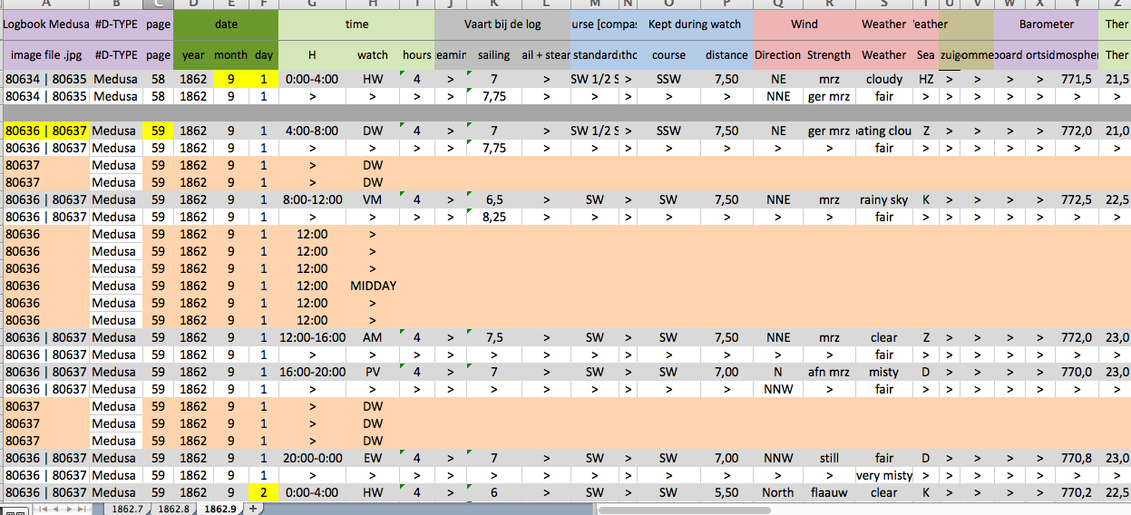

Slide 32
Preliminaruy plot of Medusa’s sailing route (Togo’s data, plotted by Hisayuki Kubota)

Slide 33
Bombardment of Shimonoseki, 1863 (for the Japanese, it was the first war to fight against allied fleet. British, French, US, and Dutch Navy organized “Four nations Fleet”.) For Dutch Navy ships involved. Medusa, Djambi, Amsterdam, and Metaalen Kruis)

Slide 34
Logbooks of Dutch navy ships Amsterdam, Djambi, Gedeh, Medusa, Metalan Kruis and Soembing stored in Nationaal Archief, Netherlands Datasets
1864 AMSTERDAM (154) May-Sep.xslx May 18 - Sep. 26 1864
1864 AMSTERDAM (154) May-Sep.docx (detail)
1865 AMSTERDAM (154) Mar.xlsx Mar. 18 -24 1865
1865 AMSTERDAM (154) Mar.docx (detail)
1863 DJAMBI (1048) Jul-Dec.xlsx Jul. 23 - Dec. 31 1863
1863 DJAMBI (1048) Jul-Dec.docx (detail)
1864 DJAMBI (1048, 1049).xlsx Jan. 1 - Dec. 31 1864
1864 DJAMBI (1048, 1049).docx (detail)
1865 DJAMBI (1049).xlsx Jan. 1 - Dec. 31 1865
1865 DJAMBI (1049).docx (detail)
1866 DJAMBI (1049) Jan.xlsx Jan. 1 - 4 1866
1866 DJAMBI (1049) Jan.docx (detail)
1869 DJAMBI (1051).xlsx Jan. 15 - Dec. 31 1869
1869 DJAMBI (1051).docx (detail)
1870 DJAMBI (1051, 1052).xslx Jan. 1 - Dec. 15 1870
1870 DJAMBI (1051, 1052).docx (detail)

Slide 35
1863 Metalen Kruis (3105) Nov, Dec.xlsx Nov. 3 - Dec. 29 1863 1864 Metalen Kruis (3105).xlsx Jan. 1 - Dec. 31 1864 1865 Metalen Kruis (3105, 3106).xlsx Jan. 1 - Dec. 31 1865 1866 Metalen Kruis (3106) Jan, Feb.xlsx Jan. 1 - Feb. 2 1866 1854 SOEMBING (4099) Jul-Dec.xlsx Jul. 8 - Dec. 31 1854 1854 SOEMBING (4099) Jul-Dec.docx (detail) 1855 SOEMBING (4099) Jan-Oct.xlsx Jan. 1 - Oct. 5 1855 1855 SOEMBING (4099) Jan-Oct.docx (detail) 1858 SOEMBING (4100) Mar-May.xlsx Mar. 28 - May 29 1858 1858 SOEMBING (4100) Mar-May.docx (detail) 1859 SOEMBING (4100) Jan-Feb.xlsx Jan. 1 - Feb. 1 1859 1859 SOEMBING (4100) Jan-Feb.docx (detail)
1853 GEDEH (1637) Feb-Dec.xlsx Feb. 11 - Dec. 31 1853
1853 GEDEH (1637) Feb-Dec.docx (detail)
1854 GEDEH (1637).xlsx Jan. 1 - Dec. 31 1854
1854 GEDEH (1637).docx (detail)
1855 GEDEH (1637) Jan-Nov.xlsx Jan. 1 - Nov. 18 1855
1855 GEDEH (1637) Jan-Jul.docx (detail)
1856 MEDUSA (3018) July-Nov.xlsx Jul. 6 - Nov. 10 1856
1856 MEDUSA (3018) July-Nov.docx (detail)
1862 MEDUSA (3020) May -Dec.xlsx Jun. 25 - Nov. 29 1862
1862 MEDUSA (3020) May -Dec.docx (detail)
1863 MEDUSA (3020).xlsx Jan. 20 - Dec. 31 1863
1863 MEDUSA (3020).docx (detail)
1864 MEDUSA (3020).xlsx Jan. 1 - Dec. 11 1864
1864 MEDUSA (3020).docx (detail)

Slide 36
Open access through web-site: JCDP
DB will be open on JCDP (Japan-Asia Climate Database Project) web-site by the end of fiscal year 2024.
https://jcdp.jp/top-jp/

Slide 37
Published recent results in e-journal Geo on-line, first author is Hisayuki Kubota. (detals in the following presentation by Hisayuki.)
Identified a few typhoon by ship log data set.
Further cooperation (for historical infrastructure building of Dutch resources, by machine reading and citizen science), sought with with KNMI (Dutch Royal Meteorological Instituut). KNAW (Dutch Royal Academy) and NA (National Archieve).

Slide 38
Commetary from Science Studie on Big Data
Powered by computer (computation, calculation).
>>> characterized as ”Neo-(Digital)-Humboltian Science”
Susan Canon 1978
Togo discussed problems generated by Big Data in the framework of Environmental Humanities.
(気候変動論におけるデジタル・フンボルト主義とデータレスキュー : 地球システム科学における人文学の役割—環境人文学 思想 (1183) 59-80 2022年11月 )

Slide 39
Togo’s recommendation to ACRE: Climatology and meteorological studies in History >>>include more Cultural elements and socio-political context.
Started by Verbiest and Jesuits in China.
From 蘭学 Dutch Studies
to 洋学 Western Learnings
then Institutionalization of climate studies and Imperial expansion.
Historians are doing “Data Rescue” activities.
With the help of computer analysis of Big Data building, we are now shifting from Fixed point data to moving point data analysis.

Slide 40
In order to understand climate change, we should base ourselves on the scientifically quantified data, however, we also need critical viewpoint made by humanities.
We should not forget the Quality/Quantity interchangeability problem, originally pointed out by Friedrich Engels in Dialectics of Nature, and most notably, recently reviewed by Japan’s rising-star economic philosopher, Kohei Saito.

Slide 41
Thank you for listening
Togo, T. 塚原東吾

