Slide 1

Public Outreach
ACRE and Science Communication
Victoria Slonosky, Open Data Rescue

Slide 2
What and why do we want to communicate?
What are our goals for outreach as a community?
  Scientific reasons
  Science education
  Climate literacy
Why do we want a higher profile?
    Volunteers
        Strategy for public outreach
    Increased visibility -> increased funding -> increased security
        Strategy for reaching governmental, academic audiences

Slide 3
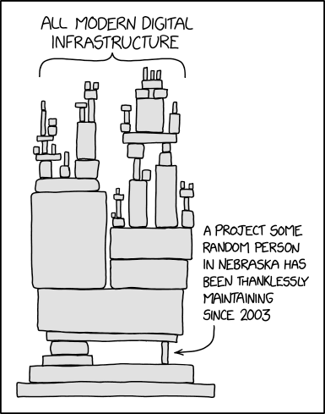
Scientific reasons
Problem: data rescue and maintenance is not seen as either
  new and exciting research OR
  as critical scientific infrastructure

Slide 4
Overhead at ACRE 2024
Put current climate in context
What lessons can be learned from past events on how people/societies coped with events/ changes and variability- which areas have increased or reduced vulnerability, resilience to events which happen rarely or may have happened more in the past
Outreach to internal community – does not understand the importance of this data, thus under resourced. We as a community have not made our case as to the value of new “old” data to the scientific community
Pipeline –> show concrete evidence of use of the data
Stefan- “most extreme flood ever”? No, data shows this has happened before.
Peter NMS rationale: Shared data –> improve reanalyses –>better machine learning –> improved warning

Slide 5
What are the human dimensions and social interests of data rescue?
Addressing Climate Anxiety
Bringing attention to our scientific and cultural heritage
Science education and backyard history: stories of local interest
Cultural differences ? Can help or impede communication

Slide 6
Risks
Social media toxicity
Blowback for being perceived as diluting urgency of current climate messaging
Need to be careful to thread needle between
A) being perceived as a climate denier for pointing out past weather similar to or worse than today’s
AND
b) Dismissing concerns of current and future change by looking at past events and concluding there’s no issue as it all happened before
As researchers we need to present our case, which is ?
Past context is important to place current eventsin context and better understand change and variability –> MISSION STATEMENT

Slide 7
Use existing resources
Universities, government departments
Need a hook/reason for PR
  new project, new interactive website, data site
Connect with organizations with similar interests and with mandate for outreach
  Archives e.g. participatory archives
  Libraries e.g. Rare Books and Special Collections
  Museums – Science museums, History of Science museums, local historical interest groups

Slide 8
Can we develop a clear and succinct mission statement

