Slide 1
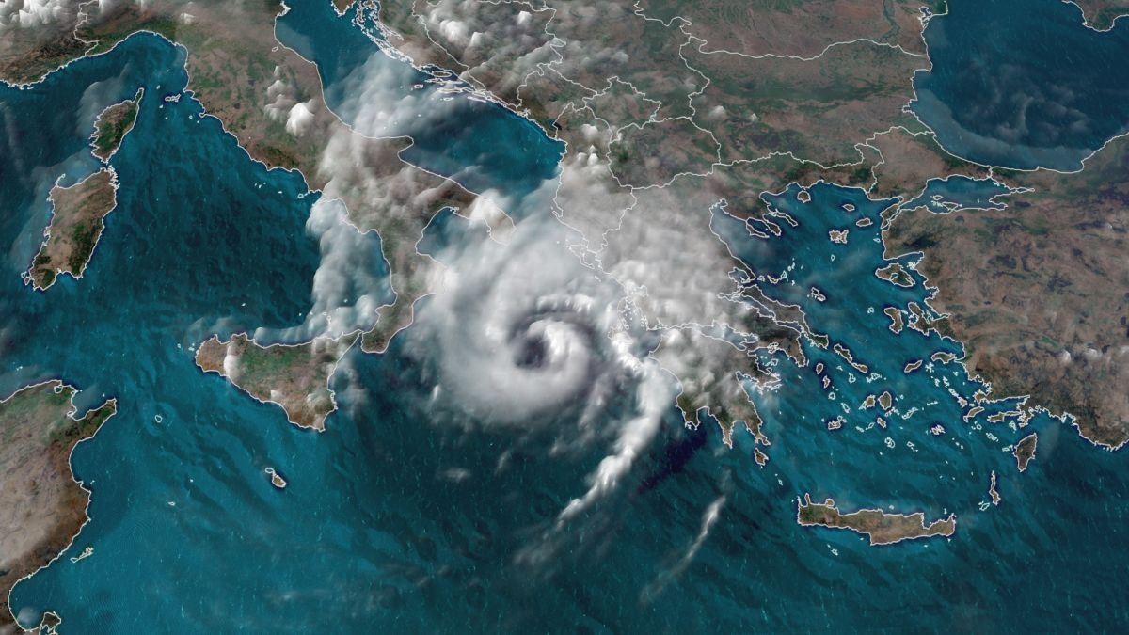
Historical Medicanes: Data Requirements
Mediterranean tropical-like cyclones, often referred to as medicanes, are warm core systems occasionally observed over the Mediterranean Sea. On a few rare occasions, some storms have been observed reaching the strength of a Category 1 hurricane.

Slide 2
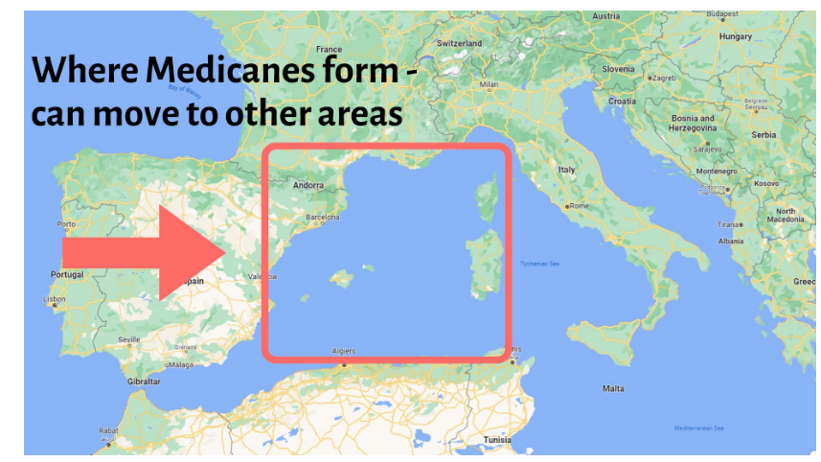

Slide 3
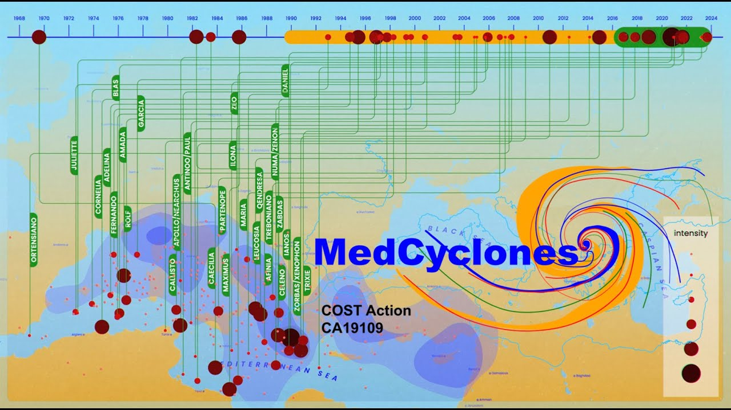

Slide 4
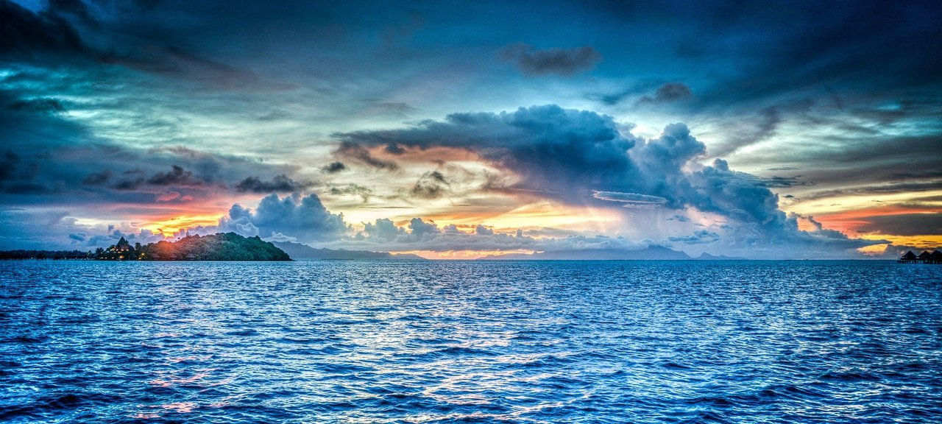
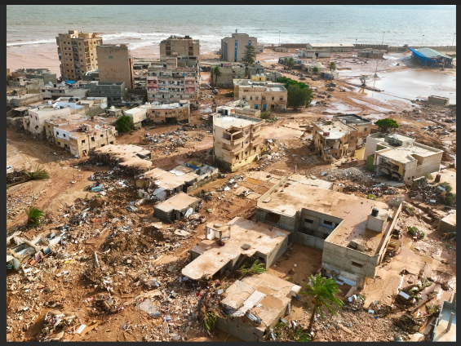
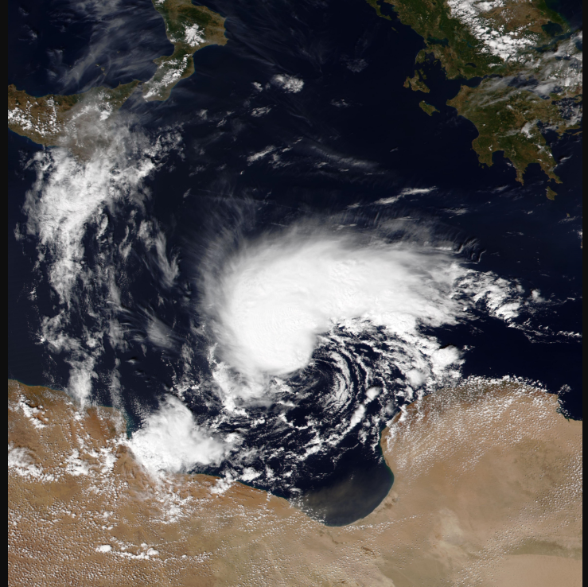
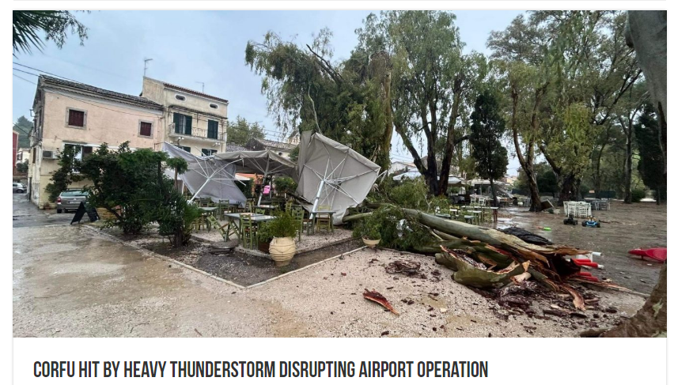
4th September 2023: A heavy thunderstorm associated with Storm Daniel hit the island of Corfu early afternoon Monday causing problems in the electricity system, while heavy lightning disturbed the operation of the Ioannis Kapodistrias international airport. Eight flights were not able to land because of the thunderstorm, while three of them had to land at nearby airports. Areas in the center and periphery of Corfu experienced power cuts.
Corfu
Medicane Daniel
Derna
Storm Daniel, also known as Cyclone Daniel, was the deadliest Medicane in recorded history, as well as one of the costliest tropical cyclones on record outside of the North Atlantic Basin.
The storm made landfall near the city of Benghazi in Libya on 10 September.
In Libya, at least 5,923 people were killed, mostly in and around the city of Derna. The Derna and Mansour dams collapsed, releasing an estimated 30 million cubic metres of water. 30,000 residents were displaced.

Slide 5
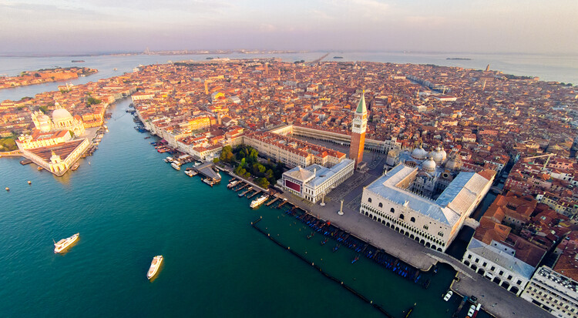
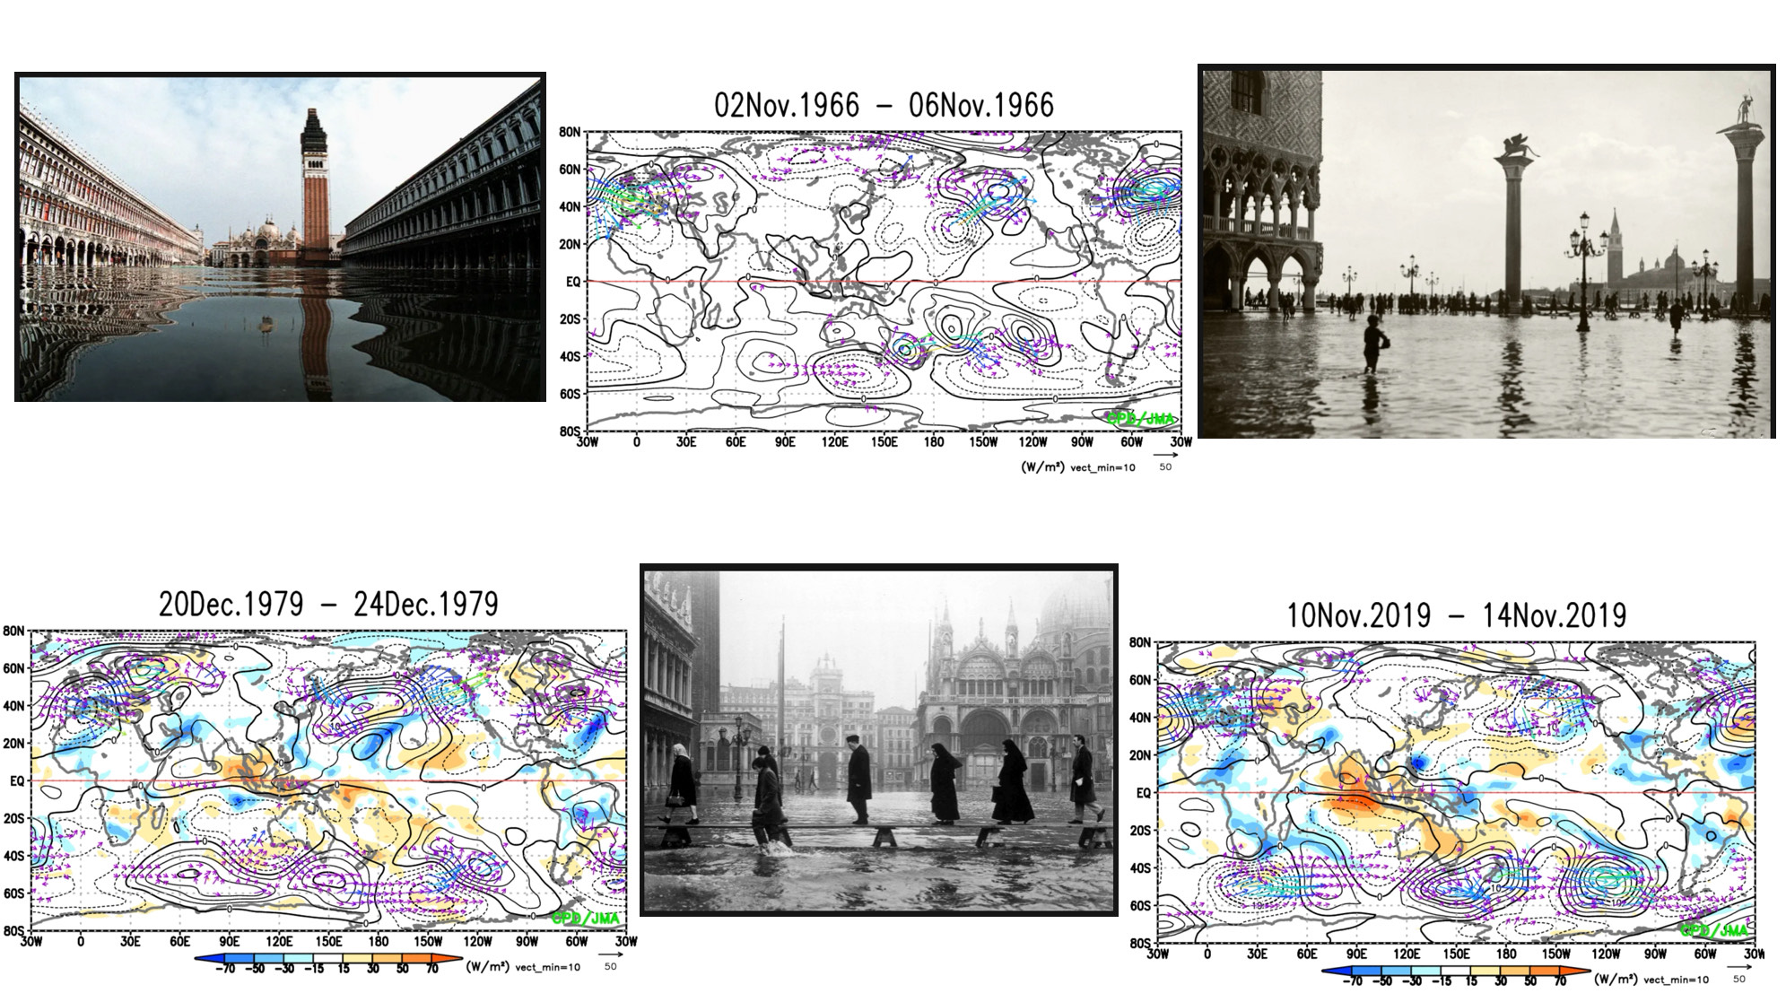
EXTREME VENICE FLOODS & MEDICANES
04 Nov 1966 H= 194 cm
22 Dec 1979 H= 166 cm
12 Nov 2019 H= 187 cm

Slide 6
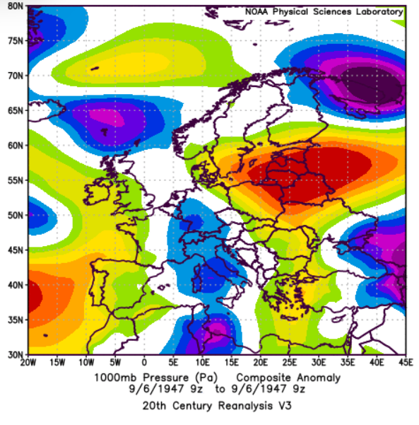
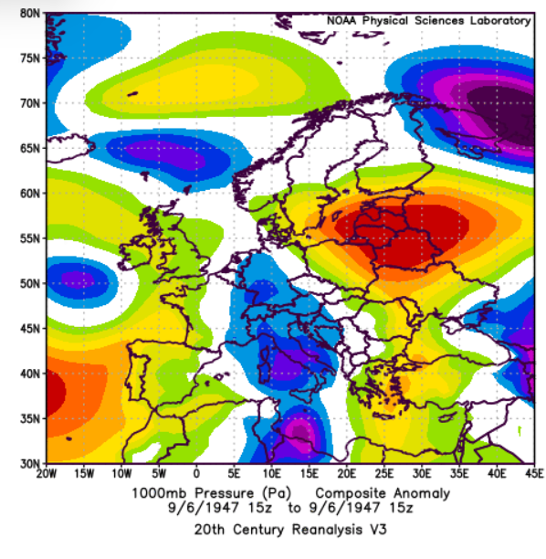
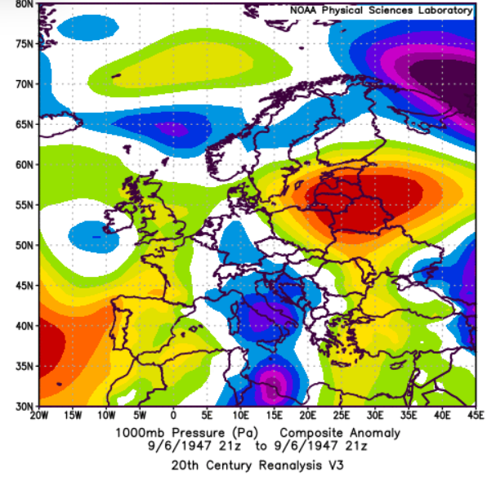
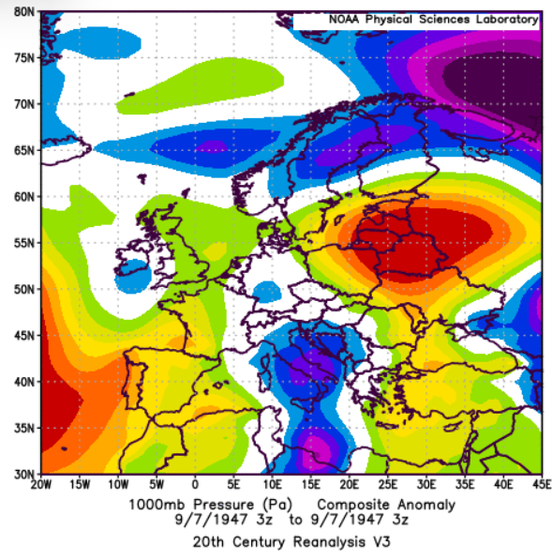
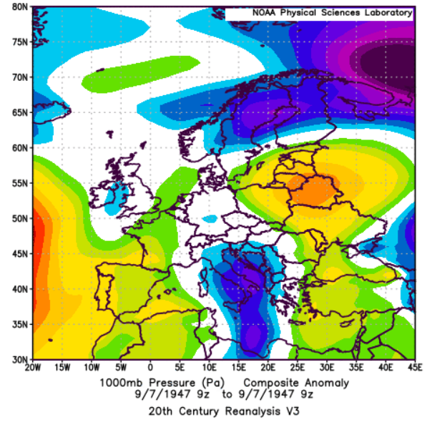
6-7th September 1947 6-hourly near-surface MSLP anomalies (hPa)
6th
9Z
6th
21Z
6th
15Z
7th
3Z
7th
9Z

Slide 7
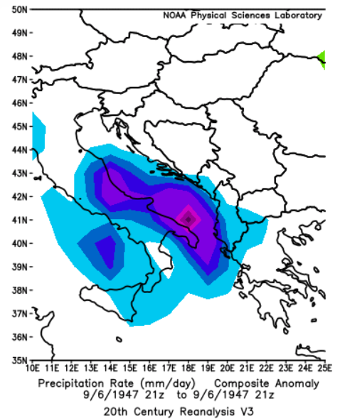
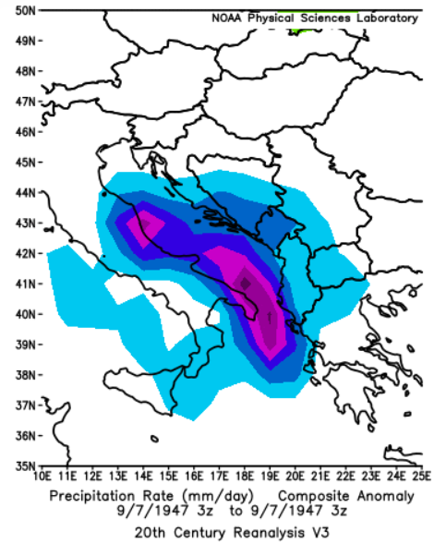
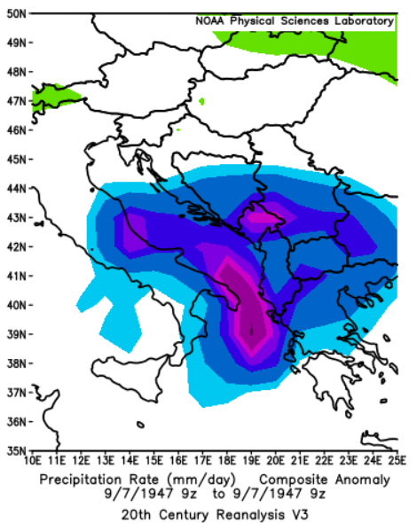
Precipitation Rate (mm/day)
6/9/1947 21Z 7/9/1947 3Z 7/9/1947 9Z

Slide 8
Historical Data Projects

Slide 9
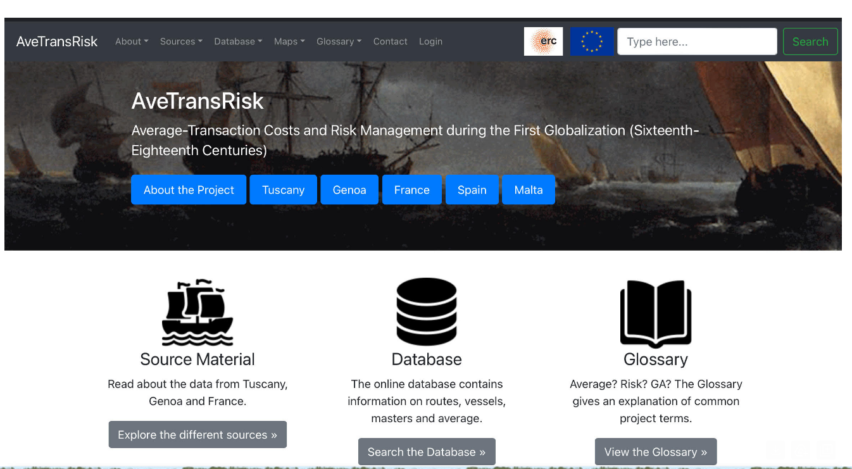

Slide 10
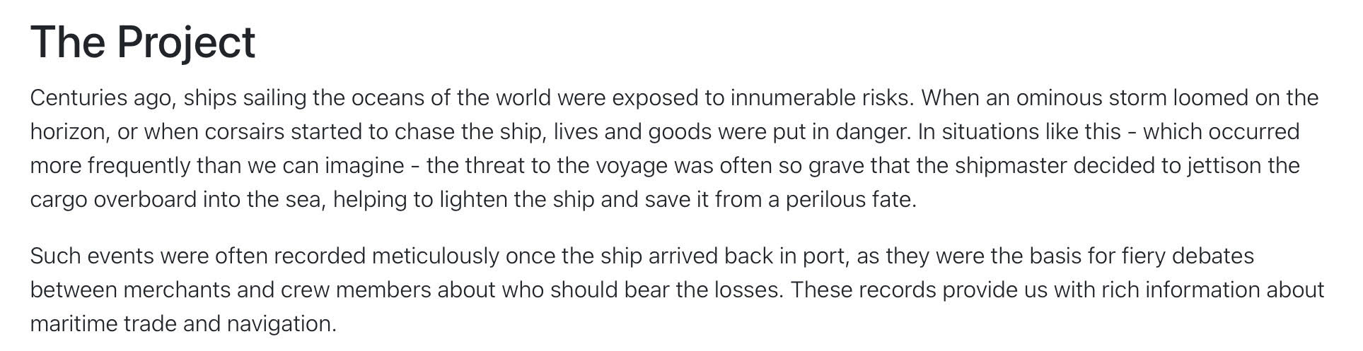


Slide 11
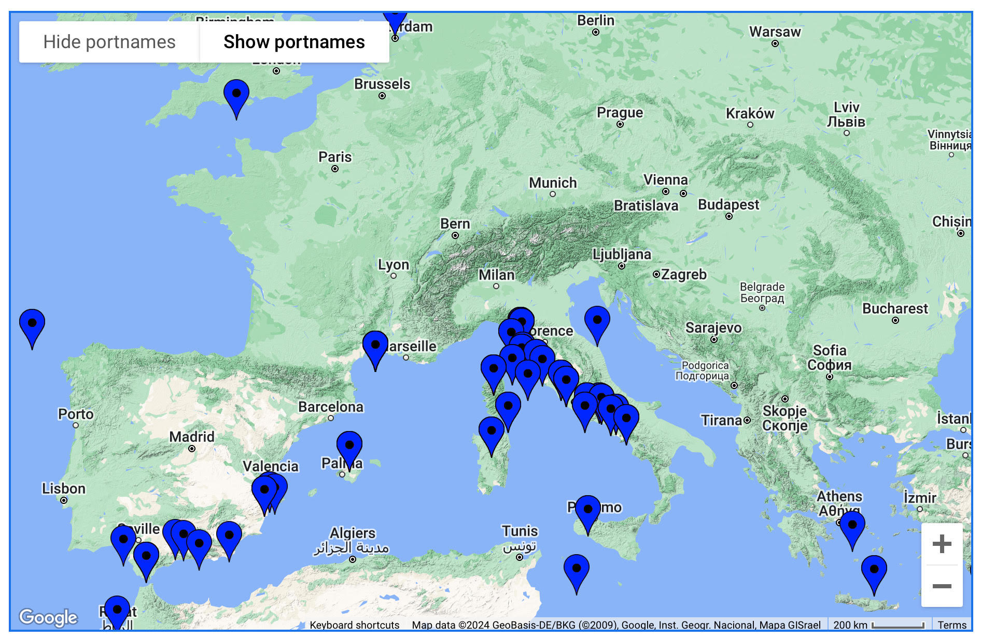

Slide 12
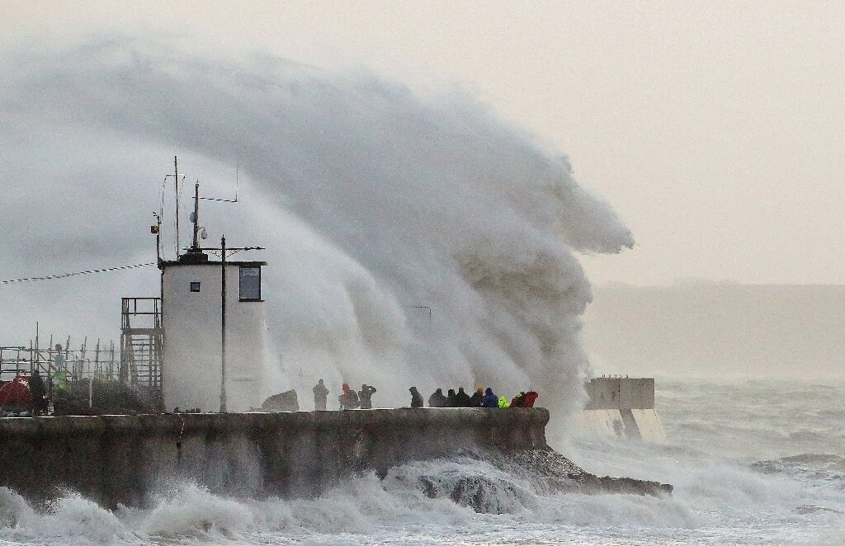

WINDS, WAVES and STORMS (WWS): historical data and modern quantitative approaches to uncover the long-term strategies to prevent and mitigate climate risks in the European seas (15th-19th centuries - PRIN PNRR Prot. P20227XHT5 / Schisani, MARIA CARMELA; Ragozini, Giancarlo; DI LORENZO, Emilia; Piscopo, Gabriella.)

