Slide 1
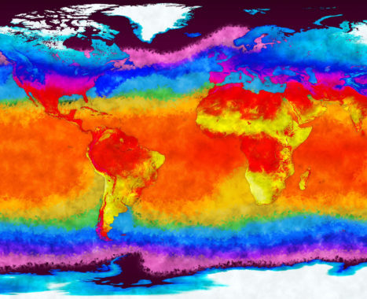









The international ACRE initiative
Prof. Rob Allan, ACRE Project Manager

Slide 2
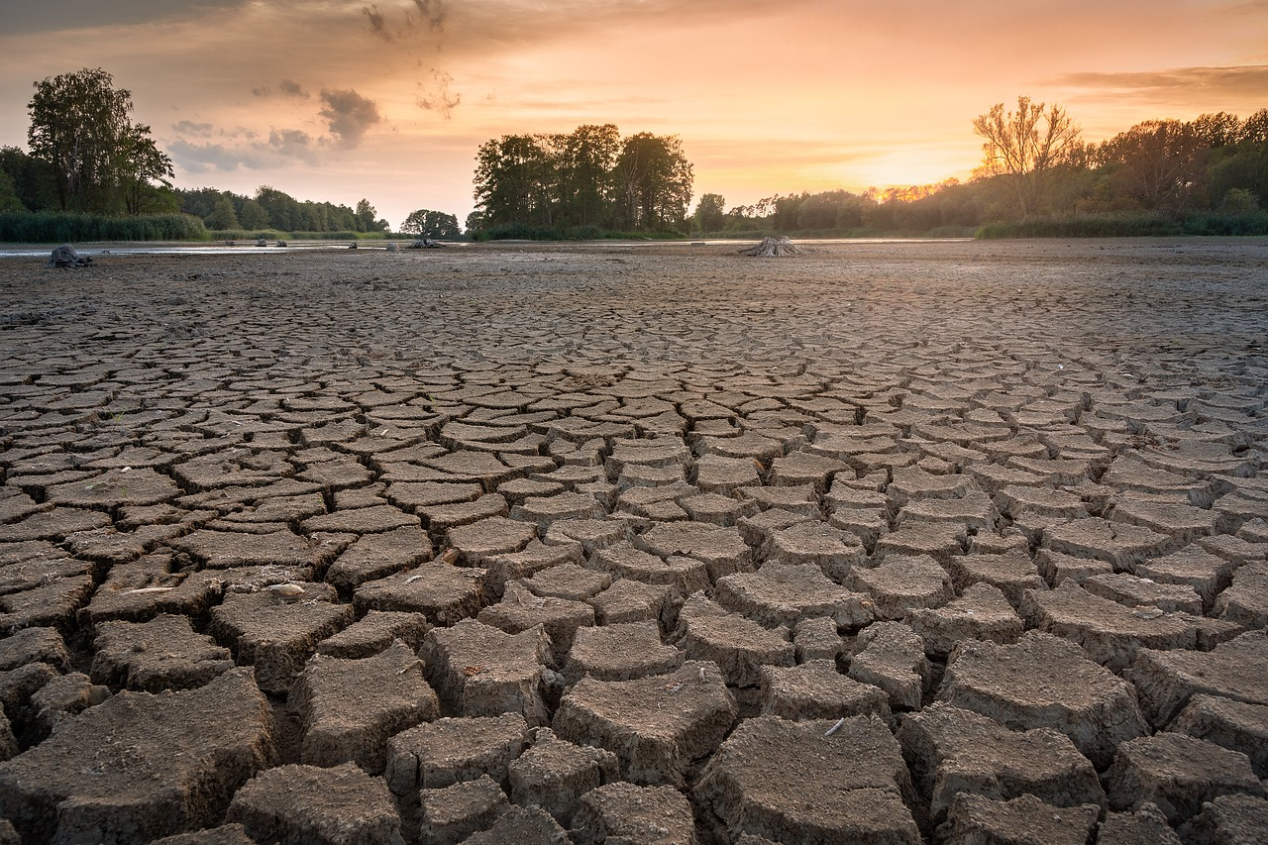
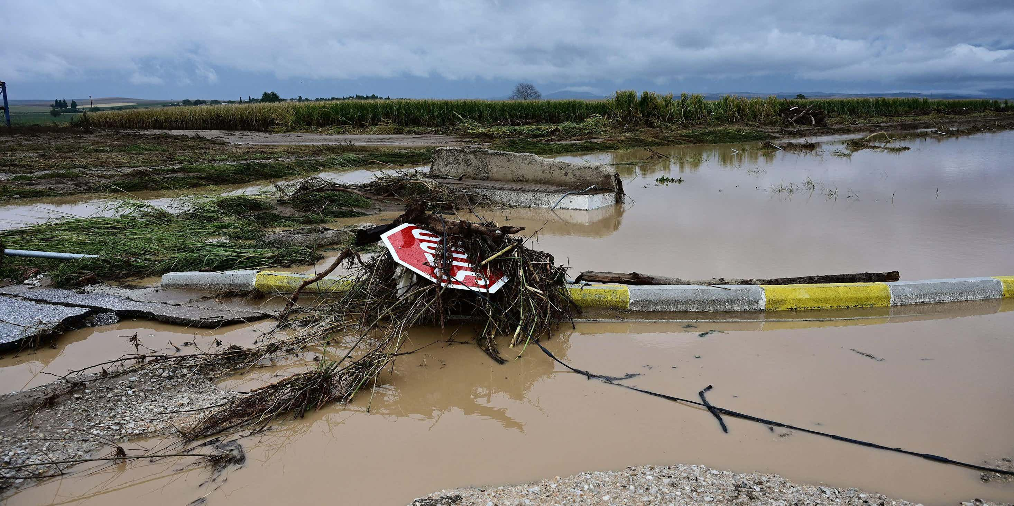
ACRE Drought & Flood Meeting,
Mon Repos,
Corfu,
September 2024

Slide 3

ACRE is a ‘grassroots’, bottom-up initiative that has marshalled together the international weather and climate data rescue and science communities over the last 17 years
It is an ‘end-to-end’ initiative, supported by WMO, GCOS, WCRP, GEO, GFCS and many others, linking:
  international historical terrestrial and marine weather data rescue (mainly prior to the 1950s/1960s)
  dynamical 4D global historical reanalyses (weather reconstruction), especially the 20CR, now back to 1806
  and climate services and applications communities
ACRE’s data rescue activities embrace the recovery, imaging/scanning, digitisation, and curation of historical global instrumental terrestrial and marine weather observations for as far back in time as possible
These data are then fed into the international repositories for both terrestrial and marine weather observations, and are freely available
This enhances the quantity of historical weather observations available to global historical reanalyses, with the newly generated global weather reconstructions freely available to the full range of global climate services and applications. ACRE has a number of individual regional data rescue foci supporting its international efforts.
It is working with other social science and humanities disciplines to meld together historical weather reconstructions with climate histories/historical climatology in order to enhance global historical reanalysis products

Slide 4

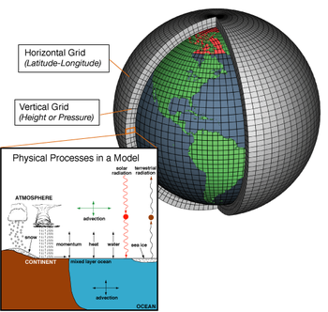
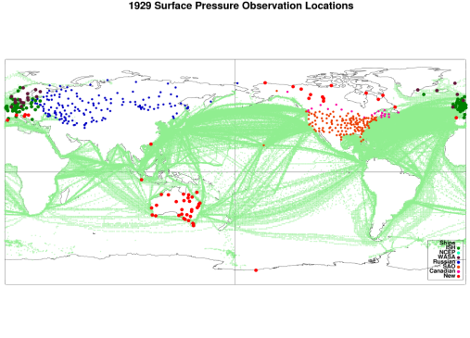
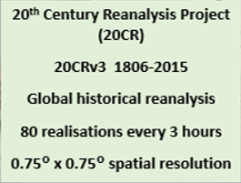
CLIMATE SERVICES
& APPLICATIONS
DATA RESCUE
REANALYSES
20CR Distributors
Environmental Assessments
Extremes, Impacts & Risks
Water resources
Agricultural
Forestry
Energy
Marine operations
Fisheries
Cultural landscapes and
built heritage
Education
Enhancing Reanalyses
MELDING: historical climatology, climate history, climate reconstructions,modelling and reanalyses
IRI
NCAR
NOAA ESRL
NERSC
KNMI
BADC
C3S DRS Portal & Registry
ICOADS GLAMOD ISPD
Citizen Science
‘Crowd Sourcing’
(eg. Oldweather
Weather Detective Southern Weather Discovery)
MO PRECIS
Downscaling
=> Higher
Resolution
Ecological
Phenological
Health & Disease
Reinsurance
Climate Monitoring
Model Validation

Slide 5

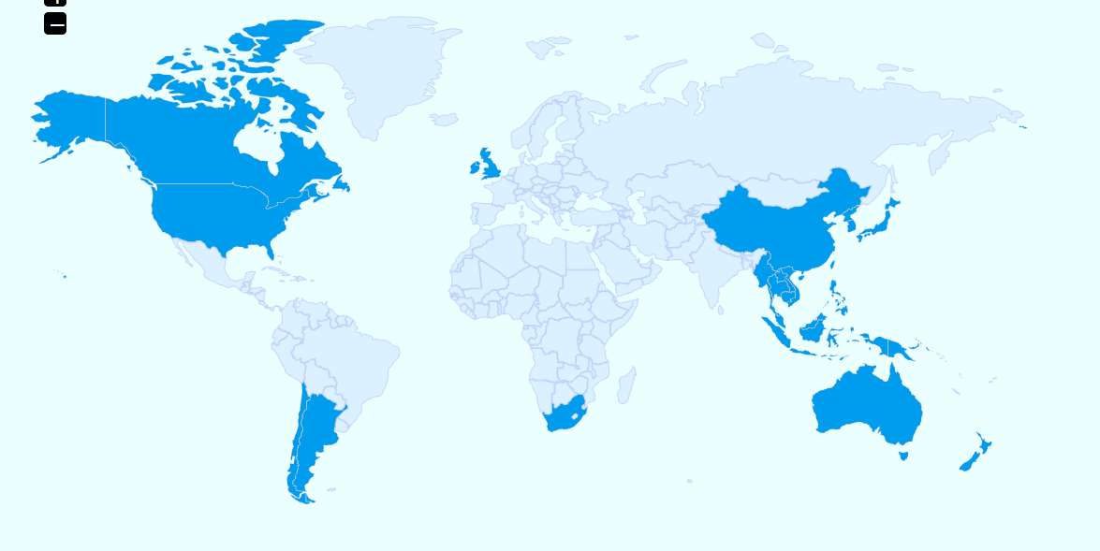
ACRE REGIONAL DATA RESCUE FOCI
ACRE Arctic
Other DARE projects linked to ACRE
ACRE British & Irish Isles
ECA&D
ACRE Canada
US Colonial Era Study
ACRE Japan
ACRE/CSSP China
ACRE Pacific
ACRE Pacific
ACRE SE Asia
LACA&D
WACA&D
COBECORE
SACA&D
ACRE Australia
ACRE Chile
ACRE/C3S/WCSSP South Africa
ACRE Argentina
ACRE Antarctica
ACRE Antarctica
ACRE Oceans

Slide 6
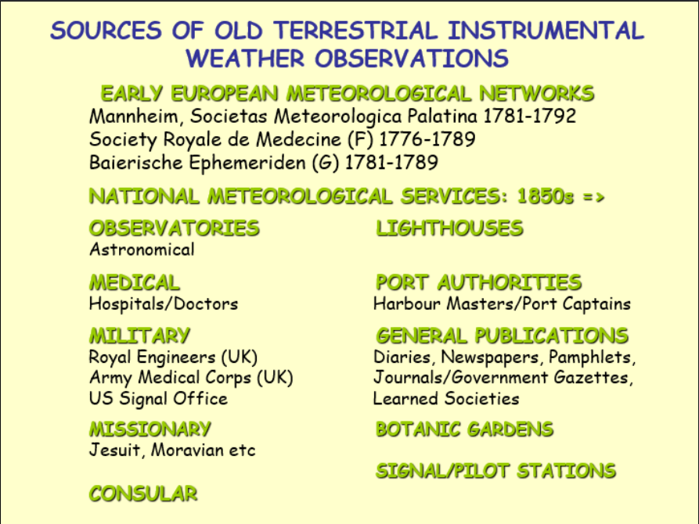

Slide 7
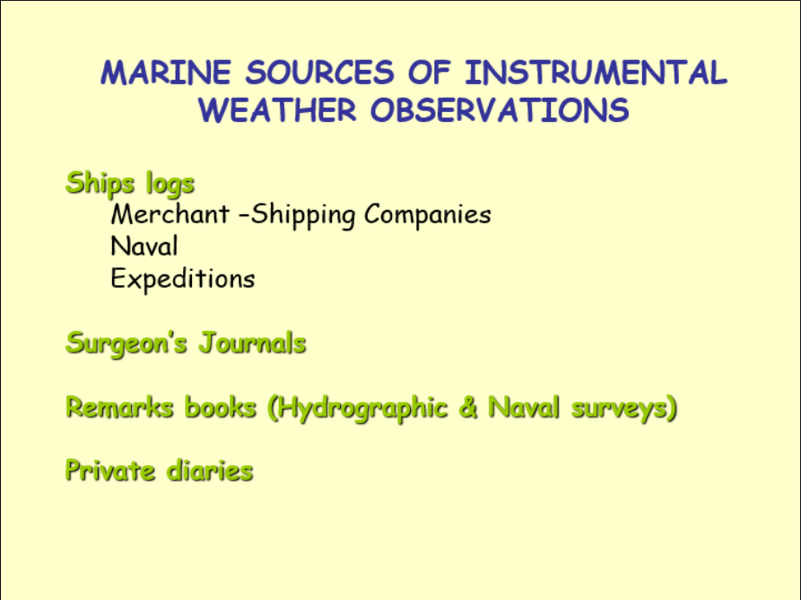

Slide 8
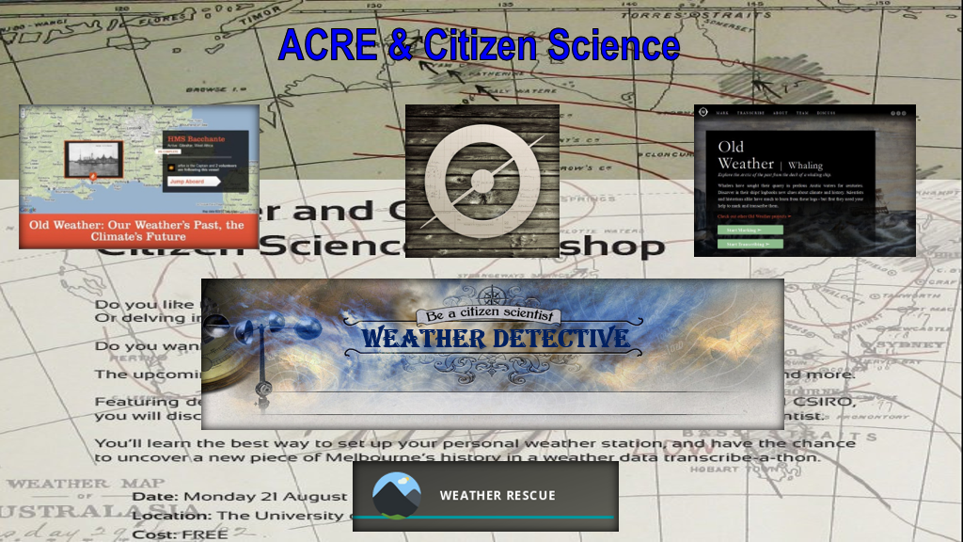

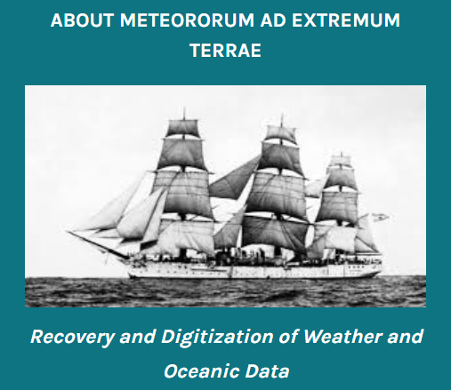
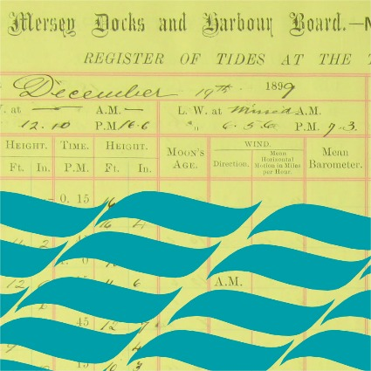
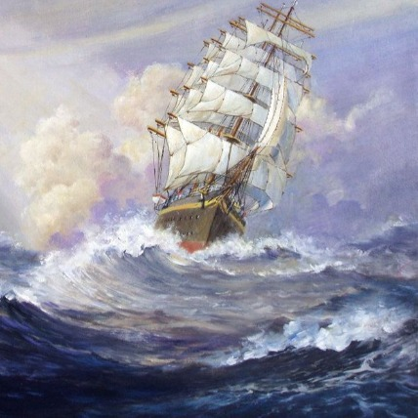
2010-2012
2013-2017
Southern Weather
Discovery
Completed 547,407 transcriptions, providing 78,845 new weather observations
2014-2017
2021=>
UK Tides
Weather Rescue
at Sea
2021=>
2019-2021
2021=>
2018=>

Slide 9

ACRE Drought and Flood meeting program
*Before name = remote presentation Presentation time 30 minutes, with recommendation of last 5 minutes for questions
Tuesday Sept 24th:
0920: Introduction & Opening Christos Zerefos & Dimitra Founda
0930: Rob Allan: Short overview of ACRE
Data & Data Rescue
Session Chair: Roger Stone
Online Presentation Coordinator: Ed Hawkins
Rapporteur: Praveen Teleti

Slide 10
0945: Andrea Kiss: Documentary evidence based multi-centennial flood and drought series in Europe: an overview.
1015: Dimitra Founda: The historical sub-daily climatic observations in Greece - Efforts to improve access and exploitation.
1045: Morning Tea.
1115: Presentation of the bi-annual WMO Professor Mariolopoulos Trust Fund Award for young scientists for exceptional contributions to meteorology and climatology in 2024.
1130: *Stefan Grab: The use of documentary and digitized farm rainfall records to place central Karoo droughts in perspective.
1200: Rob Allan: Historical Medicanes: Data Requirements.
1230: Vicky Slonosky: Canadian floods and droughts in meteorological observations and newspaper reports: the Canada-Wx historical database and DRAW.
1045: Morning Tea.
1115: Presentation of the bi-annual WMO Professor Mariolopoulos Trust Fund Award for young scientists for exceptional contributions to meteorology and climatology in 2024.
1130: *Stefan Grab: The use of documentary and digitized farm rainfall records to place central Karoo droughts in perspective

Slide 11
1300: *Richard Cornes: Marine data pipelines (getting recovered data into global international repositories).
1330: Lunch & offline discussions (at the venue).
1530: Catherine Ross: Rainfall Data Rescue activities at the UK Met Office National Meteorological Archive – current activities, use in climate monitoring, and next steps.
1600: *Mariela Vasquez: ACRE Chile, efforts and advances.
1630: *Stefan Bronnimann: Atlantic-European Jet Variability from Rescued Daily Pressure Series.
1700: Afternoon Tea.
1730: Day One Close

Slide 12
Wednesday Sept 25th
0900: Registration if needed
Data & Data Rescue (continued)
Session Chair: Gil Compo
Online Presentation Coordinator: Vicky Slonosky
Rapporteur: Christa Pudmenzky
0930: Praveen Teleti: Roadmap to discover, transcribe, and analyse early 20th Century weather observations from Singapore, West Malaysia, and northern Sumatra.
1000: *Linden Ashcroft: ACRE Australia.
1030: Togo Tsukahara, Hisayuki Kubota, Jun Matsumoto, Alice de Jong, Masumi Zaiki, Ikumi Akasaka and Atushi Ota: Preliminary result of research into Dutch Naval Logbook and weather related datasets.

Slide 13
1100: Morning Tea.
1130: Theo Brandsma: Digitization of the Royal Netherlands Navy logbooks in the 1813-1960 period for climate reconstruction.
1200: *Matt Hannaford, David Nash and Bárbara Direito: Documentary reconstruction of rainfall variability in Mozambique during the nineteenth century.
1230: Chih-Hsuan Chang, Elaine Kuanhui Lin, Yu-Shiang Lin and Wan-Ling Tseng: Adjusting Standardized Precipitation Index to reconstruct 0.5° x 0.5° drought data from documentary records in the Chinese dynasties since the mid-14th century.
1300: *Peter Thorne: Global Land and Marine Observations Database (GLAMOD).
1330: Lunch & offline discussions (at the venue).
1530: Denis Stuber: Meteo-France Data Rescue activities.

Slide 14
1600: *Pablo Canziani and Gabriela Lakkis: The four longest monthly precipitation time series (150+ years) for Argentina's Pampas and Mesopotamia regións: a preliminary analysis.
1630: Afternoon Tea.
1700: *Maria Antonia Valente: Data and metadata errors induced by publications of Instituto Geofísico do Infante D. Luiz.
1730: Alessandro Ceppi: The Dieci e Lode project - recovery of meteorological observations relating to the former Italian colonies (in particular Eritrea, Somalia, Ethiopia, Libya).
1800: Day Two Close. Guided tour of Corfu old town (catch local bus from Mon Repos)

Slide 15
Thursday 26th
0900: Registration if needed
Analysis & Reanalysis
Session Chair: Roger Stone
Online Presentation Coordinator: Vicky Slonosky
Rapporteur: Praveen Teleti
0930: Hisayuki Kubota (Hokkaido University) and Masayoshi Ishii (Meteorological Research Institute): Activities of ACRE Japan 2023-2024 - Ships around Japanese waters during the 18th and 19th centuries and new climate reanalysis “OCADA”.
1000: Gil Compo: Developing reliable drought monitoring indices from a 200-yr atmospheric reanalysis dataset and future plans for the 20th Century Reanalysis.
1030: Gil Compo: The Great California Flood of 1861-1862 and the Great Mississippi Flood of 1874: Examples of Extremes in Precipitation.

Slide 16
1100: Morning Tea.
1130: Philip Brohan: How to tame an evil variable: Machine Learning models of precipitation.
1200: Ed Hawkins: Translating extreme weather events into different climates.
1230: *Julie Jones/Richard Hall: NERC project Decades (Decadal Changes in the Amundsen Sea) - Reconstructing the Amundsen Sea Low.
1300: Marlies van der Schee: The new melded WMO IDARE and Copernicus Data Rescue Portal.
1330: Lunch & offline discussions (at the venue).
Applications & Services
Session Chair: Philip Brohan
Online Presentation Coordinator: Ed Hawkins
Rapporteur: Denis Stuber

Slide 17
1530: Roger Stone and Christa Pudmenzky: Using modern reanalysis systems to improve understanding of atmospheric instability associated with severe thunderstorms in southern Queensland and southern Victoria, Australia.
1600: Christa Pudmenzky: 20th Century Reanalysis data underpins research into wind erosion in Australia.
1630: Ian Goodwin: Australian East Coast Lows and Large-Scale Circulation from Documentary Evidence, the Natural Archive and Paleoclimate Data Assimilation.
1700: *Cathy Smith: The current status of the Web-based Reanalysis Inter comparison tools (WRIT) and plans for the future.
1730: Afternoon Tea.
1800: Day Three Close. Greek night (conference dinner) in Taverna Trypas (Kynopiastes) in a nice village (we go by bus): Accompanying persons can join the social programme without extra charge

Slide 18
Friday 27th
0900: Registration if needed
Applications & Services (continued)
Session Chair: Rob Allan
Rapporteur: Christa Pudmenzky
0930: Stavros Solomos: Modelling reconstruction of weather conditions during historical events. The examples of Salamis Battle in 480 B.C. and Arachova battle in 1826.
1000: Presentation led Open Discussion: ACRE & the future
1030: Philip Brohan: Artificial Intelligence and Machine Learning for ACRE? (5-10 minute talk leading into discussions).
1100: Ed Hawkins & Vicky Slonosky: Making an impact through the press and social media. (5 minute talks each leading into discussions).

Slide 19
1130: Morning Tea.
1200: Gil Compo: The future of reanalysis. (5-10 minute talk leading into discussions).
1230: Roger Stone: Moving ACRE more towards applications. (5-10 minute talk leading into discussions).
1300: Lunch (at the venue).
1500: Final meeting overview & next meeting in 2025.
Also if Christos Zerefos joins us, we will have a public talk (in Greek) in the Solomos Museum (Mouragia in Corfu town). We will publish proceedings in PoS (the proceedings session of the journal JHEP) or similar.
Meeting Finishes

Slide 20
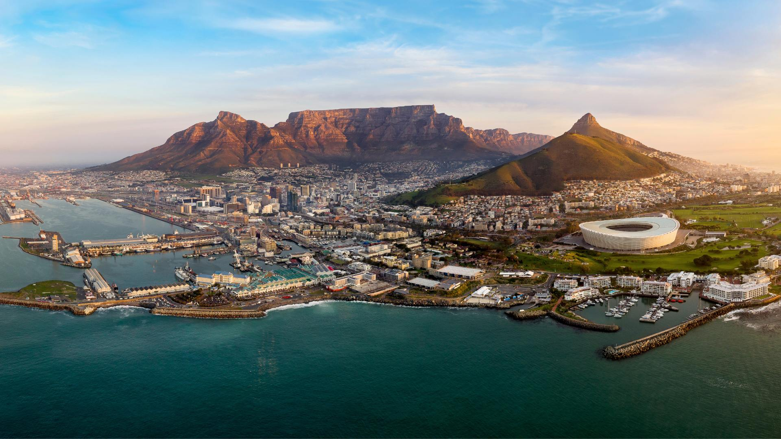
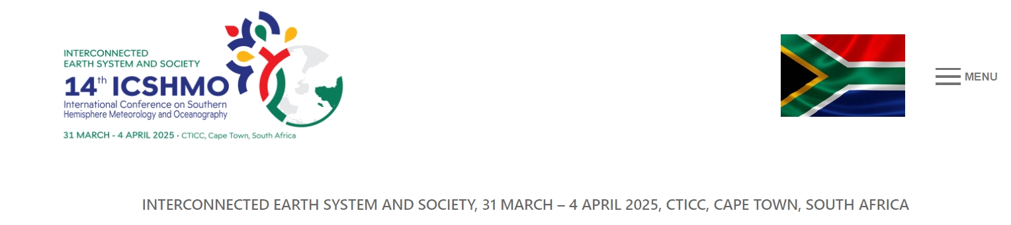
Next Potential ACRE meeting linked to the14th International Conference on Southern Hemisphere Meteorology & Oceanography (ICSHMO) being held in Cape Town, South Africa (31 March-4 April 2025)

